Slide 1

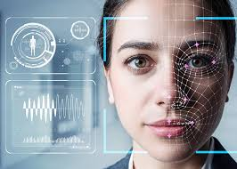
Deep fake Detection under
Adversarial attacks
Team - The Dark Side

Slide 2
Team Members
Venkatesh
Vishal
Sai Nikhil
Roll No: 220109
Roll No: 221201
Roll No: 221095
Saugat
Manasvi
Sarthak
Roll No: 210943
Roll No: 210581
Roll No: 210935

Slide 3
Table of contents
01
02
03
04
05
06
Introduction
Literature Review
Novelty
Suggested Solutions
Timeline
Contribution

Slide 4
Problem Statement
Deep Fakes are AI-generated media—images, videos, or audio—where a person’s likeness, voice, or actions are manipulated to create highly realistic but fake content. The term “deepfake” comes from the combination of “deep learning” and “fake,” as these media are generated using deep learning models, primarily Generative Adversarial Networks (GANs) and Autoencoders. Goal -Build a robust Deepfake detector (image-based: “real” vs. “fake”) that maintains high accuracy even in the presence of adversarial perturbations. Do we Have solutions?? We do have deep fake detection models in the markets which are working upto some extent. But what if some attacks involve manipulating input data in a way that causes a model to make incorrect predictions, often with the intent of compromising security or privacy. What are Adversarial attacks?
Imagine you have a face recognition system that unlocks your phone when it sees your face. Now, suppose a hacker finds a way to trick the system using a slightly altered photo that still looks like you to the human eye but confuses the AI into thinking it's someone else. How is this done???

Slide 5
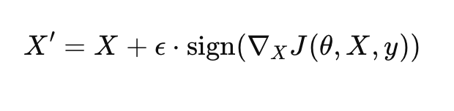
Suppose the face Recognition system uses CNN’s to process facial features by extracting embeddings in a high-dimensional space, Now an attackers comes into play and crafts an adversarial attack , like he may do this using many ways One can be:- Fast Gradient Sign Method (FGSM) :-Computes the gradient of the loss function with respect to the input image and changes the image in the direction that maximizes misclassification. For example, an attacker could generate an adversarial image X′ from the original image X using:
Here ϵ is a small perturbation factor that ensures changes becomes so small or subtle that it cannot be noticed by human senses. Y here is true label.
This type of evasion attack is particularly dangerous in real-world biometric authentication systems, as it exploits gradient-based vulnerabilities in deep neural networks, bypassing security measures without requiring direct access to the model parameters.
Let’s see some of these adversarial attacks in next slide.

Slide 6
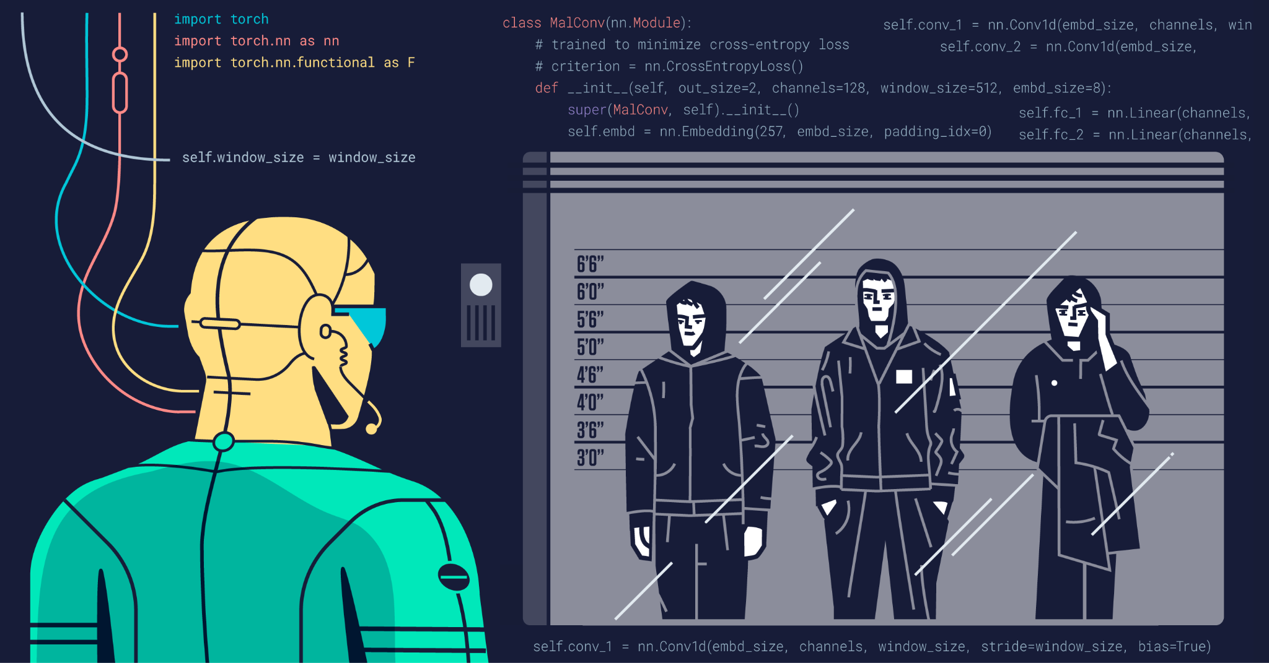
Types of Adversarial Attacks
1)Black-Box Attack 🎭 The attacker doesn’t know the AI’s internal workings but still tricks it by testing different inputs. Example:-Repeatedly submitting images to the model until it finds one that fools it.
2)Fast Gradient Sign Method (FGSM) 🏃‍♂️ Adds a small, carefully chosen change to an image to make AI misclassify it. Example:-Example: Slightly altering a cat picture so the model thinks it’s a dog.

Slide 7
Types of Adversarial Attacks
3)DeepFool Attack 🌀 Moves an image across AI’s decision boundary with the least amount of modification. Example:-Making an AI confuse handwritten “3” with an “8” using almost invisible tweaks.
4)Jacobian-based Saliency Map Attack (JSMA) 🎭
Chooses only the most important pixels to modify, making the attack more efficient. Example: Changing only a few key areas of an image to force a wrong classification.

Slide 8
02
Literature Review

Slide 9
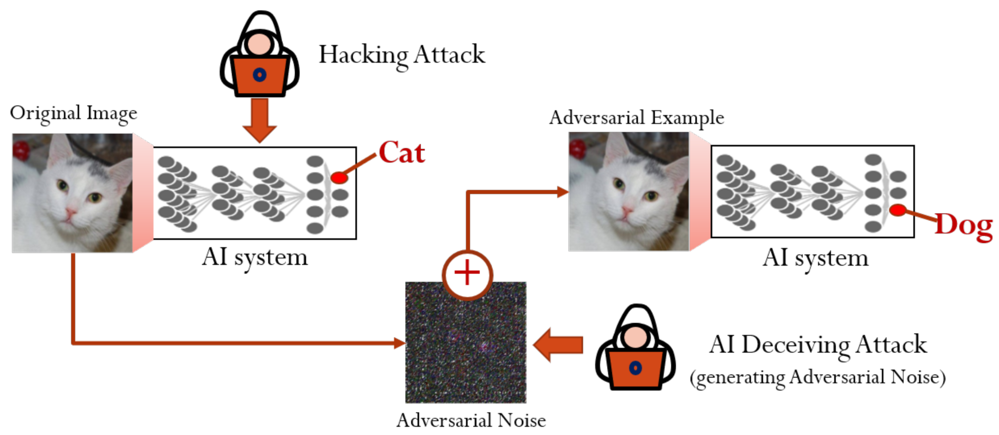
Mitigating Adversarial Attacks in Deepfake Detection(combined 2 similar papers)
Two Approaches They Are Following
Evaluating Attack Transferability: They check whether adversarial images generated for one model (e.g., EfficientNet) can also fool another model (e.g., XceptionNet).
This helps understand how widely applicable adversarial attacks can be across different architectures.
Robustness Enhancement with Augmentations: They apply data augmentation techniques (Gaussian blur, noise) during attack generation to adversarial images so that the perturbations remain effective even when the images undergo real-world distortions.
This helps ensure adversarial examples are robust against basic defenses like image compression or rescaling, which might otherwise weaken adversarial perturbations.

Slide 10
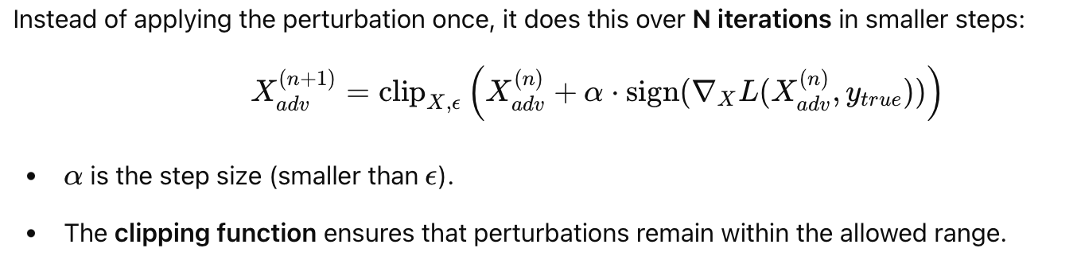
Mathematical Functions of Attacks Used
Iterative Gradient Sign (IGS) – More Powerful Version of FGSM
What is this clipping function? clip(x, min_value, max_value) = {
min_value if x < min_value x if min_value<=x <=max_value max_value if max_value < x }

Slide 11
Architecture Used
The study evaluates adversarial attacks on four different Deepfake detectors:
Baseline CNN Model – A simple convolutional neural network with 4 convolutional layers.
XceptionNet – A deeper CNN model using separable convolutions (used in top Deepfake detection competitions).
EfficientNet B3 – A compact, efficient CNN that balances accuracy and speed.
EfficientNet V2S – A more optimized version of EfficientNet designed for higher performance.
Training Details:
All models were trained on 140,000 images (70k real, 70k fake) from the Kaggle 140k Real and Fake Faces dataset.
Loss function: Binary Cross-Entropy (BCE).
Optimizer: Adam with an initial learning rate of 0.001.
Training epochs: 15.

Slide 12
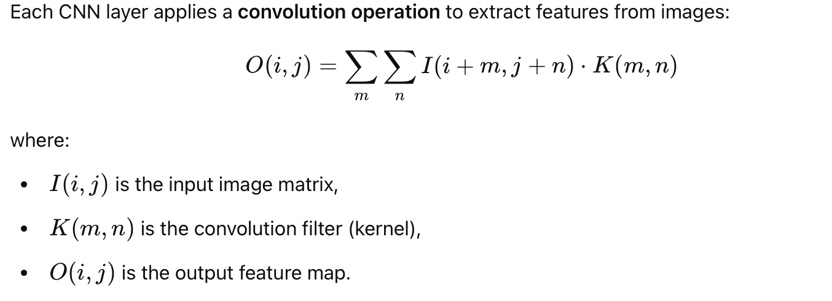
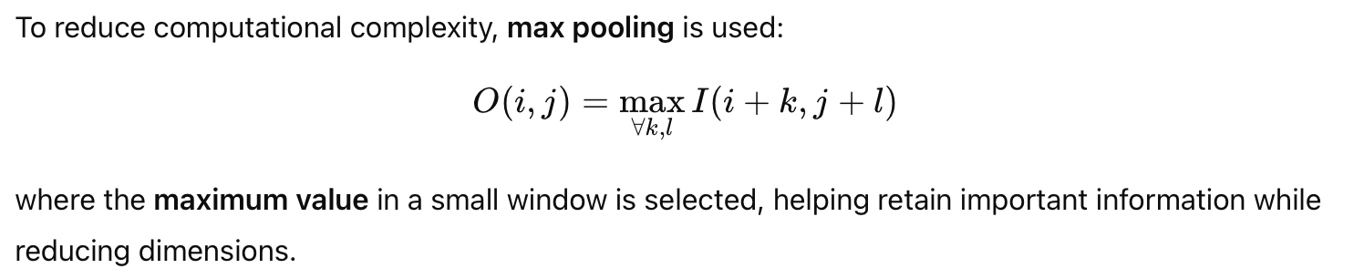
Behind the models used
A) Convolution Operation (Feature Extraction)
B)Activation Functions :- The related papers uses Relu as activation function :- f(x)=max(0,x) C)Pooling (Downsampling)

Slide 13
Limitations
(A) Vulnerability to Adversarial Attacks 🚨
(i) The models fail when compact adversarial perturbations are introduced.
(ii) Simple Fast Gradient Sign Method (FGSM) and Iterative Gradient Sign (IGS) attacks reduce model accuracy to nearly 0%.
(B)Inefficiency in Black-Box Attack Defense
(i) Black-box attacks (e.g., Natural Evolution Strategy (NES)) still fool the models without requiring gradient access.
(ii) The models rely too much on pixel-level differences, making them susceptible to transfer attacks from one model to another (c)Overfitting to Training Data (i) The models, especially EfficientNet, achieve high accuracy (98-99%) on clean images but are not robust in real-world conditions.
(ii)Adding augmentations (blur, noise) helps slightly but does not fully solve the problem.

Slide 14
Related Research Papers
Title | Approach | Result | Limitation
Transferable Adversarial Attacks on Audio Deepfake Detection | GAN-based adversarial attack that leverages an ensemble of surrogate audio deepfake detection models and incorporates self-supervised audio modeling | Reduced the accuracy from 98% to 26% in white-box scenarios, 92% to 54% in gray-box scenarios, and 94% to 84% in black-box scenarios | Doesn’t employ any defense techniques; Noise-quality tradeoff is present
Comprehensive Evaluation of Deepfake Detection Models (MDPI, 2025) | Evaluates four detection models (XCeption, ResNet-50, VGG16, MobileNet V2) across accuracy, generalization, and adversarial robustness | XCeption achieved highest accuracy (89.2%) and fastest inference (85ms/frame); all models showed 15-30% accuracy drop under adversarial attack | Limited testing against only FGSM attacks; dataset bias; results may not generalize to newer deepfake generation techniques
Building Trust in Deepfake Detection (SSRN 2024) | Systematic review of attack types and defense strategies with focus on hybrid passive/proactive defenses | Hybrid defenses (combining methods like adversarial training + denoising) outperform single-method approaches; identified vulnerability to adaptive attacks | Implementation complexity for hybrid defenses; lack of standardized benchmarks; limited coverage of audio/video deepfakes
Defense Against Adversarial Attacks on Audio DeepFake Detection(2023) | Used 3 approaches for defense - White-box, Transferability Attacks and Adversarial Adaptive Training | Equal Error Rate found to be lower than standard approaches, Memory overhead was minimal | Training time increased as compared to standard approaches

Slide 15
Related Research Papers
Title | Approach | Result | Limitation
XAI-Based Detection of Adversarial Attacks on Deepfake Detectors (2024) | Uses explainable AI to generate interpretability maps and trains a classifier to detect when deepfake detectors are being manipulated | Successfully identifies adversarial attacks without changing performance of the underlying detector | Adds computational overhead; might be vulnerable to extremely sophisticated attacks targeting both detector and XAI component
DeepFake detection against adversarial examples based on D-VAEGAN (2024) | Combines VAE and GAN architectures with specialized loss function to denoise adversarial perturbations | Achieved 96% accuracy on FaceForensics++, approximately 50% higher than comparison methods | Potential image quality degradation during reconstruction
Adversarially Robust Deepfake Video Detection | Uses adversarial training with a modified iterative FGSM (employing random step sizes) on VGG19 and combines predictions from an ensemble (including Wide ResNet and Vision Transformer) to detect deepfake video frames. | Demonstrated robust accuracy of over 55% on adversarially perturbed frames from FaceForensics++—a significant improvement over models without adversarial training. | The evaluation is limited to one deepfake video dataset, relies heavily on ensemble techniques that add computational complexity

Slide 16
Related Research Papers
Title | Approach | Result | Limitation
Mitigating Adversarial Attacks in Deepfake Detection: An Exploration of Perturbation and AI Techniques | Proposes a CNN-based framework with integrated adversarial training, and employs preprocessing steps (such as cropping and compression) | Achieved a precision rate of around 76.2% on the DFDC dataset under adversarial conditions, indicating a promising defense against adversarial attacks. | Relies on a standard CNN architecture that may not capture complex features as effectively as hybrid models; preprocessing techniques might require further tuning to generalize across diverse datasets.
Adversarial Perturbations Fool Deepfake Detectors | Uses Lipschitz regularization,which constrains gradients to reduce sensitivity to perturbations, and Deep Image Prior(DIP), an unsupervised method that removes adversarial noise via image restoration. | Lipschitz regularization improved the accuracy by 10%, while (DIP) defense achieved 95% accuracy on perturbed deep fakes and 98% accuracy on unperturbed cases. | While LR alone is not enough, DIP takes more time (around 30 min per image)

Slide 17
Related Research Papers
Title | Approach | Result | Limitation
FGSM Adversarial Attack Detection On Deep Fake Videos | Uses primarily Xception and ResNet50. It preprocesses by extracting facial regions and adding FGSM perturbations. With Xception demonstrating superior accuracy than ResNet50. | Xception achieved 98.85% training, 98.58% validation, and 93.75% testing accuracy, outperforming ResNet50, which had lower accuracies around 83%. | The approach focuses only on FGSM attacks, leaving vulnerability to other adversarial techniques.

Slide 18
Common Approaches
Adversarial Training
Denoising
Defense against single Attack
Both MDPI (2025) and SSRN (2024) highlight adversarial training as a good strategy for defense. This method involves generating adversarial examples and retraining the model to recognize them.
The audio deepfake attack paper suggests that denoising helps. These methods focus on removing perturbations added by adversarial attacks.
Majority of the papers defend against single adversarial attack making them vulnerable if multiple attacks are found in the dataset.

Slide 19
Suggested Approach
Hybrid Architecture: A multi-scale CNN extracts local, fine-grained deepfake artifacts while a Transformer captures global information—these put together provide greater detection than standard CNNs.
Robust Adversarial Training: Using PGD-based training with finely tuned hyperparameters to force the model to learn features that withstand adversarial perturbations.
Key Benefits: Enhanced feature capture, improved robustness against targeted attacks, and an image-based design that is extendable to video without added temporal complexity.

Slide 20
Why it works?
Comprehensive Features: CNNs capture local details; Transformers capture global context, ensuring comprehensive feature representation.
Enhanced Robustness: The dual extraction of local and global features helps mitigate adversarial perturbations by reinforcing robust feature learning across different scales.
Proven Efficacy: Recent studies (e.g., Dosovitskiy et al., 2020 and Paper 1) show that combining Transformers with CNNs outperforms CNN-only models, validating our design choice for deepfake detection.

Slide 21
Progress till now
Literature Review
Dataset Collection & Preparation
Completed comprehensive review on research papers related to adversarial attacks and adversarial defenses in deep fake detection.
Identified potential datasets which could be effective in dealing with the problem.Eg.,CIFAKE, Frames in FaceForensics++.

Slide 22
Final Deliverables
Robust Deepfake Detector
Comparative Analysis
Implementation of both adversarial training and multi-scale CNN + Transformer approaches.
Evaluation results comparing robust accuracy, clean accuracy, and other benchmark metrics for both methods.
Documentation & Report
Presentation
Detailed technical report including methodology, experiments, studies, and conclusions.
Final presentation slides summarizing approach, results, and future directions.

Slide 23
Project timeline
Week 1
Data Preprocessing and implementing baseline deepfake detector
Week 2
Integrate PGD-based adversarial training and tune hyperparameters
Week 3
Design and implement the multi-scale CNN + Transformer architecture
Week 4
Final results and documentation

Slide 24
Contribution
Everyone contributed equally in this project
Held various meets to discuss various ideas and finalised with the current one together

Slide 25
Thanks !
/* */ || ??

