Slide 1
I360 - Data Science Project Video Presentation link
Report by
Venkatesh Babu Sekar

Slide 2
Problem Statement
Determining which voters support reducing the U.S. national deficit versus those who support higher government spending will help i360 and partner organizations optimize the delivery of messages related to government spending to voters.
Approach:
Build a logistic regression model
Why logistic regression model ?
The dependent variable is categorical (Yes or No) we can start with logistic regression. Based on the output and the relation between Dependent & Independent variable we can look for different model if needed.

Slide 3
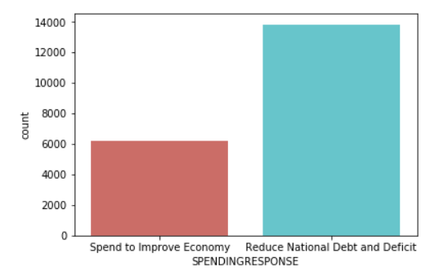
Exploratory Data Analysis
Combining the Input file File1.csv & File2.csv to obtain Dependent and Independent variable
Total No of Column (Features) = 150
Total No of Rows (records or observation ) = 2000
Total No of categorical variable = 25 (Dependent variable included)
Total No of Numerical variable = 125
Dependent variable contain 2 class
percentage of Improve Economy vote 30.845
percentage of Reduce National Debt vote 69.155

Slide 4
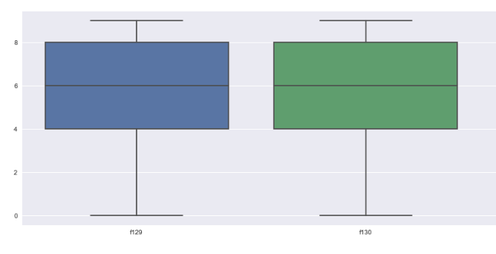
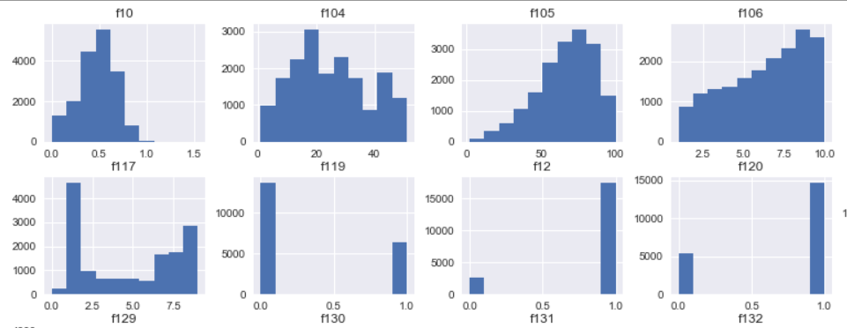
Exploratory Data Analysis
Checking the presence of
Outlier using the Box Plot
Histogram to under the distribution of each variable

Slide 5
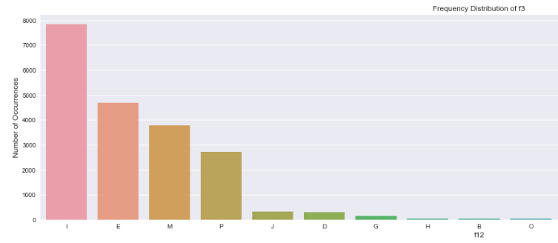
Handling the Null Values
We need to ask this question before imputing the missing value. why are those values missing? Data is rarely MAR (missing at random), so the fact that it is missing, has a meaning of its own.
Since our knowledge is limited about the data , and the source from which the data is gathered. we are going to keep the missing data a new separate category for few categorical columns
For few categorical variable we are replacing the null with the most frequent class
For numeric variable
we are replacing with
median value and
few missing data
Variable are treated
as new category

Slide 6
Data Transformation
There are different method for Encoding Categorical Data
Label Encoding
Disadvantage - Numerical values can be misinterpreted by the algorithm
One-Hot encoding
Disadvantage - can result in the curse of dimensionality
Binary encoding
Better than the Label Encoding and One-Hot encoding
Binary encoded the categorical variable, which resulted in 216 columns in total

Slide 7
Data Transformation
There are different method for Encoding Categorical Data
Label Encoding
Disadvantage - Numerical values can be misinterpreted by the algorithm
One-Hot encoding
Disadvantage - can result in the curse of dimensionality
Binary encoding
Better than the Label Encoding and One-Hot encoding
Binary encoded the categorical variable, which resulted in 216 columns in total

Slide 8
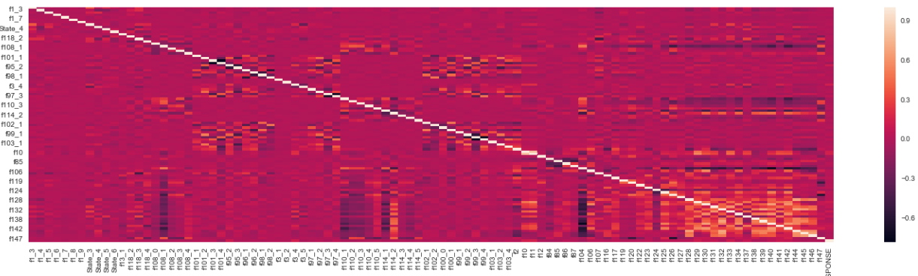
Logistics Regression Assumption
Correlating Matrix to the linearity between the variable
Removed the variable with higher (5) VIF value to avoid multicollinearity.
After removing highly collinear variable we have 96 Independent variable

Slide 9
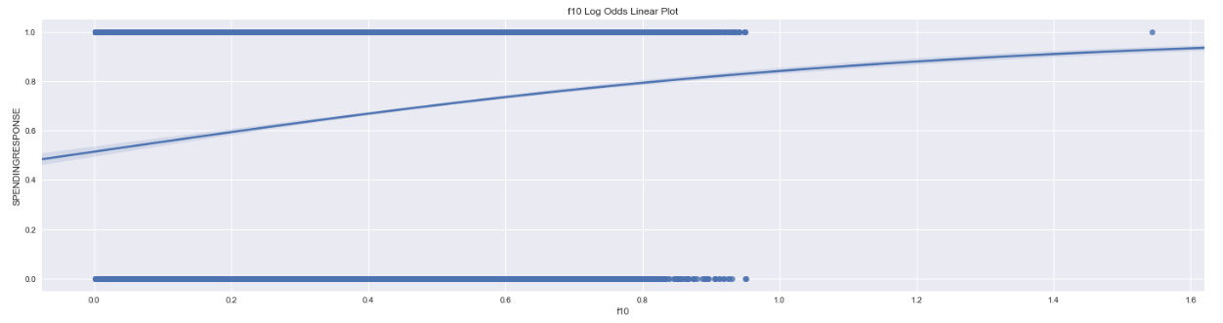
Logistics Regression Assumption
Log odd relation
It requires that the independent variables are linearly related to the log odds
In our variable there is little relation, we might need to transform the data to obtain a strong relation

Slide 10
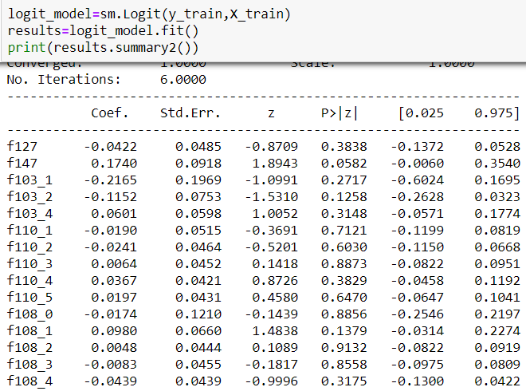
Logistics Regression Model
Model 1(logistic regression)
Build a simple logistic regression with 96 variable and found the variable which are significant
We found out 65 variable are only significant
Model 2(logistic regression – Feature selection )
Build a second model with only 65
Independent variable
Model 3(PCA-logistic regression)
Build a simple logistic regression with 20 PCA
Model 4(Random forest - logistic regression)
Build a Random forest with 100 trees

Slide 11
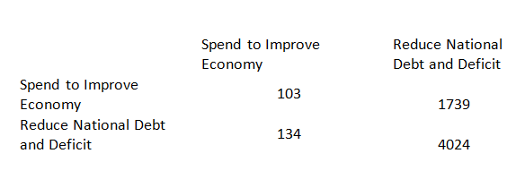
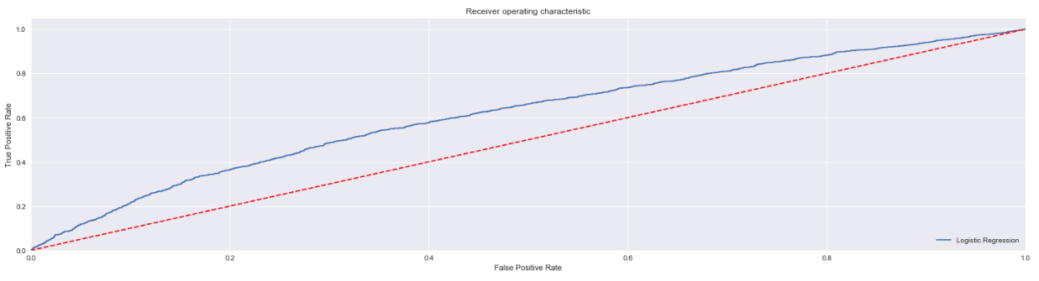
Model Accuracy
Model 2:
Accuracy of the model is 69%
Model 4:
Accuracy of the model is 100%
Model 2: Confusion matrix
Model 2: Roc

Slide 12
Conclusion
How much we care about the model interpretability and the accuracy ? How much money is at stake ?
If model interpretability is more import compared to accuracy then we will choose Model 2
If model accuracy is more import compared to interpretability then will we choose Model 4
I would like to choose Model2, because model interpretability is more important
Future scope:
We can try to check log odd relation for each variable and do the transformation according
We cab build a model with K-fold validation
We can predict the null value and build model on top that variable

