Slide 1

GROCERY STORE MANAGEMENT

Slide 2
Agenda (This should be the PPT flow)
Objective of the Project
ER Diagram and schema explanation
Key analysis questions (use cases)
SQL query results with screenshots or summaries
Final business insights and recommendations
Conclusion (Key finding overall)
Q&A Slide
Your Experience/Challenges working on SQL – Data Analysis Project.

Slide 3
Objectives
To design and implement a relational database for a grocery store.
To retrieve and manipulate data using SQL queries. To practice using joins, aggregations, subqueries, and filtering techniques.
To perform data analysis for business insights such as top customers, best-selling products, and revenue trends.

Slide 4
Introduction
The Retail and Grocery domain manages products, suppliers, customers, employees, and orders.
This project simulates a mini grocery store database system.
This project simulates a mini grocery store database system.
  Data extraction and transformation
  Deriving meaningful business insights
The project helps in:
  Tracking sales performance and revenue
  Monitoring product availability and stock levels
  Analysing customer purchasing behavior
  Improving operational efficiency

Slide 5
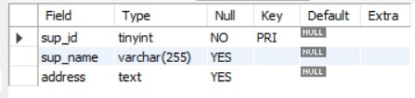

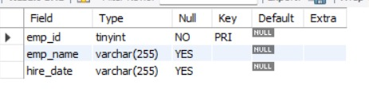
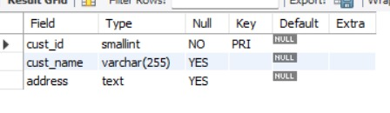
Tables
Suppliers Table
Categories Table
Employees Table
Customers Table

Slide 6
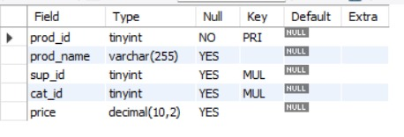
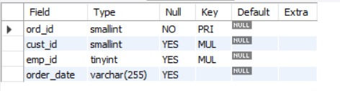
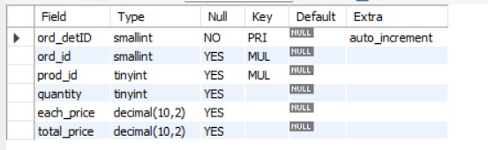
Tables
Products Table
Orders Table
Order_Details Table

Slide 7
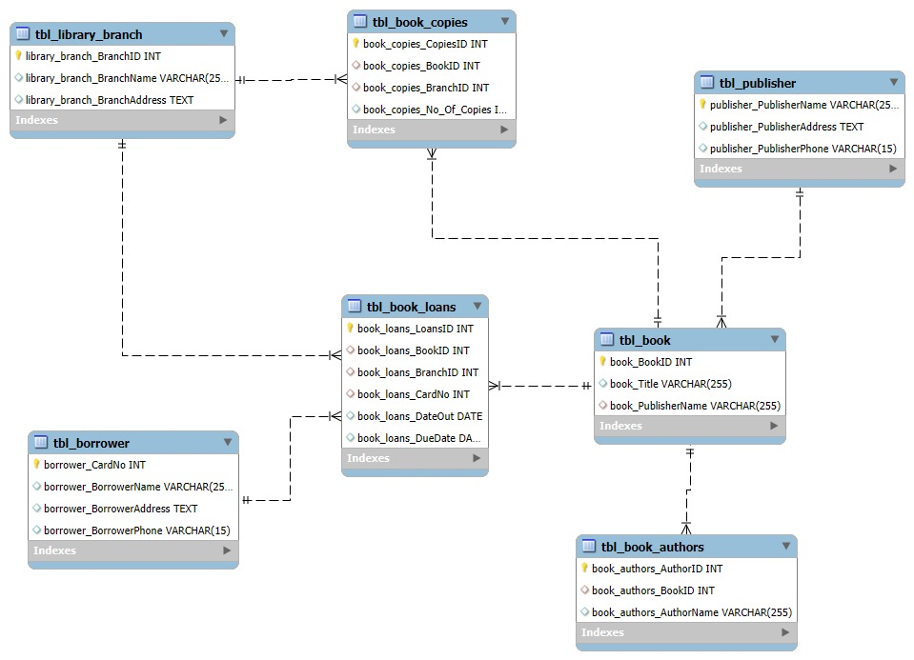
ER Diagram

Slide 8
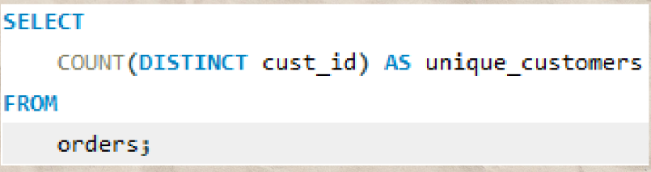

Key Analysis
1. How many unique customers have placed orders?
Query
output

Slide 9
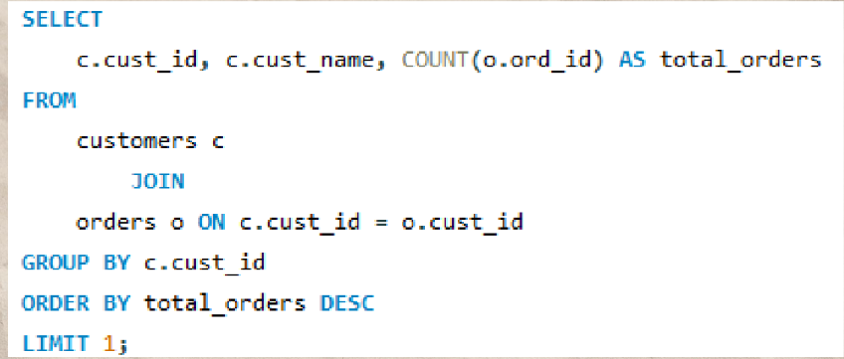
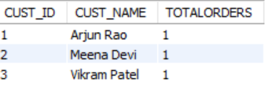
2.Which customers have placed the highest number of orders?
Query
Output

Slide 10
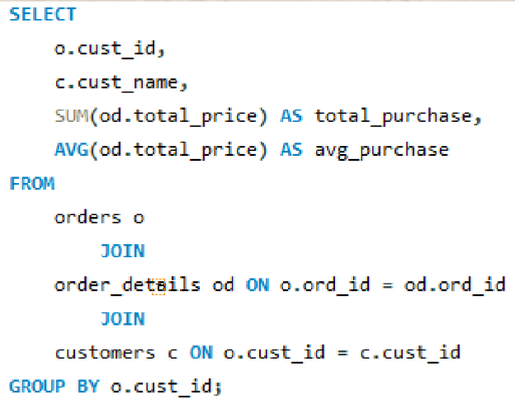
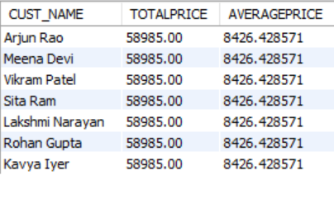
3.What is the total and average purchase value per customer?
Query
Output

Slide 11
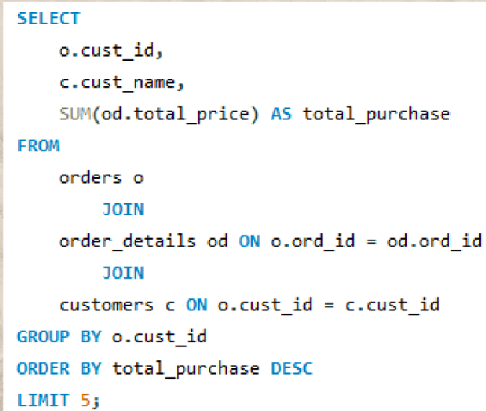
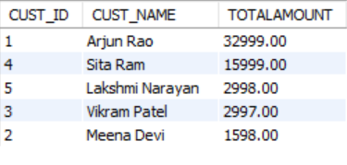
4.Who are the top 5 customers by total purchase amount?
Query
Output

Slide 12
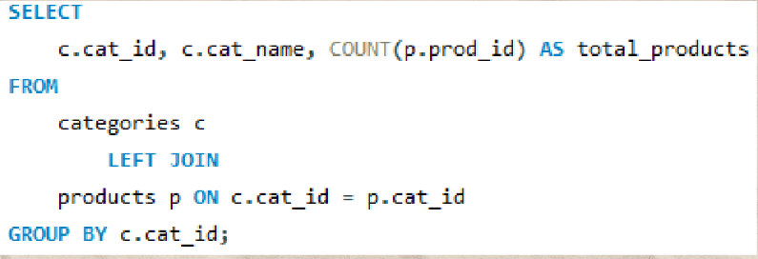
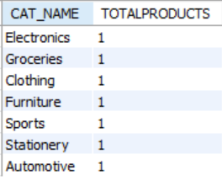
5.How many products exist in each category?
Query
Output

Slide 13
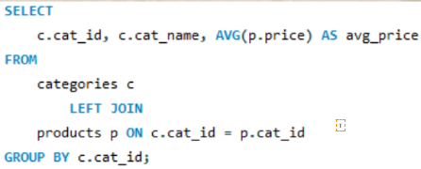
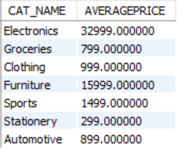
6.What is the average price of products by category?
Query
Output

Slide 14
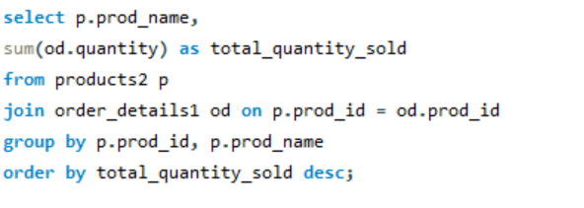
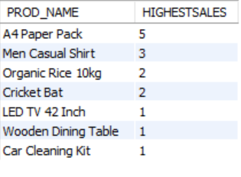
7.Which products have the highest total sales volume (by quantity)?
Query
Output

Slide 15
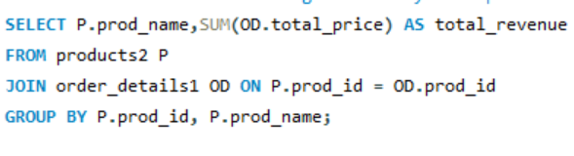
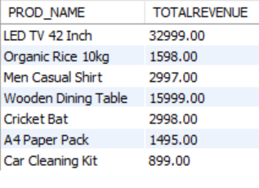
8.What is the total revenue generated by each product?
Output
Query

Slide 16
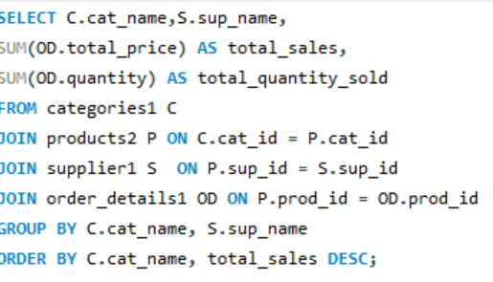
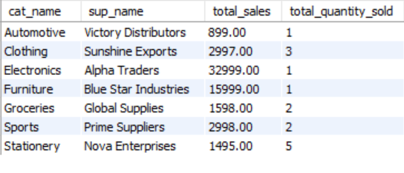
9.How do product sales vary by category and supplier?
Output
Query

Slide 17
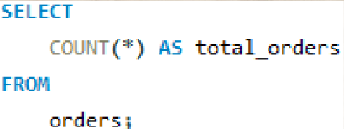

10.How many orders have been placed in total?
Query
Output

Slide 18
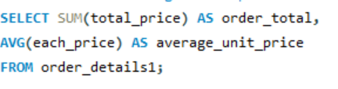

11.What is the average value per order?
Query
Output

Slide 19
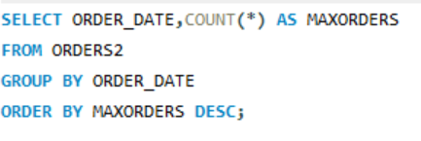
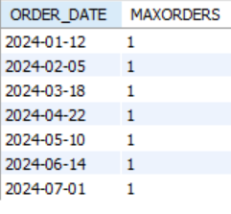
12.On which dates were the most orders placed ?
Query
Output

Slide 20
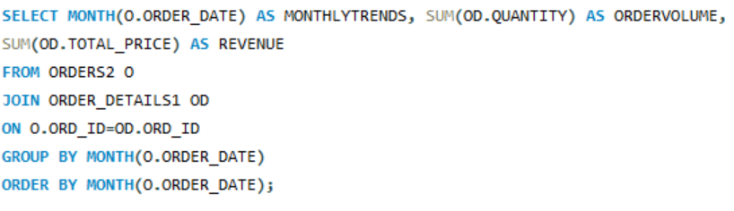
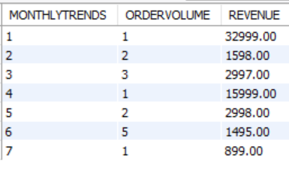
13.What are the monthly trends in order volume and revenue?
Query
Output

Slide 21
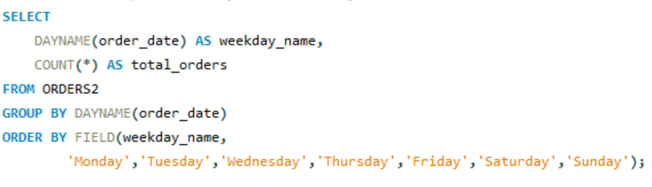

14.How do order patterns vary across weekdays and months?
Output
Query

Slide 22
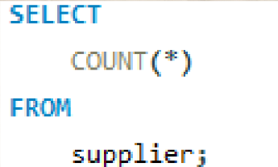

15.How many suppliers are there in the database?
Query
Output

Slide 23
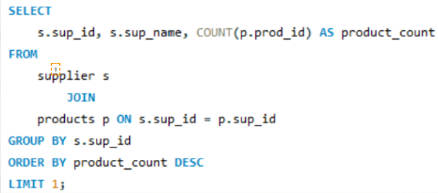

16.Which supplier provides the most products?
Query
Output

Slide 24
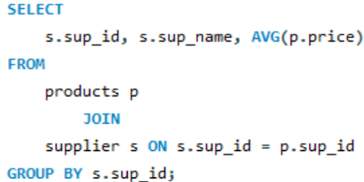
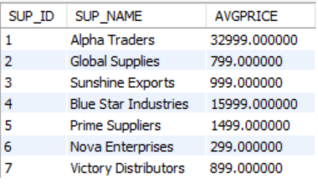
17.What is the average price of products from each supplier?
Query
Output

Slide 25
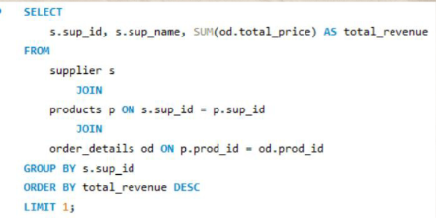

18.Which suppliers contribute the most to total product sales (by revenue)
Query
Output

Slide 26
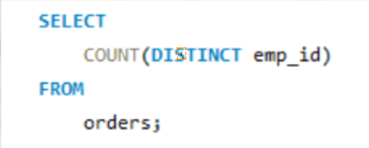
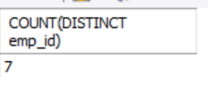
19.How many employees have processed orders?
Query
Output

Slide 27
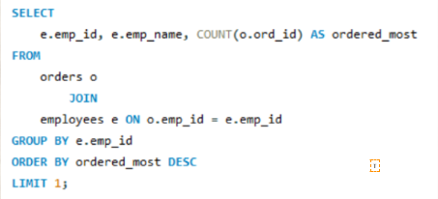

20.Which employees have handled the most orders?
Query
Output

Slide 28
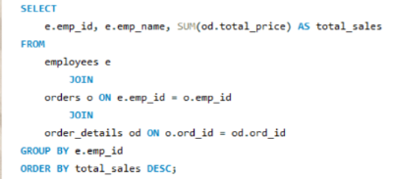
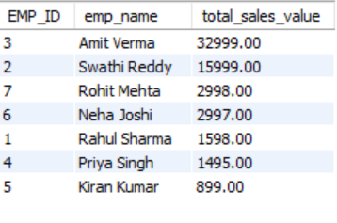
21.What is the total sales value processed by each employee?
Query
Output

Slide 29
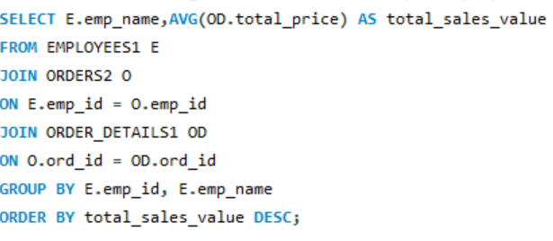
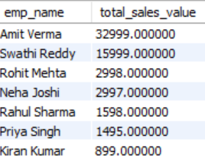
22.What is the average order value handled per employee?
Output
Query

Slide 30
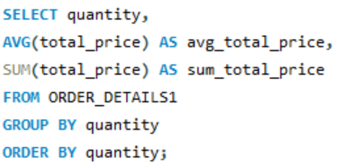
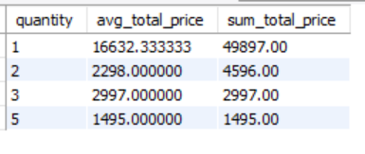
23.What is the relationship between quantity ordered and total price?
Query
Output

Slide 31
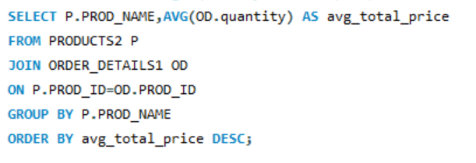
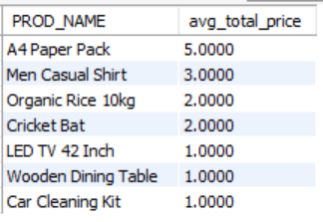
24.What is the average quantity ordered per product?
Query
Output

Slide 32
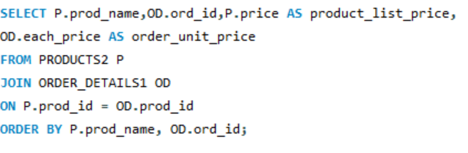
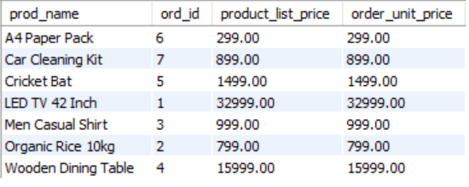
25.How does the unit price vary across products and orders?
Query
Output

Slide 33
Final INSIGHTS
Small group of customers drives majority of revenue
Top customers have higher purchase frequency and value
Orders fluctuate by date, month, and weekday/weekend
Few suppliers provide most products and revenue
Unit price variation suggests pricing optimization potential

Slide 34
Recommendations
Launch loyalty programs for top customers
Target occasional buyers with promotions
Use segmentation for marketing campaigns
Focus on high-performing products and profitable categories
Negotiate better deals with top suppliers
Consider discontinuing low-performing items

Slide 35
Conclusion
A small group of loyal customers and a few high-performing products drive most of the revenue.
Sales and order patterns fluctuate by date, month, and weekday/weekend, indicating clear seasonal and weekly trends.
Pricing and quantity ordered significantly impact total revenue, showing opportunities for optimization.
Data-driven strategies in customer targeting, product focus, supplier management, and employee performance can significantly improve profitability and operational efficiency.

Slide 36
Experience/Challenges working on SQL
Gained hands-on experience designing and implementing a relational database with multiple tables, foreign keys, and constraints.
Learned to write complex SQL queries for aggregating data, joining multiple tables, and calculating metrics like total revenue, average purchase, and product performance
Improved problem-solving and logical thinking by translating real-world business questions into SQL queries.

Slide 37
THANK YOU
Group Members
Venkatesh Boragala
Saishiva Jakkula
Harikrishna kanapuram

