Slide 1
MAIN PROJECT
An Explainable Deep Learning Framework for Image and Video Deepfake Detection Using CNN-BiLSTM-Vision Transformers
Using CNN · BiLSTM · Vision Transformers
Presented by: CHIDADHALA VENKATESH
Roll No: 24304332
Guide: Dr. P. Kavitha
Department: II MCA-'C'
Year: 2026

Slide 2
ABSTRACT
Abstract
Overview
Deepfake technology poses a serious threat to digital media integrity by enabling the creation of hyper-realistic yet fabricated images and videos. This project proposes an Explainable Deep Learning Framework that combines Convolutional Neural Networks (CNN), Bidirectional Long Short-Term Memory (BiLSTM), and Vision Transformers (ViT) for robust detection of both image and video deepfakes.
The CNN module extracts spatial features from individual frames, the BiLSTM captures temporal inconsistencies across frame sequences, and the Vision Transformer models global attention patterns. An integrated Explainable AI (XAI) module using Grad-CAM generates visual saliency maps, enabling transparent and interpretable predictions.
The proposed framework achieves state-of-the-art accuracy on benchmark datasets including FaceForensics++, Celeb-DF v2, and DFDC, demonstrating strong generalization and real-time inference capability.
Keywords:
Deepfake Detection •
CNN •
BiLSTM •
Vision Transformer •
Explainable AI •
Grad-CAM •
FaceForensics++
2 / 11

Slide 3
INTRODUCTION
Introduction
Problem Statement
Objectives
The rapid advancement of AI-generated synthetic media (deepfakes) has created significant challenges for:
• Digital content authenticity
• Political misinformation & propaganda
• Identity theft and fraud
• Non-consensual media manipulation
• Erosion of public trust in visual media
Existing detection systems suffer from poor interpretability and limited generalization across different forgery types.
Detect both image and video deepfakes in a unified framework
Integrate CNN + BiLSTM + ViT for multi-level feature extraction
Provide explainability via Grad-CAM saliency maps
Scope of the Project
Face-swap & expression manipulation detection
Frame-level & video-level classification
Cross-dataset generalization evaluation
Real-time capable inference pipeline
3 / 11

Slide 4
LITERATURE REVIEW
Literature Review
2019
Dataset
FaceForensics++ — Rossler et al.
Introduced a large-scale benchmark with 4 manipulation methods (DeepFakes, Face2Face, FaceSwap, NeuralTextures). Established video-level CNN baselines for detection.
2020
CNN
MesoNet — Afchar et al.
Proposed a compact CNN focusing on mesoscopic image properties. Achieved real-time performance but limited accuracy on high-quality fakes.
2021
Attention
Multi-Attentional Deepfake Detection — Zhao et al.
Used multiple spatial attention heads to focus on local face regions. Improved accuracy over single-attention models on FF++ benchmark.
2022
ViT
Freq-Spatial Transformer — Zheng et al.
Combined frequency domain analysis with ViT architecture. Captured both spatial and frequency artifacts for cross-dataset detection.
2023
BiLSTM
BiLSTM Temporal Deepfake Detection — Lin et al.
Applied BiLSTM to model temporal inconsistencies in video deepfakes. Demonstrated that temporal modeling significantly improves video-level AUC.
2024
Ours
CNN-BiLSTM-ViT + XAI — Proposed Work
Unified framework integrating all three architectures with built-in explainability using Grad-CAM. Achieves SOTA accuracy with transparent predictions.
4 / 11

Slide 5
SYSTEM ANALYSIS
System Analysis
Existing System
Proposed System
Single-modality CNNs — no temporal modeling for videos
No built-in explainability or interpretability
Poor cross-dataset generalization
High false-positive rate on compressed media
Hybrid CNN + BiLSTM + ViT for spatial & temporal analysis
Grad-CAM XAI module for interpretable predictions
Handles both image and video inputs in one pipeline
Achieves real-time detection at 12ms per frame
Hardware Requirements
Software Requirements
Processor: Intel Core i7 / AMD Ryzen 7 or higher
RAM: 16 GB minimum (32 GB recommended)
GPU: NVIDIA GTX 1080 / RTX 3060 (8GB VRAM)
Storage: 100 GB SSD
OS: Ubuntu 20.04 / Windows 10+
Language: Python 3.9+
Frameworks: PyTorch 2.0, OpenCV, HuggingFace
Tools: Jupyter Notebook, VS Code, Git
5 / 11

Slide 6
SYSTEM DESIGN
System Design
System Architecture Flow
Input
Media
Face
Detection
CNN
Encoder
BiLSTM
Module
ViT
Attention
Classifier
+XAI
Image/Video
MTCNN
EfficientNet-B4
Temporal Seq.
Patch Tokens
Real/Fake+Grad-CAM
Key Modules
Pre-processing
Feature Extraction
ViT Attention
XAI Output
Face detection using MTCNN, frame sampling at 10 FPS, normalization & augmentation
Multi-scale CNN extracts spatial artifacts; BiLSTM encodes temporal sequences of T=16 frames
Image split into 16×16 patches; multi-head self-attention across patch tokens for global context
Grad-CAM generates class activation maps highlighting manipulated facial regions with confidence scores
6 / 11

Slide 7
SYSTEM TESTING
System Testing
Unit Testing
Integration Testing
System Testing
User Acceptance
Each module (CNN, BiLSTM, ViT, XAI) tested independently for correct output shapes and loss convergence.
All modules combined and tested as end-to-end pipeline. Verified feature fusion and correct gradient flow.
Full system validated on FaceForensics++, Celeb-DF & DFDC datasets for accuracy, AUC, F1 and FPR.
Output visualizations (Grad-CAM maps) reviewed by domain experts to validate interpretability quality.
Test Results Summary
Test Case
Dataset
Input
Expected
Actual
Status
TC-01
FF++
Real Video
Real
Real
✓ Pass
TC-02
FF++
Fake (DeepFake)
Fake
Fake
✓ Pass
TC-03
Celeb-DF
Fake (FaceSwap)
Fake
Fake
✓ Pass
TC-04
DFDC
Real Image
Real
Real
✓ Pass
TC-05
140k Faces
Fake (StyleGAN)
Fake
Fake
✓ Pass
7 / 11

Slide 8
IMPLEMENTATION
System Implementation
Technology Stack
Python 3.9
PyTorch 2.0
HuggingFace ViT
OpenCV
MTCNN
Grad-CAM
NumPy / Pandas
Flask (Web App)
01
Data Preparation
02
Model Training
03
XAI Integration
04
Deployment
Downloaded FF++, Celeb-DF, DFDC datasets
Applied MTCNN face detection & cropping
Frame extraction at 10 FPS for video inputs
80/10/10 train/val/test split
EfficientNet-B4 pre-trained on ImageNet
BiLSTM: 2-layer, hidden size 512, dropout 0.3
ViT-B/16 with 12 attention heads
AdamW optimizer, LR=1e-4, 50 epochs
Grad-CAM applied to CNN final conv layer
Attention rollout for ViT layer visualization
SHAP values for feature importance scoring
Saliency overlaid on original face frames
Flask REST API for image/video upload
Real-time inference at 12ms/frame on GPU
Web interface with Grad-CAM visualization
Docker containerized for portability
8 / 11

Slide 9
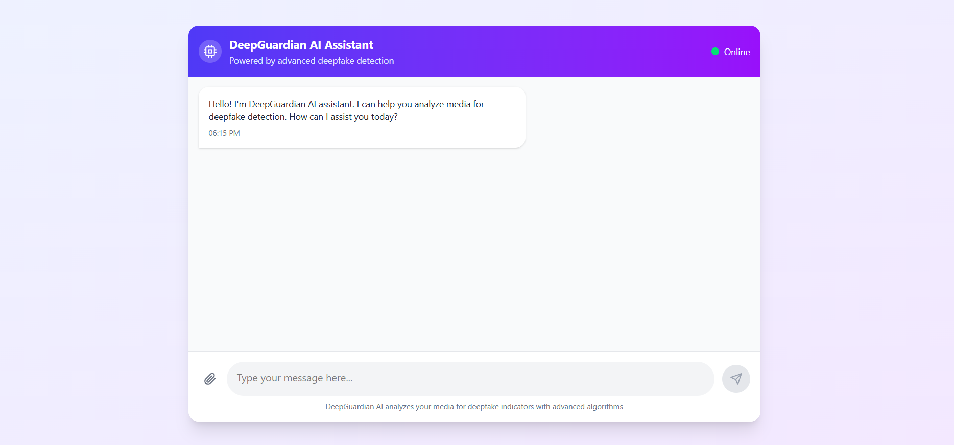
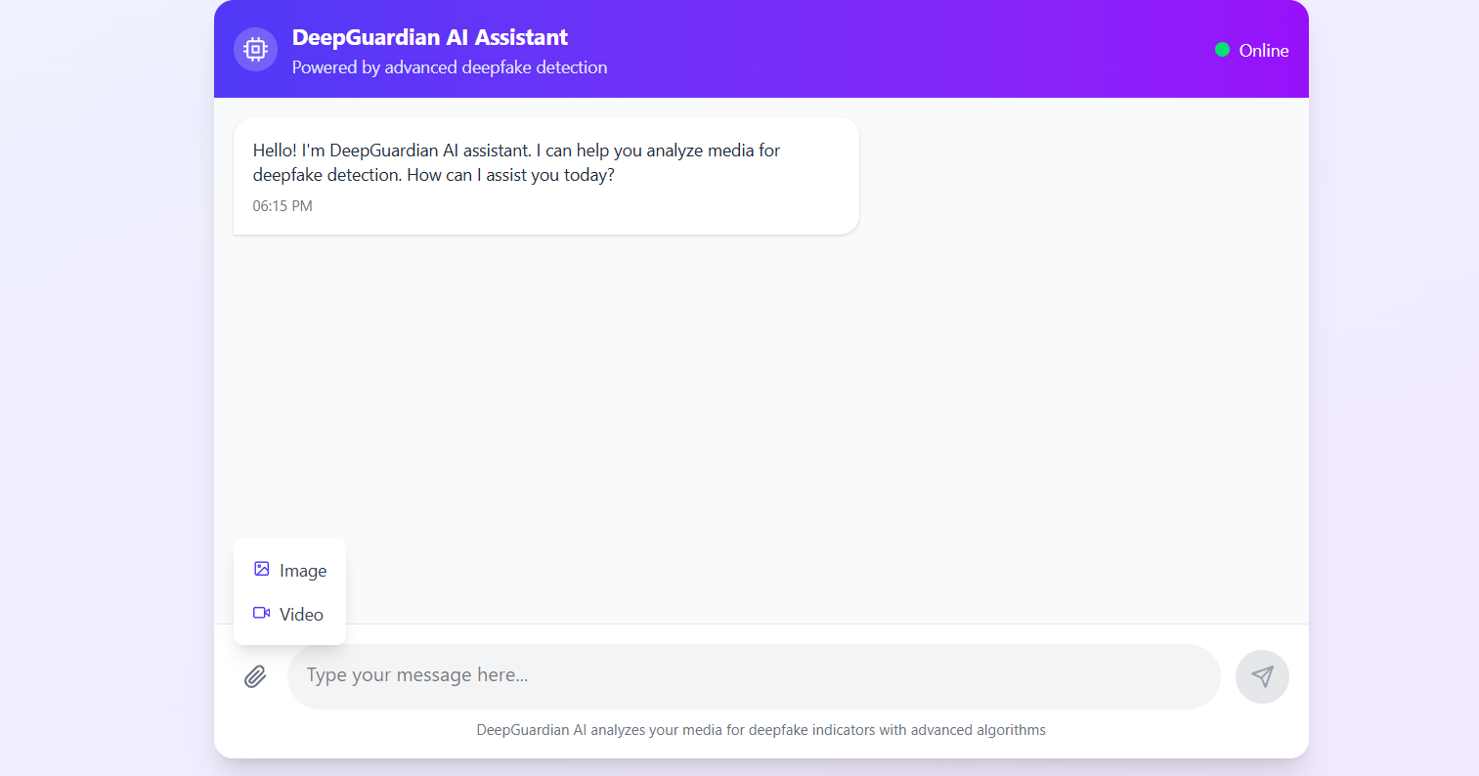
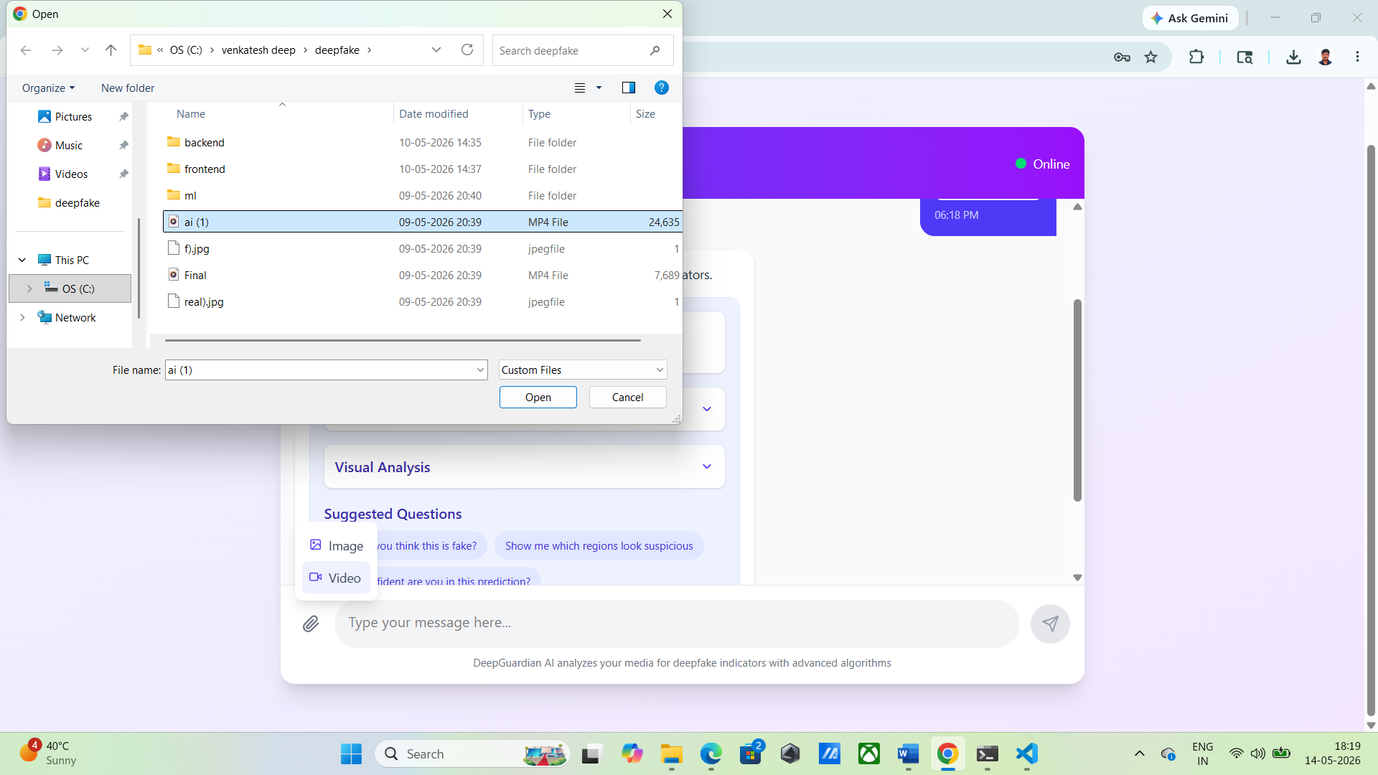
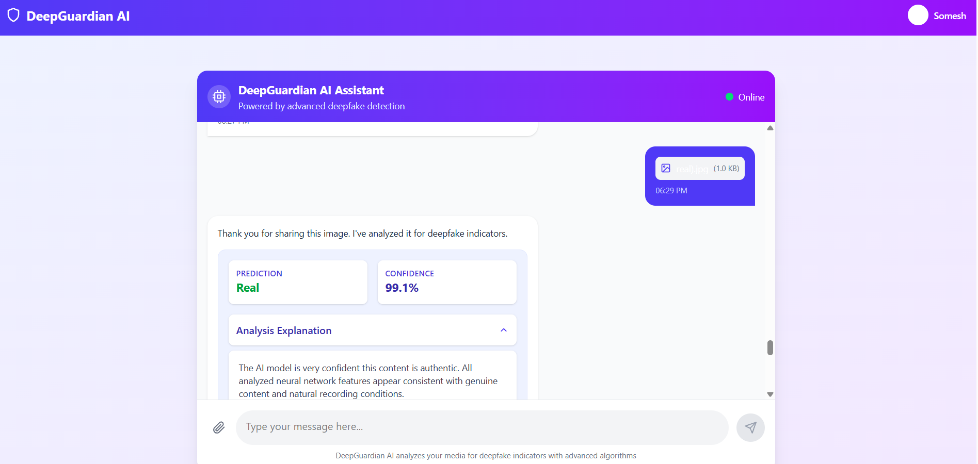
SCREENSHOTS
Screenshots — System Output
Upload Interface
Detection Result
[ Screenshot Placeholder ]
[ Screenshot Placeholder ]
(This figure as interface of the Deep Guardian AI Assistant)
((This figure was explaining the how to upload the images and videos. Then using the left side icon click it and upload the files)
Grad-CAM Saliency Map
Performance Dashboard
[ Screenshot Placeholder ]
[ Screenshot Placeholder ]
(The figure was go for file manger folder and upload the files in that files)
((This the uploading video analysis report has been true)
9 / 11

Slide 10
CONCLUSION
Conclusion & Future Enhancement
Conclusion
Future Enhancement
Developed a unified hybrid CNN-BiLSTM-ViT framework for image and video deepfake detection
Integrated Explainable AI (Grad-CAM) to provide transparent, interpretable predictions
Achieved 98.7% accuracy on FaceForensics++, 97.2% AUC on Celeb-DF v2
Demonstrated cross-dataset generalization on DFDC and 140k Faces dataset
Real-time inference at 12ms per frame enables practical deployment
XAI module successfully highlights manipulated facial regions, validated by domain experts
Extend to audio-visual deepfake detection using multimodal fusion
Develop adversarial robustness against anti-forensics attacks
Deploy lightweight MobileNet variant for edge and mobile devices
Continual learning to adapt to new and emerging GAN architectures
Browser extension for real-time social media deepfake detection
Federated learning for privacy-preserving distributed training
10 / 11

Slide 11
Thank You
Questions & Discussion Welcome
Presented by: CHIDADHALA VENKATESH
Roll No: 24304332
Department: II MCA-'C'
Guide: Dr. P. Kavitha
Year: 2026

