Slide 1

Zoom In Game

Slide 2

First Item- Slide 1:

Slide 3
First Item- Slide 2:

Slide 4
First Item- Slide 3:

Slide 5
First Item- Slide 4:

Slide 6

Second Item- Slide 1:

Slide 7
Second Item- Slide 2:

Slide 8
Second Item- Slide 43:

Slide 9
Second Item- Slide 4:

Slide 10

Third Item Slide 1:

Slide 11
Third Item Slide 2:

Slide 12
Third Item Slide 3:

Slide 13
Third Item Slide 4:

Slide 14

Fourth Item Slide 1:

Slide 15
Fourth Item Slide 2:

Slide 16
Fourth Item Slide 3:

Slide 17
Fourth Item Slide 4:

Slide 18

Fifth Item Slide 1:

Slide 19
Fifth Item Slide 2:

Slide 20
Fifth Item Slide 3:

Slide 21
Fifth Item Slide 4:

Slide 22
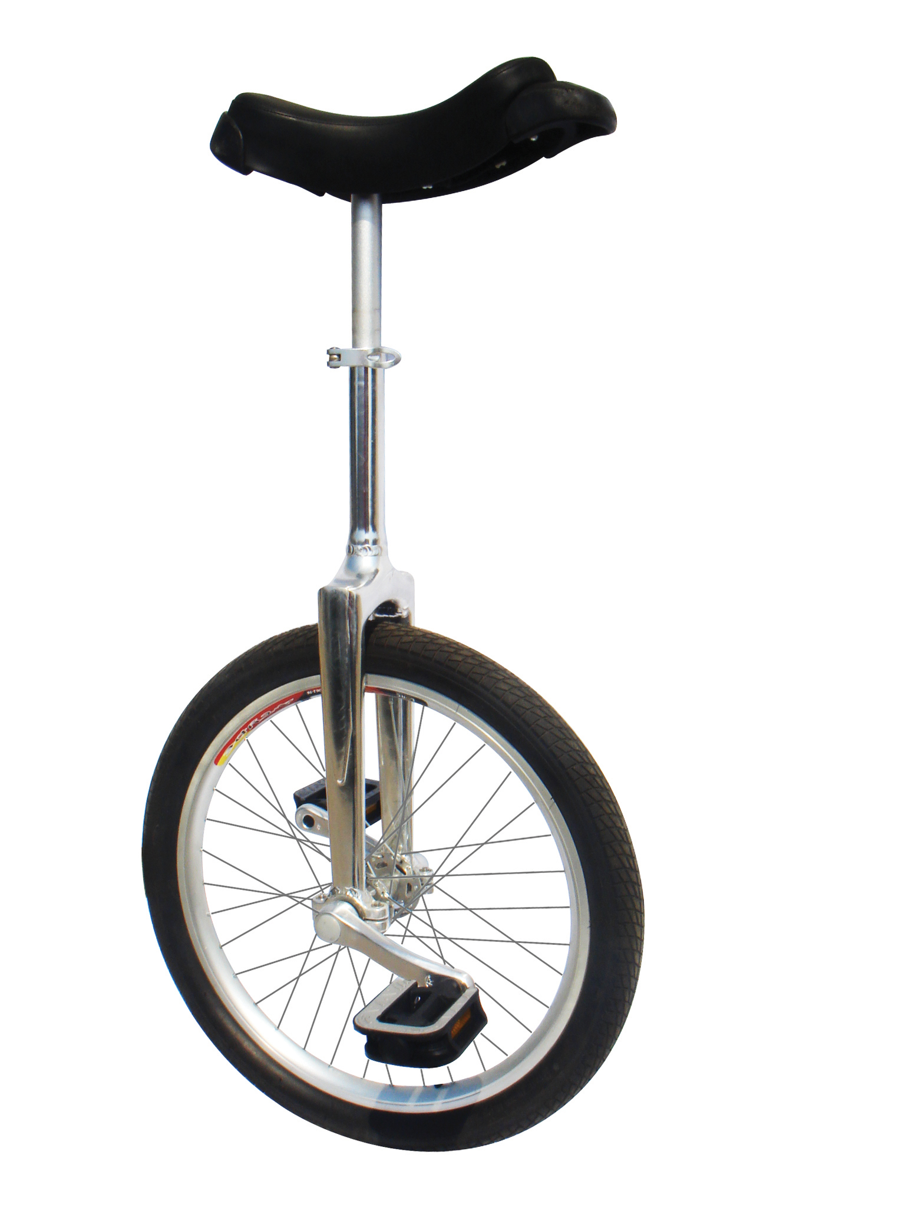
Sixth Item Slide 1:

Slide 23
Sixth Item Slide 2:

Slide 24
Sixth Item Slide 3:

Slide 25

Sixth Item Slide 4:

Slide 26

Eighth Item Slide 1:

Slide 27

Eighth Item Slide 2:

Slide 28

Eighth Item Slide 3:

Slide 29
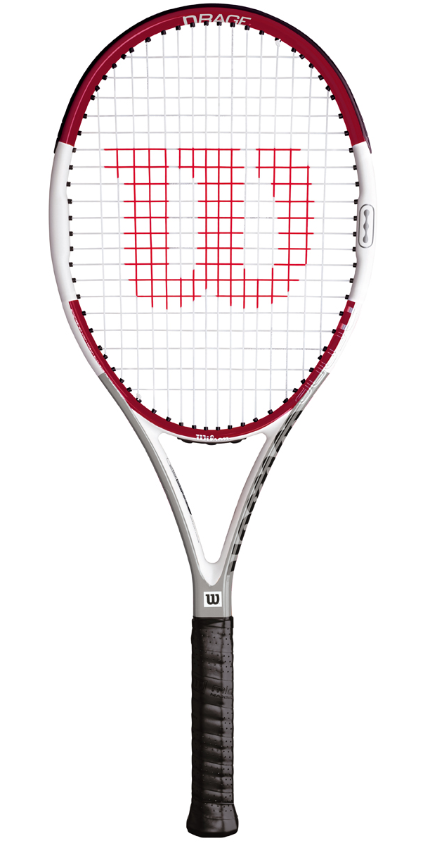
Eighth Item Slide 4:

