Slide 1
Churn prediction
Dukuru Venkatesh
21A91A6106

Slide 2
ABSTRACT
. Customer churn analysis is the process of predicting customers who tend to cancel the service (subscription) they receive for various reasons, especially in sectors such as telecommunications, finance and insurance, and determining the necessary operational steps to prevent this cancellation. The study used two separate datasets from kaggle.com to identify customers who tend to unsubscribe in the telecommunications industry. The analysis process was carried out by applying machine learning methods such as Logistic Regression, K-Nearest Neighbor, Decision Trees, Random Forest, Support Vector Machines methods on the relevant datasets. It was seen that the most successful method in the customer loss analysis performed on both datasets was the Random Forest method.

Slide 3
Introduction
Data Science is a multidisciplinary field that involves the use of scientific methods, processes, algorithms, and systems to extract insights and knowledge from structured and unstructured data. It combines expertise from various domains such as statistics, computer science, information theory, and domain-specific knowledge to analyze and interpret complex data sets.

Slide 4
Technologies Used
Data science
Machine learning
Python

Slide 5
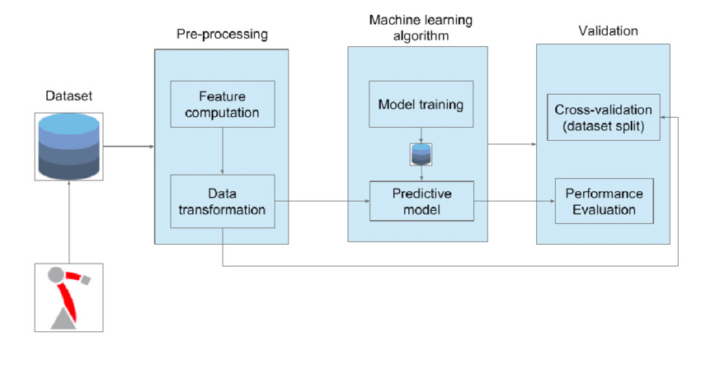
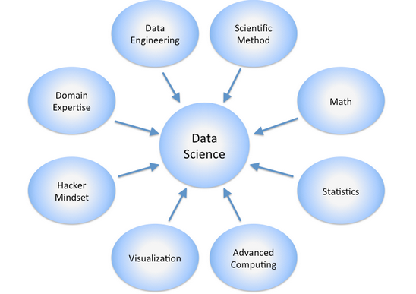
Architecture Diagram

Slide 6
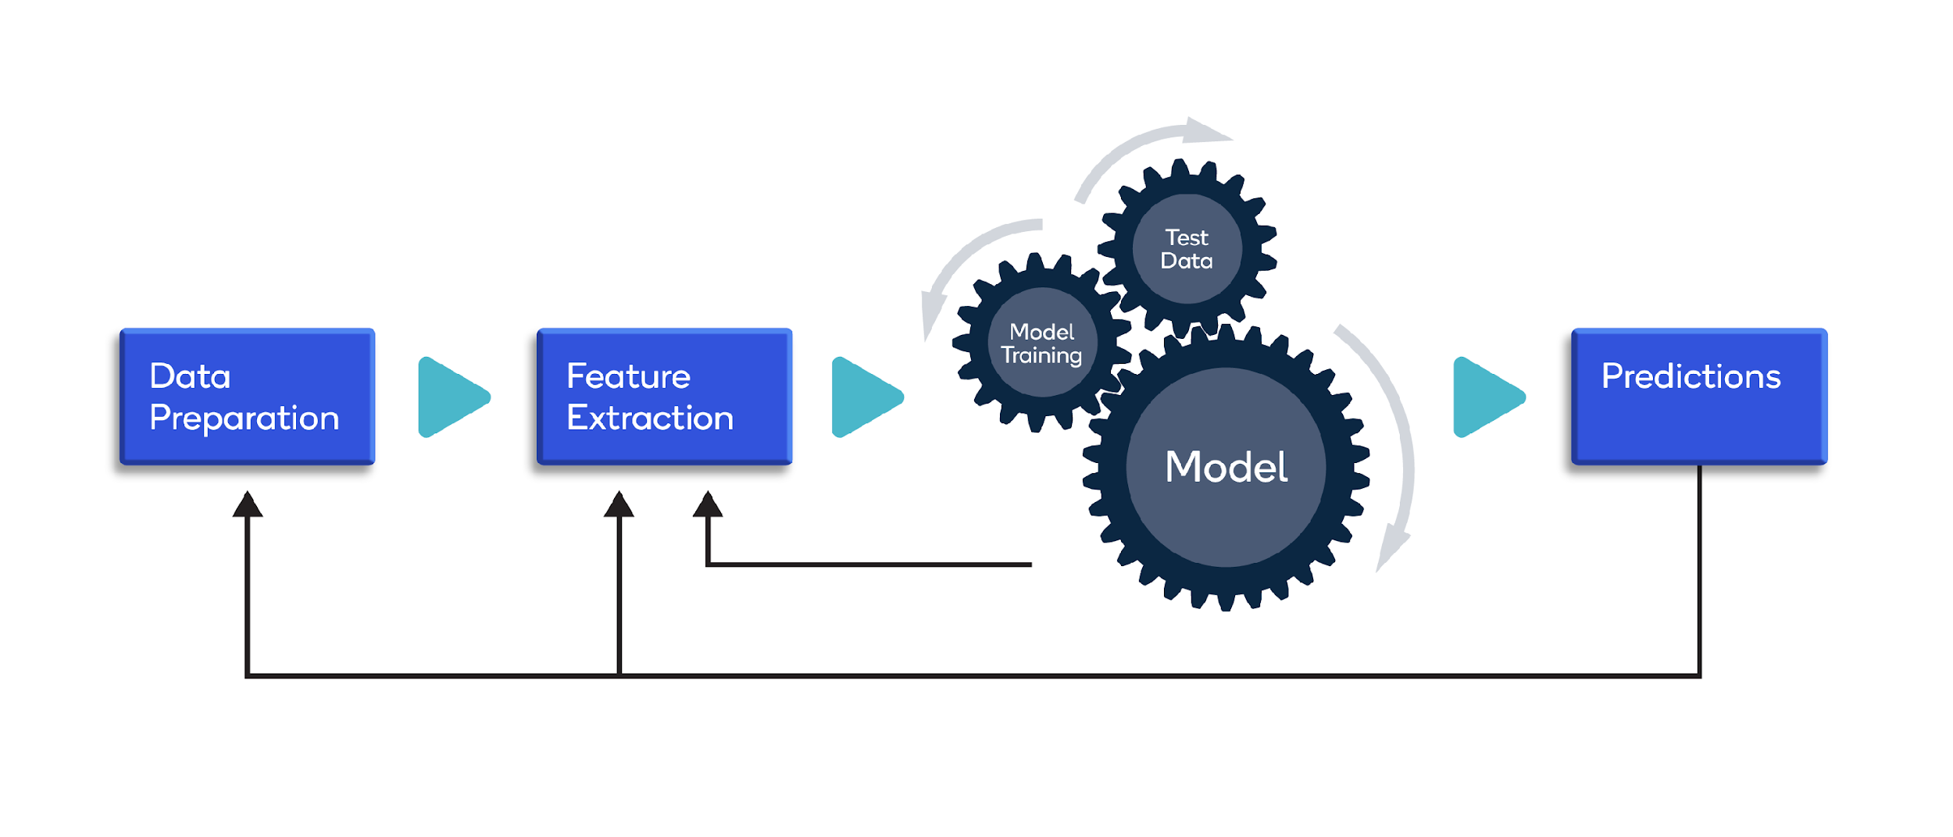
Methodology

Slide 7
Methodology
Feature Engineering:
Create new features or modify existing ones to improve model performance.
Select the most relevant features for analysis.
Exploratory Data Analysis (EDA):
Visualize and explore data patterns, trends, and relationships.
Identify outliers and anomalies.
Formulate initial hypotheses based on data exploration.
Model Development:
Select appropriate algorithms based on the problem and data.
Split the data into training and testing sets.
Train and validate the model using the training set.

Slide 8
Model Deployment:
Implement the model into a production environment.
Integrate the model with relevant systems for real-world use.
Monitor and maintain the deployed model.
Communication of Results:
Summarize findings and insights.
Create visualizations and reports for different stakeholders.
Clearly communicate the implications of the results for decision-making.
Feedback and Iteration:
Gather feedback from stakeholders.
Iterate on the model or analysis based on feedback and new data.
Continuously improve and update models as needed.

Slide 9
Key Module Code
import pandas as pd
import numpy as np
import matplotlib.pyplot as plt
Import seaborn as sns
data = pd.read_csv("/content/WA_Fn-UseC_-Telco-Customer-Churn.csv")
X = data2.drop('Churn', axis=1)
y = data2['Churn’]
from sklearn.model_selection import train_test_split
x_train, x_test, y_train, y_test = train_test_split(x, y, test_size = 0.3)

Slide 10
Key Module Code
from sklearn.linear_model import LogisticRegression
log = LogisticRegression()
log.fit(X_train, y_train)
log_y_pred = log.predict(X_test)
log_y_pred_train = log.predict(X_train)
log_test_as = metrics.accuracy_score(log_y_pred, y_test)
log_train_as = metrics.accuracy_score(log_y_pred_train, y_train)
print(metrics.classification_report(log_y_pred, y_test))

Slide 11
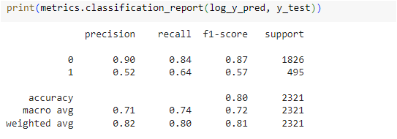
Results

Slide 12
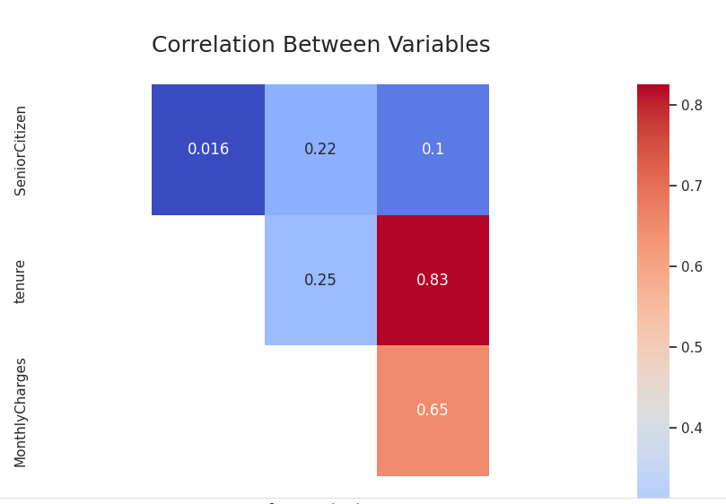
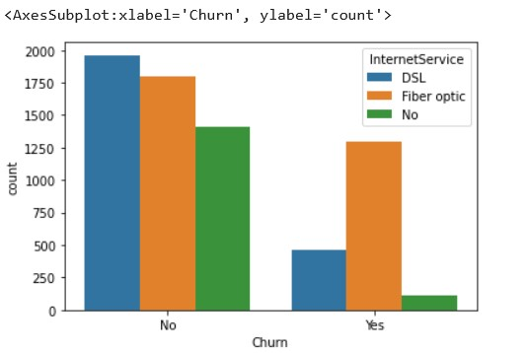
Results

Slide 13
Conclusion
Creating more targeted and effective retention strategies is one of the main advantages of customer churn prediction analysis. By examining customer data, which enables them to spot trends and patterns in consumer behavior, businesses may better understand the needs and preferences of their customers

Slide 14
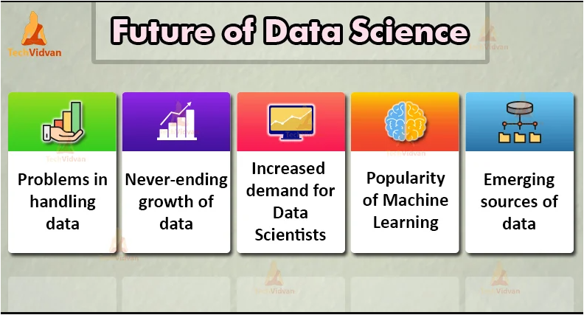
Future Enhancements

Slide 15
Queries

Slide 16
Thank you

