Slide 1
PROGRAMMING FOR PROBLEM SOLVING USING C
(201ES2T08 )
II SEM Agri,PT,Mining ,civil
A.Lakshmanarao
Associate Professor,H&BS-I Dept.
Aditya Engineering College(A)
Mail : a.lakshmanarao@aec.edu.in
Cell: +91-9951060528

Slide 2
Syllabus
UNIT-I:
Computer History, Hardware, Software, Programming Languages and Algorithms:
Components and functions of a Computer System, Concept of Hardware and Software Programming Languages: Low-level and High-level Languages, Program Design Tools: Algorithm, Flowchart, Pseudo code.
Introduction to C Programming: Introduction, Structure of a C Program, Comments, Keywords, Identifiers, Data Types, Variables, Constants, Input/Output Statements, Operators, Type Conversion.
UNIT-II:
Control Flow, Relational Expressions & Arrays: Conditional Branching Statements: if, if-else, if-else–if, switch. Basic Loop Structures: while, do-while loops, for loop, nested loops, The Break and Continue Statements, goto statement.
Arrays: Introduction, Operations on Arrays, One dimensional Array, Two dimensional Array, Multi dimensional arrays.
UNIT-III:
Strings: String Fundamentals, String Processing with and without Library Functions. Functions: Introduction, Function Declaration, Function Definition, Function call, Categories of Functions, passing parameters to Functions, Arrays as Function Arguments, Scope of Variables, Variable Storage Classes, Recursion.

Slide 3
Syllabus
UNIT-IV:
Pointers: Concept of a Pointer, Declaring and Initializing Pointer Variables, Pointer Expressions and Address Arithmetic, Null Pointers, Generic Pointers, Pointers as Function arguments, Pointers and Arrays, Pointers and Strings, Pointer to Pointer, Dynamic Memory Allocation, Dangling Pointer, Command line Arguments.
UNIT-V:
Structures, Unions, Bit Fields: Introduction, Nested Structures, Arrays of Structures, Structures and Functions, Self-Referential Structures, Unions, Enumerated Data Type–enum variables, Using Typedef keyword, Bit Fields.
Data Files: Introduction to Files, Using Files in C, Reading from Text Files, Writing to Text Files, Random File Access.
PROGRAMMING FOR PROBLEM SOLVING USING C LAB

Slide 4
PPSC UNIT-1

Slide 5
Unit – 1
Computer History, Hardware, Software, Programming Languages and Algorithms:
Components and functions of a Computer System, Concept of Hardware and Software Programming Languages: Low-level and High-level Languages, Program Design Tools: Algorithm, Flowchart, Pseudo code.
Introduction to C Programming:
Introduction, Structure of a C Program, Comments, Keywords, Identifiers, Data Types, Variables, Constants, Input/Output Statements, Operators, Type Conversion.

Slide 6
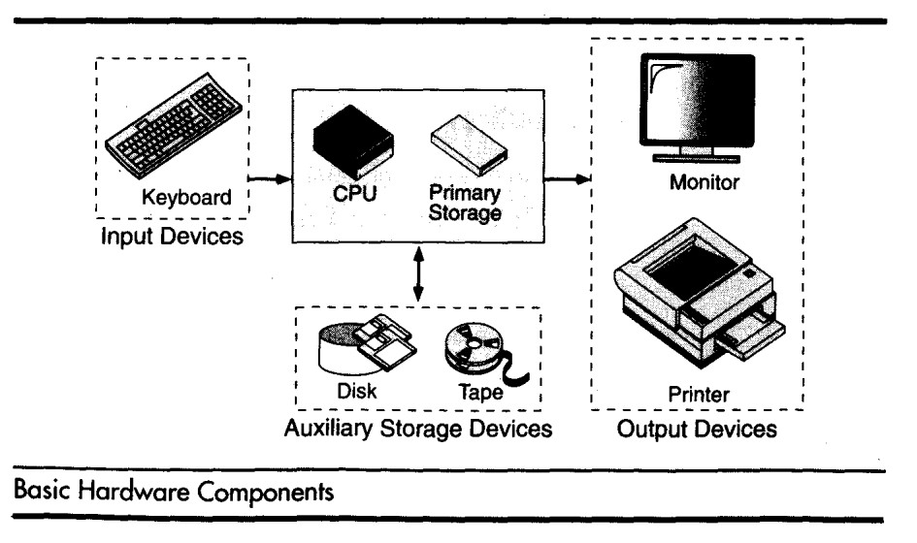
Components of Computer System
A computer is a system made of two major components: hardware and software.
The computer hardware is the physical equipment. The software is the collection of programs (instructions) that allow the hardware to do its job.

Slide 7
Components of Computer System
Computer Hardware :- The hardware component of the computer system consists of five parts: input devices, central processing unit (CPU) ,primary storage, output devices, and auxiliary storage devices.
The input device is usually a keyboard where programs and data are entered into the computers. Examples of other input devices include a mouse, a pen or stylus, a touch screen, or an audio input unit.
The central processing unit (CPU) is responsible for executing instructions such as arithmetic calculations,comparisons among data, and movement of data inside the system.
The output device is usually a monitor or a printer to show output. If the output is shown on the monitor, we say we have a soft copy. If it is printed on the printer, we say we have a hard copy.
Auxiliary storage, also known as secondary storage, is used for both input and output. It is the place where the programs and data are stored permanently. When we turn off the computer, or programs and data remain in the secondary storage, ready for the next time we need them.

Slide 8


Components of Computer System
Computer Software :-
Computer software is divided in to two broad categories: system software and application software.
•System software manages the computer resources .It provides the interface between the hardware and the users.
Application software, on the other hand is directly responsible for helping users solve their problems.

Slide 9
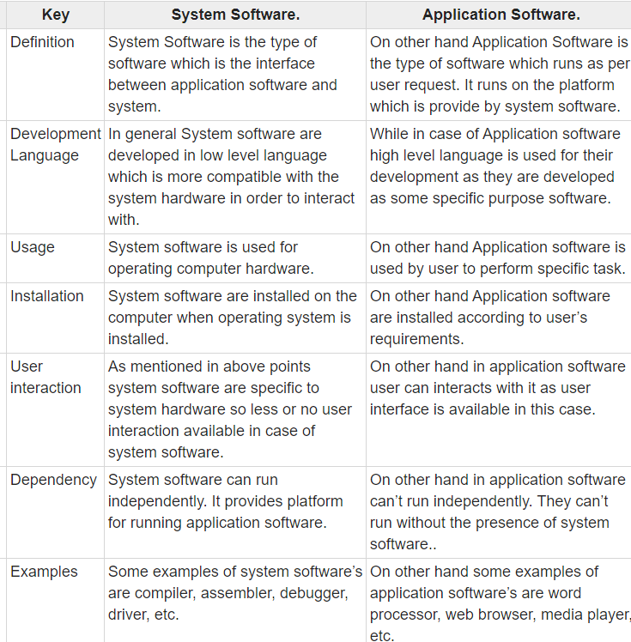

Slide 10
Computer Languages
To write a program for a computer, we must use a computer
language. Over the years computer languages have evolved from
machine languages to natural languages.
1940’s Machine level Languages
1950’s Symbolic Languages
1960’s High-Level Languages

Slide 11
Computer Languages
Machine Languages:
In the earliest days of computers, the only programming languages available were machine languages. Each computer has its own machine language, which is made of streams of 0’s and 1’s.
Instructions in machine language must be in streams of 0’s and 1’s because the internal circuits of a computer are made of switches transistors and other electronic devices that can be in one of two states: off or on. The off state is represented by 0 , the on state is represented by 1.
The only language understood by computer hardware is machine language

Slide 12
Computer Languages
Symbolic Languages:-
In early 1950’s Admiral Grace Hopper, A mathematician and naval officer developed the concept of a special computer program that would convert programs into machine language.
Computer does not understand symbolic language it must be translated to the machine language. A special program called assembler translates symbolic code into machine language.

Slide 13
Computer Languages
High Level Languages:-
Symbolic languages greatly improved programming efficiency; they
still required programmers to concentrate on the hardware that they
were using.
Working with symbolic languages was also very tedious because each
machine instruction has to be individually coded. The desire to improve
programmer efficiency and to change the focus from the computer to
the problem being solved led to the development of high-level language.

Slide 14
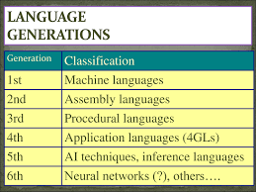

Slide 15
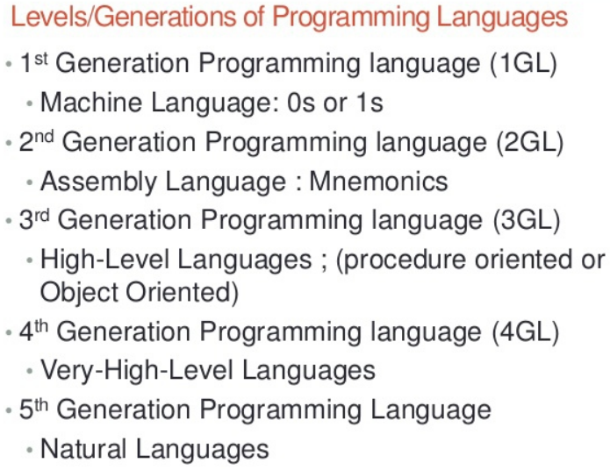

Slide 16
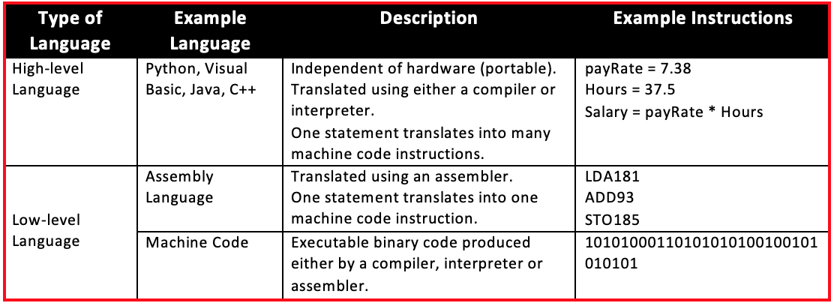
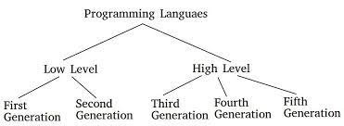
Low level and high level languages

Slide 17
TRANSLATION
Programs today are normally written in one of the high-level languages. To run the program on a computer, the program needs to be translated into the machine language of the computer on which it will run. The program in a high-level language is called the source program. The translated program in machine language is called the object program.
Two methods are used for translation:
compilation and interpretation.
Source language
Translator
Target language
Example: C,C++,python
Example: assmebly language,machine language

Slide 18
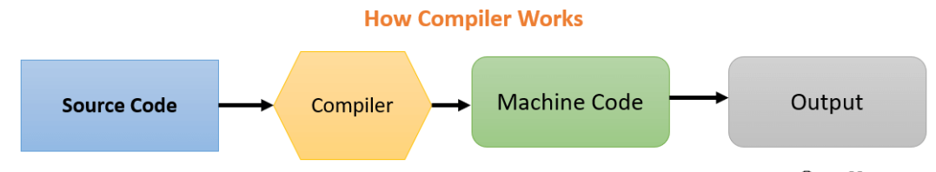
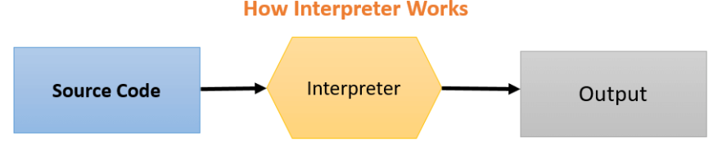
Compiler Vs Interpreter
Compiler
Interpreter
It reads the entire program and converts it into the object code.
It shows errors of the entire program.
It links different code files into a runnable program(know as exe)
Only error free programs are executed,once compiled,exeuted any no.of times.
It reads only one line of a source code at a time and converts it into object code.
In case of errors the same will be indicated instantly.
No linking of files or machine code generation.
Need to execute everytime

Slide 19
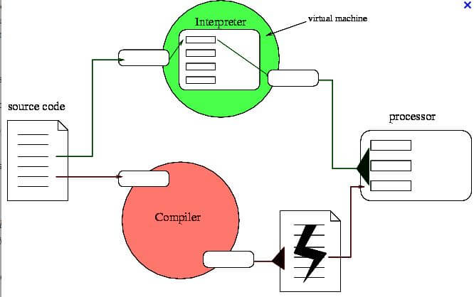
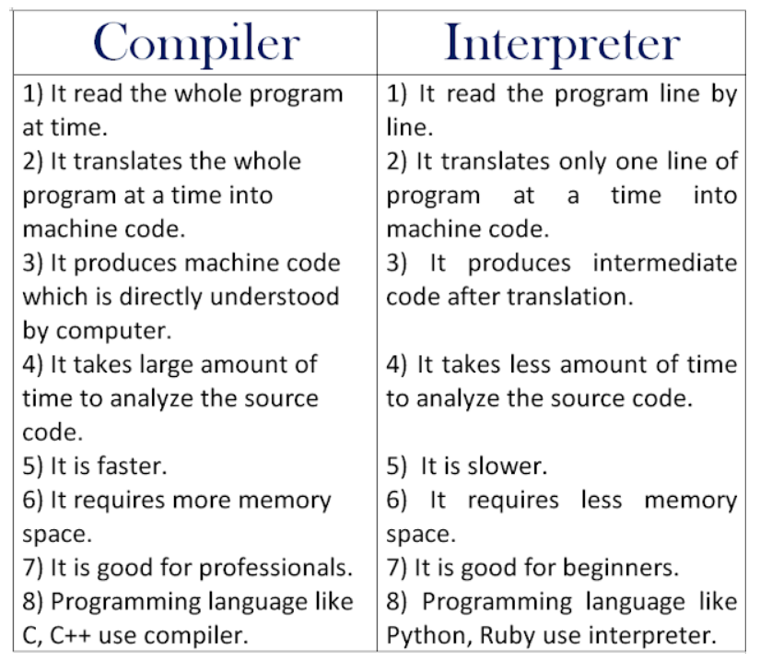

Slide 20
ALGORITHMS

Slide 21
STEP 1…
STEP 4…
STEP 2…
STEP 5…
STEP 3…

Slide 22
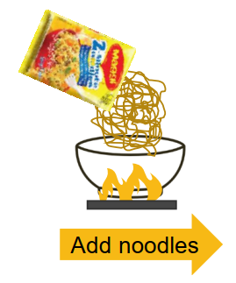
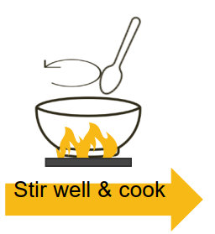
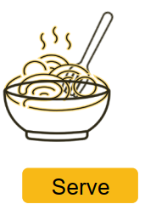
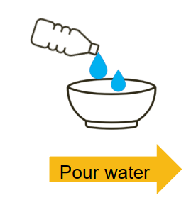
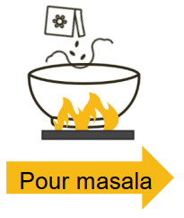
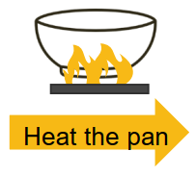
Real Life example for algorithm
How do you make Maggi?
Step-1
Step-2
Step-3
Step-4
Step-5
Step-6

Slide 23
Algorithm is a step by step procedure for solving a problem.
Example: Algorithm for find square root of a given number?
Step 1: Start
Step 2: Read a number x
Step 3: Find square root of given number x
Step 4: print the square root value
Step 5: Stop

Slide 24
Algorithm
Example: Algorithm for checking whether the given number is positive or negative?
Step 1: Start
Step 2: Read a number x
Step 3: if x is greater than or equal to zero,print x is positive
Step 4: if x is less than zero,print x is negative
Step 5: Stop

Slide 25
Algorithm
Algorithm to add two numbers entered by the user
Step 1: Start
Step 2: Read two numbers a,b
Step 3: Add two numbers and store result in c
Step 4: print c
Step 5: Stop

Slide 26
Characteristics of algorithm
Input : An algorithm has zero or more inputs, i.e, quantities which are given to it initially before the algorithm begins.
Output:An algorithm has one or more outputs i.e, quantities which have a specified relation to the inputs.
Finiteness: An algorithm must always terminate after a finite number of steps.
Definiteness:Each step of an algorithm must be precisely defined; the actions to be carried out must be unambiguously specified for each case.
Effectiveness: An algorithm is also generally expected to be effective. This means that all of the operations to be performed in the algorithm must be sufficiently basic that they can in principle be done exactly and in a finite length of time.

Slide 27
Flow chart
A Flow chart is a Graphical representation of an Algorithm or a portion of an Algorithm.
The diagrammatic representation of way to solve the given problem is called flow chart.

Slide 28
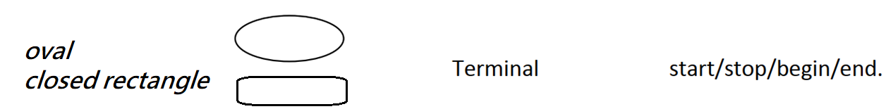
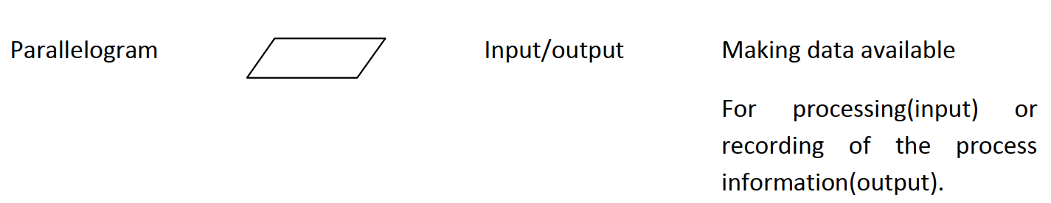
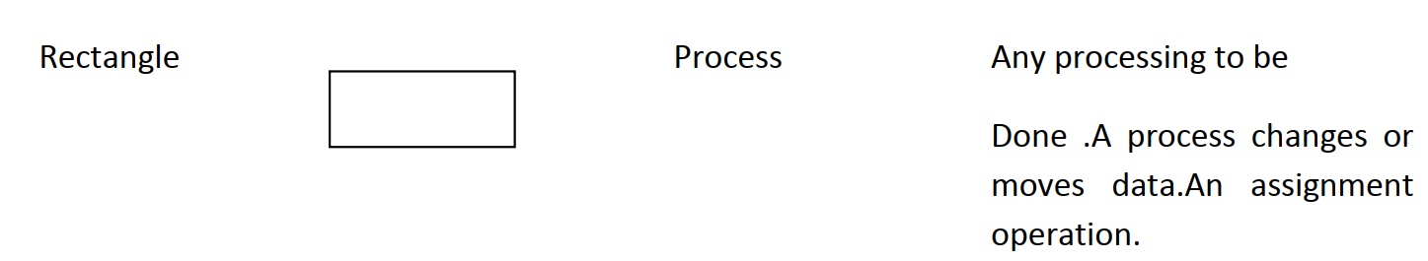
Flow chart symbols

Slide 29
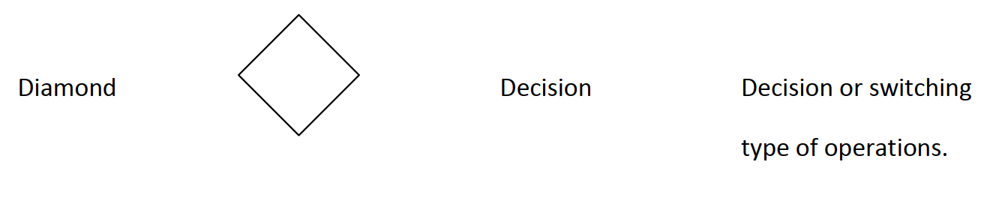
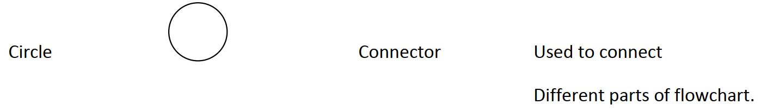
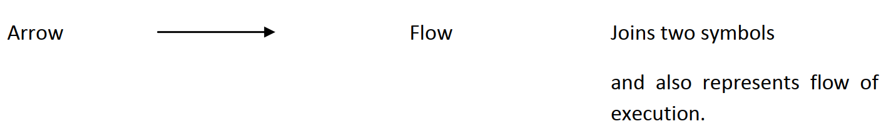

Slide 30
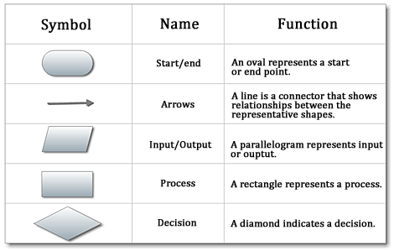

Slide 31
Flowchart for Finding area of a circle of radius r
start
Algorithm:
Step1: START
Step2:Read the Radius r of the Circle
Step3: Area PI*r*r
Step4: Print Area
Step5:END
Read radius r
Area=3.14*r*r
print Area
END

Slide 32
Flowchart to read two numbers and find their sum
start
Algorithm:
Step1: Start
Step2: Read the first number n1.
Step3: Read the second number n2.
Step4: sum n1+n2.
Step5: Print sum.
Step6: Stop
Read n1
Read n2
sum=n1+n2
print sum
stop

Slide 33
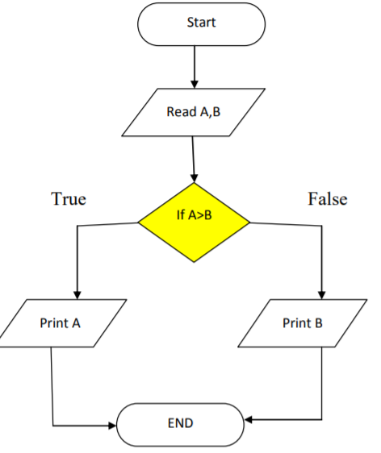
Algorithm, Flowchart to print the larger of two numbers
Step 1: Start.
Step 2: Read two numbers A,B.
Step 3: If A>B then A is big,Otherwise: B is big
Step 4: End.

Slide 34
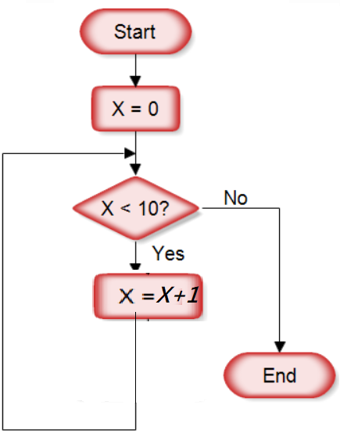
Flowchart to increment X value(initially X=0) by 1 until it reaches 10
Step 1: Start.
Step 2: Assign X with 0.
Step 3: If X<10 is true,goto step 4
Step 4: X=X+1,go to step3.
Step 5: If X<10 false,goto Step 6.
Step 6: End.

Slide 35
RAPTOR
RAPTOR is a flowchart-based programming environment,
https://raptor.martincarlisle.com/

Slide 36
Pseudo code
Set of instructions that mimic programming language instructions.
Pseudocode is one of the tools that can be used to write a preliminary plan that can be developed into a computer program.
Pseudocode is a generic way of describing an algorithm without use of any specific programming language syntax.
It is, as the name suggests, pseudo code —it cannot be executed on a real computer

Slide 37
Pseudo code examples
Pseudocode to add 2 numbers:
Begin
Set sum=0;
Read: num1, num2;
Set sum = num1+num2;
Print sum;
End
Pseudocode to find the area of a Rectangle :
Begin
Read: width, length;
Set area = width * length;
Print area;
End
Pseudocode is an informal way of writing a program. It is not exactly a computer program. It represents the algorithm of the program in natural language and mathematical notations.

Slide 38
C language
C is a general-purpose, high-level language that was originally developed by Dennis M. Ritchie at AT&TBell Labs in 1972.
C is a procedural programming language
C was invented to write an operating system called UNIX.

Slide 39
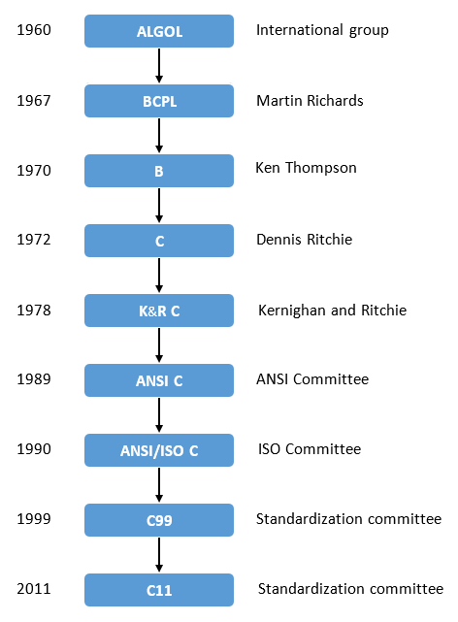
History of C

Slide 40
structure of c program
first c program

Slide 41
Structure of a c program
#include<stdio.h>
int main()
{
….
…
….
..
…
return 0;
}
Documentation section
optional
preprocessor directives
Global Declarations
optional
main()
{
local declarations
program statement
}
other functions
optional

Slide 42
Documentation Section
In this section we can declare comments.
Comments are nothing but name of the c program.
We have two types of comments.
Line comments: used to comment single line statements.
Block comments: used to comment multi line statements.

Slide 43
Line comments(single ine)
Ex: // this is a c program
// addition of two numbers

Slide 44
Block comments(Multiline)
/* this is my 1st program
Adding two numbers*/

Slide 45
Link Section
This part of the code is used to declare all the header files that will be used in the c program.
here we can use preprocessor directives to represent header files.
Each preprocessor directive starts with the symbol #.
#include<stdio.h>
We have different types of header files
All the header file have a ‘.h’ an extension

Slide 46
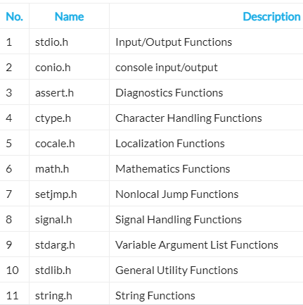

Slide 47
Global Declaration Section
All the global variable used are declared in this part. The user-defined functions are also declared in this part of the code.
int a=7;

Slide 48
main Function Section
Every C-programs needs to have the main function.
Each main function contains 2 parts.
A declaration part and an Execution part.
The declaration part is the part where all the variables are declared.
The execution part begins with the curly brackets and ends with the curly close bracket.
Both the declaration and execution part are inside the curly braces.

Slide 49
C program to display “Hello World” in screen
#include<stdio.h>
int main()
{
printf(“Hello World”);
return 0;
}
printf is a output function.
To use printf(),we use #include<stdio.h>
(standard input/output header file)
Output:
Hello World

Slide 50
C program to display your name
#include<stdio.h>
int main()
{
printf(“CP”);
return 0;
}
Output:
CP

Slide 51
C program to display your name 5 times
#include<stdio.h>
int main()
{
printf(“CP CP CP CP CP”);
return 0;
}
#include<stdio.h>
int main()
{
printf(“CP ”);
printf(“CP ”);
printf(“CP ”);
printf(“CP ”);
printf(“CP ”);
return 0;
}
Output: CP CP CP CP CP

Slide 52
C program to display your name 5 times
\n is used to get output on new line
How to get output like below( name in different lines)
CP
CP
CP
CP
CP
#include<stdio.h>
main()
{
printf("CP\n”);
printf("CP\n”);
printf("CP\n”);
printf("CP\n”);
printf("CP\n”);
}
#include<stdio.h>
main()
{
printf("CP\nCP\nCP\nCP\nCP");
}

Slide 53
printf()
printf() is a output function.
It is used in two different ways
1. Used to print text message(Type in double quotes)
2……………………

Slide 54
C program to find sum of two numbers???
Algorithm:
Step1: Start
Step2: Read the first number n1.
Step3: Read the second number n2.
Step4: sum n1+n2.
Step5: Print sum.
Step6: End
1.How to read a number in C?
2.Why the number names are n1 and n2?
3.What are the values of n1,n2?
10&20 or 10&20.5 or…….
To write this program we need to learn some more concepts like
variable
datatype
Identifier
etc.

Slide 55
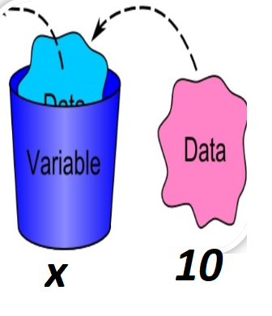
Variables
Variables in a computer program are similar to buckets where information can be maintained.
Here, x is a variable
x stores value(data) 10.

Slide 56
C Variables
Variables are nothing but reserved memory locations to store values. when you create a variable you reserve some space in memory.
Based on the data type of a variable, the compiler allocates memory and decides what can be stored in the reserved memory. Therefore, by assigning different data types to variables, you can store integers, decimals or characters in these variables

Slide 57
Variables
In C/C++/Java every variable must have “Datatype”.
“Datatype” tells what type of data is stored in a variable
For example,if x is our variable,then
We can store 10 in x(10 is a integer)
-here datatype of x is integer
We can store 22.4 in x(22.4 is a floating value)
-here datatype of x is float
like integer,float,
we have some predefined datatypes in C…

Slide 58
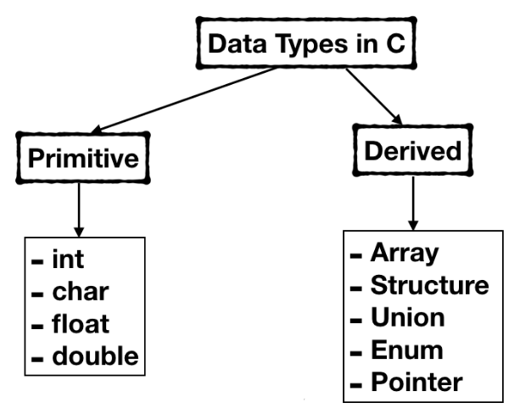
DataTypes

Slide 59
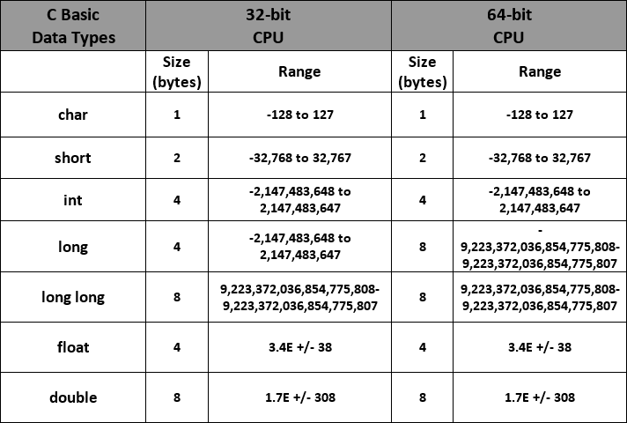
Datatypes

Slide 60
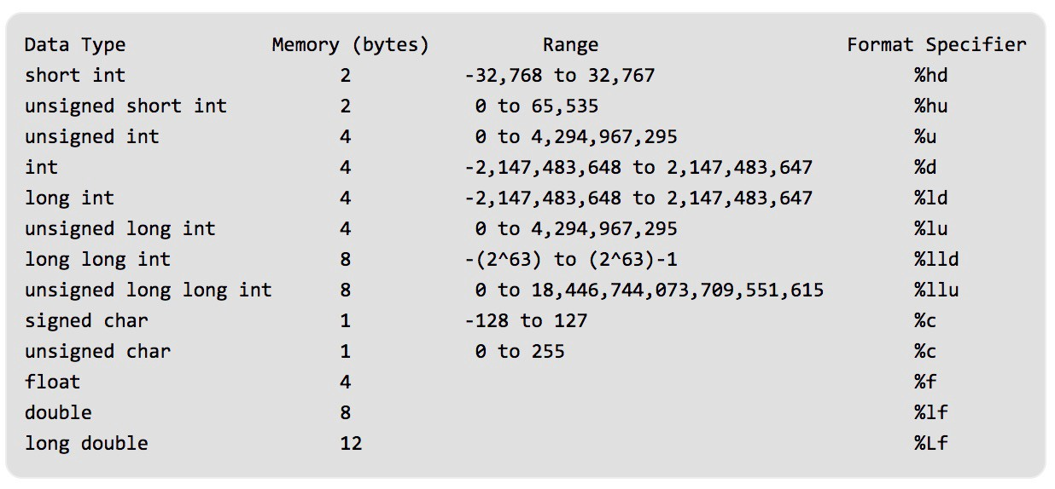
Datatypes

Slide 61
Now,how to declare variable with datatype?
Syntax:
datatype variablename;
Example:
int x; // x is declared as integer
float c; // c is declared as float
char g; // g is declared as character
This is called variable declaration
For x, 4 bytes memory allocated(because size of int is 4 bytes)
For c, 4 bytes memory allocated (because size of float is 4 bytes)
For g, 1 byte memory allocated (because size of char is 1 byte)

Slide 62
Variables
C/C++/Java
So,In C/C++/Java every variable must have “Datatype”.
int x;
float y;
x is
declared
as integer
y is
declared
as float
Ok,but why variable names are x,y?
How to assign variable names?

Slide 63
Identifiers
C identifiers represent the name in the C program, for example, variables, functions, arrays, structures, unions, labels, etc.
Rules:
First character must be alphabetic or underscore.
Must consist only of alphabetic characters,digits or underscore.
Cannot be a keyword.
length between 1 to 64.

Slide 64
Keywords(Reserved words)
Keywords are predefined, reserved words used in programming that have special meanings to the compiler.
Keywords can be used only for predefined purpose.

Slide 65
Keywords(Reserved words)
auto
break
case
char
const
continue
default
do
double
else
enum
extern
float
for
goto
if
int
long
register
return
short
signed
sizeof
static
struct
switch
typedef
union
unsigned
void
volatile
while
_Bool
_Complex
_Imaginary
inline
restrict

Slide 66
Identifiers
First character must be alphabetic or underscore.
Must consist only of alphabetic characters, digits or underscore.
Cannot be a keyword.
length between 1 t0 64.
Examples:
x
y
n1
number1
no1

Slide 67
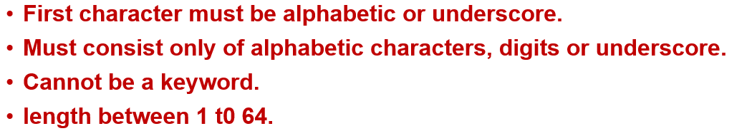
Identifiers
Check whether following variable names are correct or not?
student name
student_name
10number
marks
x
zzz
subject20
names
my
why
if
int

Slide 68
Assigning Values to Variables
After declaring a variable,we can assign a value to the variable as follows
syntax:
datatype variablename=value;
Example:
int x=10;
float y=23.4;
or
int x;
x=10;

Slide 69
Program to assign a value to variable and display it
printf() used in two different ways
1. Used to print text message(Type in double quotes)
2……………………
2. Used to print value of a variable
syntax:
printf(“format specifier”,variablename);
Example:
x=10;
printf(“%d”,x);
%d for int
%f for float
%c for char

Slide 70
Program to assign a value to variable and display it
#include<stdio.h>
void main()
{
int x=10;
printf(“%d”,x);
}
Output:
10

Slide 71
Program to assign a value to variable and display it
#include<stdio.h>
void main()
{
int x=10;
printf(“%d”,x);
}
here the value of x is taken as 10.(value assigned in the program)
We can also give x value from keyboard(as input after execution of
program).

Slide 72
Reading variable values from keyboard(Input function)
To enter input from keyboard,a input function “scanf” is used.
syntax:
scanf(“controlstring”,&variablename);
#include<stdio.h>
void main()
{
int x;
scanf(“%d”,&x);
printf(“\n%d”,x);
}
output
100
100

Slide 73
Reading variable values from keyboard(Input function)
To enter input from keyboard,a input function “scanf” is used.
syntax:
scanf(“controlstring”,&variablename);
#include<stdio.h>
void main()
{
int x;
printf(“enter number”);
scanf(“%d”,&x);
printf(“\n%d”,x);
}
output
enter number
100
100

Slide 74
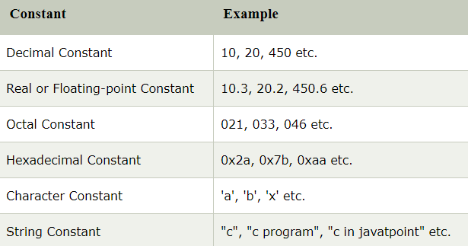
Constants
A constant is a value or variable that can't be changed in the program.
There are different types of constants in C programming.
Number system:
name digits base
binary 0,1 2
decimal 0 to 9 10
octal 0 to 7 8
hexadecimal 0 to 9, 16
A,B,C,D,
E,F
octal constant denoted with leading 0
hexadecimal constant by leading 0x or 0X
single character constant denoted in single quotes
String constant denoted with double quotes

Slide 75
Constants
There are two ways to define constant in C programming.
const keyword
#define preprocessor
2) C #define preprocessor
1) C const keyword
The const keyword is used to define constant in C programming.
syntax:
const datatype variable=value;
#define preprocessor directive is also used
to define constant in C programming.
syntax:
#define variable value
#include<stdio.h>
int main()
{
const float PI=3.14;
printf("The value of PI is: %f",PI);
return 0;
}
#include<stdio.h>
#define PI 3.14
int main()
{
printf("The value of PI is: %f",PI);
return 0;
}
output:The value of PI is: 3.140000
output:The value of PI is: 3.140000

Slide 76
Operators
An operator is simply a symbol that is used to perform operations.
Types of operators in c:
Arithmetic Operators
Assignment Operator
Relational Operators
Logical Operators
Bitwise Operators
Ternary or Conditional Operators
Special Operators

Slide 77
Arithmetic Operators
An arithmetic operator is a symbol that will perform some arithmetic operation.
SYMBOL | OPERATION | EXAMPLE | VALUE OF ans
+ | addition | ans = 7 + 3; | 10
- | subtraction | ans = 7 - 3; | 4
* | multiplication | ans = 7 * 3; | 21
/ | division | ans = 7 / 3; | 2
% | modulus | ans = 7 % 3; | 1

Slide 78
Arithmetic operators-example program
// Working of arithmetic operators
#include <stdio.h>
int main()
{
int a = 9,b = 4, c;
c = a+b;
printf("a+b = %d \n",c);
c = a-b;
printf("a-b = %d \n",c);
c = a*b;
printf("a*b = %d \n",c);
c = a/b;
printf("a/b = %d \n",c);
c = a%b;
printf(“a%b = %d \n",c);
return 0;
}
output:
a+b = 13
a-b = 5
a*b = 36
a/b = 2
Remainder when a divided by b=1

Slide 79
Assignment operators
Operator Example Equivalent
= Assignment i=10
+= i += 8 i = i + 8
-= f -= 8.0 f = f - 8.0
*= i *= 8 i = i * 8
/= i /= 8 i = i / 8
%= i %= 8 i = i % 8

Slide 80
Assignment operators-example program
c -= a; // c is 5
printf("%d\n", c);
c *= a; // c is 25
printf("%d\n", c);
c /= a; // c is 5
printf("%d\n", c);
c %= a; // c = 0
printf("%d\n", c);
return 0;
}
#include <stdio.h>
int main()
{
int a = 5, c;
c = a; // c is 5
printf("%d\n", c);
c += a; // c is 10
printf("%d\n", c);

Slide 81
Relational operators
Operator | Meaning of Operator | Example
== | Equal to | 5 == 3 is evaluated to 0
> | Greater than | 5 > 3 is evaluated to 1
< | Less than | 5 < 3 is evaluated to 0
!= | Not equal to | 5 != 3 is evaluated to 1
>= | Greater than or equal to | 5 >= 3 is evaluated to 1
<= | Less than or equal to | 5 <= 3 is evaluated to 0

Slide 82
Relational operators-example program
// Working of relational operators
#include <stdio.h>
int main()
{
int a = 5, b = 5, c = 10;
printf("%d \n", a == b);
printf("%d\n",a == c);
printf("%d\n"a > b);
printf("%d \n", a > c);
printf("%d \n", a < b);
printf("%d \n", a < c);
printf("%d\n", a != b);
printf("%d \n", a != c);
printf("%d \n", a >= b);
printf("%d \n“, a >= c);
printf("%d \n", a <= b);
printf("\n", a <= c);
return 0;
}

Slide 83
Logical Operators
Operator | Meaning | Example
&& | Logical AND. True only if all operands are true | If c = 5 and d = 2 then, expression ((c==5) && (d>5)) equals to 0.
|| | Logical OR. True only if either one operand is true | If c = 5 and d = 2 then, expression ((c==5) || (d>5)) equals to 1.
! | Logical NOT. True only if the operand is 0 | If c = 5 then, expression !(c==5) equals to 0.

Slide 84
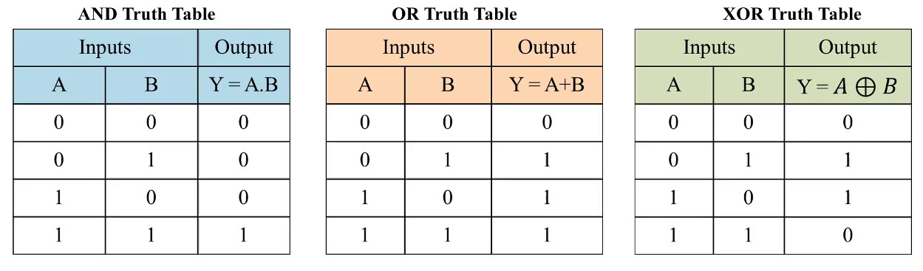
Truth Tables

Slide 85
Example program
i/p1 | i/p2 | i/p1 && i/p2 | i/p1 || i/p2 | i/p1 ^ i/p2
0 | 0 | 0 | 0 | 0
0 | 1 | 0 | 1 | 1
1 | 1 | 1 | 1 | 0
1 | 0 | 0 | 1 | 1
#include <stdio.h>
int main()
{
int a=2,b=3,c=4;
printf("%d",(a<b && b>c));
printf("\n%d",(a<b || b>c));
printf("\n%d",!(a<b && b>c)); return 0;
}
1 && 0=0
1 || 0=1
!(1 && 0)=!(0)=1

Slide 86
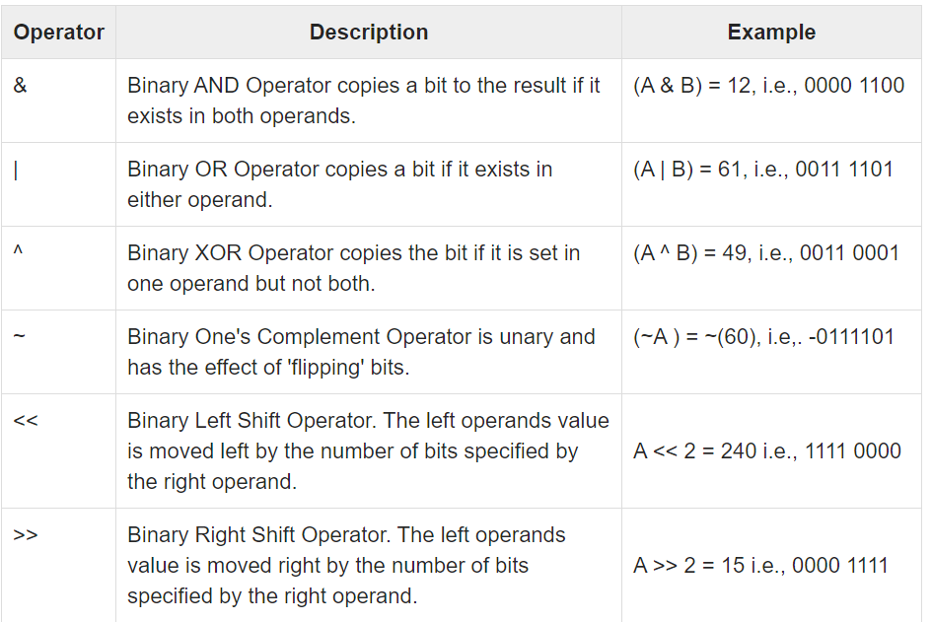
Bitwise operators

Slide 87
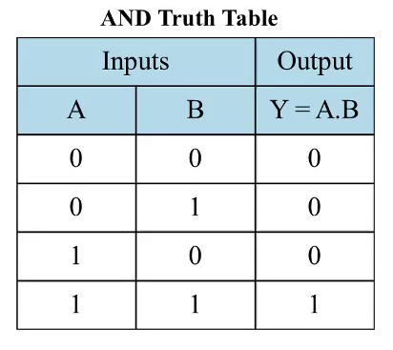
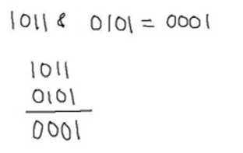
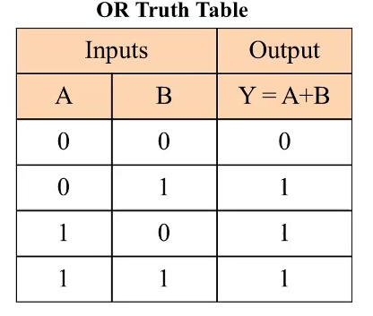
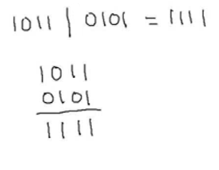
Example
11 & 5 =? 11 | 5 = ?

Slide 88
Bitwise operators-example
a=6 0000 0110
b=5 0000 0101
……………………………….
a|b 0000 0111=7
a&b 0000 0100=4
a^b 0000 0011=3
#include <stdio.h>
int main()
{
int a=6;
int b=5;
printf("%d",a|b);
printf("%d",a&b);
printf("%d",a^b);
printf("%d",~a);
printf("%d",a<<2);
printf("%d",a>>2);
return 0;}
~ operation:
a=6 0000 0110
Filp bits 1111 1001→(1)
-7 in 2’s complement form
7 0000 0111
Flip bits 1111 1000
Add 1 1111 1001 →(2)
(1),(2) are same
7
4
<< operation:
a=6 0000 0110
a<<1 0000 1100
a<<2 0001 1000 → 24
3
-7
24
1
>> operation:
a=6 0000 0110
a>>1 0000 0011
a>>2 0000 0001 → 1

Slide 89
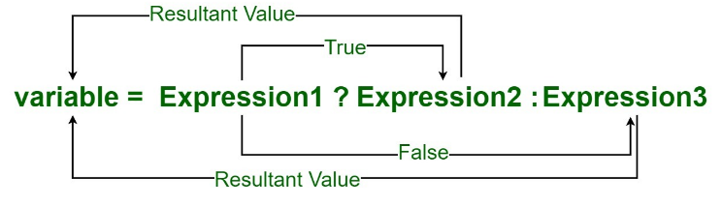
Operators
Conditional / Ternary Operator ( ?: )
Ternary operator is a shorthand version of if-else statement. It has three operands and hence the name ternary.
syntax: booleanExpression? expression1: expression2
#include <stdio.h>
int main()
{
int a=5,b; // variable declaration
b=((a==5)?(3):(2));
printf(“b value is : %d",b);
return 0;
}

Slide 90
conditional operator-example2
#include <stdio.h>
int main()
{
int a,b,c; // variable declaration
scanf(" %d%d",&a,&b);
c=((a>b)?(a):(b)); // conditional operator
printf(“big number is : %d",c);
return 0;
}

Slide 91
Increment/Decrement operators(Unary Operators)
Unary operators need only one operand. They are used to increment, decrement or negate a value.– :
Unary minus(-): used for negating the values.Examp;e: int a=-20;
Unary plus(+):used for giving positive values. Only used when deliberately converting a negative value to positive.
++ :Increment operator, used for incrementing the value by 1. There are two varieties of increment operator.
Post-Increment : Value is first used for computing the result and then incremented.
Pre-Increment : Value is incremented first and then result is computed.
— : Decrement operator, used for decrementing the value by 1. There are two varieties of decrement operator.
Post-decrement : Value is first used for computing the result and then decremented.
Pre-Decrement : Value is decremented first and then result is computed.

Slide 92
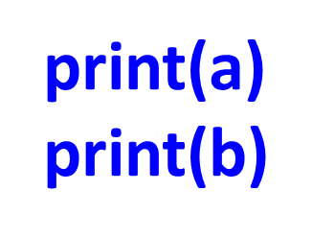
Increment/Decrement Operators example
int a=10;
a++;
print(a)
int a=10;
++a;
print(a)
11
11
preincrement:
First increment later assignment
postincrement:
First assignment later increment
int a=10;
int b;
b=++a;
print(a)
print(b)
int a=10;
int b;
b=a++;
11
11
11
10

Slide 93
Special Operators
Operator | Description | Example
sizeof() | Returns the size of a variable. | sizeof(a), where a is integer, will return 4.
& | Returns the address of a variable. | &a; returns the actual address of the variable.
* | Pointer to a variable. | *a;

Slide 94
Operators Precedence in C
Operator precedence determines the grouping of terms in an expression and decides how an expression is evaluated.
Certain operators have higher precedence than others.
for example, the multiplication operator has a higher precedence than the addition operator.

Slide 95
Operators Precedence & Associativity in C
Category | Operator | Associativity
Postfix | () [] -> . ++ - - | Left to right
Unary | + - ! ~ ++ - - (type)* & sizeof | Right to left
Multiplicative | * / % | Left to right
Additive | + - | Left to right
Shift | << >> | Left to right
Relational | < <= > >= | Left to right
Equality | == != | Left to right
Bitwise AND | & | Left to right
Bitwise XOR | ^ | Left to right
Bitwise OR | | | Left to right
Logical AND | && | Left to right
Logical OR | || | Left to right
Conditional | ?: | Right to left
Assignment | = += -= *= /= %=>>= <<= &= ^= |= | Right to left
Comma | , | Left to right

Slide 96

Precedence rules and Associativity:example
=10+10-1*4
Consider variable values as follows
a=10
b=20
c=2
d=1
e=4
What is the value of a+b/c-d*e?
In +,-,*
*(Multiply) has high precedence,so apply multiplication(*).
=10+10-4
1)+ and- have equal precdedence,so apply associativity.
2) + is left most,so apply +
=20-4
Sol)a+b/c-d*e
=10+20/2-1*4
=16
1)/ and * has more precedence than + and –.
2)But / and * has equal precedence,so apply associativity(left to right).
3)Leftmost in / and * is /.So apply division(/)

Slide 97
Type conversion
Type conversion, is a method of changing an entity from one data type to another.
1)Implicit Type Conversion( i.promotion ii.Demotion)
2)Explicit Type Conversion(Type Casting)

Slide 98
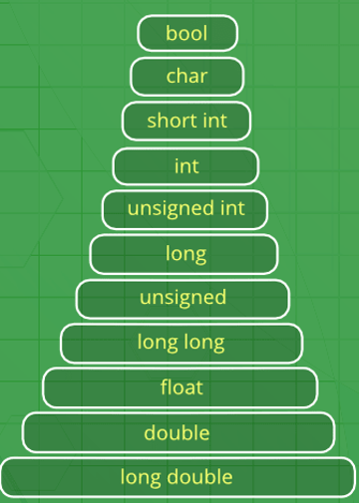
Implicit Type Conversion(Automatic Type Conversion)
Also known as ‘automatic type conversion’.
Done by the compiler on its own, without any external trigger from the user.
Generally takes place when in an expression more than one data type is present. In such condition type conversion (type promotion) takes place to avoid loss of data.
All the data types of the variables are upgraded to the data type of the variable with largest data type.
promotion
Demotion
1)Promotion Promotion does not create any problems. The rank of right expression is promoted to the rank of left expression. The value of the expression is the value of the right expression after the promotion.
bool -> char -> short int -> int -> unsigned int -> long -> unsigned ->
long long -> float -> double -> long double
2)Demotion Demotion may or may not create problems. If the size of the variable of the left expression can accommodate the value of the expression, no problem arises but the results can be a bit different from those expected.
Ex: int -> short int-> char

Slide 99
Examples(implicit conversion)
Promotion always successful
Demotion may or may not successful
Promotion:Ex2
#include <stdio.h>
int main()
{
int i;
char c='A';
i=c; // char to int
printf("%d",i);
return 0;
} // successful
Demotion
#include <stdio.h>
int main()
{
int i=650;
char c;
c=i; // int to char
printf("%c",c);
return 0;
} // not successful
Demotion
#include <stdio.h>
int main()
{
int i=65;
char c;
c=i; // int to char
printf("%c",c);
return 0;
} // successful
Promotion:Ex1
#include <stdio.h>
int main()
{
int x=10;
float y;
y=x; // int to float
printf("%f",y);
return 0;
} // successful

Slide 100
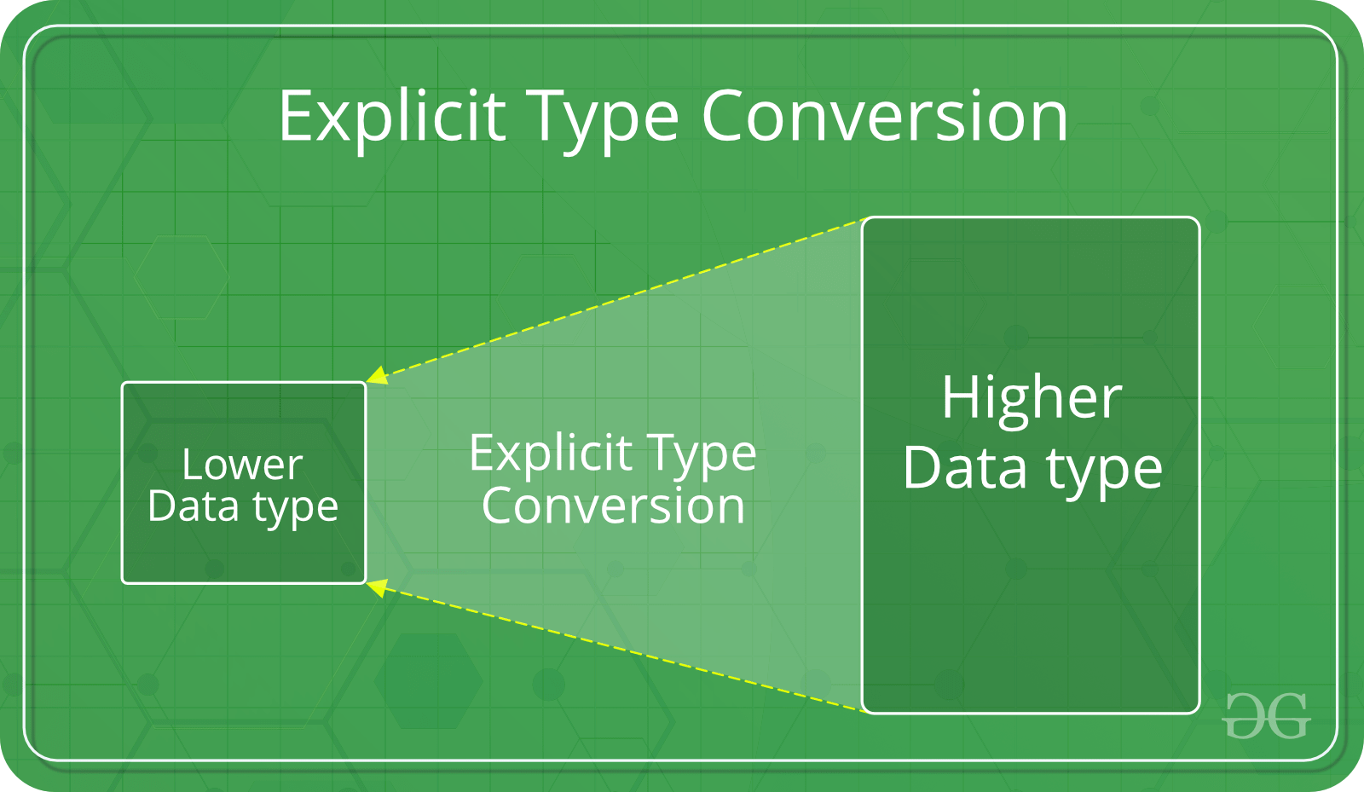
This process is also called type casting and it is user defined. Here the user can type cast the result to make it of a particular data type.
The syntax in C:
(type) expression

Slide 101
Example-type casting
Example-1
#include<stdio.h>
int main()
{
double x = 1.2;
//Explicit conversion from double to int
int sum = (int)x + 1;
printf("sum = %d", sum);
return 0;
}
Example-2
#include <stdio.h>
int main()
{
float a=10.5,b=10.5;
int c;
c=(int)a+b; //
printf("%d",c);
return 0;
}

Slide 102
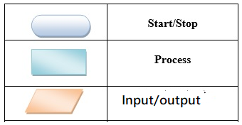
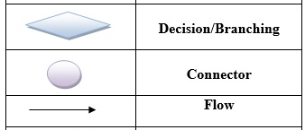
UNIT-1 Revision
Computer History, Hardware, Software:
Hardware: physical equipment
Software:programs(System S/W,Application S/W)
Low-level and High-level Languages:
Lowlevel:Machine Langugae(all binary),AssembleLangugae(binary+codes)
Highlevel:(C,C++,Java)
Algorithm:
Step by step process to perform a task.
Flow Chart: Diagramatic representation of algorithm.

Slide 103
UNIT-1 Revision
Datatypes:
int ,char, float,double,short int…
Variables:
Stores value.(some memory allocated for variable)
Identifiers: Rules for assigning variable names.
Keywords: Reserved words with special purpose.
Constants: Fixing variable value(i)by const keyword ii)by using #define
Comments: // single line comment /*………*/ multiline comments
Input statement: scanf()-to read value of variable from keyboard.
Output statement: printf()-to print text/value of variable

Slide 104
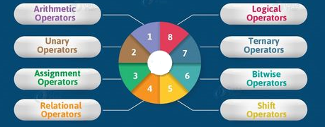
UNIT-1 Revision
Operators:
&&, || , !
+, -, *, /, %
? :
++,--
& , | ,~, ^,
=,+=,-=,*=,/=,%=
<<, >> ,>>
<,>,<=,>=,==,!=
Type conversion:
i)Implicit/Automatic Type Conversion:
a)Promotion(small size to big size type) b)Demotion(Big size to small size type)
ii)Explicit Conversion: Manual conversion
syntax: (Target Datatype) expression

