Slide 1
PROGRAMMING FOR PROBLEM SOLVING USING C
(201ES2T08 )
II SEM Agri,PT,Mining ,civil
A.Lakshmanarao
Associate Professor,H&BS-I Dept.
Aditya Engineering College(A)
Mail : a.lakshmanarao@aec.edu.in
Cell: +91-9951060528

Slide 2
UNIT-II:
Control Flow, Relational Expressions & Arrays:
Conditional Branching Statements: if, if-else, if-else–if, switch. Basic Loop Structures: while, do-while loops, for loop, nested loops, The Break and Continue Statements, goto statement.
Arrays: Introduction, Operations on Arrays, One dimensional Array, Two dimensional Array, Multi dimensional arrays.

Slide 3
Flow of control
In C, there are several options that are used to alter the flow of the program
Statements can be executed multiple times or only under a specific condition
It can be divided into 3 categories
Decision Making and Branching / Conditional Statements (if, switch, conditional)
Looping Statements (for, For each, while, do while)
Transfer Statements (break, continue, try, goto, return)
Decision Making and Branching / Conditional Statements
When a program breaks the sequential flow and jumps to another part of the code, it is known as branching.
When branching is done on a condition it is known as conditional branching.
Decision making statements are: if, switch, conditional operator

Slide 4
Types of if statements
Simple If Statement
If-else Statements
Nested if Statement
if-else ladder

Slide 5
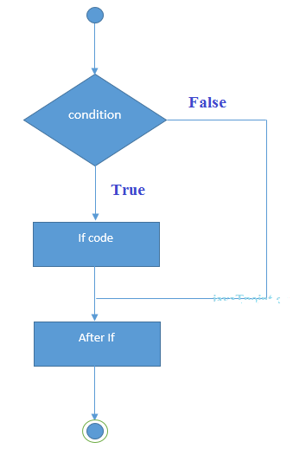
Flow of control
Decision Making and Branching / Conditional Statements
1. if statement:
it always returns the boolean value (true/false)
but not 0/1
if(condition)
{
//code to be executed
}

Slide 6
simple if statement:example
int main()
{
int i = 100;
if(i==100)
{
printf(“i is 100");
}
return 0;
}

Slide 7
simple if statement:example
/ program to check whether given number is +ve
#include <stdio.h>
int main()
{ int n;
printf("enter a number");
scanf("%d",&n);
if(n>=0)
{
printf("\ngiven number is positive");
}
}

Slide 8
//program to check whether given number is even or odd?
#include <stdio.h>
int main()
{ int x;
printf("enter value for x");
scanf("%d",&x);
if(x%2==0)
{
printf("x is even");
}
else
{
printf("x is odd");
}
return 0;
}

Slide 9
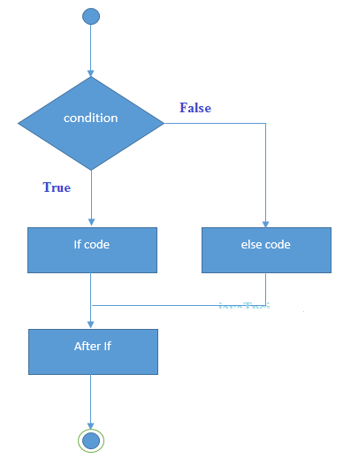
Flow of control
Decision Making and Branching / Conditional Statements
2. if-else statement:
if(condition)
{
//code if condition is true
}
else
{
//code if condition is false
}

Slide 10
if-else statement:
int main()
{
int i = 100;
if(i==100)
{ printf(“i is 100");
}
else
{
printf(“i is not 100");
} return 0;
}

Slide 11
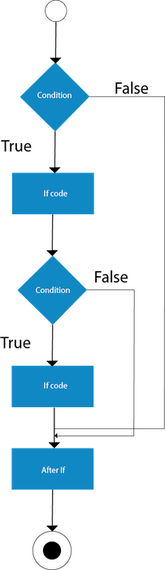
Flow of control
Decision Making and Branching / Conditional Statements
3. nested-if statement:
if(condition)
{
//code to be executed
if(condition)
{
//code to be executed
}
}

Slide 12
nested if example
int main()
{
int num=300;
if( num < 100 )
{
printf("number is less than 100");
if(num > 50)
{ printf("number is greater than 50"); }
else { printf("number is less than 100 and less than 50"); }
}
else { printf("number is >=100"); }
}

Slide 13
nested if example
Largest of three numbers
else
{
if (B >= C)
printf("%d is the largest number.", B);
else
printf("%d is the largest number.", C);
}
return 0;
}
#include <stdio.h>
int main()
{ int A, B, C;
printf("Enter three numbers: ");
scanf("%d %d %d", &A, &B, &C);
if (A >= B)
{
if (A >= C)
printf("%d is the largest number.", A);
else
printf("%d is the largest number.", C);
}

Slide 14
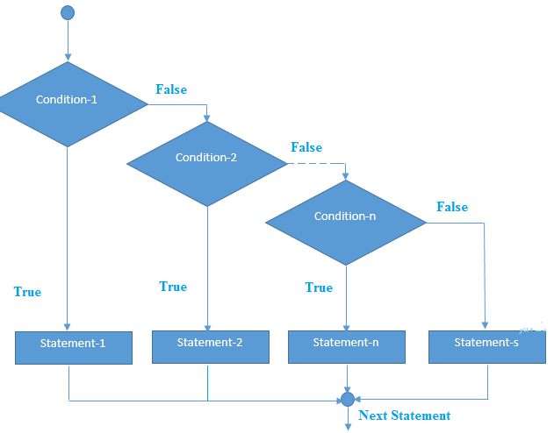
Flow of control
Decision Making and Branching / Conditional Statements
4. else-if ladder statement:
if(condition1){
//code to be executed if cond1 is true
}else if(condition2){
//code to be executed if cond2 is true
}
else if(condition3){
//code to be executed if cond3 is true
}
...
else{
//code to be executed if all the cond’s
//are false
}

Slide 15
else-if ladder statement: example
int main() {
int day;
printf("Enter Value for day: ");
scanf(“%d”,&day);
if(day==1) {
printf("sunday");
}
else if(day==2) {
printf("monday");
}
else if(day==3) {
printf("Tuesday");
}
else if(day==4) {
printf("Wednesday");
}
else if(day==5) {
printf("Thursday");
}
else if(day==6) {
printf("Friday");
}
else if(day==7) {
printf("Saturday");
}
else
{
printf("invalid number");
}
}

Slide 16
Flow of control
2. switch statement
1. The switch statement evaluates an expression, then attempts to match the result to one of several possible cases
2. The expression of a switch statement must result in an integral type, meaning an int or a char
switch (expression) it takes byte, short, int and char data type & enum (>1.5v), string (>1.7v)
{
case value1: cases allows expressions also as a label
statement-1; break;
case value2: not possible to give duplicate case labels
statement-2; break; not possible to give any statement outside of case / default
case value3: variables are not allowed as a case labels
statement-3; break;
default: it allows only one default and executes if all cases failed
statement-3; both cases and default are optional and it wont produce any output
}

Slide 17
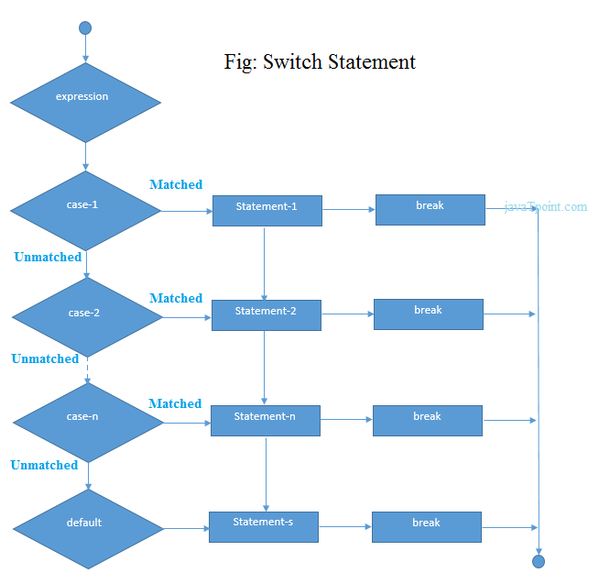

Slide 18
switch: example
int main()
{
int day;
printf("Enter Value for day: ");
scanf(“%d”,&day);
//Switch statement
switch(day){
//case statements within the switch block
case 1: printf("Monday");
break;
case 2: printf("Tuesday");
break;
case 3: printf("Wednesday");
break;
case 4: printf("Thursday") ;
break;
case 5: printf("Friday") ;
break;
case 6: printf(“Saturday") ;
break;
case 7: printf("Sunday");
break;
default: printf("Invalid day!");
}
}
}

Slide 19
Looping statements
The looping can be defined as repeating the same process multiple times until a specific condition satisfies.
Loops are of 2 types:
entry-controlled loop and
exit-controlled loop.

Slide 20
Loops in C
Entry Control Loop the test condition is checked first and if that condition is true then the block of the statement will be executed.
Ex: while loop, for loop
While in Exit control loop first executes the body of the loop and checks condition at last.
Ex: do-while

Slide 21
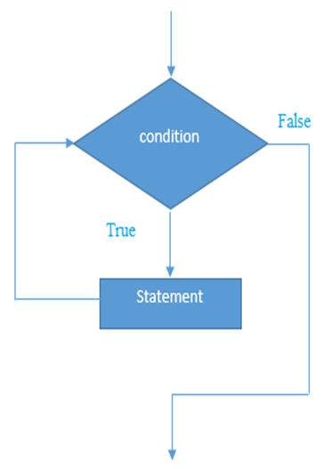
while loop in C
It is also called as pre-tested loop.
The block of statements is executed in the while loop until the condition specified in the while loop is satisfied.
Syntax:
initialization
while(condition){
//code to be executed (incrementation)
}

Slide 22
example-while loop
Aditya
// program to print your name 10 times
#include<stdio.h>
int main()
{
int i=1;
while(i<=10)
{
printf(“Aditya");
i++;
}
return 0;
}
Aditya
Aditya
i=1
while(i<=10)
printf(“Aditya”);
i++(i=i+1=1+1=2)
Aditya
Aditya
i=2
while(2<=10)
printf(“Aditya”);
i++(i=i+1=2+1=3
Aditya
Aditya
Aditya
i=3
while(3<=10)
printf(“Aditya”);
i++(i=i+1=3+1=4
Aditya
Aditya
….
…..
…….
…….

Slide 23

example-while loop
1
2
// program to print 1 to 10
#include<stdio.h>
int main()
{
int i=1;
while(i<=10)
{
printf(“%d“,i);
i++;
}
return 0;
}
3
4
i=1
while(i<=10)
printf(“%d”,i);
i++(i=i+1=1+1=2)
5
6
7
i=2
while(2<=10)
printf(“%d”,i);
i++(i=i+1=2+1=3
8
9
10
i=3
while(3<=10)
printf(“%d”,i);
i++(i=i+1=3+1=4
….
…..
…….
…….

Slide 24
example-while loop
sum=1
sum=3
sum=6
// program to print sum of 1st 10 numbers
#include<stdio.h>
int main()
{
int i=1,sum=0;
while(i<=10)
{
sum=sum+i;
i++;
}
printf((“%d”,sum);
return 0;
}
i=1
while(i<=10)
sum=sum+i=0+1=1
sum=10
i=2
while(2<=10)
sum=sum+i=1+2=3
i=3
while(3<=10)
sum=sum+i=3+3=6
i=4
while(4<=10)
sum=sum+i=6+4=10
sum=55
…..
…….

Slide 25
example-while loop
// program to print sum of 1 to 10 numbers
#include<stdio.h>
int main()
{
int i=1;
sum=0;
while(i<=10)
{
sum=sum+i;
i++;
}
printf("%d",sum);
return 0;
}

Slide 26
example-while loop
// program to print first 50 even numbers
#include<stdio.h>
int main()
{
int i=1;
sum=0;
while(i<=50)
{
if(i%2==0)
{
printf("%d“,i);
}
i++;}
}
return 0;
}

Slide 27
write a C program to find the sum of individual digits of a positive integer.
# include<stdio.h>
int main ()
{
int n, temp , sum = 0;
printf (" Enter an integer \n");
scanf ("%d", &n);
while (n != 0)
{
temp = n % 10;
sum = sum + temp ;
n = n / 10;
}
printf ("\n Sum of digits = %d ",sum );
return 0;
}
Output:
Enter an integer 123
Sum of digits = 6

Slide 28
Write a C program to check whether given number is palindrome or not.
# include <stdio .h>
int main ()
{
int n, t, sum = 0, remainder ;
printf (" Enter an integer \n");
scanf ("%d", &n);
t = n;
while (n != 0)
{
remainder = n % 10;
sum = sum *10 + remainder ;
n = n/ 10;
}
if(t== sum )
printf ("%d is palindrome number ",t);
else
printf ("%d is not palindrome number ",t);
return 0;
}
Output:
Enter an integer 141
141 is palindrome number

Slide 29
Write a C program to check whether given number is prime or not.
# include <stdio .h>
int main ()
{
int i,n,factors=0;
printf (" Enter an integer \n");
scanf ("%d", &n);
while (i<=n)
{
if(n%i==0) { factors=factors+1; }
}
if(factors==2)
printf (“prime”);
else
printf (“not a prime”);
return 0;
}
Output:
Enter an integer 17
prime

Slide 30
do while loop in C
The do while loop is a post tested loop. Using the do-while loop, we can repeat the execution of several parts of the statements.
Syntax
initialization
do{
//code to be executed (incr/decr)
}while(condition);

Slide 31
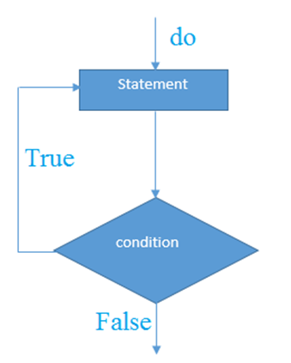
do while loop in C
Syntax
initialization
do{
//code to be executed (increment/decrement)
}while(condition);

Slide 32
do-while example
program to print your name 10 times using do-while loop
#include<stdio.h>
int main()
{
int i=1;
do
{
printf(“Aditya");
i++;
}while(i<=10);
return 0;
}

Slide 33
do-while example
program to print 1 to 10 using do-while loop
#include<stdio.h>
int main()
{
int i=1;
do
{
printf(“%d“,i);
i++;
}while(i<=10);
return 0;
}

Slide 34
Difference between while,do-while
while loop
#include<stdio.h>
int main()
{
int i=11;
while(i<=10)
{
printf(“Aditya”);
i++;
}
return 0;
}
do-while loop
#include<stdio.h>
int main()
{
int i=11;
do{
printf(“Aditya”);
i++;
}while(i<=10);
return 0;
}
No output
output:Aditya

Slide 35
BASIS FOR COMPARISON | WHILE | DO-WHILE
General Form | while ( condition) { statements; //body of loop } | do{ . statements; // body of loop. . } while( Condition );
Controlling Condition | In 'while' loop the controlling condition appears at the start of the loop. | In 'do-while' loop the controlling condition appears at the end of the loop.
Iterations | The iterations do not occur if, the condition at the first iteration, appears false. | The iteration occurs at least once even if the condition is false at the first iteration.
Alternate name | Entry-controlled loop | Exit-controlled loop
Semi-colon | Not used | Used at the end of the loop

Slide 36
For loop in c
The for loop is used in the case where we need to execute some part of the code until the given condition is satisfied.
The for loop is also called as a pre-tested loop/entry controlled.
syntax:
for(initialization;condition;increment/decrement)
{
//code to be executed
}

Slide 37
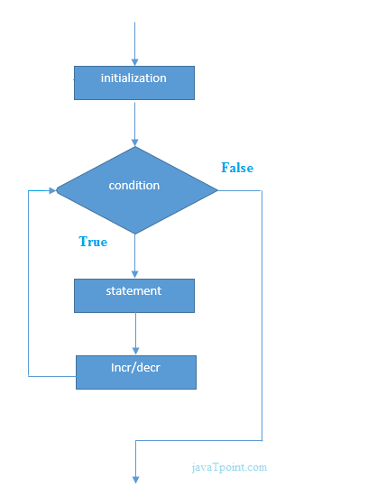
For loop flow chart
syntax:
for(initialization;condition;increment/decrement)
{
//code to be executed
}

Slide 38
for example
program to print your name 10 times using for loop
#include<stdio.h>
int main()
{ int i;
for(i=1;i<=10;i++)
{
printf(“Aditya”);
}
return 0;
}

Slide 39
for example
program to print 1 to 10 using for loop
#include<stdio.h>
int main()
{
int i;
for(i=1;i<=10;i++)
{
printf(“%d”,i);
}
return 0;
}

Slide 40
Write a C program to check whether given number is prime or not.
# include <stdio .h>
int main ()
{
int i,n,factors=0;
printf (" Enter an integer \n");
scanf ("%d", &n);
for(i=1;i<=n;i++)
{
if(n%i==0) { factors=factors+1 ; }
}
if(factors==2)
printf (“prime”);
else
printf (“not a prime”);
return 0;
}
Output:
Enter an integer 17
prime

Slide 41
Flow of control
Transfer Statements
Used to transfer the control from one place / position to another place / position
Five transfer statements: break, continue, goto

Slide 42
Flow of control:Transfer Statements
break statement
It simply stop the execution
We can use this inside the switch case / inside the loops / inside the labelled blocks.
Ex:
int main()
{
for(int i=0; i<10; i++)
{
if(i==4) { break; }
else { printf(“%d”,i); }
}
}
0 1 2 3

Slide 43
Flow of control:Transfer Statements
continue statement
Used to skip the particular iteration
We can use this only inside the loops
Ex:
int main()
{
for(int i=0; i<10; i++)
{
if(i==4) { continue; }
else { printf(“%d”,i); }
}
}
0 1 2 3 5 6 7 8 9

Slide 44
Flow of control:Transfer Statements
goto statement
The goto statement is a jump statement which is sometimes also referred to as unconditional jump statemen
Syntax:
syntax1:
goto label;
……..
……..
……..
label:
syntax2:
label:
……..
……..
……..
goto label;

Slide 45
goto example
#include <stdio.h>
int main()
{
int n = 1;
print:
printf("%d ",n);
n++;
if (n <= 10)
goto print;
return 0;
}
#include <stdio.h>
int main()
{
goto print;
printf(“go to example”);
print:
printf(“this is label");
return 0;
}

Slide 46
Nested Loops in C
C supports nesting of loops in C. Nesting of loops is the feature in C that allows the looping of statements inside another loop. Let's observe an example of nesting
Syntax of Nested loop loops in C.
Outer_loop
{
Inner_loop
{
// inner loop statements.
}
// outer loop statements.
}

Slide 47
Nested loops
while(condition) {
while(condition) {
statement(s);
}
statement(s);
}
for ( init; condition; increment ) {
for ( init; condition; increment ) {
statement(s);
}
statement(s);
}
do {
statement(s);
do {
statement(s);
}while( condition );
}while( condition );

Slide 48
Nested For Loop
If we have a for loop inside the another loop, it is known as nested for loop. The inner loop executes completely whenever outer loop executes.
int main() {
int i,j;//loop of i
for(i=1;i<=3;i++)
{
//loop of j
for( j=1;j<=3;j++)
{
printf(“%d %d”,i,j);
}//end of i
}//end of j
}
}
i=1 & j=1 : 1 1
i=1 & j=2 : 1 2
i=1 & j=3 : 1 3
O/P:
1 1
1 2
1 3
2 1
2 2
2 3
3 1
3 2
3 3
i=2 & j=1 : 2 1
i=2 & j=2 : 2 2
i=2 & j=3 : 2 3
i=3 & j=1 : 3 1
i=3 & j=2 : 3 2
i=3 & j=3 : 3 3

Slide 49
Arrays
An array is defined as the collection of similar type of data items stored a
Arrays are the derived data type in C programming language which can store the primitive type of data such as int, char, double, float, etc.t contiguous memory locations.
An array is used to represent a list of numbers , or a list of names.
Types of Array :
One-dimensional arrays
Two-dimensional arrays
Multidimensional arrays

Slide 50
One-dimensional Arrays
one dimensional arrays are also called as single dimensional arrays, Linear Arrays or simply 1-D Arrays.
syntax for Array Declaration:
datatype arrayname[array_size];
Example:
int x[10]; // can able to store 10 integers
float y[20]; // can able to store 20 float values
char z[15]; // can able to store 15 characters

Slide 51
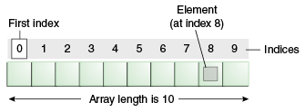
One-dimensional Arrays.
Example:
int x[10];
Name of 1st array
element:x[0]
Name of 2nd array
element:x[1]
Name of 3rd array
element:x[2]
……..
………
Name of 10th array
element is x[9]
x[0] x[1] x[2] x[3] x[4] x[5] x[6] x[7] x[8] x[9]

Slide 52
Initialization of Single Dimensional Array
Syntax:
datatype arrayName [ size ] = {value1, value2, ...} ;
here size is optional
Example:
int marks [6] = { 89, 90, 76, 78, 98, 86 } ;
Now,marks[0] contains 89
marks[1] contains 90
marks[2] contains 76
marks[3] contains 78
marks[4] contains 98
marks[5] contains 86
89 90 76 78 98 96
marks[0] marks[1] marks[2] marks[3] marks[4] marks[5]

Slide 53
Example-program
program to initialize and print array elements
#include<stdio.h>
int main() {
int i
int marks [6] = { 89, 90, 76, 78, 98, 86 } ;
//printing elements of array
printf("%d \n",marks[0]);
printf("%d \n",marks[1]);
printf("%d \n",marks[2]);
printf("%d \n",marks[3]);
printf("%d \n",marks[4]);
printf("%d \n",marks[5]); }
program to initialize and print array elements
using for loop
#include<stdio.h>
int main() {
int i
int marks [6] ={89,90,76,78,98,86};
//printing elements of array with loop
for(i=0;i<=5;i++)
{
printf("%d \n",marks[i]);
}//end of for loop
return 0; }

Slide 54
Example-program
program to read array elements from keyboard and print array elements
#include<stdio.h>
int main() {
int i
int marks [6];
printf(“enter array elements”);
for(i=0;i<=5;i++)
{
scanf("%d",&marks[i]);
}
//printing elements of array with loop
for(i=0;i<=5;i++)
{
printf("%d \n",marks[i]);
}
return 0;
}

Slide 55
Example-program
write a C program to search an element in the given array (Linear Search)-lab program
# include <stdio.h>
int main ()
{
int a[20] ,i,key ,n, found=0;
printf("How many elements ?");
scanf ("%d" ,&n);
printf("Enter array elements :\n");
for(i =0;i<n ;++ i)
{ scanf ("%d" ,&a[i]);}
printf ("\nEnter element to search :");
scanf ("%d" ,&key );
for (i =0;i<n ;++ i)
{ if(key==a[i] )
{ found=1; position=i; }
}
if(found==1)
printf (" Element found at index %d",position);
else
printf (" Element not found ");
}

Slide 56
Array Operations
The following operations are performed on arrays.
1)insertion: Insert element into array
2)Deletion:Delete an element from array
3)Searching:Search an element in the array

Slide 57
Example-program
write a C program for array insertion,deletion operations
#include<stdio.h>
int main()
{
int i,p,num,key;
int a[50]={10,20,30,40,50,60,70,80,90,100};
printf("enter position to insert ");
scanf("%d",&p);
printf("enter number to insert");
scanf("%d",&num);
for(i=9;i>=p;i--)
{ a[i+1]=a[i]; }
a[p]=num;
for(i=0;i<11;i++)
{ printf(" %d",a[i]); }
printf("\nenter position to delete");
scanf("%d",&p);
for(i=p;i<10;i++)
{
a[i]=a[i+1];
}
for(i=0;i<10;i++)
{ printf(" %d",a[i]); }
return 0;
}

Slide 58
Example-program
write a C program to find largest vlaue in the given array.
#include <stdio.h>
int main() {
int array[10] = {1, 2, 3, 4, 5, 6, 7, 8, 9, 10};
int i, large;
large = array[0];
for(i = 1; i < 10; i++) {
if( large < array[i] )
large = array[i];
}
printf("Largest element of array is %d", large);
return 0;
}

Slide 59
Two Dimensional Array
The two-dimensional array can be defined as an array of arrays.
syntax to declare the 2D array :
data_type array_name[rows][columns];
example:
int x[4][3];
x[0][0] x[0][1] x[0][2] x[1][0] x[1][1] x[1][2] x[2][0] x[2][1] x[2][2] x[3][0] x[3][1] x[3][2]

Slide 60
Two Dimensional Array-initialization
int x[4][3]={{1,2,3},{2,3,4},{3,4,5},{4,5,6}};
1 2 3 2 3 4 3 4 5 4 5 6
x[0][0] x[0][1] x[0][2] x[1][0] x[1][1] x[1][2] x[2][0] x[2][1] x[2][2] x[3][0] x[3][1] x[3][2]

Slide 61
2D array-example
Program to initialize and display elements of 2D array
#include<stdio.h>
int main(){
int i=0,j=0;
int arr[3][3]={{1,2,3},{2,3,4},{3,4,5}};
//traversing 2D array
for(i=0;i<=2;i++)
{
for(j=0;j<=2;j++)
{
printf("arr[%d] [%d] = %d \n",i,j,arr[i][j]);
}//end of j
}//end of i
return 0;
}

Slide 62
2D array-example
program to read two dimensional array elements from keyboard and print array elements
#include<stdio.h>
int main()
{
int a[10][10],b[10][10],i,j;
printf("Enter elements into A matrix");
for(i=0;i<3;i++)
{
for(j=0;j<3;j++)
{
scanf("%d",&a[i][j]);
}
}
printf("Elements of matrix A\n");
for(i=0;i<3;i++)
{
for(j=0;j<3;j++)
{
printf(" %d",a[i][j]);
}
printf("\n");
}
return 0;
}

Slide 63
2D array-example-matrix addition
printf("Addition of 2 matrices is\n");
for(i=0;i<3;i++)
{
for(j=0;j<3;j++)
{
c[i][j]=a[i][j]+b[i][j];
}
}
printf("Elements of matrix A\n");
for(i=0;i<3;i++)
{
for(j=0;j<3;j++)
{
printf(" %d",a[i][j]);
} printf("\n"); }
return 0; }
program matrix addition
#include<stdio.h>
int main()
{
int a[10][10],b[10][10],c[10][10]i,j;
printf("Enter elements into A matrix");
for(i=0;i<3;i++)
{ for(j=0;j<3;j++)
{ scanf("%d",&a[i][j]);
} }
printf("Enter elements into B matrix");
for(i=0;i<3;i++)
{ for(j=0;j<3;j++)
{ scanf("%d",&b[i][j]);
} }

Slide 64
Matrix Multiplication
for(i=0;i<2;i++) {
for(j=0;j<2;j++) {
c[i][j]=0;
for(k=0;k<2;k++) {
c[i][j]=c[i][j]+a[i][k]*b[k][j];
} } }
for(i=0;i<2;i++) {
for(j=0;j<2;j++) {
printf("%d\t",c[i][j]);
}
printf("\n");
}
}
#include<stdio.h>
main() {
int a[10][10],b[10][10],c[10][10],i,j,k;
printf("enter elements into a matrix");
for(i=0;i<2;i++) {
for(j=0;j<2;j++) {
scanf("%d",&a[i][j]);
} }
printf("enter elements into b matrix");
for(i=0;i<2;i++) {
for(j=0;j<2;j++) {
scanf("%d",&b[i][j]);
} }
printf("matrix multiplication is\n");

Slide 65
Multidimensional array
A multi-dimensional array is an array with more than one level or dimension. For example, a 2D array, or two-dimensional array, is an array of arrays.
Similarly,we also have any number of dimensions.
Example:If there are 3 dimensions,it is 3D array.
Syntax for declaring multidimensional arrays
datatype arrayname[size1][size2]...[sizeN];

Slide 66
3D array
A 3-D(Three dimensional)array consists of 3 dimensions.
syntax: int arr[n][r][c];
Here,we n*r*c elements.(n number of r*c array)
Ex: inr a[2][2][2]; // (means 2 number of 2*2 arrays/matrix)
int a[2][2][2]={{{1,2},{3,4}},{{5,6},{7,8}}};
Names of array elements(indexing)
1 2
3 4
5 6
7 8
a[0][0][0] a[0][0][1]
a[0][1][0] a[0][1][1]
a[1][0] [0] a[1][0][1]
a[1][1][0] a[1][1][1]
n=0
n=1

Slide 67
Multi dimensional array-3D array example
#include<stdio.h>
int main() {
int i,j,k,arr[2][2][2]={{{1,2},{3,4}},{{5,6},{7,8}}};
for(i=0;i<2;i++) {
for(j=0;j<2;j++) {
for(k=0;k<2;k++) {
printf(" %d",arr[i][j][k]);
}
printf("\n");
} printf("\n");
}}
Output:
1 2
3 4
5 6
7 8

