Slide 1
PROGRAMMING FOR PROBLEM SOLVING USING C
(201ES2T08 )
II SEM Agri,PT,Mining ,civil
A.Lakshmanarao
Associate Professor,H&BS-I Dept.
Aditya Engineering College(A)
Mail : a.lakshmanarao@aec.edu.in
Cell: +91-9951060528

Slide 2
UNIT-IV:
Pointers: Concept of a Pointer, Declaring and Initializing Pointer Variables, Pointer Expressions and pointer Arithmetic, Null Pointers, Generic Pointers, Pointers as Function arguments, Pointers and Arrays, Pointers and Strings, Pointer to Pointer, Dynamic Memory Allocation, Dangling Pointer, Command line Arguments.

Slide 3
pointer-introduction
The Pointer in C, is a variable that stores pointer of another variable.
If we declare a variable x of type int, x will actually store a value.
int x=10; // x is 10 now
However, each variable, apart from value, also has its pointer (or, simply put, where it is located in the memory). The pointer can be retrieved by putting an ampersand (&) before the variable name.
&x print the pointer of a variable on the screen.
& is called as pointer of operator.

Slide 4
pointer-introduction
&x print the pointer of a variable on the screen
& is called as pointer of operator.
int main()
{
int a=10;
printf("%lu",&a);
return 0;
}

Slide 5
what is pointer?
pointer is a variable which stores the pointer of another variable.
This variable can be of type int, char, array, function, or any other pointer.
Declaring a pointer
datatype *pointername; // * is called indirection operator
EX:
int *p1; // p1 can able to store pointer of integer variable
float *p2; //p2 can able to store pointer of float variable
Later,using & operator p1,p2 can able to pointeres.

Slide 6
what is pointer?
Declaring a pointer
datatype *pointername;
EX:
int *p1; // p1 can able to store pointer of integer variable
float *p2; //p2 can able to store pointer of float variable
Example:
int x=10;
int *p;
p=&x;

Slide 7
pointer example
int main()
{
float a=10;
float *p;
p=&a;
printf("%x",p);
printf("\n%x",&a);
return 0;
}
#include <stdio.h>
int main()
{
int a=10;
int *p; p=&a;
printf("%x",p);
printf("\n%x",&a);
return 0;
}

Slide 8
pointer to pointer(Double Pointer )
As we know that, a pointer is used to store the pointer of a variable in C.
Pointer reduces the access time of a variable.
we can also define a pointer to store the pointer of another pointer. Such pointer is known as a double pointer (pointer to pointer).
Declaration:
datatype **ptr; // ptr can able to store pointer of *ptr

Slide 9

pointer to pointer(Double Pointer )
Declaration:
datatype **ptr; // ptr can able to store pointer of *ptr
int x=10;
int *p1=&x;
int **p2=&p1;
10
p2
p1
x

Slide 10
pointer to pointer example
#include<stdio.h>
intmain ()
{
int a = 10;
int *p;
int **pp;
p = &a; // pointer p is pointing to the pointer of a
pp = &p; // pointer pp is a double pointer pointing to the pointer of pointer p
printf("pointer of a: %x\n",p); // pointer of a will be printed
printf("pointer of p: %x\n",pp); // pointer of p will be printed
printf("value stored at p: %d\n",*p); // value stoted at the pointer contained by p i.e. 10 will be printed
printf("value stored at pp: %d\n",**pp); // value stored at the pointer contained by the pointer stoyred at pp
return 0;}

Slide 11
pointer Arithemetic
We can perform arithmetic operations on the pointers like addition, subtraction, etc.
But,someIllegal arithmetic with pointers
There are various operations which can not be performed on pointers. Since, pointer stores address hence we must ignore the operations which may lead to an illegal address, for example, addition, and multiplication. A list of such operations is given below.
pointer + pointer = illegal (but,pointer+number,pointer++,pointer– are valid)
pointer * pointer = illegal
pointer % pointer = illegal
pointer / pointer = illegal
pointer & pointer = illegal
pointer ^ pointer = illegal
pointer | pointer = illegal
~pointer = illegal restrictions are there.

Slide 12
pointer Arithemetic-example
#include<stdio.h>
int main ()
{
int a = 10;
int b=20;
int *p1,*p2;
p1 = &a; p2=&b ;
printf("\n p1 is %u",p1);
printf("\np1+1 is%u",p1+1); //p1+n= p1+n*size of datatype
printf("\np1+1 is%u",p1-1); //p1-n= p1-n*size of datatype
printf("\np2 is %u",p2);
printf("\np1-p2 is is %u",p2-p1);//p1-p2=(Subtraction of two addresses)/size of data type
}

Slide 13
NULL pointer in C
A null pointer is a pointer which points nothing.
Some uses of the null pointer are:
a) To initialize a pointer variable when that pointer variable isn’t assigned any valid memory address yet.
b) To pass a null pointer to a function argument when we don’t want to pass any valid memory address.

Slide 14
NULL pointer in C-example
#include <stdio.h>
int main() {
int *p= NULL;//initialize the pointer as null.
printf("The value of pointer is %u",p);
return 0;
}
o/p:The value of pointer is 0.

Slide 15
void pointer
The void pointer in C is a pointer which is not associated with any data types. It points to some data location in the storage means points to the address of variables.
It has some limitations −
1) Pointer arithmetic is not possible with void pointer due to its concrete size.
2) It can’t be used as dereferenced.

Slide 16
generic(void) pointer=example
#include<stdio.h>
int main()
{
int x=10;
float y=4.5;
void *p;
p=&x;
printf("\n%d",*(int*)p);
printf("\n%u",p);
p=&y;
printf("\n%f",*(float*)p);
printf("\n%u",p);
printf("\n%u",ptr);
return 0;
}

Slide 17
Pointers as Function arguments (Parameter passing methods)
There are 2 types of parameter passing methods:
1)call by value
In call by value method, the value of the actual parameters is copied into the formal parameters.
Changes made to formal arguments cannot effect actual arguments
2)call by reference
In call by reference, the address of the variable is passed into the function call as the actual parameter.
Changes made to formal arguments can effect actual arguments

Slide 18
call by value-example
In call by value method, the value of the actual parameters is copied into the formal parameters.
int main()
{
int a = 10;
int b = 20;
printf("\nBefore call");
printf(" %d %d",a,b);
swap(a,b);
printf("\nAfter call");
printf(" %d %d",a,b);
}
#include <stdio.h>
void swap (int a, int b)
{
int temp;
temp = a;
a=b;
b=temp;
printf("\nIn call ");
printf(" %d %d",a,b);
}

Slide 19
call by reference-example
In call by reference, the address of the variable is passed into the function call as the actual parameter.
int main()
{
int a = 10;
int b = 20;
printf("\nBefore call");
printf(" %d %d",a,b);
swap(&a,&b);
printf("\nAfter call");
printf(" %d %d",a,b);
}
#include <stdio.h>
void swap (int *a, int *b)
{
int temp;
temp = *a;
*a=*b;
*b=temp;
printf("\nIn call ");
printf(" %d %d",*a,*b);
}

Slide 20
Arrays and Pointers
An array is a block of sequential data.
#include <stdio.h>
int main() {
int x[4];
int i;
for(i = 0; i < 4; ++i) {
printf("&x[%d] = %p\n", i, &x[i]);
}
printf("Address of array x: %p", x);
return 0;
}
*The address of &x[0] and x is the same.
* Array name is address of first element.
&x[0] is equivalent to x. and, x[0] is equivalent to *x.
&x[1] is equivalent to x+1 and x[1] is equivalent to *(x+1).
&x[2] is equivalent to x+2 and x[2] is equivalent to *(x+2).

Slide 21
pointers and arrays
#include <stdio.h>
int main()
{
int a[5]={1,2,3,4,5};
int *p,i;
p=&a;
printf("%u",&a[0]);
printf("\n%u",a+1);
printf("\n%u",a+2);
for(i=0;i<5;i++)
printf("\n%u",*(a+i));
for(i=0;i<5;i++)
printf("\n%u",*(p+i));
return 0;

Slide 22
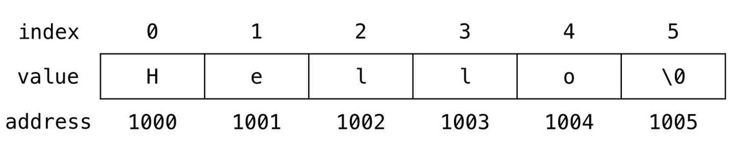
pointer and strings
char str[6] = "Hello";
The variable name of the string str holds the address of the first element of the array i.e., it points at the starting memory address.
#include <stdio.h>
int main(){
char str[6]="Hello"; printf("%x",str);
printf("\n%x",&str[0]);
return 0;}
O/P:prints address of str[0] 2 times

Slide 23
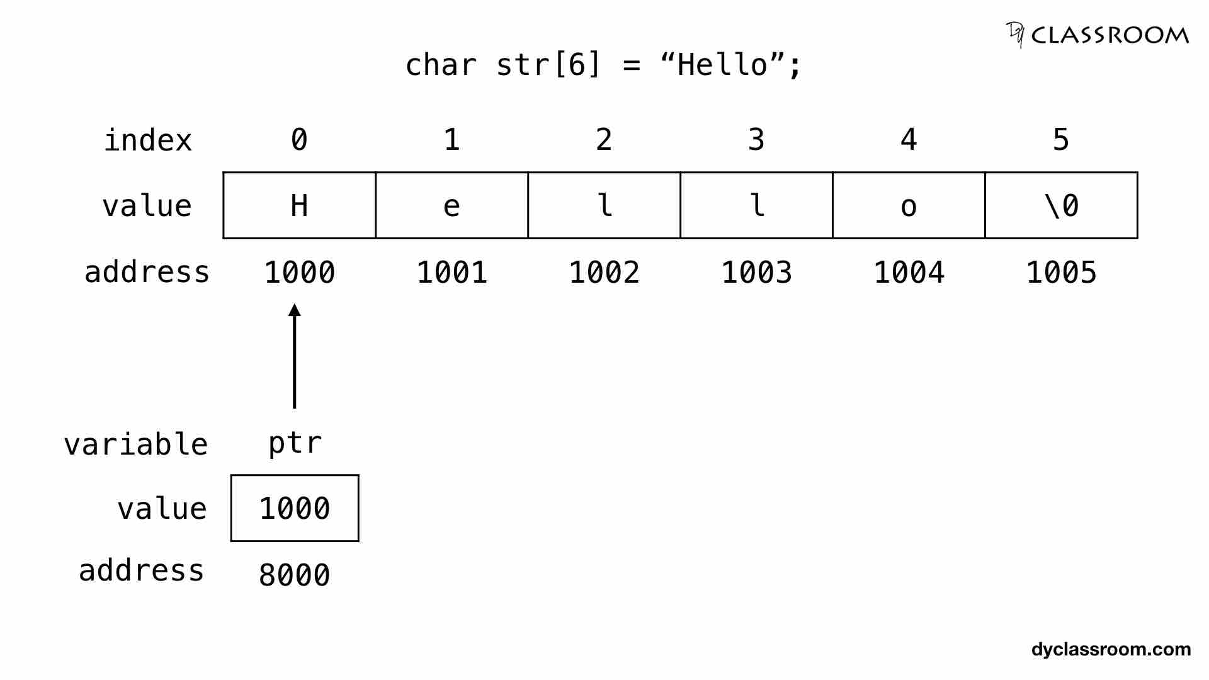
pointer and strings
we can create character pointer and store the address of the string .
char str[6] = "Hello";
char *ptr = str;
#include <stdio.h>
int main(void) {
char str[6] = "Hello";
char *ptr = str;
printf("%c", *ptr);
printf(" %c", *(ptr+1));
printf(" %c", *(ptr+2));
printf(" %c", *(ptr+3));
printf(" %c", *(ptr+4));
return 0;
}

Slide 24
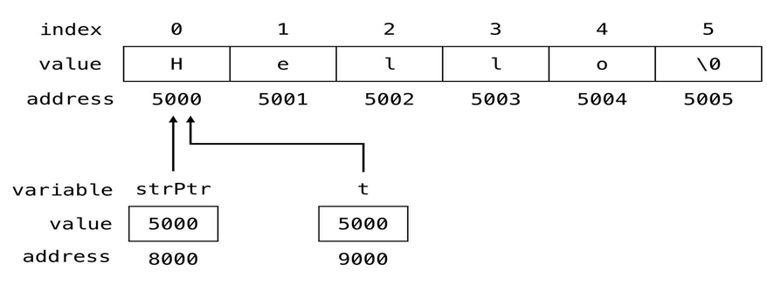
pointer and strings
We can also directly create a string using pointers.
char *strPtr = "Hello";

Slide 25
pointer and strings
We can also directly create a string using pointers.
char *strPtr = "Hello";
#include <stdio.h>
int main(){
char str1[6]="Hello";
char *str2="Hello";
printf("%s",str1);
printf("\n%s",str2);
return 0;
}

Slide 26
pointer and strings
#include <stdio.h>
int main()
{
char name[20]="Aditya College";
char *p="Aditya College";
char *ptr;
ptr=name;
//printf("%u",ptr);
while(*p!='\0')
{
printf("%c",*p); p++;
}
return 0;}

Slide 27
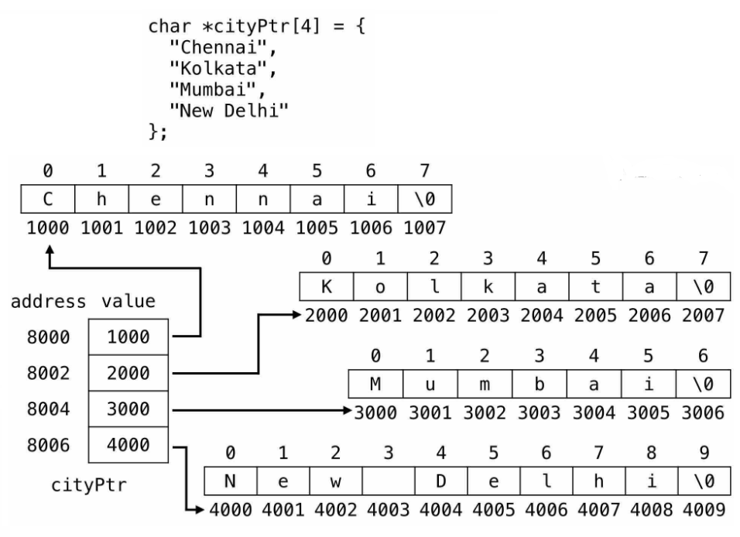
pointer and strings
#include <stdio.h>
int main()
{
char *cities[4] = {"Chennai","Kolkata","Mumbai","New Delhi" };
int i;
for(i=0;i<4;i++)
{
printf("\n%s",cities[i]);
}
return 0;
}

Slide 28
Memory allcoation
static memory allocation | dynamic memory allocation
memory is allocated at compile time. | memory is allocated at run time.
memory can't be increased while executing program. | memory can be increased while executing program.

Slide 29
Dynamic memory allocation in C
The concept of dynamic memory allocation in c language enables the C programmer to allocate memory at runtime. Dynamic memory allocation in c language is possible by 4 functions of stdlib.h header file.
malloc()
calloc()
realloc()
free()

Slide 30
Dynamic memory allocation functions
malloc() | allocates single block of requested memory.
calloc() | allocates multiple block of requested memory.
realloc() | reallocates the memory occupied by malloc() or calloc() functions.
free() | frees the dynamically allocated memory.
Header file: #include<stdlib.h>

Slide 31
malloc()
The malloc() function allocates single block of requested memory.
It doesn't initialize memory at execution time, so it has garbage value initially.
It returns NULL if memory is not sufficient.
syntax:
ptr=(cast-type*)malloc(byte-size)
Ex:
ptr = (int*) malloc(100 * sizeof(int));

Slide 32
malloc()-example
#include<stdio.h>
#include<stdlib.h>
int main(){
int n,i,*ptr;
printf("Enter number of elements: ");
scanf("%d",&n);
ptr=(int*)malloc(n*sizeof(int));
printf("Enter elements of array: ");
for(i=0;i<n;++i)
{
scanf("%d",ptr+i);
}
for(i=0;i<n;++i)
{
printf(" %d ",*(ptr+i));
}
free(ptr);
return 0;
}

Slide 33
calloc()
"calloc" stands for contiguous allocation.
The malloc() function allocates memory and leaves the memory uninitialized, whereas the calloc() function allocates memory and initializes all bits to zero.
syntax:
ptr = (castType*)calloc(n, size);
Ex:
ptr = (float*) calloc(25, sizeof(float));

Slide 34
calloc()-example
#include<stdio.h>
#include<stdlib.h>
int main(){
int n,i,*ptr,sum=0;
printf("Enter number of elements: ");
scanf("%d",&n);
ptr=(int*)calloc(n,sizeof(int));
printf("Enter elements of array: ");
for(i=0;i<n;++i)
{
scanf("%d",ptr+i);
}
for(i=0;i<n;++i)
{
printf(" %d ",*(ptr+i));
}
free(ptr);
return 0;
}

Slide 35
calloc()
"calloc" stands for contiguous allocation.
The malloc() function allocates memory and leaves the memory uninitialized, whereas the calloc() function allocates memory and initializes all bits to zero.
syntax:
ptr = (castType*)calloc(n, size);
Ex:
ptr = (float*) calloc(25, sizeof(float));

Slide 36
realloc()
If the dynamically allocated memory is insufficient or more than required, you can change the size of previously allocated memory using the realloc() function.
syntax:
ptr = realloc(ptr, newSize); //ptr is reallocated with new size 'newSize'.
Ex:

Slide 37
realloc()-example
ptr=(int*)realloc(ptr,10*sizeof(int));
printf("Enter another 5 elements");
for(i=5;i<10;++i)
{
scanf("%d",(ptr+i));
}
printf(“Numbers are\n”);
for(i=0;i<10;++i)
{
printf("%d ",*(ptr+i));
}
free(ptr);
return 0; }
#include<stdio.h>
#include<stdlib.h>
int main(){
int i,*ptr,sum=0;
ptr=(int*)calloc(5,sizeof(int));
printf("Enter 5 elements: ");
for(i=0;i<5;++i)
{
scanf("%d",(ptr+i));
}

Slide 38
Dangling Pointers in C
The most common bugs related to pointers and memory is sometimes the programmer fails to initialize the pointer with a valid address, then this type of initialized pointer is known as a dangling pointer in C.
The pointer is pointing to the memory, which is de-allocated.

Slide 39

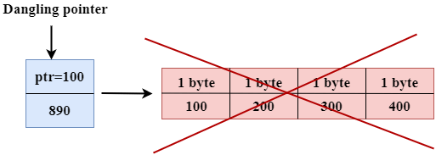

Dangling Pointers in C-example
#include <stdio.h>
int main()
{
int *ptr=(int *)malloc(sizeof(int));
int a=560;
ptr=&a; printf("%d",*ptr);
printf("\n%lu",ptr);
// ptr=NULL;
free(ptr);
return 0; }
The statement int *ptr=(int *)malloc(sizeof(int)); will allocate the memory with 4 bytes shown in the below image:
free(ptr) de-allocates the memory as shown in the below image with a cross sign, and 'ptr' pointer becomes dangling as it is pointing to the de-allocated memory.
we have created two variables, i.e., *ptr and a where 'ptr' is a pointer and 'a' is a integer variable.
The *ptr is a pointer variable which is created with the help of malloc() function. As we know that malloc() function returns void, so we use int * to convert void pointer into int pointer.
If we assign the NULL value to the 'ptr', then 'ptr' will not point to the deleted memory. Therefore, we can say that ptr is not a dangling pointer, as shown in the below image:

Slide 40
Command Line Arguments in C
The arguments passed from command line are called command line arguments. These arguments are handled by main() function.
To support command line argument, you need to change the structure of main() function as given below.
int main(int argc, char *argv[] )
Here, argc counts the number of arguments. It counts the file name as the first argument.
The argv[] contains the total number of arguments. The first argument is the file name always.

Slide 41
Command Line Arguments in C-example
#include <stdio.h>
int main(int c, char *x[] ) {
printf("%s\n", x[0]);
printf("%s\n", x[1]);
printf("%s\n", x[2]);
printf("%s\n", x[3]);
printf("\n%d\n", c);
return 0;
}
o/p:
./a.out C Programming Language
./a.out
C Programming
Language

