Slide 1
PROGRAMMING FOR PROBLEM SOLVING USING C
(201ES2T08 )
I SEM EEE
Dr K.Swaroopa ,Associate Professor, CSE Dept.
Aditya Engineering College(A)
Mail : swaroopak@aec.edu.in
Cell: +91-8328100635

Slide 2
UNIT-V:
Structures, Unions, Bit Fields: Introduction, Nested Structures, Arrays of Structures, Structures and Functions, Self-Referential Structures, Unions, Enumerated Data Type–enum variables, Using Typedef keyword, Bit Fields.
Data Files: Introduction to Files, Using Files in C, Reading from Text Files, Writing to Text Files, Random File Access.

Slide 3
C Structure
Structure is a user-defined datatype in C language.
Structure is a group of variables of different data types represented by a single name.
The struct keyword is used to define the structure.

Slide 4
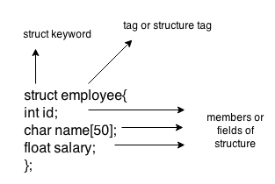
SYNTAX-structure declaration
Example1:
struct employee
{
int id;
char name[50];
float salary;
};
struct structure_name
{
data_type member1;
data_type member2;
.
.
data_type memeberN;
};

Slide 5
structure declaration
struct student
{
int roll_no;
char name[20];
float CGPA;
};
We can write structure in two places 1)above main 2)In main
int main()
{
struct student
{
int rollno;
char name[20];
float CGPA;
};
…..
…
…return 0;}
struct student
{
int rollno;
char name[20];
float CGPA;
};
int main()
{…..
…
…return 0;}

Slide 6
Accessing members of the structure
Structure members(data) cannot be accessed directly.
step1)First, we need to create a structure variable with the following syntax.
syntax for creating structure variable:
strucut structure_name variable;
step2)Next,use dot operator to access structure member.
syntax for accessing structure member:
strucuturevariable.structuremember;

Slide 7
Creating structure variable-2 ways
struct employee
{ int id;
char name[50];
float salary;
}e1;
int main()
{
..
..
.
..}
struct employee
{ int id;
char name[50];
float salary;
};
int main()
{
struct employee e1;
..
..
...}

Slide 8
Initialization of structure members
struct student
{
int rollno=20; //gives error
char name[20]=“ABCD”; //gives error
float CGPA=9.5; //gives error
};
int main()
{…..
…
…return 0;}
cannot initialize members here
Reason:
when a datatype is declared, no memory is allocated for it. Memory is allocated only when variables are created.
Initialization can be done with structure variable only.

Slide 9
structure-example
int main( )
{
s1.rollno=39;
strcpy(s1.name, "ABCD");//copying string into char array
s1.cgpa=9.8;
printf( "student1-id : %d\n", s1.rollno);
printf( "student1-cgpa : %f\n", s1.cgpa);
printf( "student1-1 name : %s\n", s1.name);
return 0;
}
#include<stdio.h>
#include <string.h>
struct student
{ int rollno;
char name[50];
float cgpa;
}s1; //declaring s1 variable for structure

Slide 10
structure-example
int main( )
{ struct book b1; //declaring s1 variable for structure
b1.pages=250;
b1.name=“C programming”;
b1.price=345.50;
//printing first employee information
printf( "book-pages : %d\n", b1.pages);
printf( "book-price : %f\n", b1.price);
printf( "book name : %s\n", b1.name);
return 0;
}
#include<stdio.h>
#include <string.h>
struct book
{ int pages;
char *name
float price;
};

Slide 11
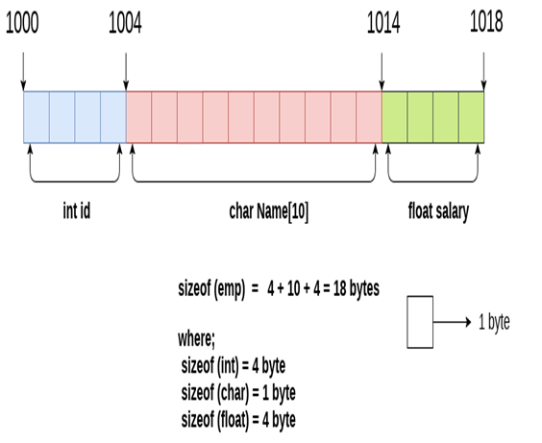
Memory allocation of the structure
struct Employee
{
int id;
char Name[10];
float salary;
};

Slide 12
Nested Structures
The structure can be nested in the following ways.
By separate structure
By Embedded structure

Slide 13
Nested Structures-By separate structure
#include<stdio.h>
struct DOB
{
int dd;
int mm;
int yyyy;
};
struct Student
{
int rollno;
char *name;
struct DOB d;
}s1;
int main() {
s1.rollno=10;
s1.name="ABCD";
s1.d.dd=6;
s1.d.mm=8;
s1.d.yyyy=1996;
printf("roll no=%d",s1.rollno);
printf("\nname is %s",s1.name);
printf("\n DOB is %d %d %d",s1.d.dd,s1.d.mm,s1.d.yyyy);
return 0; }

Slide 14
Nested Structures-By Embedded structure
#include<stdio.h>
struct Student
{
int rollno;
char *name;
struct DOB
{
int dd;
int mm;
int yyyy;
}d;
}s1;
int main()
{
s1.rollno=10;
s1.name="ABCD";
s1.d.dd=6;
s1.d.mm=8;
s1.d.yyyy=1996;
printf("roll no=%d",s1.rollno);
printf("\nname is %s",s1.name);
printf("\n DOB is %d %d %d",s1.d.dd,s1.d.mm,s1.d.yyyy);
return 0;
}

Slide 15
Nested Structure-summary
1. By separate structure
2. By Embedded structure
#include<stdio.h>
struct DOB
{
int dd;
int mm;
int yyyy;
};
struct Student
{
int rollno;
char *name;
struct DOB d;
}s1;
#include<stdio.h>
struct Student
{
int rollno;
char *name;
struct DOB
{
int dd;
int mm;
int yyyy;
}d;
}s1;
int main() {
s1.rollno=10;
s1.name="ABCD";
s1.d.dd=6;
s1.d.mm=8;
s1.d.yyyy=1996;
printf("roll no=%d",s1.rollno);
printf("\nname is %s",s1.name);
printf("\n DOB is %d %d %d",s1.d.dd,s1.d.mm,s1.d.yyyy);
return 0; }

Slide 16
Array of Structures
An array of structres in C can be defined as the collection of multiple structures variables where each variable contains information about different entities.
The array of structures in C are used to store information about multiple entities of different data types.
The array of structures is also known as the collection of structures.

Slide 17
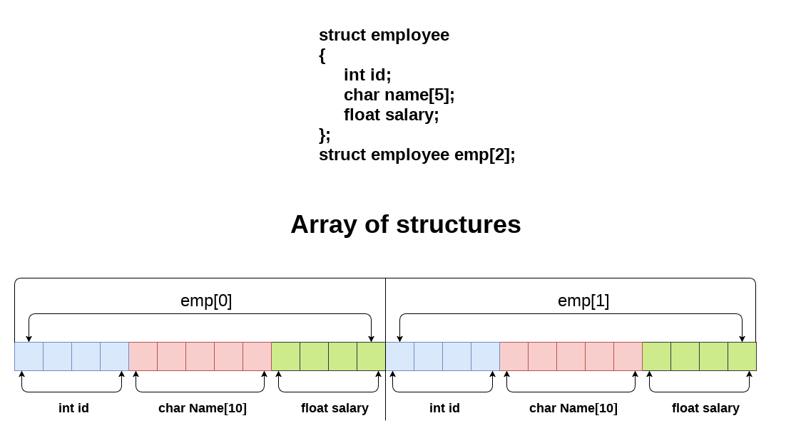
Array of Structures-Example

Slide 18
Array of Structures-Example
for(i=0;i<5;i++){
printf("\nEnter Rollno:");
scanf("%d",&s[i].rollno);
printf("\nEnter Marks:");
scanf("%f",&s[i].marks);
}
printf("Entered Details of 5 studentsare:\n");
for(i=0;i<5;i++){
printf("%d %f\n",s[i].rollno,s[i].marks);
}
return 0;
}
#include<stdio.h>
struct student{
int rollno;
float marks;
}s[5];
int main()
{
int i;
printf("Enter Records of 5 students");

Slide 19
Structure and Function
We can pass structure members as arguments to a function.
#include <stdio.h>
struct student{
int no;
int marks;
}s;
void display(int x,int y)
{
printf("%d %d",x,y);
}
int main()
{
s.no=10;
s.marks=20;
display(s.no,s.marks);
return 0;
}

Slide 20
Structure and Function
We can pass struct variables as arguments to a function.
int main() {
struct student s1;
printf("Enter name: ");
// read string input from the user until \n is entered
// \n is discarded
scanf("%[^\n]%*c", s1.name);
printf("Enter age: ");
scanf("%d", &s1.age);
display(s1); // passing struct as an argument
return 0;
}
#include <stdio.h>
struct student {
char name[50];
int age;
};
void display(struct student s) {
printf("\nDisplaying information\n");
printf("Name: %s", s.name);
printf("\nAge: %d", s.age);
}

Slide 21
Union
union is a group of variables of different data types represented by a single name.
Like Structures, union is a user defined data type.

Slide 22
Union
Example1:
union employee
{
int id;
char name[50];
float salary;
}e;
union union_name
{
data_type member1;
data_type member2;
.
.
data_type memeberN;
}variable;

Slide 23
union-example
int main( )
{
s1.rollno=39;
strcpy(s1.name, "ABCD");//copying string into char array
printf( "student1-id : %d\n", s1.rollno);
s1.cgpa=9.8;
printf( "student1-cgpa : %f\n", s1.cgpa);
printf( "student1-1 name : %s\n", s1.name);
return 0;
}
#include<stdio.h>
#include <string.h>
union student
{ int rollno;
char name[50];
float cgpa;
}s1; //declaring s1 variable for structure

Slide 24
Bitfileds
a bit field is a data structure that allows the programmer to allocate memory to structures and unions in bits in order to utilize computer memory in an efficient manner.
Need for Bit Fields in C
Bit fields are of great significance in C programming, because of the following reasons:
Used to reduce memory consumption.
Easy to implement.
Provides flexibility to the code.
Declaration
struct structname
{
data_type variable_name : size_in_bits;
};

Slide 25
Bitfileds-example
int main()
{
s.x=2;
s.y=3;
printf("\n%d",s.x);
printf("\n%d",s.y);
printf("\nSize of test is %lu bytes\n",sizeof(s));
return 0;
}
#include <stdio.h>
// A structure with forced alignment
struct test {
int x : 5;
int y: 4;
}s;

Slide 26
Enumeration (or enum) in C
Enumeration (or enum) is a user defined data type in C. It is mainly used to assign names to integral constants, the names make a program easy to read and maintain.
The enum in C is also known as the enumerated type.
syntax:
enum flag{integer_const1, integer_const2,.....integter_constN};

Slide 27
Enumeration (or enum) in C-example
#include <stdio.h>
int main()
{
enum day{Sunday, Monday, Tuesday, Wednesday, Thursday, Friday, Saturday};
printf("\n%d", Sunday);
printf("\n%d", Monday);
printf("\n%d", Tuesday);
printf("\n%d", Wednesday);
printf("\n%d", Thursday);
printf("\n%d", Friday);
printf("\n%d", Saturday);
return 0;
}

Slide 28
typedef
C programming language provides a keyword called typedef, which you can use to give a type a new name.
typedef is a keyword used in C programming to provide some meaningful names to the already existing variable in the C program.
Syntax:
typedef originaldatatypename newname;
Example:
typedef int Integer;
Then,we can use Integer in the place of int.

Slide 29
typedef-example
#include <stdio.h>
int main()
{
typedef unsigned int unit;
unit i,j;
i=10;
j=20;
printf("Value of i is :%d",i);
printf("\nValue of j is :%d",j);
return 0;
}

Slide 30
Using typedef with structures
typedef struct student
{
char name[20];
int age;
}stud;
// we can use ‘stud’ for structure student from this point onwards….
int main()
{
stud s1, s2;
…..
}

Slide 31
Storage Classes in C
Storage classes in C are used to determine
Lifetime,
Visibility,
Memory location, and
Initial value of a variable.
Four types of storage classes in C :
Automatic
External
Static
Register

Slide 32
Storage Classes in C
Storage Classes | Storage Place | Default Value | Scope | Lifetime
auto | RAM | Garbage Value | Local | Within function
extern | RAM | Zero | Global | Till the end of the main program Maybe declared anywhere in the program
static | RAM | Zero | Local | Till the end of the main program, Retains value between multiple functions call
register | Register | Garbage Value | Local | Within the function

Slide 33
auto
Automatic variables are allocated memory automatically at runtime.
The visibility of the automatic variables is limited to the block in which they are defined.
The scope of the automatic variables is limited to the block in which they are defined.The automatic variables are initialized to garbage by default.
The memory assigned to automatic variables gets freed upon exiting from the block.
The keyword used for defining automatic variables is auto.
Every local variable is automatic in C by default.

Slide 34
auto
#include <stdio.h>
int main()
{
int a; //auto
char b;
float c;
printf("%d %c %f",a,b,c); // printing initial default value of automatic variables a, b, and c.
return 0;
}
Output :garbage garbage garbage

Slide 35
Static
he variables defined as static specifier can hold their value between the multiple function calls.
Static local variables are visible only to the function or the block in which they are defined.
A same static variable can be declared many times but can be assigned at only one time.
Default initial value of the static integral variable is 0 otherwise null.
The visibility of the static global variable is limited to the file in which it has declared.
The keyword used to define static variable is static.

Slide 36
Static
#include<stdio.h>
static char c;
static int i;
static float f;
static char s[100];
void main ()
{
printf("%d %d %f %s",c,i,f); // the initial default value of c, i, and f will be printed.
}
Output: 0 0 0.000 (null)

Slide 37
Register
The variables defined as the register is allocated the memory into the CPU registers depending upon the size of the memory remaining in the CPU.
We can not dereference the register variables, i.e., we can not use &operator for the register variable.
The access time of the register variables is faster than the automatic variables.
The initial default value of the register local variables is 0.
The register keyword is used for the variable which should be stored in the CPU register. However, it is compiler? s choice whether or not; the variables can be stored in the register.
We can store pointers into the register, i.e., a register can store the address of a variable.
Static variables can not be stored into the register since we can not use more than one storage specifier for the same variable.

Slide 38
example
#include <stdio.h>
int main()
{
register int a; // variable a is allocated memory in the CPU register. The initial default value of a is 0.
printf("%d",a);
}
Output : 0

Slide 39
External
The external storage class is used to tell the compiler that the variable defined as extern is declared with an external linkage elsewhere in the program.
The variables declared as extern are not allocated any memory. It is only declaration and intended to specify that the variable is declared elsewhere in the program.
The default initial value of external integral type is 0 otherwise null.
We can only initialize the extern variable globally, i.e., we can not initialize the external variable within any block or method.
An external variable can be declared many times but can be initialized at only once.
If a variable is declared as external then the compiler searches for that variable to be initialized somewhere in the program which may be extern or static. If it is not, then the compiler will show an error

Slide 40
example
include <stdio.h>
int a;
int main()
{
extern int a; // variable a is defined globally, the memory will not be allocated to a
printf("%d",a);
}
Output : 0
0

