Slide 1

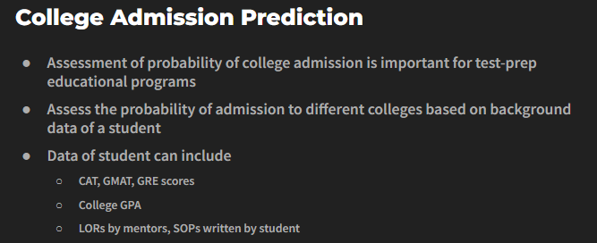
Domain : Education
Problem Statement

Slide 2
Understanding the problem statement
Output
ML Model
Input
GRE Score
TOEFL Score
University Rating
SOP
LOR
CGPA
Research
Chance of Admit
Tech Stack : Python

Slide 3
Systematic Approach
Given Dataset
Data cleaning
Data Visualization
Train Test split
(80-20)
Normalization of the data
Machine Learning models
Feature Importance
Error analysis results
End user visualization
Hyper parameter tuning(Grid Search)
1)Lasso Regression
2)Ridge Regression
3)Elastic-Net Regression
4)SVR
5)Decision tree Regressor
6)XG Boost Regressor
7)Random Forest Regressor
8)KNN
9)Gradient Boosting Regressor
10)MLP Regressor
Min Max Scalar
Standard Scalar
Libraries :
Numpy,Pandas,Matplotlib, Seaborn,sklearn,eli5,gradio

Slide 4
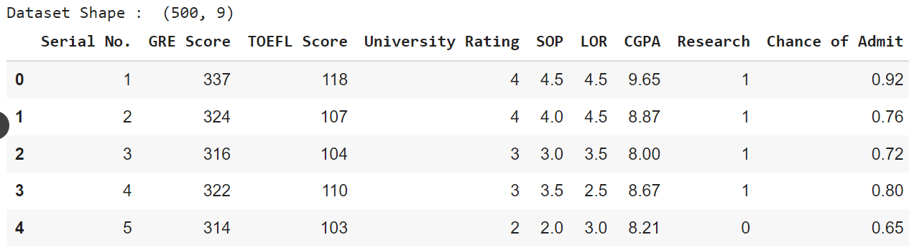
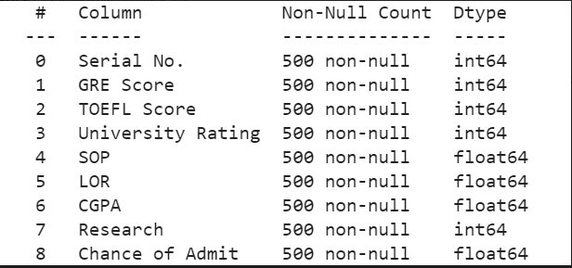
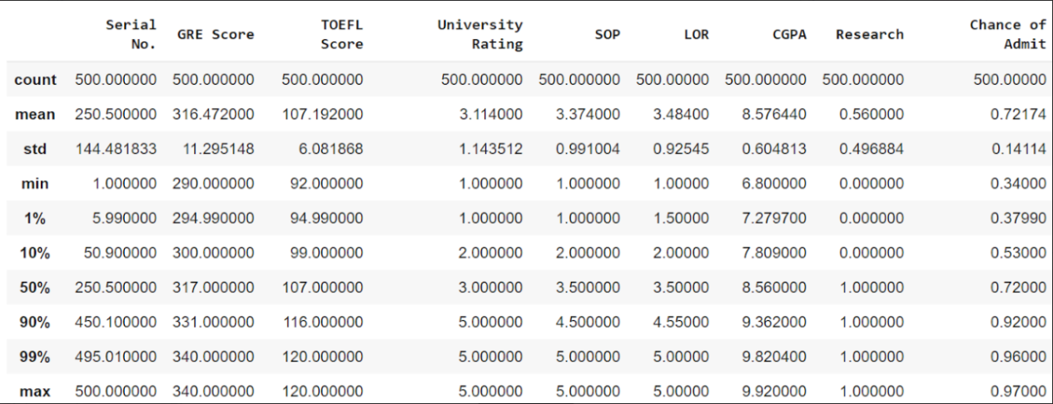
About the Dataset
Given Dataset
Data Info
Data statistics

Slide 5
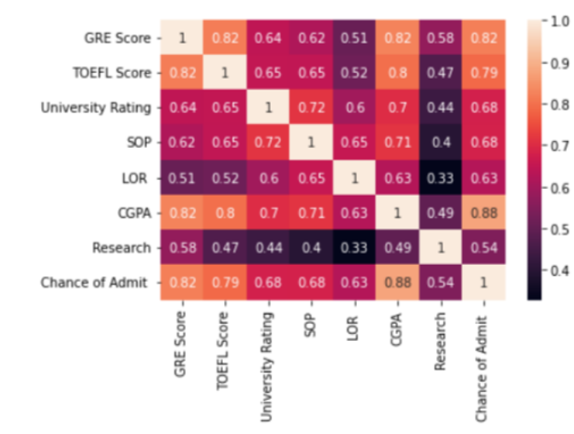
Data Visualization
Heat Map (Relation between input vs output variable)

Slide 6
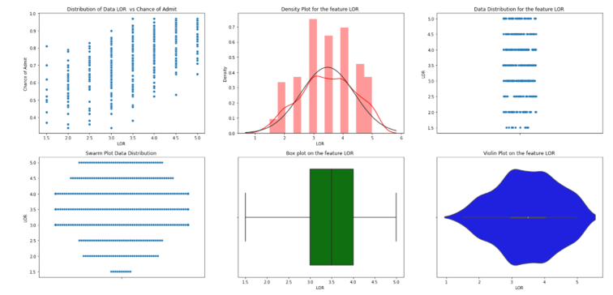
LOR Feature Visualization

Slide 7
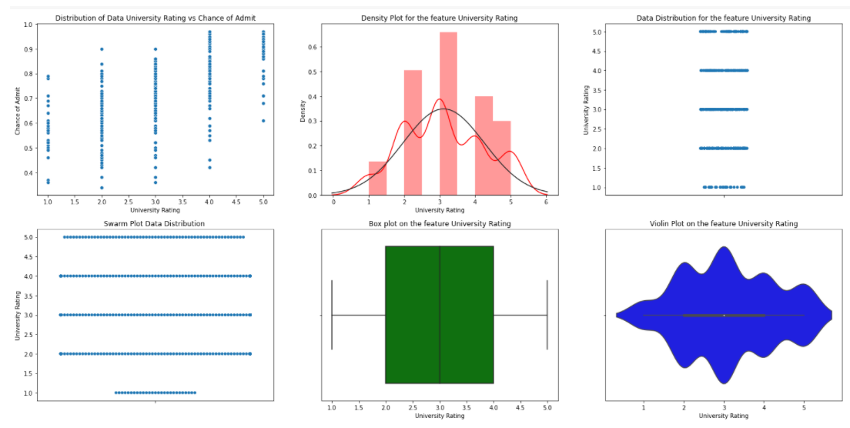
University Rating Feature Visualization

Slide 8
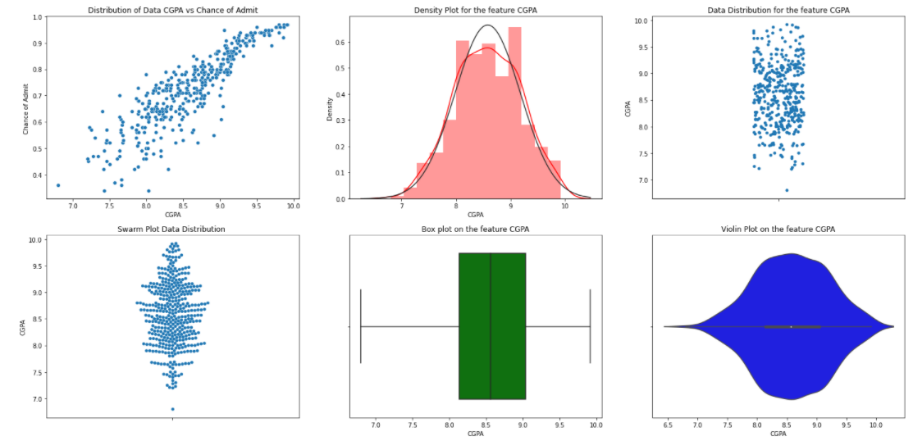
CGPA Feature Visualization

Slide 9
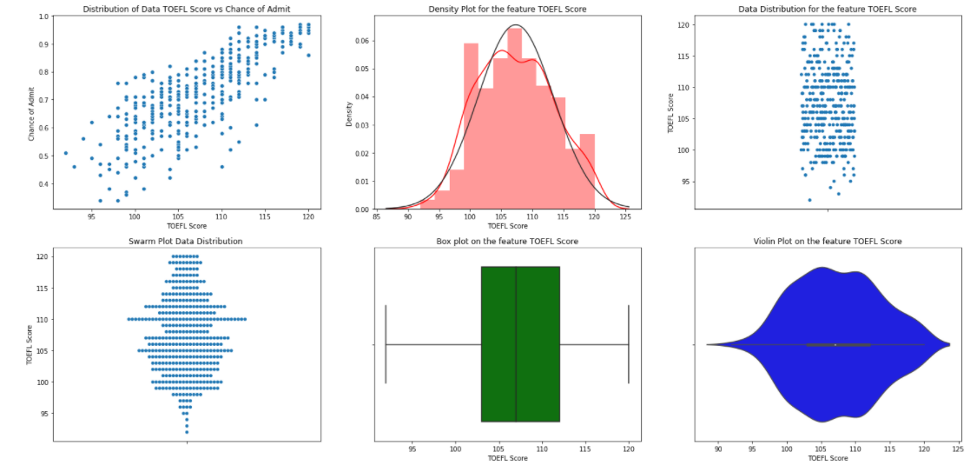
TOEFL score Feature Visualization

Slide 10
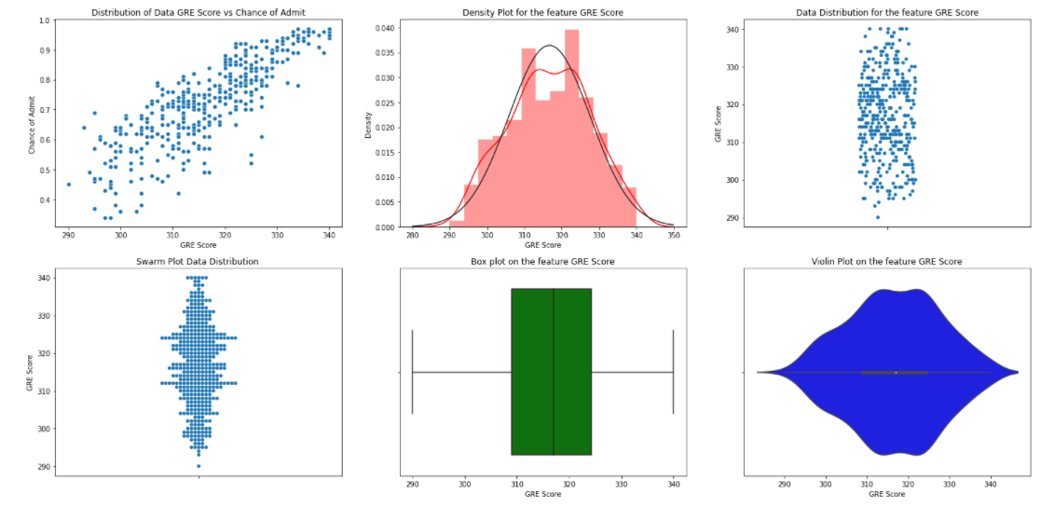
GRE score Feature Visualization

Slide 11
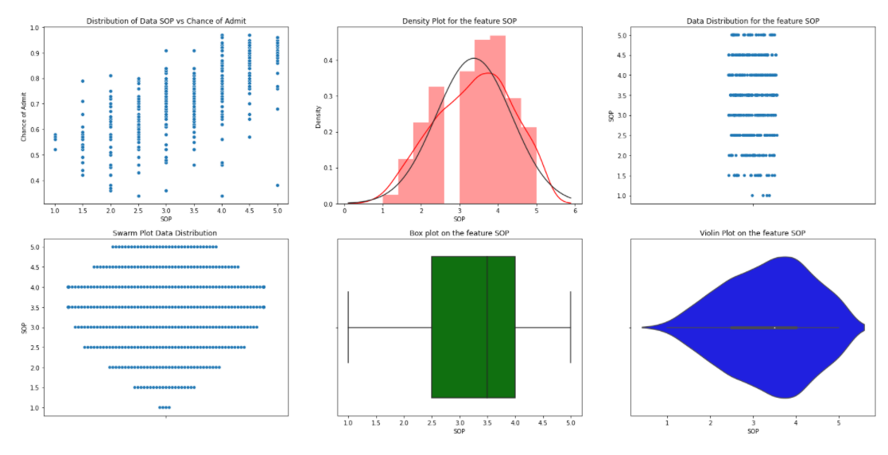
SOP Feature Visualization

Slide 12
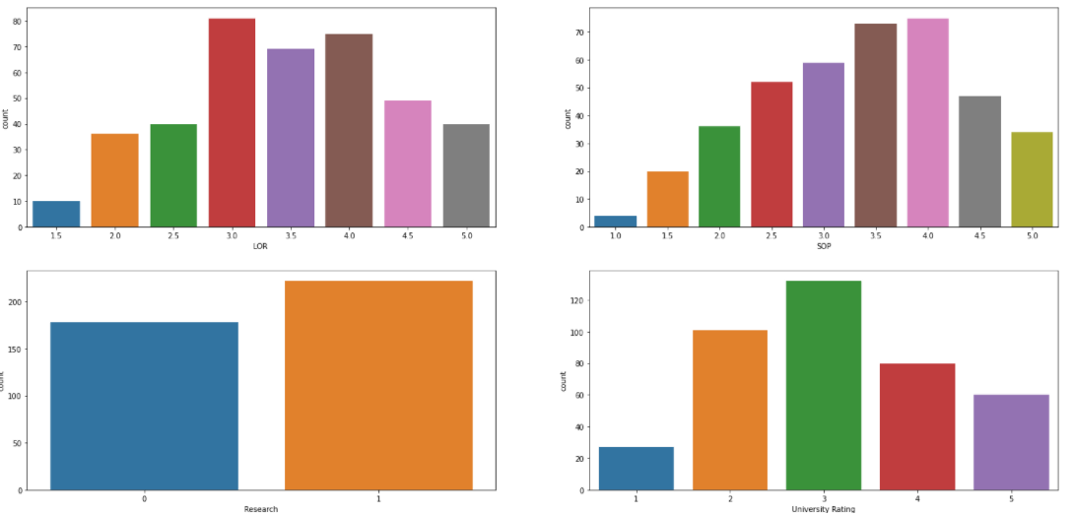
Categorical Features – Count plot

Slide 13
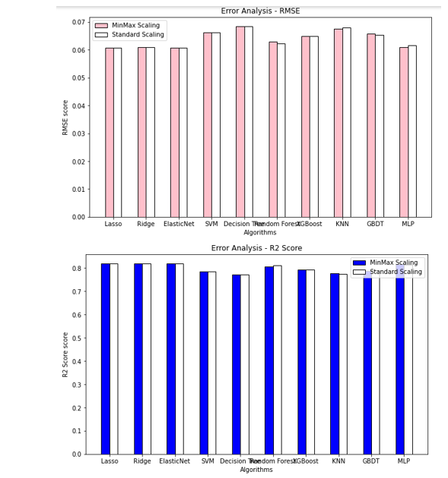
Error Analysis

Slide 14
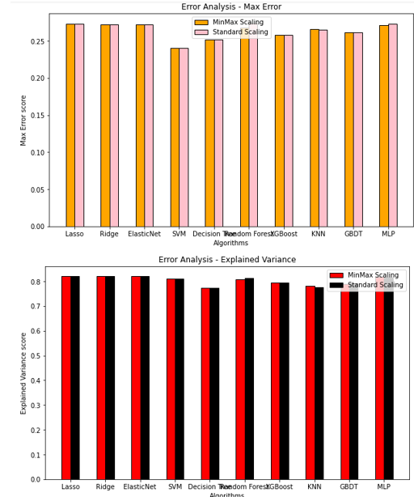
Error Analysis

Slide 15
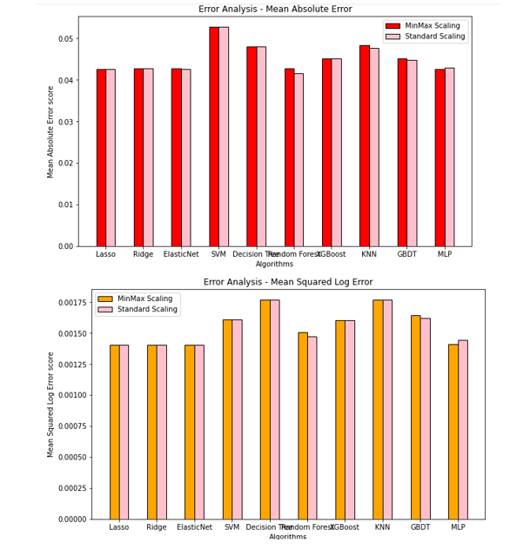
Error Analysis

Slide 16
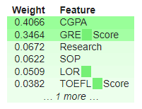
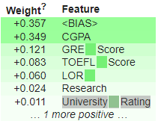
Feature Visualization
Model : Lasso Regression
Model : XGBoost Regressor
Library : eli5

Slide 17
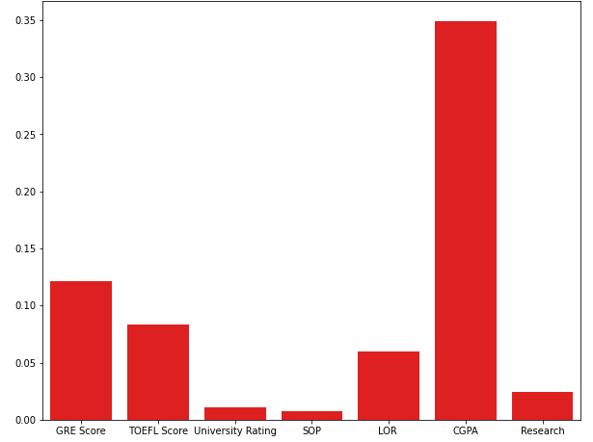
Feature visualization
Model : Lasso Regression

Slide 18
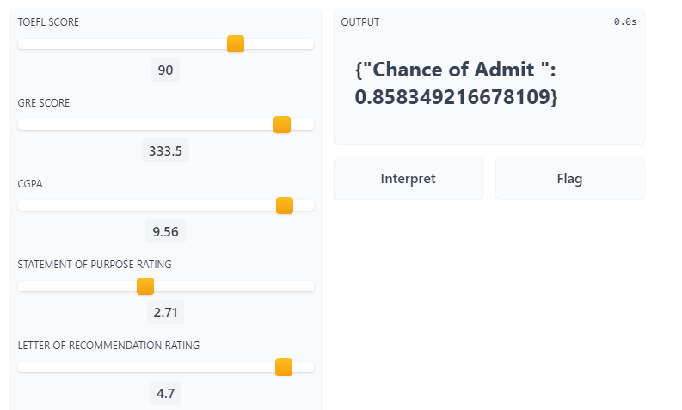

End user interface
Video Demo

Slide 19
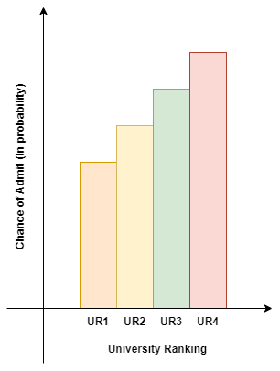
Future Work Extension
Recommendation Systems
University Recommendations to Students

Slide 20
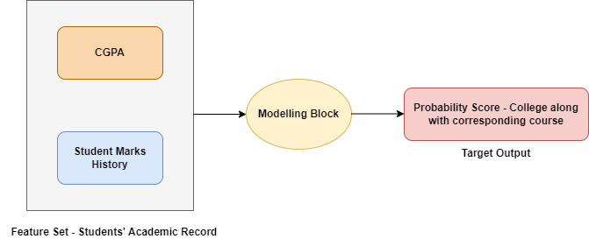
Future Work Extension
Feature Set Collection for Course Selection to Students based on their past Grade

