Slide 1
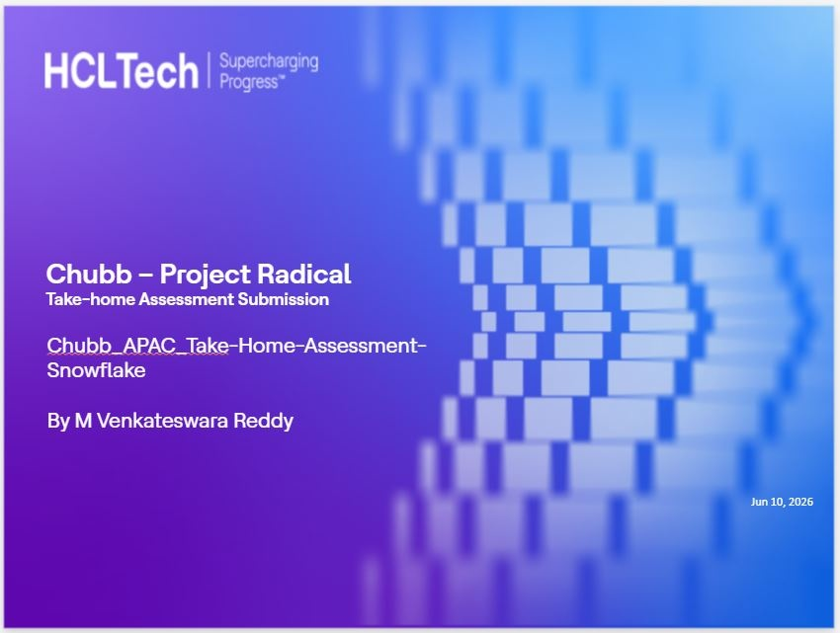

Slide 2
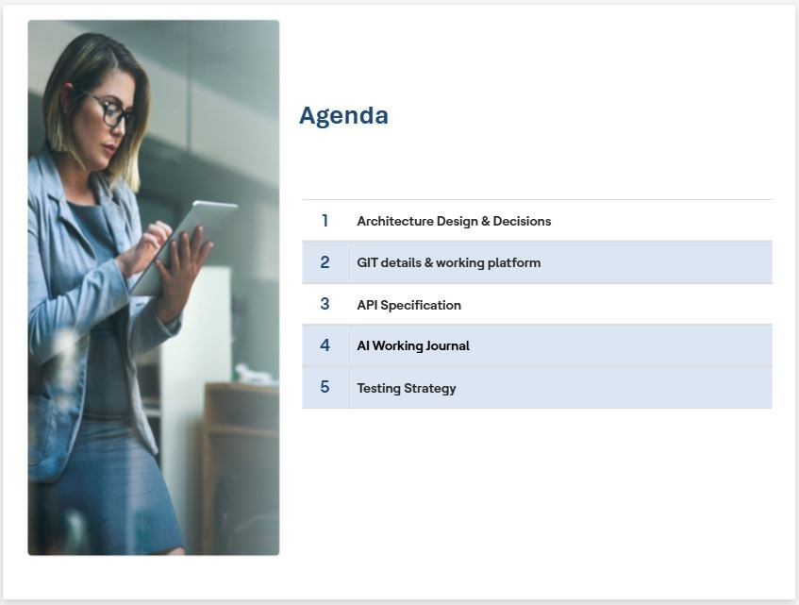

Slide 3
Architecture Design & Decisions
Medallion Architecture (RAW → CURATED → DWH → SEMANTIC)
CDC using Streams & MERGE
Star Schema in DWH
Derived columns: Risk & Expiry
Automated pipeline with SP & Task
Scalable & cost-efficient design

Slide 4
GIT Details & Working Platform
Structured repo: SQL / Queries / Use Cases / Docs / AI
Platform: Snowflake + VS Code + GitHub
Modular SQL design
Layer-based organization
Version-controlled scripts

Slide 5
API Specification
Semantic Layer Views used
V_POLICIES – Policy listing
V_POLICY_SUMMARY – Aggregated data
V_POLICY_SEARCH – Fast lookup
Optimized for BI & dashboards

Slide 6
AI Working Journal
AI used for architecture and SQL design
Generated CDC and MERGE logic
Helped build stored procedure and automation
Reduced development time significantly
Improved productivity

Slide 7
Testing Strategy
Row count validation (RAW vs CURATED)
Null and data checks
CDC validation using streams
Functional testing of queries
Task monitoring via TASK_HISTORY

Slide 8
Conclusion
End-to-end Snowflake pipeline
CDC implemented using Streams
Star Schema for analytics
Automated pipeline execution
Production-ready solution

