Slide 1
Predicting Perovskite Solar Cell Efficiency
Machine-learning analysis of 20,000 device records. Target: power conversion efficiency (PCE).
Notes:
Title slide. All numbers in this deck come from the outputs saved in solar_dataset_FINAL.ipynb.

Slide 2
Project at a glance
1
2
3
4
5
Explore & clean
Engineer features
Train five models
Evaluate
Explain & quantify
Inspect 20,000 records and drop rows with no PCE.
Keep outputs out of the inputs and add count features.
Ridge, Random Forest, Gradient Boosting, Voting, Stacking.
5-fold cross-validation, then a held-out 20% test set.
Importance, SHAP, anomalies and 90% intervals.
Target variable: JV_default_PCE, the power conversion efficiency in %.
Notes:
Five stages, from raw records to explained predictions.

Slide 3
Dataset: 20,000 perovskite cells
20,000
30
records in the raw data, with 0 duplicate rows
columns: 25 inputs and 5 performance outputs
19,588
33
rows kept after cleaning the target
model features after adding 8 count features
Notes:
The raw file has 20,000 rows and 30 columns with no duplicates. Removing rows without a PCE value leaves 19,588.

Slide 4
30 columns across the device stack
Group | Columns | What varies
Cell structure | Cell_stack_sequence, Cell_architecture | 13 stack sequences; nip or pin
Substrate | Substrate_stack_sequence | 4 variants (e.g. SLG | FTO, SLG | ITO)
Electron transport layer | ETL_stack_sequence, ETL_deposition_procedure | 7 stacks, 6 deposition methods
Perovskite composition | A, B and C ions; short form | 6 A-site, 3 B-site, 2 C-site, 10 formulas
Perovskite additives | Additive compounds, concentrations | 8 compounds, 6 concentration levels
Perovskite deposition | Procedure, solvents, quenching, annealing, steps, thickness | 6 procedures, 6 solvent systems
Hole transport layer | HTL_stack_sequence, HTL_deposition_procedure | 7 stacks, 3 methods
Back contact | Stack, thickness, deposition procedure | 5 stacks, 2 methods
Encapsulation | Encapsulation, Encapsulation_stack_sequence | 2 flags, 6 stacks
Outputs (not used as inputs) | JV_default_Voc, Jsc, FF, PCE; JV_measured | PCE is the prediction target
Notes:
Each row describes one cell recipe plus its measured photovoltaic outputs. The five output columns are excluded from the model inputs.

Slide 5
Where the data is missing
40.1%
of perovskite thickness values are missing (8,028 rows)
412
rows without a PCE value were removed (2.1%)
Notes:
Perovskite thickness is the one column with a large gap (8,028 of 20,000). The rest are small. Median or most-frequent imputation inside the pipeline handles them.

Slide 6
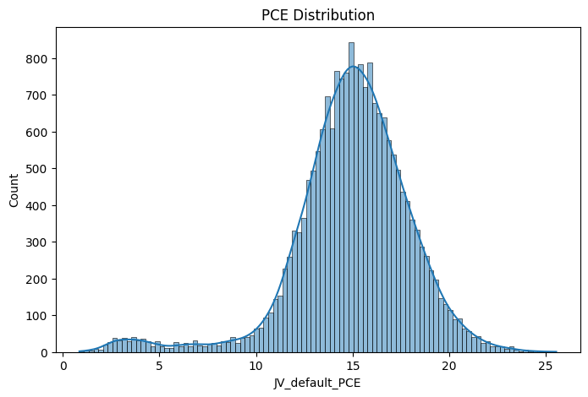
Target: power conversion efficiency
14.95
15.12
mean PCE (%)
median PCE (%)
3.05
0.86–25.54
standard deviation
observed range (%)
A small low-efficiency cluster (below about 10%) sits apart from the main peak near 15%.
Notes:
PCE is centred near 15% with a long tail up to 25.5%. A small cluster of low-efficiency cells sits below about 10%.

Slide 7
Photovoltaic metrics summary
Metric | Count | Mean | Std | Min | 25% | Median | 75% | Max
Voc (V) | 19,406 | 1.052 | 0.115 | 0.350 | 1.016 | 1.067 | 1.116 | 1.250
Jsc (mA/cm²) | 19,389 | 20.01 | 2.42 | 2.33 | 19.08 | 20.30 | 21.42 | 26.00
FF | 19,393 | 0.703 | 0.048 | 0.500 | 0.670 | 0.700 | 0.740 | 0.860
PCE (%) | 19,588 | 14.95 | 3.05 | 0.86 | 13.49 | 15.12 | 16.80 | 25.54
PCE is centred near 15%
Mean 14.95%, median 15.12%, middle half between 13.49% and 16.80%.
Wide device-to-device range
Voc runs 0.35–1.25 V and Jsc 2.33–26.00 mA/cm².
Fill factor is tight
FF has a standard deviation of only 0.048 around a mean of 0.70.
Notes:
Summary statistics from df.describe(). Voc and Jsc units follow standard convention for this kind of dataset.

Slide 8
Preparing the data for modelling
1
Clean the target
Non-numeric PCE becomes missing; 412 rows dropped; PCE kept within 0–100%.
2
Block leakage
PCE, Voc, Jsc, FF and JV_measured are excluded from the inputs.
3
Engineer features
Layer and additive counts parsed from stack and additive strings (+8).
4
Build the pipeline
Numeric: median impute and scale. Categorical: most-frequent impute and one-hot.
Notes:
Outputs are removed from the inputs so the model cannot see them. Sequence and additive strings are turned into count features.

Slide 9
Five models, one shared pipeline
Model | Type | Settings
Ridge Regression | Linear baseline | alpha = 1.0
Random Forest | Bagged decision trees | 150 trees
Gradient Boosting | Boosted shallow trees | 100 trees, learning rate 0.05, depth 3
Voting Regressor | Average of three models | Ridge + Random Forest + Gradient Boosting
Stacking Regressor | Learned blend of three models | Same base models; Ridge meta-learner; 3-fold
80/20 train–test split (seed 42)
5-fold CV on the training set
Same preprocessing for every model
Notes:
All five models use the same preprocessing. The split is 80/20 with random_state 42, and cross-validation runs on the training portion only.

Slide 10
Ridge baseline sets the bar
0.538
1.585
test R²
test MAE, in PCE points
2.001
0.592 ± 0.020
test RMSE, in PCE points
5-fold CV R² (mean ± std)
The test R² sits about 0.054 below the cross-validation mean.
Notes:
Ridge reaches a test R² of 0.538. The cross-validation mean is higher at 0.592, about 0.054 above the test figure.

Slide 11
5-fold cross-validation results
Model | Mean R² | Std R² | MAE | RMSE
Stacking | 0.5937 | 0.0200 | 1.5556 | 1.9595
Ridge | 0.5921 | 0.0204 | 1.5594 | 1.9633
Voting | 0.5878 | 0.0215 | 1.5672 | 1.9736
Gradient Boosting | 0.5730 | 0.0193 | 1.5958 | 2.0090
Random Forest | 0.5332 | 0.0269 | 1.6674 | 2.0999
Stacking ranks first on RMSE, but Ridge is within 0.004.
Notes:
Stacking has the lowest RMSE, but Ridge is within 0.004. Random Forest is clearly behind.

Slide 12
Held-out test: R² by model
+0.0001
Stacking R² over Ridge (0.5380 vs 0.5379)
0.452
Random Forest, the lowest test R²
Notes:
Stacking and Ridge are tied on the test set. Random Forest has the lowest R² at 0.452.

Slide 13
Held-out test: errors and bias
Predicted mean vs actual mean (15.0105%)
Model | Predicted | Diff (pp)
Ridge | 15.0016 | −0.0089
Random Forest | 15.0228 | +0.0124
Gradient Boosting | 15.0029 | −0.0076
Voting | 15.0099 | −0.0006
Stacking | 15.0032 | −0.0073
Every model is unbiased on average: the largest gap is 0.0124 percentage points.
Notes:
Stacking has the lowest MAE and RMSE, but only by a hair. All five models predict the mean PCE almost exactly.

Slide 14
Top drivers of predicted PCE
7.6×
B-site importance vs the next feature (5.29 vs 0.69)
Worth checking
Only 844 of 20,000 cells lack Pb, so this may reflect a small, distinct group.
Notes:
Permutation importance on the test set, measured as the increase in squared error when a column is shuffled. B-site ions dominate. Only 844 of 20,000 cells lack Pb, so this may reflect a small, distinct group.

Slide 15
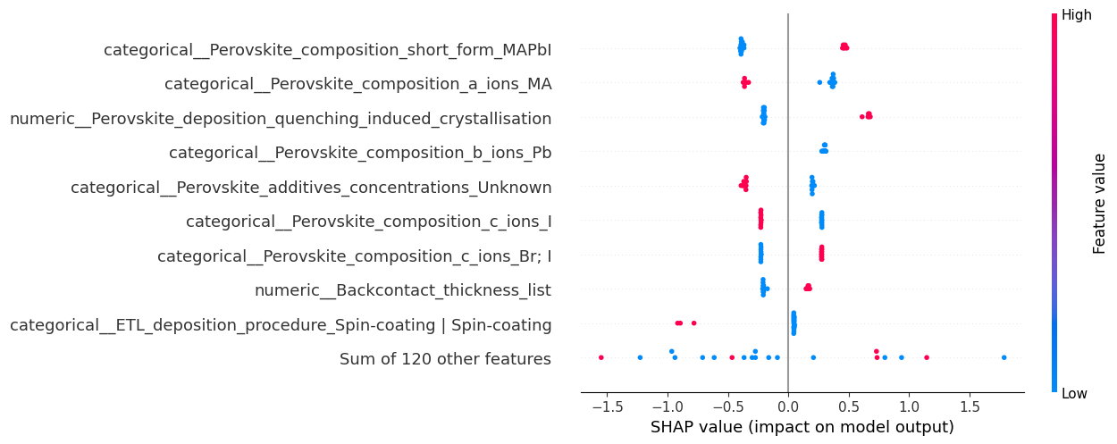
SHAP: direction of each effect
Quenching helps
Quenching-induced crystallisation pushes predictions up by about +0.65.
Composition cuts both ways
MAPbI is about +0.45; MA as an A-site ion is about −0.4.
Computed on 20 test samples against a 100-sample background, so read the pattern rather than the exact values.
Spin-coated ETL pulls down
The few samples shown sit near −0.9.
Notes:
Values are read from the beeswarm plot and are approximate. SHAP was run on 20 test samples with a 100-sample background.

Slide 16
Anomaly detection: three methods
Method | Records | Anomalies | Rate
Isolation Forest | 2,000 | 51 | 2.55%
Local Outlier Factor | 2,000 | 0 | 0.00%
One-Class SVM | 2,000 | 103 | 5.15%
The methods disagree
Isolation Forest flags 2.55%, LOF flags none, and One-Class SVM flags 5.15% (its nu = 0.05 setting targets about 5%).
Notes:
A 2,000-record sample of the processed training data was scored by each method. Isolation Forest's 51 flagged records were traced back to the original rows.

Slide 17
Prediction intervals: 90% target
88.62%
observed coverage, 1.4 points under the 90% target
6.42
mean interval width, in PCE points
Notes:
Intervals come from quantile Gradient Boosting models at the 5th and 95th percentiles. Coverage is 88.62% against a 90% target.

Slide 18
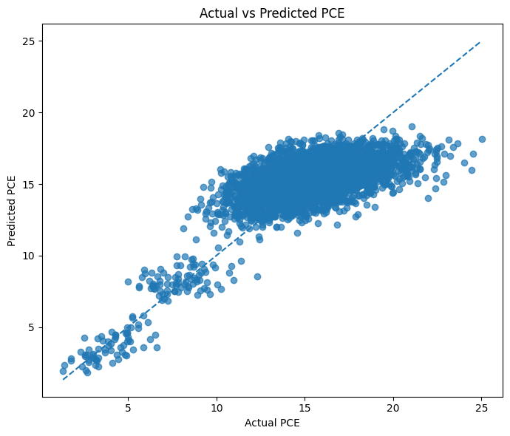
Actual vs predicted PCE
Stacking, held-out test | Value
Test R² | 0.5380
Test MAE | 1.5832
Test RMSE | 2.0005
Interval coverage | 88.62%
Mean interval width | 6.42
Where it works and where it doesn't
Cells below about 10% sit close to the diagonal. Predictions flatten out near 18% even when actual PCE reaches 25%.
Notes:
Low-efficiency cells track the diagonal. Above about 15% the model compresses predictions toward the mean.

Slide 19
Key findings
1
Moderate predictive power
Best test R² is 0.538 with an MAE of about 1.58 PCE points.
2
Model choice matters little
Stacking, Ridge and Voting land within 0.013 R² of each other.
3
Composition dominates
B-site (Pb) ions lead, followed by A-site and C-site ions and quenching.
4
Uncertainty is close to calibrated
88.6% of test values fall inside the interval, against a 90% target.
Notes:
Four takeaways to close on.

Slide 20
Limitations and next steps
Limitations
Suggested next steps
40% of perovskite thickness values are missing.
A test R² of 0.538 leaves about 46% of PCE variance unexplained.
High-efficiency cells are under-predicted.
SHAP was computed on only 20 samples.
Tune hyperparameters; Ridge and Stacking are already tied.
Add numeric material descriptors instead of one-hot labels.
Check the non-Pb cells as their own subset.
Recalibrate the intervals to reach 90% coverage.
Notes:
Limitations come from the notebook outputs. Next steps are suggestions.

