Slide 1

LangGraph for Stateful,
Controllable Agents
A practical developer overview

Slide 2
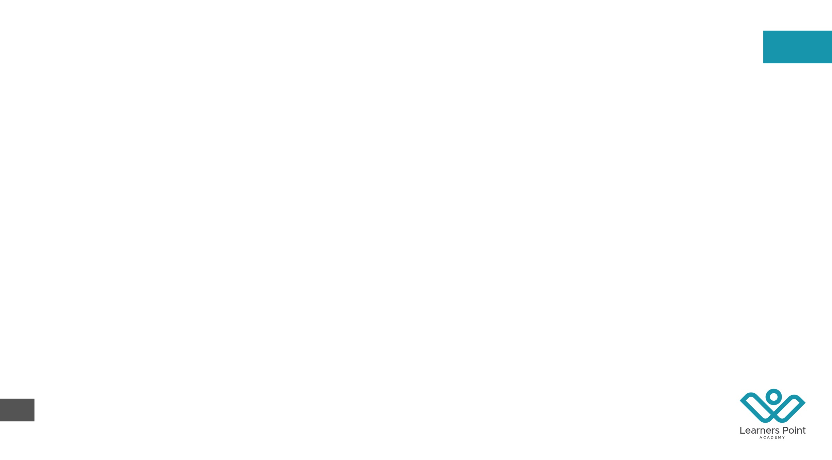
From orchestration basics to production
01 Why LangGraph
02 Graph model
03 Agent loop
04 State design
05 Durable execution
06 Human oversight
07 Memory & composition
08 Production path

Slide 3
LangGraph makes control explicit
LangGraph is a low-level orchestration framework and runtime for long-running, stateful agents. It combines deterministic code with LLM-driven decisions in one explicit graph.
Fine-grained control
Make branching, loops, retries, and tool calls visible in code.
Stateful by design
Carry structured state across steps, threads, pauses, and failures.
Built for operations
Stream progress, interrupt safely, trace behavior, and deploy durable runs.

Slide 4
FOUNDATIONS — GRAPH MODEL
State, nodes, and edges define execution
State — the shared snapshot every step reads and partially updates.
Nodes — plain functions that perform model, tool, or deterministic work.
Reducers — rules that merge concurrent updates to the same state key.
Edges — fixed or conditional routes that select the next node.
START / END — explicit boundaries for entry and completion.
Super-steps — message-passing rounds; independent nodes can run in parallel.

Slide 5
FOUNDATIONS — PRACTICAL LOOP
A tool-calling agent is an explicit loop
Scenario
A user asks a question that may require one or more external tools before a final answer.
1 Model decides
Read message state; answer directly or emit a structured tool call.
2 Tool executes
Run the requested function and append its result to message state.
3 Route or finish
A conditional edge loops to the model or ends when no tool call remains.

Slide 6
FOUNDATIONS — STATE
State design keeps branches correct
Nodes return partial state updates—not hidden mutations. A clear schema and merge rules keep loops, branches, and parallel work predictable.
Typed schema
Use TypedDict, dataclasses, or supported schemas to define shared channels.
MessagesState
Start with the built-in messages channel for conversational agents.
Run context
Pass dependencies and per-run values through context, separate from state.

Slide 7
BUILD — GRAPH API
Compile once; invoke or stream
Build — StateGraph(schema) defines the shared execution contract.
Connect — add_node, add_edge, and conditional edges shape the control flow.
Compile — compile() creates the executable graph and validates structure.
Run — invoke / ainvoke return a result from one input.
Observe — stream / astream expose updates while the graph executes.
Configure — thread_id selects persisted state; context carries run-scoped values.

Slide 8
RUNTIME — DURABLE EXECUTION
Checkpoints make execution durable
Scenario
A tool or network call fails after several expensive model steps have already completed.
Checkpoint
Persist a thread’s state snapshot at graph boundaries with a checkpointer.
Resume
Reinvoke with the same thread_id to continue from saved state instead of restarting.
Recover & inspect
Support fault tolerance, conversation continuity, and time-travel debugging.

Slide 9
RUNTIME — HUMAN-IN-THE-LOOP
Interrupts enable safe approvals
interrupt() pauses inside a node, persists the current graph state, and returns a JSON-serializable request. Resume later with Command and the same thread.
Dynamic control point
Pause anywhere in node logic—and only when the condition requires it.
Structured handoff
Surface proposed actions, context, and approval choices to an external UI.
Persistent cursor
The thread_id identifies the checkpoint to resume, even much later.

Slide 10
RUNTIME — MEMORY
Memory has two distinct scopes
Checkpointer — persists graph-state snapshots for one thread.
Short-term — supports conversation continuity, interrupts, and recovery.
Access — pass thread_id in graph configuration to load the right checkpoint.
Store — persists application-defined data across multiple threads.
Long-term — keeps preferences, facts, shared knowledge, and searchable memories.
Production — Agent Server can manage persistence infrastructure automatically.

Slide 11
COMPOSITION — SUBGRAPHS
Subgraphs scale coordinated systems
Scenario
A complex agent needs specialist reasoning, private state, and independent team ownership.
Isolate
Build a focused graph for each reusable capability or specialist agent.
Map state
Share state keys directly—or wrap the subgraph to transform its input and output.
Compose
Add the compiled subgraph as a parent node and preserve a clear interface boundary.

Slide 12
OPERATE — OBSERVABILITY
Streaming makes behavior observable
Updates / values — emit partial changes or the full state after each step.
Messages — stream model tokens with metadata for responsive interfaces.
Custom events — publish progress from nodes; checkpoints and tasks support debugging.
Traces — record model calls, tools, retrieval, and nested runs end to end.
Threads — group traces into the history of one multi-turn session.
Evaluation — turn traces into datasets; run offline regressions and online monitors.

Slide 13
OPERATE — DEPLOYMENT
Production needs state and queues
Scenario
A team must serve long-running agents through reliable APIs for real-time and background work.
Graphs & assistants
Deploy one or more graph blueprints with task-specific assistant configuration.
Threads & database
Persist state and long-term memory so runs survive pauses and failures.
Runs & task queue
Use Agent Server APIs to manage runs, concurrency, background jobs, and schedules.

Slide 14
DECIDE — FRAMEWORK FIT
Use LangGraph when control matters
LangGraph is deliberately low-level. It earns its complexity when the application needs custom control flow, durable state, or operational intervention.
Best fit
Bespoke loops, branching, approvals, recovery, multi-agent composition, and long runs.
Start higher-level when
A standard model-and-tools loop is enough; use LangChain create_agent first.
Trade-off
More explicit state and routing means more design, tests, and operational ownership.

Slide 15
BUILD — STARTING CHECKLIST
Start with one state and two nodes
Install — use Python 3.10+ and install the current langgraph package.
Model state — begin with MessagesState or a minimal typed schema.
Draw the loop — add only the model, tools, routes, and explicit termination you need.
Compile & test — exercise branches, retries, invalid tools, and termination.
Add durability — attach a checkpointer early and choose a stable thread_id strategy.
Use current v1 APIs — prefer langchain.agents.create_agent over deprecated create_react_agent.

Slide 16
REFERENCE — OFFICIAL SOURCES
Official docs are the source of truth
Overview — docs.langchain.com/oss/python/langgraph/overview
Graph API — docs.langchain.com/oss/python/langgraph/graph-api
Persistence — docs.langchain.com/oss/python/langgraph/persistence
Interrupts — docs.langchain.com/oss/python/langgraph/interrupts
Subgraphs — docs.langchain.com/oss/python/langgraph/use-subgraphs
LangSmith — docs.langchain.com/langsmith/observability • /evaluation

