Slide 1

Prior authorization prediction for prescribed medication
Kunda Venkatesh
Batch 27, INSOFE, Bangalore
September 16,2017

Slide 2
What is Prior Authorization
Prior authorization is a process used by some health insurance companies to determine
if they will cover a prescribed procedure, service, or medication. The process is intended to
act as a safety and cost-saving measure.
There are a number of reasons that insurance providers require prior authorization, including age,
medical necessity, the availability of a generic alternative, or checking for drug interactions.
A failed authorization can result in a requested service being denied, or an insurance company
requiring the patient to go through a separate process known as "step therapy" or "fail first".
Step therapy dictates that a patient must first see unsuccessful results from a medication or
service preferred by the insurance provider, typically considered either more cost effective or safer,
before the insurance company will cover a different service

Slide 3
Existing System
After a physician orders a medical service for a patient, the physicians staff will contact the patient’s
Insurer to determine if they require a prior authorization check to be run. If at all it requires a prior
Authorization check they will initiate the authorization process which may take up to 30 days to approve
A request
As of May 2013, the National Council for Prescription Drug Programs (NCPDP) had adopted a
standardized process for the exchange of electronic prior authentication which reduced the time
taken to 90% when compared to manual prior authentication process.

Slide 4


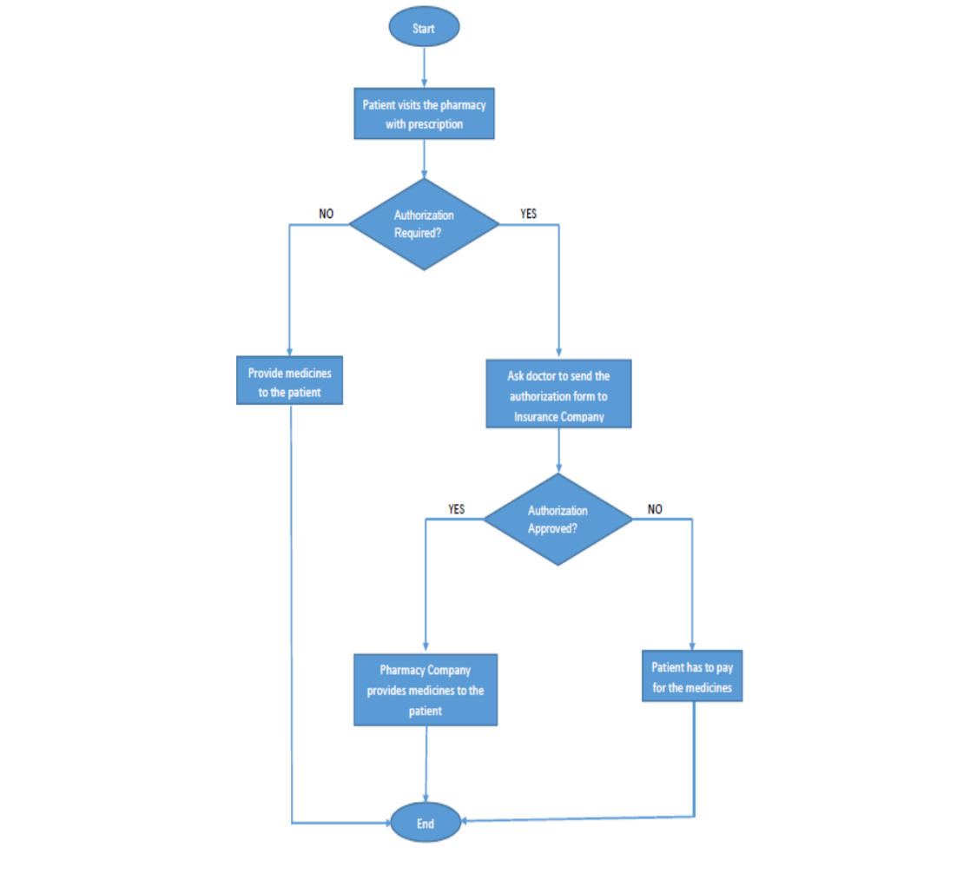



Flow Chart

Slide 5
Purpose
The purpose of this study was to determine whether and under what circumstances prior
authorization(PA) required
To replace labor-intensive administrative procedure results in approval of the PA Which is Time
Consuming through Automation using R
Health plans and health policy analysts are interested in whether or not PA programs affect the
original prescription rate and the actual utilization rate of affected drugs, given the expensive and
administratively intensive nature of these procedures

Slide 6
Goal
To develop an analytics engine for doctors to inform them
whether particular medication will require a prior authorization
or not based on the patients historical transactions
and his/her Insurance Plan

Slide 7
Method
R programming helps to automate the process
Machine Learning techniques are built R used to Solve the Problem
Initially reduce the Levels in the Data
Forming the Groups based on similarity between records
Clustering Technique used to form similar groups
Metric To from Similar groups is Mean Distance (wss)between the records of each type
Fitting the whole data into Mean number of clusters required in order to reduce dimensionality
Challenge is to find the clusters required to fit the data
Tuning the required no of clusters to Fit the data

Slide 8
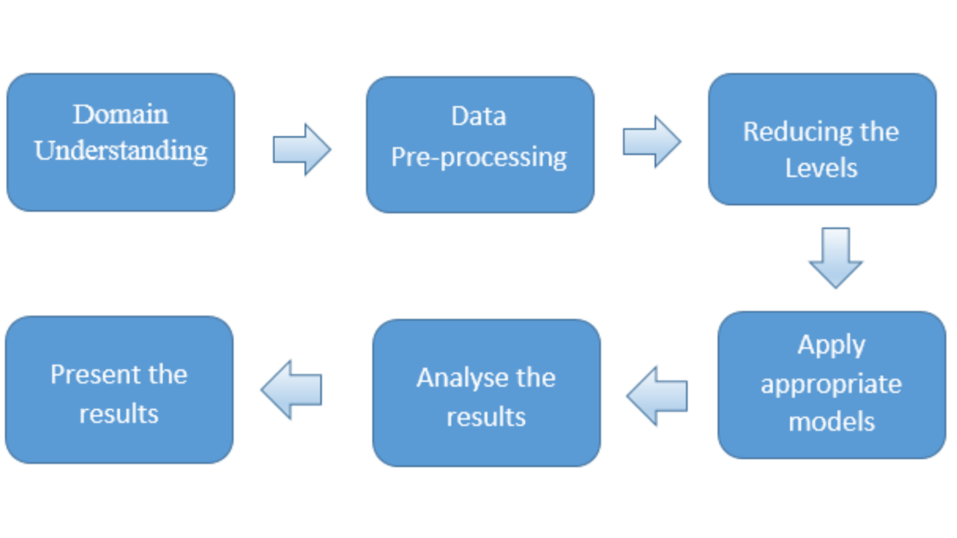
Project Flow

Slide 9
Data
Insurance Companies / Health Care Organizations will receive prescriptions for processing
Prescription Data will be provided by Health Care Organizations / Insurance companies
Client may provide data in any form . In this case data provided in Excel
Tuning the Data to enable it for prediction
Provided Data is Ideal to perform Prediction
New attributes are not required to create
Using the attributes which are static, programmed engine can be leveraged for prediction
If new Attribute is added engine has to be tuned and synched to run prediction

Slide 10
Domain Understanding
Following are the attributes in the Data:
UserID
Drug
DrugSubClass
DrugClass
Drug_Chemical_Name
GPI
NDC
DrugGroup
DoctorID
RXGroupId
Bin
PCN
State
TransDate
Targe

Slide 11
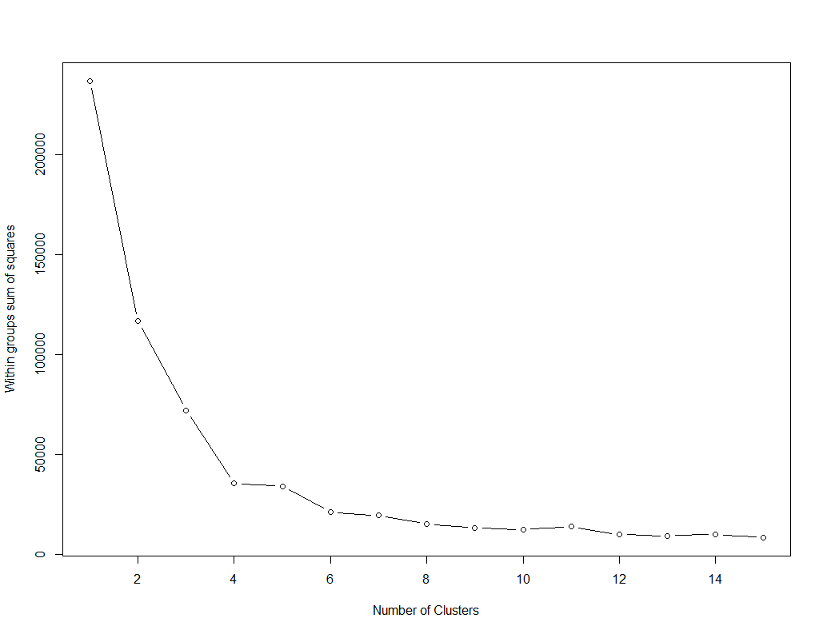
Data Pre Processing
Sample plot
X-axis - No of Clusters
Y-axis – WSS(with in Sum of Squares)
Finding the clusters till where WSS is flat / low which doesn’t impact prediction
Iterating the algorithm to find the Mean no of clusters to fit the data

Slide 12
After Reducing the number of levels
Feature | Before | After
Drug | 742 | 12
DrugSubClass | 310 | 10
DrugClass | 249 | 11
Drug_Chemical_Name | 489 | 10
GPI | 974 | 14
NDC | 1609 | 13
DrugGroup | 77 | 7
Doctor ID | 2468 | 15
RX Group ID | 849 | 10
Bin | 97 | 8
PCN | 196 | 6
State | 47 | 6

Slide 13
Choosing the Performance metric
Recall is the preferred performance metric in this case, because model should not predict as
Authentication not required where actually it required

Slide 14
Model Building
Provided Data is divided in to Training and Testing
Model is built on training and evaluated on Testing
Data provided has Target with Binary type
In this case Classification Algorithm is best for prediction
Using Decision Trees Algorithm to find the possible outcome with the combination of attributes
Generating the rules to find the combinations which are predicting PA either TRUE/FALSE Pertaining to Target Attribute
Generating rules until no division is possible Approach is bit greedy and also having a chance of over fit (risk). To Avoid this Random Forest algorithm is useful
Algorithm will take a tree from the forest and find the prediction
Outcome of the Random Forest Algorithm decide the Authenticity of the Decision tree Algorithm
Naïve Bayes Algorithm is used to find Whether outcome of the new Record PA is TRUE/FALSE

Slide 15
Results
Confusion Matrix
Decision Tree
T/F | FALSE | TRUE
FALSE | 438 | 562
TRUE | 70 | 1748
Random Forest
T/F | FALSE | TRUE
FALSE | 408 | 592
TRUE | 376 | 1442
Naïve Bayes
T/F | FALSE | TRUE
FALSE | 509 | 491
TRUE | 284 | 1534

Slide 16
Metrics
Metric | Model
 | C50 | Random Forest | Naïve Bayes
Accuracy | 77.57275 | 65.494 | 72.49823
Recall | 96.14961 | 79.31793 | 84.37844
Precision | 75.671 | 70.89479 | 75.75309

