Slide 1
Docker Tutorial

Slide 2
What is Virtualization?
Virtualization is the technique of importing a Guest operating system on top of a Host operating system.
Advantages
Multiple operating systems can run on the same machine
Maintenance and Recovery were easy in case of failure conditions
Total cost of ownership was also less due to the reduced need for infrastructure

Slide 3
What is Containerization?
Containerization is the technique of bringing virtualization to the operating system level. While Virtualization brings abstraction to the hardware, Containerization brings abstraction to the operating system.
Advantages
Containers on the same OS kernel are lighter and smaller
Better resource utilization compared to VMs
Boot-up process is short and takes few seconds

Slide 4
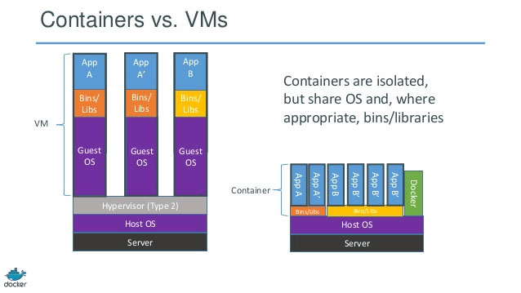
Virtualization vs Containerization

Slide 5
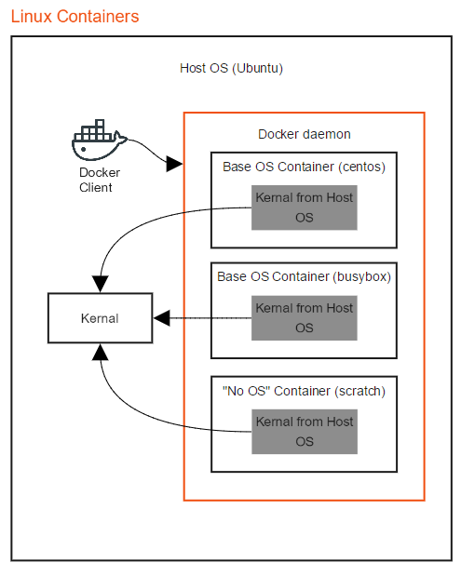
Containerization explained

Slide 6
What is Docker ?
Docker is a containerization platform from which we can build our application, package them along with all dependencies in to a box.

Slide 7
Installation of Docker
CentOS/RHEL
yum install -y yum-utils device-mapper-persistent-data lvm2
yum-config-manager \ --add-repo \ https://download.docker.com/linux/centos/docker-ce.repo
yum install docker-ce
Ubuntu
add-apt-repository \ "deb [arch=amd64] https://download.docker.com/linux/ubuntu \ $(lsb_release -cs) \ stable“
apt-get install docker-ce
Source: https://docs.docker.com/install/linux/docker-ce/ubuntu/#install-docker-ce-1

Slide 8
Test Docker setup
To check docker version
docker --version
To view more information about docker installation
docker info
Test docker installation
docker run hello-world

Slide 9
Behind the scene
Find the image locally, If not found, docker will try to find and pull it from Docker registry to local image store.
Extract the image and create a container accordingly.
Execute the entrypoint defined in the image with commands which are args after the image name.
When the entrypoint process exited, the container then exists.

Slide 10
What is Docker Image and Container
A Docker Image is an executable package that includes everything that is needed to run an application – The code, a runtime, libraries, environment variables and configurations.
A Docker container is a runtime instance of an Image – what the image becomes in memory when executed i.e an image with state or a user process.

Slide 11
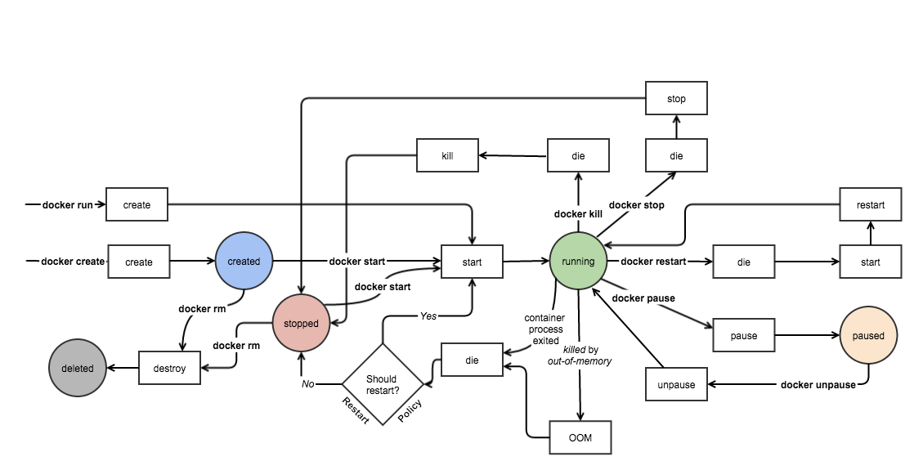
Docker container life cycle

Slide 12
Docker commands

Slide 13
General Usage
Start a container in background
docker run -d jenkins
Start an interactive container
docker run -it ubuntu bash
Export port from a container
docker run -p 80:80 -d nginx
Start a named container
docker run --name mydb redis
Restart a stopped container
docker start mydb
Stop a container
docker stop mydb
Add metadata to container
docker run -d \ label=traefik.backend=jenkins jenkins

Slide 14
Building Images
Build an image from Dockerfile in current directory
docker build --tag myimage .
Manage Containers List running containers
docker ps
Force rebuild of Docker image
docker build --no-cache .
Convert a container to image
docker commit c7337 myimage
Remove all unused images
docker rmi $(docker images \ -q -f "dangling=true"

Slide 15
Manage Containers
List running containers
docker ps
List all containers ( running & stopped )
docker ps –a
Inspect containers metadata
docker inspect c7337
List locally available images
docker images
Delete all stopped containers
docker rm $(doker ps –filter status=exited –q )
List all containers with a specific label
docker ps –filter label=demoproject

Slide 16
Debug commands
Run another process in running container
docker exec -it c7337 bash
Show live logs of running daemon container
docker logs -f c7337
Show exposed ports of a container
docker port c7337

Slide 17
Stateless and Statefull application
Stateless application
e.g: spring boot application, nodejs app
Statefull application
e.g: All databases

Slide 18
Volumes
Create a local volume
docker volume create --name myvol
Mounting a volume on container start
docker run -v myvol:/data redis
Destroy a volume
docker volume rm myvol
List volumes
docker volume ls

Slide 19
Network
Create a local network
docker network create mynet
Attach a container to a network on start
docker run -d --net mynet redis
Connect a running container from a network
docker network connect mynet c7337
Disconnect container to a network
docker network disconnect mynet c7337

Slide 20
What is Dockerfile ?
Dockerfile is a text document that contains all the commands a user could call on the CLI to assemble an image.
Using docker build command users can create an automated build that executed several command-line instructions in succession.
docker build -t {IMAGE_NAME} .

Slide 21
Docker Image vs Layer
Image: A Docker image is built up from a series of read-only layers
Layer: Each layer represents an instruction in the image’s Dockerfile.

Slide 22
Dockerfile instructions
FROM
RUN
CMD
MAINTAINER
LABEL
EXPOSE
ENV
ADD
COPY
ENTRYPOINT
VOLUME
USER
WORKDIR
ONBUILD

Slide 23
Creating docker image from Dockerfile

Slide 24
docker-compose
Docker Compose is a tool for defining and running multi-container Docker applications.
Installation on Linux Env:
curl -L "https://github.com/docker/compose/releases/download/1.23.2/docker-compose-$(uname -s)-$(uname -m)" -o /usr/bin/docker-compose
chmod +x /usr/bin/docker-compose

Slide 25
docker-compose lifecycle
Creating docker multi container environment
docker-compose up
Destroying multi container environment
docker-compose down
Starting multi container environment
docker-compose start
Stopping multi container environment
docker-compose stop
Pausing multi container environment
docker-compose pause
Unpausing multi container environment
docker-compose unpause
To view docker processes
docker-compose ps

Slide 26
Running multiple containers using docker-compose

Slide 27
Questions ?

Slide 28
Thank you

