Slide 1

BitBucket tutorial

Slide 2
Session-1 Version Control Systems

Slide 3
Agenda
☞ Need of Version Control System(VCS)
☞ Understanding of VCS
☞ Types of Version Control Systems
☞ DVCS vs CVCS

Slide 4
Need of Version Control System(VCS)
☞ For working by yourself.
Gives you a “time machine” for going back to earlier versions.
Gives you great support for different versions(standalone, webapp) of same basic project.
☞ For working with others.
Greatly simplifies concurrent work, merging changes.

Slide 5
Understanding of VCS
☞ Version control is a system that records changes to a file or set of files over time so that you can recall specific versions later.
☞ It allows you to revert files back to a previous state, revert the entire project back to a previous state, compare changes over time, see who last modified something that might be causing a problem, who introduced an issue and when, and more. Using a VCS also generally means that if you screw things up or lose files, you can easily recover.

Slide 6
Types of Version Control Systems
Centralized Version Control Systems
e.g: SVN and Perforce
Distributed Version Control Systems
e.g: Git and Mercurial

Slide 7
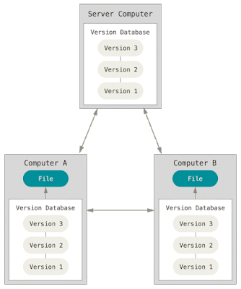
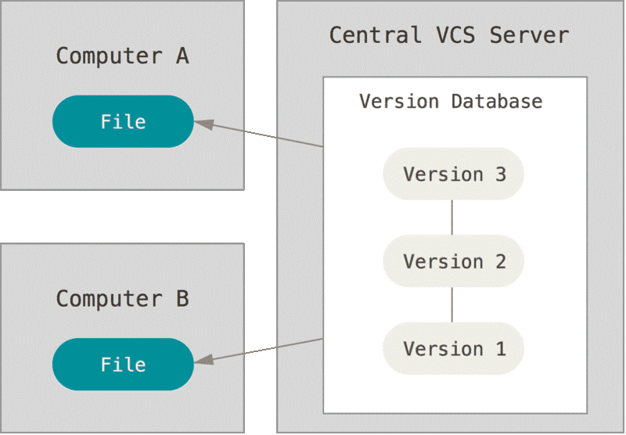
DVCS vs CVCS
Distributed Version Control System
Central Version Control System

Slide 8
Session -2 Introduction to Git

Slide 9
Agenda
What is Git ?
Installation of Git
Git advantages
Git Architecture
Git Commands
Git realtime

Slide 10

What is Git ?
Git is an open source program for tracking changes in files.
It implements a replicated version control system.

Slide 11
Git Advantages
Resilience
No one repository has more data than any other
Speed
Very fast operations compared to other VCS (I’m looking at you CVS and Subversion)
Space
Compression can be done across repository not just per file
Minimizes local size as well as push/pull data transfers
Simplicity
Object model is very simple
Large userbase with robust tools

Slide 12
Git Architecture
Index
Stores information about current working directory and changes made to it
Object Database
Blobs (files)
Stored in .git/objects
Indexed by unique hash
All files are stored as blobs
Trees (directories)
Commits
One object for every commit
Contains hash of parent, name of author, time of commit, and hash of the current tree
Tags

Slide 13
Git Commands
Setup and branch management
init, checkout, branch
Modify
add, delete, rename, commit
Get information
status, diff, log
Create reference points
tag, branch

Slide 14
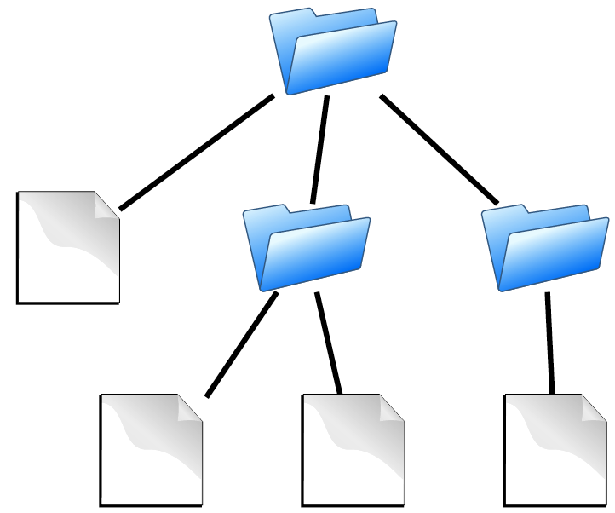
Sample Source Code structure
contains
Directories
Files

Slide 15
Basic Operations in Git
Repository (.git directory)
Index (staging area)
Working directory
checkout the project
add (stage) files
commit

Slide 16
Our First Git repo
mkdir first-git-repo && cd first-git-repo
git init
Creates the basic artifacts in the .git directory
echo “Hello World” > hello.txt
git add .
Adds content to the index
Index reflects the working version
Must be run prior to a commit
git commit -a -m “check in number one”

Slide 17
Key Git Files/Directories
~/.gitconfig
.git
In top level of repository
Contains all objects, commits, configuration, for project
.git/config has project specific configurations
.gitignore
Stored in directory for ignoring

Slide 18
Working With Git
echo “I love Git” >> hello.txt
git diff
Shows changes we have made
git status
Shows list of modified files
git add hello.txt
git diff
No changes shown as diff compares to the index
git diff HEAD
Now can see the changes in working version
git status
git commit -m “Second Commit”

Slide 19
Viewing What Has Changed
git log
Note the hash code for each commit.
git show <OBJECT>
Can use full or shortened hash
git reflog to see all changes that have occurred

Slide 20
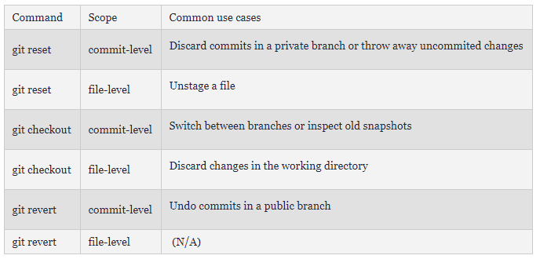
Undoing What is Done

Slide 21
Git and Tagging
Tags are just human readable shortcuts for hashes
Branches can be made from any commit
git tag <tag-name>

Slide 22
Branching
Git branching is lightweight
No massive copying a la CVS/Subversion
Tools for helping merge branches and changes easily
You are ALWAYS on a branch
Branches can be local or remote
Key commands
git branch
git merge
git cherry-pick
Allows you to choose specific commits to apply
You can edit the commits while cherry picking

Slide 23
Using Branches
git checkout -b branch
git checkout -b devel/branch
git branch
Lists all local branches available
We can now make changes in one branch and propagate change using
git merge
git cherry-pick

Slide 24
BitBucket Adminstration

Slide 25
Agenda
Installation of BitBucket
Creating Project
Creating Repos
Creating Users and Groups
Configuring SMTP server
Configuring AD/LDAP with BitBucket

Slide 26
Questions ?

Slide 27
Thank you

