Slide 1
Table of Contents
Architecture
Objects
Container Orchestration
Docker
Training
Introduction

Slide 2
Introduction
The purpose of this document is to provide a high-level overview of Docker and provide training links. After going through this document, you should have a high-level understanding of Docker and it’s key components and functions. The document will describe how PV First utilizes Docker. In addition, the document will cover key topics for Docker even if they are not used in PV First.
The majority of this deck’s content has come directly from Docker documentation.

Slide 3
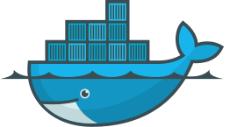
What is Docker
Docker is an open platform for developers and sysadmins to build, ship, and run distributed applications, whether on laptops, data center VMs, or the cloud. It is designed to provide an additional layer of abstraction through operating-system (OS) level virtualization on Windows and Linux platforms.
Docker enables you to separate applications from infrastructure so you can deliver software quickly. With Docker, you can manage your infrastructure in the same ways you manage your applications.
While Docker did not invent containers, it has become the most adopted implementation. LXC (Linux Containers) was the pioneer for containerization.

Slide 4
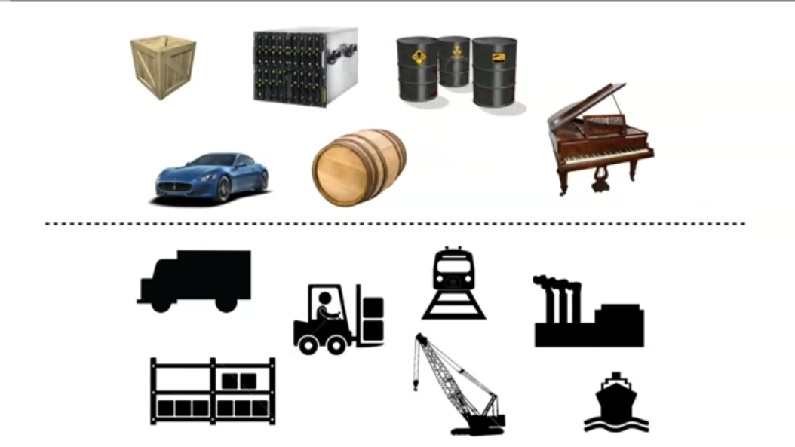
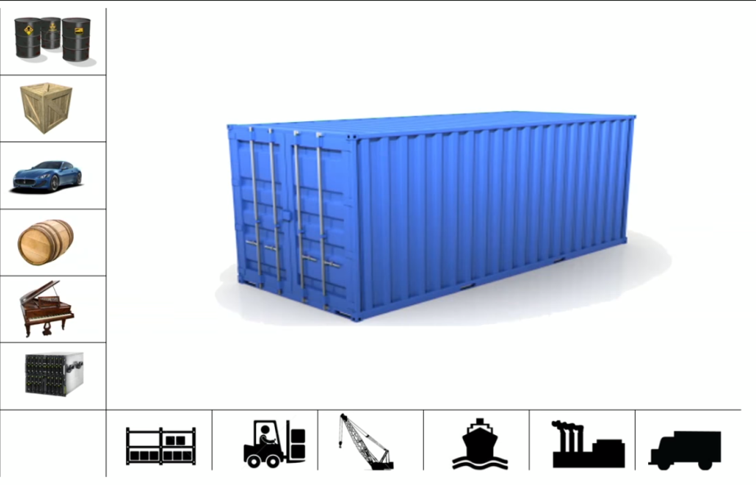
Containerization
Containerization is an OS-level virtualization method which deploys a lightweight, standalone, executable package that includes everything needed to run it: code, runtime, system tools, system libraries and settings/configurations.
Containerized applications will always run the same regardless of the environment since containers are isolated from the physical infrastructure.
Similar to how the standardization of shipping containers lead to efficiencies throughout the shipping and freight industry (e.g. Same container “format” can sit on a ship or be loaded on a trailer and trucked across the country), containerization of an application can achieve the same result.

Slide 5
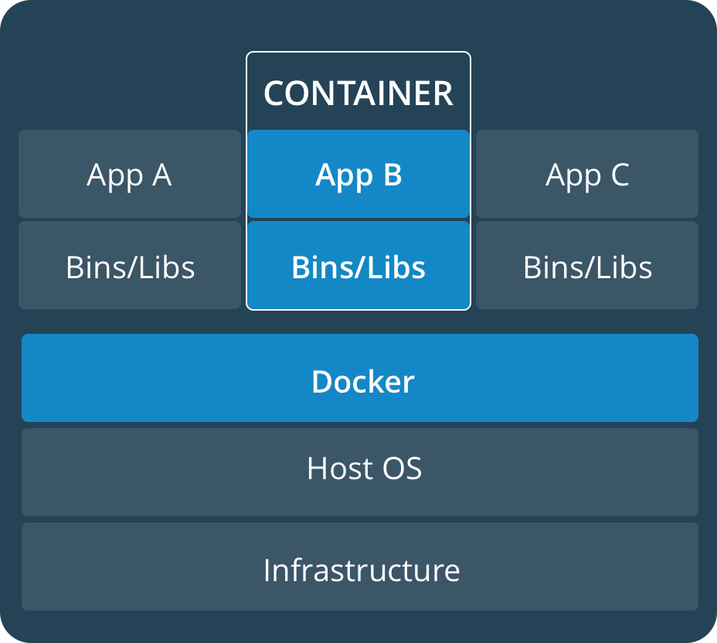
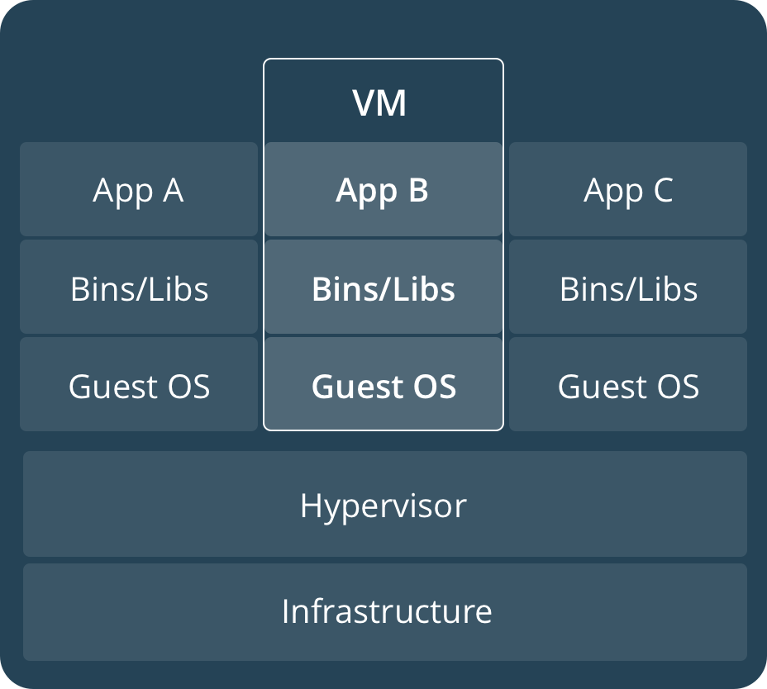
Containers vs Virtual Machines
Containers and virtual machine are similar in that they both provide resource isolation and allocation benefits, but function differently due to how the virtualization occurs.
Multiple containers can run on the same machine and share the OS kernel with other containers, each running as isolated processes in user space. Containers take up less space than VMs (container images are typically tens of MBs in size) and start almost instantly.
Virtual machines (VMs) are an abstraction of physical hardware turning one server into many servers. The hypervisor allows multiple VMs to run on a single machine. Each VM includes a full copy of an operating system, one or more apps, necessary binaries and libraries

Slide 6
Benefits of Docker
Docker provides numerous benefits to both the development and operations of an application platform:
Portability
Scalability
Continuous Integration / Continuous Deployment (CI/CD)
Application deployments can be done in a matter of seconds since the container does not boot an OS.
Isolation
Externalize application configurations and account credentials without exposing them within the stack configuration and limiting the number of rebuild/recompilation required
Containers can be deployed in local machines to test changes
Containers can be scaled on the fly to handle any spikes in workloads
A container running in the cloud on an AWS EC2 instance can easily be migrated to an Azure Virtual Machine or an on-site data center.
Docker containers are abstracted from the underlying infrastructure and can be deployed on any compatible OS (currently Linux & Windows).*
Applications are bundled into a single, portable image that is independent of the host OS.
Containers have their own resources that are isolated from other containers and the underlying OS.
OS-level virtualization allows for various containers to be running with completely different technology stacks.
Docker ensures that each container only uses the resources that have be assigned to them.
*Containerization is OS-virtualization which does not solve portability between Windows and Docker. Windows containers still need a Windows node to run. Docker allows for the same tools to be used to manage applications across OS.

Slide 7
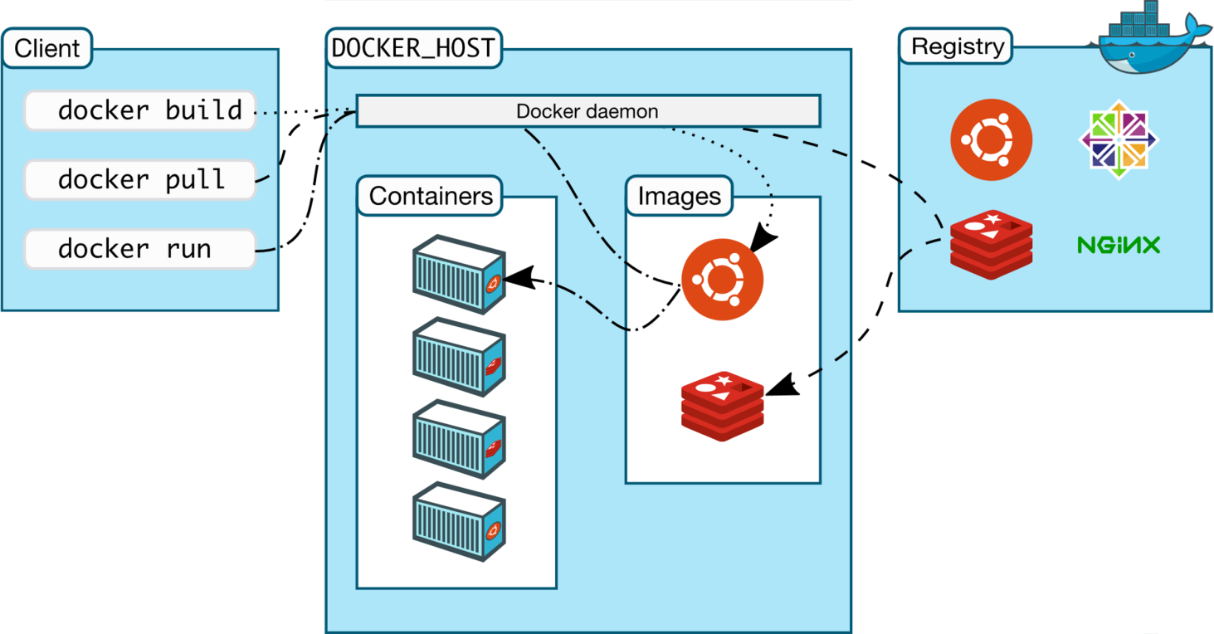
Docker Architecture
Docker uses a client-server architecture and the Docker client and daemon can run on the same system.
The Docker daemon listens for API requests and manages Docker objects such as images, containers, networks, and volumes. A daemon can also communicate with other daemons to manage Docker services.
The Docker client is the primary means for most users to access Docker objects on the Docker host. The Docker commands issued by the user are sent to the Docker daemon to be executed.
A Docker registry is used to store Docker objects, in particular Docker images. Docker Hub and Docker Cloud are public registries offered by Docker, but you can run your own private registry (ex. AWS Elastic Container Registry (ECR) or Nexus). By default, Docker will look for images within Docker Hub.

Slide 8
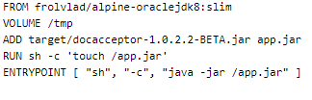
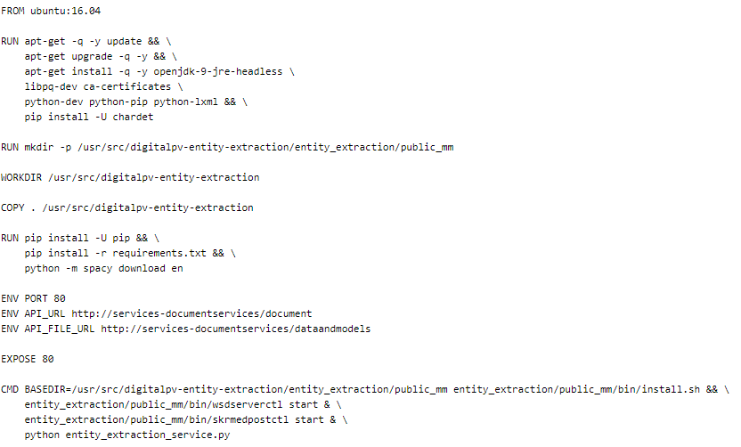

Docker Images
Docker builds images based on the contents specified in a template (Dockerfile). A container is an instance of that Docker image. More often than not, a Docker image is based on another image with some additional configurations. An image will require a base OS and then is customized to fit the needs of the application.
Below is an example of the images for PV First’s entity-extraction, mongoDB and entity-extraction.
Services-DocAcceptor:
PV First utilizes Alpine Linux as the base image for services-docacceptor which contains OracleJDK 8 and then deploys the microservice.
Infra-MongoDB:
PV First utilizes the base image of MongoDB with no additional configurations or application deployments.
Entity-Extraction:
PV First utilizes the base image of Ubuntu and adds several required packages, directories and configurations for the application to function.

Slide 9
Deep Dive into Images
The Dockerfile to create the entity-extraction microservice contains eleven steps to customize and build the image.
Step 1: The base image for this microservice is Ubuntu. The version 16.04 is pulled from the official Ubuntu registry on Dockerhub.
Step 3: The microservice requires a directory to be created that does not exist at the source repository. Therefore, we run the command to make a directory on the image.
Step 2: In order to prepare the image for entity-extraction, several packages need to be installed. Using the default Ubuntu Advanced Package Tool (APT), we run commands to install the required packages into the image.
Step 4: We create the working directory for the image.
Step 5: For the microservice to function, we copy the entire contents of source repository which reside in the current directory on the local machine to the image’s working directory.
Step 6: The application requires that certain Python libraries are installed. In this step, we run the command to install the Python libraries within the image.
Step 10: For the application to be reached, we expose the image on port 80.
Steps 7-9: Environment variables are set within the image.
Step 11: In the final step, we set our base directory and provide the image

Slide 10
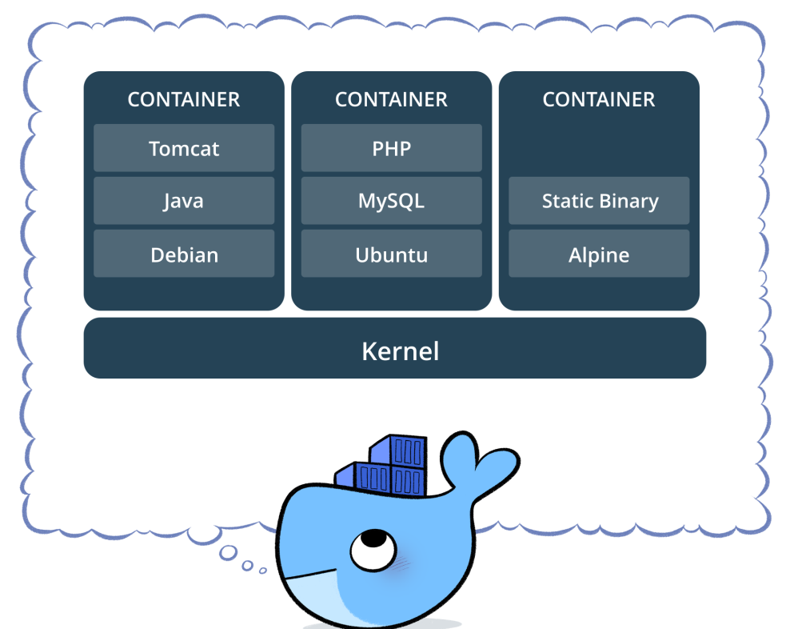
Docker Containers
A container is a runnable instance of a Docker image. These containers can be created, restarted, stopped, moved or deleted through the Docker API or CLI. Containers are defined by its image as well as any configuration options provided upon creation or start. A container and its’ storage are ephemeral in nature and unless configured, the data will not be persisted.
By default, containers are relatively isolated from other containers and the host machine. However, you can control the container’s level of isolation to other containers or the host infrastructure through the container’s network, storage and underlying subsystems.

Slide 11
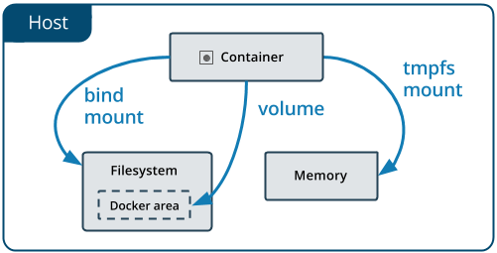
Docker Volumes
Data can be stored within the writable layer of a container. However, data does not persist when the container is no longer running. In order to persist the data and to provide access to the data outside of the container, Docker provides three different types of data mounts:
Volumes:
Volumes are the preferred mechanism for persisting the container’s data and are completely managed by Docker.
Using a volume does not increase the size of containers using it and the contents exist outside the lifecycle of a container.
Bind Mount
When you use a bind mount, a file or directory on the host machine is mounted into a container.
The file or directory is referenced by its full or relative path on the host machine and rely on the host machine’s filesystem having a specific directory structure available.
Tmpfs Mounts
The container’s data is not stored on the host machine or the container’s writeable layer. Once the container is stopped, the tmpfs mount is removed.
The container has access to the data without writing it anywhere permanently which is only stored in the host machine’s memory (or swap).

Slide 12
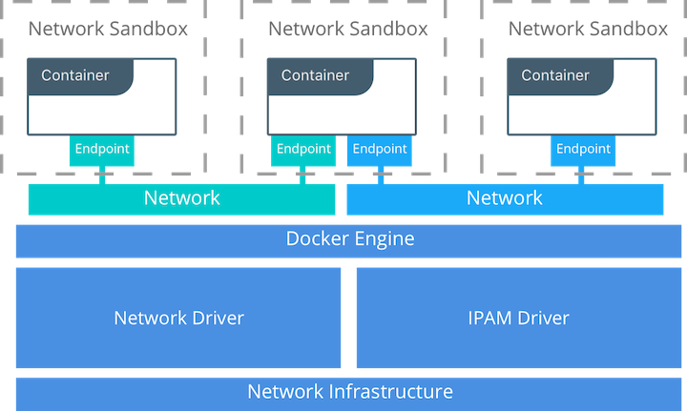
Docker Networking
When Docker is installed, there are three networks created automatically, bridge, host and none.
Bridge Network: The default bridge network is present on all Docker hosts. If you do not specify a different network, new containers are automatically connected to the default bridge network.
Host Network: The host network adds a container on the host’s network stack. As far as the network is concerned, there is no isolation between the host machine and the container.
None Network: The none network adds a container to a container-specific network stack. That container lacks a network interface.

Slide 13
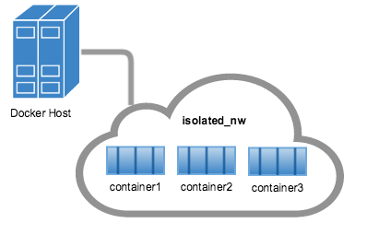
Deep Dive into Bridge Networking
Containers connected to the default bridge network can communicate with each other by IP address. Docker does not support automatic service discovery on the default bridge network. If you want containers to be able to resolve IP addresses by container name, you should use user-defined networks instead.
The containers you launch into this network must reside on the same Docker host. Each container in the network can immediately communicate with other containers in the network. Though, the network itself isolates the containers from external networks.

Slide 14
Development Best Practices
Docker can build images automatically by reading the instructions from a Dockerfile, a text file that contains all the commands, in order, needed to build a given image. Dockerfiles adhere to a specific format and use a specific set of instructions. Below covers the best practices and methods recommended by Docker, Inc. and the Docker community for building efficient images.
Containers should be ephemeral
A container should be able to be stopped, destroyed and a new one rebuilt with minimal set-up and configuration.
Use multi-stage builds
By using multi-stage builds, the Docker image is comprised of several layers which will only be recreated on an as-needed basis.
Avoid installing unnecessary packages
In order to reduce complexity, dependencies, file sizes and build times, limit the number of extra or unnecessary packages that may be “nice to have”.
Each container should have only one concern
Decoupling an application into microservices which are each an individual container makes horizontal scaling easier
Utilize build caches
As each instruction is examined Docker will look for an existing image in its cache that it can reuse, rather than creating a new (duplicate) image.

Slide 15
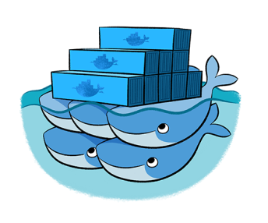
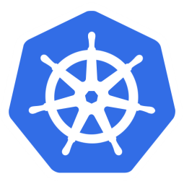
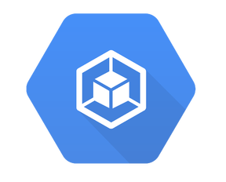
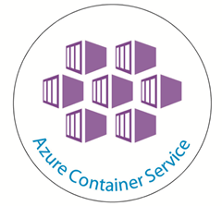
Kubernetes
Container orchestration tools help with the management and operational aspects of complex, multi-container workloads that are deployed on a cluster of machines. Container orchestration helps automate the deployment, scaling and management of containerized applications.
Horizontal Scaling:
Self-healing:
Service Discovery
Automatic Deployment:
Metrics:
Scale the containers on the fly to handle any spikes in workloads
Automatically restart and redeploy containers if they are identified as “unhealthy”
A unique DNS name can be configured which load balances running containers.
Based on resource requirements and availability, containers are deployed to nodes to best balance the application workload
Monitor and gather resource usage and performance metrics
Docker Swarm
Kubernetes
Google GKE
Amazon ECS

Slide 16
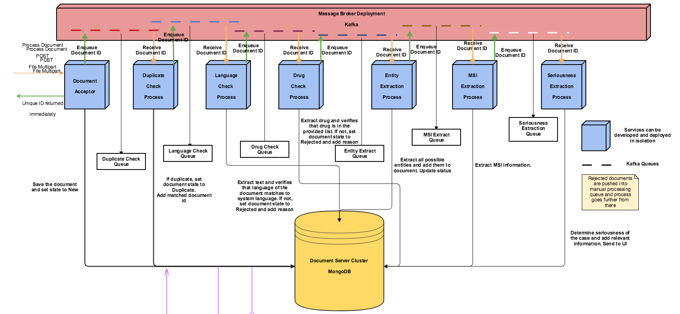
PV First & Docker
The cognitive model is built with light-weight, containerized microservices which provides PV First with flexibility and scalability. The cognitive model can be deployed via Docker containers within a matter of seconds and scaled to meet the file intake workload. PV First utilizes Kafka as a message broker to move through the pipeline.

Slide 17
PV First Operations
PV First utilize Accenture’s DockerHub for an image repository.
PV First utilizes Kubernetes as a container orchestration tool. As such, the DevOps team does not directly interface with Docker. However, the developers have direct access to Docker to check application logs and connect to the individual microservices for troubleshooting.
For more information on Kubernetes, there is a separate deck for Kubernetes & PV First.

Slide 18
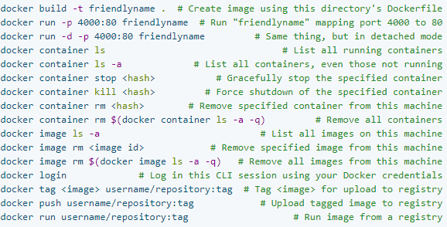
Common Docker Commands
Below are the most common Docker commands:

Slide 19
Docker Troubleshooting
While the container troubleshooting detailed in this deck can be used for PV First, the majority of PV First troubleshooting should occur through the container orchestration, Kubernetes (K8).

Slide 20
Installing Docker
Docker is available in two editions: Community Edition (CE) and Enterprise Edition (EE).
Docker Community Edition (CE) is ideal for developers and small teams looking to get started with Docker and experimenting with container-based apps.
Docker Enterprise Edition (EE) is designed for enterprise development and IT teams who build, ship, and run business critical applications in production at scale.
For more information and specification requirements, please review the official Docker documentation at https://docs.docker.com/engine/installation/.
PV First utilizes Docker CE for CentOS. The Docker logs and relevant data is stored in /var/lib/docker, but the storage location can be configured to meet a client’s requirements. For more information on how PV First installs Docker, review the Jenkins configuration and script used for installation.

Slide 21
Interacting with Docker
The Docker daemon binds to a Unix socket instead of a TCP port. By default, that Unix socket is owned by the user root and other users can only access it using sudo. The docker daemon always runs as the root user.
Instead of using sudo when using the docker commands, PV First has created a Unix group called docker to add approved users to. This group is able to run docker commands without sudo.
To create a docker group and add users:
Create the docker group if it does not already exist
sudo groupadd docker
Add a user to the docker group
sudo usermod –aG docker $USER
Have the user log out and log back in so the user’s group membership is re-evaluated
Verify that the user can run docker commands without sudo

Slide 22
Docker Debug Mode
Docker has a –debug flag which provides a more verbose output for Docker commands.
docker –D [command] [arguments]

Slide 23
Docker Image Troubleshooting
Docker images can be managed through Docker CLI. To view Docker images on the local machine, you can run docker images. The docker child command reference material can be found here.
Common issues related to Docker images include:
Docker image was not created – This is typically related to the Dockerfile
Docker image cannot be pushed/pulled to Docker Registry – This is typically related to the Docker Registry

Slide 24
Image Troubleshooting – Dockerfile
A Dockerfile is a read-only resource that is used as a configuration file for Docker. It contains step-by-step instructions for how to Docker is to build the image. Each line within the Dockerfile correlates to a step within the process. Theses processes are layers of the image which are built by temporary containers. Once the build is successful, the layers are merged into the final Docker image.
Syntax errors and caching problems are the most common issues when it comes to trying to build a Dockerfile. An error at any step within the process will immediately kill the containers. The command to build an image is docker build.
Remember, when it comes to adding additional packages to the Dockerfile, it is abstracted from the underlying infrastructure. In some cases, packages (ex. nano) that are available within the base image (ex. Debian) may not be cached. You may have to cleanup and update sources prior to installing new packages.
Another common issue is available memory. If there is not available memory for Docker to build the containers, then the Dockerfile build will fail.

Slide 25

Image Troubleshooting – Docker Registry
Docker highly encourages the use of a Docker Registry to store Docker images. The registry can either be a public registry (ex. DockerHub) or a private registry (ex. Nexus). The use of the Docker Registry allows for images to be shared across Docker instances. The most common Docker Registry problems are related to authentication and the repository name.
To utilize a Docker repository, you must be logged into the Docker Registry. By default, Docker will authenticate to DockerHub. However, since PV First utilizes Accenture’s DockerHub, users must authenticate directly to the registry. This is done by executing docker login dockerhub.accenture.com. In addition to authentication, PV First images require authorization to be pushed and pulled in DockerHub.
When interacting with DockerHub, the registry and repository must be an exact match. Using PV First’s services-entity-extraction module as an example, the command has to be docker pull dockerhub.accenture.com/ips/pvfirst-services_entityextraction. The repository is case sensitive. For example, using docker push dockerhub.accenture.com/ips/pvfirst-Services-EntityExtraction or docker pull dockerhub.accenture.com/ips/pvfirst-services-entityextraction would cause the command to fail.
To rename an image, the command is docker tag <<TARGET_IMAGE>> <<SOURCE_IMAGE>>.

Slide 26
Image Troubleshooting – Removing an image
Docker images are kept on the local machine until they are removed. These images are used to build containers from the cached image. If the image does not exist on the local machine, then it is pulled from the Docker Registry.
To remove an image from the local machine, run docker rmi <<IMAGE_NAME>>.

Slide 27
Docker Container Troubleshooting
Docker containers can be managed through Docker CLI. To view containers running on the local machine, run docker ps. The docker child command reference material can be found here.
Common issues related to Docker containers include:
Container is not running – This is typically related to the status of container
Container is not functioning as expected – This is typically related to an error within the container
While the container troubleshooting detailed in this deck can be used for PV First, the majority of PV First troubleshooting should occur through the container orchestration, Kubernetes (K8).

Slide 28
Container Troubleshooting – Status
A container can have one of the following statuses:
Created
Restarting
Running
Removing
Paused
Exited
Dead
To identify the status of a container, run docker ps which will list the running containers.
To identify the status of all containers, run docker ps –a which will list all containers.

Slide 29
Container Troubleshooting – Application Logs
Each container is designed to run a specific function or process for an application. During the lifecycle of a container, the container’s functionality may fail. This may stop the container from running, but that is not always the case.
In order to see the logs of the container, run docker logs <<CONTAINER_NAME>> which will provide logs for debugging the container’s functionality or process.

Slide 30
Inspecting a Container
Docker inspect is a great tool which returns information about the Docker resource. The command docker inspect <<RESOURCE>> where <<RESOURCE>> could be a container or image.
Docker inspect provides a lot of information that can help identify the root cause of an issue. Key values include:
Path to log history files
Current state of the container
Values of set environment variables
Mapped ports
Volume mounts
Network configurations

Slide 31
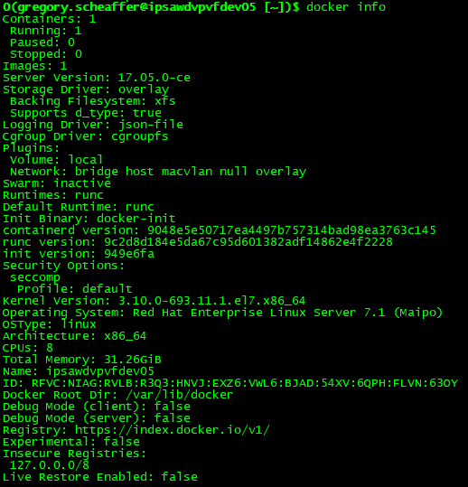
Docker Management
System-wide information regarding the Docker installation can be found by running docker info

Slide 32
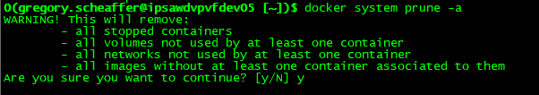
Container Management
Docker containers can be maintained through the Docker CLI. The main commands for container management are:
Start
Stop
Restart
Pause
Kill
A handy cheat sheet on how to clean up the Docker system can be found here. It is a quick reference to commands that are useful for freeing up disk space
A quick way to clean up all dangling resources is docker prune. A dangling resource is a resource that is not associated with a container.
docker system prune will remove all images, containers, volumes and networks that are not associated with a container.
Prune can also be used for individual resources by executing docker <<RESOURCE>> prune where <<RESOURCE>> is the requested resource such as image for example (docker image prune).

Slide 33
Copying between a container and local filesystem
Often times there are files or folders that need to be copied between a container and the local machine, or the reverse. This is achieved by docker cp <<SRC_PATH>> <<DEST_PATH>>.

Slide 34
Training
For a deeper dive into Docker, please feel free to use the following links:
Official Docker Trainings:
Develop with Docker Labs
Dockerfile Best Practices
Build an image from a Dockerfile
Use multistage builds to keep your images lean
Manage application data using volumes
Docker for Java Developers
Port a node.js app to Docker
Docker Labs
Docker CE Installation for Ubuntu
Docker Manuals
Docker Reference Documentation
Docker Samples
Accenture Docker Trainings:
Docker - Various MyLearning
Docker - Learning Boards

