Slide 1
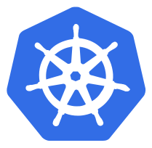
Kubernetes Tutorial

Slide 2
Kubernetes Tutorial
Day-1) Kubernetes Introduction
a) Introduction
b) Kubernetes Architecture
c) Kubernetes Objects
Day-2) Kubernetes scripts examples and real-time scenarios
Day-3) Auto scaling and Roll-Back of app deployments

Slide 3
Agenda
☞ Overview
☞ Kubernetes Introduction
☞ Kubernetes Architecture
☞ Containers
☞ Workloads
☞ Deployment
☞ Networking
☞ Storage
☞ Configuration
☞ Cluster Administration

Slide 4
Introduction
The purpose of this document is to provide a high-level overview of Kubernetes (K8) and provide training links. After going through this document, you should have a high-level understanding of Kubernetes and it’s key components and functions. The document will describe how PV First utilizes Kubernetes. In addition, the document will cover key topics for Kubernetes even if they are not used in PV First.
The majority of this deck’s content has come directly from Kubernetes documentation.

Slide 5
What is Kubernetes (K8s)
Kubernetes is a container orchestration tool designed to help automate the deployment, scaling and management of containerized applications. Containers are grouped into logical units for easy management and discovery. Since Kubernetes is open source, the solution can be implemented on-premises or in the cloud (hybrid, public or private).

Slide 6
Why Kubernetes?
Kubernetes is a production-grade, open-source infrastructure for the deployment, scaling, management, and composition of application containers across clusters of host. It is primarily targeted at applications composed of multiple containers. It therefore groups containers using pods and labels into tightly coupled and loosely coupled formations for easy management and discovery.

Slide 7
Benefits of Kubernetes (K8s)
Kubernetes provides a container-centric management environment. It orchestrates computing, networking, and storage infrastructure on behalf of user workloads. This provides much of the simplicity of Platform as a Service (PaaS) with the flexibility of Infrastructure as a Service (IaaS), and enables portability across infrastructure providers.
Kubernetes provides the following features:
Horizontal Scaling:
Self-healing:
Secret and Configuration Management:
Automatic Deployment:
Metrics:
Scale the containers on the fly to handle any spikes in workloads
Automatically restart and redeploy containers if they are identified as “unhealthy”
Externalize application configurations and account credentials without exposing them within the stack configuration and limiting the number of rebuild/recompilation required
Based on resource requirements and availability, containers are deployed to nodes to best balance the application workload
Monitor and gather resource usage and performance metrics

Slide 8
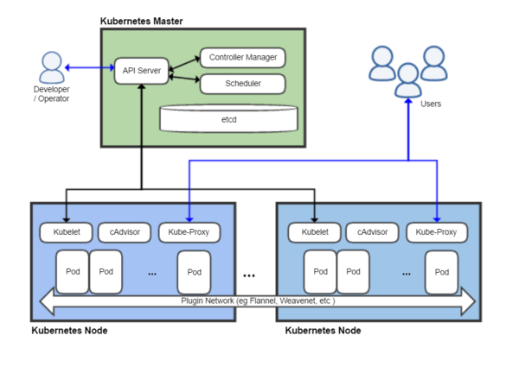
Kubernetes Architecture
A running Kubernetes cluster contains node agents (kubelet) and a cluster control plane (AKA master), with cluster state backed by a distributed storage system (etcd).

Slide 9
API Server
The API server acts as the gateway to the cluster. By definition, the API server must be accessible by clients from outside the cluster whereas the nodes and containers may not be. Clients authenticate the API server and also use it as a bastion and proxy/tunnel to nodes and pods (and services).
Kubernetes cannot function without this basic API machinery, which includes:
REST semantics, watch, durability and consistency guarantees, API versioning, defaulting, and validation
Built-in admission-control semantics, synchronous admission-control hooks, and asynchronous resource initialization
API registration and discovery
It is intended to be a relatively simple server, with most/all business logic implemented in separate components or in plug-ins. It mainly processes REST operations, validates them, and updates the corresponding objects in etcd. All persistent cluster state is stored in an instance of etcd.

Slide 10
Controller Manager
Most other cluster-level functions are currently performed by a separate process, called the Controller Manager. It performs both lifecycle functions (e.g., namespace creation and lifecycle, event garbage collection, terminated-pod garbage collection, cascading-deletion garbage collection, node garbage collection) and API business logic (e.g., scaling of pods controlled by a ReplicaSet).
The application management and composition layer provides self-healing, scaling, application lifecycle management, service discovery, routing, and service binding and provisioning.

Slide 11
Scheduler
Kubernetes enables users to ask a cluster to run a set of containers. The scheduler component automatically chooses hosts to run those containers on.
The scheduler watches for unscheduled pods and binds them to nodes according to the availability of the requested resources, quality of service requirements, affinity and anti-affinity specifications, and other constraints.

Slide 12
Kubelet
The most important and most prominent controller in Kubernetes is kubelet which is the primary implementer of pod and node APIs that drive the container execution layer.
Kubernetes manages isolated application containers. Not only are application containers isolated from each other, but they are also isolated from the hosts on which they reside on. This is critical to decoupling management of individual applications from each other and from management of the underlying cluster’s infrastructure. Kubernetes provides pods that can host multiple containers/storage volumes and decoupling deployment-time concerns from build-time concerns..
API admission control may reject pods or add additional scheduling constraints to them, but kubelet is the final arbiter of what pods can and cannot run on a given node, not the schedulers or DaemonSets.

Slide 13
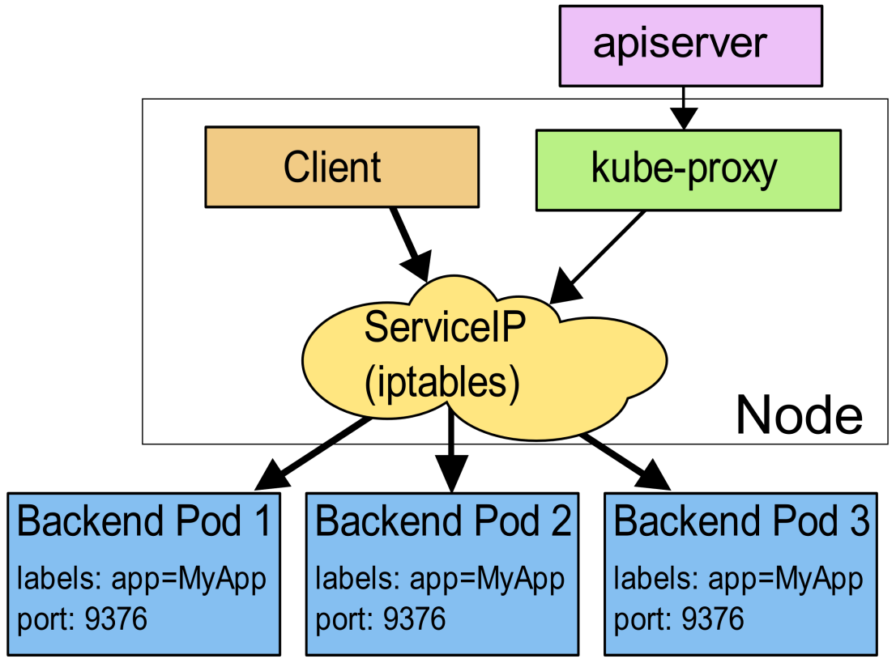
Kube-Proxy
The service abstraction provides a way to group pods under a common access policy (e.g., load-balancer). The implementation of this creates a virtual IP which clients can access and which is transparently proxied to the pods in a Service. Each node runs a kube-proxy process which programs iptables rules to trap access to service IPs and redirect them to the correct backends.
This provides a highly-available load-balancing solution with low performance overhead by balancing client traffic from a node on that same node.

Slide 14
Cluster -> Master Communication
All communication paths from the cluster to the master terminate at the apiserver. In a typical deployment the apiserver is configured to listen for remote connections on a secure HTTPS port (443).
Pods that wish to connect to the apiserver can do so securely by leveraging a service account so that Kubernetes will automatically inject the public root certificate and a valid bearer token into the pod when it is created. Kubernetes services (in all namespaces) are configured with a virtual IP address that is redirected (via kube-proxy) to the HTTPS endpoint on the apiserver.

Slide 15
Master -> Cluster Communication
There are two primary communication paths from the master (apiserver) to the cluster. The first is from the apiserver to the kubelet process which runs on each node in the cluster. The second is from the apiserver to any node, pod, or service through the apiserver’s proxy functionality.
The connections from the apiserver to the kubelet process are used for the usage of kubectl and providing kubelet’s port-forwarding functionality. Kubectl will be covered in more detail later in this deck, but at a high level, kubectl can be used for:
Basic commands (i.e. create, display and delete a resource)
Deploy commands (i.e. rolling updates and scaling)
Cluster management commands (i.e. display cluster info, resource usage and manage the nodes)
Troubleshooting and debugging commands (i.e. fetch logs, describe resources and attach to a resource)

Slide 16
Node Status
Node Condition | Description
OutOfDisk | True if there is insufficient free space on the node for adding new pods False otherwise
Ready | True if the node is healthy and ready to accept pods False if the node is not healthy and not accepting pods Unknown if the node controller has not heard from the node in the last 40 seconds
MemoryPressure | True if pressure exists on the node memory (i.e. memory is low) False otherwise
DiskPressure | True if pressure exists on the disk size (i.e. disk capacity is low) False otherwise
NetworkUnavailable | True if the network for the node is not correctly configured False otherwise
ConfigOK | True if kubelet is correctly configured False otherwise

Slide 17
Network Overview
By design, Kubernetes does not install a networking solution upon creation of the cluster. Kubernetes aims to preserve user choice and flexibility where it is important. This means a third-party CNI-compliant networking solution must be installed by using kubectl apply.
While there are numerous networking solutions given as examples in Kubernetes documentation, the most commonly used seem to be Calico, Flannel and Weave Net. Since PV First utilizes Weave Net, the deck will focus on Weave Net.

Slide 18
Kubernetes Cluster Objects
Containers
Workloads
Configuration
Services, Load Balancing & Networking
Storage

Slide 19
Images
Kubernetes uses images create from the container runtime that is implemented within the cluster. Docker is the container runtime used by PV First and will be used as the example
A Docker image is created and pushed to a registry (DockerHub) before referring to it in a Kubernetes pod.
The default pull policy is IfNotPresent which causes the kubelet to not pull an image if it already exists. To change this, set the imagePullPolicy of the container to Always. While using the :latest tag is alternative option to force an image pull, it has been deprecated and does not follow best practices. The use of :latest makes it difficult to track versions of an image when deployed and limits the ability to roll back.
Private registries may require keys to read images from them. Credentials can be provided in several ways:
https://kubernetes.io/docs/concepts/containers/images/

Slide 20
Container Environment Variables
The Kubernetes container environment provides several important resources to containers:
A filesystem which is a combination of an image and one or more volumes
Information about the container itself
Information about other objects in the cluster
Container Information:
The hostname of a container is the name of the pod in which the container is running.
The pod name and namespace are available as environment variables
User-defined environment variables from pod definitions (i.e. ConfigMap, Secrets) are available
Statically defined environment-variables from the image (i.e. Dockerfile) are available
Cluster Information:
A list of all services that were running when the container was created are available as environment variables
Services have dedicated IP addresses and are available to a container via DNS when the DNS addon is enabled.

Slide 21
Kubernetes Pods
This section provides an overview of a Pod, the smallest deployable object in Kubernetes, which represents a running process within the cluster.
A pod is the combination of an application container (or in some cases, multiple containers), storage resources, a unique network IP, and options on how the container(s) should run. A pod represents a unit of deployment: a single instance of an application in Kubernetes.
There are two main ways that a Kubernetes pod is used within a cluster:
Single Container Pod: The “one-container-per-pod” model is the most common Kubernetes use case. The pod is used as a wrapper around a single container with its’ storage resources, networking and options. Kubernetes manages the pod rather than the container directly.
Multi-Container Pods: A pod might contain an application composed of multiple co-located containers that are tightly coupled and need to share resources. These co-located containers might form a single process or application – one container is serving files from a shared volume to the public, while a separate “sidecar” container refreshes or updates those files. The pod wraps these containers and storage resources together as a single manageable entity.

Slide 22
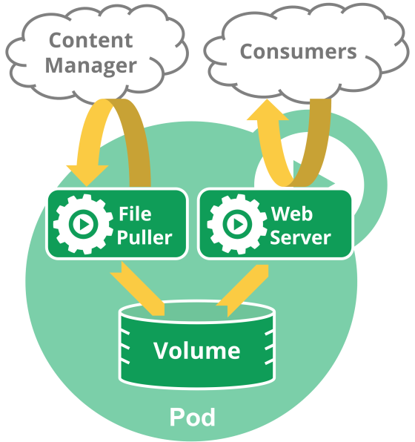
Multi-Container Pods
An example of a multi-container pod contains a container that acts as a web server for files in a shared volume and a separate “sidecar” container that updates those files from a remote source.

Slide 23
Deployment of pod
kubectl create -f https://raw.githubusercontent.com/mhausenblas/kbe/master/specs/pods/pod.yaml
kubectl create -f https://raw.githubusercontent.com/mhausenblas/kbe/master/specs/pods/constraint-pod.yaml

Slide 24
Pod Networking
Each pod is assigned a unique IP address regardless of the number of containers within a pod. Each container within the pod shares the network namespace which includes the IP address and network ports.
Containers within the pod can communicate using localhost. However, processes outside of the pod (i.e. other pods, databases (MongoDB), messaging solutions (Kafka) must communicate through the Services created for the pod.

Slide 25
Pod Storage
A pod can have a storage volumes attached where all containers within the pod have access. This enables the containers within the pod to share data. Volumes allow for data to be persisted beyond the lifespan of the container(s) within the pod.
Volumes will be covered in more detail later within the deck.

Slide 26
Pod Lifecycle
A pod’s status is determined by it’s phase. The phase is a simple, high-level summary of where the pod is in within its lifecycle. The possible values for phase are:
Pending: The pod has been accepted by the Kubernetes system, but one or more of the containers have not been created. This also includes time before being scheduled as well as the time to download images from the container registry.
Running: The pod has been bound to a node, all of the containers have been created and/or at least one container is still running.
Succeeded: All containers in the pod have terminated successfully and will not be restarted.
Failed: All containers within the pod have been terminated, but at least one container has exited with a non-zero status or was terminated by the system.
Unknown: The state of the pod could not be obtained
PodStatus has an array of PodConditions with types such as “PodScheduled”, “Ready”, “Inititiailized” and “Unscheduleable” with a status of “True”, “False” and “Unknown”.
Typically, pods do not disappear until someone destroys them. This might be a human or a controller; however, the exception to the rule is pods with a phase of Succeeded or Failed for a pre-determined duration will expire and be terminated.
A pod has a restartPolicy with possible values Always, OnFailure, and Never. The default value is Always and applies to all containers in the pod. Failed containers that are restarted by the kubelet are restarted with an exponential back-off delay (10s, 20s, 40s …) capped at five minutes, and is reset after ten minutes of successful execution.

Slide 27
Container Probes
A Probe is a diagnostic performed periodically by the kubelet on a Container. To perform a diagnostic, the kubelet calls a Handler implemented by the Container. There are three types of handlers:
ExecAction: Executes a specified command inside the Container. The diagnostic is considered successful if the command exits with a status code of 0
TCPSocketAction: Performs a TCP check against the Container’s IP address on a specified port. The diagnostic is considered successful if the port is open.
HTTPGetAction: Performs an HTTP Get request against the Container’s IP address on a specified port and path. The diagnostic is considered successful if the response has a status code greater than or equal to 200 and less than 400.
The kubelet can optionally perform and react to two kinds of probes on running Containers:
livenessProbe: Indicates whether the Container is running. If the liveness probe fails, the kubelet kills the Container, and the Container is subjected to its restart policy. If a Container does not provide a liveness probe, the default state is Success.
readinessProbe: Indicates whether the Container is ready to service requests. If the readiness probe fails, the endpoints controller removes the Pod’s IP address from the endpoints of all Services that match the Pod. The default state of readiness before the initial delay is Failure. If a Container does not provide a readiness probe, the default state is Success

Slide 28
Pod Disruption
Pods do not disappear until someone (a person or a controller) destroys them or there is an unavoidable hardware/software error. Kubernetes breaks down pod disruptions to two types: involuntary disruptions and voluntary disruptions.
Involuntary Disruptions:
These disruptions are typical conditions that are not specific to Kubernetes
Examples:
Hardware failure on the machine backing the node
Hypervisor failure
Kernel panic
Node disappears from the cluster
Eviction of a pod due to resources
Voluntary Disruptions:
These disruptions include actions initiated by the application owner and a cluster administrator
Examples:
Deleting a deployment or other controller that manages the pod
Updating a deployment’s pod template causing a restart
Directly deleting a pod
Draining a node

Slide 29
ReplicaSet
ReplicaSet is the next-generation ReplicationController which is mainly used by Deployment as a mechanism to orchestrate pod creation, deletion and updates. The only difference between a ReplicaSet and a Replication Controller right now is the selector support. ReplicaSet supports the new set-based selector requirements. Set-based label requirements allow filtering keys according to a set of values. Three kinds of operators are supported: in,notin and exists (only the key identifier).
Note: It is recommended to use Deployments instead of directly using Replica Sets, unless you require custom update orchestration or don’t require updates at all. When you use Deployments you don’t have to worry about managing the ReplicaSets that they create. Deployments own and manage their ReplicaSets.

Slide 30
Deployment of RS
kubectl create -f https://raw.githubusercontent.com/mhausenblas/kbe/master/specs/rcs/rc.yaml
To scale RS
kubectl scale --replicas=3 rc/rcex

Slide 31
Deployment
A Deployment controller provides declarative updates for Pods and ReplicaSets. ReplicaSets and Pods are not managed by the cluster admin, rather than through manipulation of the Deployment object. A desired state is described and the Deployment controller changes the actual state of the deployment to the desired state at a controlled rate.
Common use cases of a Deployment include:
Rollout of a ReplicaSet to create pods
Rollback to a previous version of the pods
Scale pods to facilitate the load

Slide 32
Deployment of Deployment
kubectl create -f https://raw.githubusercontent.com/mhausenblas/kbe/master/specs/deployments/d09.yaml
kubectl apply -f https://raw.githubusercontent.com/mhausenblas/kbe/master/specs/deployments/d10.yaml
kubectl edit deploy/sise-deploy
kubectl rollout history deploy/sise-deploy
kubectl rollout undo deploy/sise-deploy --to-revision=1
kubectl rollout history deploy/sise-deploy

Slide 33
Rolling Back a Deployment
Sometimes a Deployment will need to be rolled back. This could be due to instability, such as a crash loop, or the containers need to be rolled back to a previous version. In order to do this, the following command is run:
kubectl set image deployments <POD_NAME> <CONTAINER_NAME>=<IMAGE_NAME>:<VERSION>
This will implement a rolling update of all pods that are the older version one at a time. At least one instance of the pod will be running until the update is complete. The exact number of instances will be depended on the Desired value defined in the Deployment

Slide 34
Scaling a Deployment
There are two ways of scaling a deployment: manual and auto-scaling.
Manual Scaling:
In order to manually scale a deployment, the following command must be run:
kubectl scale deployment <DEPLOYMENT-NAME> --replicas=10
Auto-Scaling:
An autoscaler can be configured to determine the minimum and maximum number of pods you want to run based on the CPU utilization of your existing pods.

Slide 35
DaemonSet
A DaemonSet ensures that all (or some) nodes have a copy of a pod running. As nodes are added to the cluster, pods are added to them. As nodes are removed from the cluster, those pods are removed. If you delete a DaemonSet, the pods it created will be deleted.
Typical use cases of a DaemonSet are:
Running a cluster storage daemon, such as glusterd, ceph, etc., on each node.
Running a logs collection daemon on every node, such as fluentd or logstash, etc.
Running a node monitoring daemon on every node, such as Prometheus, collectd, etc.
Running a network daemon on every node, such as Weave Net, Kube-Proxy, etc.

Slide 36
Storage
Containers are ephemeral in nature, regardless of container orchestration or runtime. Changes to the file system and file contents are lost when the container crashes. When the container is brought back up, the changes made in the previous container are lost since the container starts with a clean slate. Another common challenge faced with containers is how files are shared between containers.
Kubernetes provides several options on how to combat these challenges through volumes. There are two types of volumes: Volumes and PersistentVolumes.

Slide 37
Volumes
A Kubernetes volume simply a “directory” which is accessible to the containers within a pod. What backs the volume (ex. Azure, AWS, GCP, local, NFS, etc.) and whether there is data initially stored on the volume is entirely determined by the user.
Pods can use any number of them simultaneously. To use a volume, a pod specifies what volumes to provide for the pod and where to mount the volumes on the container.
The lifecycle of a volume is explicitly tied to the pod that is using it. A volume can outlive containers within the pod which will see the data preserved. But when the pod no longer exists, neither does the volume.

Slide 38
PersistentVolumes
PersistentVolume (PV) are a step above Kubernetes Volumes. A PV is a piece of storage in the cluster that has been provisioned by the administration. As the name suggests, the difference between a PV and Volume is its’ lifecycle. A PV has a lifecycle independent of any pod that uses it. If a pod no longer exists, the PV, and it’s data, will still exist.
A PersistentVolumeClaim (PVC) is a request for storage by a user. It is similar to a pod. Pods consume node resources and PVCs consume PV resources. PVCs can request a specific size and access mode for the PV. For example, the PV can only be mounted once read/write or many times read-only.

Slide 39
ConfigMap
ConfigMaps bind configuration files, command-line arguments, environment variables, port numbers, and other configuration artifacts to your Pods' containers and system components at runtime. ConfigMaps allow you to separate your configurations from your Pods and components, which helps keep your workloads portable, makes their configurations easier to change and manage, and prevents hardcoding configuration data to Pod specifications.
ConfigMaps are useful for storing and sharing non-sensitive, unencrypted configuration information. To use sensitive information in your clusters, you must use Secrets.

Slide 40
Secrets
Secrets are designed to hold sensitive information such as credentials, Oauth tokens and ssh keys. The use of Secrets provides greater flexibility and security for this information in comparison to putting it within the pod definition (i.e. YAML) or in a Docker image (i.e. Dockerfile or application.properties).
Built-in Secrets:
Kubernetes automatically creates secrets which contain credentials for accessing the API and it automatically modifies your pods to use this type of secret.
Custom Secrets:
Custom secrets can be created to handle the pod’s use of credentials like a database.
Secrets can be mounted as data volumes or be exposed as environment variables to be used by a container in a pod. They can also be used by other parts of the system, without being directly exposed to the pod. A secret is only sent to a node if a pod on that node requires it. It is not written to disk. It is stored in a tmpfs and does not come to rest on the node. It is deleted once the pod that depends on it is deleted.
There may be secrets for several pods on the same node. However, only the secrets that a pod requests are potentially visible within its containers. Therefore, one Pod does not have access to the secrets of another pod.

Slide 41
Service
A Service is a policy that defines how a pod is accessed. The pod, or set of pods, that are targeted by a Service is typically defined by a Label Selector. The value of the Label Selector is matched to a label that is within a pod’s definition.
Each Service is assigned a unique IP address (also called clusterIP). This address is tied to the lifespan of the Service. It will not change while the Service is alive. Pods can be configured to talk to the Service and the communication to the Service will be automatically load-balanced out to one pod that is a member of the Service through endpoints. Each pod will be given an endpoint and the endpoint is automatically removed and disassociated from the Service when the pod dies. New pods with the matching selector will have their endpoints get automatically added.

Slide 42
Questions ?

Slide 43
Thank you

