Slide 1
Smart Waste Monitoring And Management System For City
T.M.venkatesh
L.Pragalbha
Vishnuvardhan N V
S.Srinivasan

Slide 2
OBJECTIVE
We were inspired by Narendera Modi’s SWACCH BHARAT campaign to make India clean, so we have come up with an objective to establish smart management and monitoring system of waste.
This project would provide a much more enhanced waste management solution for the optimization of conventional waste collection system.
This reduces the contamination of waste due to time consumption and complex traditional system which are toxic in nature.

Slide 3
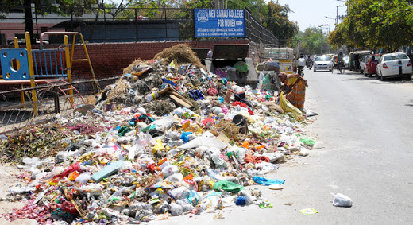

OBJECTIVE(Cont.)

Slide 4
PURPOSE
To make the environment clean by avoiding the overflow of dustbins.
To implement intelligent positioning of dustbins.
To provide dynamic routing for corporation trucks.

Slide 5
SCOPE
Many smart systems have been introduced to provide information of various things efficiently by establishing communication between everything which is termed as IOT(internet of things).
It will be very useful for a country like India which is highly populated , congested and is prone to epidemic diseases such as malaria, swine flu.
The outcome of this project will be highly beneficial for the corporation in waste management.

Slide 6
PROBLEM STATEMENT
The day-by-day problems faced by the corporation, is in regular monitoring and management of waste.
The conventional waste collection systems are difficult to maintain since operation and maintenance costs are high.
It is also a burden for the corporation truck drivers to do a periodic check up of fill level of dustbins.
Due to the overflow of waste near the dustbins, people are prone to various diseases.
We believe our project will be a solution in overcoming these problems.

Slide 7
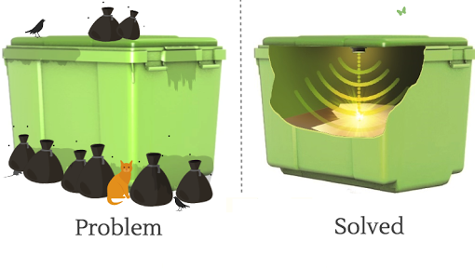
PROBLEM STATEMENT(Cont.)

Slide 8
METHODOLOGY
The main concept behind this project is to provide communication within smart space which comprises dustbins, base station , corporation trucks.
The real time information of capacity of wastes are monitored by keeping a proximity sensor below the lid of the dustbin.
The weight of waste generated are monitored by weight sensors and vacuum space in the dustbin is identified by it which goes undetected by proximity sensor.

Slide 9
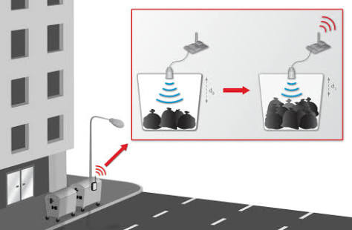
METHODOLOGY(Cont.)

Slide 10
METHODOLOGY(Cont.)
Furthermore, it is also important to determine the position of the dustbin.
The Wi-Fi shield enabled Raspberry pi b+ collects, processes and transmits information about the waste level of dustbin to the base station.
This data provides real time information on fill-level of dustbin whether they are empty or not.

Slide 11
METHODOLOGY(Cont.)
Load Sensor
Internet
Raspberry pi
Proximity sensor
Waste bin management system
Router
Load Sensor
Raspberry pi
Proximity sensor

Slide 12
METHODOLOGY(Cont.)
With the help of recorded GPS coordinates of the dustbin the location of the filled dustbin is identified.
The base station intimates about this information to the truck to collect waste.

Slide 13
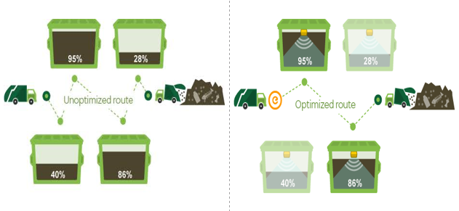
METHODOLOGY(Cont.)

Slide 14
BUDGET
S.NO | COMPONENT | COST | QUANTITY | TOTAL COST
1 | Wifi shield enabled raspberry pi | 6000 | 2 | 12000
2 | Capacitive Proximity sensor | 250 | 2 | 500
3 | Weight sensor | 250 | 2 | 500
 |  |  |  | 13000

Slide 15
REFERENCES
https://fruct.org/publications/fruct15/files/Cat.pdf
http://www.cooking-hacks.com
http://www.adafruit.com
http://www.wikipedia.com

