Slide 1


Sagoserve Data Integration and Reporting
Daily Auction Announcement
Tender
Emp051
Tender Date
Tender Number
Number only
Session Time
It should be populated from Master table COMMODITY
Interval Time
Commodity
Dummy Number From
Number only
Dummy Number To
Number only
Session Number
Number only
In Time
Decimal only
Out Time
Decimal only
On Submit button click, data should be saved in the table.
No redirection required.
Close : Clear the field and redirect to Tender Section home
Page.
View : Grid View with todays data
Bid Rate
Number only
Submit
View
Close

Slide 2

Sagoserve Data Integration and Reporting
Dummy Number Entry
Tender
Emp051
Tender Date
Tender Number
Number only
Commodity
If user entered the LotNo, data should be fetched from table and should be filled in the remaining text boxes.
Dummy Number
Number only
LotNo
Number only
Bags
Auto fill - Read only
Rate
Auto fill - Read only
Bags Type
Auto fill - Read only
Bid Rate
Auto fill - Read only
Outside
Auto fill - Read only
Advance Type
Auto fill - Read only
On Submit button click, data should be saved in the table.
No redirection required.
Close : Clear the field and redirect to Tender Section home
Page.
View : Grid View with todays data
Godown Part
Auto fill - Read only
Submit
Close

Slide 3
Sagoserve Data Integration and Reporting
Top Rate Entry
Tender
Emp051
Tender Date
Tender Number
It should be populated from Master table COMMODITY
Commodity
Dummy Number
LotNo
Bags
Number only
When user enter or click on this field; a popup window should open with Merchant Abbreviation and their name from the master table.
This text field should be filled the value from the user selected merchant from this list-view
Rate
Number only
Merchant Name
On Submit button click, data should be saved in the table.
No redirection required.
Close : Clear the field and redirect to Tender Section home
Page.
View : Grid View with todays data
Submit
Close

Slide 4
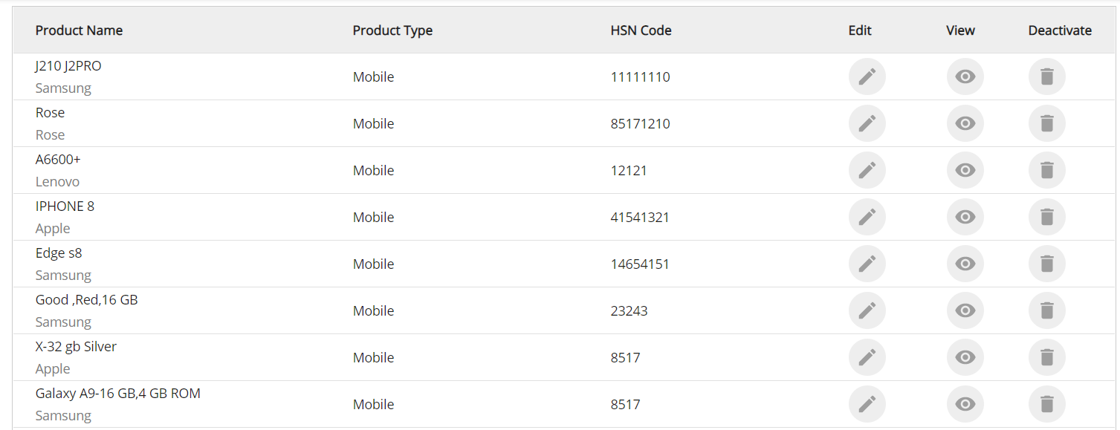
Sagoserve Data Integration and Reporting
Sample View
Tender
Emp051
Close

Slide 5
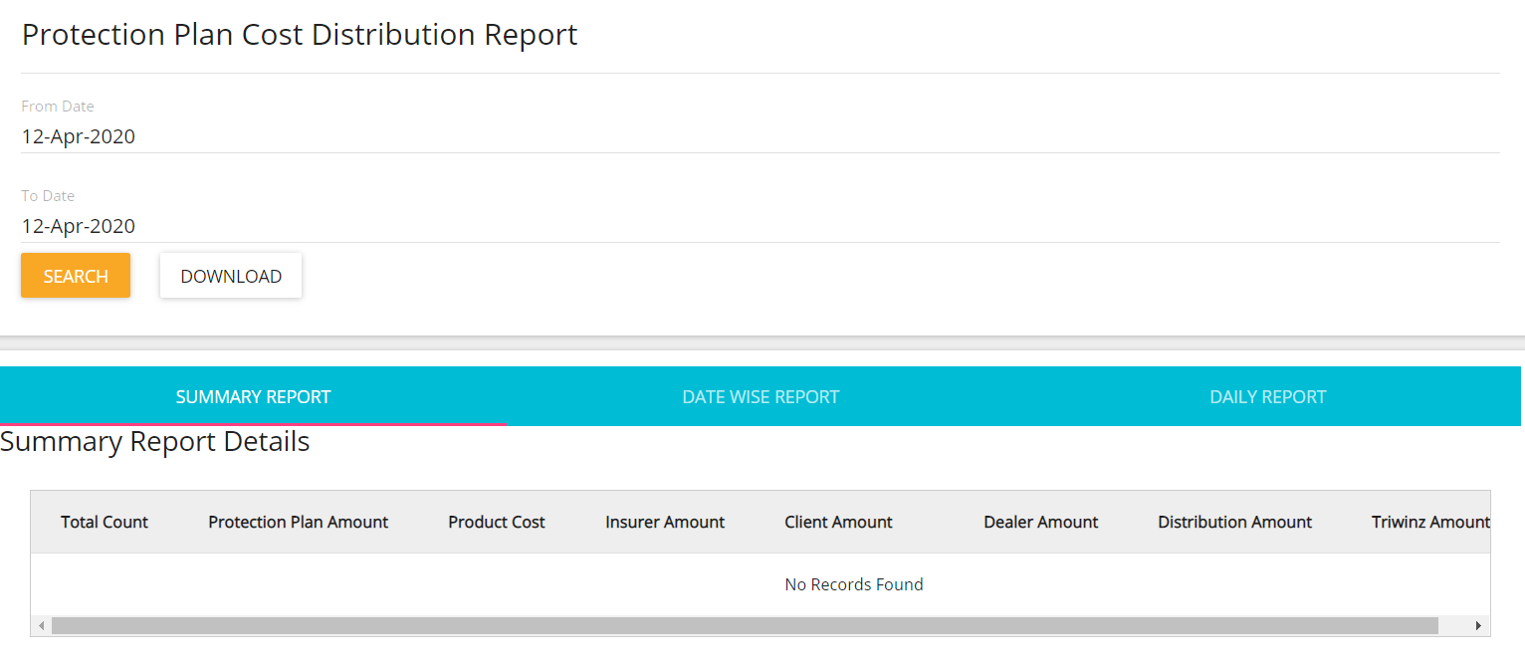
Sagoserve Data Integration and Reporting
Sample Report
Tender
Emp051
Close

