Slide 1
Final Project
Presenter: Venkatesh Prasad Venkataramanan,
Shakeel Ahamed Mansoor Shaikna
10th of June, 2020

Slide 2
Outline
Scene
Demo
Strategy
Development Process
Limitation

Slide 3
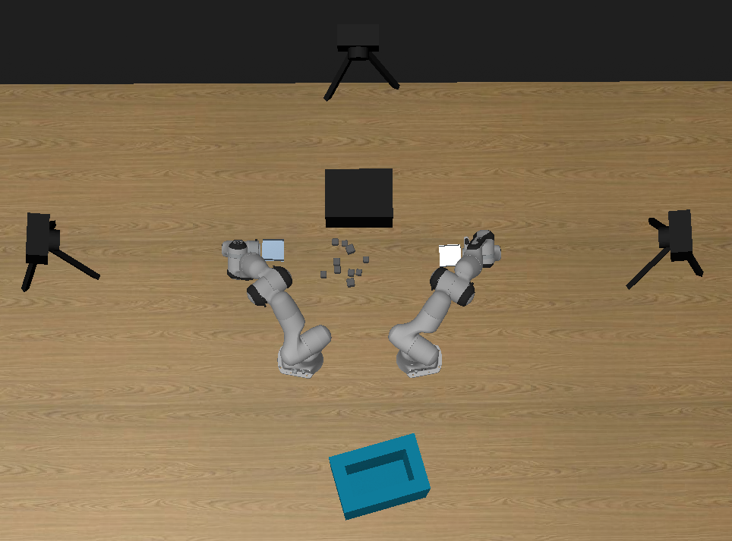
Scene

Slide 4
Demo

Slide 5
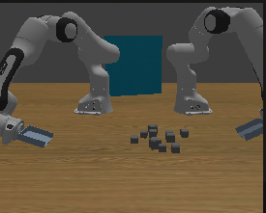
Strategy
Visual Information
Notes:
Front Cam

Slide 6
Strategy
Swoop-in and Pick

Slide 7
Strategy
Tipping the cubes to lower arm

Slide 8
Strategy
Retract

Slide 9
Strategy
Drop

Slide 10
Development Process
Ran the baseline code, which gave very poor results. So then we went about modifying the baseline code.
Used Jacobian based twist calculation from HW-2. Implemented that using the inbuilt internal controller.
This performance was obtained by optimising certain parameters like bin offset, using front camera instead of top camera for deciding when to move to the next scene, etc.
Tried to use our own developed PID controller. Tuned each joint separately.
Notes:
The pick up strategy continued to fail even after a lot of tuning. Hence we developed a hybrid controller which uses a combination of internal and the self-developed PID controller. The PID controller performed really well for sequences where the robots had fixed joint targets, and hence it was employed there, whereas for all other sequences, we continued to use the internal controller. This hybrid controller gave a further boost in the success rate, taking it to 89.09\%.

Slide 11
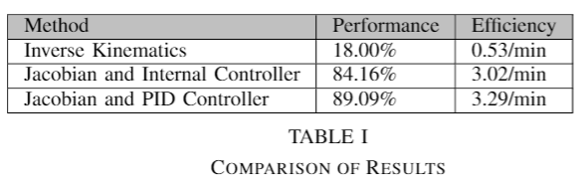
Results and Discussion

Slide 12
Limitation and Future Work
In certain cases, the robots were unable to pick up the cubes, they did not stop trying.
Some cases the robots got stuck trying to move back to the swoop-in position. In those cases, we coded it to move on to the next scene.
Future work might include working on using Machine Learning techniques to improve the performance.
Notes:
For example if the cubes were very small, and the robots were unable to pick them up, they ended up choosing the same box ID every time and failed repeatedly.
--
There is a huge body of literature proving that machine learning can help improve the performance in such repetitive tasks, and so that is something that could definitely be tried on in the future.

Slide 13
Thank You ☺

