Slide 1

Predicting Polycystic Ovary Syndrome Using Machine Learning
Venkatesh Shamala (1031744)
Bhavani Goddindla (1036504)
Komal Satyanarayan Rajput (1037918)
Final Project Presentation
DS 600 – Data Mining
Professor – Sanjeev Thapar

Slide 2
Project Overview
This project leverages advanced machine learning techniques to predict Polycystic Ovary Syndrome (PCOS), aiming to enhance early detection and improve treatment outcomes
Aim of the project:
Use machine learning to predict PCOS to improve early diagnosis and treatment outcomes.

Slide 3
Problem Statement
The project addresses the challenge of early and accurate diagnosis of PCOS through the use of predictive analytics, which involves processing and analysing clinical and physiological data to uncover patterns indicative of the disorder.
The main goals are to develop a model that can:
Accurately identify potential PCOS cases from clinical data.
Support healthcare providers with tools to diagnose PCOS early, improving patient outcomes.

Slide 4
Objectives
Data mining is central to this project, involving:
Data Preparation: Cleaning and preprocessing data to ensure model accuracy.
Exploratory Data Analysis (EDA): Identifying patterns, correlations, and anomalies in the data.
Feature Engineering: Enhancing model effectiveness through the development and selection of predictive features.
Predictive Modelling: Applying and evaluating multiple machine learning models to find the most effective predictor of PCOS.

Slide 5
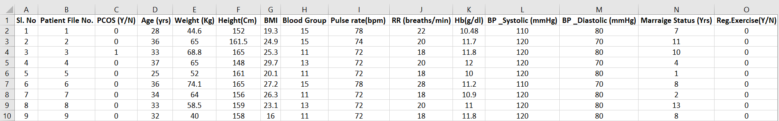
Data Preparation
Data Source: https://www.kaggle.com/code/leylatl/pcos-prediction-randomforest
The dataset consists of clinical measurements from women suspected of having PCOS. It consists of 26000 rows and 44 columns. Preprocessing involved several critical steps
Hormone Levels: Essential for assessing the hormonal imbalances characteristic of PCOS.
BMI (Body Mass Index): An important metric given the relationship between weight and PCOS.
Diastolic Blood Pressure: Reflects vascular health, which may be affected in PCOS cases.
Systolic Blood Pressure: Used to assess the risk of hypertension associated with PCOS.
Follicle Number: A direct indicator of PCOS as it's related to the number of small cysts in the ovaries.
Hair Growth: Hirsutism is indicative of PCOS due to higher levels of androgens.
Skin Darkening: Can indicate insulin resistance, commonly associated with PCOS.

Slide 6
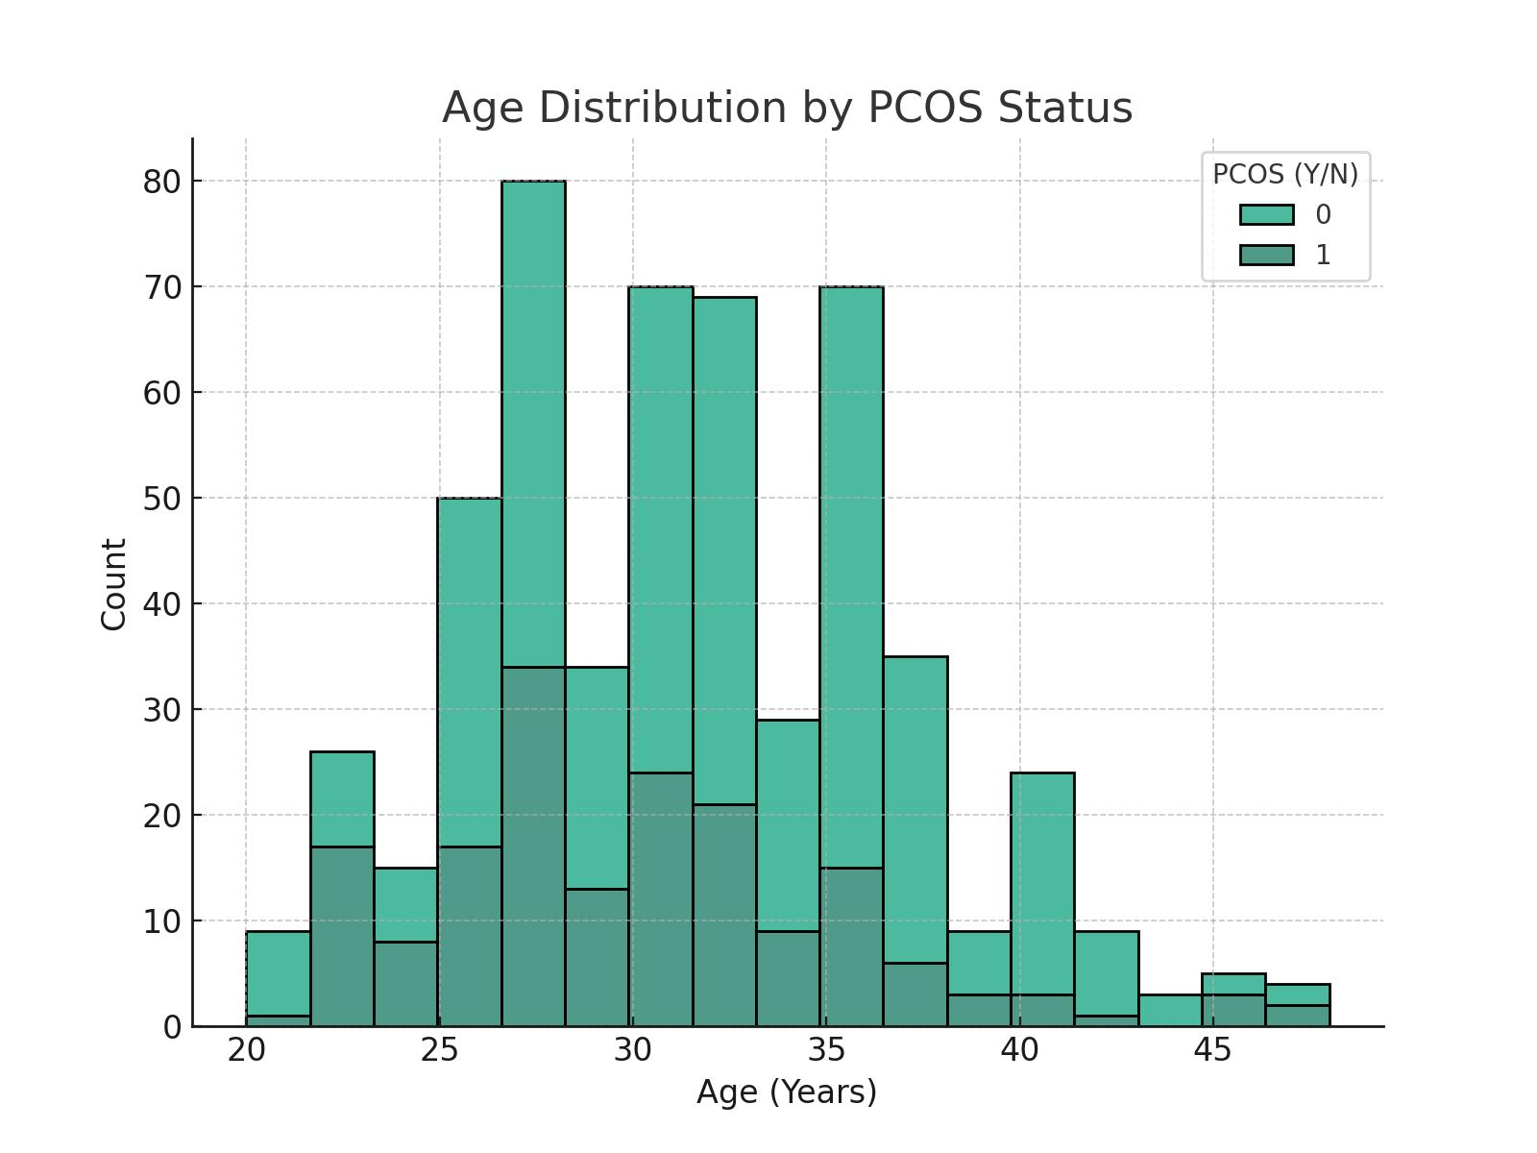
Age vs PCOS status
The distribution shows that PCOS affects a wide range of ages, with a notable number of cases in younger women, suggesting early diagnosis or onset.

Slide 7
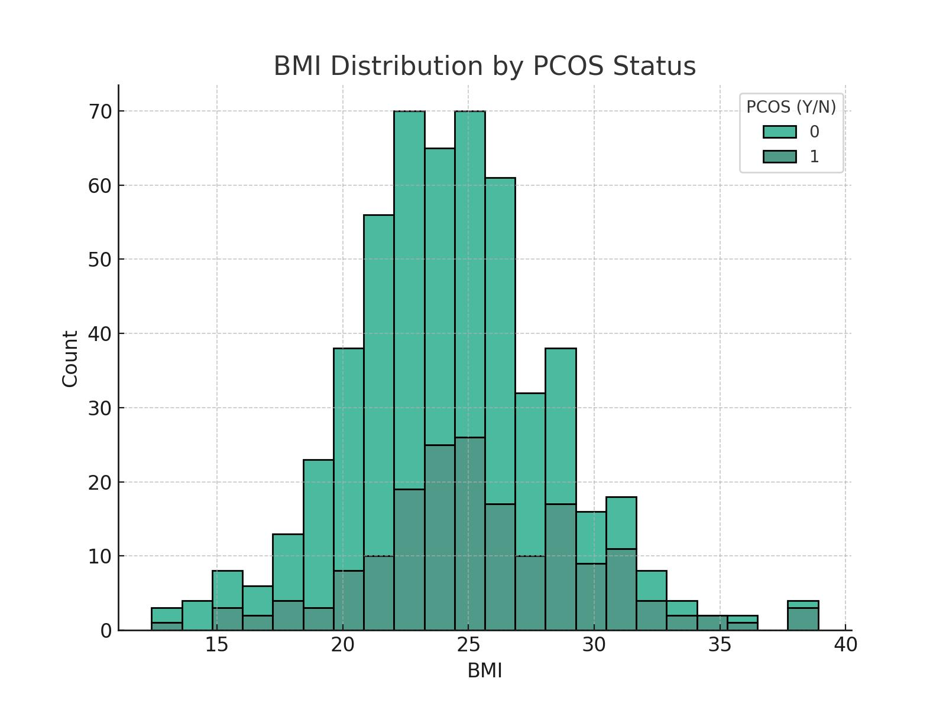
BMI level by PCOS status
PCOS patients appear to have a higher BMI distribution compared to non-PCOS individuals, supporting the link between obesity and PCOS.

Slide 8
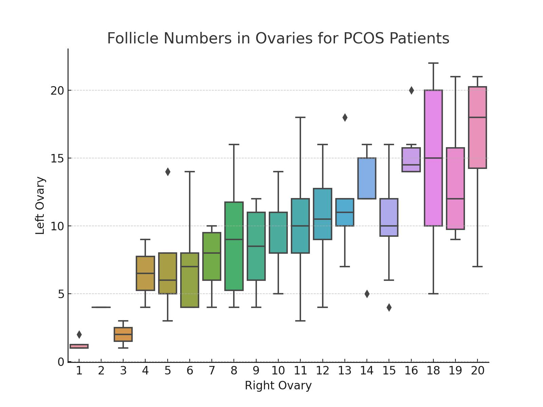
Follicle numbers for PCOS positive patients
There is significant variation in follicle count between the left and right ovaries in PCOS patients, indicating asymmetry in ovarian activity.

Slide 9
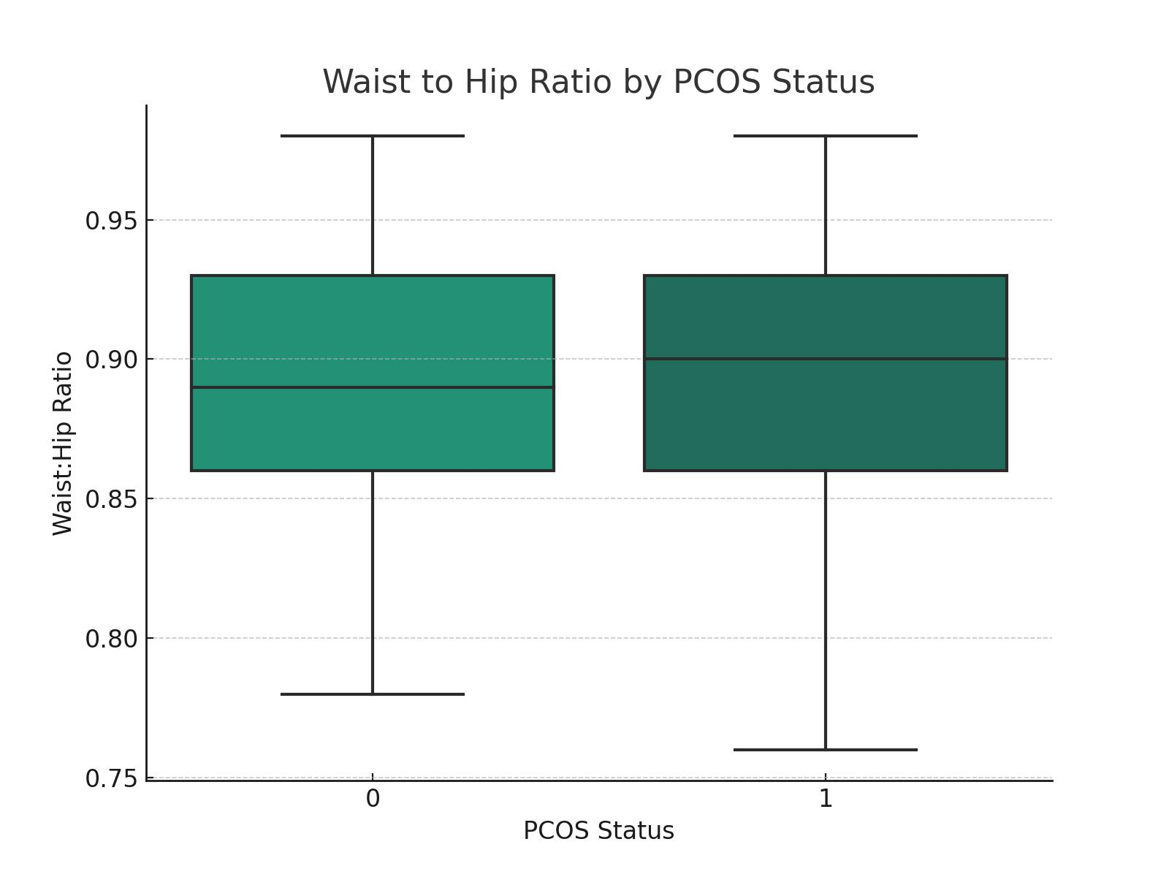
Waist to Hip Ratio by PCOS Status
Patients with PCOS tend to have a higher waist-to-hip ratio, which aligns with the common PCOS symptom of central obesity.

Slide 10
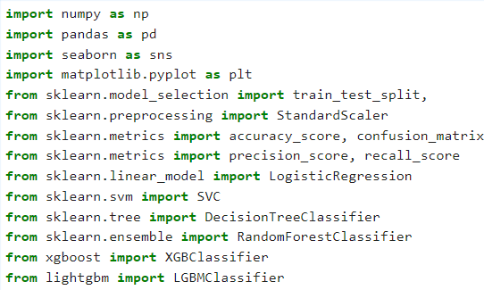
Exploratory Data Analysis
Importing necessary libraries
- Dropping Columns: Columns such as `I_beta_HCG(mIU/mL)` and `II_beta_HCG(mIU/mL)` were dropped due to their high percentage of missing values or irrelevance to the outcome variable, which could skew the model results.
- Handling Missing Data: We used median imputation for skewed distributions and mean imputation for normally distributed variables to address missing values, chosen based on the nature of the data distribution in each column.

Slide 11
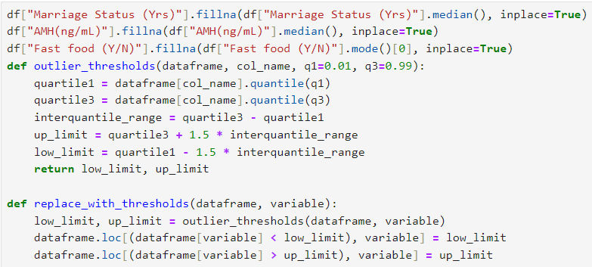
Fixing Outliers
- Outlier Detection and Treatment: Outliers were identified using statistical techniques (e.g., Z-scores, IQR). In cases where outliers could not be reasonably explained, they were replaced with median values to mitigate their impact on the models.
Detecting outlier using interquartile range
Replacing the outliers with lower and upper limits

Slide 12
Feature Engineering and Dataset Splitting
We transformed several categorical variables into numerical formats using encoding techniques to make them suitable for modelling.
The dataset was then split into features (`X`) and the target variable (`y`).
where `y` represents the presence or absence of PCOS.
Splitting Data into Training and Test Sets:
We used `train_test_split` from `scikit-learn`,
Maintaining a test size of 20% which is and stratifying on `y` to ensure both training and test datasets have similar proportions of positive and negative cases.

Slide 13
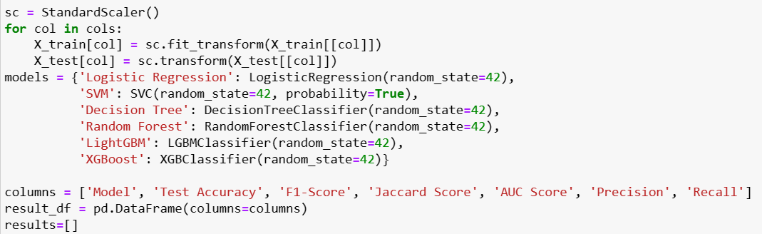
Normalizing
Importance- Ensures all features contribute equally to the model’s predictions.
Method used - Standard Scaling
Standard Scaling: To ensure that all features contribute equally to the model's prediction power, we scaled the data using `StandardScaler`. This normalization ensures that the unit variance and mean zero of each feature prevent models from being biased toward variables with larger scales.

Slide 14
Model selection and training
- Logistic Regression
- Support Vector Machine (SVM)
- Decision Tree
- Random Forest
- LightGBM
- XGBoost
These models were chosen for their diverse approaches to classification, from linear models like Logistic Regression to ensemble methods like Random Forest and boosting methods like XGBoost and LightGBM.

Slide 15
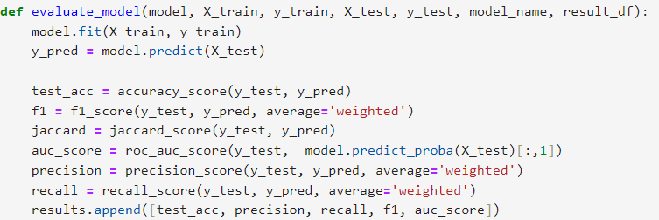
Model Evaluation
Evaluation Metrics included accuracy, F1-score, Jaccard score, ROC-AUC score, precision, and recall. These metrics provide a comprehensive understanding of model performance, considering aspects like the balance between precision and recall, and the model’s ability to distinguish between classes.

Slide 16
Evaluation Metrics
Accuracy: Measures the overall correctness of the model — the ratio of correct predictions to total predictions.
Precision: The proportion of positive identifications that were actually correct, important when the cost of a false positive is high.
Recall (Sensitivity): The proportion of actual positives that were correctly identified, crucial in scenarios were missing a positive is detrimental.
F1-Score: The harmonic mean of precision and recall, useful in uneven class distributions, balancing the trade-offs between precision and recall.
Jaccard Score: Measures the similarity between the predicted labels and the true labels, defined as the size of the intersection divided by the size of the union of the label sets.
ROC Score: Represents the model's ability to discriminate between classes. An area of 1 represents a perfect model, and 0.5 a random guess.

Slide 17
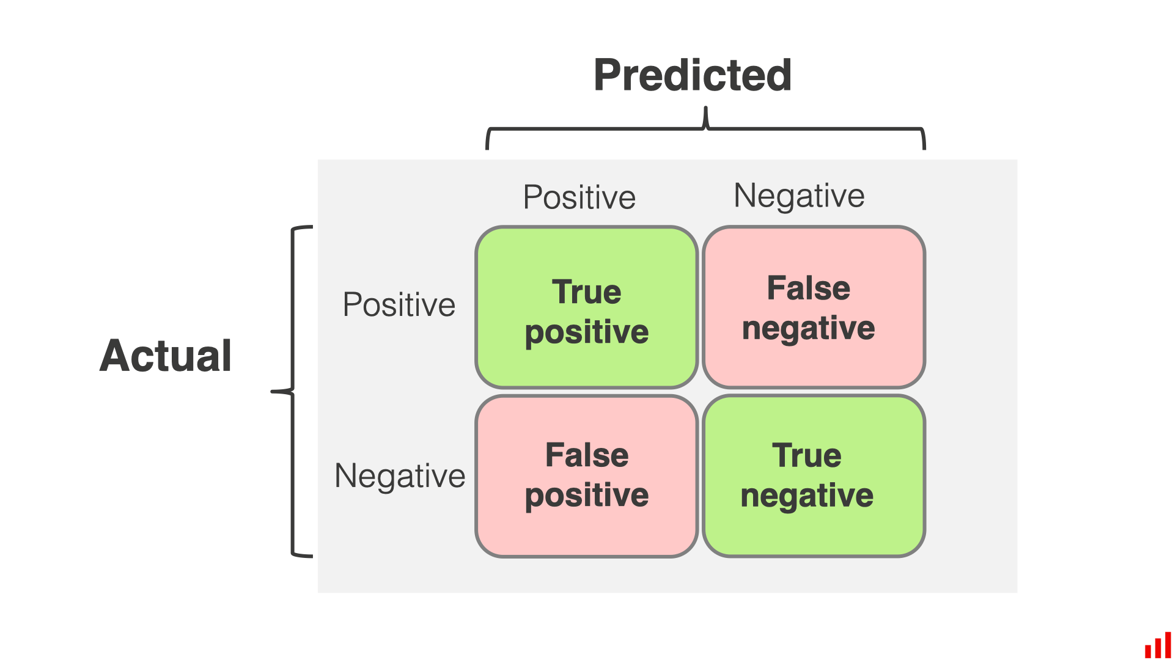
Confusion Matrix
This is a table used to describe the performance of a classification model on a set of test data for which the true values are known. It summarizes the correct and incorrect predictions, broken down by each class.
True Positives (TP): Correct predictions of PCOS presence.
True Negatives (TN): Correct predictions of PCOS absence.
False Positives (FP): Incorrectly predicted as PCOS presence.
False Negatives (FN): Incorrectly predicted as PCOS absence.
This matrix helps identify the type of errors (false positives vs. false negatives), which can guide model adjustments and improve diagnostic accuracy.

Slide 18
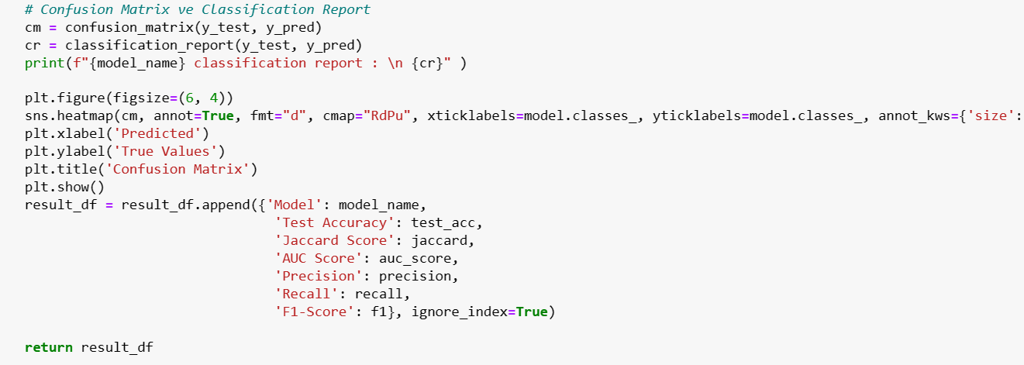
Plotting Evaluation Metrics

Slide 19
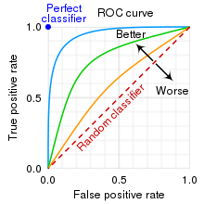
ROC curve
Receiver Operating Characteristic curve : A graphical plot that illustrates the diagnostic ability of a binary classifier system as its discrimination threshold is varied, by plotting the true positive rate against the false positive rate.

Slide 20
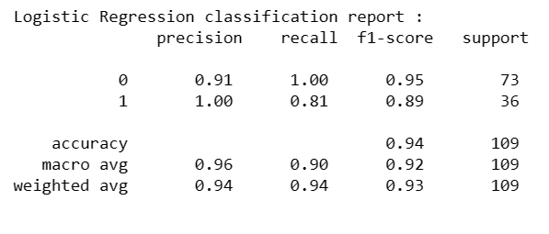
Classification report
A classification report is a text summary that shows the main metrics for each class of a machine learning model.
A classification report is a summary of the key metrics derived from a confusion matrix.
It usually includes the precision, recall, F1-score, and support for each class, as well as the weighted average of these metrics across all classes.
For example:

Slide 21
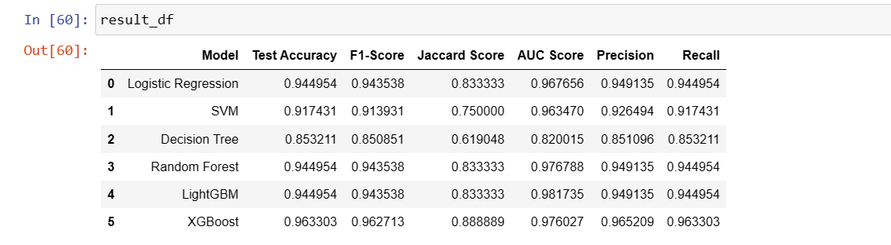
Results
After the evaluation and training of each model we get the test accuracy, F1-score, Jaccard score, AUC score, Precision and recall values. By these values we can conclude which model gives us the highest and most accurate results.
These values were derived before tuning:

Slide 22
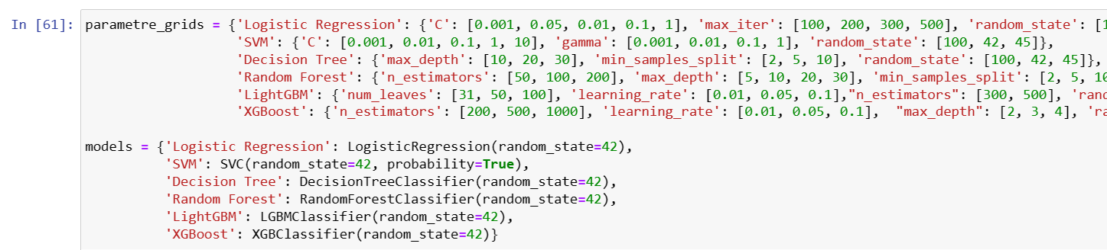
Hyper-parameter tuning
Grid Search: We employed grid search to find the optimal parameters for models, particularly focusing on hyperparameters like `n_estimators` and `max_depth` for tree-based models.
Tuning Impact: Tuning the parameters generally improved the model's performance by finding a good balance between bias and variance, enhancing both accuracy and the ROC score.

Slide 23
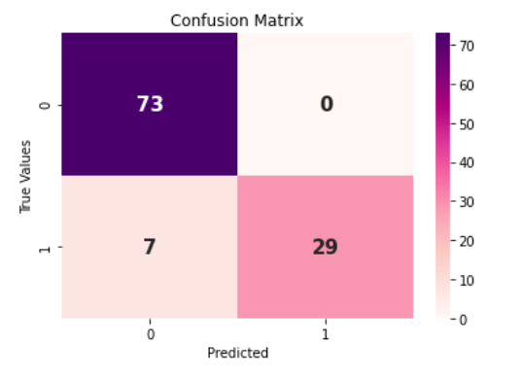

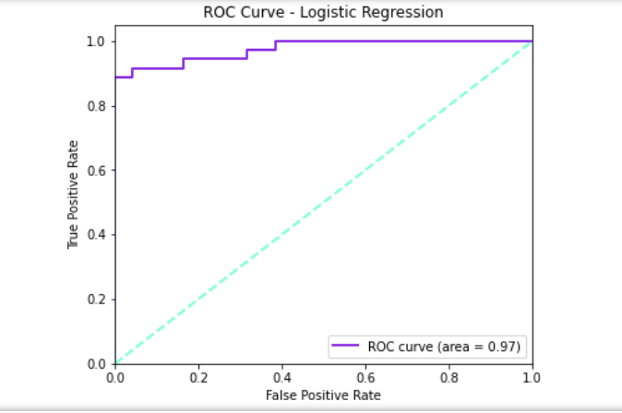
The ROC curve, comparison report and confusion matrix after hyperparameter tuning on logistic regression:

Slide 24
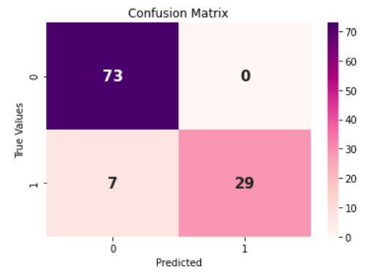

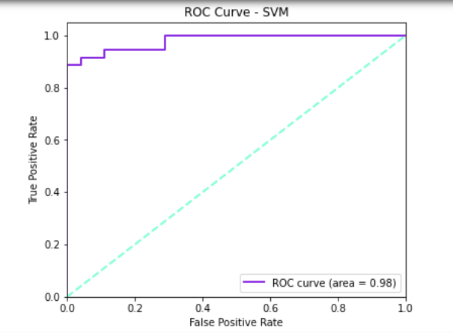
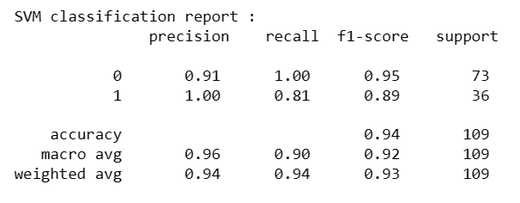
The ROC curve, comparison report and confusion matrix after hyperparameter tuning on support vector machines (SVM) :

Slide 25
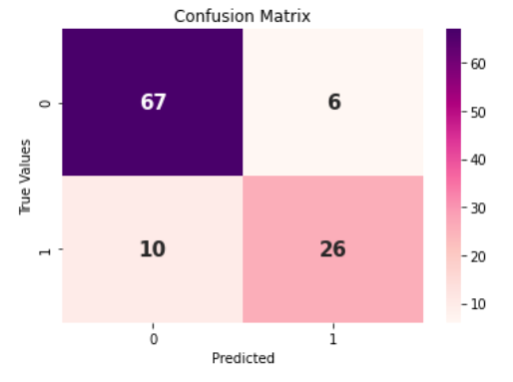

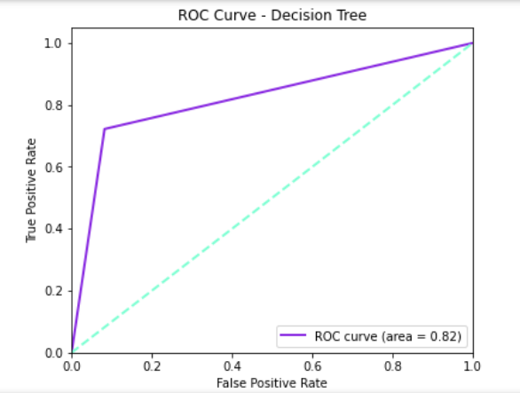
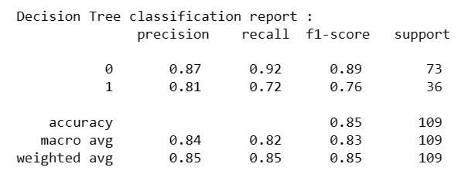
The ROC curve, comparison report and confusion matrix after hyperparameter tuning on Decision tree:

Slide 26

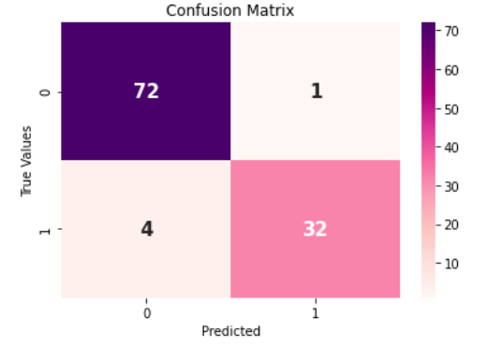
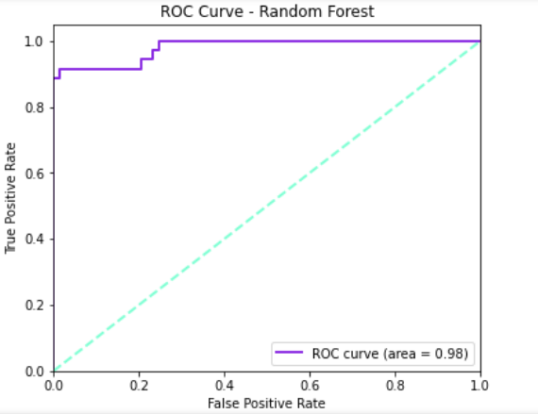
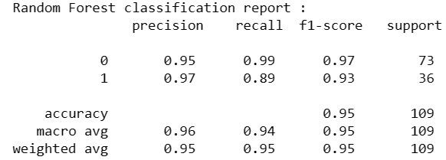
The ROC curve, comparison report and confusion matrix after hyperparameter tuning on Random forest:

Slide 27
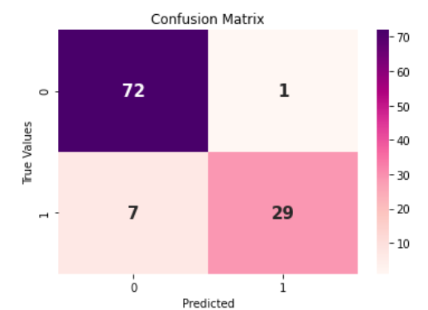
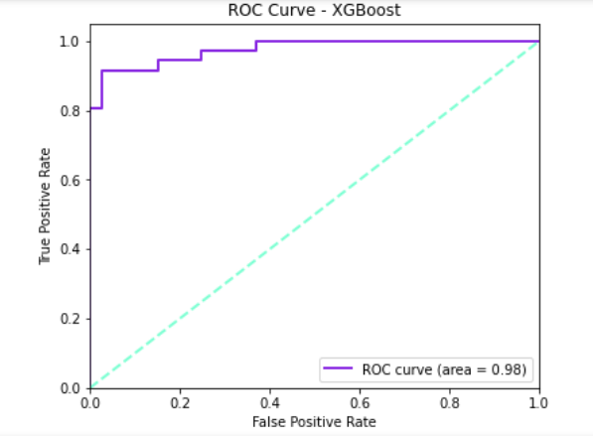
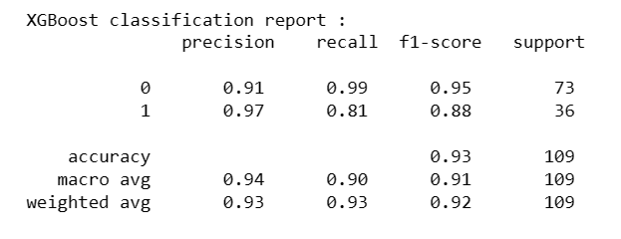
The ROC curve, comparison report and confusion matrix after hyperparameter tuning on XGBoost:

Slide 28

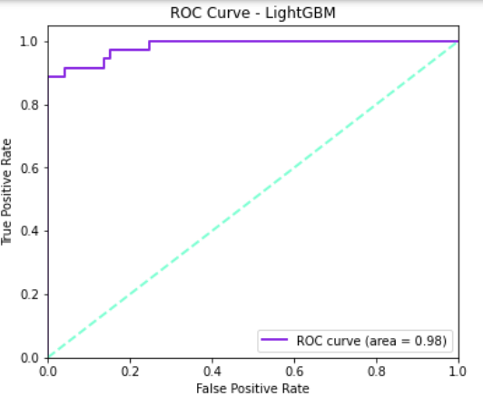

The ROC curve, comparison report and confusion matrix after hyperparameter tuning on Light GBM :

Slide 29
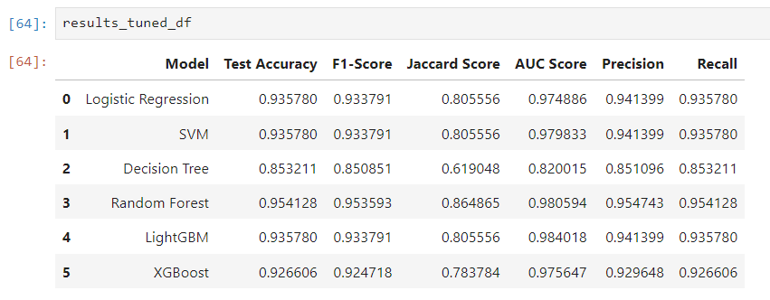
Final Model Selection
Random Forest was selected as the final model due to its superior performance and ability to indicate feature importance. This model provided insights into which variables are most influential in predicting PCOS, which included features like hormone levels and BMI.
The results after tuning were as follows:

Slide 30
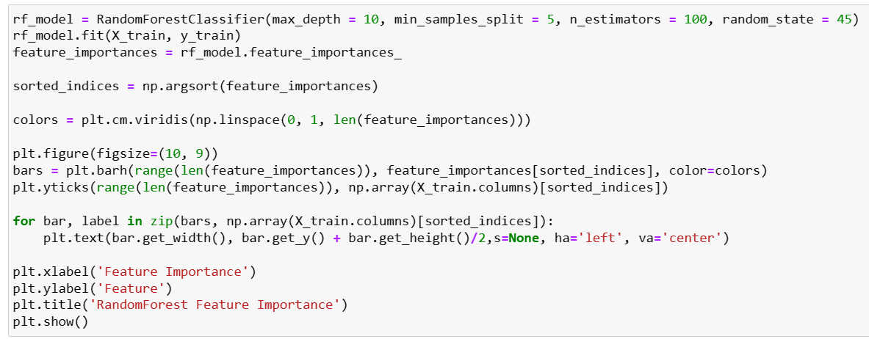
Plotting Feature Importance
Random Forest classifier gave the best results after tuning.
The code for the same is given below

Slide 31
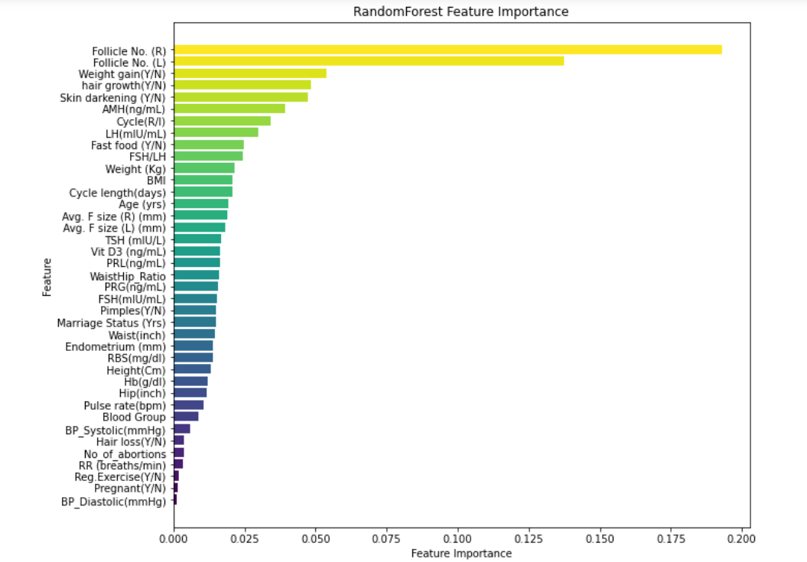
The graph below shows the Random Forest feature importance:

Slide 32
Conclusion and Recommendations
The Random Forest model's ability to classify and rank the importance of features presents a valuable tool in predicting PCOS.
The Random Forest model revealed that the number of follicles in the ovaries, weight gain, hair growth, and skin darkening are the main features that help predict PCOS.
These findings could significantly impact the early detection and management of PCOS.
The predictive modelling techniques used in this project have broader applications in other domains of data mining, such as identifying risk factors in chronic diseases or tailoring personalized treatment plans in healthcare.
The approach underscores the versatility of machine learning in extracting actionable insights from complex data sets across multiple disciplines.

