Slide 1
“Silvertongues : Next Word Predictor”
Venkatesh Sridharan | student ID 100943071
Zahra Mouhammad| Student (ID) 100945804
Harshil Mistry| Student (ID) 100945466
Venkata Ramana Immani| Student (ID) 100943136

Slide 2
Project Definition and overview.
Project definition: Create an AI next-word predictor tool that helps users increase efficiency and inspires them to find the best next word for their phrase/sentence.
Objective: Help users compose accurate texts by offering contextually relevant suggestions, which enhances typing speed and text accuracy without confusion.
Scope: Anywhere writing is relevant e.g. financial, technical articles

Slide 3
Project Functionalities and stages.
Functionalities:
Contextual Word prediction: suggest the next word based on previous words in the sentence
Easy to use interface for user interaction without distraction
Give users a range of choices of words with a prediction percentage score
Stages:
Research and planning
Data Collection
Model Development
Frontend and Backend development
Testing
Deployment

Slide 4
Application
Frontend
Backend
Input field
suggestion Box
Click to complete option
Backend logic
Request handling
ML Model

Slide 5
Frontend: Design choices and Functionalities
Design Choice
Monolithic Django Application – HTML,CSS,JS are all built into the Django backend frameworks and so there is no need for an API
Templates, views, models, and frontend assets (HTML, CSS, JavaScript) are all part of the same project
Functionality
A responsive and intuitive UI/UX that caters to diverse user needs

Slide 6
Backend: Design Choices and Functionality.
Design Choice
Monolithic Django Application
Functionality
Handles incoming requests, processes inputs, and returns outputs from the ML model
Frameworks: Django
Model: Custom Keras model integrated into the backend

Slide 7
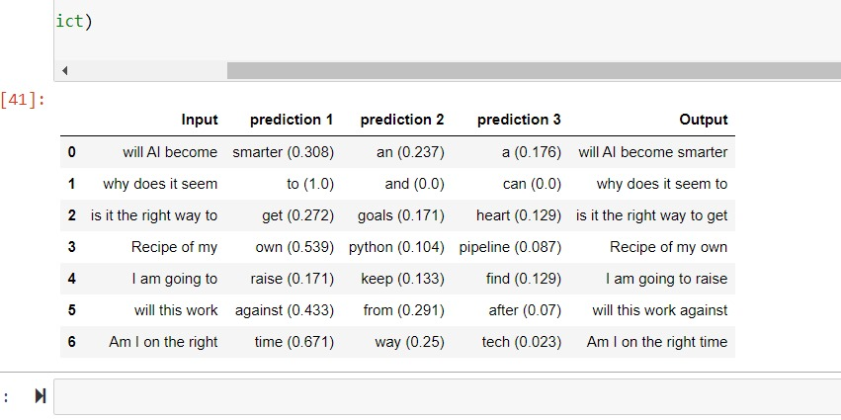
Proof of Concept / Progress Update
Testing the ML model with test inputs and observing the predictions and outputs

Slide 8
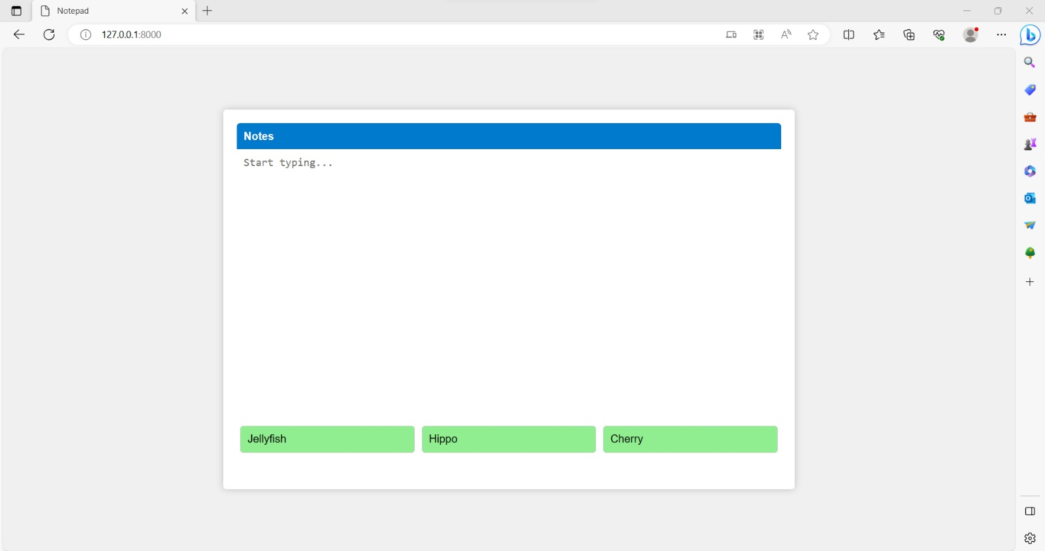
Proof of Concept / Progress Update
Django Webapp with dummy word suggestions
Text input
Dummy suggestions

Slide 9
Thank you

