Slide 1

Implementation Of High Speed Constant Multiplication
BATCH-9B
N. Sandeep sai-15JN1A0493
K. G. N. Sai Sriram -15JN1A0475
M. Sasi Kumar-15JN1A0487
P. Pradeep-15JN1A04a8
M. Ravi Kumar-15JN1A0478
Under the guidance of
Mr. P. Anil kumar, M. Tech., (Ph.D)
Asst.prof., Department of ECE

Slide 2
CONTENT:
Introduction
Motivation of the project
Reconfigurable Constant Multipliers
Algorithm
Application
Results
Advantages
Conclusion

Slide 3
INTRODUCTION:
In this, optimization methods to implement run-time reconfigurable constant multipliers (RCMs) on field programmable gate arrays (FPGAs) are proposed.
FPGA contains the limited resources such as limited multipliers, look up tables, memory and DSP blocks.
The performance, hardware effort, reconfiguration time and power consumption of resulting circuits are evaluated.
The resulting solutions add some important trade-off points to the design space of RCM on PGAs and make new applications possible.

Slide 4
MOTIVATION OF THE PROJECT:
Multiplication with constants is one of the most frequent operations in digital signal processing (DSP).
Operation such as FIR contains a large number of multipliers.
The main motivation to choose this project is to implement a reconfigurable multiplier based on the Look up tables which saves a lot of resources.

Slide 5
RECONFIGURABLE CONSTANT MULTIPLIER:
It is based on an optimal algorithm which fuses already optimized pipelined constant multipliers generated by an existing method called reduced pipelined adder graph (RPAG).
The results of RPAG are adder graphs representing multiplier-less pipelined constant multipliers using additions, subtractions, and bit-shifts only.
The main idea of multiplier-less multiplication as applied in RPAG is to compose a constant multiplication of an addition of shifted inputs.

Slide 6
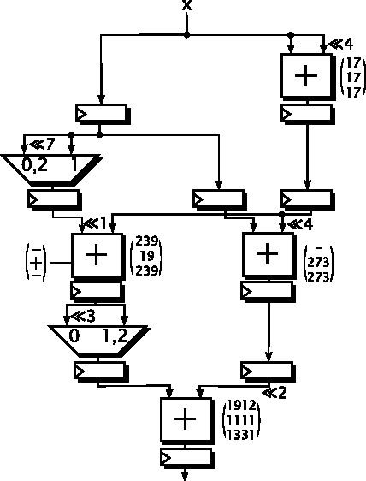
ALGORITHM:

Slide 7
APPLICATION:
Now we are implementing in FIR
By using the proposed method, it reduces the run-time of the fusion process, which raises the usability and application domain of the proposed method of run-time reconfiguration.

Slide 8
RESULTS

Slide 9
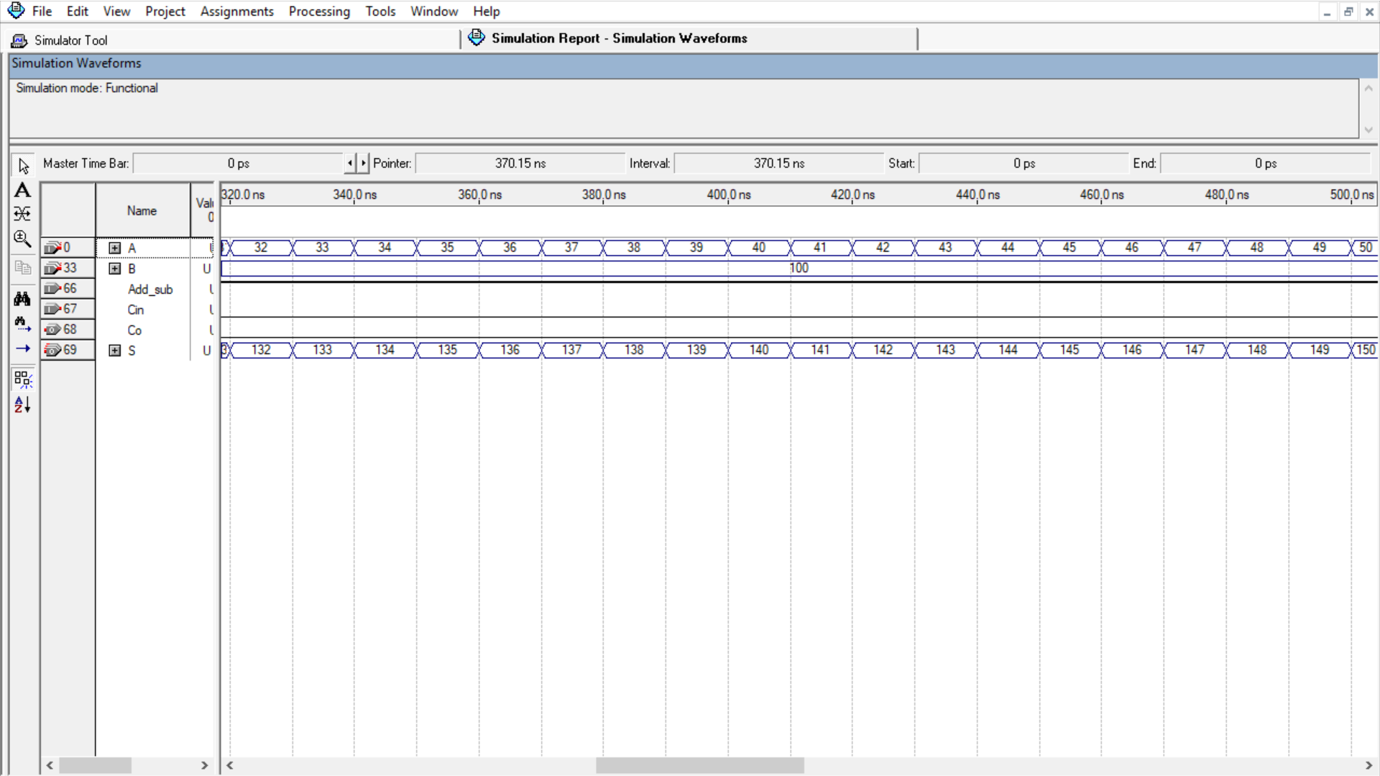
Fig: simulation for FA32

Slide 10
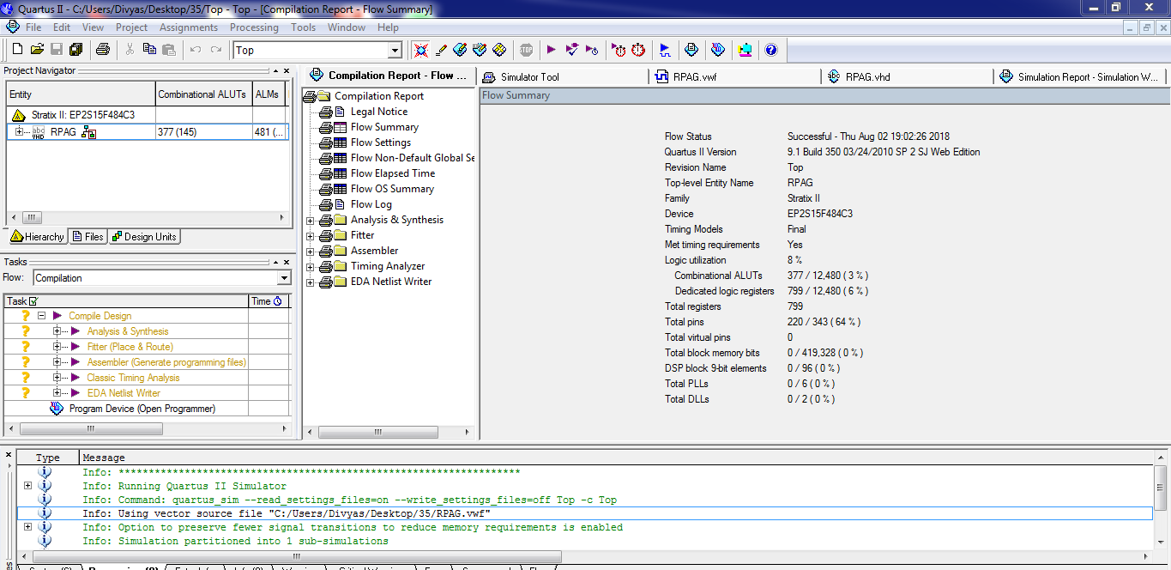
Fig: Compilation Report of RPAG.

Slide 11
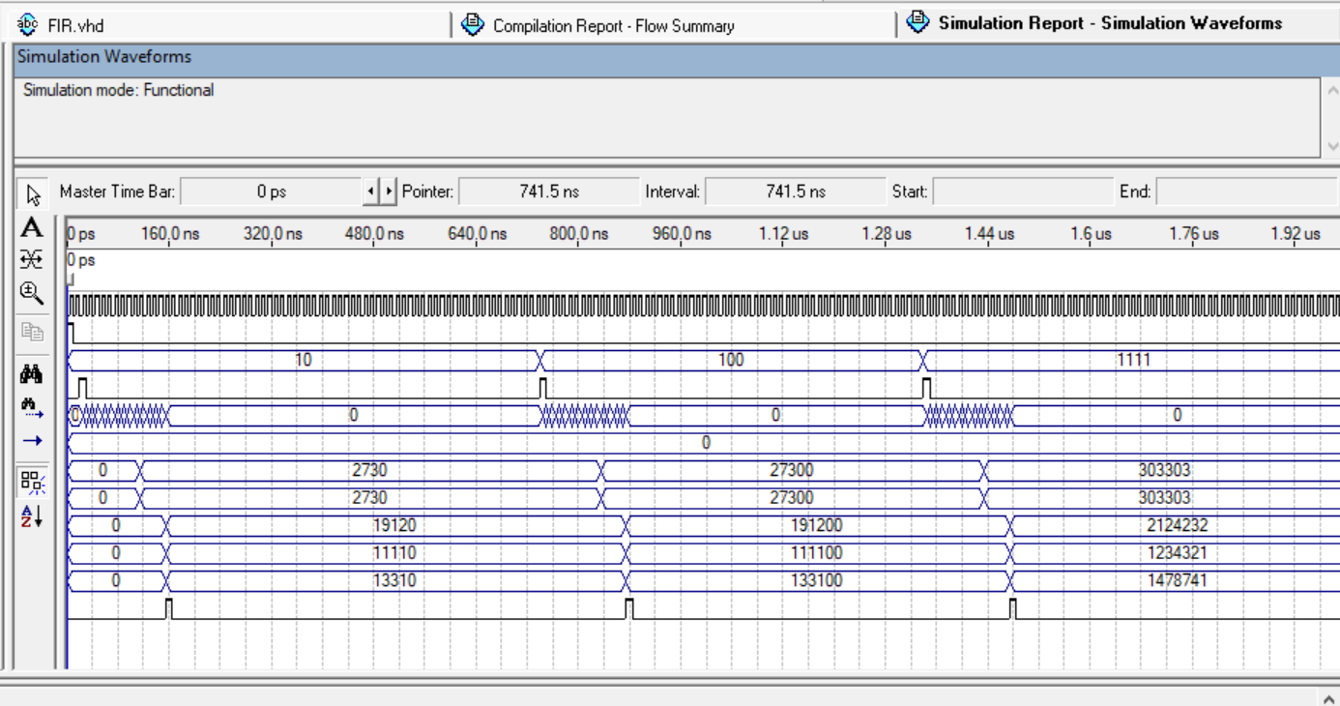
Fig: Simulation report for RPAG

Slide 12
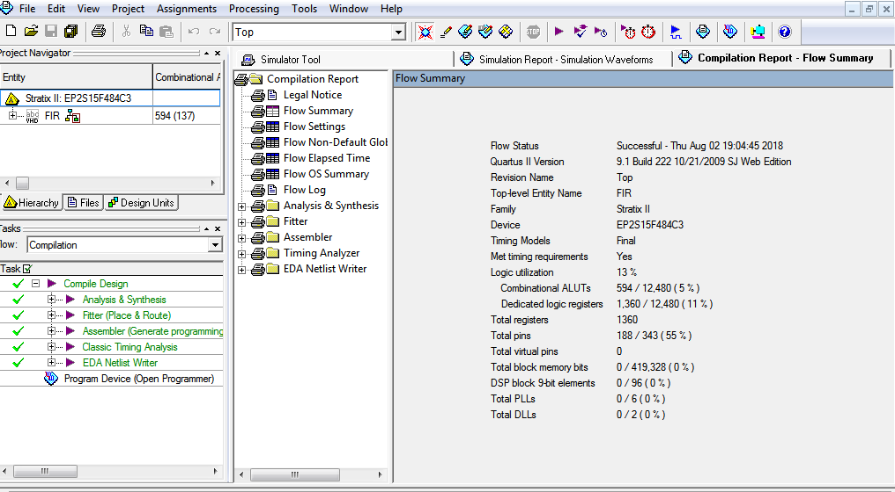
Fig: compilation report for FIR

Slide 13
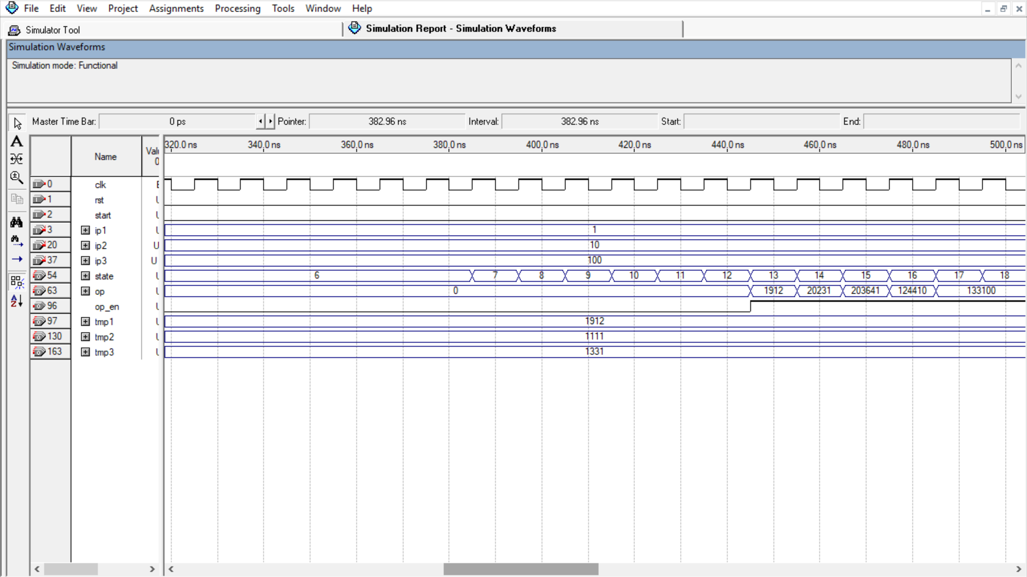
Fig: simulation Report of FIR

Slide 14
Tabular Column:
 | LUT | DSP | FREQUENCY/delay
FA32 | 90 | 0 | 20.191ns
RPAG | 377 | 0 | 143.10MHz
FIR | 578 | 0 | 131.61MHz

Slide 15
Advantages:
High level optimisation
Less power consumption
Less complexity
Faster configuration
Multiplier-less constant multiplication
Easy to implement FIR filters

Slide 16
CONCLUSION:
The new algorithms and reconfigurable processing element architectures are developed on reconfigurablity, low-complexity, low area, low cost, low power consumption, and high speed perspective.

Slide 17


