Slide 1
Restoring Faces from Surveillance Cam-images
Presented by :
Yeturi Venkatesh – 224102324
Shayan Kumar -- 224102319

Slide 2
CONTENTS
Introduction
Limitations & Challenges
Image Restoration
Implementation
Future Scope
Benefits
Conclusion

Slide 3
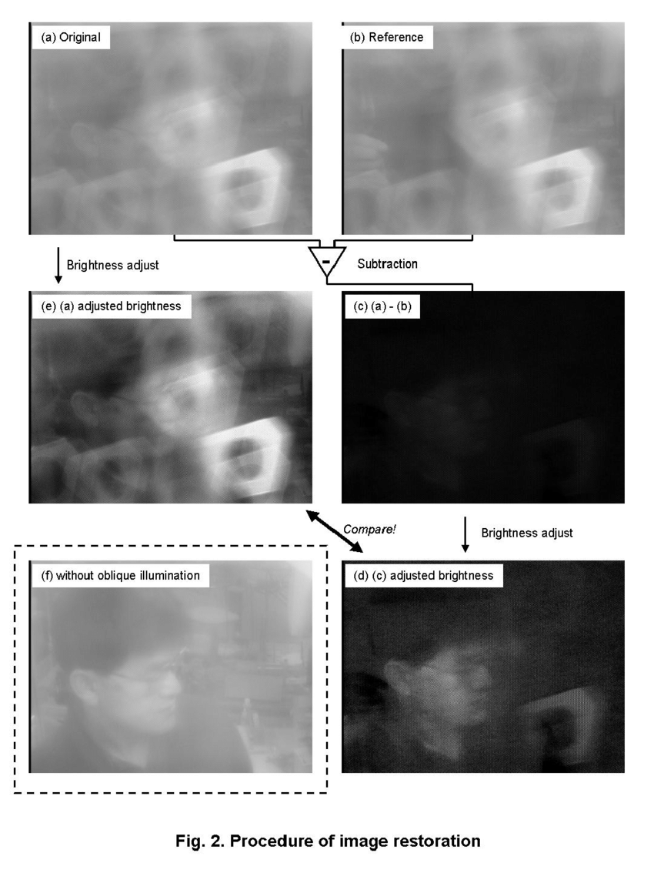
INTRODUCTION
The images from surveillance cameras are of low resolution often.
There are Image processing, Machine learning techniques to restore the faces from camera images.
Fig – 1: Without and with adjusted brightness

Slide 4
IMPLEMENTATION
Face Detection
Face Alignment
Face Tracking
Face synthesis

Slide 5
IMPLEMENTATION
Face Detection :
Preprocessing of
Image / Video
Detection
of
Human Face
Localization of
Detected Face

Slide 6
IMPLEMENTATION
IMPLEMENTATION
Eyes
Nose
Mouth
Face Alignment :
Identification and localization
of
Facial Landmarks
Alignment of face to a reference frame
Normalization of Face

Slide 7
IMPLEMENTATION
Face Tracking :
Initialization :
Define a region of interest around the face region and set initial position.
Tracking :
Subsequent frames – template matching, deep learning based methods.
Adaption :
Update the features, adjusting the position, size of face tracker.

Slide 8
IMPLEMENTATION
Face Synthesis :
Super Resolution
De-Noising
De-Raining
De-Hazing
De-Blurring
Color-Correction
Different categories of Image Restoration

Slide 9


IMPLEMENTATION
Super Resolution :
Recovering a high resolution image from a single low resolution image
Speedy but less accuracy
Super resolution
Interpolation based
Reconstruction based
Learning based
Time consuming
Fast and accurate
Benchmark datasets for face Hallucination : ImagePairs, T91, Set14

Slide 10
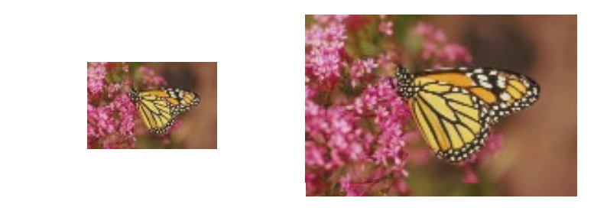
IMPLEMENTATION
Learning based Super Resolution :
Generative Adversarial Networks (GAN)
Deep Boltzmann machine (DBM)
Uses Deep Neural Networks
Generative Adversarial Networks (GAN)
Variational
Auto-Encoders
Generate new data samples similar to given dataset
Consists of two neural networks – Generator and Discriminator
Fig-2 : Super Resolution of image

Slide 11
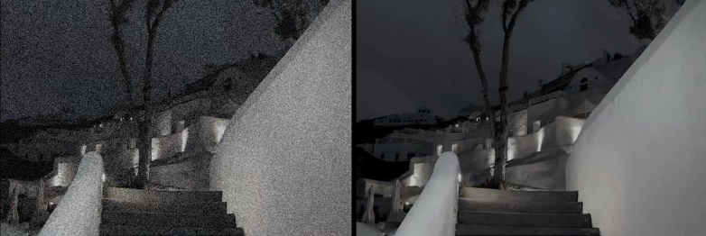
IMPLEMENTATION
De-Noising :
Identification of type of noise ( Gaussian, salt and pepper, speckle noise )
Respective denoising algorithm to be applied.
Gaussian filter , Median filter, Wavelet- based and CNN based methods.
Bilinear Filtering : Gaussian filter with weights depending on pixel intensities too.
Fig – 3 : De-Noising of an Image

Slide 12
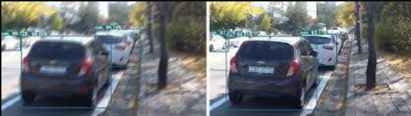
IMPLEMENTATION
De-Blurring : Motion blur, out-of-focus blur, Gaussian blur
Blind Deconvolution : Used when the Blur kernel is unknown
2. Wiener Deconvolution : Known blur kernel and tries to reduce the MSE b/w blurred
image and estimated image
3. Lucy- Richardson Deconvolution : Iteratively convolving an estimate of original
image with blur kernel and comparing.
Fig – 4 : De-Blurring of an Image

Slide 13
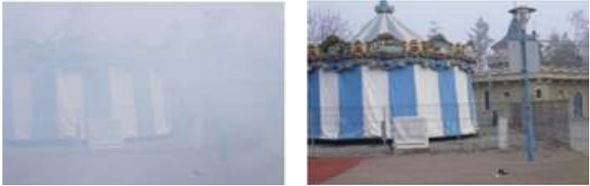
IMPLEMENTATION
De-Hazing / De-Raining:
Causes : Atmospheric conditions, Distance, Humidity, Raining
Use deep learning models, such as CNNs, to learn the mapping between hazy and clear images.
Model : DehazeFormer-B, based on Swin Transformer,(adapting softRELU)
Datasets : D-Hazy, O-Haze, MRFID, Rain14000
Fig – 5 : De-Hazing of an Image

Slide 14
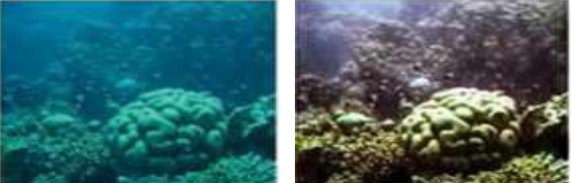
IMPLEMENTATION
Color - Correction :
Causes : Improper transmission of light, color distortions and noise.
Skin tone detection, contrast adjustment, Histrogram equalization
Analyse in several color space models like HSV and then revert back to RGB.
Model : Water-Net, AquaGAN
Datasets : OUC-VISION, UIEB, RUIE
Fig – 6 : Color-Correction of an Image

Slide 15
BENEFITS
Enhanced Security
Cost Effective Solution
Prevention of Crime
Automation can be achieved

Slide 16
FUTURE SCOPE
Advancement of camera Technology
Integration of
multi-modal data
(Audio, video)
Real time Restoration
Mobile Device Integration

Slide 17
CONCLUSION
Limitations & Challenges :
Less quality images can sometimes lead to error in final restored face
Variability in face pose, expressions may cause error in feature extraction
Faces in different climate conditions causes identification difficult
Conclusion :
The restoration of low-level facial images from surveillance cameras is a crucial area of research that has the potential to significantly enhance the effectiveness of surveillance systems and improve public safety.

Slide 18
REFERENCES
A. S. J. A. Aakerberg, "Semantic segmentation guided real-world super resolution," in IRRR/CVF Winter Conf. Appl. Comput. Vis. Woekshops (WACVW),, 2022.
X. Z. Y. T. W. W. J.-H. X. Q. L. Wenming Yang, "Deep Learning for Single Image Super-Resolution: A Brief Review," {IEEE} Transactions on Multimedia, vol. 21, pp. 3106--3121, 2019.
Y. W. S. C. LUJUN ZHAI, "A Comprehensive Review of Deep Learning- Based Real-World Image Restoration," IEEE, 2023.
S. W. O. J. K. Yoounghyun Jo, "Deep-Video Super Resolution Network using Dynamic Upsampling filters without Explicit Motion Compensation," in IEEE/CVF Conference on Computer Vision and Pattern Recognition, 2018.

