Slide 1
Superstore Sales Analysis using Excel and Power BI
ApexPlanet Internship Task 4
Presented By
Presentation Scope
Eddula Venkateswarlu
Business problem definition and objectives
Dataset overview and tool stack
End-to-end project workflow
Power BI dashboard and KPI analysis
Business insights and strategic recommendations
Data Analytics Intern · ApexPlanet
EXCEL · POWER BI · BUSINESS INTELLIGENCE · RETAIL ANALYTICS

Slide 2


Business Problem
Context & Challenge
Key Business Questions
Data Overload: Businesses generate massive volumes of sales data daily — without structured analysis, patterns and opportunities remain hidden beneath the noise. Raw transactional records alone cannot drive strategy.
Revenue Drivers
Which categories and products drive the most revenue?
Primary Objective
Analyze sales performance across categories, regions, and time periods to surface actionable insights that enable data-driven decision-making and improve profitability.
Regional Gaps
Where are the regional performance disparities?
Analytical Approach
Leverage Microsoft Excel for data cleaning and validation, and Power BI for interactive dashboard creation and business intelligence reporting — combining the strengths of both tools in a structured pipeline.
Trend Patterns
How do sales trends shift month over month?
Outcome: Enable data-driven decisions to improve profitability, optimize inventory, and guide strategic planning.

Slide 3
Dataset Overview
Dataset & Tools
Key Columns Analyzed
Dataset: Superstore Orders — a widely used retail sales dataset simulating real-world business transactions across multiple years, regions, and product hierarchies.
Microsoft Excel: Data cleaning, validation, pivot analysis, and summary statistics.
Power BI Desktop: Interactive dashboards, DAX measures, and visual business intelligence reporting.
Scope: Multi-year transactional data spanning four regions, three product categories, and multiple customer segments.
Field
Purpose
Order ID
Unique transaction identifier
Order Date / Ship Date
Time-series and fulfillment analysis
Customer
Segment-level profiling and behavior
Category / Sub-Category
Product hierarchy and revenue attribution
Region
Geographic performance benchmarking
Sales / Profit / Quantity
Core financial KPIs and margin analysis

Slide 4







Project Workflow
A structured, seven-stage analytical pipeline was followed — from raw data ingestion through to stakeholder-ready recommendations — ensuring rigor, reproducibility, and business relevance at every step.
Data Collection
Data Cleaning
Data Validation
Sourced Superstore Orders dataset; verified completeness and field definitions before analysis.
Removed duplicates, handled null values, and standardized date formats in Microsoft Excel.
Cross-checked totals, validated category mappings, and ensured referential integrity across all fields.
Exploratory Data Analysis
Dashboard Creation
Business Insights
Pivot tables, summary statistics, and trend identification conducted in Excel to surface initial patterns.
Built interactive Power BI dashboards with slicers, KPI cards, and drill-through visuals for stakeholders.
Interpreted visual outputs to identify top performers, seasonal patterns, and regional performance gaps.
Recommendations
Formulated strategic actions based on data findings for presentation to business stakeholders.

Slide 5
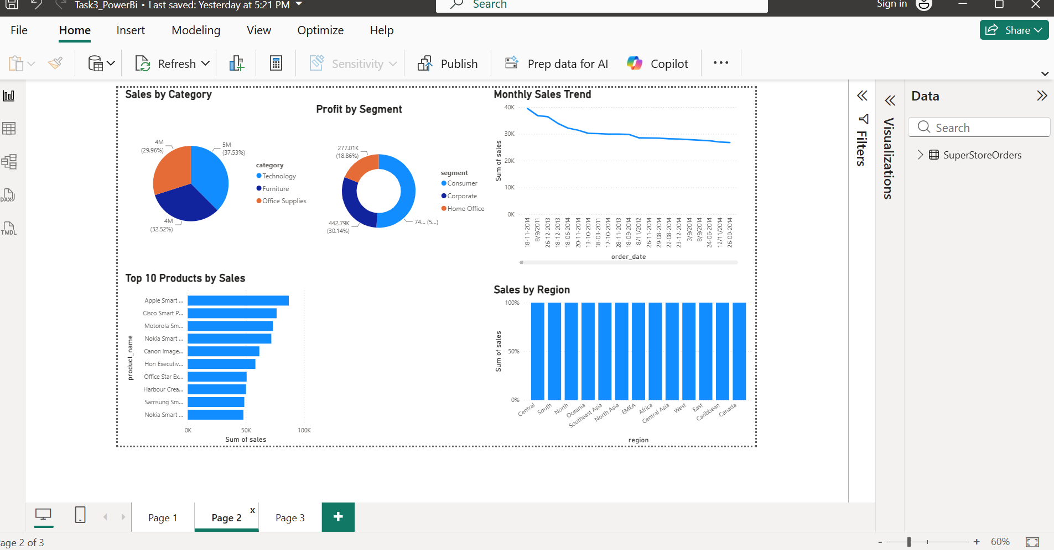
Dashboard Overview
Key Performance Indicators
Power BI Dashboard — Interactive View
Total Sales
Aggregate revenue across all orders and regions — primary top-line performance metric.
Average Sales
Mean transaction value used to benchmark order performance and identify outliers.
Total Orders
Volume of transactions processed across the full dataset — measures business activity scale.
The Power BI dashboard provides an interactive, single-pane view of all KPIs with dynamic filtering by region, category, and time period.

Slide 6

Sales Analysis
Four core analytical views were constructed in Power BI to answer the primary business questions — each chart targets a distinct dimension of sales performance.
📊 Sales by Category
🏆 Top 10 Products by Sales
Technology · Furniture · Office Supplies — Compare revenue contribution and profit margins across the three main product categories. Technology expected to lead.
Ranked by total sales value — identifies high-revenue SKUs that drive a disproportionate share of income. Classic Pareto (80/20) distribution observed across the product catalog.
📈 Monthly Sales Trend
🗺️ Sales by Region
Time-series line chart revealing seasonal peaks, demand cycles, and year-over-year growth patterns — Q4 peaks and Q1 dips are key signals to monitor.
Geographic breakdown across East, West, Central, and South — highlights underperforming markets and surfaces regional growth opportunities for targeted investment.

Slide 7
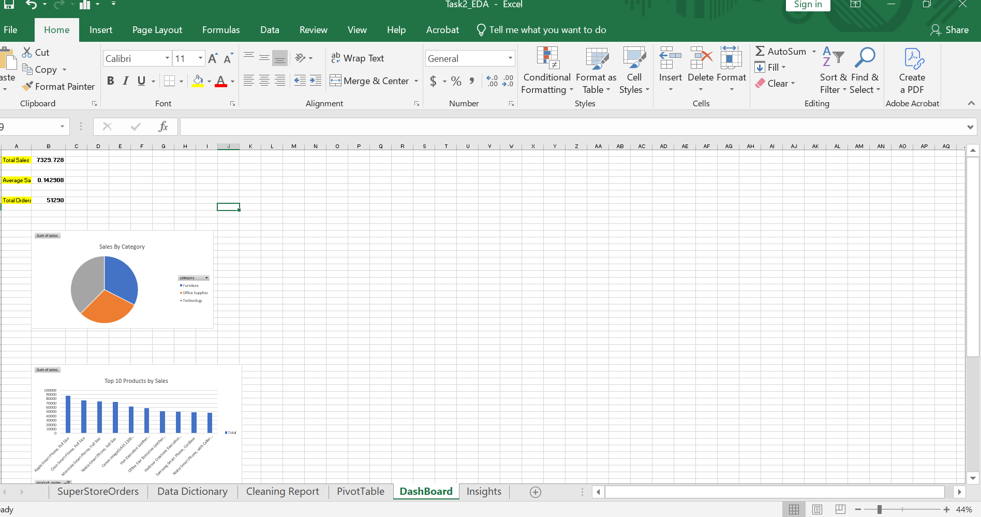

Slide 8
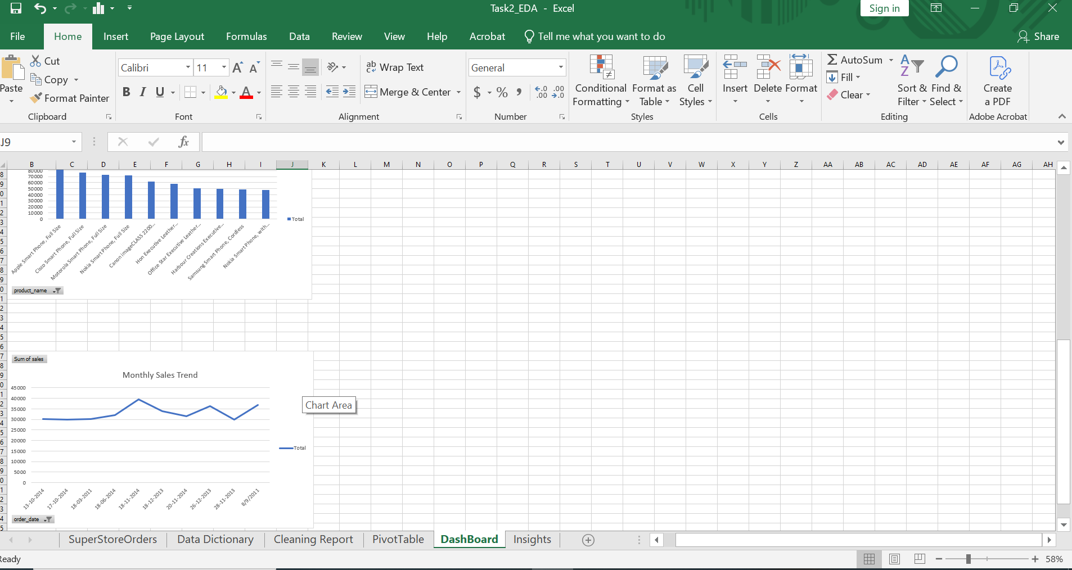

Slide 9
Business Insights
Five high-confidence insights derived from Power BI visual analysis and Excel pivot exploration — each directly actionable for business strategy.
Technology Leads Revenue
Pareto Effect in Products
Seasonal Demand Cycles
Technology generates the highest total sales, outperforming Furniture and Office Supplies — driven by high-value items such as phones, machines, and copiers with strong unit economics.
A small number of SKUs (top 10–20 products) contribute a disproportionately large share of total revenue — classic 80/20 distribution confirmed across the product catalog.
Monthly sales exhibit clear cyclical patterns — peaks in Q4 (holiday/year-end purchasing) and dips in Q1, indicating predictable seasonal demand sensitivity.
Consumer Segment Profitability
Regional Sales Disparity
The Consumer segment contributes the highest profit margin compared to Corporate and Home Office segments — a key target for retention, upsell, and cross-sell strategies. Segment-specific campaigns can amplify this advantage.
Significant variation exists across the four regions — West and East outperform Central and South, suggesting untapped market potential in lower-performing geographies. Targeted investment in these regions represents a clear growth lever.

Slide 10
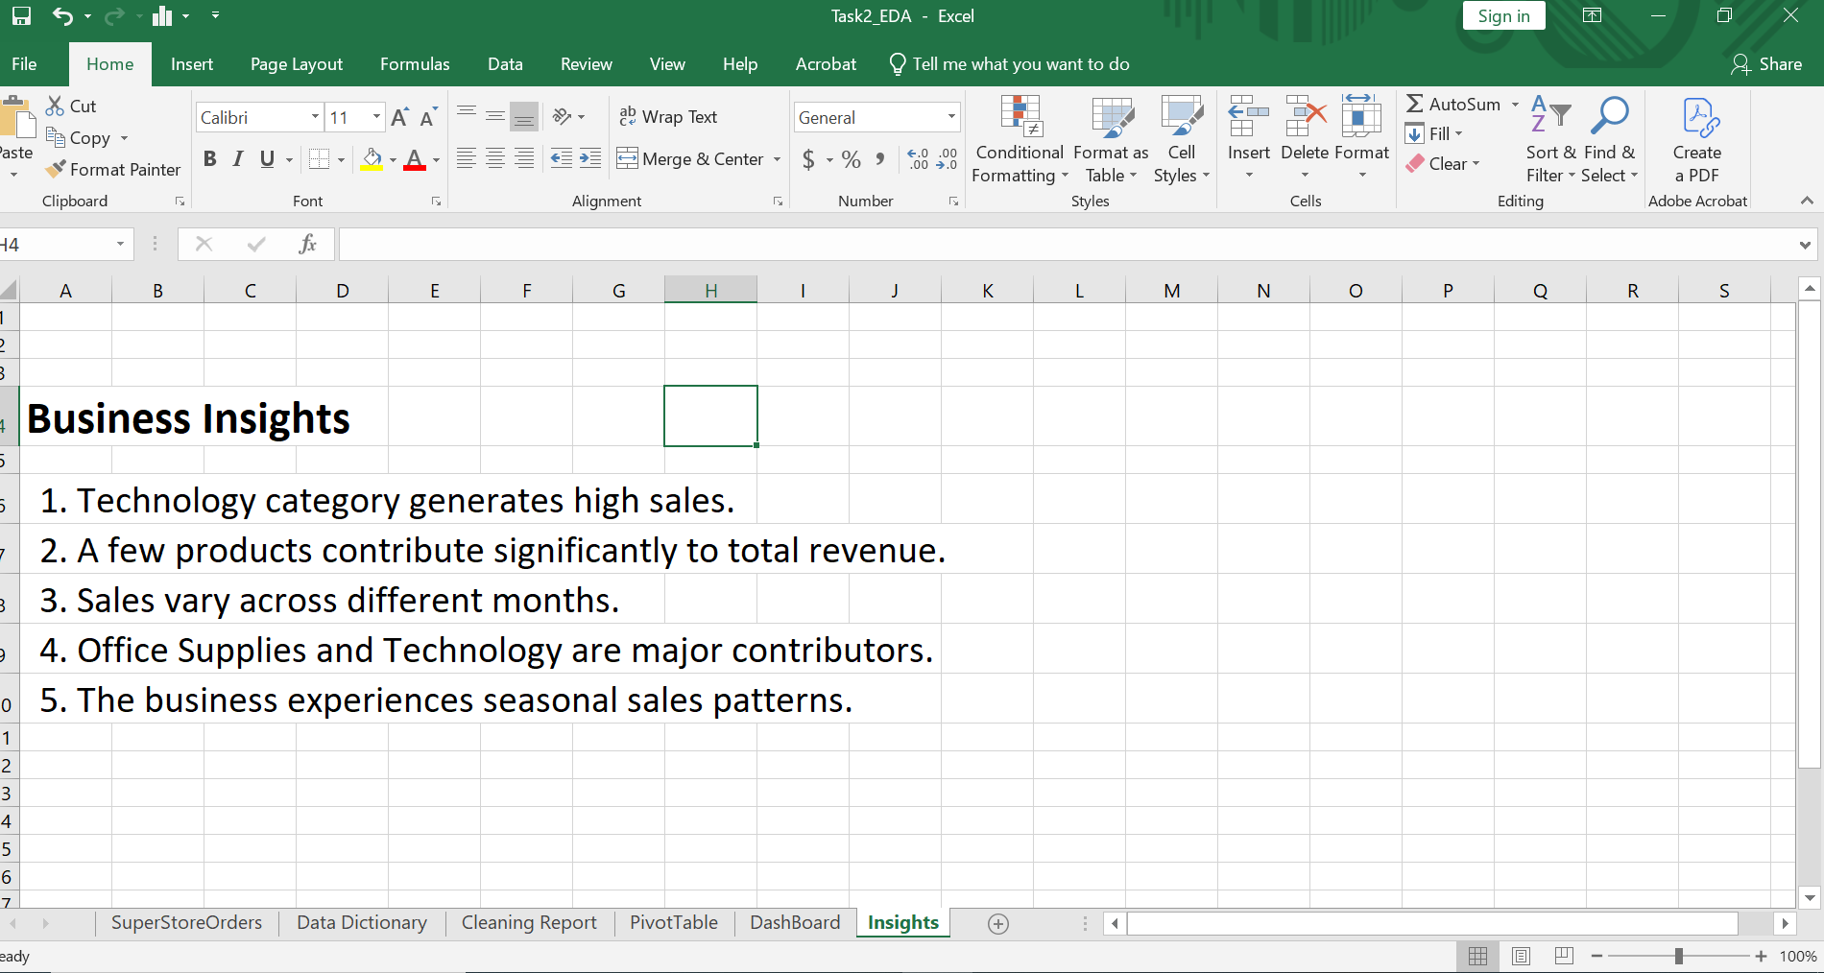

Slide 11


Statistical Validation
Objective
Validate whether observed sales patterns are statistically meaningful and not the result of random variation — ensuring insights are reliable and defensible for business decision-making at the stakeholder level.
Descriptive Statistics
Data Visualization
Mean, median, standard deviation, and range computed for Sales, Profit, and Quantity — establishes baseline distribution and identifies statistical outliers that may skew aggregate metrics.
Charts and graphs used to visually confirm statistical findings — histograms, scatter plots, and bar charts support pattern recognition and communicate findings to non-technical stakeholders.
Trend Analysis
Business Intelligence via DAX
Moving averages and period-over-period comparisons applied to monthly sales data to confirm directional trends and filter short-term noise from the signal.
Power BI DAX measures used to compute dynamic KPIs — ensuring calculations are consistent, reproducible, and audit-ready across all dashboard views and filter states.
Category Comparison
Cross-category performance benchmarked using aggregated metrics — validates Technology's dominance with quantitative evidence rather than visual inference alone.
Statistical rigor ensures that business recommendations are grounded in evidence — not coincidence or visual bias.

Slide 12





Recommendations
Five strategic recommendations derived directly from data findings — each mapped to a specific insight and designed for immediate implementation by business stakeholders.
Optimize Inventory
Regional Growth Strategy
Category-Focused Marketing
Increase stock levels for high-performing Technology products. Reduce carrying costs for low-velocity SKUs in underperforming sub-categories to free working capital.
Deploy targeted sales initiatives in Central and South regions. Allocate additional marketing budget and sales resources to close the performance gap with East and West.
Concentrate campaigns on Technology and high-margin Office Supplies. Leverage Consumer segment loyalty for structured upsell and cross-sell programs.
Seasonal Planning
Continuous Monitoring
Align procurement and promotional calendars with identified demand peaks. Prepare Q4 inventory buffers and Q1 demand stimulation campaigns to smooth revenue cycles.
Embed Power BI dashboards into monthly business reviews. Establish KPI thresholds and automated alerts for sales anomalies and trend deviations.

Slide 13
Conclusion
Summary of Findings
Tool Value Delivered
Excel enabled rigorous data preparation, cleaning, and validation — establishing a trustworthy analytical foundation.
Power BI delivered interactive, stakeholder-ready dashboards that support ongoing, real-time decision-making beyond this project.
Technology Drives Revenue
Highest sales contribution across all categories — a clear priority for inventory and marketing investment.
Consumer Segment Leads Profitability
Highest margin segment — targeted retention and upsell strategies will maximize lifetime value.
Broader Impact
Organizations that embed data visualization into their workflows consistently improve profitability, reduce operational inefficiencies, and respond faster to market changes.
Seasonal Patterns Are Predictable
Q4 peaks and Q1 dips are consistent — enabling proactive procurement and promotional planning.
Thank You
Regional Gaps = Growth Opportunities
Questions Welcome
Central and South underperformance represents addressable upside with targeted resource allocation.
Eddula Venkateswarlu · ApexPlanet Internship Task 4

