Slide 1
Mail Simulation Application Development
Presented By :
Anushka Arora
Amit Maity
Amrit Raj
Jison James
Praghya Singh
Reddy Shekhar

Slide 2
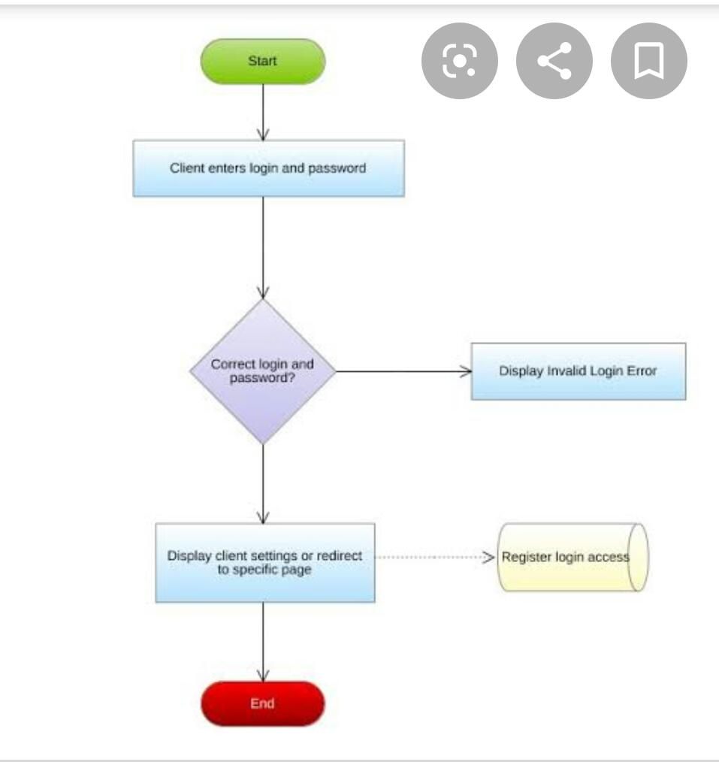
FlowChart

Slide 3
1. Problem Statement
Mail Simulation Application is an application where user can interact with each other through mail .
People use to communicate through letters and telegram which is not faster . So mailing system got introduced to over come this problem .

Slide 4
1.1 Objective
This will reduce time and increase efficiency
To simulate mailing system so users can communicate easily . This application will have users and those users can communicate through mail .

Slide 5
2 Technology And Tools
Technologies
Backend
Spring Boot With Hibernate
Frontend
Angular 7.0
Tools
Eclipse IDE 2019-09
Visual Studio Code

Slide 6
5 Modules
Register
Login
Change password
Sent Mail
Compose Mail
Inbox
Delete
Draft
Home

Slide 7
Roles
Anushka - Back end Login , Register , Forgot Password
Amit Maity- Front end login , register , Forgot Password
Amrit Raj- Back end and front end Compose mail module
Jison James- Back end and front end inbox module
Praghya Singh- Back end and front end draft , Compose mail
Reddy Shekhar- Back end and front end delete , home modules

