Slide 1
Design & Verification of a Parameterized Systolic Array Matrix Multiplication Accelerator
ECE 593: Fundamentals of Pre-Silicon Validation Maseeh College of Engineering and Computer Science · Spring 2026
Project Team
Hanisha Dhananjaya Produtur · hanisha@pdx.edu
RTL Top / Systolic Array · UVM Env & Scoreboard
Nikhil Swarna · nikhilsw@pdx.edu
RTL Controller · UVM Driver & Sequences
Venkat Sai Sumanth Koyada · koyada@pdx.edu
RTL PE & Input Skew · UVM Coverage & Monitor
4/15/2026

Slide 2
Project Overview & Motivation
Why Systolic Arrays?
Design At a Glance
▸ Matrix multiply is at the core of ML inference, signal processing, and scientific computing.
▸ Naive O(N³) software loops are too slow for real-time embedded and edge-AI systems.
▸ Systolic arrays achieve high throughput through data-reuse: each PE computes a MAC every clock cycle.
▸ Parameterized RTL scales the same design from 2×2 (edge devices) to 16×16 (server-class) without re-engineering.
▸ UVM verification ensures correctness is proven not assumed before tape-out.
Language:
SystemVerilog (RTL) + UVM (TB)
Array Size:
Parameterized N × N (default N = 4)
Data Width:
8-bit inputs (DATA_WIDTH)
Accumulator:
32-bit result (ACCUM_WIDTH)
FSM States:
IDLE → LOAD → DRAIN → DONE
Drain Time:
2N cycles after last input row
Verification:
Constrained-random + 4 corner sequences
Coverage:
Functional cover groups + cross coverage
Scoreboard:
Cycle-accurate SW reference model (A×B)
ECE 593 — Spring 2026 | Portland State University 2/8

Slide 3
RTL Architecture
SystemVerilog — rtl/ folder · 4 key modules
pe.sv
input_skew.sv
Processing Element (PE)
Input Skew Module
• MAC: accum += a_in × b_in every valid cycle
• Pass-through: a_in → a_out (horizontal), b_in → b_out (vertical)
• Synchronous clear resets accumulator for back-to-back multiply
• 8-bit inputs / 32-bit accumulator prevents overflow
• Staggers row i of matrix A by i clock cycles
• Staggers col j of matrix B by j clock cycles
• Aligns data so PE(i,j) receives correct elements simultaneously
• Built from parameterized shift-register chains (no control logic)
controller.sv
mm_accelerator_top.sv
FSM Controller
Top-Level Integration
• 4-state FSM: IDLE → LOAD → DRAIN → DONE
• Counts N input cycles (LOAD), then 2N drain cycles (DRAIN)
• Generates: clear, valid_in, ready, result_valid
• BUG1: off-by-one in drain counter was caught by scoreboard
• Wires Controller → Input Skew → Systolic Array
• Flat packed result bus: C[i][j] at result[(i×N+j)×ACCUM_WIDTH]
• Supports back-to-back multiplications via clear pulse
• All three params (N, DATA_WIDTH, ACCUM_WIDTH) propagate through
ECE 593 — Spring 2026 | Portland State University 3/8

Slide 4
System Block Diagram
Data-flow through the accelerator pipeline
Systolic Array (N×N PEs)
a_in [N×DW]
Input Skew
Output Pack
result [N²×ACCUM]
PE(i,j): accum += a×b Horiz A · Vert B · Diag valid
Stagger A by row i Stagger B by col j
result[(i×N+j)×ACCUM] result_valid pulse
b_in [N×DW]
Controller FSM
IDLE
→
LOAD
→
DRAIN
→
DONE
ECE 593 — Spring 2026 | Portland State University 4/8

Slide 5
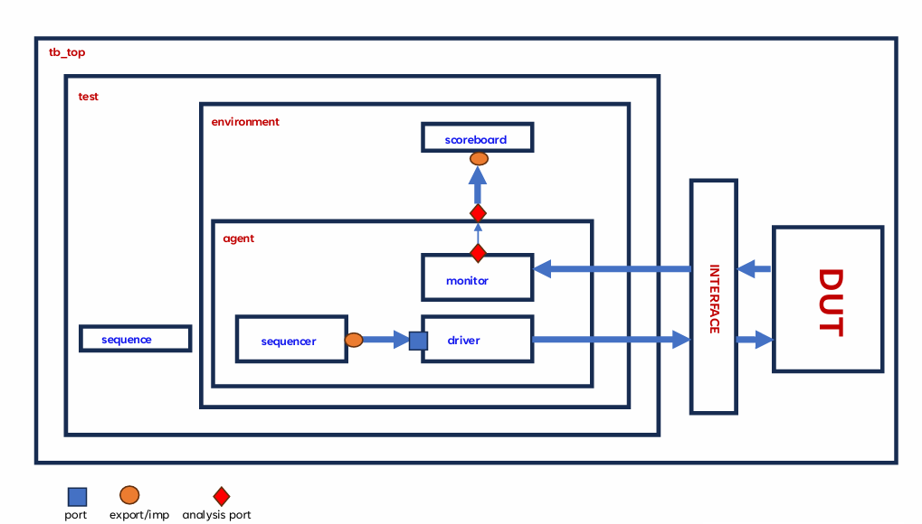
UVM TESTBENCH ARCHITECTURE
ECE 593 — Spring 2026 | Portland State University 4/8

Slide 6
UVM Testbench Architecture
UVM_TB/ folder · 11 files · component hierarchy
Component Hierarchy
UVM_TB/ Files
tb_top.sv
DUT inst + clk gen + UVM run_test()
└─ env [mm_env]
mm_uvm_if.sv
Virtual interface — clk, rst_n, DUT ports
mm_seq_item.sv
Stimulus packet: a_in, b_in, corner_mode + rand
├─ agnt [mm_agent]
mm_sequence.sv
5 sequences: base / test / zero / identity / max
├─ seqr [mm_sequencer]
mm_sequencer.sv
Arbitrates items from sequence to driver
├─ drv [mm_driver]
mm_driver.sv
Reset + drive start, valid_in_upstream, a/b
mm_monitor.sv
Observes result_valid, captures & broadcasts
└─ mon [mm_monitor]
mm_scoreboard.sv
SW ref model: expected = A × B (32-bit accum)
├─ scb [mm_scoreboard]
mm_coverage.sv
Cover groups: corner modes, reset, b2b multiply
└─ cov [mm_coverage]
mm_env.sv
Builds agnt/scb/cov; wires TLM ports
mm_test.sv
Selects sequences; sets UVM verbosity
ECE 593 — Spring 2026 | Portland State University 5/8

Slide 7
Team Contributions
Equal split across RTL design and UVM verification
Hanisha Dhananjaya Produtur
Nikhil Swarna
Venkat Sai Sumanth Koyada
hanisha@pdx.edu
nikhilsw@pdx.edu
koyada@pdx.edu
RTL
RTL
RTL
▸ mm_accelerator_top.sv — top-level wiring & param propagation
▸ controller.sv — 4-state FSM (IDLE/LOAD/DRAIN/DONE)
▸ pe.sv — MAC datapath, pass-through, valid pipeline, clear
▸ systolic_array.sv — N×N PE grid, a_wire/b_wire interconnect
▸ Drain-cycle counter & result_valid timing
▸ input_skew.sv — parameterized shift-register skew chains
UVM
UVM
UVM
▸ mm_env.sv — build/connect phases, TLM analysis fan-out
▸ mm_driver.sv — reset, start handshake, N-cycle data drive
▸ mm_monitor.sv — observes result_valid, broadcasts seq_item
▸ tb_top.sv- DUT + interface instantiation
▸ mm_uvm_if.sv - Bundles all DUT I/O
▸mm_agent.sv -Factory creates seqr/drv/mon
▸ mm_scoreboard.sv — SW reference model, element-wise check
▸ mm_sequence.sv — 5 sequence classes (base/test/zero/ident/max)
▸ mm_coverage.sv — cover groups: corner modes, reset, b2b
▸ mm_test.sv — sequence selection, UVM verbosity control
▸ mm_sequencer.sv — TLM arbitration, seq_item_export wiring
▸ mm_seq_item.sv — packet class, rand constraints, post_randomize
ECE 593 — Spring 2026 | Portland State University 7/8

