Slide 1
DDS MINI PROJECT
DIGITAL CLOCK IMPLEMENTATION
SUBMITTED BY:
C.MASTHANAIAH – 191792CS115
KINTALI PRAVEEN – 191753CS129
K.SRINIVAS KALYAN – 191807CS130
M.L.S.V.SANDEEP – 191927CS226
Y.VENKAT KUMAR – 191803CS263

Slide 2
CONTRIBUTIONS
RESOURCE COLLECTION & DESIGN
KINTALI PRAVEEN
M.L.S.V.SANDEEP
CODE IMPLEMENTATION
Y.VENKAT KUMAR
C.MASTHANAIAH
K.SRINIVAS KALYAN
SIMULATION
Y.VENKAT KUMAR
C.MASTHANAIAH
REPORT & PPT MAKING
K.SRINIVAS KALYAN
M.L.S.V.SANDEEP
KINTALI PRAVEEN

Slide 3
CONTENTS
PROJECT INFORMATION
DESIGN PROCEDURE
ADVANTAGES AND DISADVANTAGES
SIMULATION PROCEDURE
SIMULATION RESULTS
CONCLUSION
REFERENCES

Slide 4
PROJECT NUMBER: 10
PROBLEM STATEMENT:
You have a circuit that represents a digital watch. The watch displays the time in the 12-Hour format: Hour: Minute: Second. But due to some error, the watch displays time in 24-Hour format. Design, implement, and synthesize the clock that can auto-detect and auto-correct the fault when it exists.
PLATFORM USED FOR DESIGNING:
-Xilinx ISE Design Suite 14.7 for FPGA design

Slide 5
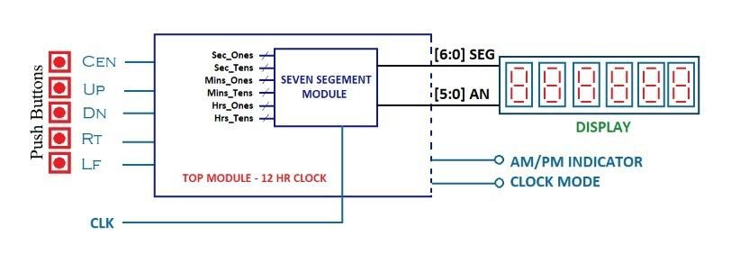
DESIGN PROCEDURE
We have implemented a 12-Hour format clock. After that, we modified it to a 24-hour format through a switch model which asks the user to switch between the 24-hour and 12-Hour format (in fact this switch is used as an error switch. When switch is on 24-Hour format, we treat it as error and when switch is on 12-Hour format, it shows the corrected 12 -Hour format from 24 -Hours at any time we switch to it). It displays Hours, Minutes, and Seconds through four 7-bit segments. The following model consists of two files
1. Digital_Clock_12_hrs_format.v 2.SSM_Seven_Segment_Module.v
Fig. Design Diagram

Slide 6
implementation
The file Digital_Clock_12_hrs_format.v is to generate a four 7-segment code to display the time by taking inputs which set the time through an interactive way on the board we implement it . By default, it is set to 12:00:00 AM. When it runs, it quickly changes to 12:00:00 AM .
We use 5 controls to set the time.
1. Center
2. Up
3. Down
4. Left
5. AM-PM LED Indicator
Center is a switch which on click moves from set mode to display mode on click. Up is used to increase the number while setting (once it is 9 then jump to 0 again). Similarly Down to decrease the number. Left is to shift between the 7-segment‘s. AM-PM indicator shows whether the set time is in AM or PM.
The SSM_Seven_Segment_Module.v file takes the input of six 7-segment codes and displays the Time and AM_PM led based on the cases implemented for all four blocks one after the other

Slide 7
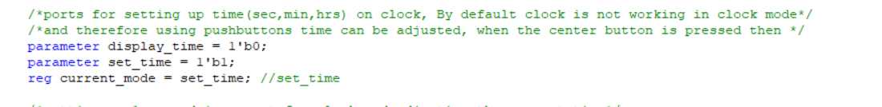
Code walkthrough
The above piece of code displays the usage of setting current mode:
Current Mode : This is used to toggle between the set_time mode and display_time mode. Initially the current mode is set to 1 i.e., set_time mode. It allows us to set a specific time initially, if no time is set, then the system takes 12:00:00AM as default time.
When we change the current mode to 0. The clock starts running from the time which is set during set_time mode.

Slide 8
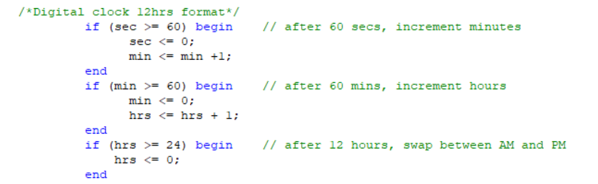
Code walkthrough (Contd.)
The above piece of code sets the link between Hours, Minutes and Seconds. As soon as the second reaches ‘60’ , it is set to 0 and minutes increment by 1. Similarly , as the minute reaches ‘60’ , it is set to 0 and hours increment by 1. And finally as the hour reaches 24, it is set to ‘0’ and the day changes (which is not shown in our project).

Slide 9
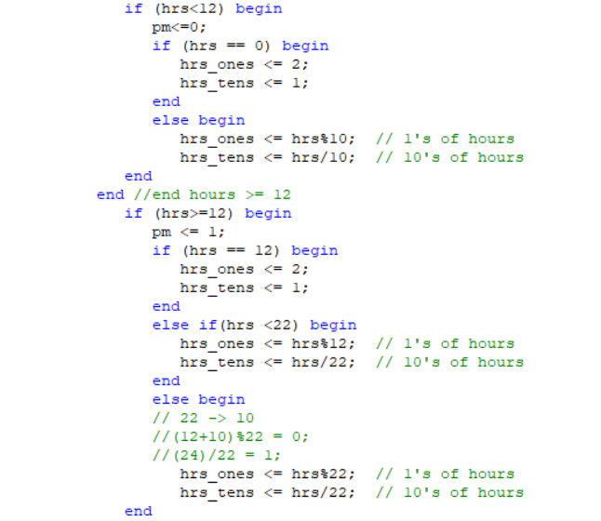
This piece of code shows the solving part of the problem statement. The code displays the set time(24 hr format) in 12 hr format. When it set time is in 12 hr format. It just extract the digits from the hours and displays them. If the set time is above 12, then the above code is used to convert it into 12 hour format and the pm indicator set to 1.

Slide 10
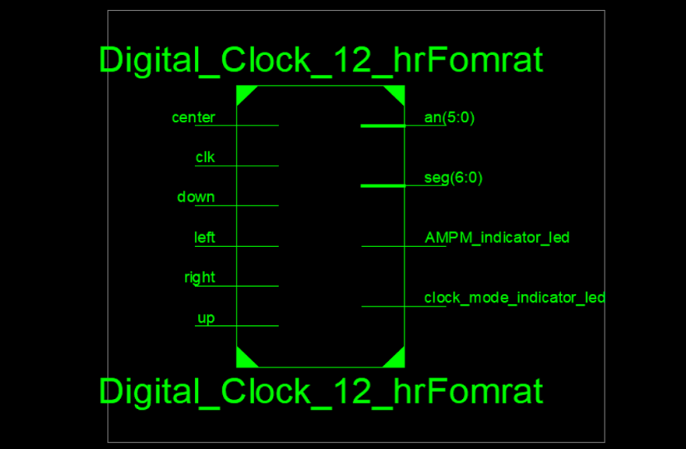
RTL DIAGRAMS
Top module:
Inputs:
CEN: Selecting Clock Mode.
UP: Increment Value.
DOWN: Decrement Value.
RT: Toggle between Hours and minutes.
LF: Toggle between Hours and minutes.
Outputs:
[6:0] seg: 7 bit binary which is required to display digits in seven segment display.
[5:0] an: 6 bits enable which allows us to distinguish between the 4 display units (hrs_tens, hrs_ones, min_tens, min_ones, sec_tens, sec_ones).

Slide 11
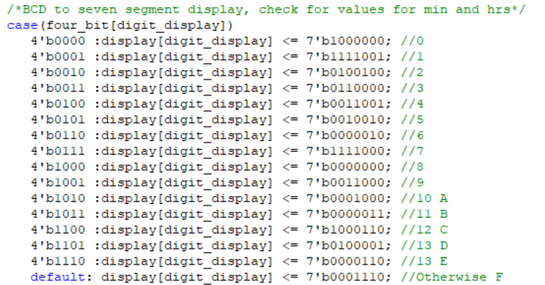
This piece of code shows the conversion of 4 digit binary (BCD) into seven segment display:
It is used to display the given number in the seven segment display box. Each display unit is divided into seven segments in order to display a digit in it. The 4 big input shows the binary form of the number to be displayed. and there is a 7 bit output assigned for each binary number. In the 7 bit binary, the digit 0 shows that the respective bulb in the display is on and the bulb is off when the bit is 1.

Slide 12
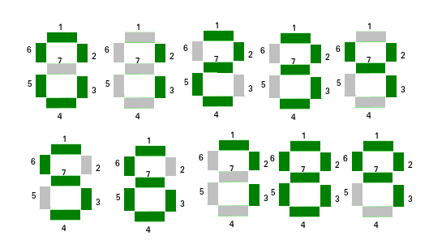
SEVEN SEGMENT DISPLAY
The following figure shows the display of digits in the seven segment display unit. Each digit is shown when a certain combination of 7 bits is given as input. The numbers shown on each digit implies that the certain bits must be given 0 and the rest should be given 1 in the seven bit binary.
Hence, the above piece of code assign the unique 7 bit binary for each digit, to show in the seven segment display.

Slide 13
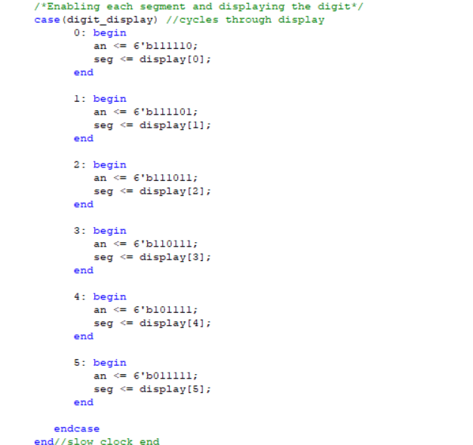
Segment and Enable:
This piece of code helps to update the time, so when there is a change in the time, the enable(an) triggers the specific digit in the display box and the segment(seg) gets the respective updated digit. and all the 6 digits gets updated as the enable triggers each bit.

Slide 14
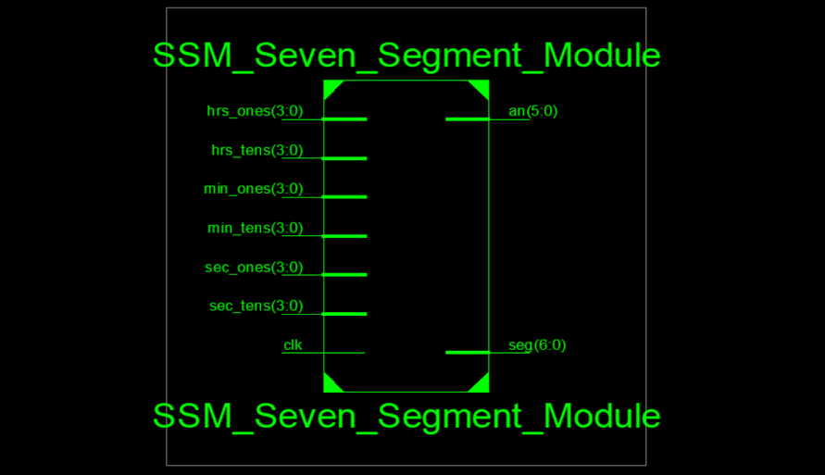
RTL DIAGRAMS
Seven Segment Module:
Inputs:
Clk: The system clock with 100Mhzs frequency and Basys
3 board.
Hrs_tens: tens digit of hours.
Hrs_ones: unit digit of hours.
Min_tens: tens digit of minutes.
Min_ones: unit digit of minutes.
Sec_tens: tens digit of seconds.
Sec_ones: unit digit of seconds.
Outputs:
The outputs are same as in the top module as the output will be a combination of both the modules.
We basically use wires to connect the outputs to the display box.

Slide 15
SIMULATION PROCEDURE
The hours and minutes are broken into tens and ones . The model will take 5 inputs as mentioned above in the Implementation section. When we press the center button, it moves between set mode and display mode based on the previous state. It changes the mode whenever a user presses the center button .
Once the center button enables the display mode , it starts with the value set during the set mode and runs the clock from that point. If it enables the set mode , then the clock stops until it is pressed again. During the set mode , it allows the user to set the time using the other 4 controls i.e., left ,right, up, down. Left is used to shift from one block to immediate left block except for the leftmost block for which it shifts to the rightmost block .
Similarly right is used to shift from one block to immediate right except for the rightmost block for which it moves to the left most block . the block which is under change is indicated with blinking action (same as cursor in PPT).
When the user increases the minutes beyond 59 ,it reflects in the hours(increase by one),resetting the minutes to zero. But when the user goes beyond 12 it alters the AM_PM indicator LED and reset the hours to 1. Once the user got the desired time then he needed to click the center button to start the clock.

Slide 16
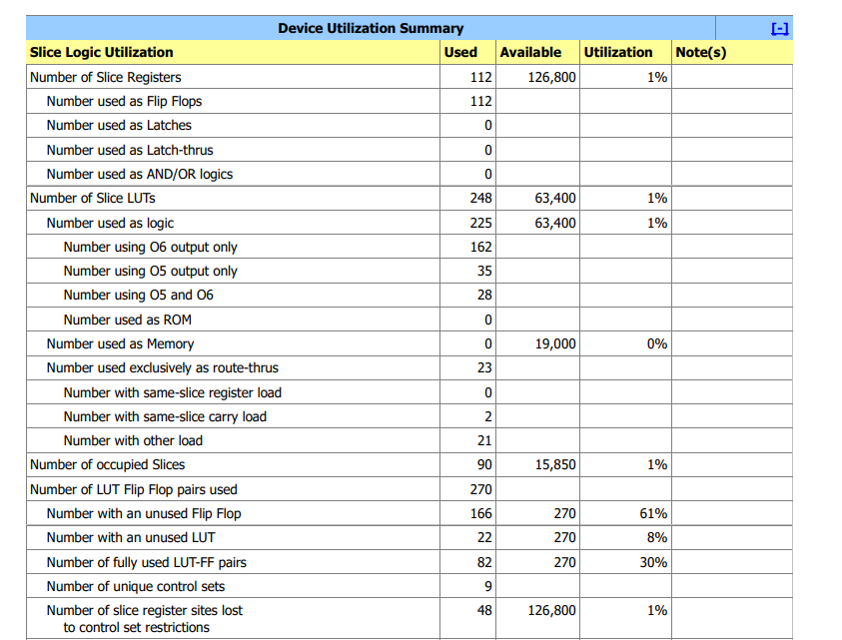
RESULTS TABLE
We have auto-corrected the 24-hours format into 12-hours format .

Slide 17
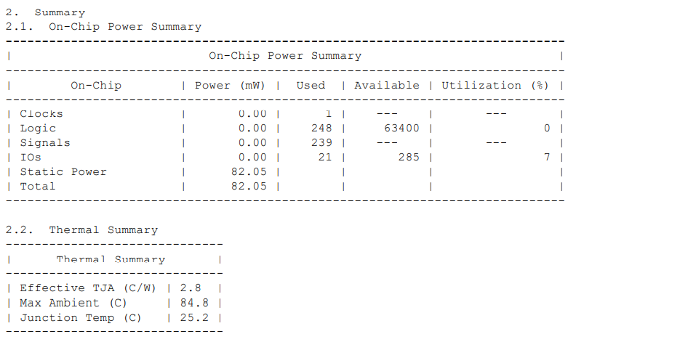
POWER REPORT

Slide 18
Solving
As we have given 24-Hour format to convert to 12-Hour format whenever the time exceeds 12PM, we need to change only hours segments by decreasing it by 12 hours and turning on the AM_PM indicator LED. It can be auto corrected by the Switch already mentioned in the introduction section . Whenever the time is set , it check the switch whether it should display in 24-Hours format or 12-Hours format . When the Switch is changed from 24-Hours-format to 12-Hours format, the program checks whether the set time is greater than 12 or not . If it is greater than 12 ,it is changed to 12-hours format and enables the LED .

Slide 19
ADVANTAGES AND DISADVANTAGES
ADVANTAGES
Set Mode helps us to set the time we wish and run the clock from there.
AM_PM LED Indicator helps us to know whether the displayed time is in AM | PM.
Speed of the clock that we designed is equal to the speed of the system clock. So, whenever we set a time to the clock it runs parallel to the system clock.
We can alter the speed at which the clock runs in the code.
DISADVANTAGES
While setting the time we must ensure that AM_PM Led is on if we wish to set the time in PM.
We aren't giving the output signals simultaneously, rather we change each segment of the 4 blocks one after the other .But it is changed in a short time such that we don't observe this disadvantage .
It only displays the hours and minutes block due to restrictions on the FPGA board.
While setting the time in set_mode, it is possible to change only minutes and hours while the seconds cant be changed manually.

Slide 20
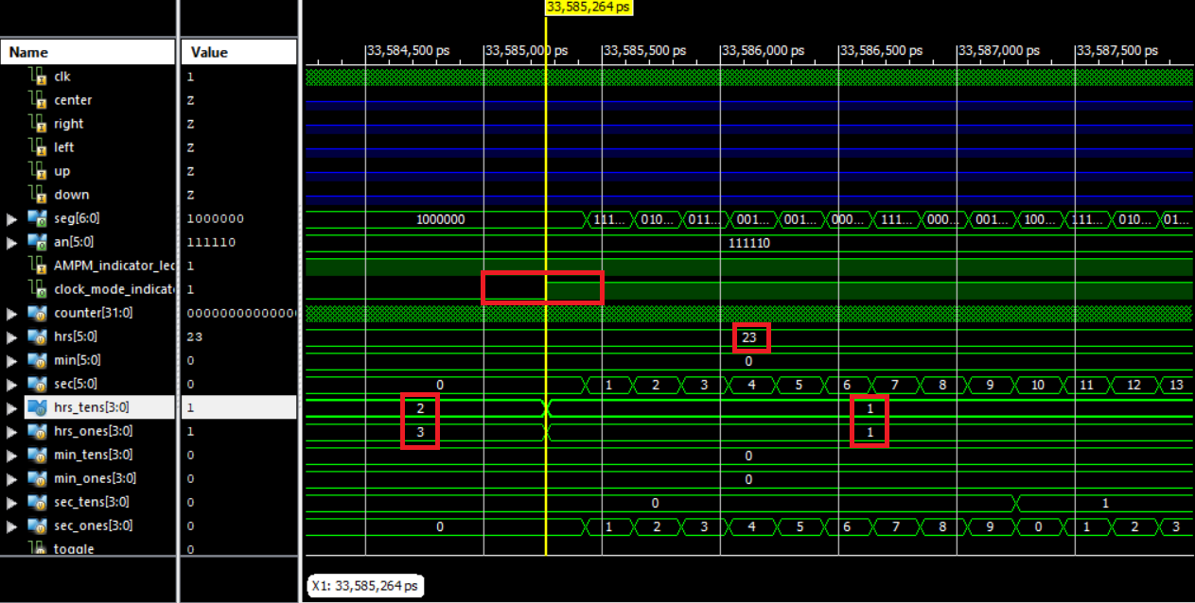
SIMULATION RESULTS
Timing Diagrams:
Timing diagrams are extracted using Xilinx design suite.
The following are the different cases where timing diagram shows changes.
Clock runs when clock mode is 1, allows us to set time when clock mode =0.

Slide 21
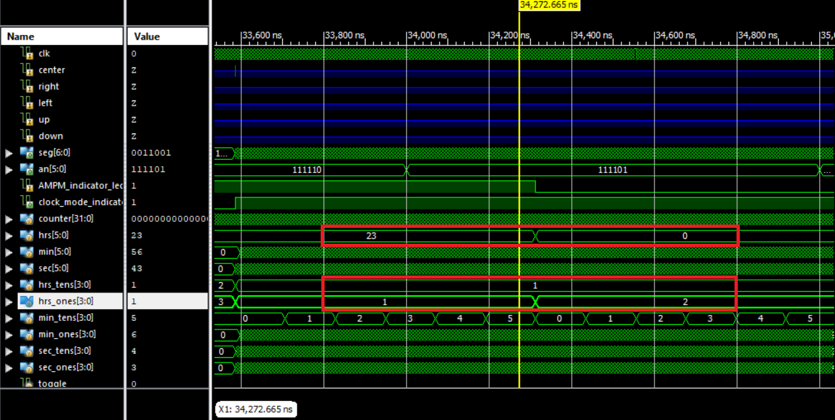
Seconds coming back to 0 after it exceeds 59, Minutes coming back to 0 after it exceeds 59, hours coming back to 0 after it exceeds 23.
Increment of minute for every cycle of seconds, increment of hours for every cycle of minutes.

Slide 22
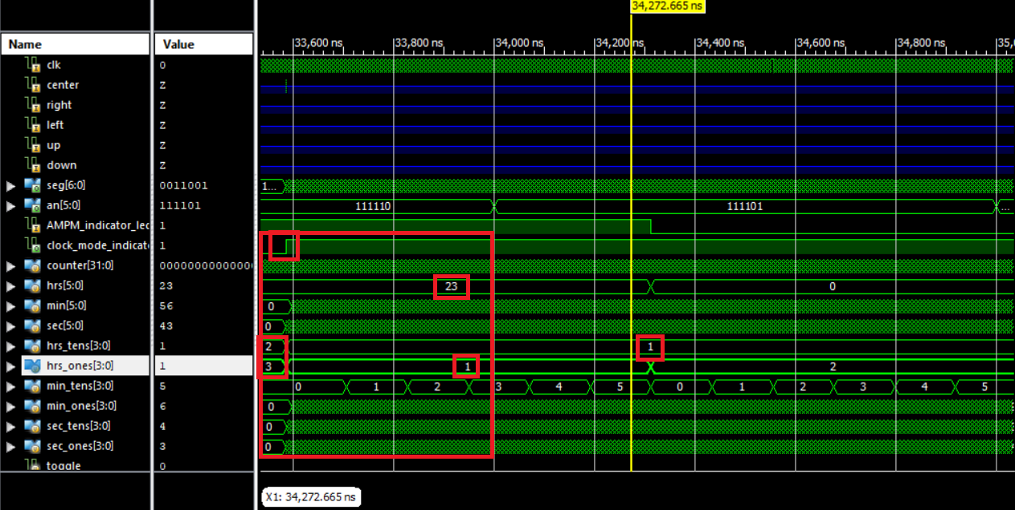
When clock mode is off and the time is set in 24 hr format, when the clock runs, the digits are displayed in 12 hr format(problem statement).

Slide 23
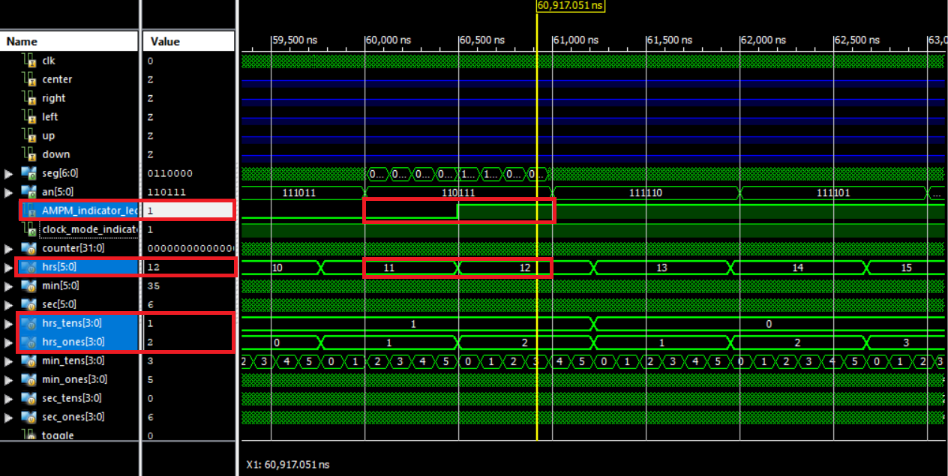
AM/PM Conversion
When the time is set to 11:59:00AM and the clock is set to display mode, we can observe that as soon as the clock time exceeds 12:00:00 noon, the AM/PM indicator changes from 0 to 1, which shows that the time time changes from AM to PM.

Slide 24
CONCLUSION
This project gave us the knowledge about working of counters and digital clocks. By implementing verilog code , We have gained experience about hardware design with the help of Xilinx ISE Design Suite.
We have verified the working of the digital clock we designed with the system clock(PC).
REFERENCES
https://youtu.be/pFHKVLrjOSk
https://youtu.be/YM8s4SfHBPU
https://youtu.be/8_Um6Cx6bD8

Slide 25
THANK
YOU

