Slide 1
SWILLER
DINING MADE SIMPLE
Korada Srinivas Kalyan – 191cs130
Yenumula Venkat kumar – 191cs263
MLSV Sandeep – 191CS226
Tummala ajay – 191Cs259

Slide 2
PROCESS MODEL
Waterfall process model is used in our project SWILLER – DINING MADE SIMPLE. This model is generally applied to the projects where the requirements are very clear and the customer keeps on patience. Different phases of model are as follows.
Feasibility Study
Requirement Gathering and Analysis
System Design
Implementation
Testing
Maintenance
Security

Slide 3
FEASIBILITY STUDY
Feasibility Study determine whether it would be financially and technically feasible to develop the software.
Since it is a hotel management system that provides many services that a management team requires and make their work easier.
This application is cost effective as both admin as well as client modules exists in the same app and various components are comprised into one.
Thus, build this application feels feasible to us with the resources that we have.

Slide 4
REQUIREMENT GATHERING
To automate the managing system of a restaurant for easy use of both client and the management.
To provide fast, efficient and reliable system that manages records of the transactions
To provide an efficient system that allows clients to order food easily
Effective maintenance of the staff
To build a feature rich for automatic billing
To provide a platform itself being a select and order the menus and book services
To maximize profit by increasing efficiency and decreasing overheads without compromising customer satisfaction

Slide 5
REQUIREMENT ANALYSIS
Initially we have listed few ideas upon creating a mobile application with some novelty. Finally settled with Restaurant Management system and created an SRS on it. That SRS includes all the possible requirements to be developed and all the components that must be included in it.
The components are:
Authentication – Login/Sign-Up page for user and admin.
User Home - This contains the menu and the payment portal for both takeaway and dine in.
Table reservation - This screen allows us to reserve vacant tables based on the slots.
Admin Home – This screen consists of staff list and ability to make changes in it.
Profile - Details of the client and the ability to update as their choice.

Slide 6
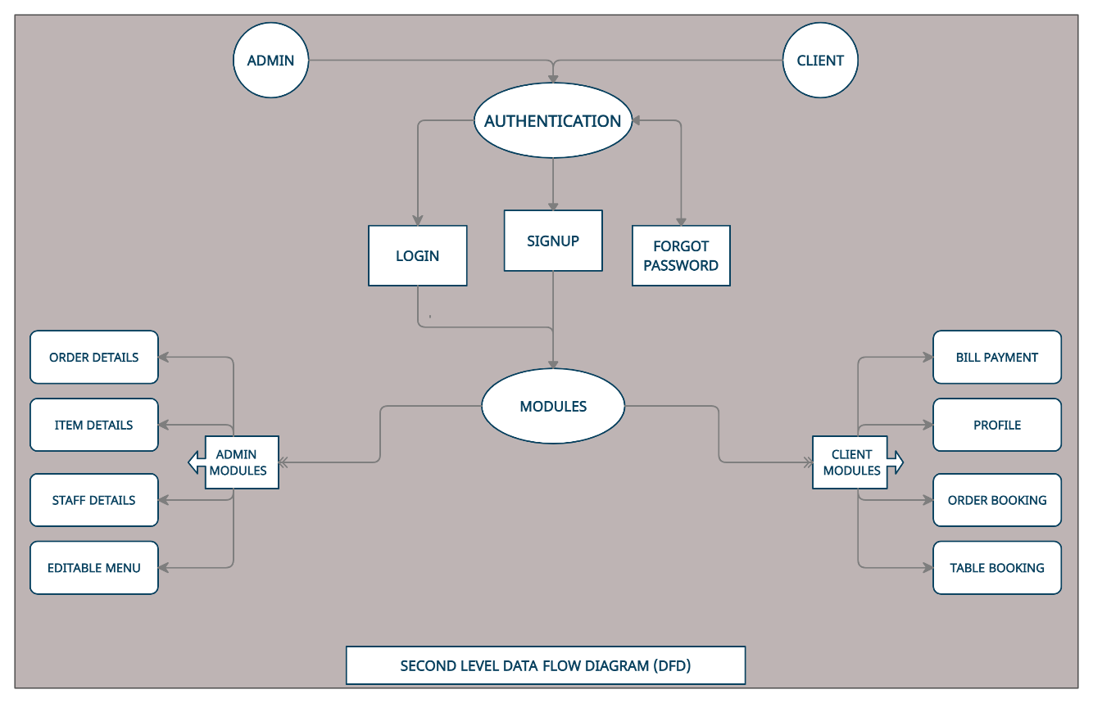
REQUIREMENT ANALYSIS
Based on the above mentioned components screens must be developed in the admin and user modules respectively.
Data Flow diagrams are made basing on the analysis done before. Those diagrams are already shown in the previous labs.

Slide 7
SYSTEM DESIGN
SYSTEM DESIGN
This phase helps in specifying hardware and system requirements and helps in defining the overall system architecture.
The system architecture is developed basing the analysis done in the previous phase.
The software and hardware specifications are analysed in this phase.
The software required to develop the application include:
React Native - Material UI - Expo
Firebase - Android Studio - Text Editor
The hardware that a system require to develop the application are:
Microsoft Windows 7/8/10(32 or 64 bit) - Mac OS X 10.8
> 2GB RAM - 500 MB Disk space - 1GB for Android SDK
The hardware that require to run the application are:
> Android 4.1 - IOS(Pie version-12) - 4Gb to 10GB space in OS
The design phase ends after all the hardware and software requirements are achieved successfully. Some other requirements can also be made while developing the application.

Slide 8
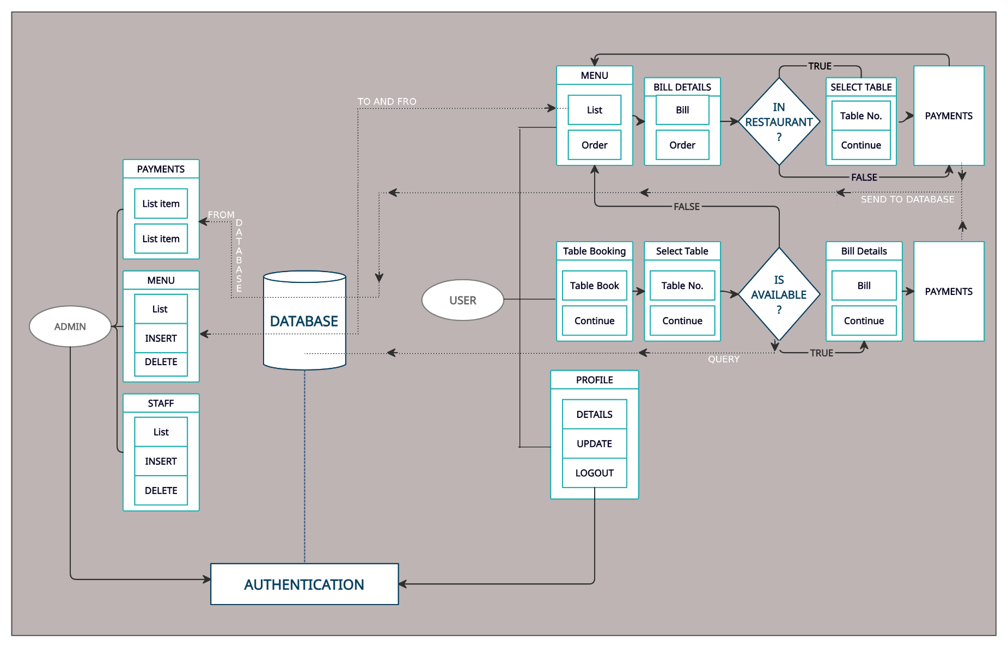
SYSTEM DESIGN

Slide 9
IMPLEMENTATION
After getting all the required software and hardware, the app is build. I.e., the coding part.
This is done using visual studio as our code editor.
Initially the authentication part is developed using a navigation component named Auth Provider that connects to the firebase authentication where the login details of existing users are present and can also add the credentials of new user.
Based on the authentication type(user/admin) it is redirected to home page of user/admin which are developed using screens.
All the different pages that are generated are created in a folder named screens.
Navigation through screens can be managed by created a file named routes where different components can be linked in order to navigate from one screen to other.
A tab bar is implemented in both admin and client sides.
Admin tab bar consists of Staff, menu, payments, tables, profile options where as user tab bar consists of menu, tables and profile options.
The resulting screens are shown below:

Slide 10
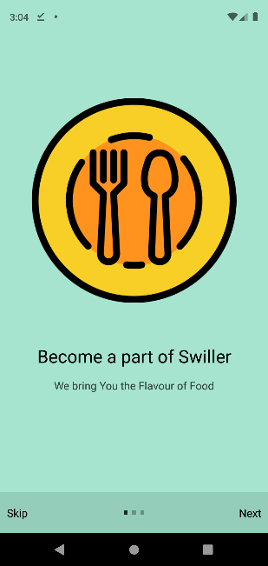
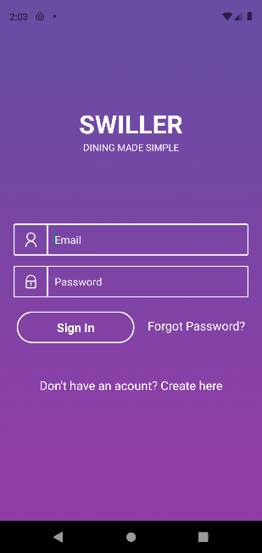
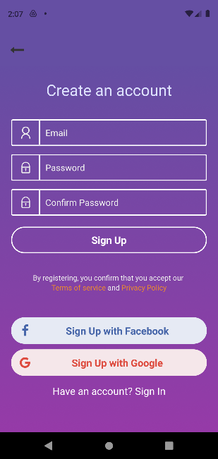
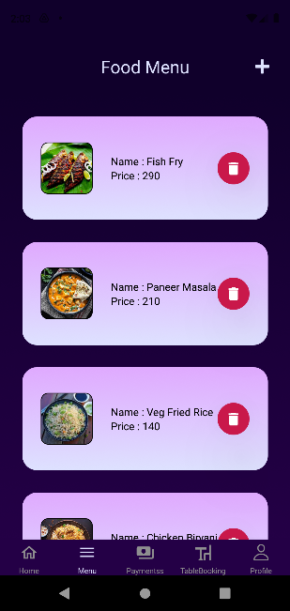
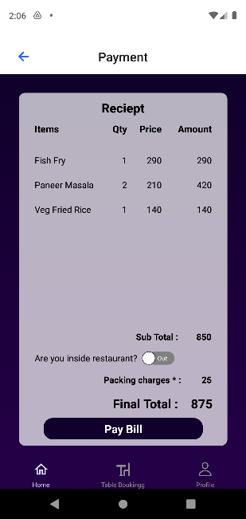
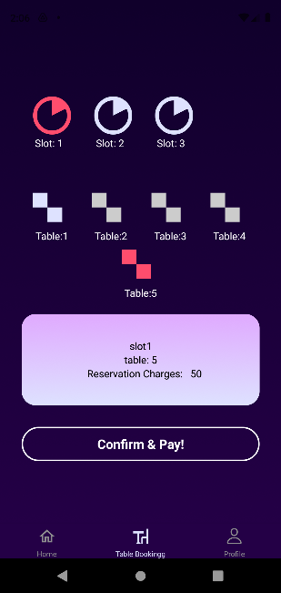
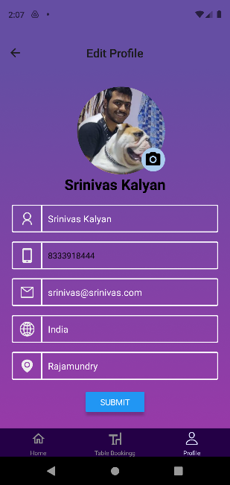
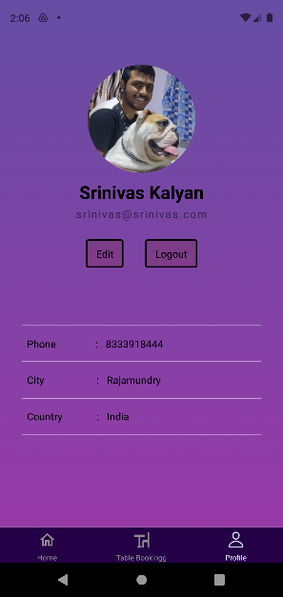
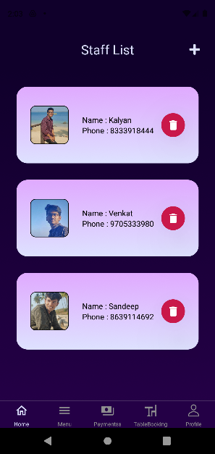
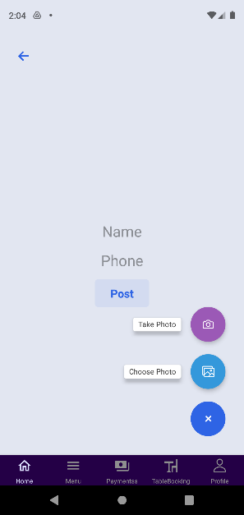
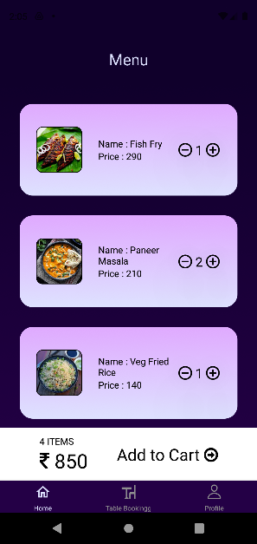
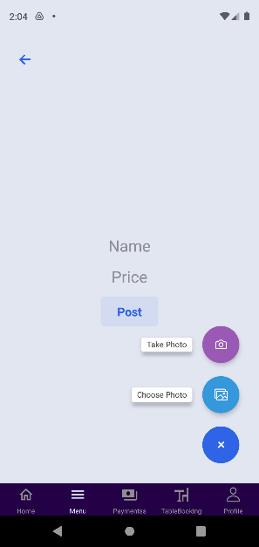
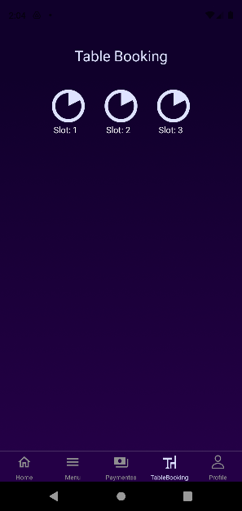
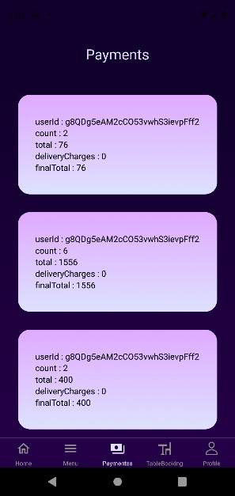
IMPLEMENTATION

Slide 11
TESTING
We have tested our application using firebase testlab which is a cloud-based app testing tool that lets an app test on a range of devices and configurations and displays the result in a test matrix.
From the list of various tests we have chose robo test to test our application which captures the log files and saves a series of screenshots and creates a video based on the simulation process.
The robo test crawl shows the stats regarding the actions, activities and screens that occur during the test.
A complete flowchart is generated which runs through the entire application and trigger each activity buttons and test in several ways possible.
Few bugs regarding the authentication page have been trigger and have been rectified later.
A final report is generated which shows the compatibility of the application.
The application is tested again after rectifying the bugs and a final report is generated where all the bugs have been rectified, stating the app is safe to use.

Slide 12
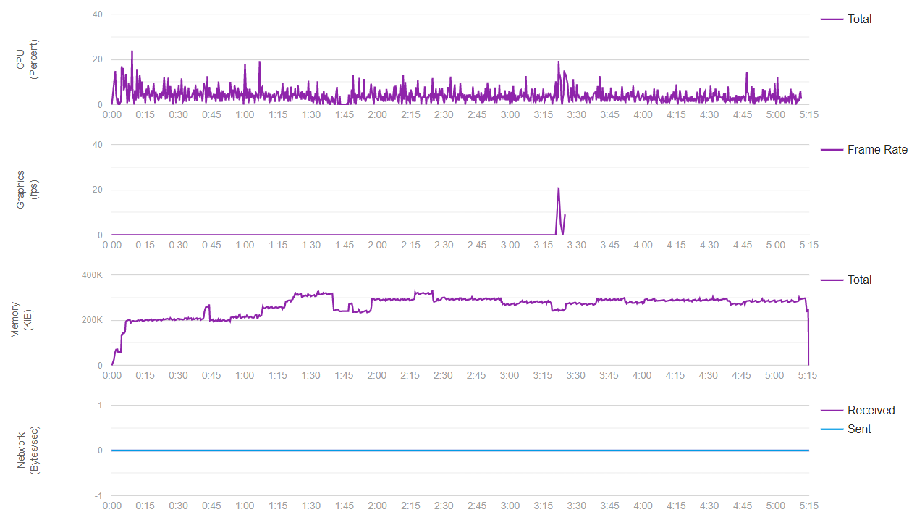
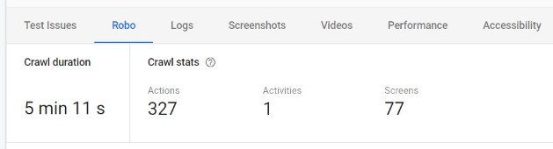
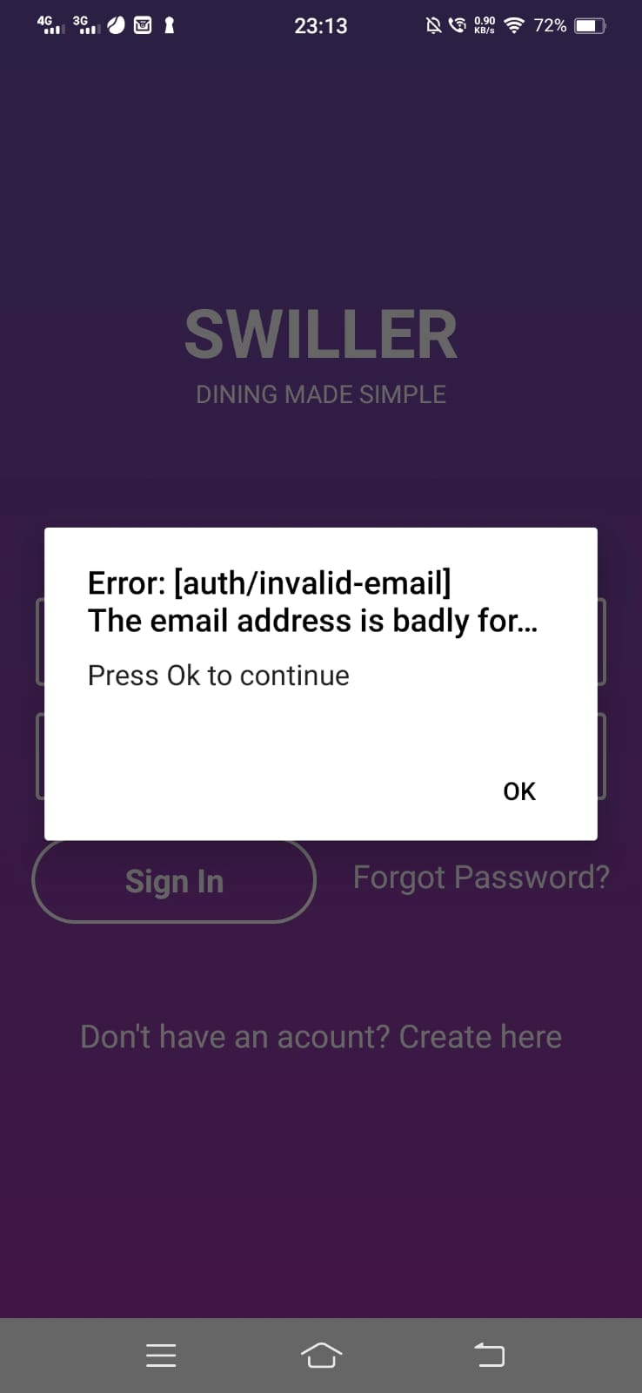
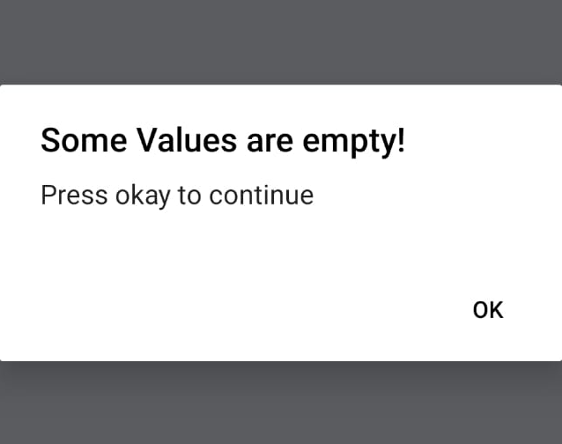
TESTING

Slide 13
MAINTAINANCE
As we know maintenance is an important part of the cycle that comprises the major part(around 60%) of the entire waterfall model. This is the process of enhancing and optimizing deployed software and rectifying defects.
Our application is maintained under the 4 categories of maintenance namely,
Corrective Maintenance – Majority of the bugs occurred during testing are rectified and some are to be taken care of. Once the app gets deployed, then some other bugs can be found and rectified based on user feedbacks.
Adaptive Maintenance – Implementing a real payment module when the application is set to release. Any further implementations can be taken care of based on user requests.
Perfective Maintenance – Some asynchronous actions while retrieving data from the database can be taken care of by providing loading screens or by creating some default component when the data is being rendered.
Preventive Maintenance – Technologies used in the development are of latest version. So, this issues will not occur in near time. This could be taken care later when required. A cloud storage that lasts longer must be chosen so that we could have a stable and secure database.

Slide 14
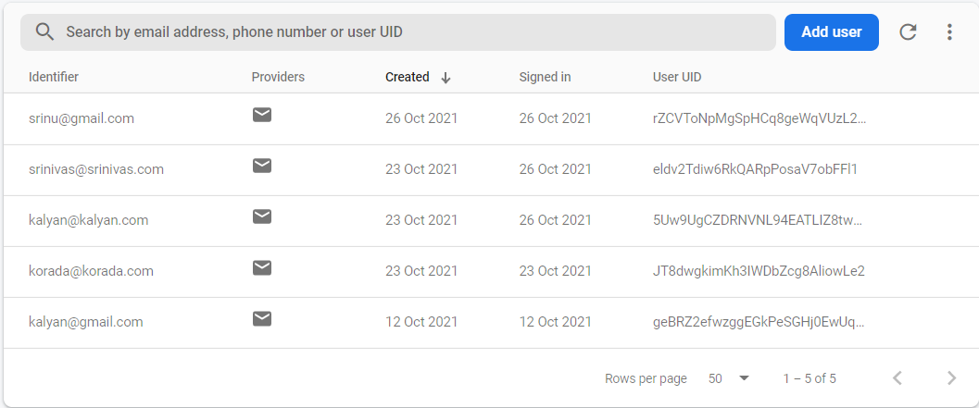
SECURITY
Coming to security concerns, Firebase Security Rules work by matching a pattern against database paths, and then applying custom conditions to allow access to data at those paths. All Rules across Firebase products have a path-matching component and a conditional statement allowing read or write access.
We have used O-Auth authentication that hashes the passwords during login so that the passwords cannot be retried even when the person gets the hash code. Each password will have a specific hash code that cannot be decoded back. So, this makes the authentication secure and make the users feel safe using our application.

Slide 15
SUMMARY
Swiller is an full stack android application that tries to automate the services of a restaurant
We aim to provide the basic services that we usually feel more tiring at a restaurant
The Application can be further improved by including many other modules like become a staff member, order status, user bookings etc..,
Overall this project helps in understanding the concepts of software Engineering.

Slide 16
THANK YOU

