Slide 1
Supply-chain-Analysis-Client-Project Project-Team-ID: PTID-CDA-MAR-25-402

Slide 2
Slide 1: Title Slide Title: Supply Chain Analysis Report Subtitle: Overview of Product Performance, Inventory, Transportation & Manufacturing

Slide 3
Slide 2: Executive Summary Content: Total Revenue: ₹5.77M Total Cost: ₹52.9K Key locations: Mumbai, Chennai, Delhi, Bangalore, Kolkata Focus Areas: Product performance, logistics, inventory levels, lead times.

Slide 4
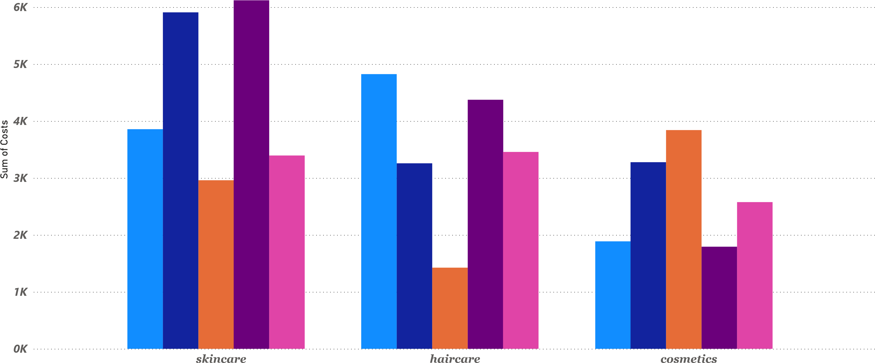
Product Performance : Revenue VS Cost by Location

Slide 5
Slide 3: Revenue vs Cost by Location Chart: Bar chart Insights: Mumbai generated the highest revenue (₹34.3K) Bangalore had the lowest cost (₹815.15) Delhi had a good revenue-to-cost efficiency

Slide 6
Product: Sales by Region
13
K (2.05%
)
102.6
K (16.45%
)
137.08K (21.98%)
5
K (0.87%
)
10
K (1.56%
)
119.14K (19.1%)
81.03
K (12.99%
)
9
K (1.41%
)
9
K (1.51%
)
137.76K (22.09%)

Slide 7
Slide 4: Product Sales by Region
Chart: Pie or column chart by Product type and region
In sights
: Top-selling categories: cosmetics and skincare Strong sales concentration in Mumbai and Kolkata

Slide 8
Route-Wise Revenue –Contribution by Location
10
K (1.56%
)
81.03
K (12.99%
)
137.76K (22.09%)
5
K (0.87%
)
9
K (1.51%
102.6
K (16.45%
)
)
9
K (1.41%
)
137.08K (21.98%)
119.14K (19.1%)
13
K (2.05%
)

Slide 9
Slide 5: Route-Wise Revenue Contribution
Chart: Stacked bar or map
Insights:
Mumbai and Kolkata contribute over 44% of route-based revenue
Suggests regional logistics strengths

Slide 10
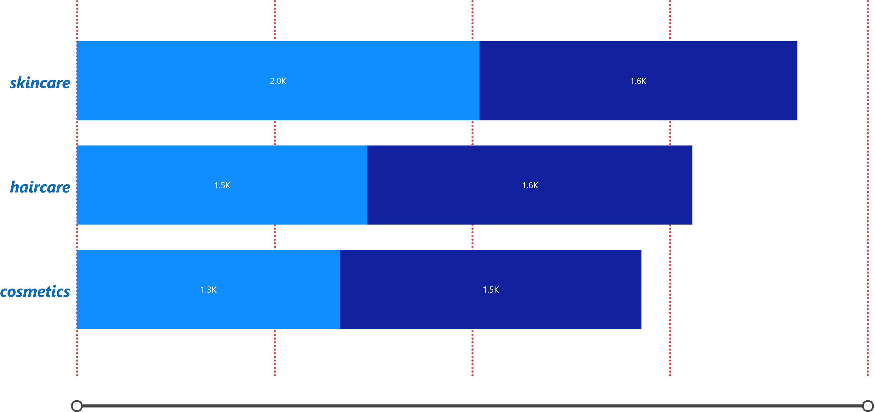
Inventory Levels Overview

Slide 11
Slide 6: Inventory Levels Overview
Chart: Clustered bar (Availability vs Stock Levels)
Insights:
Balanced availability across most product types
Overstocks identified in certain regions

Slide 12
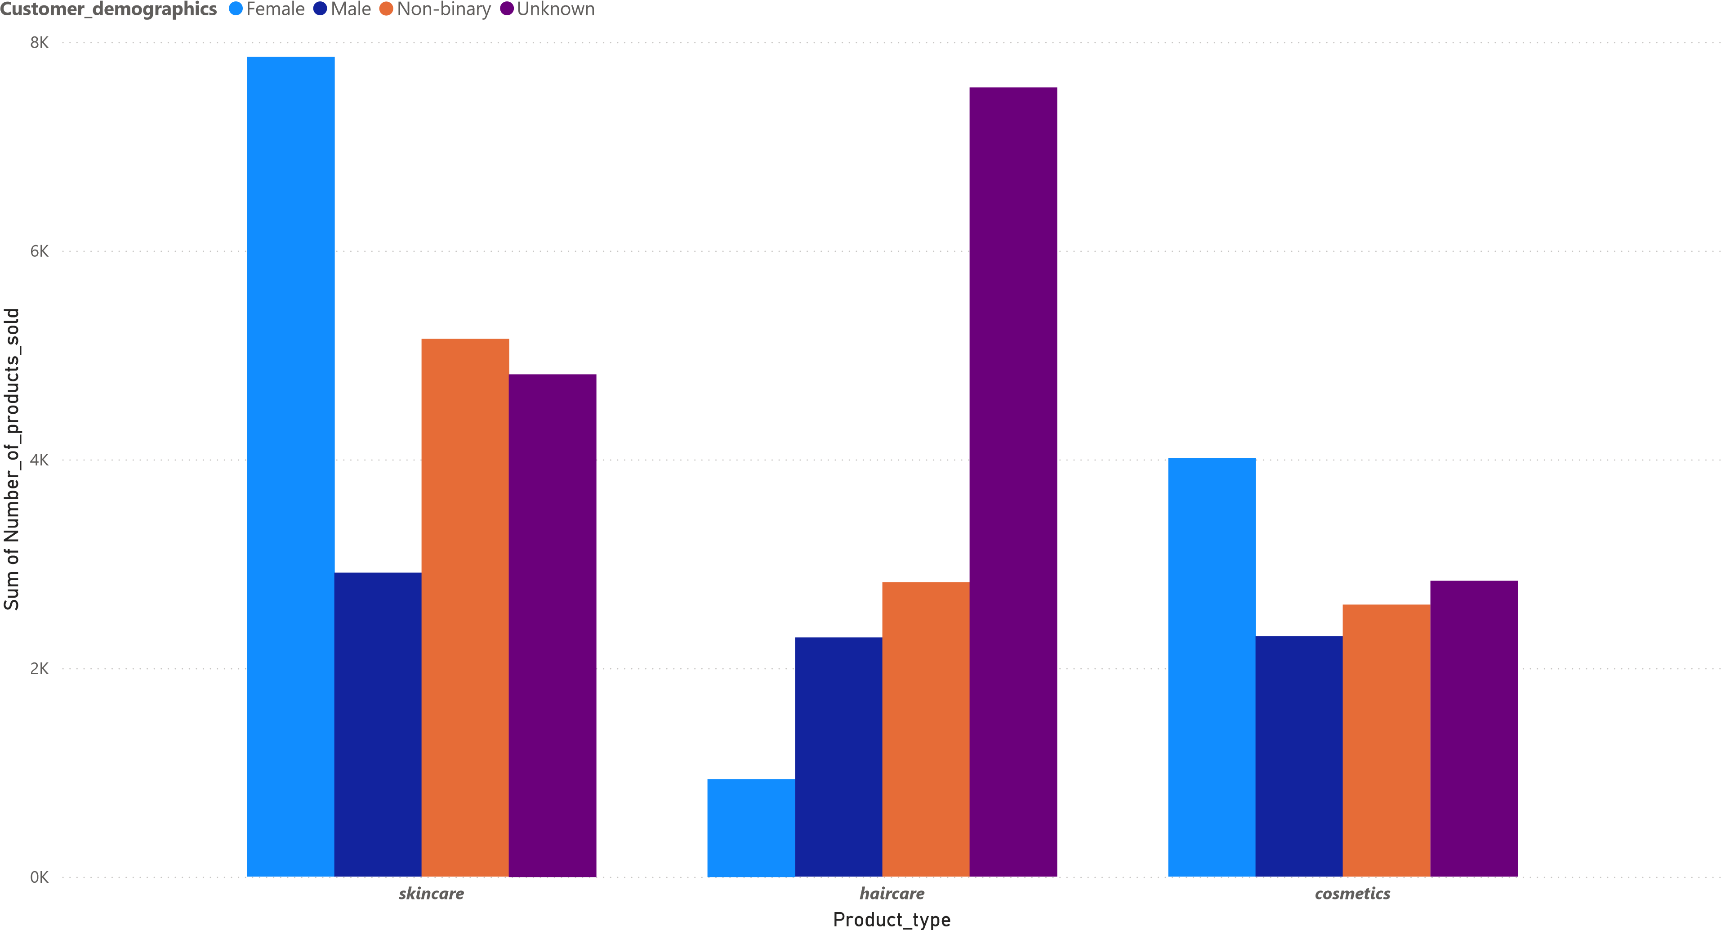
Product Sales vs Customer Demographics

Slide 13
Slide 7: Product Sales vs Customer Demographics
Chart: Heatmap or matrix (Product Type x Customer Segment)
Insights:
Skincare popular across all demographics
Cosmetics more targeted to specific age groups

Slide 14
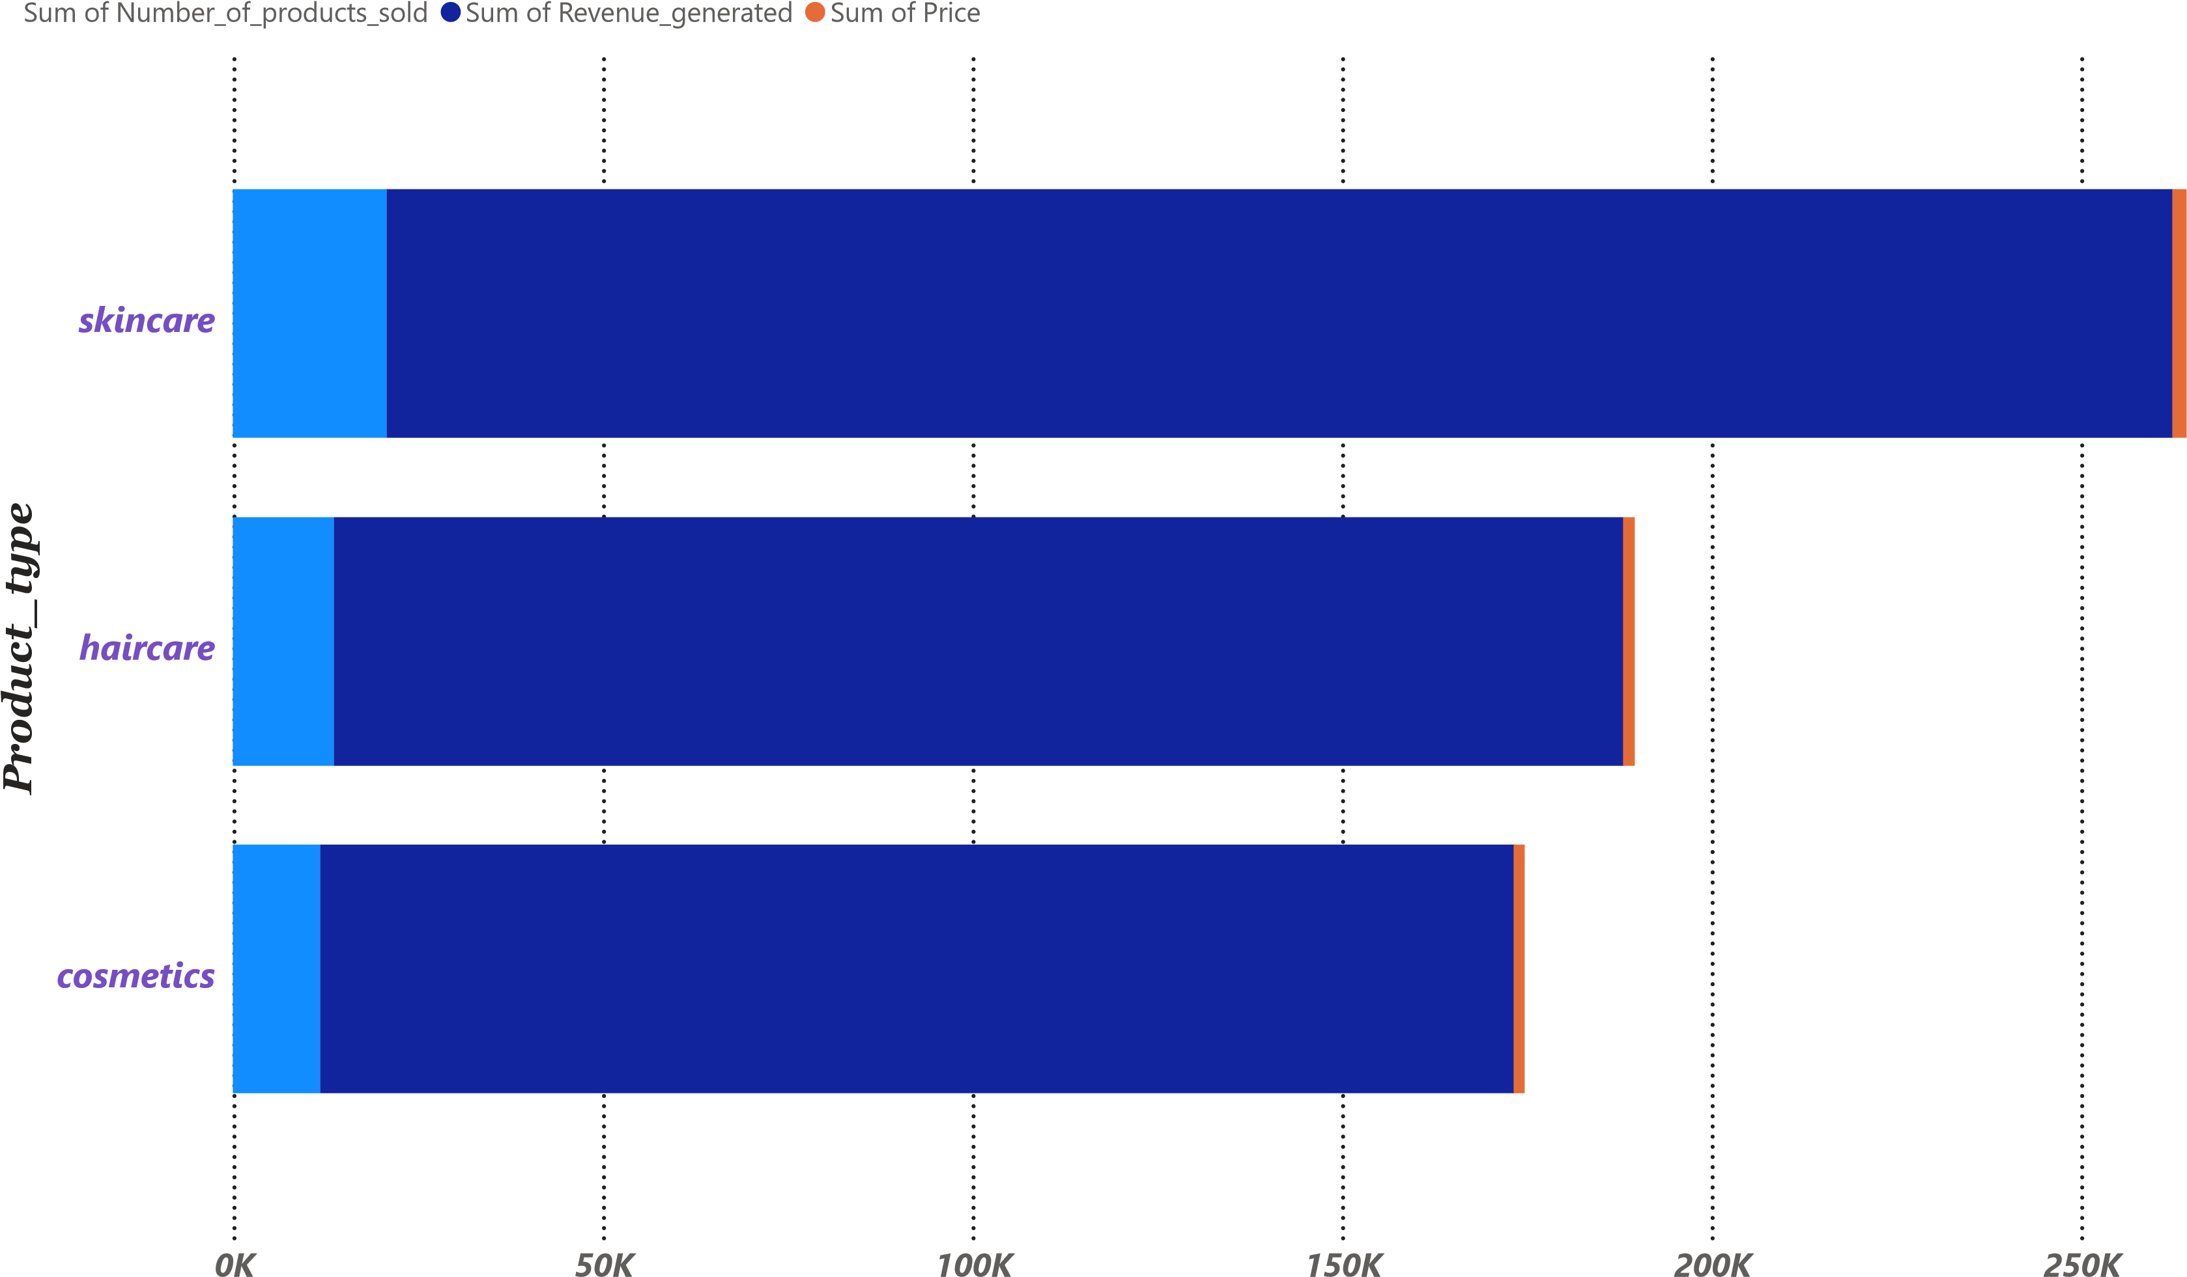
Revenue & Pricing Analysis

Slide 15
Slide 8: Revenue & Pricing Analysis
Chart: Combo chart (Sales Volume, Revenue, and Average Price)
Insights: Strong price correlation with product type
Products priced higher have slightly lower volumes

Slide 16
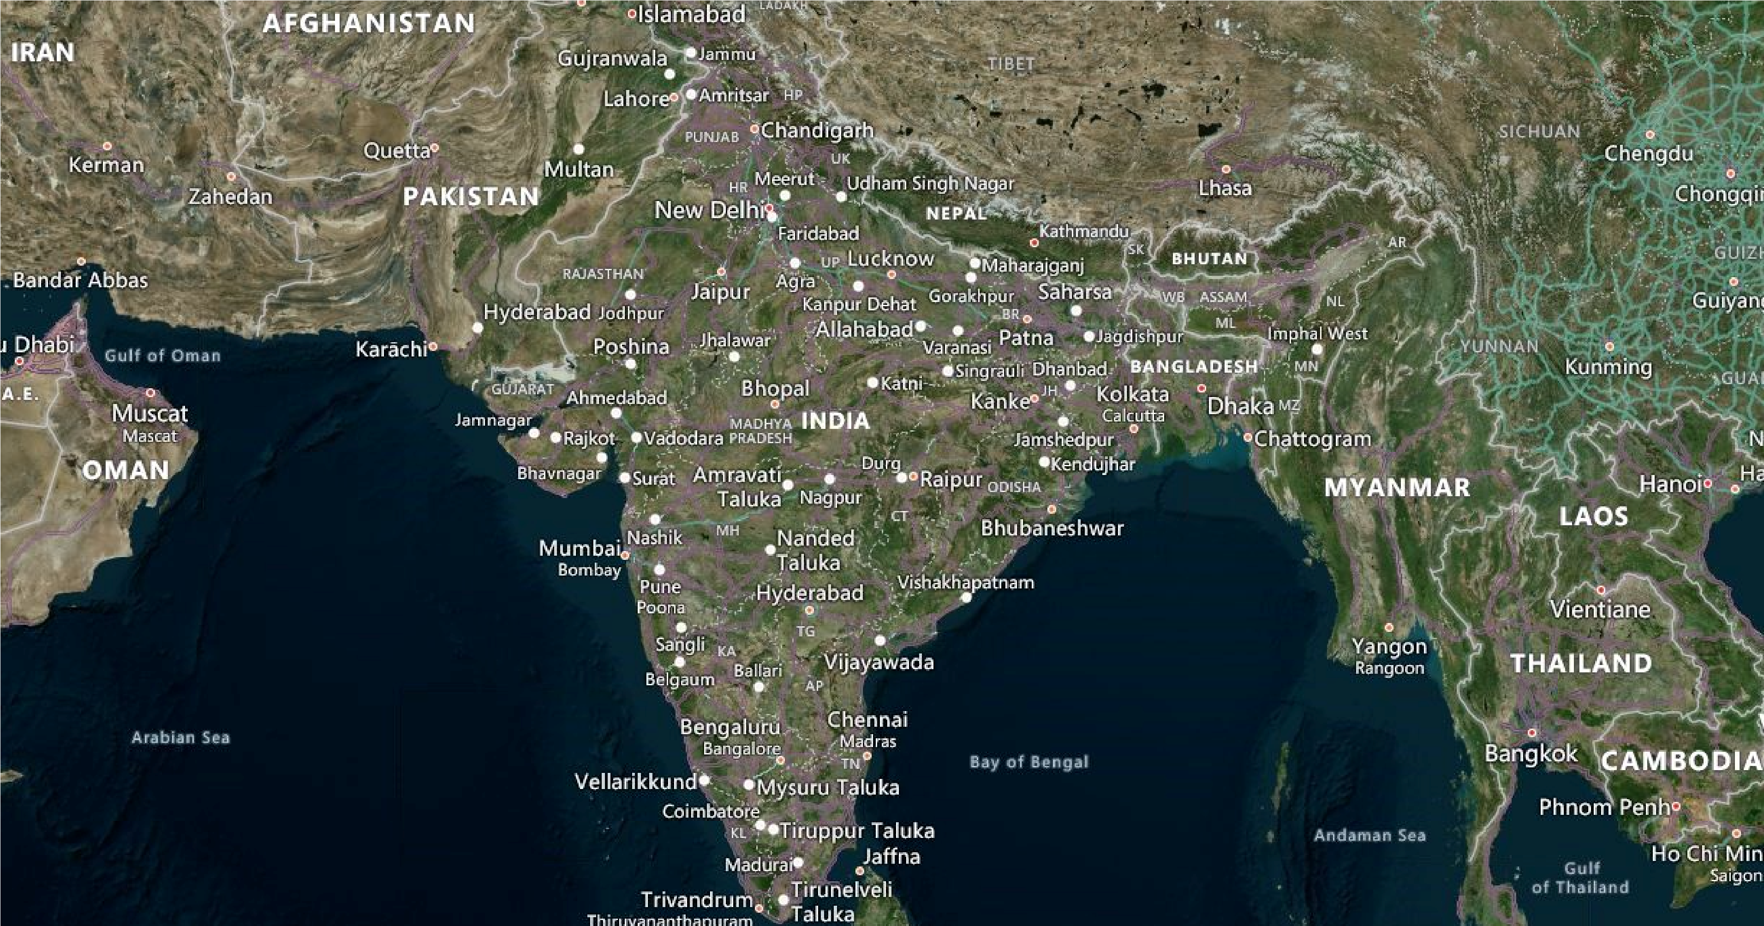

Transportation Cost and Mode Comparison
Transportation_modes
Air
Rail
Road
Sea

Slide 17
Slide 9: Transportation Cost and Mode Comparison
Chart: Stacked column by mode (Air, Road, Rail, Sea)
Insights: Road transport used most, but also highest cost
Sea transport is least used, possibly underutilized

Slide 18
Product Inspection & Defect Rates Slide 10 :
Chart: Stacked bar by product type (Pass, Fail, Pending)
Insights: Cosmetics have the lowest defect rate
Skincare has the highest pending inspections

Slide 19
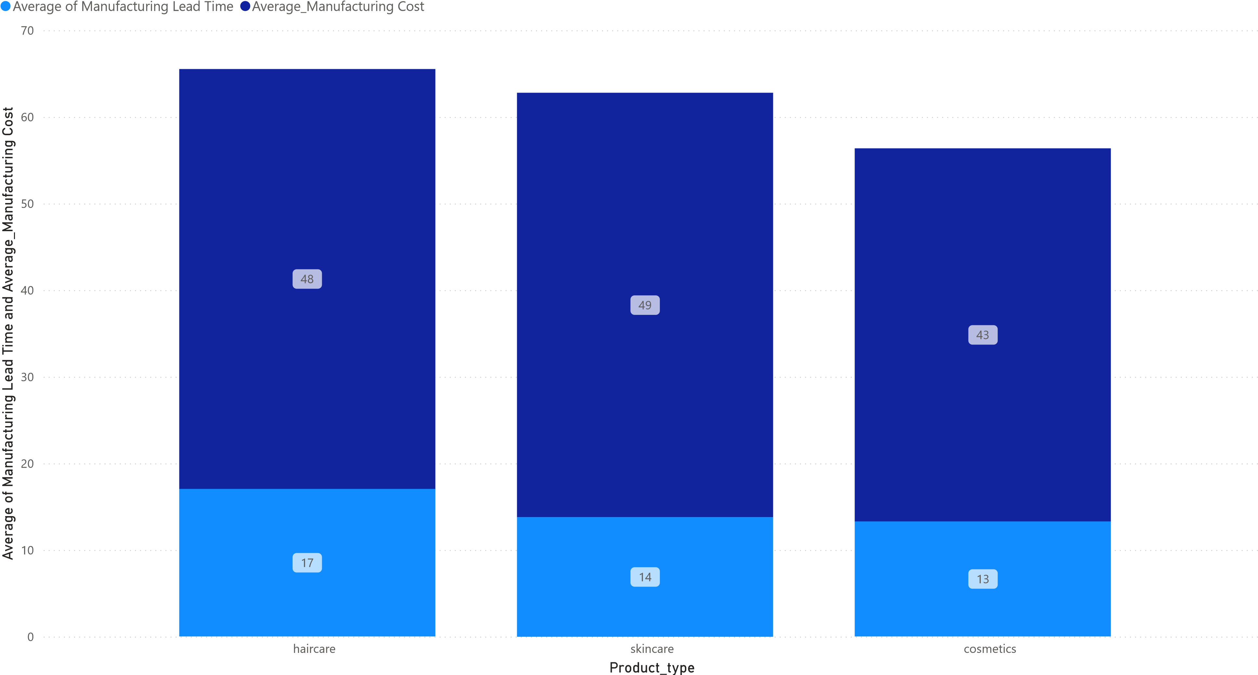
Manufacturing Lead Time & Costs

Slide 20
Slide 11: Manufacturing Lead Time & Costs
Chart: Line chart (Lead Time vs Avg Cost per Product Type)
Insights: Haircare has highest cost and longest lead time
Cosmetics show best efficiency in time and cost

Slide 21
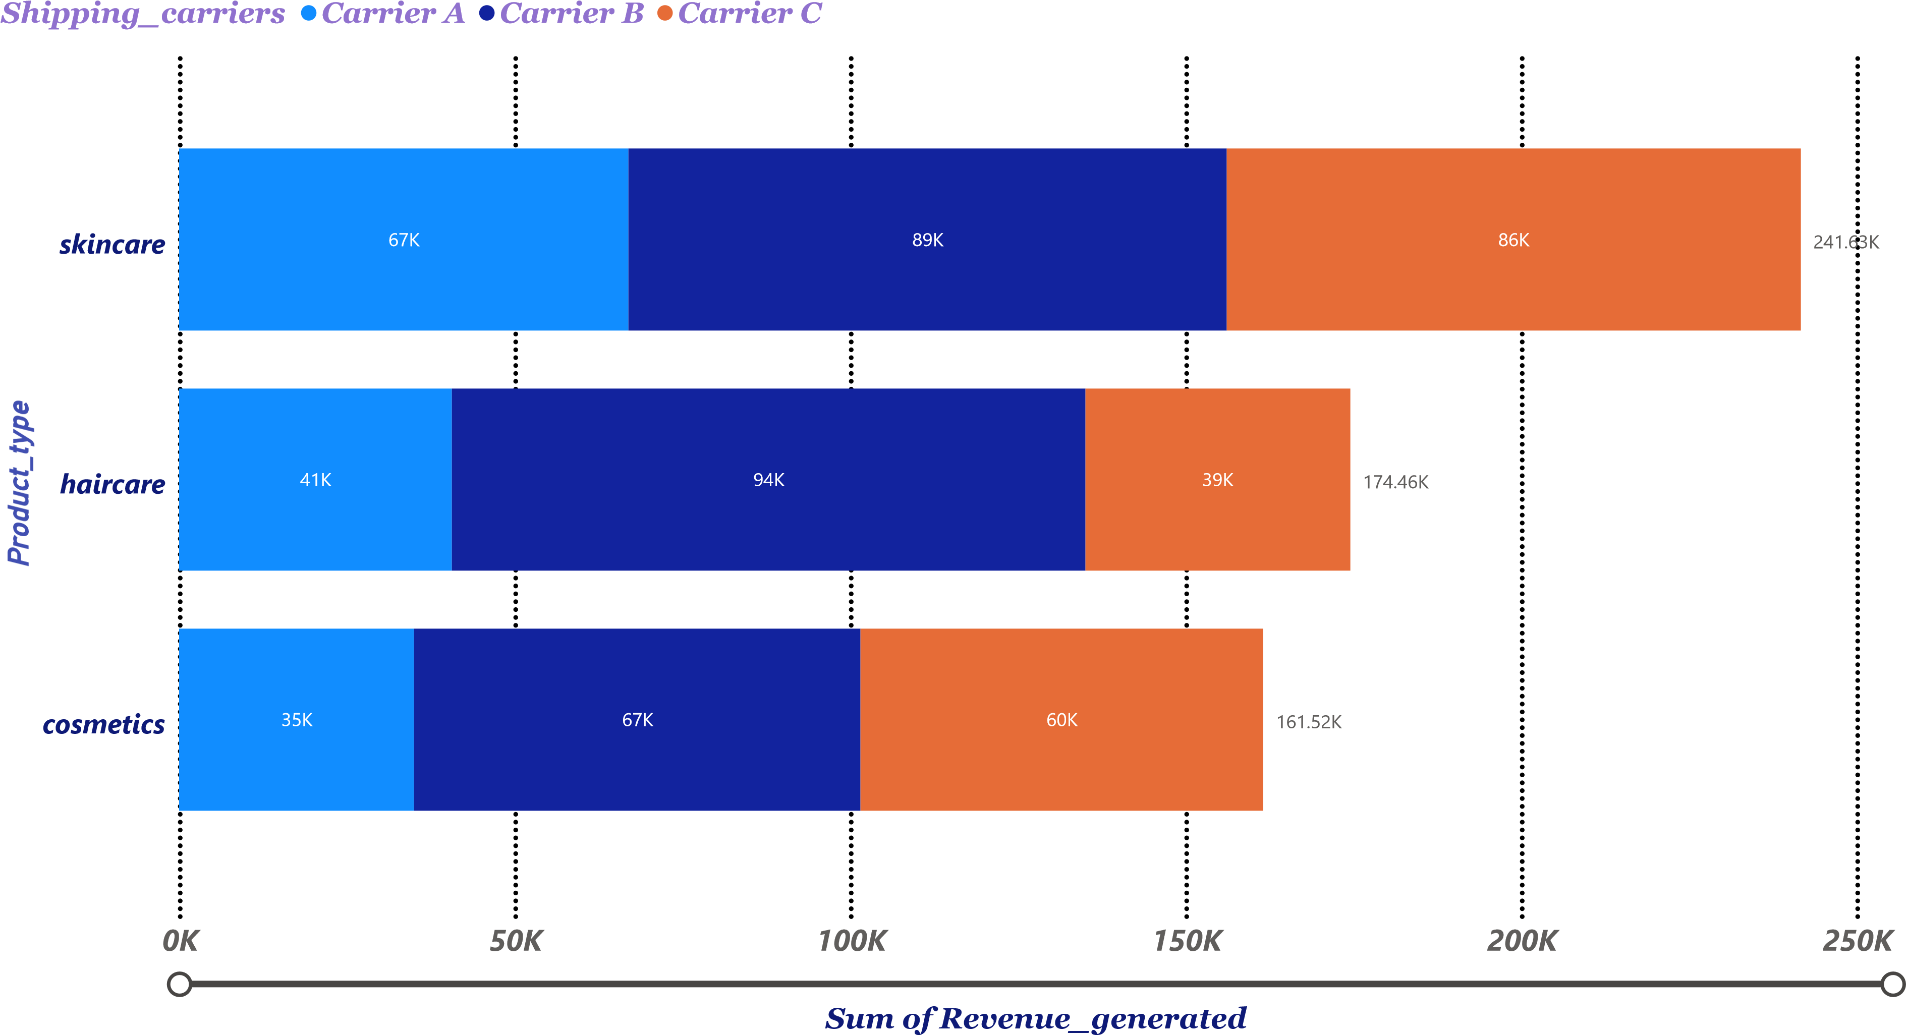
Shipping Carrier & Route Profitability

Slide 22
Slide 12: Shipping Carrier & Route Profitability
Chart: Tree map or combo chart
Insights:
Route selection impacts profit significantly
Need to optimize high-cost low-profit routes

