Slide 1
Data Pages

Slide 2
Data Pages in Constellation
In Pega Traditional UI architecture, Data Page processing is run completely on the server side, while in the Constellation architecture Data Page processing can also be handled on the client side.
Data Pages and the DX API
DX APIs are stateless, which means that after a request is fulfilled, the session (requestor) that processed the request is closed. This means that:
Any thread/requestor-level Data Pages that are created to fulfill the request are not available for the next request from the same browser session.
With the Constellation architecture, Data Pages are able to be cached on the client side to further improve application performance.
So as not to lose all caching benefits that Data Pages provide, a cache is maintained on the server.
Note: With the DX API, Data Pages are also referred to as Data Views.

Slide 3
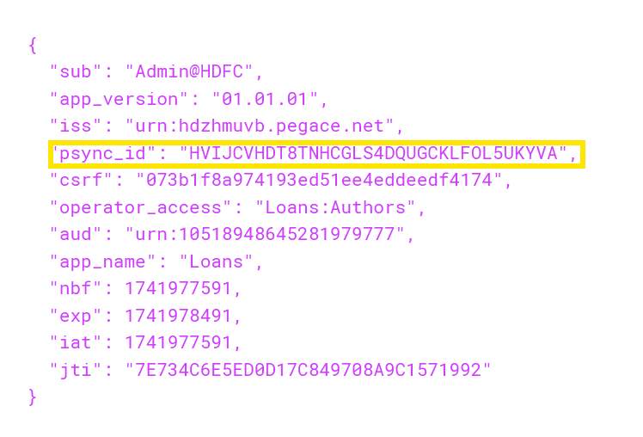
Data Page server-side cache
With Constellation, a cache of Data Pages is kept on the server, but because of the stateless architecture there needs to be a way to link a browser session to the thread/requestor-level Data Pages created from that session.
The cache is maintained using the psync_id element, which is passed in the payload of the Pega-AAT cookie, as seen in the following figure:
Pega-AAT is a JWT token. AAT stand for Authorized Access Token and is generated by Pega's OAuth2.0/authorize endpoint.

Slide 4
The cache is maintained either in the JVM memory or in the database.
Read-only Data Pages are cached at server-side with the exceptions, as follows:
Thread and Requestor scope read-only pages are cached, except when:
Reload once per interaction is selected.
Keyed page access is enabled.
Clear pages after non-use is selected.
Editable Data Pages do not get cached.
Single-page Data pages do not get cached.
Client-side caching
In the Constellation architecture, Data Pages are also eligible to be cached on the client side to provide further performance benefits.
We can check the contents of the client-side cache using the function PCore.getDataPageUtils(); Use this in browser's DevTools Console.

Slide 5
Allow querying any column (Pega connection only)
To use a Data Page in a Constellation , this setting must be enabled

