Slide 1
User Interface
Principles , Guidelines and Theories

Slide 2
Principle 1 : Recognize User Diversity
Usage profiles
  “Know thy user”
  All design should begin with an understanding of the intended users.
  population profiles that reflect age, gender, physical abilities, education, cultural or ethnic background, training, motivation, goals, and personality.
  user communities—such as high-school teachers, nurses, doctors, computer programmers, museum patrons, or librarians - have various combinations of knowledge and usage patterns.
  Other variables - regional differences, location, economic profile, disabilities, and attitudes toward using technology, poor reading skills, limited education, and low motivation.

Slide 3
Three classes of usage
Novice or first-time users
  The number of actions should be small, so they can carry out simple tasks successfully and thus reduce anxiety, build confidence, and gain positive reinforcement.
  Restricting vocabulary to a small number of familiar, consistently used concept terms.
  Informative feedback about the accomplishment of each task is helpful
  specific error messages should be provided when users make mistakes
  paper manuals and step-by-step online tutorials may be effective

Slide 4
Cont..
Knowledgeable intermittent users
  irregular or not continuous user.
  They have stable task concepts and broad knowledge of interface but have difficulty retaining the structure of menus or the location of features.
  Orderly structure in the menus, consistent terminology, and high interface appearance, which emphasizes recognition rather than recall.
  Consistent sequences of actions, meaningful messages, and guides to frequent patterns of usage.
  online help screens to fill in missing pieces of task or interface knowledge will benefit.

Slide 5
Cont..
3. Expert frequent users
Familiar with the task and interface concepts and seek to get their work done quickly.
demand rapid response times, brief and non-distracting feedback, and the shortcuts to carry out actions with just a few keystrokes or selections
macro or other abbreviated form to reduce the number of steps.

Slide 6
Task profiles and user-needs assessment
After the user profile, the developers must identify the tasks.
Every designer would agree that the set of tasks must be determined before design can proceed, but too often the task analysis is done informally or implicitly.
High-level task actions can be decomposed into multiple middle-level task actions, which can be further refined into atomic actions that the user executes with a single command, menu selection, and so on.

Slide 7
Task profiles and user-needs assessment (cont..)
Example: In MS-Word
  Frequent actions - performed by special keys
  Intermediately frequent actions - performed by a single letter plus the Ctrl key
  Infrequent actions or complex actions - sequence of menu selections or form fill-ins.

Slide 8
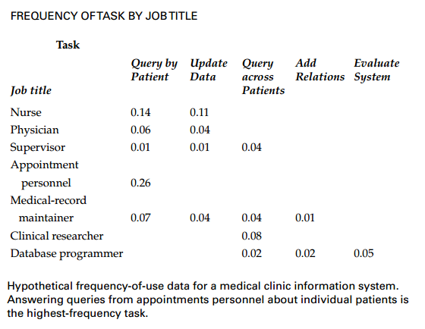

Slide 9
Principle 1 (cont..)
Interaction styles
  Direct manipulation
  Menu selection
  Form fill-in
  Spreadsheets
  Command language
  Natural language
  Question/answer interfaces
  Metaphor
  Web Navigation
  3D Interface

Slide 10
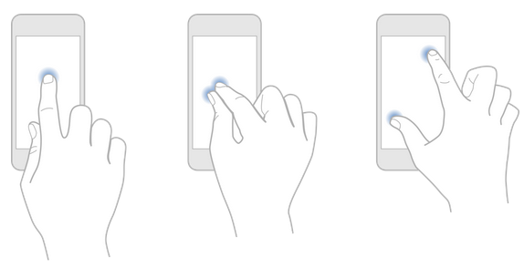
  Direct manipulation
Users point at visual representations of object and actions, carry out tasks rapidly and see immediate results; keyboard control replaced by cursor-motion control devices.
Designers need to choose appropriate icons and graphics to successfully "immerse" user - minimal user training indicated.
Advantage
  Visually presents task concepts
  Allows easy learning
  Allows easy retention
  Allows errors to be avoided
  Encourages exploration
  Affords high subjective satisfaction
Disadvantages
  May be hard to program
  May require graphics display and pointing devices

Slide 11
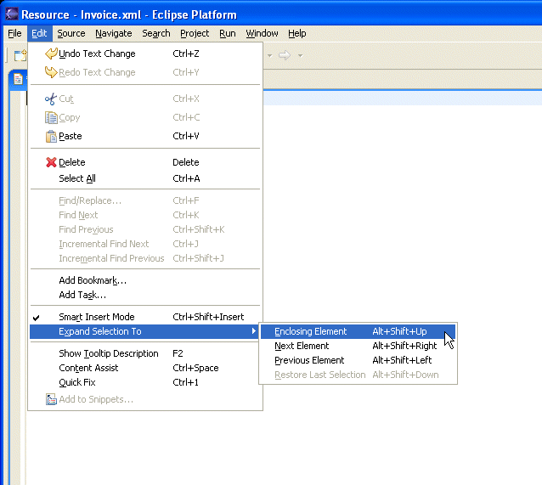
  Menu selection
User read list items; select appropriately according to task; apply syntax to indicate selection; confirm choice; initiate action; observe effect
Designers may need to use careful task analysis to ensure all functions appropriate and consistent in use
Advantage
  Shortens learning
  Reduces keystrokes
  Structures decision making
  Permits use of dialog-management tools
  Allows easy support of error handling
Disadvantages
  Presents danger of many menus
  May slow frequent users
  Consumes screen space
  Requires rapid display rate

Slide 12
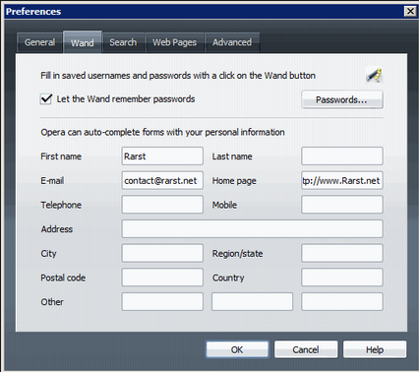
  Form fill-in
User see a display of related fields; move a cursor among the fields, and enter data as appropriate
Designer need to ensure that users understand field labels, appropriate values and the data-entry method, and are capable of responding to error messages - some user training may be necessary.
Advantage
  Simplifies data entry
  Requires modest training
  Gives convenient assistance
  Permits use of form-management tools
Disadvantage
  Consumes screen space

Slide 13
Spreadsheets
These are sophisticated variations of form fill-ins.
The first spreadsheet was VISICALC developed by VisiCorp followed by Lotus 1-2-3.
Microsoft Excel is the most popular spreadsheet nowadays.
The spreadsheet consists of a grid of cells that contain values or formulas.
Formulas can involve values of other cells and the user can enter and alter data to the spreadsheet.
Spreadsheets have unlimited space to work with and allow to perform complex calculations.
On the other hand, they can be difficult to learn and might require programming skills.

Slide 14
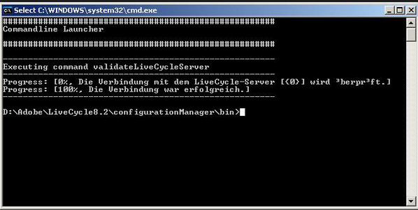
  Command language
user learn syntax; can express complex possibilities rapidly without reading distracting prompts
Designer must allow for high error-rates; diversity of possibilities and complexity of mapping from task to computer syntax is hard; user training is necessary.
Advantage
  Is flexible
  Appeals to “power” users
  Supports user initiative
  Allows convenient creation
  of user-defined macros
Disadvantage
  Has poor error handling
  Requires substantial training
  and memorization

Slide 15
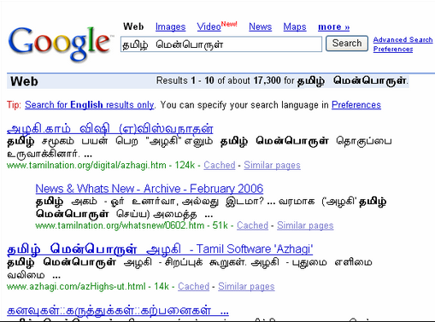
Natural language
Users enter natural language sentences; computer often seeks clarification before beginning task.
Designers need to understand task domain to narrow range of interpretations to manageable level; design is extremely difficult.
Advantage
  Relieves burden of learning syntax
Disadvantage
  Requires clarification dialog
  May require more keystrokes
  May not show context
  Is unpredictable

Slide 16
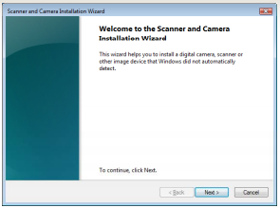
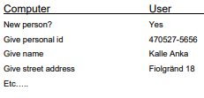
Question/answer interfaces
Much used in the early history of computing. The user is supposed to answer a sequential set of questions.
user led through interaction via series of questions
suitable for novice users but restricted functionality
often used in information systems
Question and answer interfaces are also called wizards.

Slide 17
Question/answer interfaces
Advantages of question and answer interfaces:
  – Low memory requirements
  – Self-explanatory
  – Simple linear presentation
  – Easy for beginners
Disadvantages of question and answer interfaces:
  – Require valid input supplied by user
  – Require familiarity with interface controls
  – Can be tedious to correct mistakes

Slide 18
Metaphors
GUIs use visual relationships to real-world objects (metaphors)
  Metaphors can help people relate to complex concepts and procedures by drawing on real world knowledge
  Real-world affordances can be reflected
What metaphors are used by contemporary GUIs?
Skeuomorphism

Slide 19
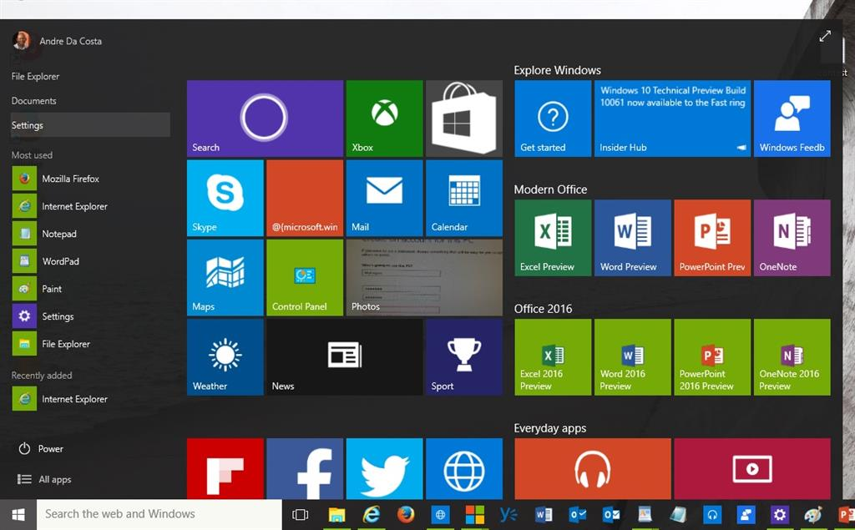
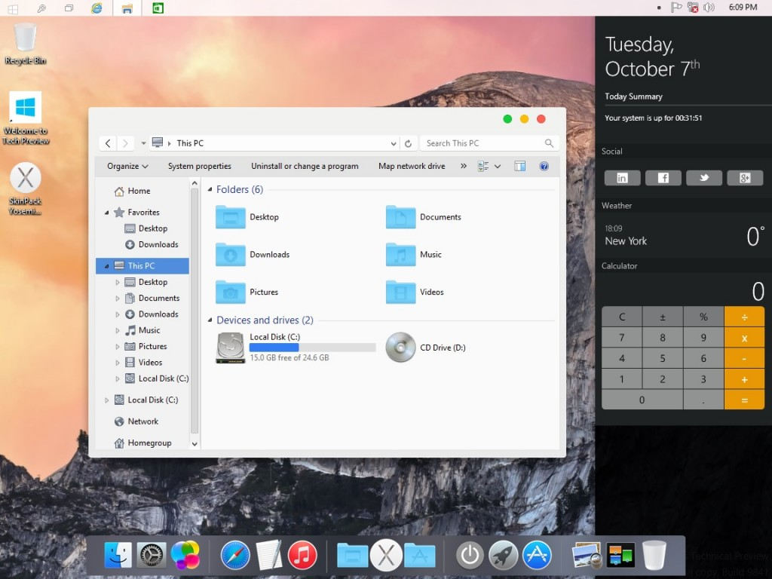
Metaphors

Slide 20

Metaphors
A metaphor’s function must be consistent with real-world expectations
  Metaphors that do not behave the way people expect will cause confusion and frustration
  Macintosh trashcan
Potential problems with metaphors
  Run out of metaphors
    Some virtual processes and objects have no real-world counter parts
  Mixed metaphors
  Carry connotations and association

Slide 21
Skeuomorphism
Skeuomorphism is when something is designed with extra ornamentation to make it resemble another object so it is more familiar.
designs to add real-world design cues to virtual objects to make them easier to understand.
focuses on recreating familiar real-world elements as digital analogues that let users more easily identify their purpose.

Slide 22
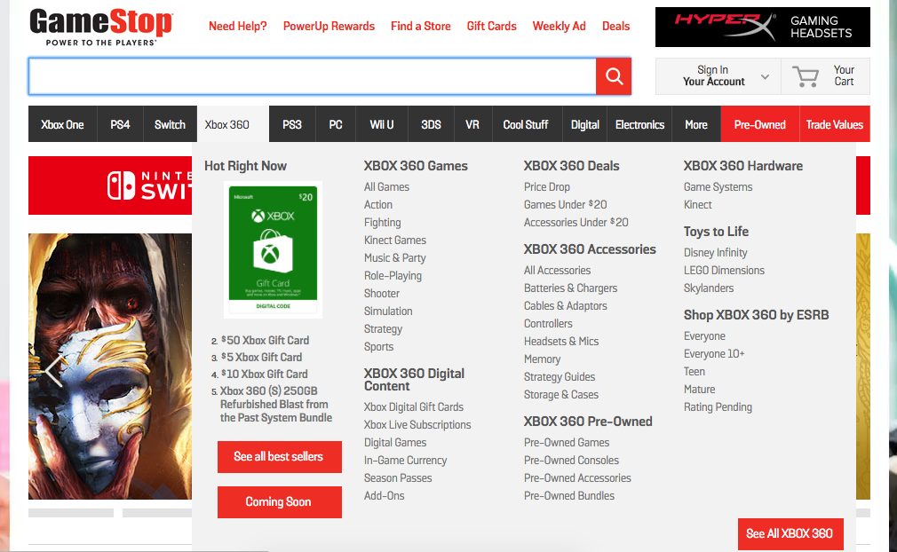
Web Navigation

Slide 23
Web Navigation
Two basic interaction styles
  Link-based navigation
    Sensitive to articulatory distance - reflects the relationship between the physical form of an expression in the interaction language and its meaning.
    Ambiguous link labels increase the gulf of evaluation
  Search
    Sensitive to semantic distance - reflects the relationship between the user intentions and the meaning of expressions in the interface languages.
    Inadequate search engine algorithms increase the gulf of execution
    Slight advantage in development of mental models
Adult Internet users increasingly “search dominant”
Kids navigate the web using bookmarks, remembering their favorite sites, and accessing paid subscription content and games (https://gigaom.com/2010/09/13/usability-study-shows-kids-dont-search/)

Slide 24
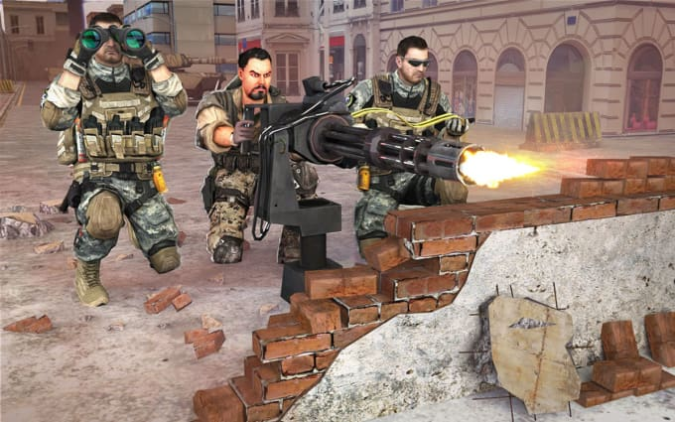
3D Environments

Slide 25
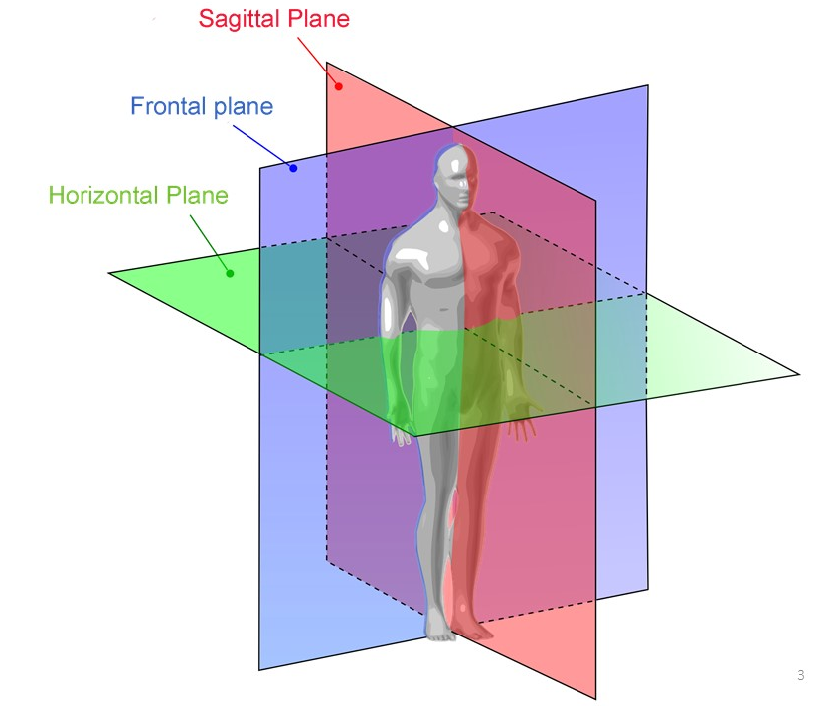
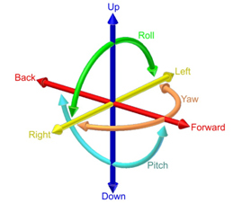
3D Environments
3D interaction is natural in the real-world
3D environments are common in digital games
Rich graphical 3D environment are processor intensive
3D Navigation
  Involves two types of movement
    Translation – movement on a plane
    Rotation – movement around an axis

Slide 26
3D Environments
Desktop 3D
  Current GUIs are predominantly 2D
  3D environments presented on 2D screens are difficult to navigate
Web-based 3D
  Use vector-based graphics to decrease file size
  Virtual Reality Modeling Language (VRML)
    Uses polygons with parameters
      Transparency
      Texture maps
      shininess
  X3-D is XML based - Web3D.org
    Offers greater flexibility and control
    Three-dimensional navigation can quickly become difficult and confusing

Slide 27
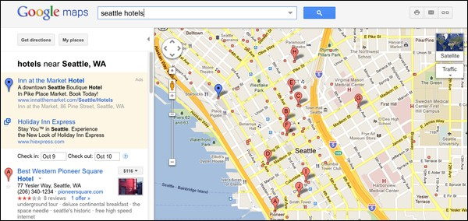
Zoomable Interface

Slide 28
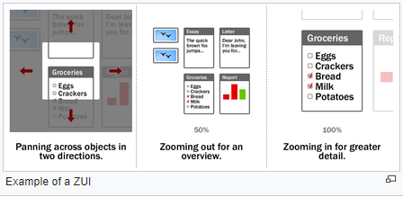
Zoomable Interface
ZoomWorld (Jeff Raskin - human–computer interface expert best known for conceiving and starting the Macintosh project at Apple in the late 1970s) is based on the zooming interface paradigm (ZIP)
ZIP is based on landmarks and relative positioning (organizational cues)
  Proportion
  Color
  Patterns
  Proximity
Pad++: Zoomable User Interface (ZUI) (http://www.cs.umd.edu/hcil/pad++/)

Slide 29
Principle 2: Use the Eight Golden Rules of Interface Design
Strive for consistency
Enable frequent users to use shortcuts
Offer informative feedback
Design dialogs to yield closure
Prevent errors
Permit easy reversal of actions
Support internal locus of control
Reduce short-term memory load

Slide 30
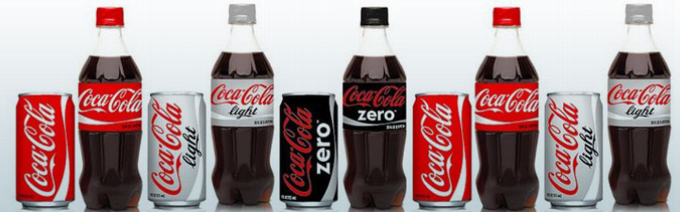
Strive for consistency
Consistent sequences of actions should be required in similar situations
identical terminology should be used in prompts, menus, and help screens and
consistent color, layout, capitalization, fonts, and so on should be employed throughout
no echoing of passwords or confirmation of the delete command, should be comprehensible employed throughout.
  Colour consistency
  Font consistency
  Positional consistency
  Graphical consistency

Slide 31
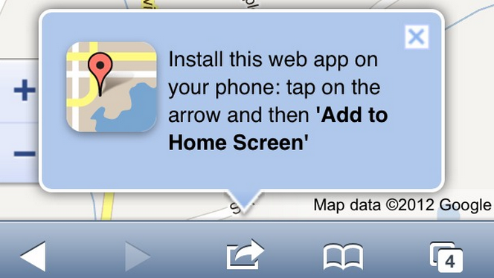
Enable frequent users to use shortcuts
To reduce the number of interactions and to increase the pace of interaction
Abbreviations, special keys, macro facilities, and menu shortcuts are appreciated by frequent knowledgeable users
Short response times and fast display rates are other attractions for frequent users

Slide 32
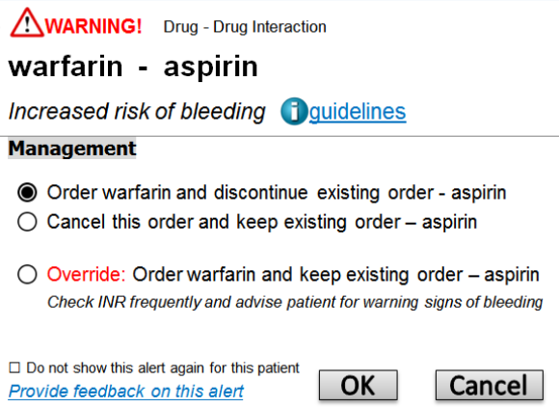
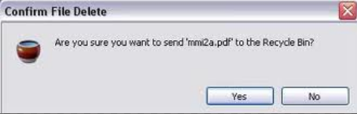
Offer informative feedback
For every user action, there should be system feedback.
For frequent and minor actions, the response can be modest, whereas for infrequent and major actions, the response should be more substantial.

Slide 33
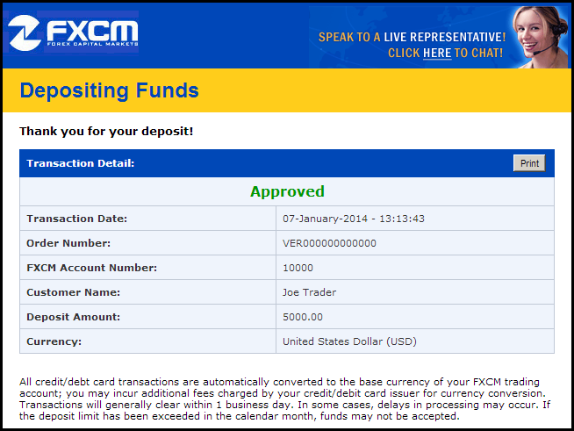
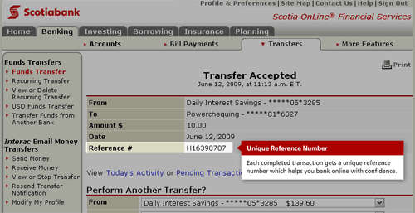
Design dialogs to yield closure
Sequences of actions should be organized into groups with a beginning, middle, and end.
Informative feedback at the completion of a group of actions gives operators the satisfaction of accomplishment, a sense of relief, the signal to drop contingency plans from their minds, and a signal to prepare for the next group of actions.
For example, checkout sequences for e-commerce Web sites move users toward completion of their purchases, ending with a clear confirmation page

Slide 34
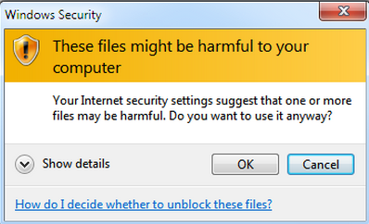
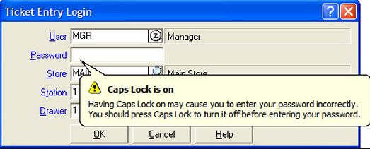
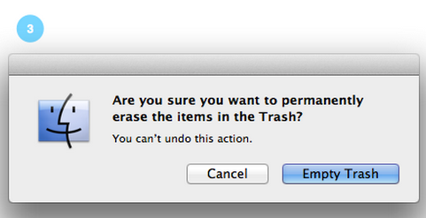
Prevent errors
As much as possible, design the system such that users cannot make a serious error
If users make an error, the system should detect the error and offer simple, constructive, and specific instructions for recovery. For example, users should not have to retype an entire name-address form if they enter an invalid zip code, but rather should be guided to repair only the faulty part.
Erroneous actions should leave the system state unchanged, or the system should give instructions about restoring the state.

Slide 35
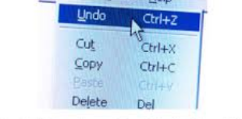
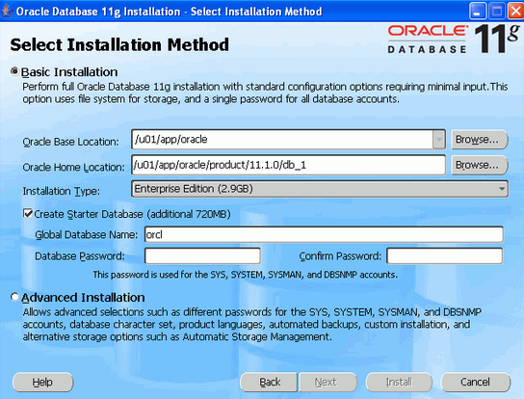
Permit easy reversal of actions
As much as possible, actions should be reversible. This feature relieves anxiety, since the user knows that errors can be undone, thus encouraging exploration of unfamiliar options.
The units of reversibility may be a single action, a data-entry task, or a complete group of actions, such as entry of a name and address block.

Slide 36
Support internal locus of control
Experienced operators strongly desire the sense that they are in charge of the system and that the system responds to their actions.
Surprising system actions, tedious sequences of data entries, inability to obtain or difficulty in obtaining necessary information, and inability to produce the action desired all build anxiety and dissatisfaction
Design the system to make users the initiators of actions rather than the responders.

Slide 37
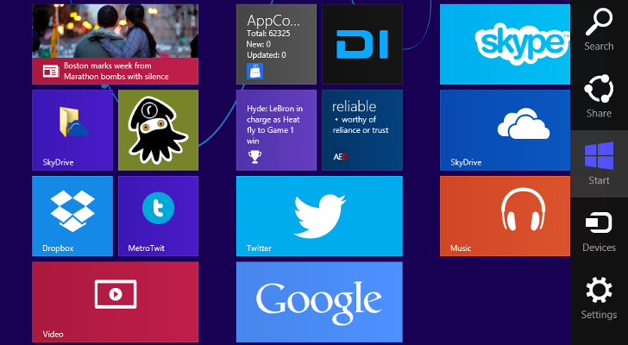
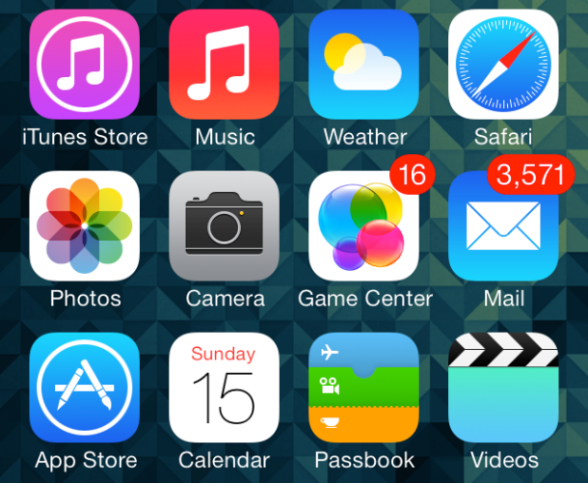
Reduce short-term memory load
displays be kept simple, multiple-page displays be consolidated, window-motion frequency be reduced, and sufficient training time be allotted for codes, mnemonics, and sequences of actions.
Where appropriate, online access to command-syntax forms, abbreviations, codes, and other information should be provided.

Slide 38
Principle 3: Prevent Errors
Improve the error messages provided by the computer system to reduce the loss in productivity .
Instead of vague and hostile messages, such as “Syntax Error” or “Illegal Data,” designers can use informative messages, such as “Unmatched Left Parentheses” or “Menu Choices Are in the Range of 1 to 6.”
Important is to understand the nature of errors. One perspective is that people make mistakes or “slips” (Norman, 1983) that designers can help them to avoid by organizing screens and menus functionally, designing commands or menu choices to be distinctive, and making it difficult for users to take irreversible actions.
Correct matching pairs – Ex. { } , <B> .. <\B>
Complete sequences
Correct commands

Slide 39
Guidelines for Data Display
Organizing the display
  Consistency of data display
    the terminology, abbreviations, formats, colors, capitalization, and so on should all be standardized and controlled by use of a written dictionary
  Efficient information assimilation by the user
    rules for neat columns of data, left justification for alphanumeric data, right justification of integers, lining up of decimal points, proper spacing, use of comprehensible labels, and appropriate measurement units and numbers of decimal digits
  Minimal memory load on user
    minimizing the chance of forgetting to perform a step
  Compatibility of data display with data entry
    The format of displayed information should be linked clearly to the format of the data entry
  Flexibility for user control of data display
    the order of columns and sorting of rows should be easily changeable by users

Slide 40
Cont..
Getting the user’s attention
  Intensity. Use two levels only, with limited use of high intensity to draw attention.
  Marking. Underline the item, enclose it in a box, point to it with an arrow, or use an indicator such as an asterisk, bullet, dash, plus sign, or X.
  Size. Use up to four sizes, with larger sizes attracting more attention.
  Choice of fonts. Use up to three fonts.
  Inverse video. Use inverse coloring.
  Blinking. Use blinking displays (2–4 Hz) with great care and in limited areas.
  Color. Use up to four standard colors, with additional colors reserved for occasional use.
  Color blinking. Use changes in color (blinking from one color to another) with great care and in limited areas.
  Audio. Use soft tones for regular positive feedback and harsh sounds for rare emergency conditions.

Slide 41
Guidelines for Data Entry
Five high-level objectives for data entry:
Consistency of data-entry transactions
  Similar sequences of actions should be used under all conditions
Minimal input actions by user
  greater operator productivity and fewer chances for error
  Making a choice by a single keystroke, mouse selection, or finger press
Minimal memory load on users
  During data entry, users should not be required to remember lengthy lists of codes and complex syntactic command strings.
Compatibility of data entry with data display
  format of data-entry information should be linked closely to the format of displayed information
Flexibility for user control of data entry
  data-entry operators may prefer to enter information in a sequence that they can control
  flexibility should be used cautiously, since it goes against the consistency principle

Slide 42
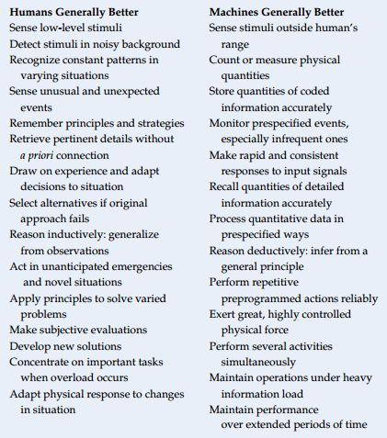
Balance of Automation and Human Control
Relative capabilities of humans and machines

Slide 43
Norman’s Seven Principles

Slide 44
Norman’s Seven Principles
Use both knowledge in world & knowledge in the head.
Simplify task structures.
Make things visible.
Get the mapping right (User mental model = Conceptual model = Designed model).
Convert constrains into advantages (Physical constraints, Cultural constraints, Technological constraints).
Design for Error.
When all else fails − Standardize.

Slide 45
Use both knowledge in world & in the head.
Knowledge in the Head
  Requires memorization and learning
  Can be difficult to retrieve at times
Knowledge in the World
  Does not require memorization
  Understanding is not always necessary
  We interact with things to figure out how they work
Users rely on both external (world) and internal (head) knowledge.
Reduce memory load by presenting relevant information. Users rely on both external (world) and internal (head) knowledge.
Reduce memory load by presenting relevant information.

Slide 46
Real-time Example: ATM Machine
When you withdraw cash from an ATM:
Knowledge in the head:
  You know your 4-digit PIN.
  You know that you need to insert your card.
  You know the concept of entering an amount.
Knowledge in the world:
  The ATM screen displays options like "Withdraw Cash," "Balance Inquiry."
  Buttons are labeled.
  The machine prompts you step by step ("Enter PIN", "Select Account", "Enter Amount").
  Error messages appear if you enter an incorrect PIN.
The ATM doesn't expect you to memorize the entire process. It guides you through each step while relying on your existing knowledge of PINs and banking.

Slide 47
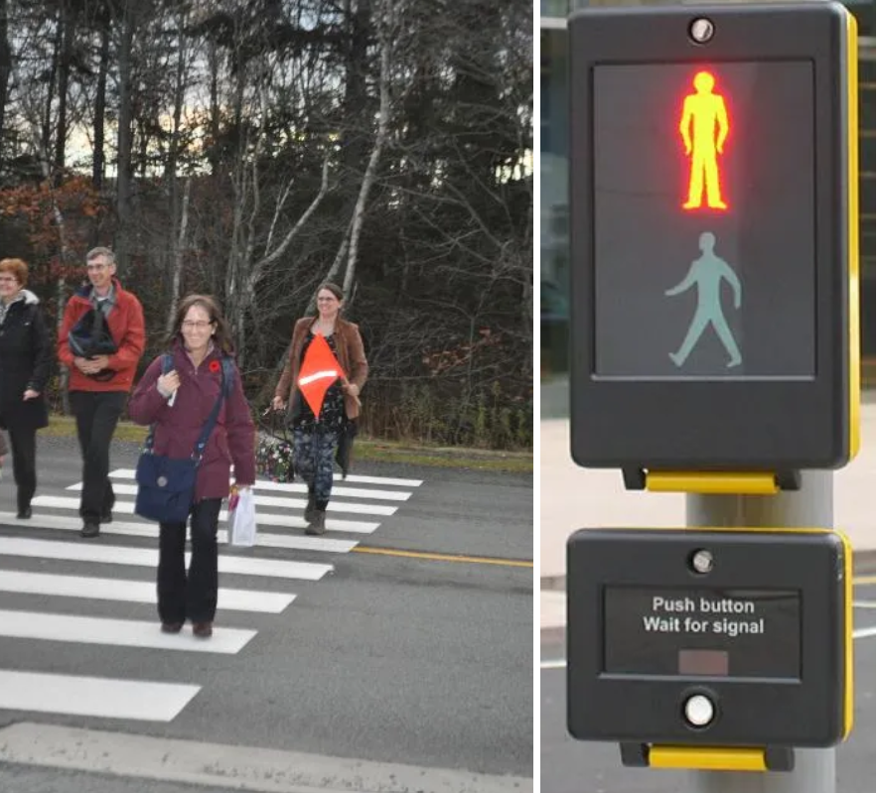
Use both knowledge in world & in the head.

Slide 48
Simplify task structures.
Minimize complexity by breaking tasks into simpler steps.
Reduce cognitive load and friction.
Eliminate or restructure complexities, minimizing the planning and problem solving a task requires.
Pay attention to the psychology of a user and the limits on memory and attention.
Progressive disclosure of information
Clear navigation and feedback

Slide 49
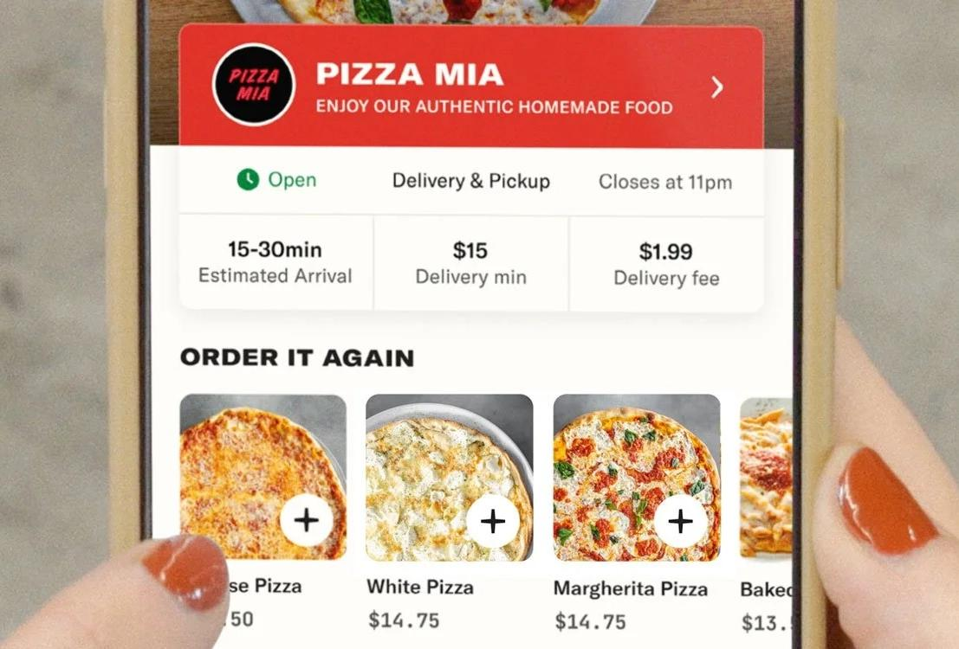
Break a complex task into simple, manageable steps so users can complete it easily with fewer errors.
Example: Online Food Delivery App
Saved addresses eliminate repeated typing.
Reorder lets users order previous meals with one tap.
Step-by-step flow:
  Select food
  Confirm address
  Choose payment
  Place order

Slide 50
Make things visible.
Bridge Gulfs Between Execution and Evaluation
Easy to see what’s visible: what can be done and what their effects are.
Actions should match intentions
It’s important to make the correct things visible so the users for the correct interpretations and mental models through the system image

Slide 51
Ensure that important controls, options, and system status are clearly visible so users know what actions are possible and what is happening.
Example: Car Dashboard
Fuel warning light indicates low fuel.
Speedometer shows the current speed.
Turn signal arrows blink when indicators are on.
Seatbelt warning reminds the driver to buckle up.

Slide 52
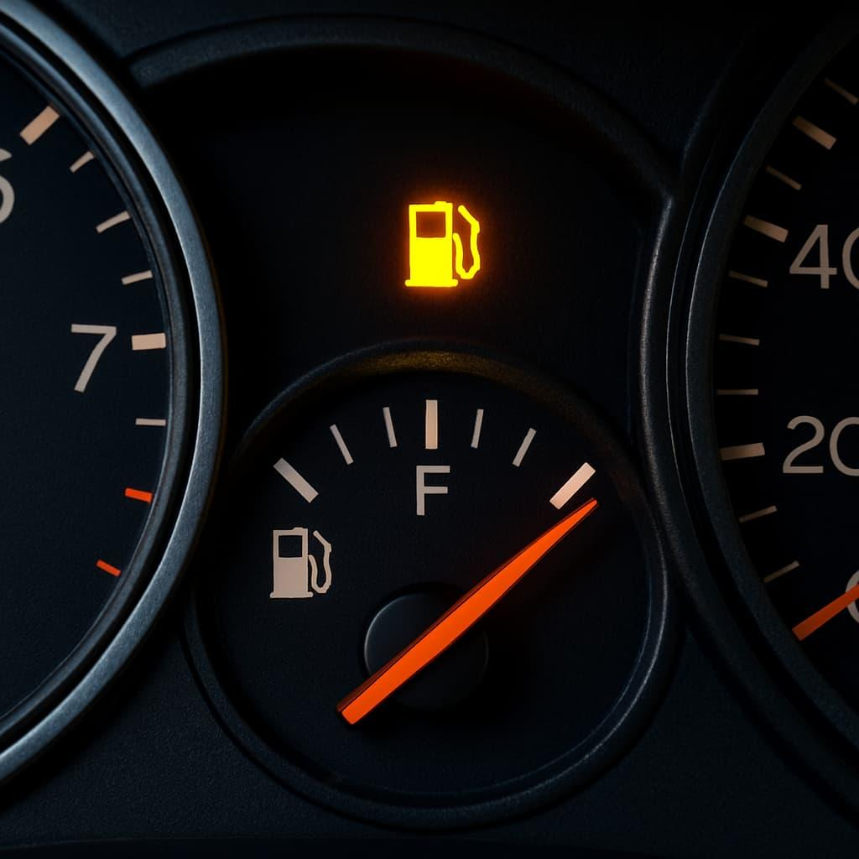
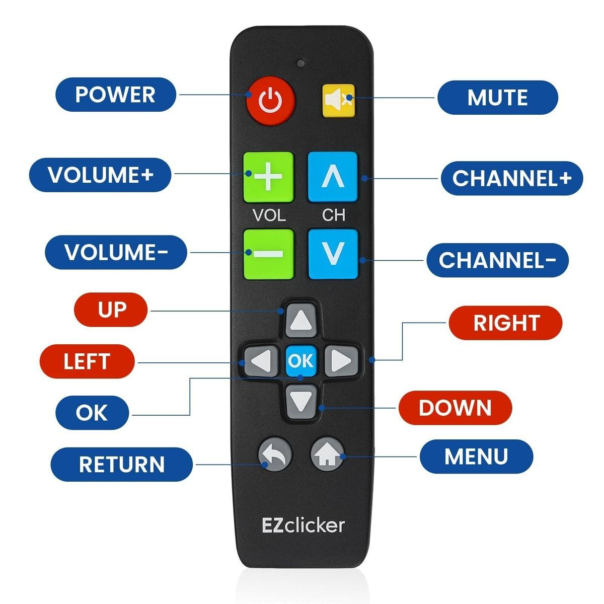
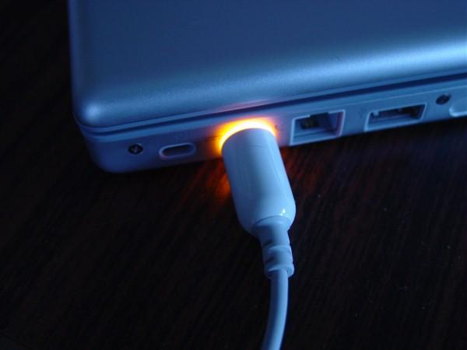

Slide 53
Get the mapping right
Ensure the user’s mental model matches the conceptual and designed model.
Users should predict system behavior based on design.
The movements of the control should be similar or analogous to the expected operation of the system.
feedback must be timely and easy to understand

Slide 54
Arrange controls so that their relationship to the action or result is natural and intuitive.
Example: Gas Stove
Each control knob corresponds to one specific burner.
The layout of the knobs matches the physical arrangement of the burners.
Users can easily identify which knob controls which burner.
Good mapping creates a natural connection between controls and their effects, reducing confusion and user errors.

Slide 55
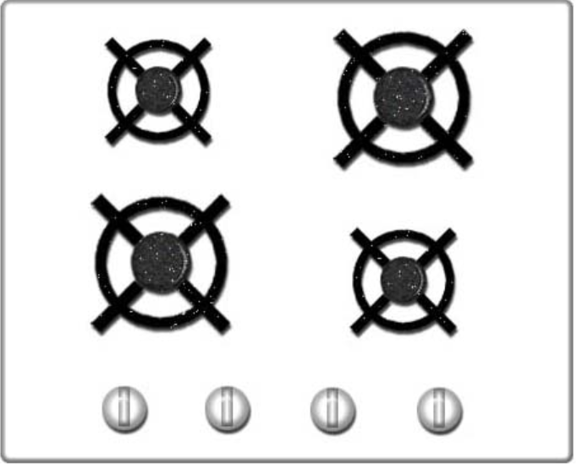
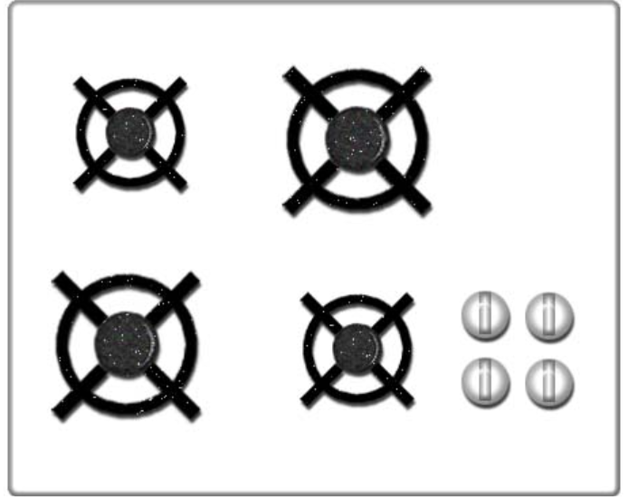
Get the mapping right

Slide 56
Convert constrains into advantages
Reduce the number of possible alternative actions at each step to a few or ideally just one
By strategically limiting alternatives at each step, designers guide users toward the correct actions.
a well-constructed system that simplifies decision-making for users, fostering a sense of clarity and purpose in their interactions with the designed environment.

Slide 57
Use design constraints to prevent errors and guide users toward the correct action. Instead of seeing constraints as limitations, use them to make the product easier and safer to use.
Example: SIM Card
The SIM card has a notched corner.
It can be inserted in only one correct orientation.
This prevents incorrect insertion and protects both the card and the device.
A good constraint guides users to the correct action, reduces mistakes, and improves usability.
Other quick examples:
USB-C connector – Reversible design eliminates the frustration of plugging it in the wrong way.
Automatic car gear selector – You must press the brake before shifting out of Park, preventing accidental movement.
SD card write-protect switch – Prevents accidental deletion or modification of data.

Slide 58
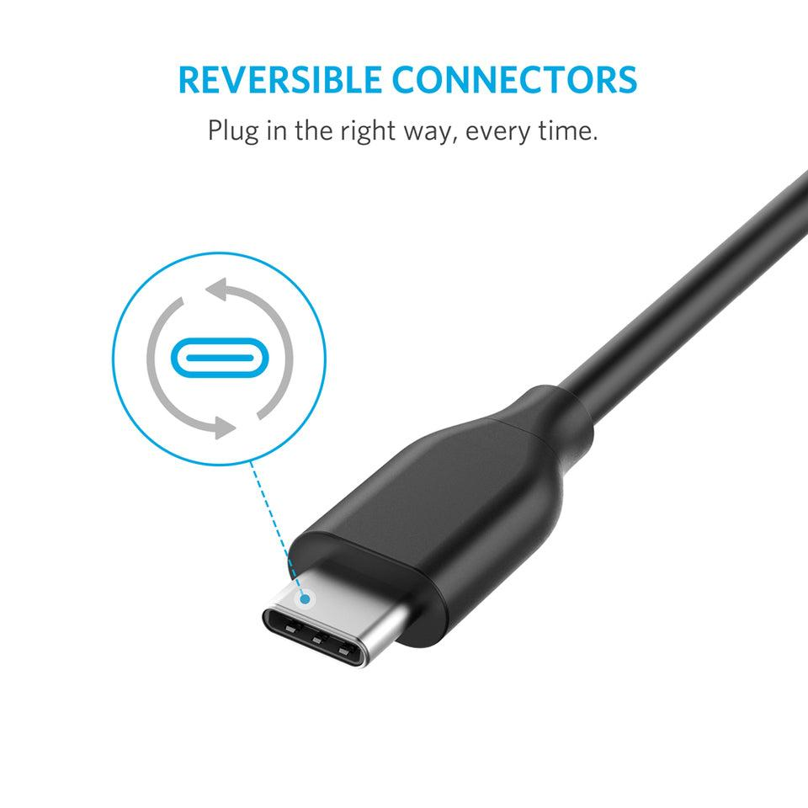
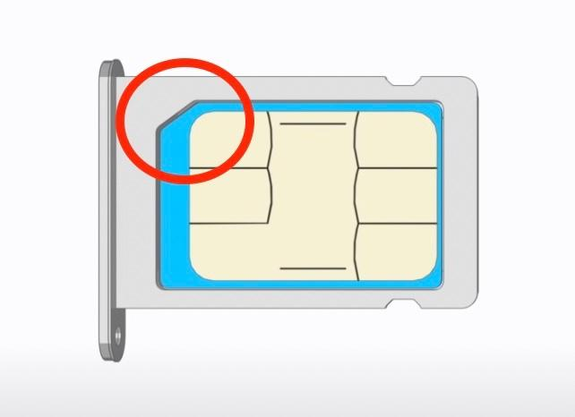
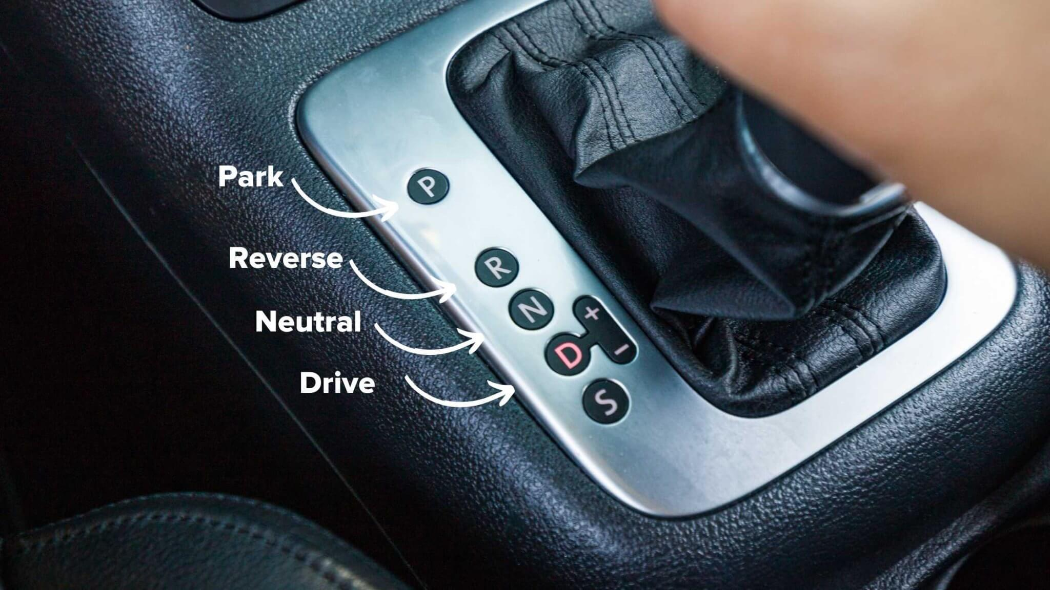
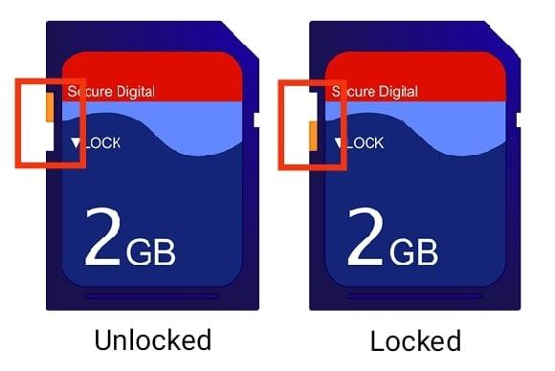

Slide 59
Designing for Error
Acknowledging the inevitability of human error, the principle of designing for error encourages designers to adopt an anticipatory approach.
Assume errors will be made. Allow for recovery. Use forcing functions
Each user action is an attempt to a step in the right direction
An error is incompletely or improperly specified actions

Slide 60
Design systems that prevent errors, detect mistakes, and allow users to recover easily when errors occur.
Example: Gmail – Undo Send
After sending an email, Gmail displays an "Undo Send" option for a few seconds.
If the user realizes a mistake (wrong recipient, typo, missing attachment), they can cancel the send before the email is delivered.
Good design assumes users will make mistakes and provides simple ways to prevent, correct, or recover from them.

Slide 61
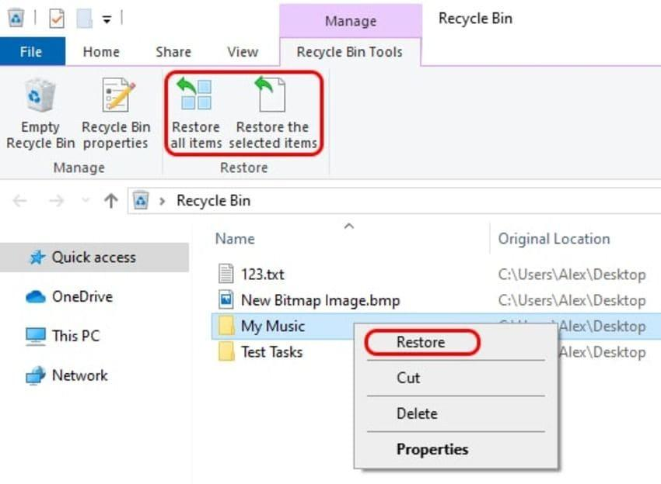
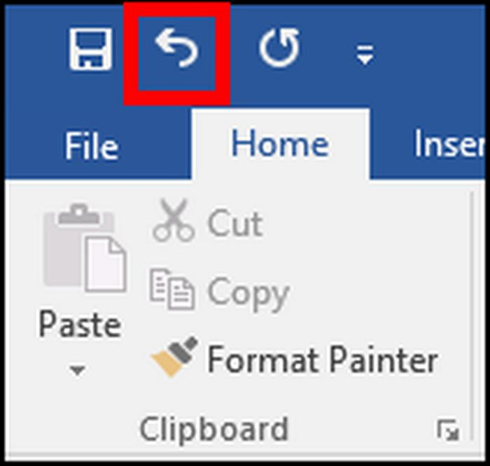

Slide 62
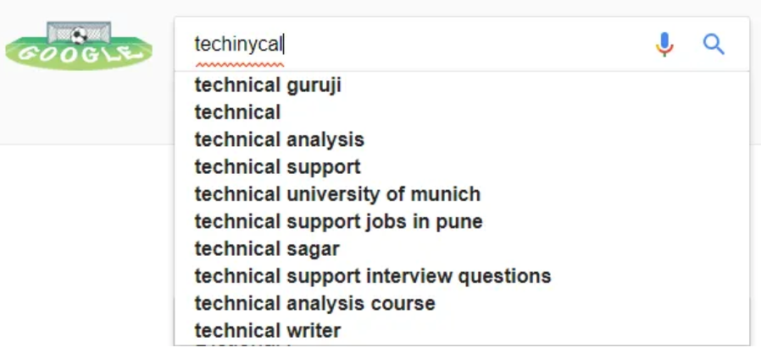
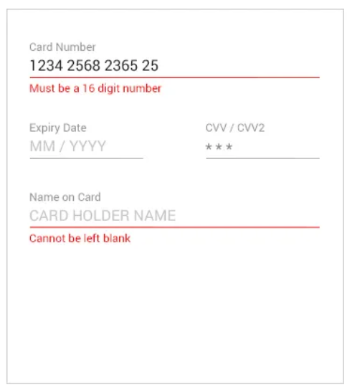
Designing for Error

Slide 63
When All Fails, Standardize
Standardize the problem and processes, so arbitrary mappings only have to be learned once
It maybe difficult to obtain an agreement, early enough to save trouble later on, and late enough to take into account of the existing technologies and procedures
Standardization is only essential when all necessary information cannot be placed in the world or when normal mapping cannot be exploited
Users must be trained for this

