Slide 1
Module_2
HUMAN FACTORS AS HCI THEORIES

Slide 2
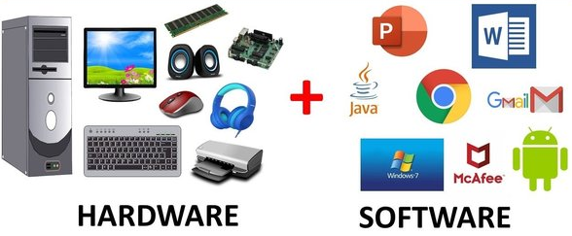
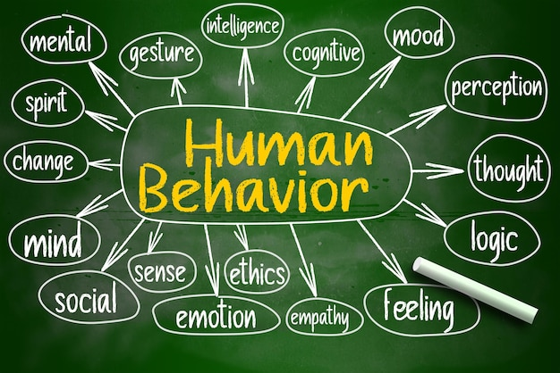
HUMAN INFORMATION PROCESSING
Two basic elements to design an effective interface
  an understanding of
    computer factors (software/hardware)
    human behavior

Slide 3
Our focus - Human factors
Human factors be divided into:
cognitive science
  the human’s capability and model of conscious processing of high-level information
  the human mind and brain, focusing on how the mind represents and manipulates knowledge and how mental representations and processes are realized in the brain.
ergonomics,
  how raw external stimulation signals are accepted by our five senses, are processed up to the pre attentive level, and are later acted upon in the outer world through the motor organs.
  design and implementation of interfaces that ensure user comfort, efficiency, and effectiveness.

Slide 4
Human factors
Human-factors knowledge will particularly help us design HCI in the following ways.
  Task/interaction modeling
  Prediction, assessment, and evaluation of interactive behavior

Slide 5
Human factors
  Task/interaction modeling
    Formulate the steps for how humans might interact to solve and carry out a given task/problem and derive the interaction model.
    A thoughtful HCI designer integrates direct user observation and cognitive science expertise for comprehensive model development.

Slide 6
Human factors
Prediction, Assessment, and Evaluation of interactive behavior:
  Understand and predict how humans might react mentally to various information-presentation and input-solicitation methods as a basis for interface selection.
  Evaluate interaction models and interface implementations and explain or predict their performance and usability.

Slide 7
Task Modeling and Human Problem-Solving Model
Sensation, which senses external information (e.g., visual, aural, haptic), and Perception, which interprets and extracts basic meanings of the external information.
Memory, which stores momentary and short-term information or long-term knowledge. This knowledge includes information about the external world, procedures, rules, relations, schemas, candidates of actions to apply, the current objective (e.g., accomplishing the interactive task successfully), the plan of action, etc.
Decision maker/executor, which formulates and revises a “plan,” then decides what to do based on the various knowledge in the memory, and finally acts it out by commanding the motor system (e.g., to click the mouse left button).

Slide 8
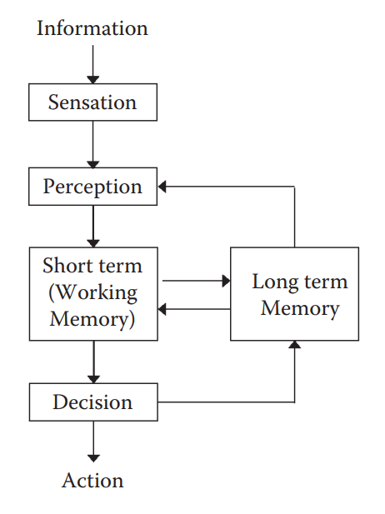
Overall human problem-solving model and process

Slide 9
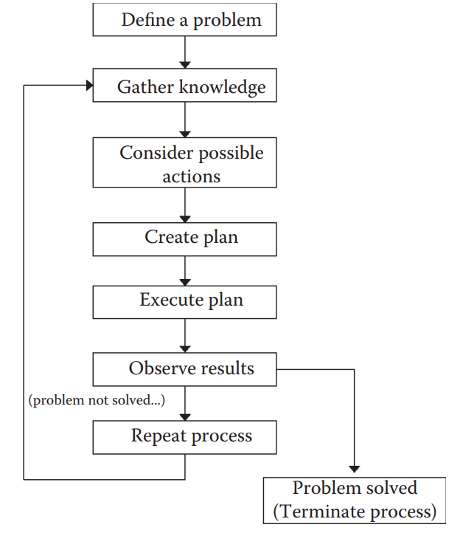
Detailed view of the “decision maker/executor.”

Slide 10
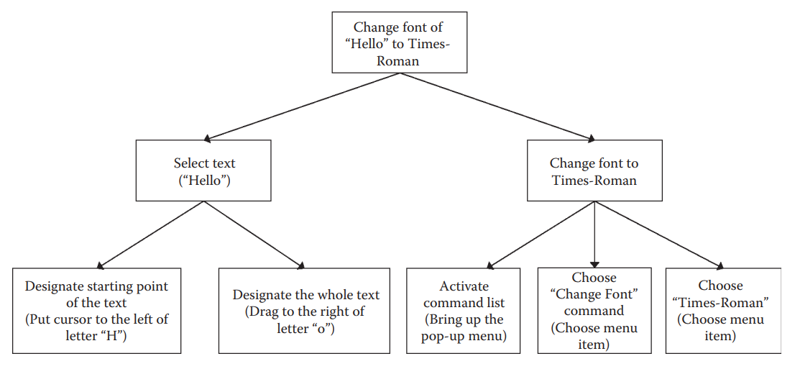
Hierarchical task model of changing a font for a short text

Slide 11
Human Reaction and Prediction of Cognitive Performance

Slide 12
GOMS (Goals, Operators, Methods, and Selection)

Slide 13
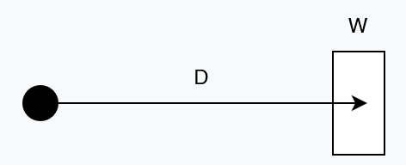
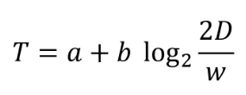
Human Body Ergonomics (Motor Capabilities)
Fitts’s Law
The relationship between the time it takes a pointer (such as a mouse cursor, a human finger, or a hand) to move to a particular target (e.g., physical or digital button, a physical object) in order to interact with it in some way (e.g., by clicking or tapping it, grasping it, etc.)
D is the distance to the target, w is the width of the target (technically, measured along the axis of movement), and a and b are constants that vary depending on the type of pointer (e.g., mouse, finger, etc.).

Slide 14
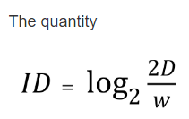

an index of difficulty
an index of difficulty and is measured in bits. An alternative formulation of Fitts’s law is then:

Slide 15
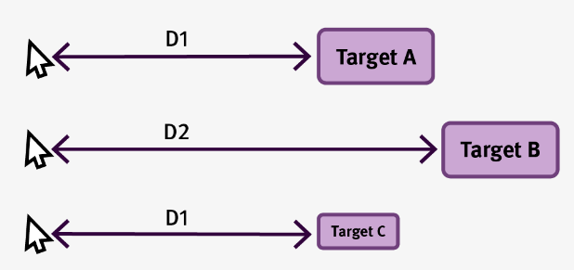
Fitts’s Law
The bigger the distance to the target, the longer it will take for the pointer to move to it. In other words, closer targets are faster to acquire.
The larger the target, the shorter the movement time to it. In other words, bigger targets are better.

Slide 16
Implications of Fitts’s law

Slide 17
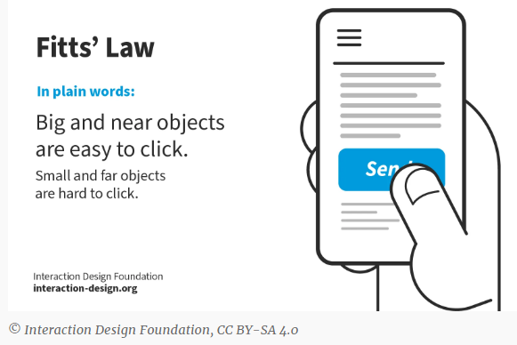
Fitts’s Law

Slide 18
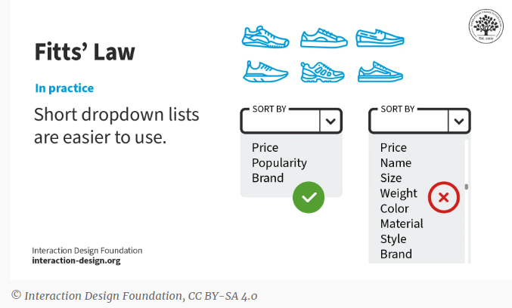
Fitts’s Law

Slide 19
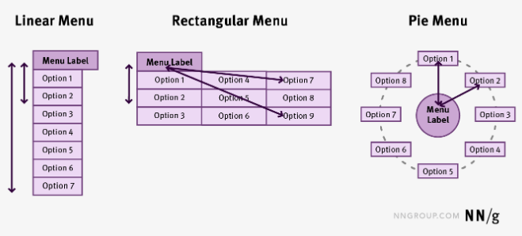
Optimizing Distance to Target
The average distance from menu handle to a menu element depends on the type of menu: linear menus are less efficient than rectangular menus, which, in turn, are less efficient than pie menus.

Slide 20
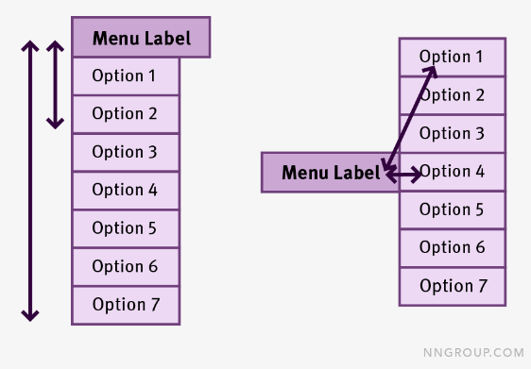
Optimizing Distance to Target
The average movement time in a linear menu can be improved by aligning the handle with the middle of the menu.

Slide 21
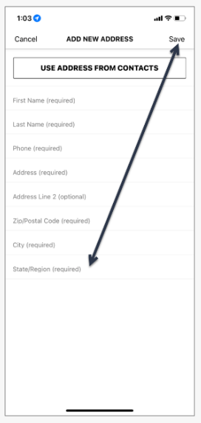
Place Related Targets Close to Each Other
Sephora for iPhone places the Save button in the top right corner of the screen. The user’s finger needs to travel a relatively long way from the last field of the form to the Save button.

Slide 22
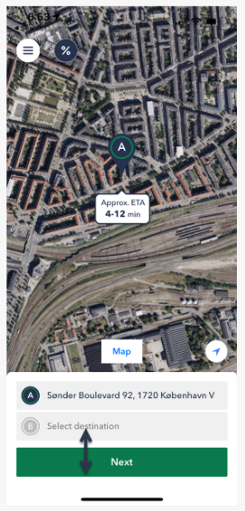
Place Related Targets Close to Each Other
In contrast, Taxa 4x35, a Danish taxi app, places the main call to action at the very bottom of the form, close to the last form field.

Slide 23
Optimizing Target Size
Bigger Is Better
  make targets big.
  Fitts’s law clearly says that people will be faster to click, tap, or hover on bigger targets.
  Not only that, but error rates go down as target sizes increases.

Slide 24
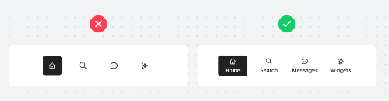
Optimizing Target Size
Icons Plus Labels
  any target made up of both an icon and a label will be greater than just an icon and, therefore, according to Fitts’s law, will be easier to acquire.

Slide 25
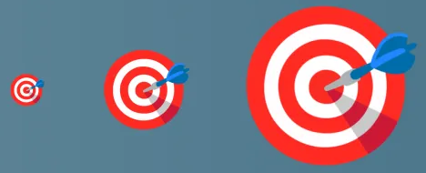
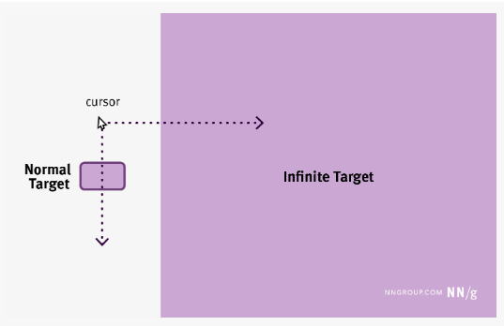
Optimizing Target Size
Infinite Targets Along Screen Edges
  the final-movement component can be greatly reduced if the target is very big — or even infinite.

Slide 26
Optimizing Target Size
Infinite Targets Along Screen Edges
  in order to reach a target placed on the edge of the screen, the user doesn’t have to slow down as much as if the target was in the middle of the screen because there is no danger of overshooting – the pointer will be automatically stopped once it hits the edge of the screen.
  Ex., in MacOS, application menus are shown at the very top of the screen, on the horizontal edge. This enables the user to reach that area very easily.
  Ex., in Windows (at least until Windows 8) the start button was placed in the bottom left corner of the screen. In both operating systems, icons for various frequently used applications are placed along the bottom of the screen.

Slide 27
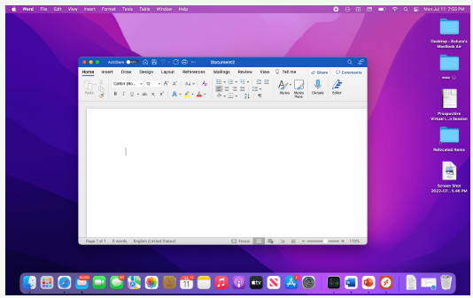

In MacOS, the application menu is placed at the top edge of the screen, which acts as an infinite edge. This placement optimizes movement time to this frequently accessed area, as the options in the menu become infinite targets and users will not need to slow down in order to hit them accurately.
In Windows, the task bar hosting a variety of commonly used apps, is shown at the bottom of the screen. This location also optimizes movement time because the application icons become infinite targets.

Slide 28
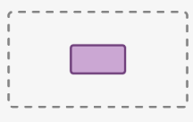
Optimizing Target Size
Don’t Crowd Targets
  If you place targets too close to each other, there is a risk that people will accidentally overshoot and accidentally trigger the wrong target.
Padding Is Not Enough
  if people do not realize that a target is padded, they may still cautiously slow down more than necessary as they get closer to the target, in order to make sure they will not go beyond the target area.

