Slide 1
Human Computer Interaction
Module 3
Design Interaction

Slide 2
Principles of Good Interface and Screen Design
A well-designed interface and screen
  Reflects the capabilities, needs and tasks of its users.
  Is developed within the physical constraints imposed by the hardware on which it is displayed.
  Utilizes the capabilities of its controlling software effectively.
  Achieves the business objectives of the system for which it is designed.

Slide 3
Human Considerations in Interface and Screen Design
Poor Design Discourage the User (Barnett 1993, 2005)
  Unclear captions and badly worded questions.
  Improper type and graphic emphasis.
  Misleading headings.
  Information requests perceived to be irrelevant or unnecessary.
  Information requests that require one to backtrack and rethink a previous answer, or look ahead to determine possible context.
  Cluttered, cramped layout.
  Poor quality of presentation, legibility, appearance, and arrangement.

Slide 4
Human Considerations in Interface and Screen Design
Most common problems in visual interface design Howlett (1995)
  Visual inconsistency in screen detail
  Lack of restraint in the use of design features and elements.
  Overuse of three-dimensional presentations.
  Overuse of too many bright colors.
  Poorly designed icons.
  Bad typography.
  Metaphors that are either overbearing, too cute or too literal, thereby restricting design options.

Slide 5
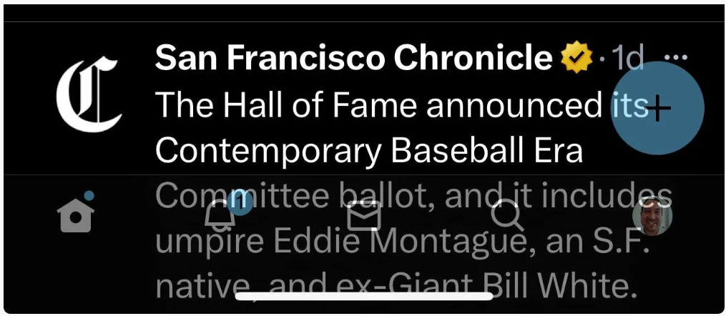
Ex’s:
Overlapping Elements

Slide 6
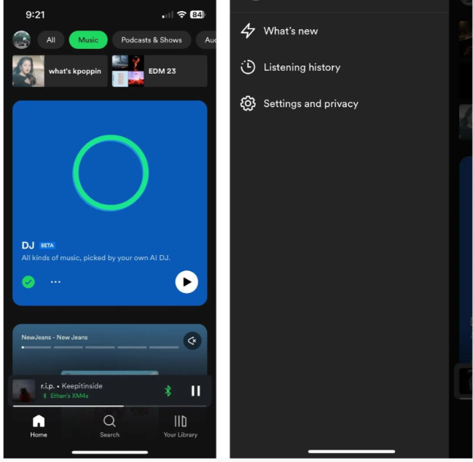
Ex’s:
Badly Prioritizing Elements

Slide 7
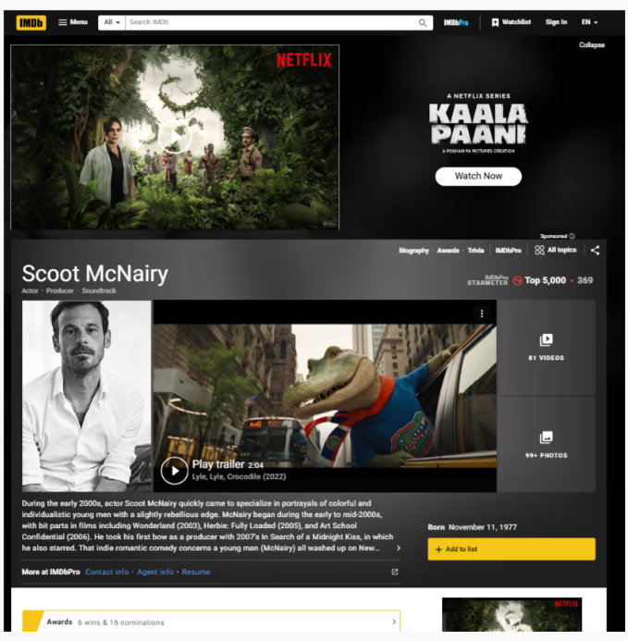
Ex’s:
Cluttered Layout

Slide 8
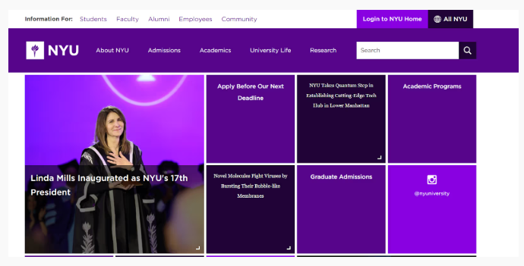
Ex’s:
High Contrast and Visibility

Slide 9
Web page distractions
Numerous visual and auditory interruptions.
Extensive visual clutter.
Poor information readability.
Poor information legibility.
Incomprehensible screen components.
Confusing and inefficient navigation.
Inefficient operations and extensive waste of user time.
Excessive or inefficient page scrolling.
Information overload.
Design inconsistency.
Outdated information.
Stale design caused by emulation of printed documents and past systems.

Slide 10
Top design mistakes in Web design Nielsen (2005e)
1. Legibility problems, including small fonts and poor contrast between text and backgrounds.
2. Nonstandard presentation of links.
3. Annoying use of Flash.
4. Content that has not been written for the Web.
5. Poor search facilities.
6. Browser incompatibilities.
7. Cumbersome forms to fill out.
8. No contact or other company information included.
9. Frozen layouts with fixed page widths resulting in cutting off the side of a page.
10. Inadequate photo enlargement.

Slide 11
Interface Design Goals
Reduce visual work.
Reduce intellectual work.
Reduce memory work.
Reduce motor work.
Minimize or eliminate any burdens or instructions imposed by technology

Slide 12
Consistency
Provide real-world consistency. Reflect a person’s experiences, expectations, work conventions, and cultural conventions.
Provide internal consistency. Observe the same conventions and rules for all aspects of an interface screen, and all application or Web site screens, including
  Operational and navigational procedures.
  Visual identity or theme.
  Component
    Organization.
    Presentation.
    Usage.
    Locations.
Follow the same conventions and rules across all related interfaces.
Deviate only when there is a clear benefit for the user

Slide 13
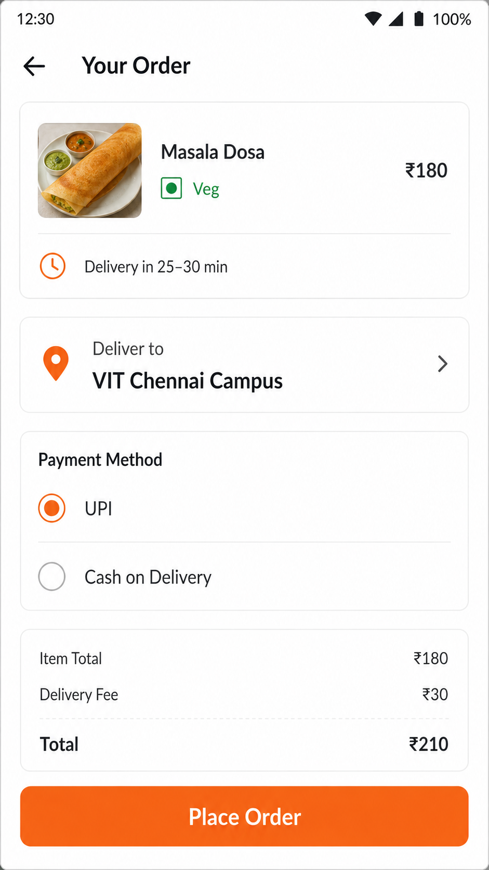
Real-world consistency - Uses familiar Indian conventions—₹ pricing, vegetarian symbol, UPI/Cash on Delivery, delivery time and a clear Place Order button.

Slide 14
Ordering of Data and Content
Divide information into units that are logical, meaningful, and sensible.
Organize by the degree of interrelationship between data or information.
Provide an ordering of screen units of information and elements that is prioritized according to the user’s expectations and needs.
Form groups that cover all possibilities.
Ensure that information that must be compared is visible at the same time.
Ensure that only information relative to the users’ tasks or needs is presented on the screen.

Slide 15
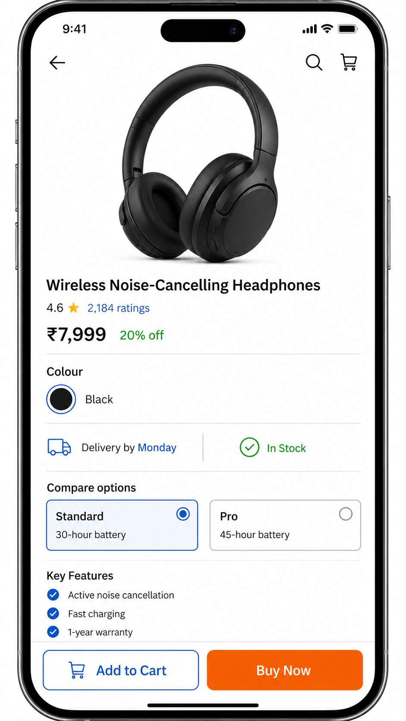
The screen follows a logical order, groups related delivery information, shows product options side by side for comparison, and displays only purchase-relevant details.

Slide 16
Ordering of Data and Content
Common information ordering schemes include the following:
  Conventional
  Sequence of use
  Frequency of use
  Function or category
  Importance
  General to specific

Slide 17
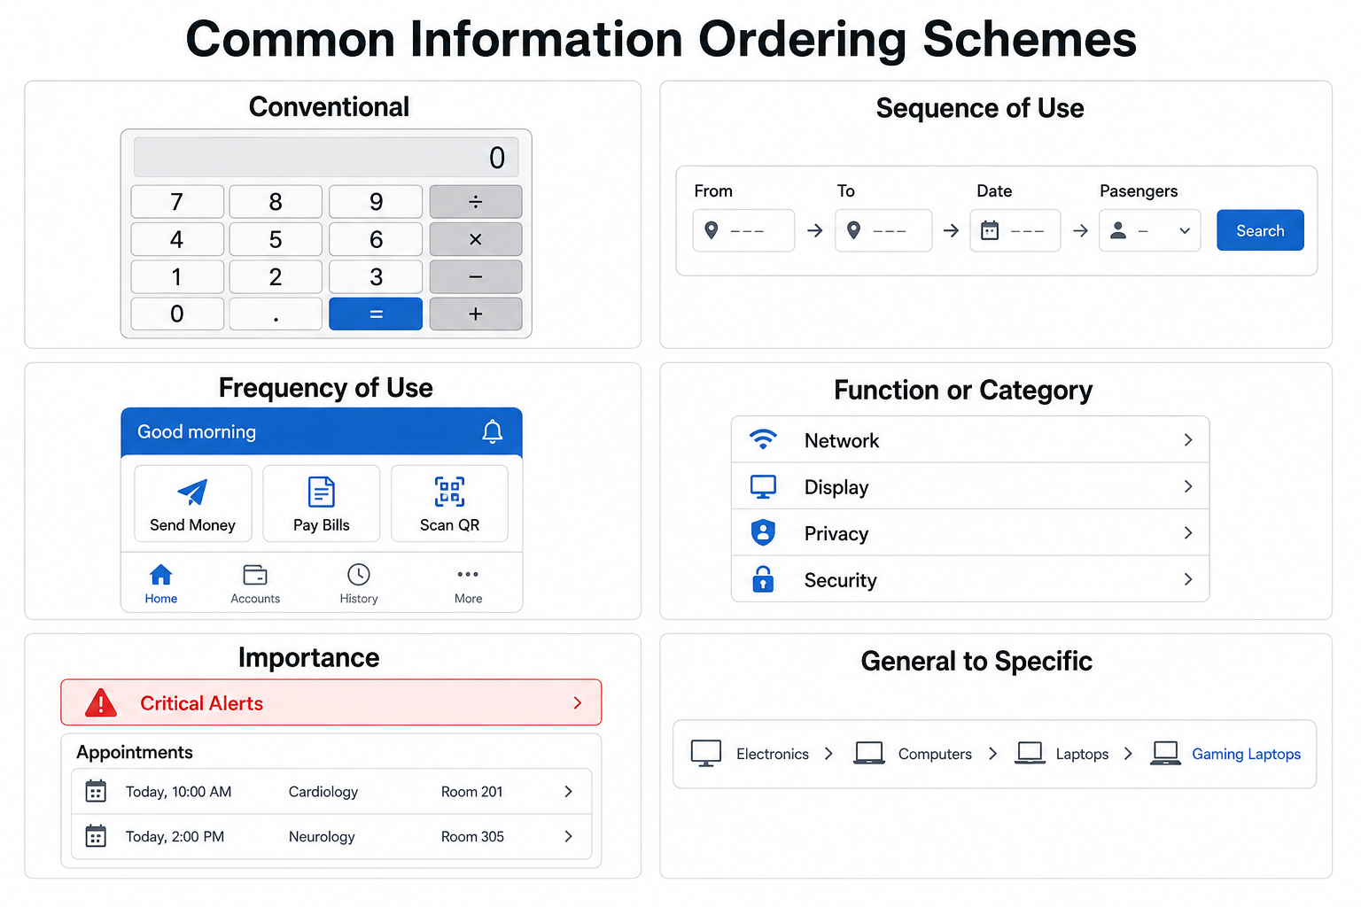

Slide 18
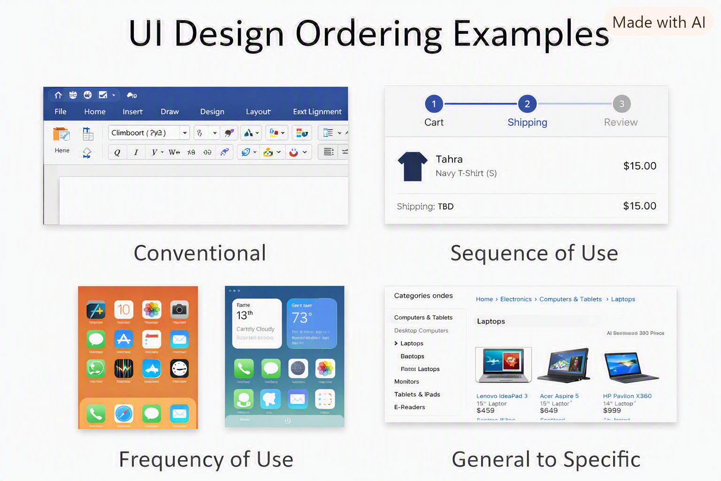

Slide 19
Ordering of Data and Content
Ordering Web Pages
  Establish levels of importance.
  Place critical information near the top of the Web site.
  Place important items at the top of a page.
  Organize information clearly.
  Place important items consistently.
  Facilitate scanning.
  Structure for easy comparison.

Slide 20
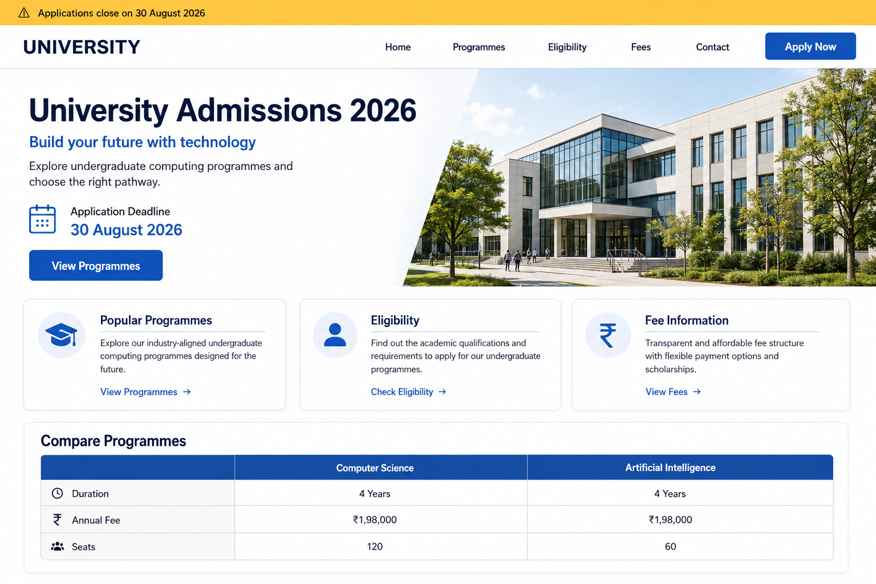
The webpage places the application deadline and primary action at the top, groups related information clearly, supports quick scanning, and displays programmes side by side for easy comparison.

Slide 21
Navigation and Flow
Provide an ordering of screen information and elements that
  Is rhythmic, guiding a person’s eye through the display.
  Encourages natural movement sequences.
  Minimizes pointer and eye movement distances.
Locate the most important and most frequently used elements or controls at the top left.
Maintain a top-to-bottom, left-to-right flow.
Assist in navigation through a screen by
  Aligning elements.
  Grouping elements.
  Using line borders.

Slide 22
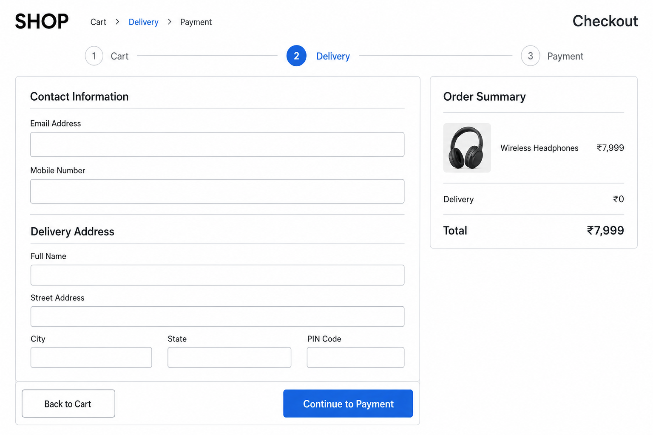
The checkout screen guides the eye naturally from Cart → Delivery → Payment, groups related fields, maintains clear alignment and borders, and places actions close to where users complete the task.

Slide 23
Navigation and Flow
Through focus and emphasis, sequentially, direct attention to items that are
  Critical.
  Important.
  Secondary.
  Peripheral.
Tab through windows in logical order of displayed information.
Locate command buttons at end of the tabbing order sequence.
When groups of related information must be broken and displayed on separate screens, provide breaks at logical or natural points in the information flow.

Slide 24
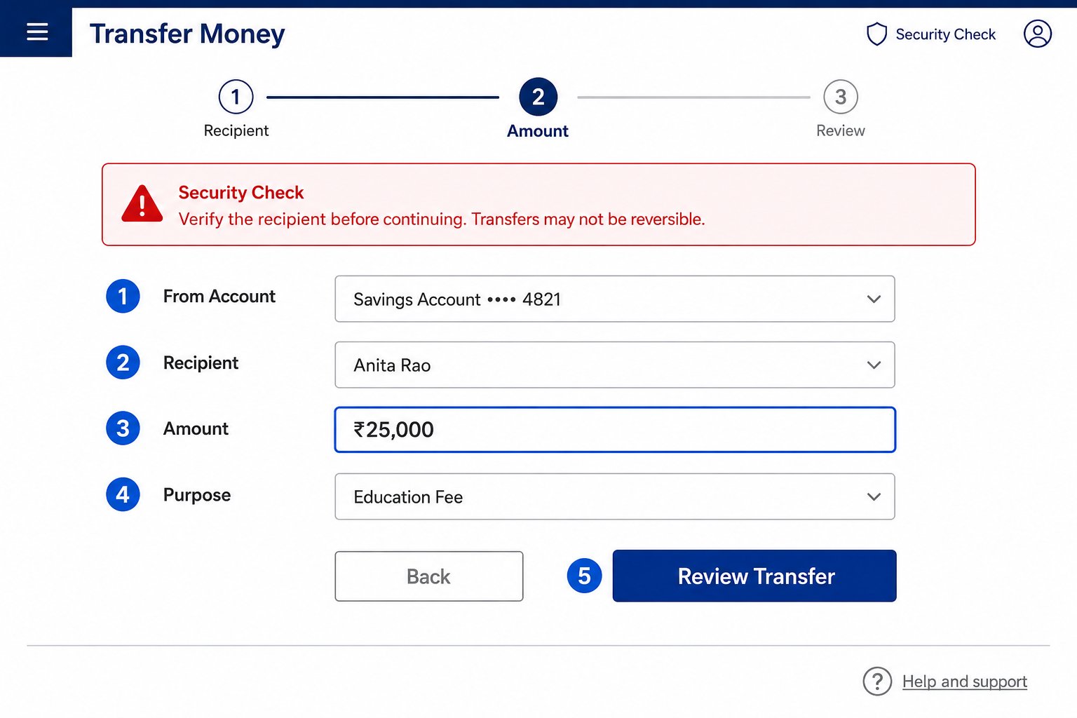
The screen emphasizes critical information first, follows a logical 1–5 tab order, places the command button last, and divides the task into natural stages: Recipient → Amount → Review.

Slide 25
Navigation and Flow
Eye movement through a screen
the eye tends to move sequentially,
  From dark areas to light areas.
  From big objects to little objects.
  From unusual shapes to common shapes.
  From highly saturated colors to unsaturated colors.
  Through this, we can guide a person's attention to a specific area of the screen and then redirect it elsewhere.

Slide 26
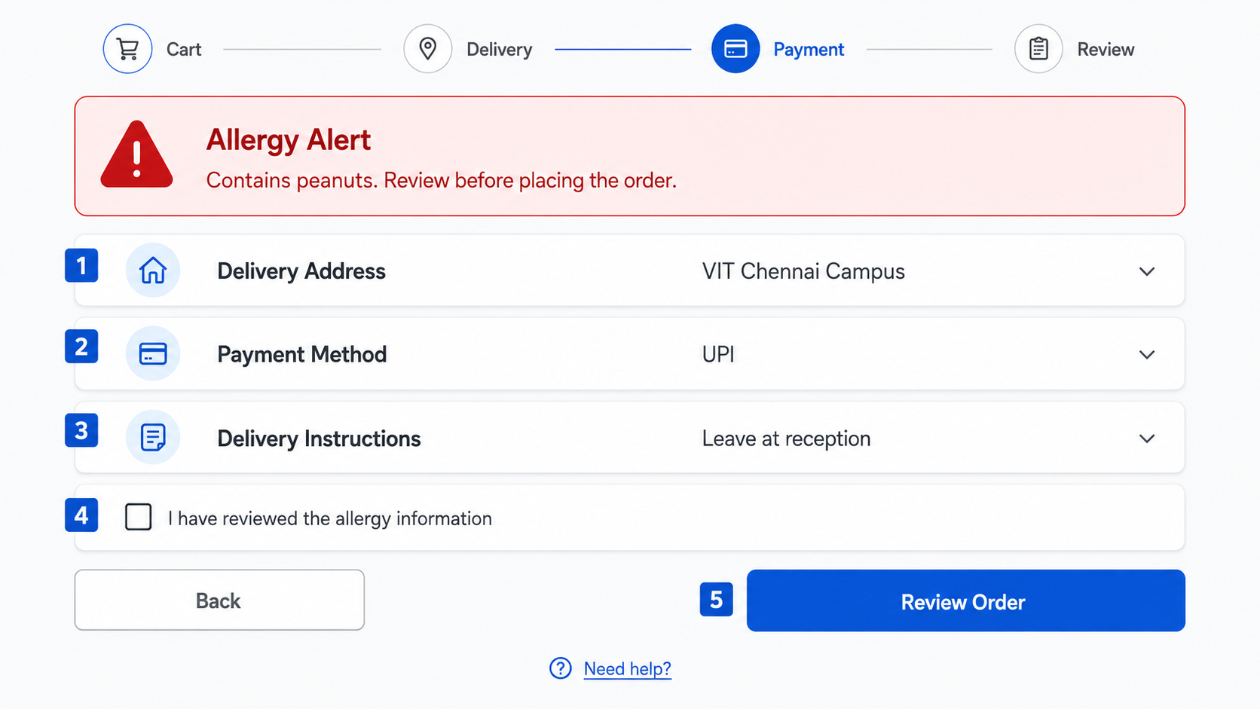
This food-delivery checkout demonstrates:
Clear emphasis: critical allergy warning appears first.
Logical navigation: focus order is numbered 1–5.
Natural stages: Cart → Delivery → Payment → Review.
The main command, Review Order, appears at the end.
Related information is grouped for easy scanning.

Slide 27
Navigation and Flow
Maintain a top-to-bottom, left-to-right flow through the screen.
The top-to-bottom orientation is recommended for information entry for the following reasons:
  Eye movements between items will be shorter.
  Control movements between items will be shorter.
Groupings are more obvious perceptually (Gestalt principles).
When one’s eye moves away from the screen and then back, it returns to about the same place it left, even if it is seeking the next item in a sequence (a visual anchor point remains)

Slide 28
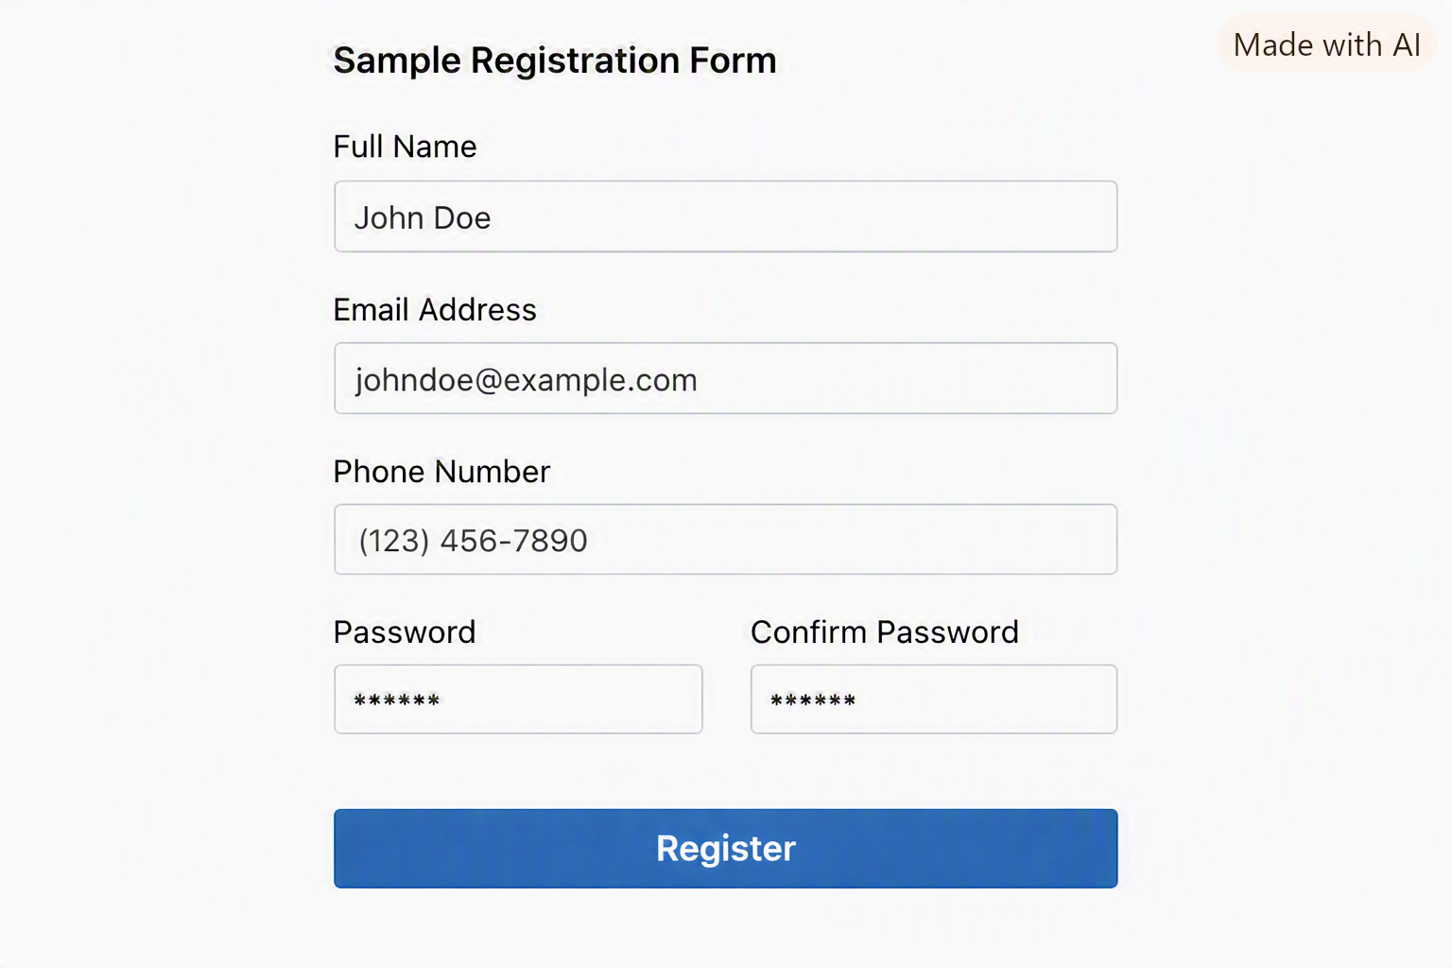

Slide 29
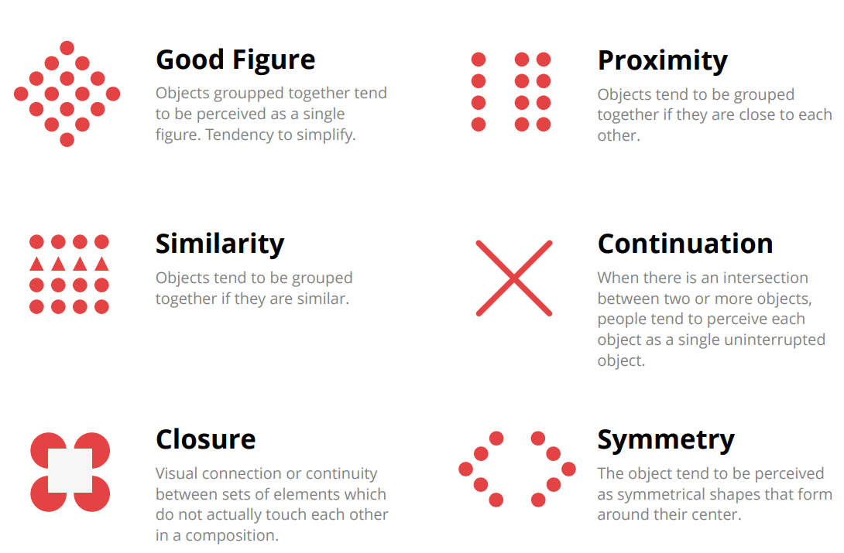
Gestalt Principles

Slide 30
Gestalt Principles
Proximity: Elements that are close to each other tend to be perceived as a group.
Example: Words in a paragraph are seen as separate lines because of spacing.
Similarity: Elements that look alike (in color, shape, size, or texture) are perceived as belonging together.
Example: Items in the same color on a dashboard are grouped mentally.
Continuity: Our eyes follow the smoothest path, creating continuous forms rather than disjointed elements.
Example: A curved line intersecting a straight line is
seen as two continuous lines, not a random shape.

Slide 31
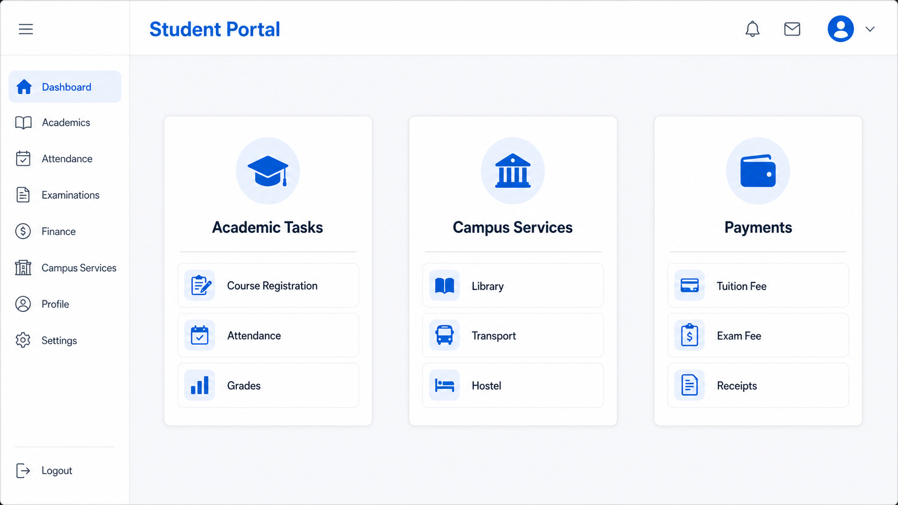
Proximity: Related portal options are placed close together in separate cards.

Slide 32
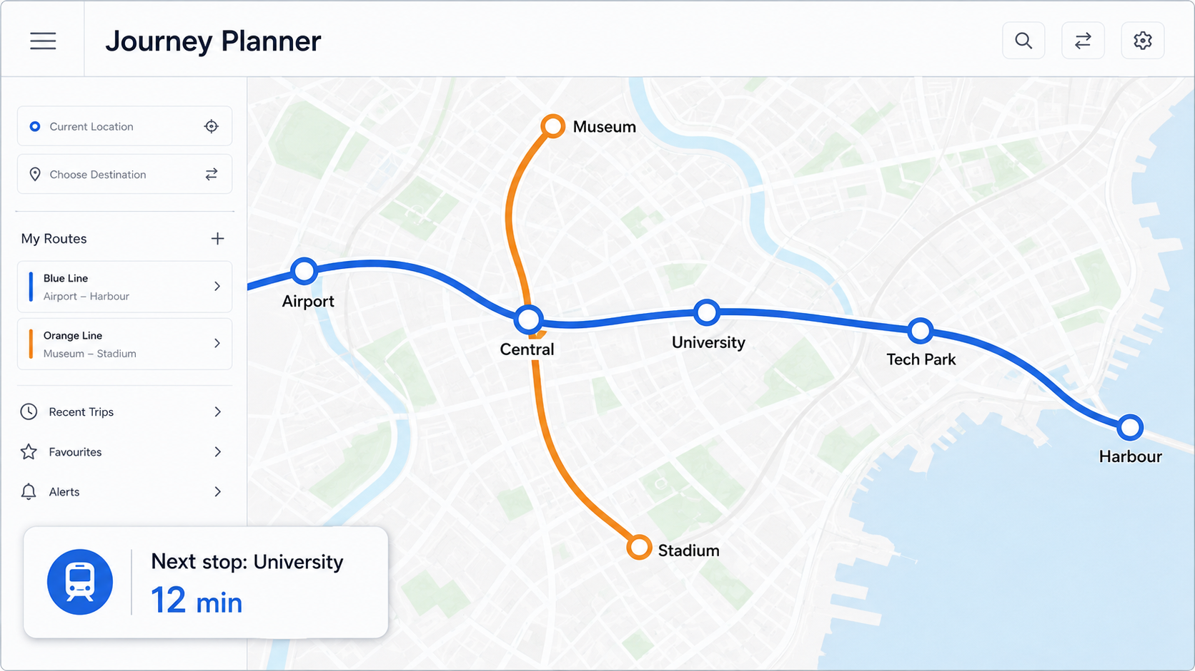
Continuity: The eyes naturally follow the smooth metro lines as continuous routes.

Slide 33
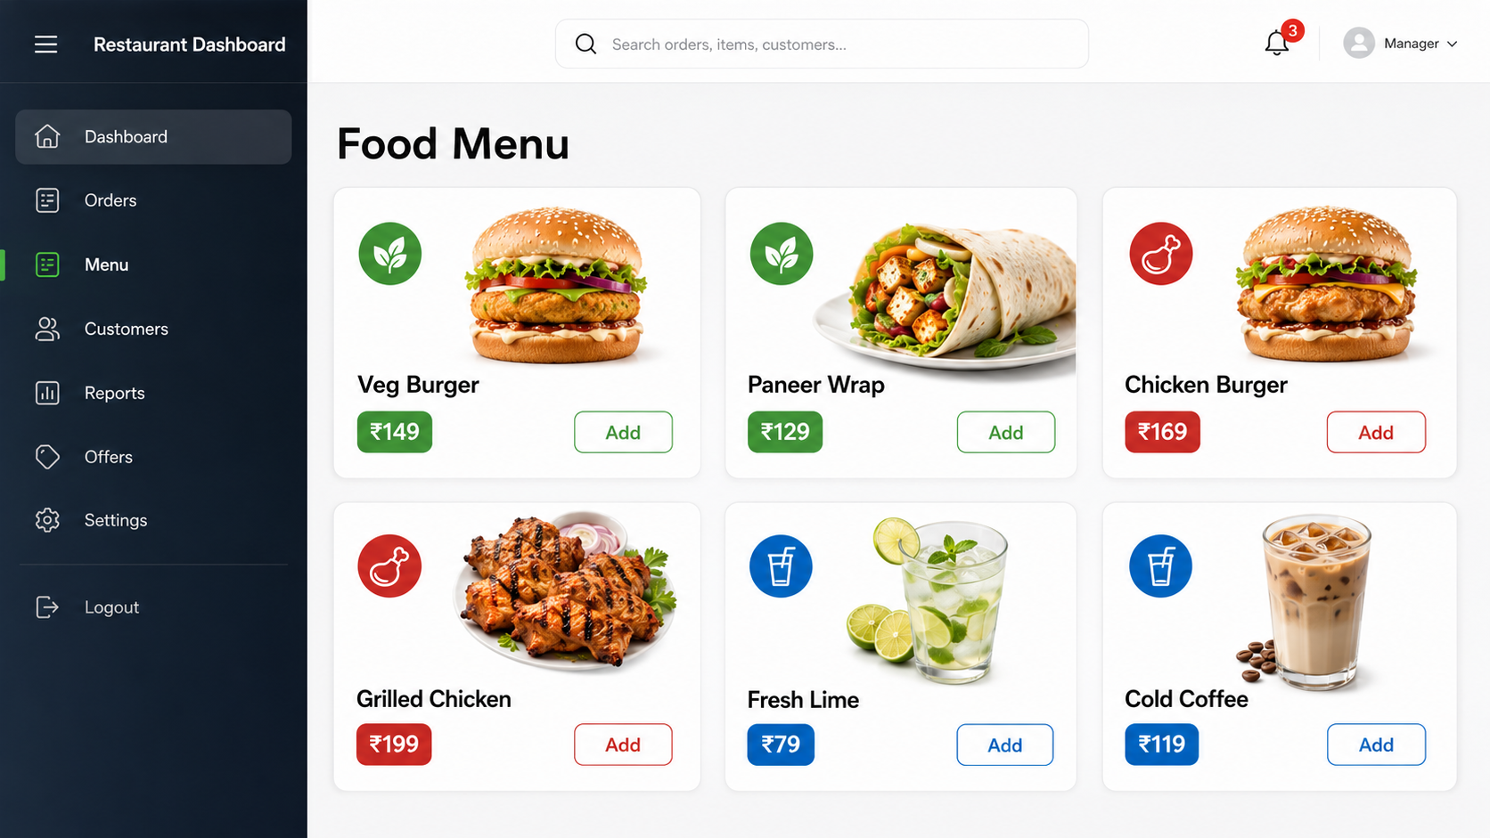
Similarity: Matching colours and shapes identify vegetarian, non-vegetarian and beverage items.

Slide 34
Gestalt Principles
Closure: The mind fills in gaps to perceive complete shapes. Example: A circle drawn with gaps is still seen as a complete circle.
Symmetery: Elements that move together are perceived as part of the same group. Example: Birds flying in the same direction appear as a single flock.
Figure-Ground: We tend to separate objects from their background, focusing on either the figure or the background at a time. Example: A white vase on a black background can also look like two faces in profile.

Slide 35
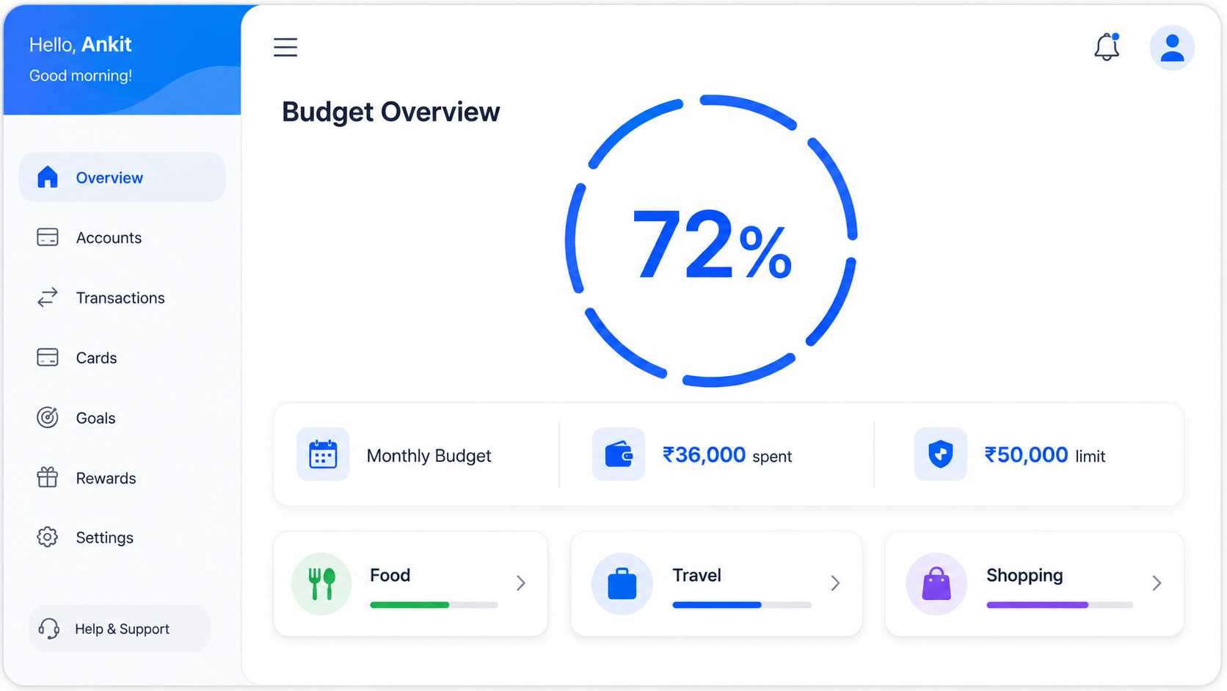
Closure: The incomplete circular progress ring is perceived as a complete circle.

Slide 36
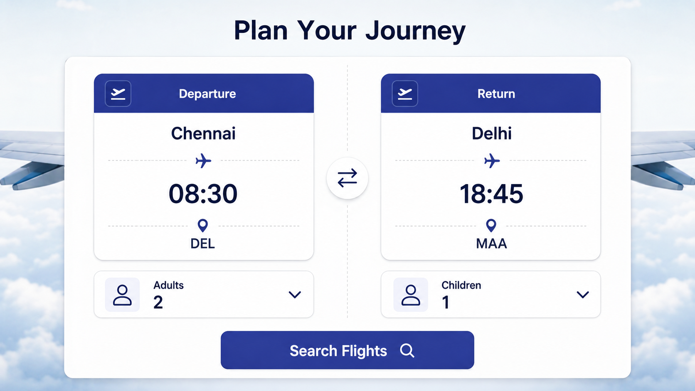
Symmetry: Mirrored departure and return sections appear related and balanced.

Slide 37
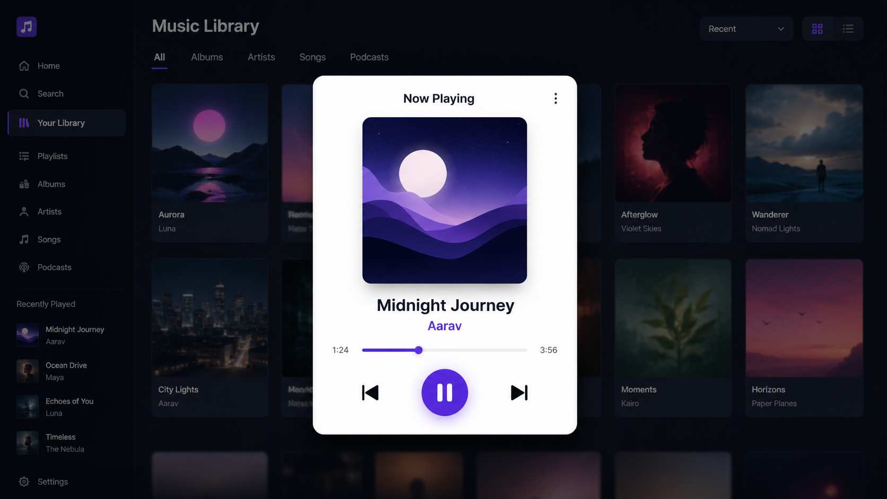
Figure–Ground: The bright music-player card stands out clearly from the dark background.

Slide 38
Visually Pleasing Composition
Provide a visually or aesthetically pleasing composition possessing the following qualities:
  Balance
  Symmetry
  Regularity
  Predictability
  Sequentiality
  Economy
  Unity
  Proportion
  Simplicity
  Groupings

Slide 39
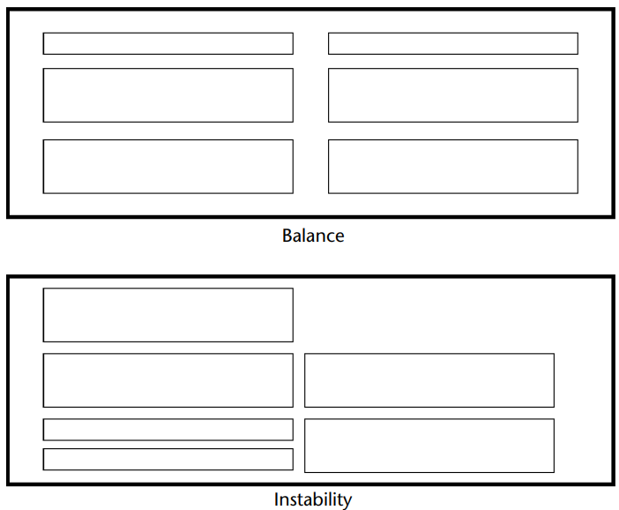
Balance
Create screen balance by providing an equal weight of screen elements, left and right, top and bottom.

Slide 40
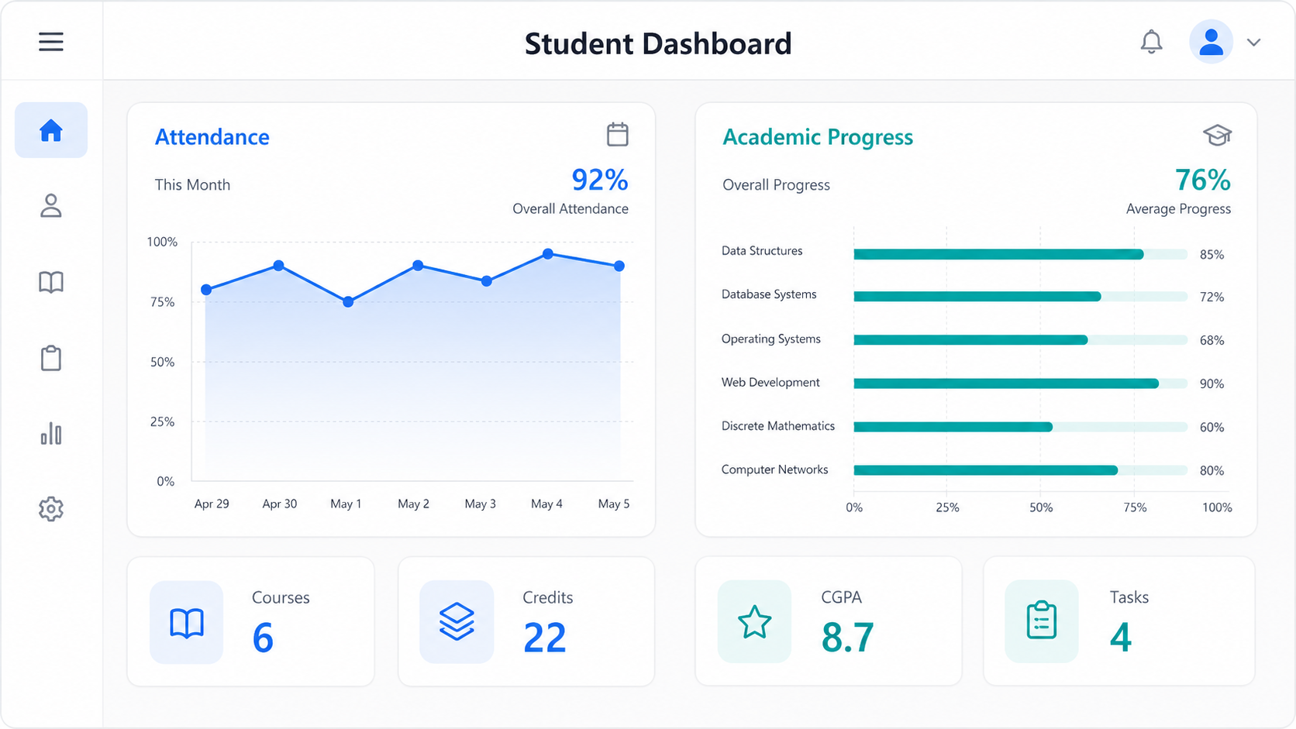
Balance: The dashboard distributes visual weight evenly between attendance and academic-progress sections.

Slide 41
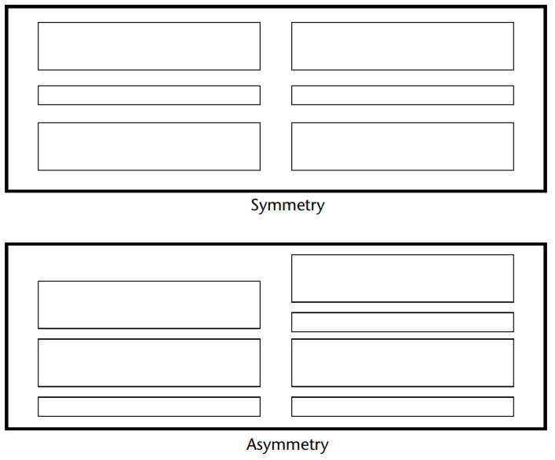
Symmetry
Create symmetry by replicating elements left and right of the screen centerline.

Slide 42

Symmetry: Identical check-in and check-out sections are mirrored around a central axis.

Slide 43
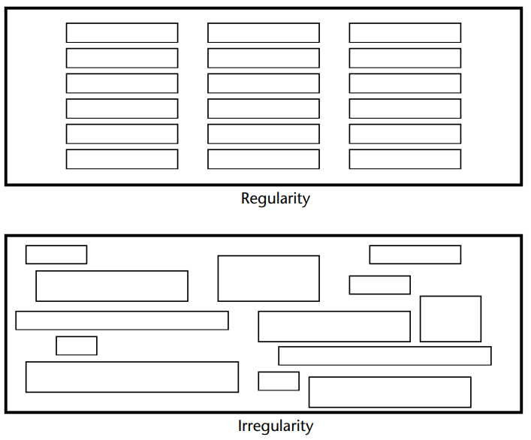
Regularity
Create regularity by establishing standard and consistently spaced horizontal and vertical alignment points.
Also, use similar element sizes, shapes, colors, and spacing.

Slide 44
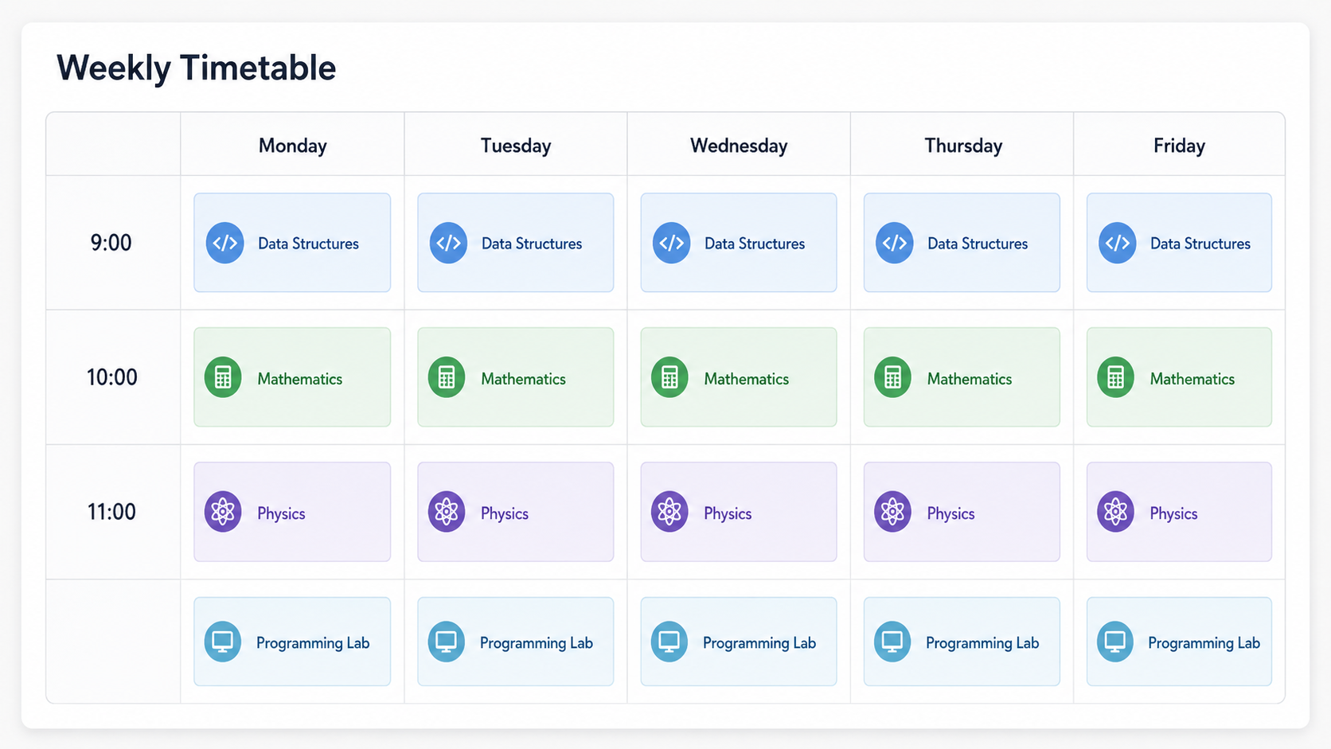
Regularity: Equal rows, columns, spacing and card styles create an orderly timetable.

Slide 45
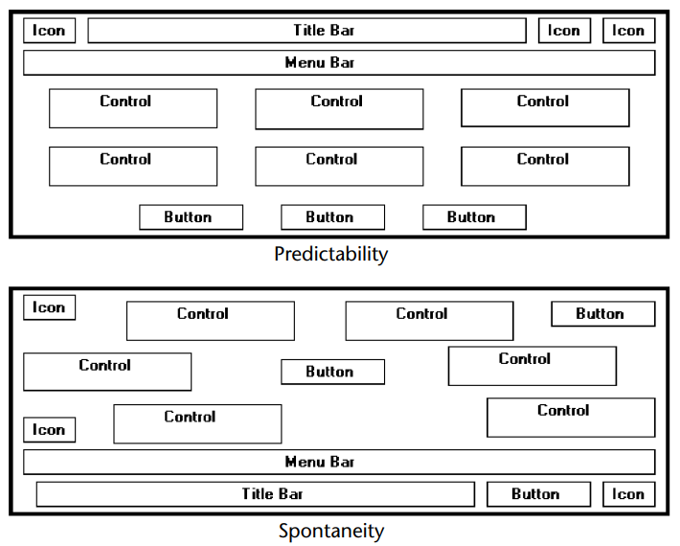
Predictability
Create predictability by being consistent and following conventional orders or arrangements

Slide 46
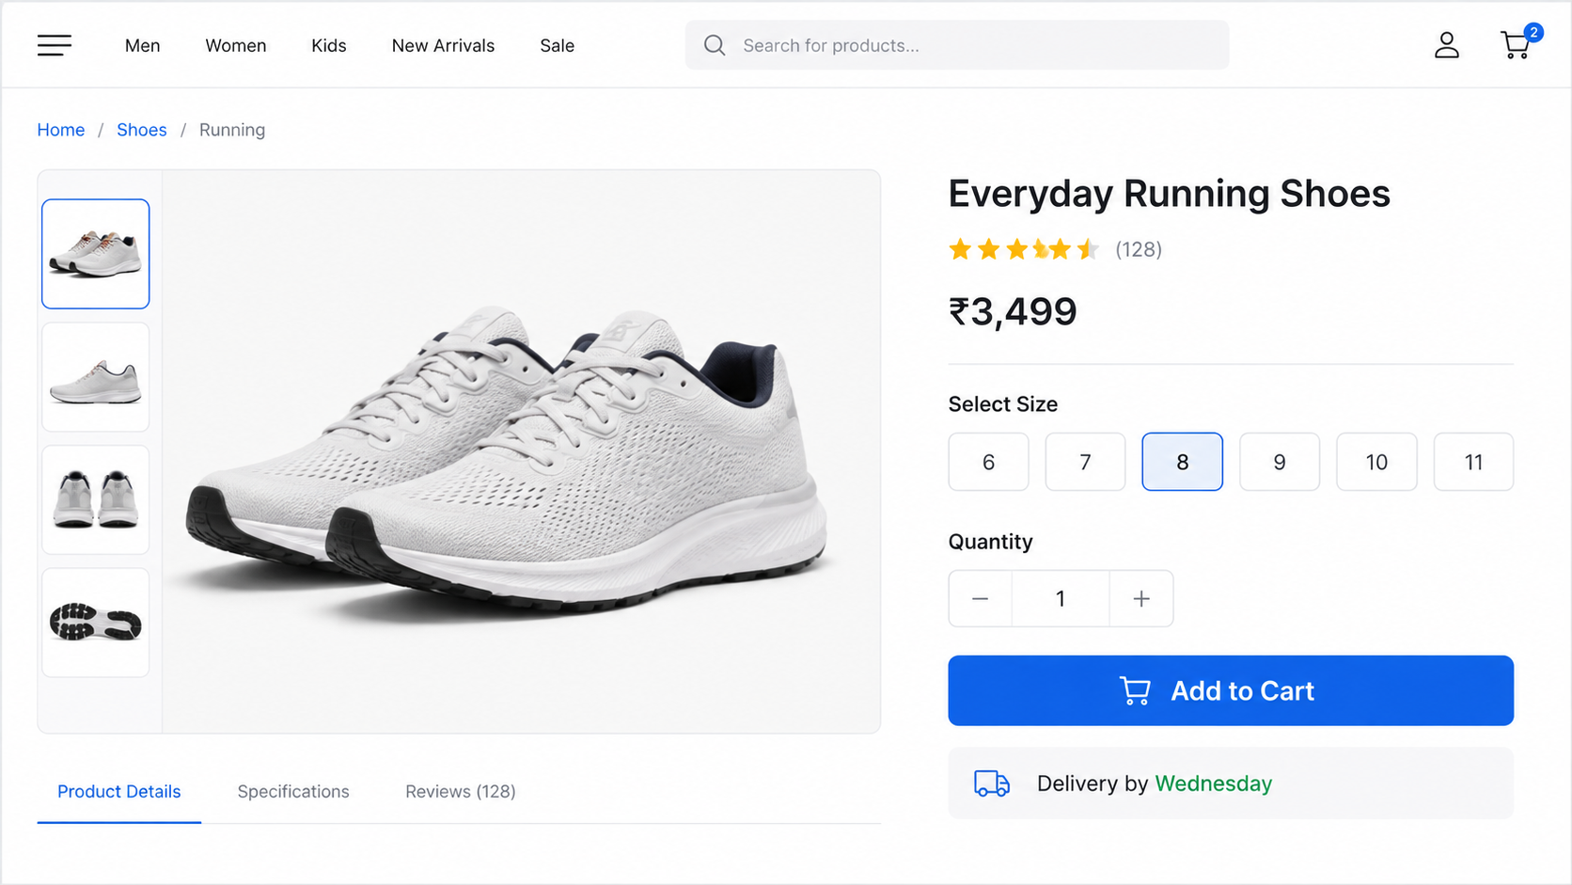
Predictability: Familiar product-page conventions help users immediately locate the price, size and Add to Cart button.

Slide 47
Sequentiality
Provide sequentiality by arranging elements to guide the eye through the screen in an obvious, logical, rhythmic, and efficient manner.
The eye tends to be attracted to
  A brighter element before one less bright.
  Isolated elements before elements in a group.
  Graphics before text.
  Color before black and white.
  Highly saturated colors before those less saturated.
  Dark areas before light areas.
  A big element before a small one.
  An unusual shape before a usual one.
  Big objects before little objects.

Slide 48
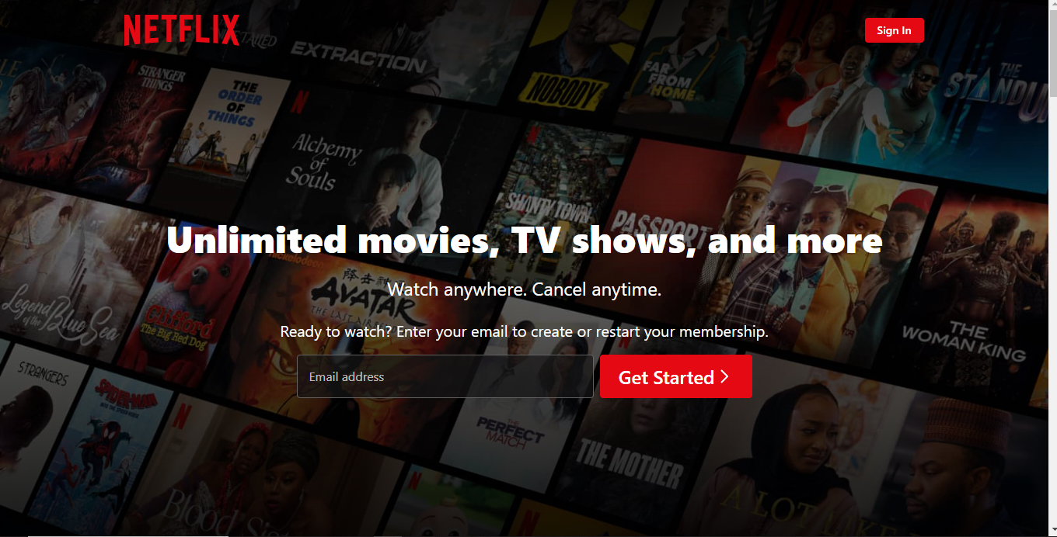

Slide 49
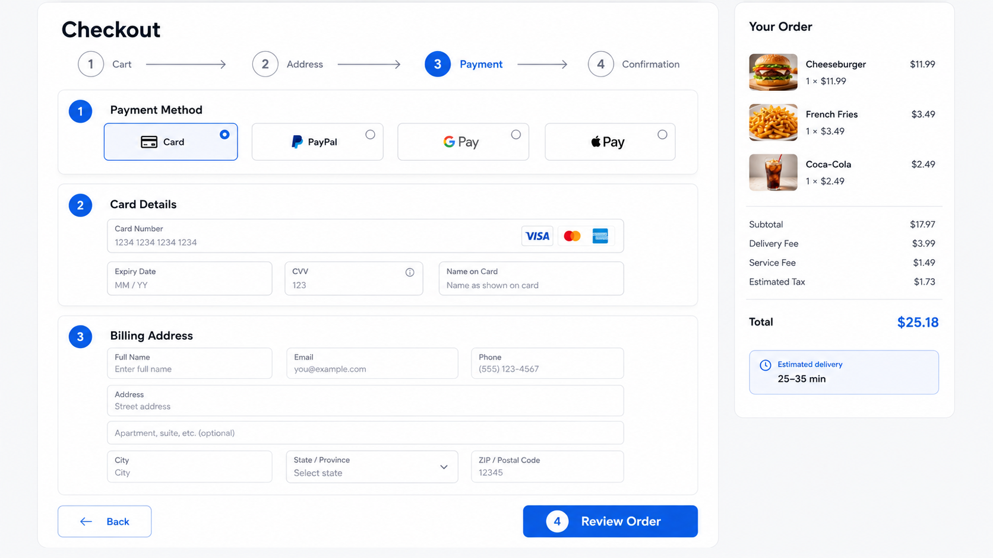
Sequentiality: Numbered steps guide users through checkout in a clear, logical order.

Slide 50
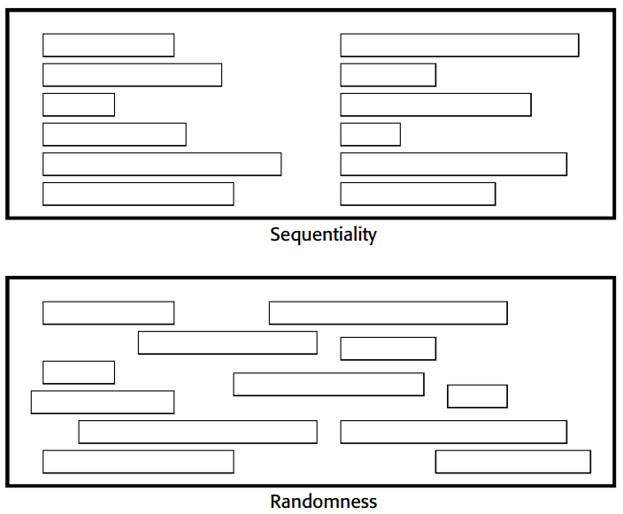
Sequentiality

Slide 51
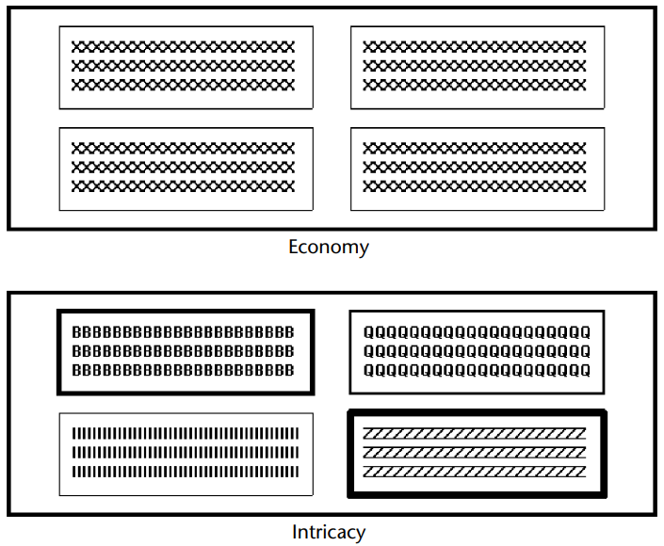
Economy
Provide economy by using as few styles, display techniques, and colors as possible

Slide 52
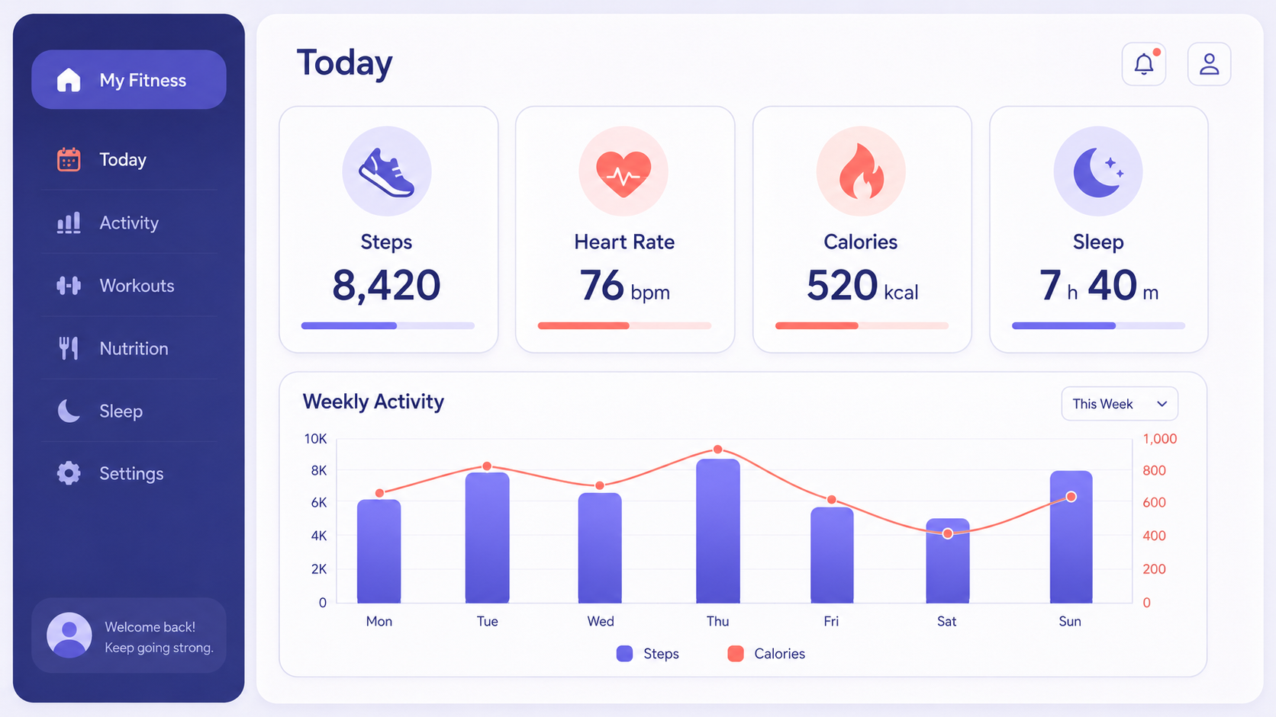
Economy: Only the information and controls necessary to transfer money are displayed.

Slide 53
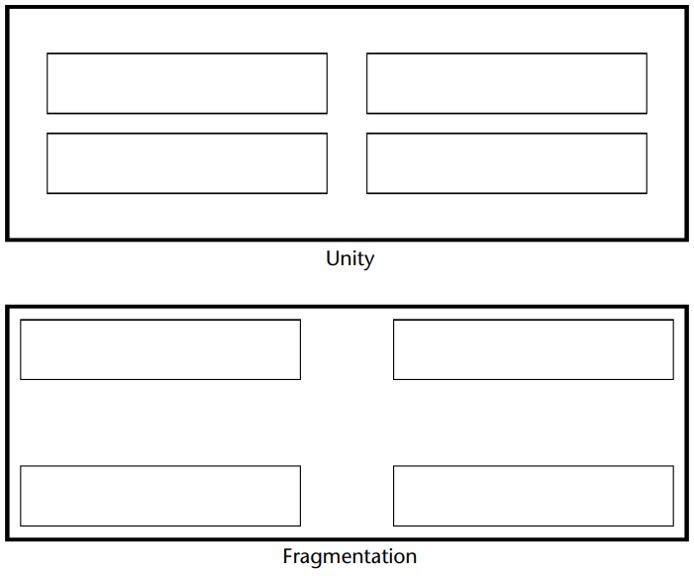
Unity
Create unity by
  Using similar sizes, shapes, or colors for related information.
  Leaving less space between elements of a screen than the space left at the margins.

Slide 54
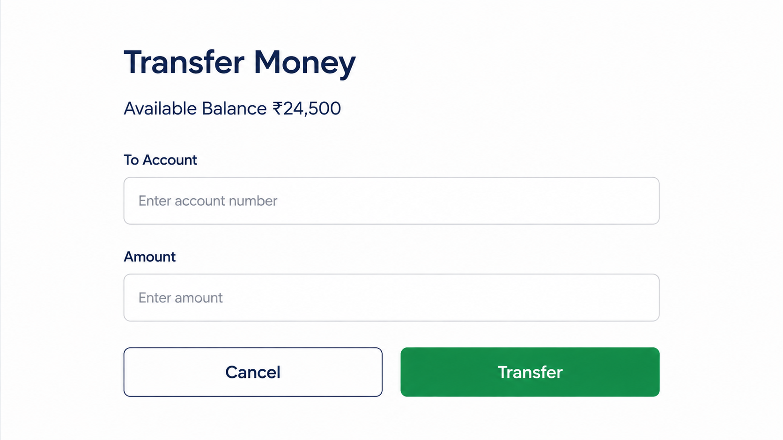
Unity: Consistent colours, icons, typography and card designs make the dashboard feel like one composition.

Slide 55
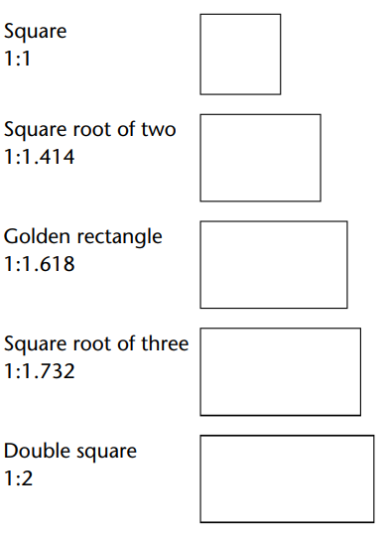
Proportion
Create windows and groupings of data or text with aesthetically pleasing proportions.

Slide 56
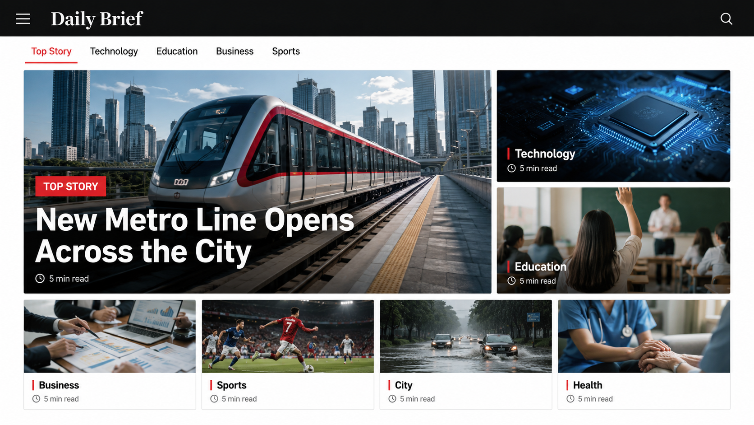
Proportion: The most important news occupies the largest area, while secondary stories use progressively smaller cards.

Slide 57
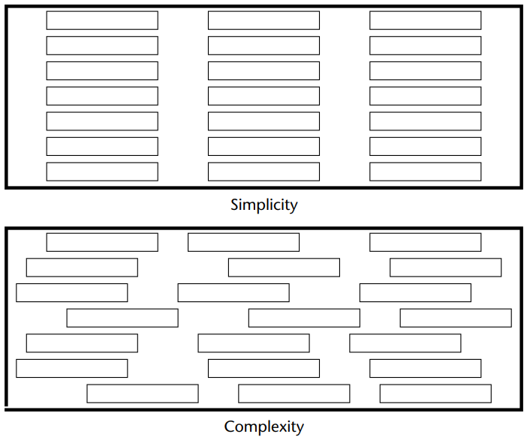
Simplicity (Complexity)
Optimize the number of elements on a screen, within limits of clarity.
Minimize the alignment points, especially horizontal or columnar.
  Provide standard grids of horizontal and vertical lines to position elements.

Slide 58
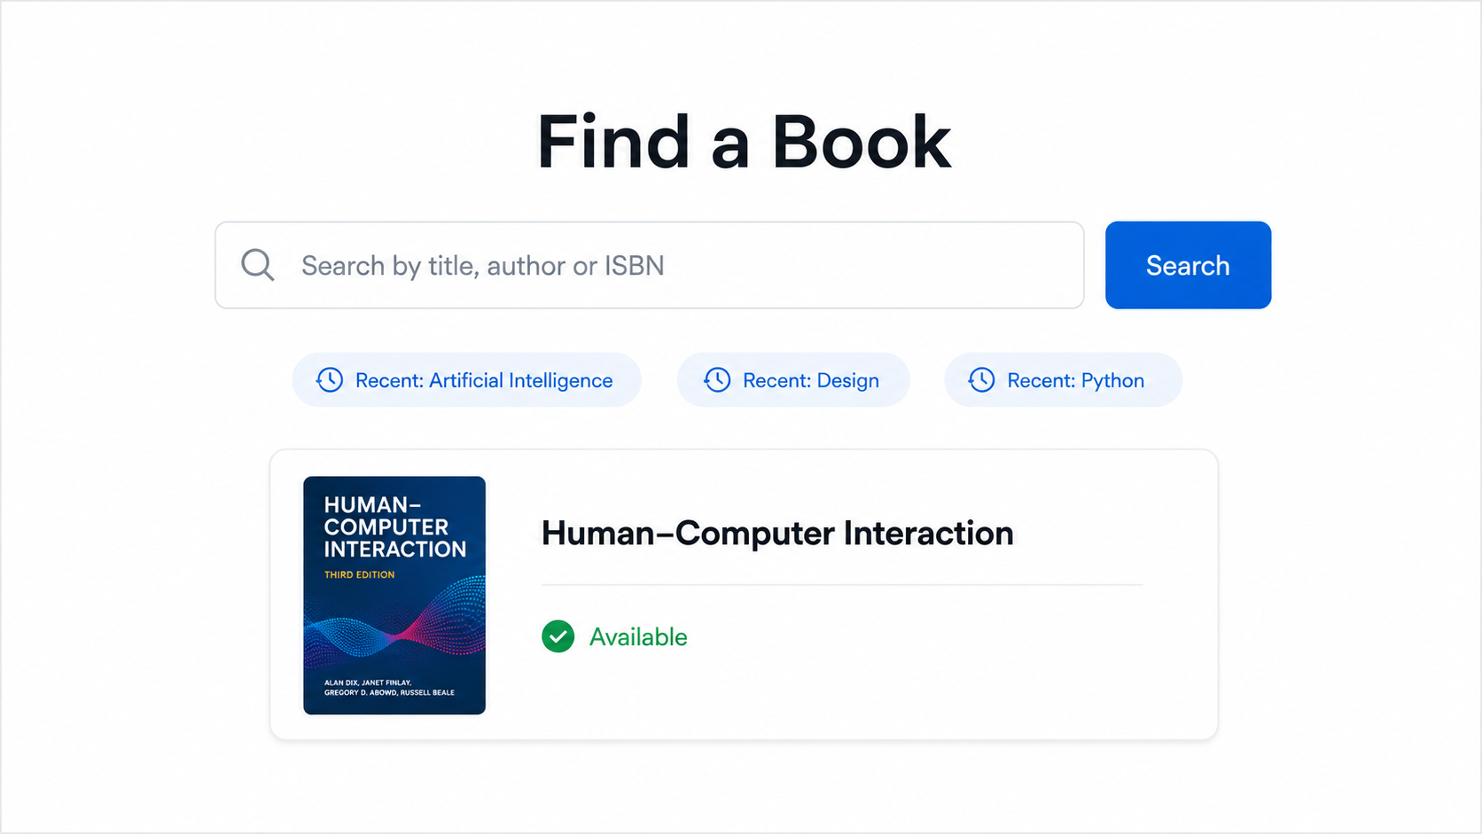
Simplicity: One search field, one action and minimal supporting information make the interface easy to understand.

Slide 59
Groupings
Provide functional groupings of associated elements.
Create spatial groupings as closely as possible to five degrees of visual angle (1.67 inches in diameter or about 6 to 7 lines of text, 12 to 14 characters in width).
Evenly space controls within a grouping, allowing 1/8 to 1/4 inch between each.
Visually reinforce groupings:
  Provide adequate separation between groupings through liberal use of white space.
  Provide line borders around groups.
Provide meaningful titles for each grouping

Slide 60
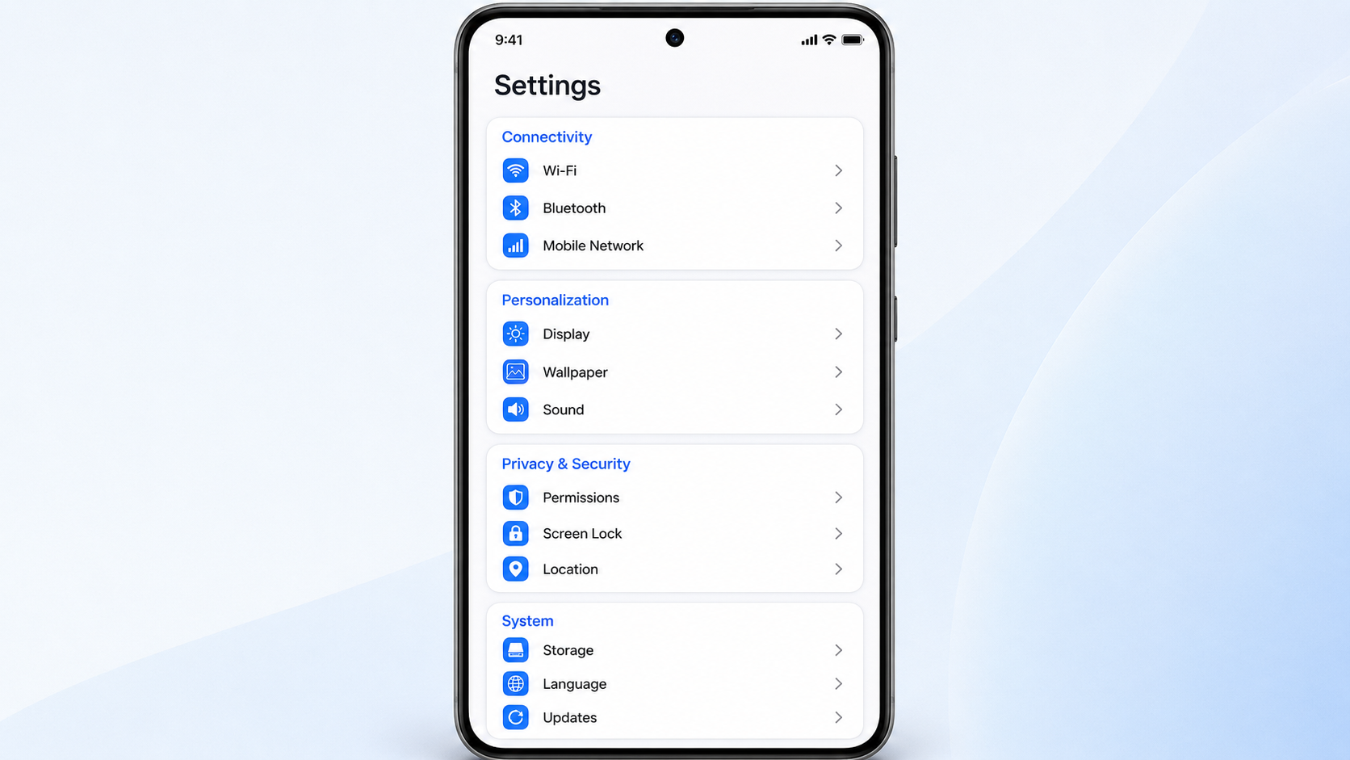
Groupings: Related settings are placed together under clearly separated category headings.

Slide 61
Distinctiveness
Individual screen controls, and groups of controls, must be perceptually distinct.
Screen controls
  Should not touch a window border.
  Should not touch each other.
Field and group borders
  Should not touch a window border.
  Should not touch each other.
Buttons
  Should not touch a window border.
  Should not touch each other.
A button label should not touch the button border.
Adjacent screen elements must be displayed in colors or shades of sufficient contrast with one another.

Slide 62

Focus and Emphasis
Emphasis is used to indicate importance or dominance.
Emphasis is a powerful way to control how a user will experience your design by making elements stand out when necessary.
Visually emphasize components such as
  Most prominent elements.
  Most important elements.
  Central idea or focal point.
  Changing elements.
  Most critical elements.

Slide 63

Visually emphasize components
The fewer elements you have on a page, the easier it is to understand what you intended to communicate.

Slide 64
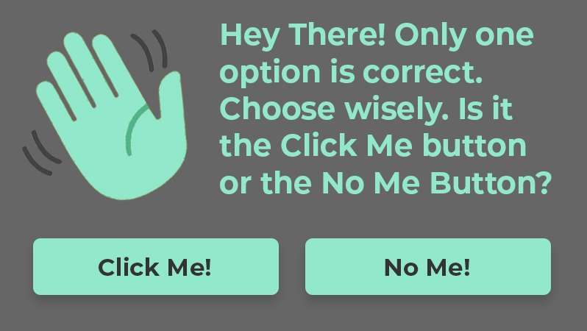
Visually emphasize components
more elements are added to your design, it becomes difficult for the eye to distinguish what it should focus on first, effectively losing any sense of hierarchy.
In this case, each element has roughly the same amount of emphasis. As a result, it’s not immediately obvious what your supposed to look at or what you’re supposed to do.

Slide 65
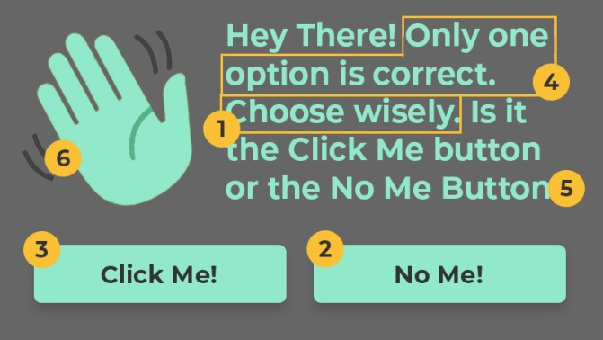
Visually emphasize components
Assessing the Hierarchy
  The call-to-action will be to “Choose Wisely,” making it immediately clear what the user should do.
  The primary button will be the “No Me” button. We’ll make this the second most emphasized element, so the user can can have confidence that it’s the “right choice.”
  The secondary button will be the “Click Me” button. This button will have less emphasize to make it clear that it’s not as important as the primary button.
  Next, we’ll make sure the reader knows “only one option is correct” by giving it more emphasis than the remaining text.
  The remaining text is merely provided for more context. Since it’s not as important as the previous elements it will be toned down a bit.
  Finally, the waving hand icon is the least important element. If anything, it only serves to help communicate the message subconsciously. Therefore, it will be muted to fade into the background.

Slide 66
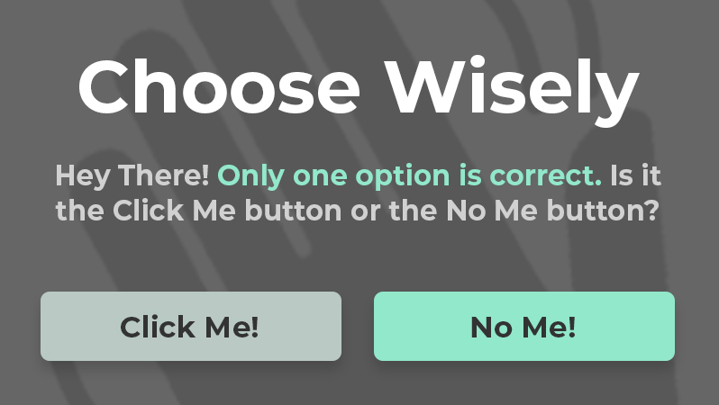
Visually emphasize components
With this plan in place, we can now strategically add or reduce focus for each element until we’ve created visual hierarchy:

Slide 67
Focus and Emphasis
To provide emphasis use techniques such as
  Higher brightness.
  Reverse polarity or inverse video.
  Distinctive Typeface.
    Bold.
    Italics.
    Underlining.
Blinking.
Line rulings and surrounding boxes or frames.
Color.
Larger size.
Animation.
Positioning.
Distinctive or unusual shape.
Isolation.

Slide 68
Focus and Emphasis
De-emphasize less important elements.
To ensure that emphasized screen elements stand out, avoid
  Emphasizing too many screen elements.
  Using too many emphasis techniques.
Minimize screen clutter.
In Web page design
  Call attention to new or changed content.
  Ensure that page text is not overwhelmed by page background.

Slide 69
Presenting Information Simply and Meaningfully
Provide legibility.
  Information is noticeable and distinguishable.
Provide readability.
  Information is identifiable, interpretable, and attractive.
Present information in usable form.
  Translations, transpositions, and references to documentation should not be required to interpret and understand information.
Utilize contrasting display features.
  To attract and call attention to different screen elements.
Create visual lines.
  Implicit and explicit, to guide the eye.
Be consistent.
  In appearance and procedural usage.

Slide 70
Statistical Graphics
A statistical graphic is data presented in a graphical format.
A chart or graph, consists of complex ideas communicated with clarity, precision, and efficiency.
It gives its viewer the greatest number of ideas, in the shortest time and in the smallest space and with least possible clutter

Slide 71
Qualities of statistical graphic
The objective and use of the graph should be obvious and apparent.
The graph type should be recognizable.
The graph type should help users understand the data more easily.
The data should be formatted and presented correctly.
The data should be formatted and presented for the using audience.
The graph should avoid distortions by telling the truth about the data.

Slide 72
Use of Statistical Graphics
Graphs are used for
  Simple comparisons of data.
  Presentation of changes over time.
  Statistical analysis.
  Illustration of proportions.
Reserve for material that is rich, complex or difficult.
  Less than or equal to 3 numbers - use a sentence.
  For 4 to 20 numbers - use a table.
  More than 20 numbers - use a graph.

Slide 73
How to choose the right chart type
Choosing the right chart type depends on what kind of data you want to present.
  Do you want to display composition of something?
  Do you want to compare values or show differences over time?
  Do you want to better understand the relationship between two or more variables?
  Do you want to show the distribution of your data?

Slide 74
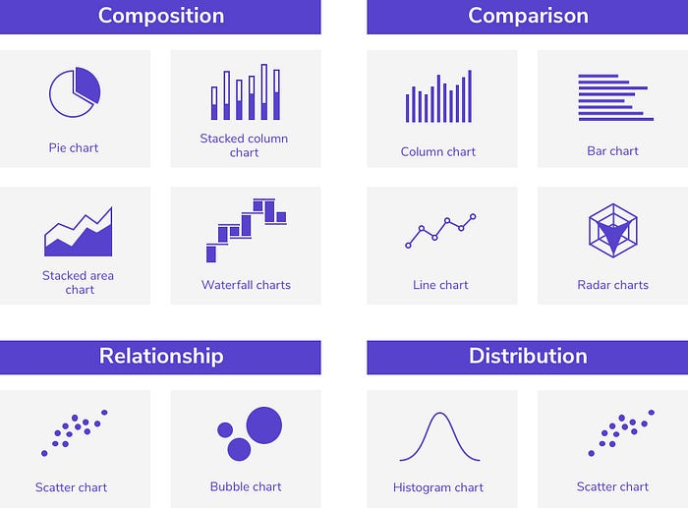

Slide 75
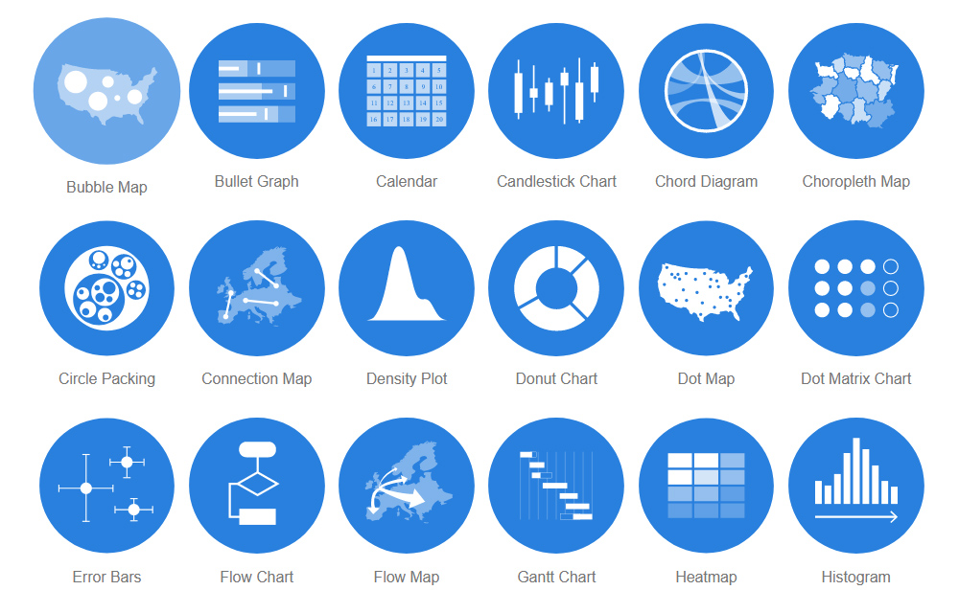
Use Visualizations To Present Data

Slide 76
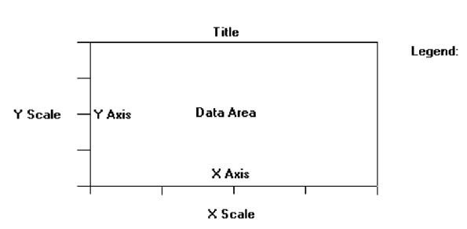
Components of a Statistical Graphic

Slide 77
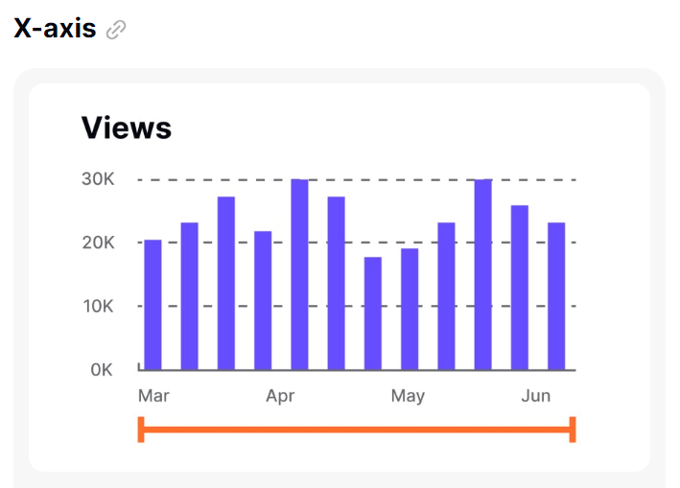
Components of a Statistical Graphic

Slide 78
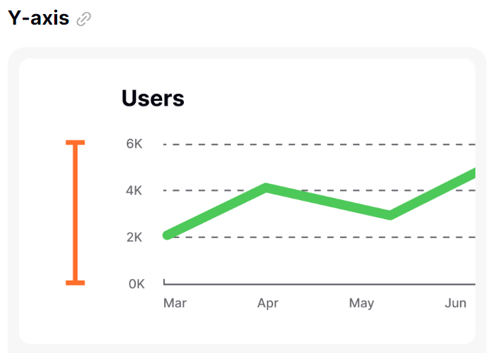
Components of a Statistical Graphic

Slide 79
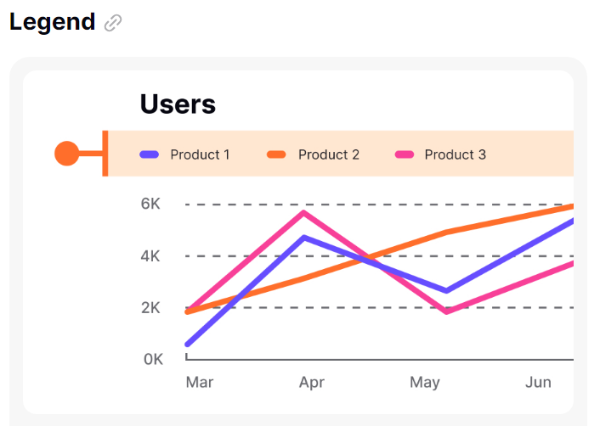
Components of a Statistical Graphic
A legend in a chart is a guide that explains the symbols, colors, or patterns used in the chart.

Slide 80
Axes Label
Center the X-axis label below its scale.
Center the Y-axis label above the scale or adjacent to the scale.
State units of measurement.
Provide information about the source of the data.

Slide 81
Axes
Values on an axis should increase as they move away from the origin.
Use the horizontal axis (X) to show time or cause of an event (the independent variable).
Use the vertical axis (Y) to show a caused effect (the dependent variable).
Provide additional axes when appropriate. For example, to show
  Two scales for the same data.
  Two or more related graphs within the same area and frame.
Assure the area enclosed by the axes is the proper size for the displayed data.

Slide 82

Scales and Scaling
Place ticks to marks scales on the outside edge of each axis.
Employ a linear scale.
Mark scales at standard or customary intervals.
Create relatively square grid cells.
Start a numeric scale at zero (0).
Keep the number of digits in a scale to a minimum.
For scales containing decimals, put zeros in front of the decimal.
If data points are on the zero (0) line, offset the scale.
Display only a single scale on each axis.
For large data matrices, consider displaying duplicate axes.
Provide aids for scale interpretation.
Provide scaling consistency across two or more related graphics.
Clearly label each axis in a left-to-right reading orientation.

Slide 83
Data Presentation in Graphs
Emphasize the data.
Minimize the nondata elements.
Minimize redundant data.
Show data variation, not design variation.
Provide the proper context for data interpretation.
Restrict the number of information-carrying dimensions depicted to the number of data dimensions being illustrated.
Employ data in multiple ways, whenever possible.
Maximize data density.
Employ simple data-coding schemes.
Avoid unnecessary embellishment (decoration) of
  Grids.
  Vibration.
  Ornamentation.
Fill the graph’s available area with data.

Slide 84
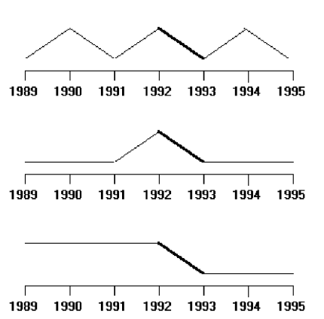
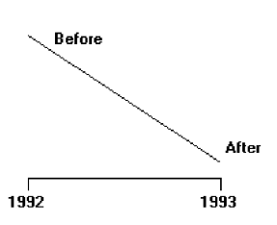
Proper context for data interpretation
A change between 1992 and 1993 without proper context for interpretation.
Changes between 1992 and 1993 with proper contexts for interpretation.

Slide 85
Proportion
Provide accurate proportion of the displayed surfaces to the data they represent.
Provide proper proportion by
  Conforming to the shape of the data.
  Making the width greater than the height.

Slide 86
Lines
Data lines should be the heaviest.
Axes lines should be of medium weight.
  Extend the lines entirely around the graphic.
Grid lines should be very thin or absent.
  Let the user turn the grid on or off.

Slide 87
Labeling
Employ clear, detailed and thorough labeling.
Maintain a left-to-right reading orientation.
Integrate the labeling with the drawing.
  Do not curve letters to match the shape of curved lines.
Use only one typeface, font, and weight.
  For emphasis, use different type sizes.
Do not separate labeling from the data through ruled lines.

Slide 88
Title
Create a short, simple, clear, and distinctive title describing the purpose of the graphic.
Position the title above, centered, or left-aligned to the rectangle formed by the extended axes.
Spell it out fully, using a mixed-case or uppercase font.

Slide 89
Key or Legend
Incorporate a key or legend for complicated graphs.
Data Labels
  Permit data labels to be turned on or off

Slide 90
Aiding Interpretation of Numbers
Display a grid on request.
Permit the viewer to click on a data point to display actual values.
Show numeric values automatically for each point or bar.
Permit the viewer to zoom in on an area of the graphic.
Permit the user to change the scale values.
Permit toggling between a graphic and a table.

Slide 91

Types of graphs
Surface Charts
Order the data categories so that
  The least variable is at the bottom, and the most variable at the top.
  The largest is at the bottom and the smallest at the top.
Use different texture or shading coding schemes to differentiate the areas below each curve or line.
Incorporate labels within the bands of data.

Slide 92

Pie Charts
Pie charts should be used with caution.
If pie charts are used,
  They must add up to 100 percent.
  Use five segments or fewer.
  Each segment should take up at least 5 percent (18 degrees) of the circle.
  Place the largest segment starting at 12:00.
  Directly label each segment in the normal reading orientation.
    If leaders for labels in small segments are necessary, orient them in as few
  angles as possible.
  Include numbers with segment labels to indicate percentages of absolute values.
  Texture- or color-coding selected for segments should not emphasize one segment over another (unless it is intended).
  Highlight segments requiring particular emphasis through a contrasting display technique or by “exploding” it.
  Never tilt a pie.

Slide 93


Segmented or Stacked Bar
Order the data categories in the same sequence.
Order the data categories so that
  The least variable is at the bottom.
  The most variable is at the top.
Limit the number of segments to those that are large enough to be seen and labeled.
Use different texture or coding schemes to differentiate the areas within each bar.
Clearly associate labels with bars or segments.
  Place segment labels to the right on a vertical chart or above on a horizontal chart.

Slide 94

Bar Charts
Orient bars consistently, either horizontally or vertically.
Use vertical bars when the item being counted is of greatest interest.
Use horizontal bars
  When the data labels are long.
  To highlight the information rather than the count.
Use a meaningful organizing principle.
  If none exists, arrange the bars so that the length of bars is in ascending or descending order.
Make the spacing between bars equal to one-half the width of the bars or less.
  If groupings of bars are presented, leave space between the groupings only.

Slide 95
Bar Charts
If different kinds of bars must be easily distinguished, provide differentiation through a coding technique.
  If possible, use a pattern or color that reinforces the data.
Highlight bars representing important or critical data.
Provide a consistent ordering for related groups of bars.
Display a reference index if displayed data must be compared to a standard or critical value.
Identify each bar with an adjacent label.
  Place labels below, or to the left of, the baseline.
When a great many pieces of data must be compared, consider using histograms or step charts

Slide 96

Scatterplots
Limit use to two-dimensional displays of data.
Maintain consistent scale size intervals.
Provide distinguishable, equal-sized plot points.
If there is more than one set of data on the plot, use different symbols for each data set’s points.
Visually distinguish points of particular significance through a highlighting technique

Slide 97

Curve and Line Graphs
Display data curves or lines that must be compared in a single graph.
Display no more than four or five curves in a single graph.
Identify each curve or line with an adjacent label whenever possible.
If a legend must be included, order the legend to match the spatial ordering of the lines.
For tightly packed curves or lines, provide data differentiation with a line-coding
technique, such as different colors or different line composition types.
Highlight curves or lines representing important or critical data.
When comparing actual to projected data
  Use solid curves or lines for actual data.
  Use broken curves or lines for projected data.
Display a reference index if the displayed data must be compared to a standard or
critical value.
Display differences between two data sets as a curve or line itself.

Slide 98
Technological Considerations in Interface Design
Interface design is also affected, and constrained by, characteristics of the hardware being used and the interface’s controlling software.

Slide 99
Graphical Systems
Screen design must be compatible with the capabilities of the system, including
  System power.
  Screen size.
  Screen resolution.
  Display colors.
  Other display features.
Screen design must be compatible with the capabilities of the
  System platform being used.
  Development and implementation tools being used.
  Platform style guide being used.

Slide 100
Graphical Systems
System Power
  A slow processing speed and small memory may inhibit effective use of a system.
  Feedback and animation capabilities may be limited, reducing the system’s usability.
  Slow responses can be error prone, grossly inefficient, and very aggravating.
  A slow screen refresh rate will increase the user’s chances of perceiving screen flicker, which can be visually fatiguing.
  A system must be powerful enough to perform all necessary actions promptly, responsively, and meaningfully.

Slide 101
Graphical Systems
Screen Size
  Mostly screens are not large enough in size to take full advantage of windowing capabilities.
  Best monitor size
  21-inch monitor resulted in fastest task completion than 19-inch monitor.
  On web navigation, no performance difference was found between small and medium screens, but the large screen elicited a 26 percent faster performance.
  So, bigger screens may be better.
  Expanding monitor and screen size may create other problems such as it will require longer control movements to reach all locations on the screen, and more head and eye movements.

Slide 102
Graphical Systems
Screen Resolution
  Screen resolution is the horizontal and vertical height of a screen in pixels.
  Poor screen resolution may deter effective use of a graphical system by not permitting sharp and realistic drawings and shapes. Window structure and icon design may be severely affected.
  Higher resolution screen was searched significantly faster.

Slide 103
Graphical Systems
Colors
The color palette must be of a variety large enough to permit establishment of a family of discriminable colors.
The colors used must be accurately and clearly presented in all situations.

Slide 104
Technological considerations - Web site design.
Compatibility:
  Design for the most common browsers.
  Account for browser differences.
Operating systems:
  Design for popular operating systems.
Connection speed:
  Design for the most commonly used connection speeds.
Monitor size and resolution:
  Design within the boundaries of an image-safe area for all browsers.
  Design for commonly used screen resolutions.
Fonts:
  Use fonts that can be displayed on a variety of browsers.
Colors:
  Use colors that succeed on a variety of browsers and platforms.
    Use a palette of 216 colors.
Versions:
  Create multiple versions that support multiple browsers.
    Always provide a text-only version.
    Make use of browser sniffers.

Slide 105
Visual Display (page) Layout
Addressing page layout challenges involves efficiently organizing and allotting relevant and UI elements within one visible screen or scrollable page.
Optimizing the display layout should be such that
  it is organized according to the information content (e.g., importance, sequence, functionality),
  is sized manageably (e.g., divided into proper sections),
  is attention grabbing, and is visually pleasing (e.g., aligned and with restricted use of colors).

Slide 106

Guidelines for US Government Web Page Layout

Slide 107
Guidelines for Indian Government Websites (GIGW)
https://guidelines.india.gov.in/quick-tips/

Slide 108
Information Structuring and Navigation
Navigation refers to the method used to find information within a Web site.
A navigation page is used primarily to help users locate and link to destination pages.
A Web site’s navigation scheme and features should allow users to find and access information effectively and efficiently.
. . To facilitate navigation, designers should differentiate and group navigation elements and use appropriate menu types. It is also important to use descriptive tab labels, provide a clickable list of page contents on long pages, and add “glosses” where they will help users select the correct link. In well-designed sites, users do not get trapped in dead-end pages.

Slide 109

Grouped navigation: Academic Services and Student Support
Descriptive menu labels and breadcrumb trail (A breadcrumb is a small navigation path that shows the user’s current location in a website. Ex. Home / Academics / Course Registration)
“On this page” links for quick access on a long page ; Clear action button and help panel
A “Return to Dashboard” link so users do not reach a dead end

Slide 110
Users with Disability
Perceivable
  Provide text alternatives for nontext content.
  Provide captions and other alternatives for multimedia.
  Create content that can be presented in different ways, including by assistive technologies, without losing meaning.
  Make it easier for users to see and hear content.

Slide 111

This UI screenshot demonstrates the Perceivable accessibility principle through:
Alternative text for images
Captions and transcripts for video
Adjustable text size and high contrast
Audio description and volume controls
Adaptable layout for different devices and assistive technologies

Slide 112
Users with Disability
2. Operable
  Make all functionality available from a keyboard.
  Give users enough time to read and use content.
  Do not use content that causes seizures.
  Help users navigate and find content.
Understandable
  Make text readable and understandable.
  Make content appear and operate in predictable ways.
  Help users avoid and correct mistakes.
Robust
  Maximize compatibility with current and future user tools.

Slide 113

It shows:
Operable: Skip link, keyboard focus on the button, keyboard navigation.
Understandable: Clear labels, step indicator, helpful email-error message, saved confirmation.
Robust: Semantic headings and screen-reader compatibility shown in the accessibility panel.

Slide 114
Mobile Device
More specific and important principles by Tidwell [2]:
  Fast status information (especially with regard to network connection and services)
  Minimize typing and leverage on varied input hardware (e.g., buttons, touch, voice, handwriting recognition, virtual keyboard, etc.)
  Fierce task focus (for less confusion in a highly dense information space)
  Large hit targets (for easy and correct selection and manipulation)
  Efficient use of screen space (with condensed information)

Slide 115


Slide 116
Nokia developer’s Guidelines - Ex
Enable shortcuts (e.g., hot keys) for frequently used functions
Keep the user informed of his or her actions
Follow the device’s (vendor’s) interface patterns (positioning of the buttons and menus).

Slide 117
“Earcon” Design for Aural Interface
Earcon is distinctive sound that represents a specific event or conveys other information
lattner, Sumikawa, and Greenberg suggested a few guidelines for designing “auditory” analog-to-visual icons.
  symbolic,
  nomic, and
  metaphoric.

Slide 118

Symbolic: door-unlock chime—meaning learned by the user.
Nomic: rising Wi-Fi tone—sound pattern indicates the connection state.
Metaphoric: dripping-water sound—resembles the real-world event.

Slide 119
“Earcon” Design for Aural Interface
Symbolic earcons rely on social convention such as applause for approval;
nomicones are physical such as a door slam; and
metaphorical ones are based on capturing the similarities such as a falling pitch for a falling object
Aural feedback (including earcons) involves a careful choice of sound-related parameters such as the amplitude/ loudness, frequency/pitch, timbre, and duration.

Slide 120

It clearly shows:
Symbolic earcon: approval applause
Nomic earcon: door-closing sound
Metaphoric earcon: falling pitch for a dropped file
Adjustable loudness, pitch, timbre, and duration

