Slide 1
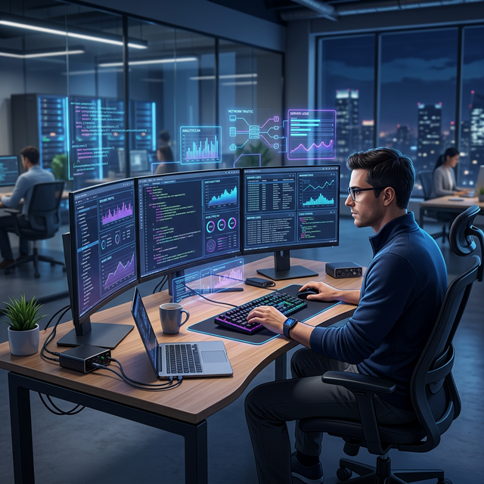
StressDetect AI
Intelligent Stress Monitoring for IT Professionals

Slide 2
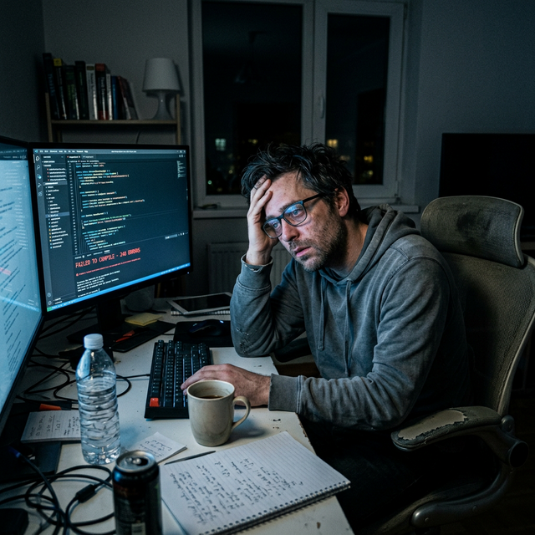
The Hidden Crisis in IT
High Burnout Rates: IT professionals face complex problem-solving, tight deadlines, and long screen times.
Undetected Stress: Chronic stress often goes unnoticed until it leads to severe burnout or health issues.
Loss of Productivity: Unmanaged stress impacts focus, code quality, and overall team morale.

Slide 3
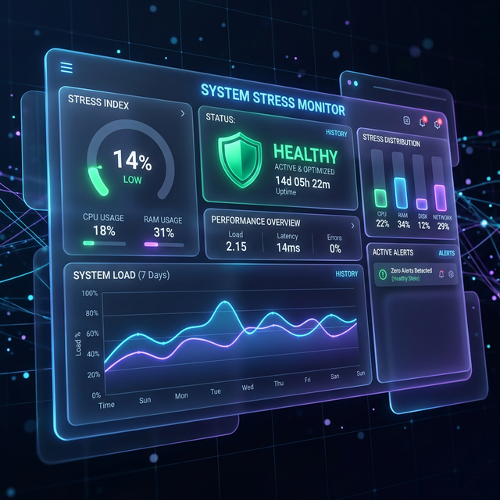
Proactive Stress Detection
Real-time Monitoring: AI-driven facial analysis to detect early signs of stress and fatigue.
Data-Driven Insights: Combining visual data with behavioral surveys for high accuracy.
Actionable Relief: Providing instant, personalized recommendations to mitigate stress.

Slide 4
Empowering the Modern Developer
Instant Scans: Quick webcam-based stress checks directly from the browser.
Comprehensive Dashboards: View historical trends, stress levels, and emotional states over time.
Privacy-First: All facial analysis is processed securely, ensuring user confidentiality.

Slide 5
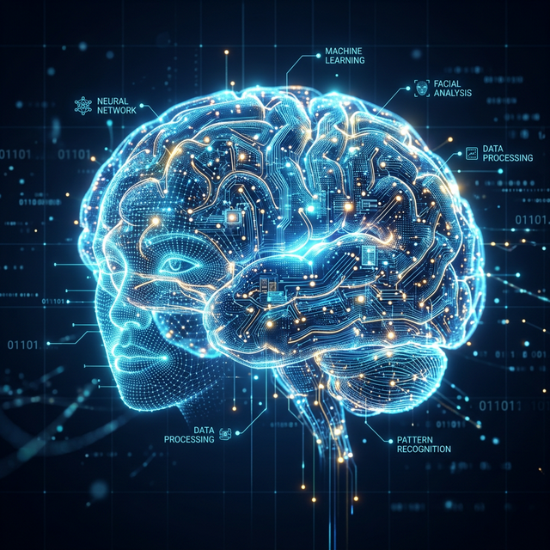
Powered by Advanced Machine Learning
Computer Vision: Utilizing face-api.js for lightweight, in-browser emotion tracking and facial landmark detection.
Indicators Tracked: Eye strain, brow tension, and facial fatigue.
Dual-Model Approach: Correlating visual cues with self-reported survey data for a holistic view.

Slide 6
A Seamless 3-Step Process
1. Capture: The user initiates a quick scan via their dashboard or takes the periodic survey.
2. Analyze: Our AI models evaluate micro-expressions and survey responses in real-time.
3. Report: The system generates a stress score and provides immediate relief techniques (e.g., breathing exercises, screen breaks).

Slide 7
Organizational Insights
Holistic Analytics: Admins gain a bird's-eye view of organizational stress trends.
Data management: Export datasets securely for deeper HR analytics and well-being initiatives.
Threshold Alerts: Identify structural bottlenecks causing department-wide stress spikes.

Slide 8
A Modern, Scalable Stack
Frontend: Responsive, glassmorphism UI built with HTML5, CSS3 Variables, and vanilla JS.
Animations: Premium scroll-reveals and dynamic backgrounds tailored for a professional feel.
Backend Integration: Built to connect seamlessly with Python Django APIs for heavy-lifting ML tasks.

Slide 9
Beyond the Webcam Context
Why Surveys? Visuals alone don't tell the whole story.
Predictive Analysis: Capturing hours worked, sleep quality, and active deadlines.
Holistic Score: Merging behavioral context with physical signs to greatly improve prediction accuracy.

Slide 10
Enterprise-Grade Trust
No Image Storage: Webcam frames are analyzed in real-time and immediately discarded.
Encryption: End-to-end data protection for user histories and personal identifiable information.
Opt-In Architecture: Users have full control over when they are monitored and can delete history at any time.

Slide 11
What's Next for StressDetect AI?
Phase 1: IDE Integrations (VS Code extension to detect typing patterns).
Phase 2: Wearable integrations (Apple Watch / Garmin HR data).
Phase 3: Automated workflow adjustments (Snoozing non-critical Slack notifications during high stress).

Slide 12
Building Healthier Tech Teams
A well-rested developer writes better code.
Thank you for your time.
Questions?
Contact: hello@stressdetect.ai | admin@example.com

