Slide 1
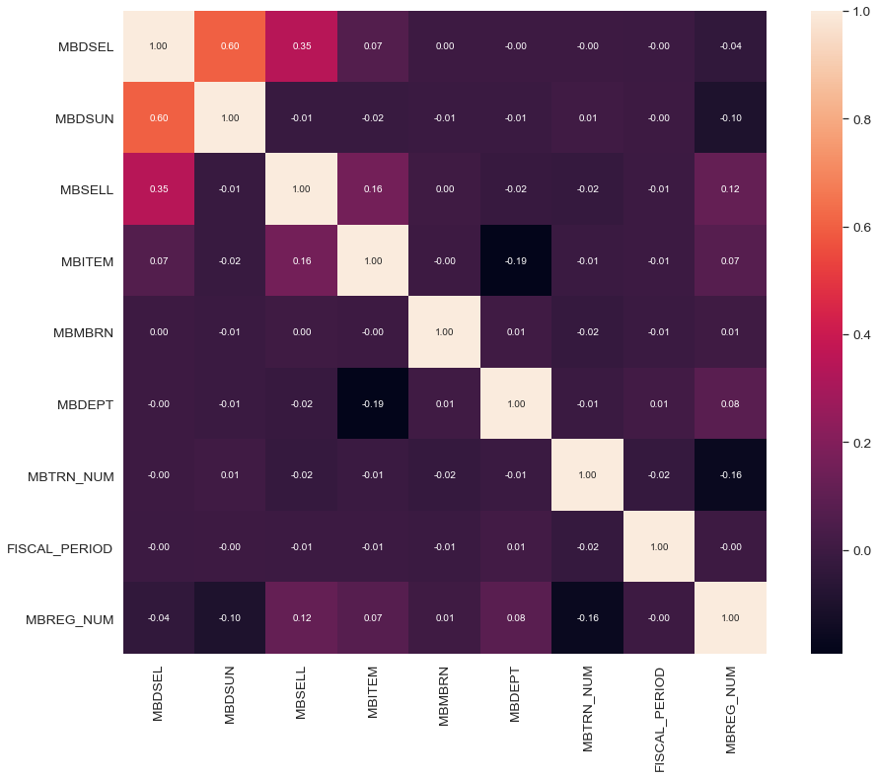
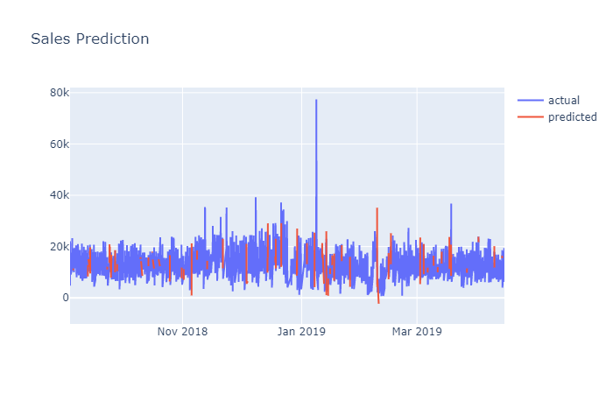
Kirkborne Progress – Sales forecasting
Joined 8 months ware house sales data
Converted MBTIME into 24hr format
Removed outlier data before 09:00 AM and after 06:30 PM
Grouped data by hourly with total amount of sales
Further data exploration and cleaning may be necessary
Applied LSTM on the sales data
Split data in 80% train and 20% test by random sampling
rms error is: $3677
r2 is 0.62
Mean sales per day: $14251.7

