Slide 1
FPGA PROJECT
Pipelined Posit Multiplier implementation and comparison with IEE 754 floating point . (Group 23)
Github link : https://github.com/smartplay28/posit_multiplier
Team Members:
Akshat Mittal (IMT2023606)
Nachiappan (IMT2023605)

Slide 2
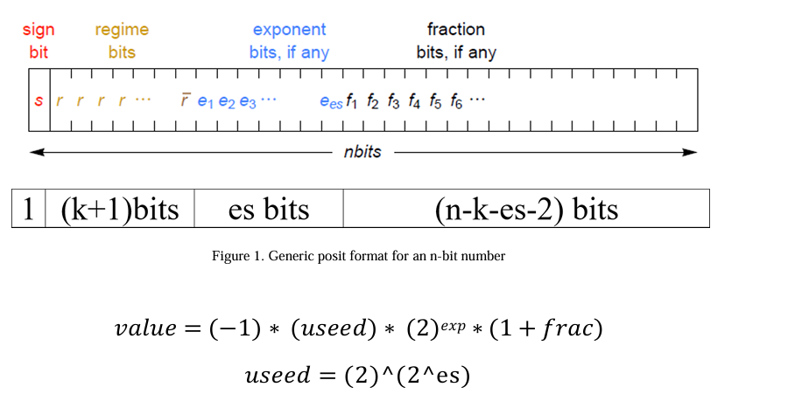

Introduction
Posit number system is an emerging number system which aims to be a competitor to the existing IEEE floating-point number system.
It was introduced to provide higher accuracy and larger dynamic range for the same number of bits

Slide 3
Posit multiplier Unlike IEEE 754, which has fixed-width fields for exponent and mantissa, Posit uses a dynamic bit allocation strategy.
This allows "Posits" to allocate more bits to the fraction (precision) when numbers are close to 1, and more bits to the exponent (range) when numbers are extremely large or small.
Methodology
Stage 1: Decode (Extraction)
Extract regime bits using Leading Zero/One Detector (LZOD) to determine run-length k
Separate sign bit, exponent e, and fraction f from the 32-bit Posit format
Stage 2: Execution (Core Computation)
Calculate output sign using XOR and compute total scale factor using adder logic
Perform mantissa multiplication (1.f_A) × (1.f_B) using FPGA DSP48 slices with pipelining
Stage 3: Encode (Packing)
Normalize the product by shifting fraction if result ≥ 2.0 and apply rounding
Re-pack the sign, regime, exponent, and fraction into final 32-bit Posit output

Slide 4
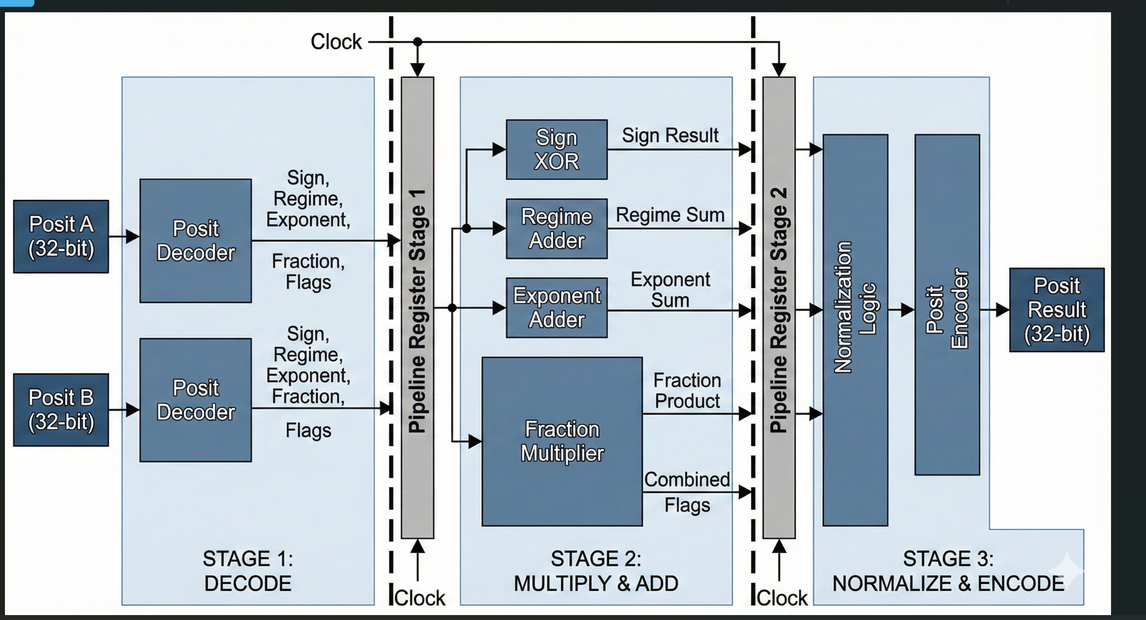
Architecture of Posit Multiplier

Slide 5
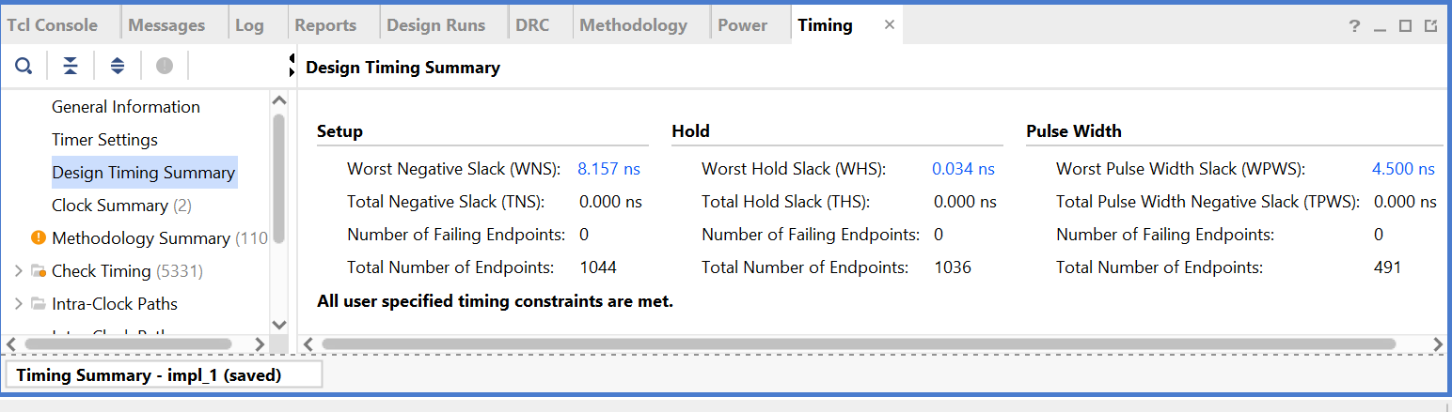
Results: Timing Summary

Slide 6
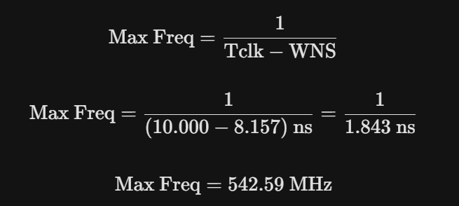
Max Frequency

Slide 7
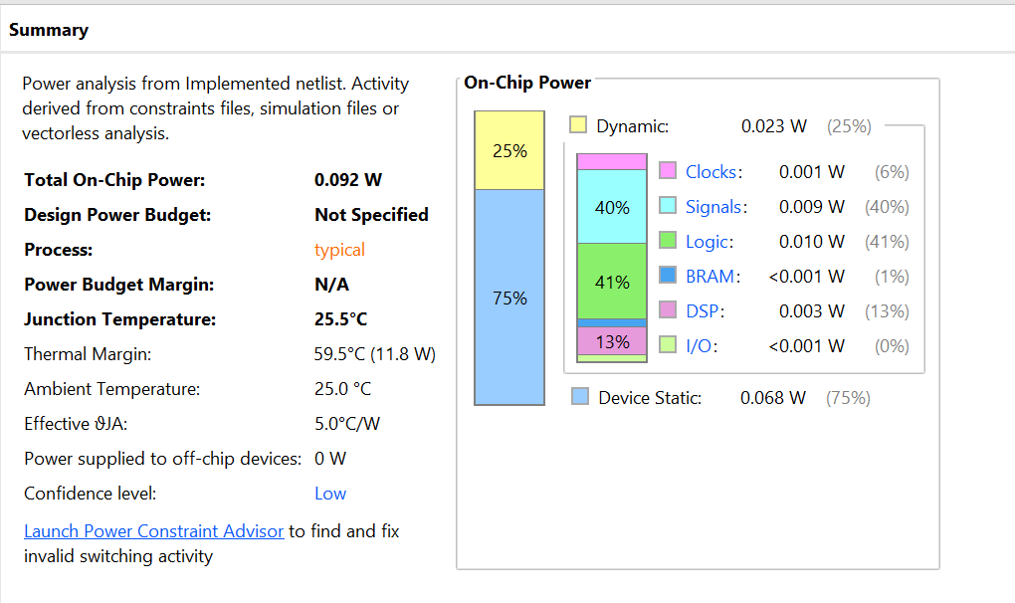
Power Summary

Slide 8
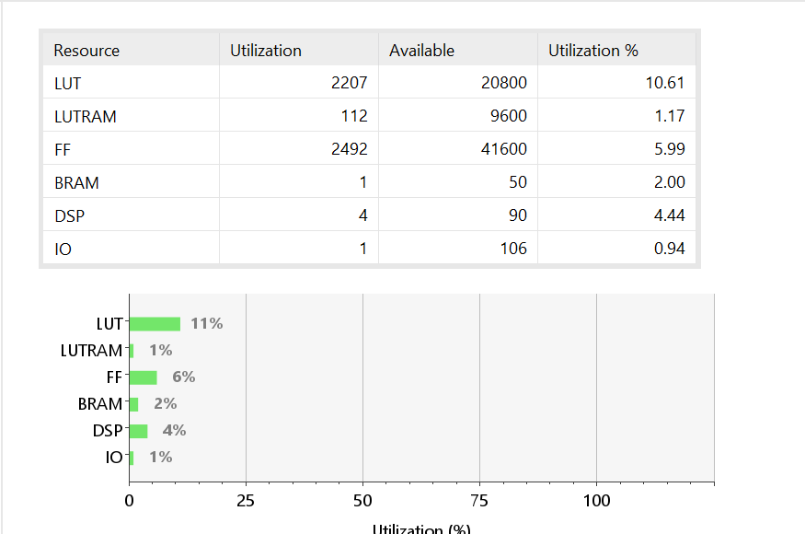
Resource Utilisation Summary

Slide 9
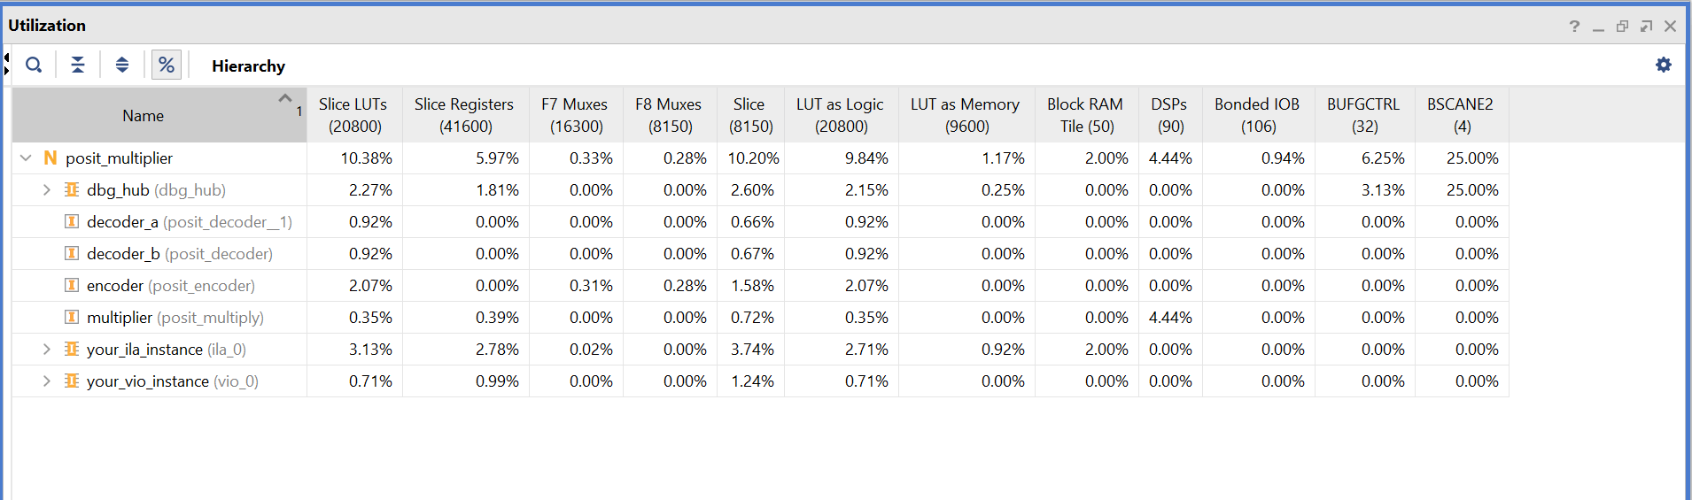
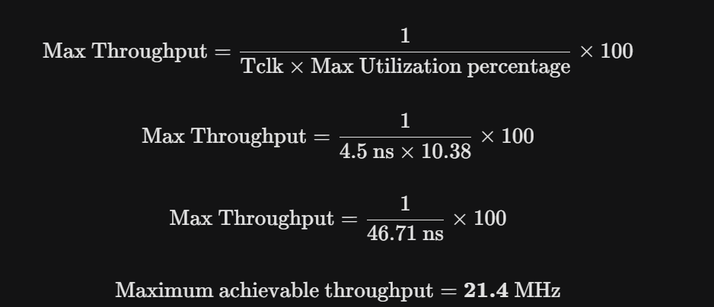

Slide 10
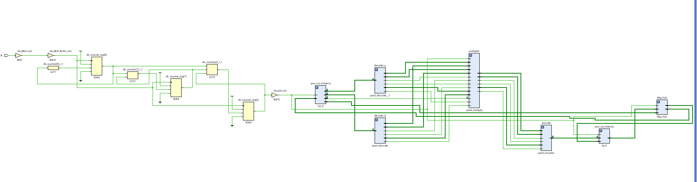
Schematic

Slide 11
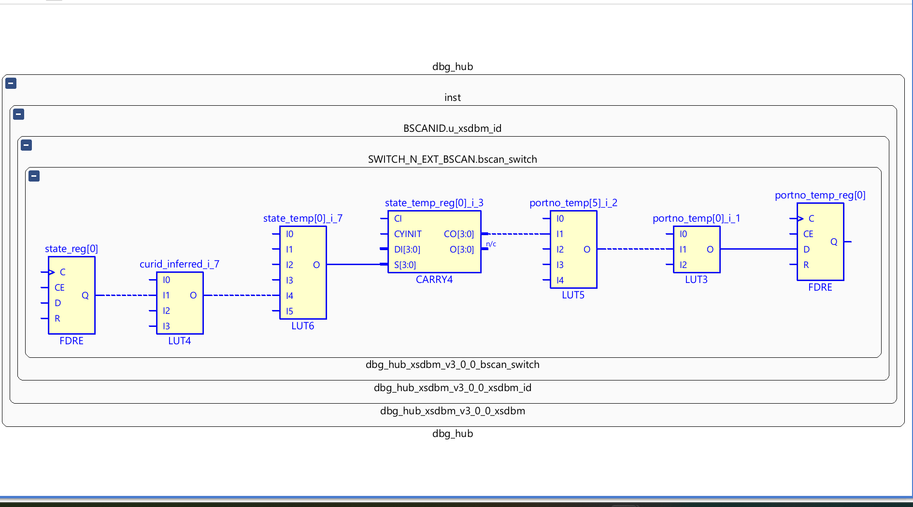
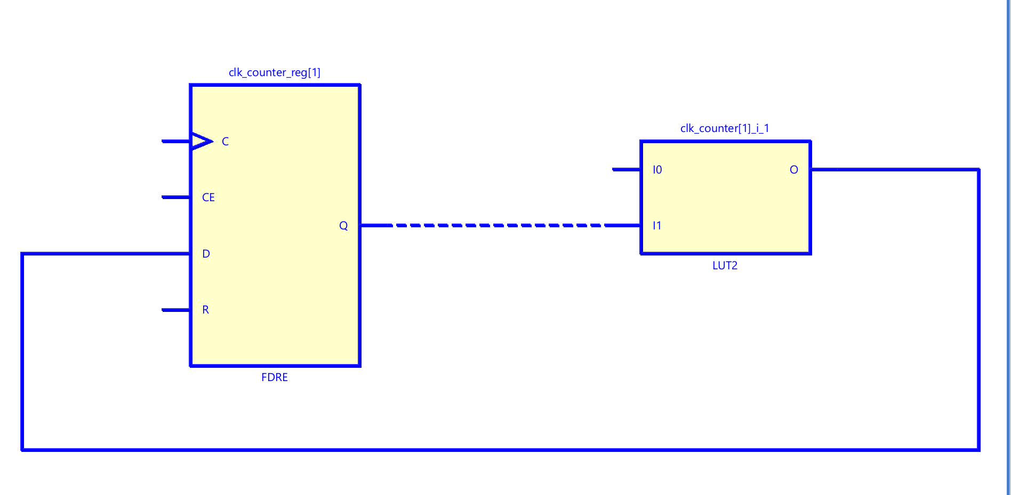
Critical path
I implemented bitstream ila too issue related to that
This is with clock divider
This is without clock divider

Slide 12
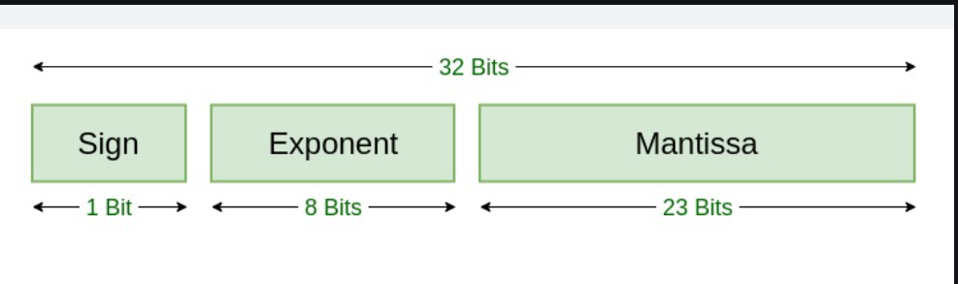
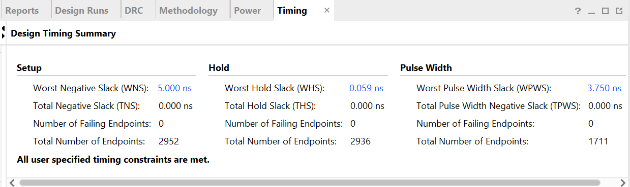
Comparison with IEE754 and posit multiplier
Basic info
Timing sumary

Slide 13
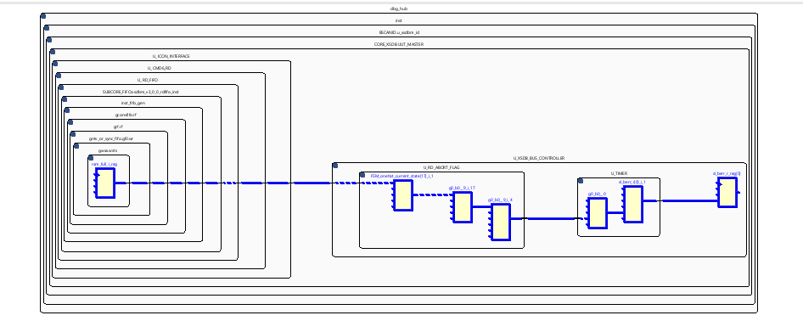
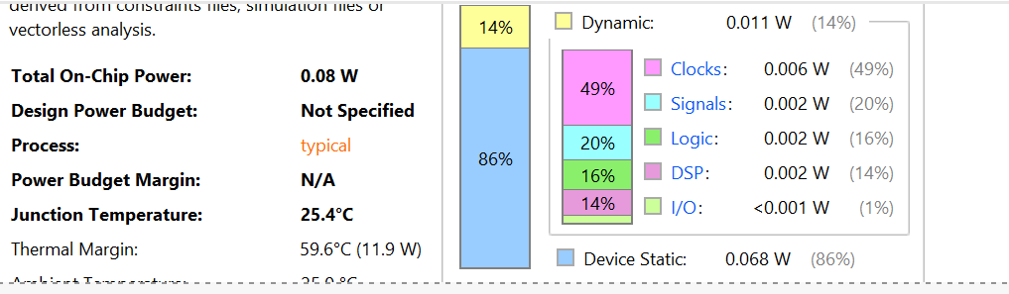
Critical path
Power

Slide 14
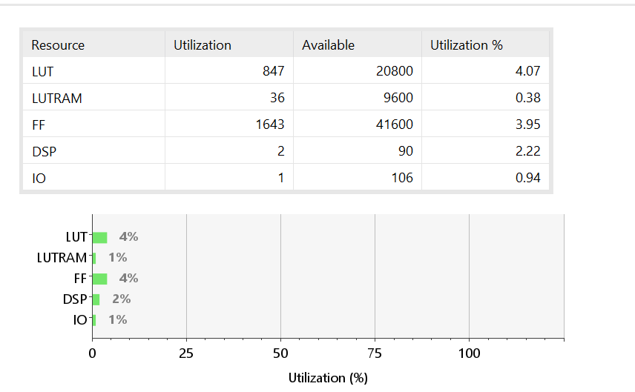
Resource utilization
Posit better for accuracy , dynamic range per bit and reduced errors for rest of all stuff as we can see critical path of posit is larger , power consumption is more , time taken is more , resources being used for posit is larger etc.

