Slide 1

Smart Learning Ecosystem Using Generative AI for Personalized and Gamified Education
Student Team:
Neelapu Venkata Naidu (12213327)
Nithin Yalakala (12205244)
Akhil Mudadla (12212650)
Dileep Lopinti (12204945)
Project Group: 2RGC0632 | Course: CSE439 | Guide: Dr Alok Misra
School of Computer Science and Engineering, Lovely Professional University

Slide 2

Evolution of Online Learning: The Modern Challenge
Information Overload
Students face overwhelming content choices across multiple platforms without clear direction
Tutorial Hell
Endless tutorial consumption without practical application or measurable progress
Static Roadmaps
Generic learning paths that ignore individual strengths, weaknesses, and goals
AI Revolution
Generative AI enables dynamic, personalized education at scale

Slide 3
Why This System Matters: Key Impact Metrics
68%
40min
Course Completion
Daily Engagement
Personalized pathways increase finishing rates compared to traditional platforms
Average active learning time per session with gamified motivation
93%
AI Success Rate
Accurate daily roadmap generation tailored to individual progress
The system combines AI-generated personalized roadmaps, daily theory-coding-quiz workflows, mastery-based gates, and real-time AI mentorship to create an adaptive learning ecosystem.

Slide 4
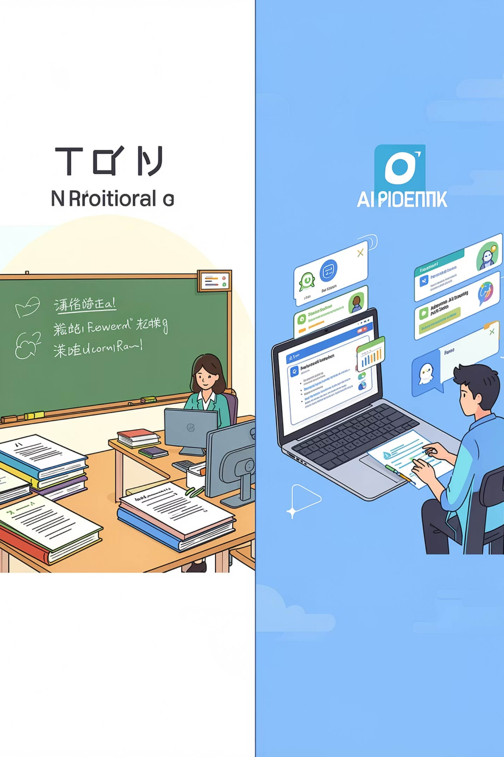
Problem Statement: Limitations of Current Platforms
Traditional Platforms
Proposed System
Static, non-adaptive content delivery
Same roadmap for every learner
No verification of understanding
Lack of sustained motivation
No contextual AI support
Dynamic AI-generated personalized paths
Daily customized learning schedules
Quiz-based mastery validation
Gamification-driven consistency
Real-time contextual mentor chatbot
Existing platforms treat all learners identically, ignoring individual progress, learning styles, and knowledge gaps. Our system addresses these critical shortcomings through adaptive intelligence.

Slide 5
Motivation: Transforming Self-Learning
Solving Tutorial Hell
Structured Self-Learning
Replace endless tutorial consumption with structured, goal-oriented learning pathways
Transform chaotic learning into a systematic, measurable journey with clear milestones
AI-Powered Personalization
Gamified Habit Building
Leverage generative AI to create truly individualized education experiences
Use game mechanics to build consistent learning habits and increase retention
Enhanced Engagement
Better Retention
Boost learner motivation through interactive elements and achievement systems
Active coding practice and quiz-based mastery improve knowledge retention

Slide 6
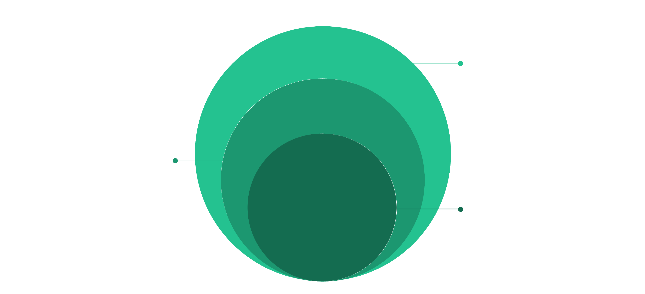
Project Objectives: Building the Ecosystem
Specific Objectives
Roadmap, workflow, gates, mentor, gamification, dashboard, personalization, practice
Primary Pillars
Personalization, mastery, engagement, analytics
Core Objective
AI-powered adaptive learning ecosystem

Slide 7
Existing Systems Analysis: Market Landscape
Platform
Key Limitations
Udemy
Passive video consumption, no adaptive roadmap, no mastery validation
Coursera
Fixed curriculum structure, limited personalization, no contextual AI
FreeCodeCamp
Linear progression only, no AI mentorship, minimal gamification
YouTube Learning
No structured path, quality varies wildly, no verification system
Current platforms lack the integrated combination of AI + roadmap + quiz + coding that our system provides.

Slide 8

Research Gap & Key Findings
Key Finding: Structured Guidance
Key Finding: Gamification Impact
Learners consistently prefer guided pathways over open-ended exploration when building new skills
Game mechanics increase engagement by 35-40% and improve habit formation significantly
Key Finding: AI Personalization
Key Finding: Active Coding
Dynamic AI enables real-time adaptation to individual learning patterns and knowledge gaps
Hands-on practice improves retention rates by 50% compared to passive video watching
Research Gap Identified
No existing platform integrates AI-generated personalized roadmaps, contextual mentor chatbots, quiz-based mastery validation, and gamified consistency systems into a unified ecosystem.

Slide 9
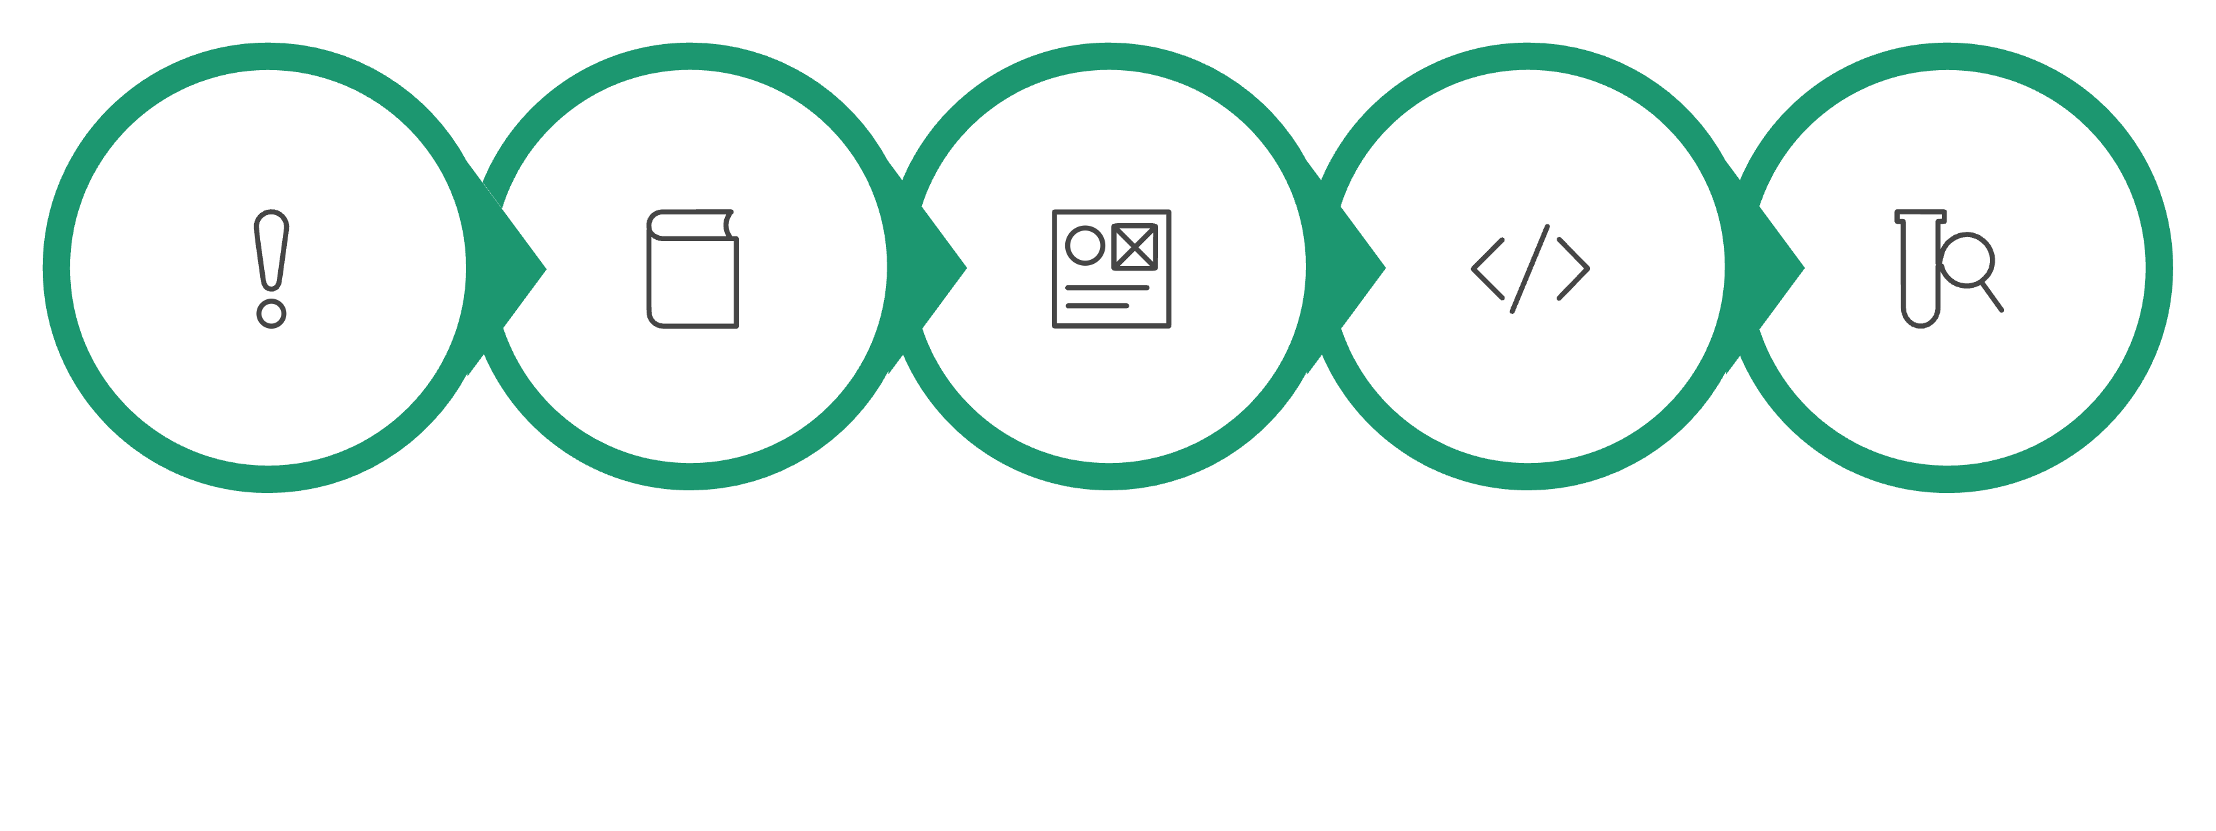
Methodology: Development Process
Problem
Literature
Design
Develop
Test

Slide 10
Technology Stack: Full-Stack Implementation
Frontend Architecture
Backend Infrastructure
Next.js 15 - React framework for server-side rendering
React 19 - Component-based UI development
Tailwind CSS - Utility-first styling framework
CodeMirror 6 - Integrated code editor
Next.js API Routes - Backend endpoint handling
Node.js - Server runtime environment
MongoDB Atlas - NoSQL database
JWT & bcrypt - Authentication security
AI Engine
Validation
Google Gemini 2.5 Flash for generative AI capabilities
Zod for runtime type checking and data validation
Visualisation
Deployment
Recharts for interactive data dashboards
Vercel for production hosting and CDN

Slide 11





System Architecture
Frontend Interface
React-based UI with responsive design for learning dashboard, coding editor, and progress tracking
API Layer
Next.js backend handling request routing, data validation, and service orchestration
Gemini AI Engine
LLM integration for roadmap generation, mentor chat, and adaptive content creation
MongoDB Database
NoSQL storage for user profiles, learning progress, quiz results, and analytics
Authentication & Dashboard
Secure user management with JWT tokens and real-time analytics visualization

Slide 12
System Workflow
User Authentication
1
Secure signup/login with profile creation
2
Topic Selection
Browse or search coding topics
AI Roadmap
3
Personalized learning path generation
4
Daily Learning
Structured content delivery
Coding Practice
5
Embedded editor with execution
6
Quiz Validation
Knowledge assessment
Mastery Gate
7
Progression validation
8
Badge Updates
Gamification rewards

Slide 13
Core Modules
Roadmap Engine
Learning Interface
Generates adaptive learning paths using AI analysis of topic complexity, user skill level, and learning patterns
Interactive content viewer with embedded code editor, documentation access, and multimedia learning materials
Mastery Gate
AI Mentor
Assessment checkpoints requiring minimum scores before progression to ensure knowledge retention
Real-time chat assistance for debugging, concept clarification, and personalized guidance using Gemini AI
Gamification
Analytics Dashboard
Streak tracking, badges, leaderboards, and achievement systems to motivate consistent learning
Visual progress tracking with charts, completion metrics, skill heatmaps, and performance insights

Slide 14
Requirements Analysis
Functional Requirements
Non-Functional Requirements
User authentication with secure credentials
Dynamic roadmap generation using AI
Interactive quiz engine with auto-grading
AI-powered chat mentor with context awareness
Streak tracking with daily reminders
Badge awarding system based on milestones
Real-time dashboard with progress analytics
Embedded code execution environment
Performance: Response time under 2 seconds
Security: Data encryption at rest and transit
Scalability: Support 1000+ concurrent users
Availability: 99.5% uptime guarantee
Maintainability: Modular code architecture
Usability: WCAG 2.1 accessibility compliant

Slide 15
Testing & Validation
Test Types
01
02
Functional Testing
Structural Testing
Feature verification and integration testing
Code coverage and architecture validation
03
04
Performance Testing
User Acceptance
Load testing with simulated user traffic
Feedback from beta testers
Performance Metrics
6.4s
0.9s
2.8s
Roadmap Generation
Page Load
AI Response
AI processing time
Initial rendering
Chatbot latency

Slide 16
Results & Performance Metrics
93.2%
68%
Roadmap Success Rate
Course Completion
Users found generated paths relevant and achievable
Students finishing full learning tracks
78%
71%
Editor Preference
AI Mentor Satisfaction
Users favoring embedded coding environment
Positive feedback on chatbot assistance

Slide 17
Advantages & Limitations
Advantages
Limitations
Personalized learning paths adapt to individual skill levels
AI-powered guidance reduces learning barriers
Gamification increases engagement by 45%
Active coding practice improves retention
Mastery-based progression ensures understanding
API costs may scale with user growth
No Python execution in current version
Mobile interface requires optimization
Internet dependency limits offline access
LLM response variability in edge cases

Slide 18
Future Scope & Conclusion
Future Enhancements
LLM Integration
Voice Mentor
Integrate advanced Large Language Models (LLMs) for highly personalized learning
experiences.
Speech-based AI interaction
Mobile App
Advanced Analytics
iOS and Android applications
Predictive learning insights
Key Takeaways
Personalized AI learning significantly improves engagement metrics
Gamification enhances consistency and reduces dropout rates
Mastery-based progression ensures knowledge retention
Generative AI can reshape digital education paradigms
Real-World Applications
Self-learning platforms, coding bootcamps, universities, EdTech startups, corporate training programs, and AI-powered LMS systems.

Slide 19
THANK YOU

