Slide 1

Manual Testing Demo
By Venkat

Slide 2
1.What is software testing? 2.Why it is important? 3.Features of manual testing 4.Type of testing? 5.Difference between manual & automation
Manual Testing Topics

Slide 3
Testing importance
Testing should be introduced in the early stage of the SDLC, The cost of fixing the bug is larger if testing is not done in early stage & bugs found in later stages.
· In the today’s competitive market only the quality product stays long time firmly, so to make sure the produce the good quality product the testing of application is key factor in SDLC.
· As it not possibly makes it software application is defect free, but testing will be necessary.
· Most important thing of testing is the development environment is different than the Testing environment and the testing done on testing environment is similar to the Production environment.

Slide 4
Testing advantage
Manual testing can be used in both small and big project
Easy to learn for new people who are entering QA waters
Manual is more reliable then automated (in many cases automated doesn’t cover all cases)
It allows the tester to perform more ad-hoc. In my experience, more bugs are found via ad-hoc than via automation. And, the more time a tester spends playing with the feature of the software, so he gets few user level bugs

Slide 5
Type of testing performed by dev
Unit Testing : Testing of an individual software component or module is termed as Unit Testing. It is typically done by the programmer and not by testers, as it requires detailed knowledge of the internal program design and code. It may also require developing test driver modules or test harnesses.
Integration Testing : Testing of all integrated modules to verify the combined functionality after integration is termed as Integration Testing. Modules are typically code modules, individual applications, client and server applications on a network, etc. This type of testing is especially relevant to client/server and distributed systems.

Slide 6
Types of testing
System Testing : Under System Testing technique, the entire system is tested as per the requirements. It is a Black-box type Testing that is based on overall requirement specifications and covers all the combined parts of a system.
Acceptance Testing : An Acceptance Test is performed by the client and verifies whether the end to end the flow of the system is as per the business requirements or not and if it is as per the needs of the end-user. Client accepts the software only when all the features and functionalities work as expected.
It is the last phase of the testing, after which the software goes into production. This is also called User Acceptance Testing (UAT).

Slide 7

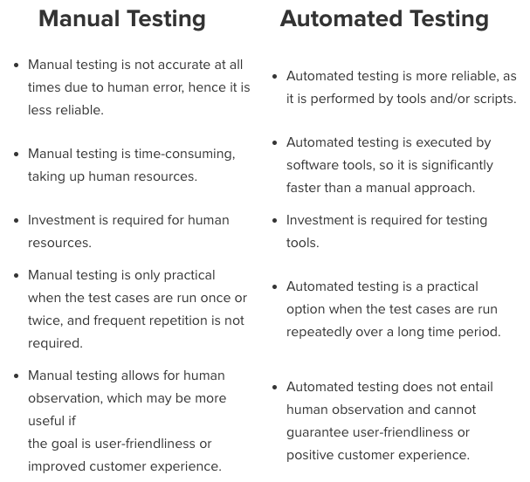



Manual Testing and Automation Testing

