Slide 1
Predicting Epilepsy Seizures
Rahul Kakani | Venkat Vaddula

Slide 2
Contents
Background Information
Information about Data
Data Preprocessing
Approach/Hypothesis
Model Selection
Classification with Model
Results
Future Works

Slide 3
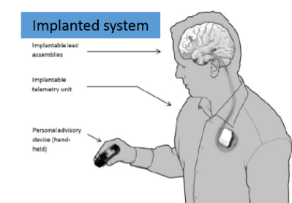
Background Information:
Epilepsy is a Neurological disorder that causes spontaneous sensory disturbances in the brain,
also called as Seizures.
These spontaneous disturbances are associated with abnormal electrical activities in the
brain.
These Seizures can be prevented by providing sufficiently high amount of
anticonvulsant medicines to the patient.
Monitoring Electrical Brain Activity(EEG)
can help forecast a seizure occurrence.
If these seizures are successfully identified, designing
devices to warn patients about seizures would be possible.
Notes:
Nearly 1% of world population suffers from epilepsy
But predicting them is a challenging task as they occur spontaneously with no proper symptoms. Persistent Anxiety, cannot lead normal life.

Slide 4
Background Information(2):
There is emerging evidence that these temporal dynamics in brain can be classified
into 4 states:
Preictal: Time prior to the seizure occurrence.
Ictal: The Seizure state.
Inter–ictal: Between the seizures.
Post–ictal: After the seizures .
The Seizures are known to occur in groups, so the patients who typically have cluster of seizures receive a little benefit from forecasting follow-on seizures.

Slide 5
Information about Data:
The data is taken from a Kaggle Competition, which is sponsored by MathWorks, National Institute of Neurological Disorder and Stroke (NINDS), American Epilepsy Society and the University of Melbourne.
The data is taken from 3 different patients suffering with epilepsy:
Each patient data is further split into training and testing data.
As for the project, we considered training data from Patient 1(5.73GB) and Patient 2 (11.43GB).
The Training data for patient 1 consists of iEEG data for 217 hours which is divided into 10 minute files forming a total of 1302 files, similarly the training data of patient2 has 2346 files.

Slide 6
Information about Data(2):
The data is an analog signal which can be represented in a matrix of numerals.
The data is collected from 16 different electrodes that are placed on the surface
of cerebral vertex and the electrical signals are recorded by an ambulatory system.
The digital data is of size 240000x16 matrix each column representing
different electrode for just a 10 minute file.
Project Training Data- Train data of patient 2
Testing Data-Train data of patient 1
We added a Target column to the train data which consists 0(No seizure) and
1(Seizure) to help in classification of the data.

Slide 7
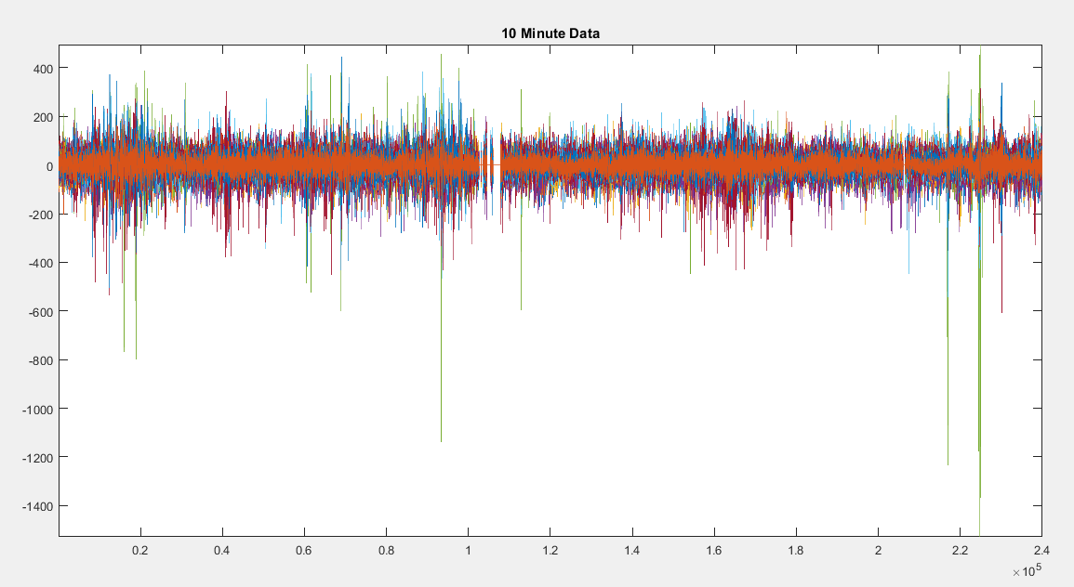

Slide 8
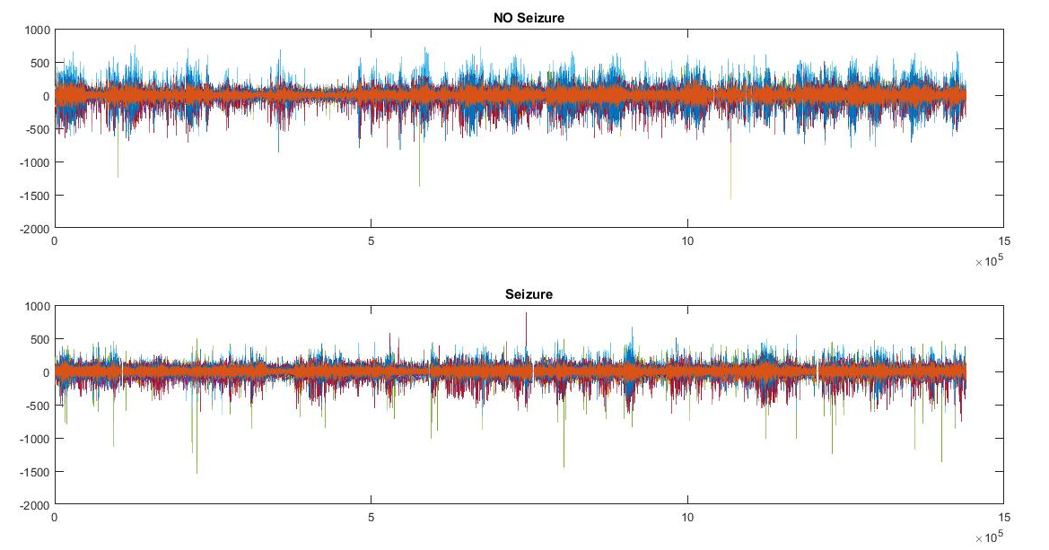
Data Preprocessing:
The preprocessing is probably the most important phase in our data.
The data for seizure and non seizure cases are almost identical.

Slide 9
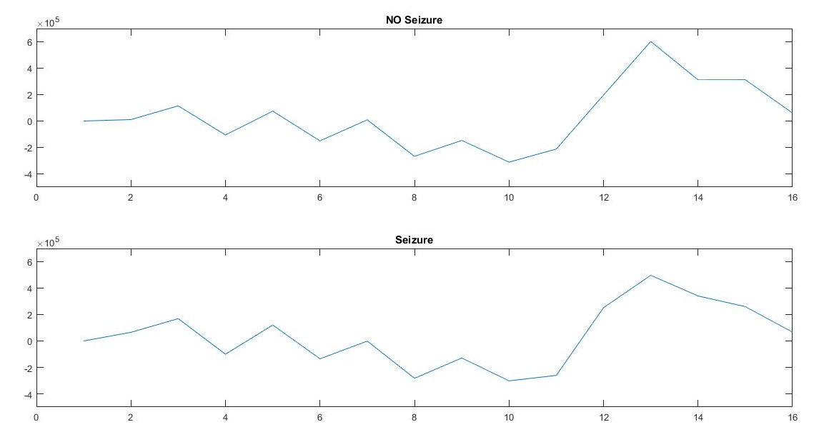
Data Preprocessing(2):
Summing up the data from all the 16 electrodes.

Slide 10
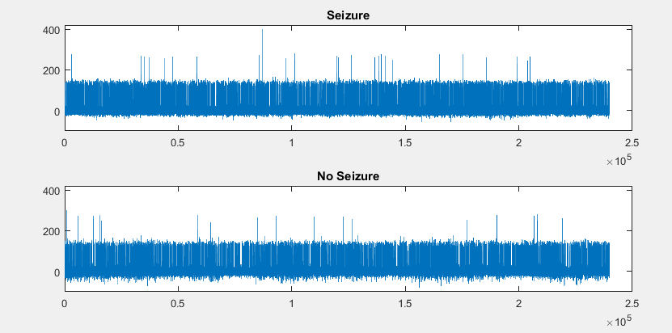
Data Preprocessing(3):
Concatenating the data from all the 16 electrodes helped us to locate the seizure and the electrode(s) responsible for seizure beforehand.

Slide 11
Data Preprocessing(4):
Applying the Amplification on the peaks and Attenuation on noise.
After applying various filters (Average, Butterworth, Bessel, Chebyshev, Moving Average, Peak Envelope …) we found that applying both Chebyshev Low pass and High Pass filters reduced the noise from both top and bottom the data.
Now applying transformations on the data to see if we can create any further differences in the data.
We applied many transformations (Convolution, Fourier, Laplace, Wavelet) in both Time and Frequency domains, we found that applying 2-D Fast Fourier Transformation helped us the best to distinguish between the 2 cases.

Slide 12
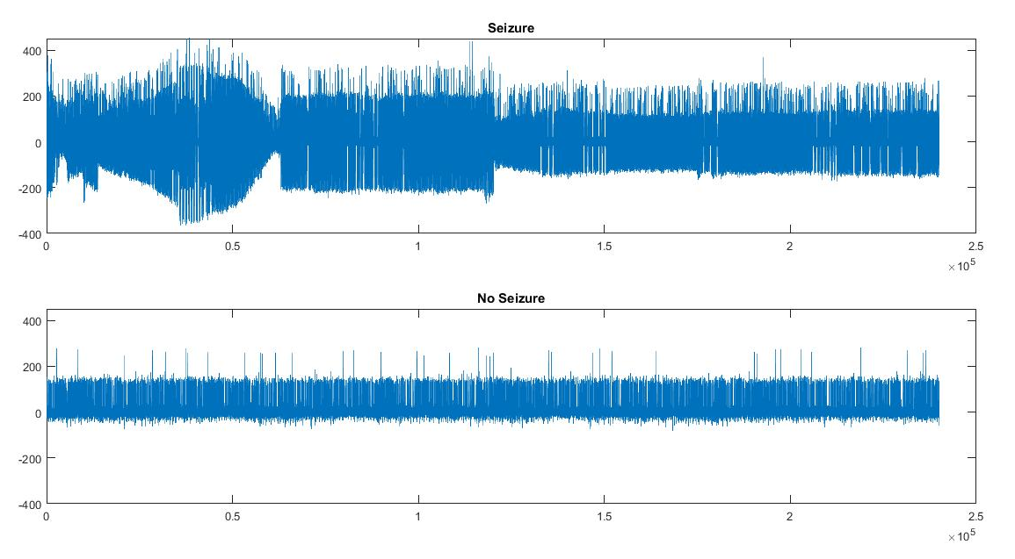

Slide 13
Approach/ Hypothesis:
We plan to classify each of the given 10 minute file into Seizure(1) or No Seizure(0) Case.
Trained with different Classification models like Decision Trees, KNN and Logistic Regression.
Each Model was trained by using the training dataset from patient 2, with 10 fold cross validation applied to each one of them.
Used the accuracy of the predictions validation data to determine which model to be used.

Slide 14
Models:
Decision Trees:
A decision tree takes as input an object (or) situation described by a set of properties and outputs a yes/no “decision”.
K- Nearest Neighbor:
A KNN algorithm stores all available cases and classifies new cases based on a similarity measure.
Logistic Regression:
Logistic regression measures the relationship between the categorical dependent variable and one or more independent variables by estimating probabilities using a logistic function.

Slide 15
Model Selection:
The Validation Accuracy of each model used to train the data:
Decision Trees : 88.2%
Logistic Regression : 93.6%
KNN : 88.9%
Based on the Accuracy of the predictions on the Validation data, Logistic Regression model performs the best when compared to other models.

Slide 16
Classifying with Model:
As the Accuracy of predictions of validation data using the Logistic Regression appeared to be the best, we used the Logistic Function to predict the test data.
Everything seemed fine until we saw the confusion matrix of validation data predictions using Logistic Regression.

Slide 17
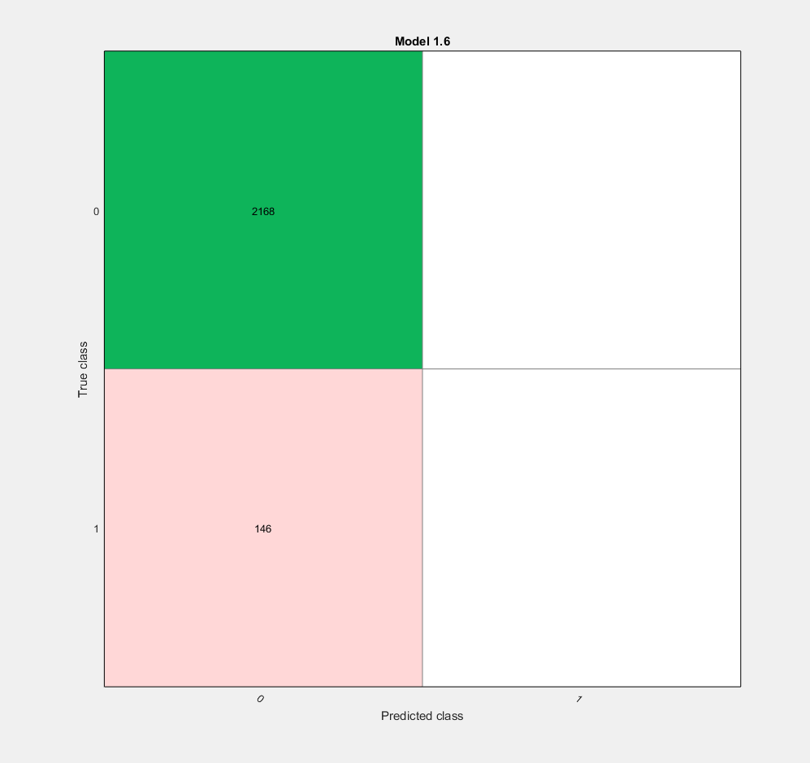
Performance on Validation:
What Happened!?
May be predicting a Seizure before 10 min is not optimal
May be join the data into 1hour blocks so that we can predict the seizure before 1 hour?
So, Going back to the Hypothesis, now using data concatenated as 1 hour blocks.

Slide 18
Approach/ Hypothesis:
Updated Hypothesis
We combine 10 mins of data to get 1 hour seizure data that are classified into seizure(0) and non-seizure(1).
Classification models like Decision Trees, KNN, Logistic Regression were used again to train data.
Each Model was trained with the training dataset from patient 2, applying 10 fold cross validation to each and every model.
Model was determined using the accuracy on the predicted validation data.

Slide 19
Selecting the Model:
Updated Hypothesis:
The Validation Accuracy of each model used to train the data:
Decision Trees : 88.6%
KNN : 83.4%
Logistic Regression : 79.9%
Based on the Accuracy of the predictions on the Validation data, Decision Trees model performs the best when compared to other models.

Slide 20
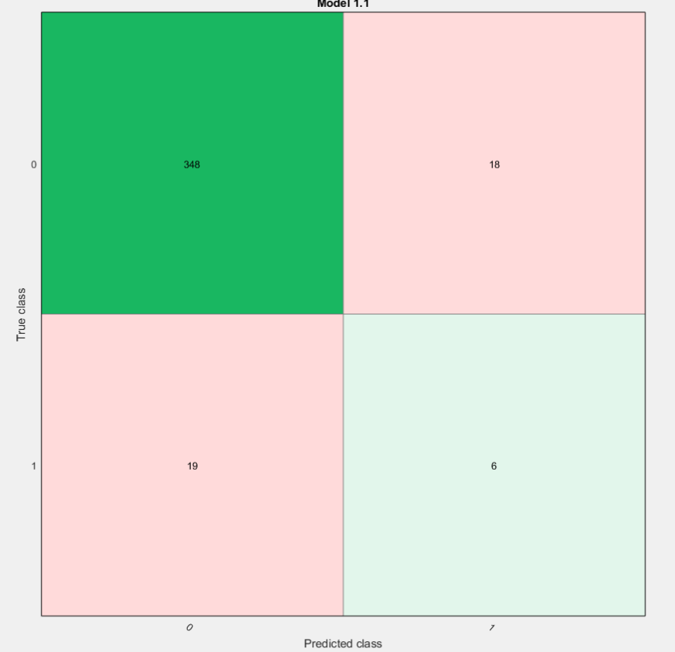
Performance on Validation:
Previously using logistic regression we were unable to predict the seizure cases.
By updating hypothesis the model could predict “6 ” seizure cases out of “25”.

Slide 21
Classifying with Model:
Updated Hypothesis:
As stated above, we used the Decision Trees to predict the test data.

Slide 22
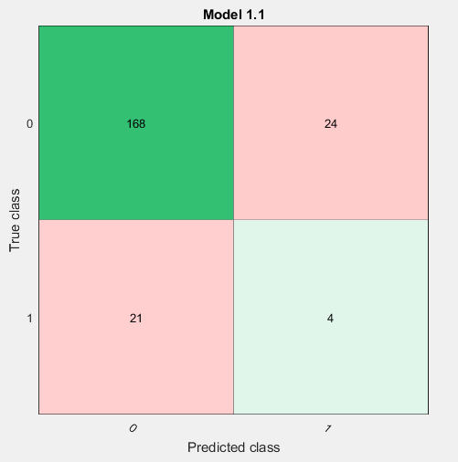
Results:
Although the Test MSE that we obtained is very low we are still able to predict only 4 of the 21 upcoming seizures.
So, may be by increasing the time blocks of data to 2-4 hours (instead of 1 hour in updated hypothesis) then we can predict the seizures with a better ratio.

Slide 23
Future Work:
With all the predicting measures in the current world only 30% of the seizures are being predicted.
According to Walter J. Koroshetz , deputy director of the National Institute of Neurological Disorders and Stroke (NINDS),the prediction rate can be improved over to 80% if the Seizure detecting measures are improved.
To Improve the Seizure detection from data, Electroencephalogram (EEG) has been updated to identify the seizure with high difference in the data. So, maybe training and predicting the models on the data from the updated models might give us a better prediction.

