Slide 1
Online Food Store
By
Venkat Chowdary Peddi

Slide 2
Contents:
Project Idea
  Initiation
  Planning
  Executing
  Monitoring and Controlling
  Closing
Challenges
Conclusion

Slide 3
Project Idea
The exact idea can be explained with an example , Mr.John is busy in some work and he was hungry,there should be a way to server food without need of john to travel untill the food store.
Instead he can buy the things through online and food can be delivered to the door step.This is the main project idea that is to design the food store website.
So, then came the idea of Online bidding that helps many people like John.

Slide 4
Initiation Phase
It actually started that day, searching for solution in different platforms. Finally, thought of creating a website that helps the people to order the food, go through the menu items.
Then after deciding about the platform then i decided what the steps that should be taken place in order to perform an transaction, such as registration process, create a post process etc.

Slide 5
Planning Phase
This is the crucial phase where I had to decide what fields should be present in registration processs.
Listed out the challenges that arises in each step of the process and solutions to each and every challenge.
And even planned the design of the website, the main point is that it should be simple and very easy to understand the GUI and place the order conviniently.

Slide 6
  Tools I have used to develop this project are notedpad++ editor for editing the code, xampp for database and connection purpose.
  Programming languages I have used are html,css,js,php,mysql.
  Html:HTML Stands for Hypertext markup language, It is used for creating web pages.html elements are represented using tags.
  Css: Cascading styling sheets,it is used to styling the website.
  Php:It is a server side scripting language used for connecting with server.

Slide 7
Executing Phase
This is the very important phase in which the idea, planning is converted into what i actually taught of.
The phase in which paper work is converted into a product.
This is the longest phase as it involves development phase of the product.
It is developed with the help of HTML, that is suitable for all the browsers and can be accessed by anybody.

Slide 8
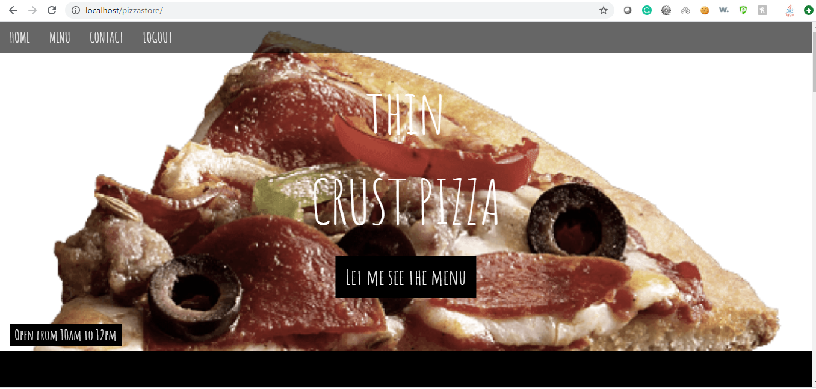
This is the home page of the online Pizza store,have a look into it:

Slide 9
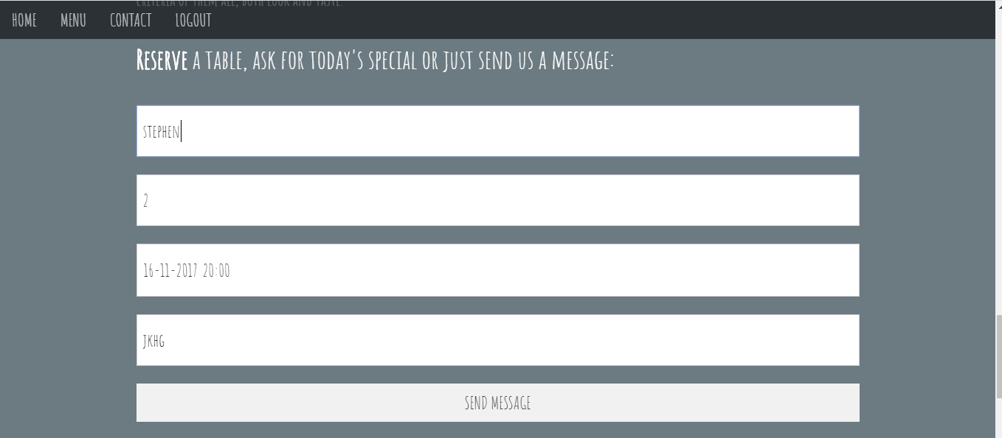
The process for booking the table through online saves time,the gui for the same would be:

Slide 10
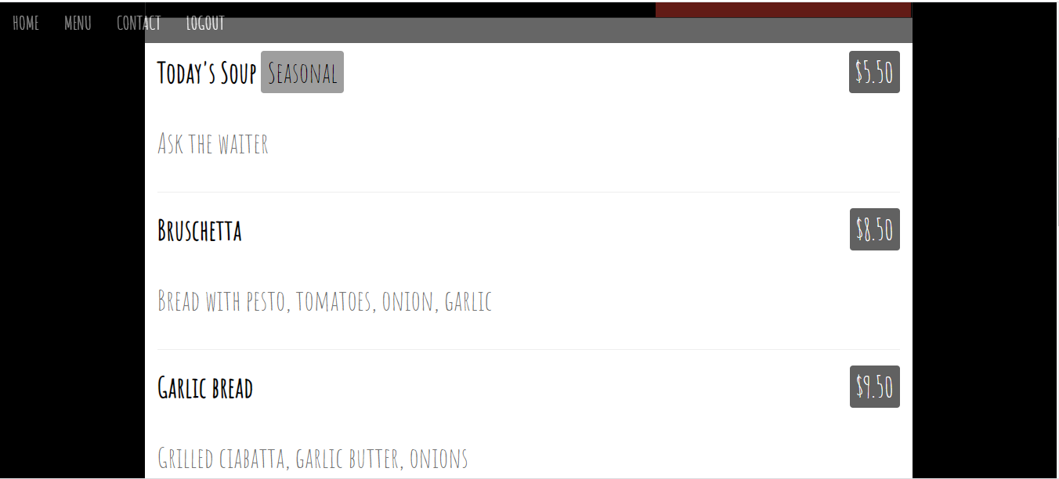
The image below shows the selection of menu items with respective prices:

Slide 11
The other option has been shown in the below image:

Slide 12
Monitoring and Controlling
Only development of this is not sufficent,constant monitoring of this is required,so there should be control on the orders placed by each customer.
There can be also any kind of mis-usage of the website for any other illegal activities.
There should be admin to view all this kind of posts so that any kind of mis leading activities are not going on.

Slide 13
Closing Phase
This is the phase everything related to the project has come to an end.
In this Agile Model is used, this means that when ever the requirements changes the product that is being developed is also being changed accordingly.

Slide 14
Challenges
No Payment Gateway.
Quality Issue

Slide 15
Conclusion
The most important is to gain trust among the people.
This automatically increases as it is not restricted to one place ,spread over the web with 100s of million users.
If this is converted as business with any creative changes then,the scope of growth is large when the business gains the trust and goodwill of the customers.It could be any kind of matter or thing that can be placed in the auction.

Slide 16
References
https://www.w3schools.com/html/
https://www.tutorialspoint.com/css/
https://www.cloudways.com/blog/connect-mysql-with-php/

Slide 17


