Slide 1
Linear Regression Assignment

Slide 2
Assignment-based Subjective Questions

Slide 3
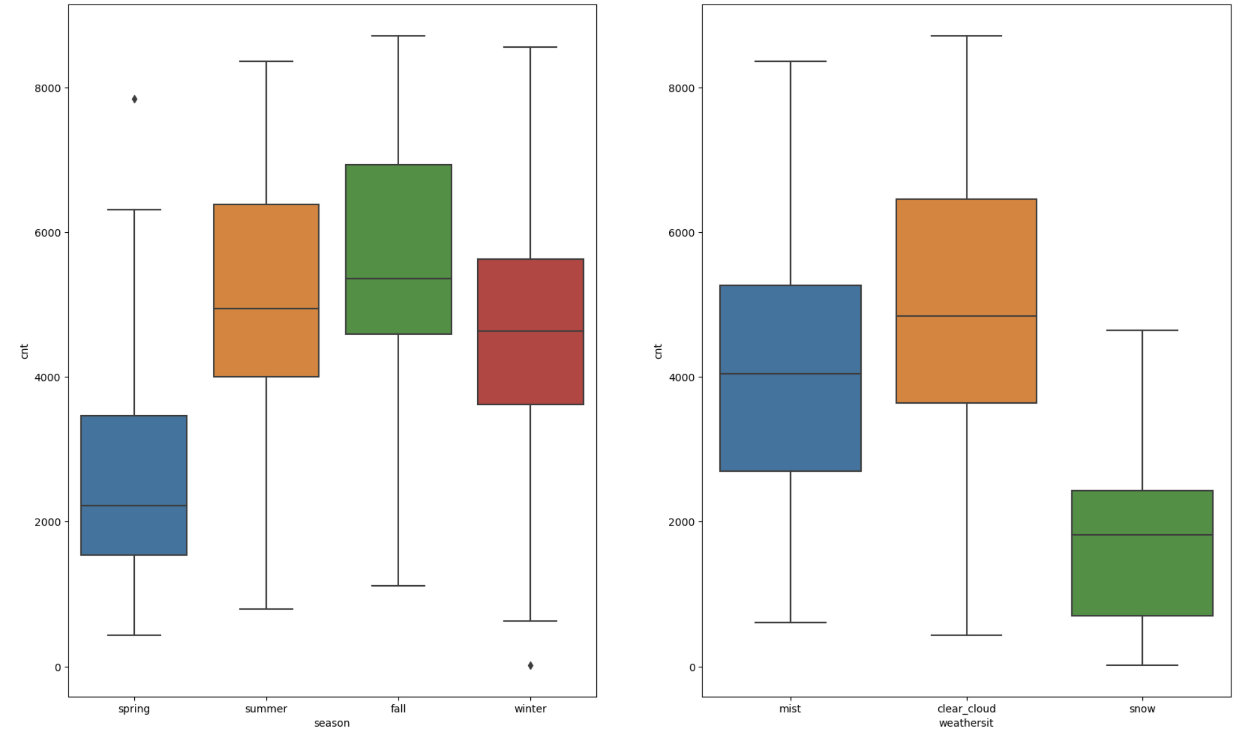
1. From your analysis of the categorical variables from the dataset, what could you infer about their effect on the dependent variable? (3 marks)
we have two categorical variable season and weathersit. By looking at their box plot against the cnt.
For season:
During the snow time we see the cnt is less. The mean and 1 and 2 nd quartile also less compared to other two (mist, clear_cloud)
For weathersit:
During the sprint season we see the cnt is less. The mean and 1 and 2 nd quartile also less compared to other three (summer, fall, winter)

Slide 4
2. Why is it important to use drop_first=True during dummy variable creation? (2 mark)
When we have categorical variable of level n, we need to create n dummy variable. It is redundant to have n. We can simply use n-1 variable. If all the other new columns are zero, which indicates that the removed categorical variable.
This removal of the first categorical variable will speed up the model performance.

Slide 5
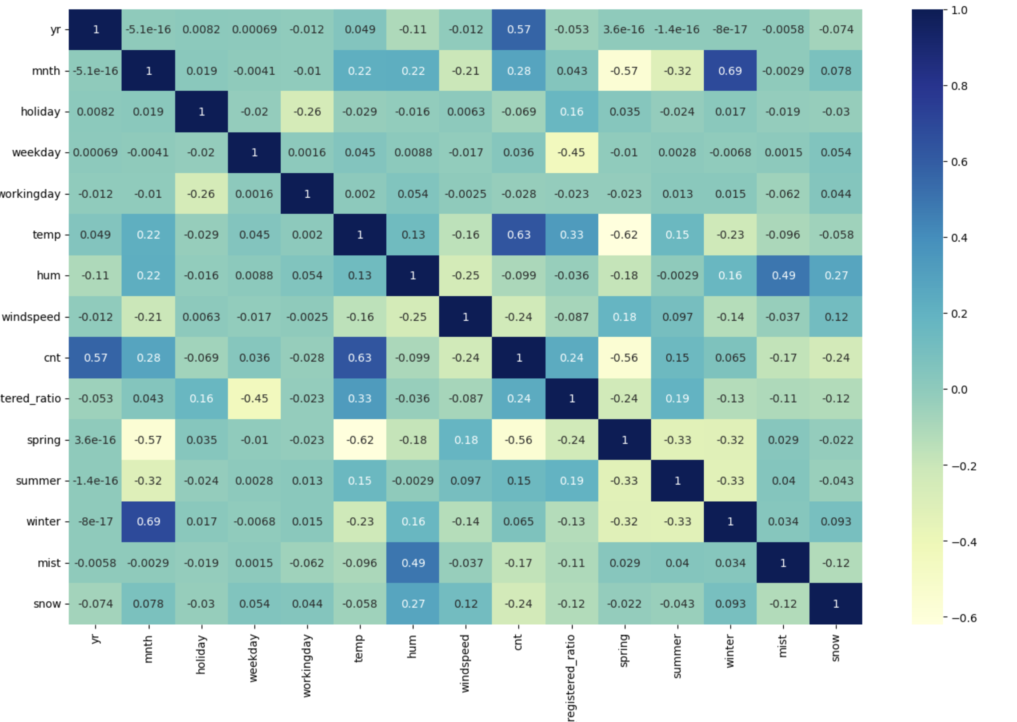
3. Looking at the pair-plot among the numerical variables, which one has the highest correlation with the target variable? (1 mark)
temp have the higher corelation with the target variable cnt.
The corelation varaible value is 0.63

Slide 6
4. How did you validate the assumptions of Linear Regression after building the model on the training set? (3 marks)
I predicted the value of test and train data set. I calculated the residual and plotted the distribution of the error terms From the distplot, we can see the error terms are normally distributed
Assumptions of Linear Regression:
The model should have linear relation ship: From the pari plot I can see the target variable (cnt) have linear relationship with temp variable
The error terms are normally distributed : Dist plot of res analysis, we see error terms are normally distributed
The error terms have constant variation: We plotted the distribution of y_test VS y_test_pred and y_train vs y_train_pred and concluded this
There is no pattern in the error terms : We plotted the distribution of y_test VS y_test_pred and y_train vs y_train_pred and concluded this
PLEASE REFER THE PICTURES IN THE NEXT SLIDE

Slide 7
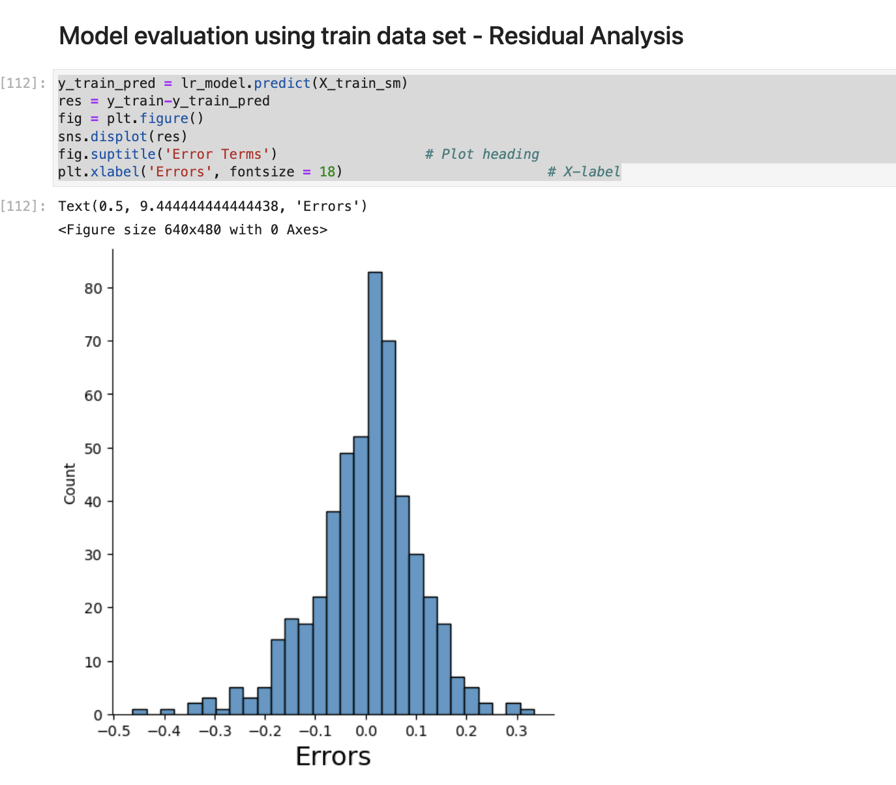
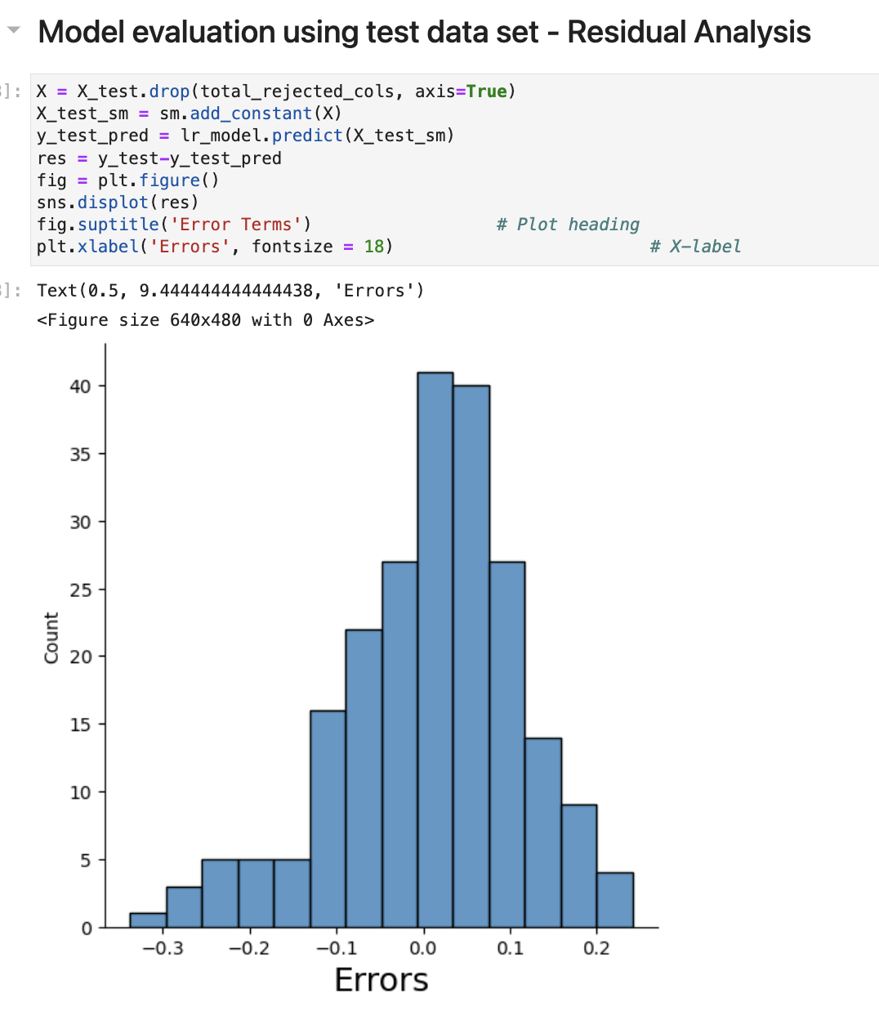
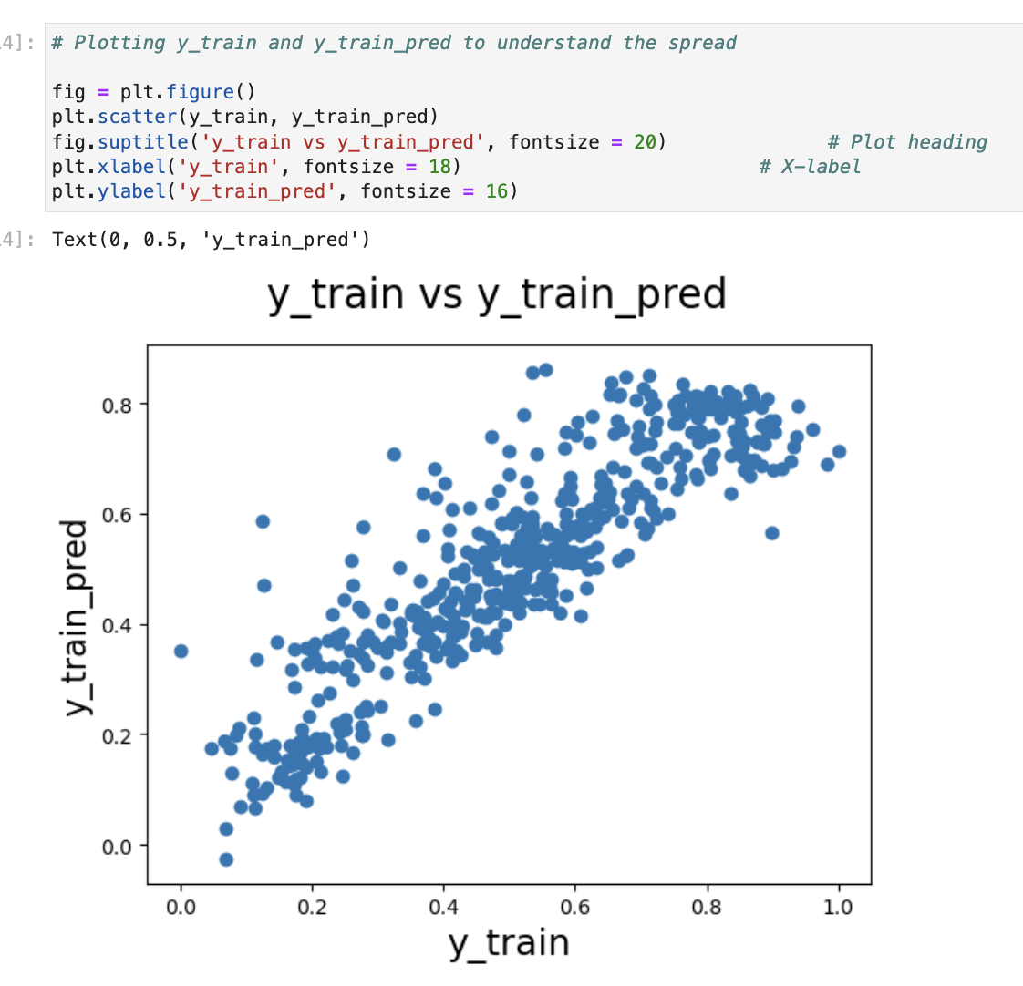
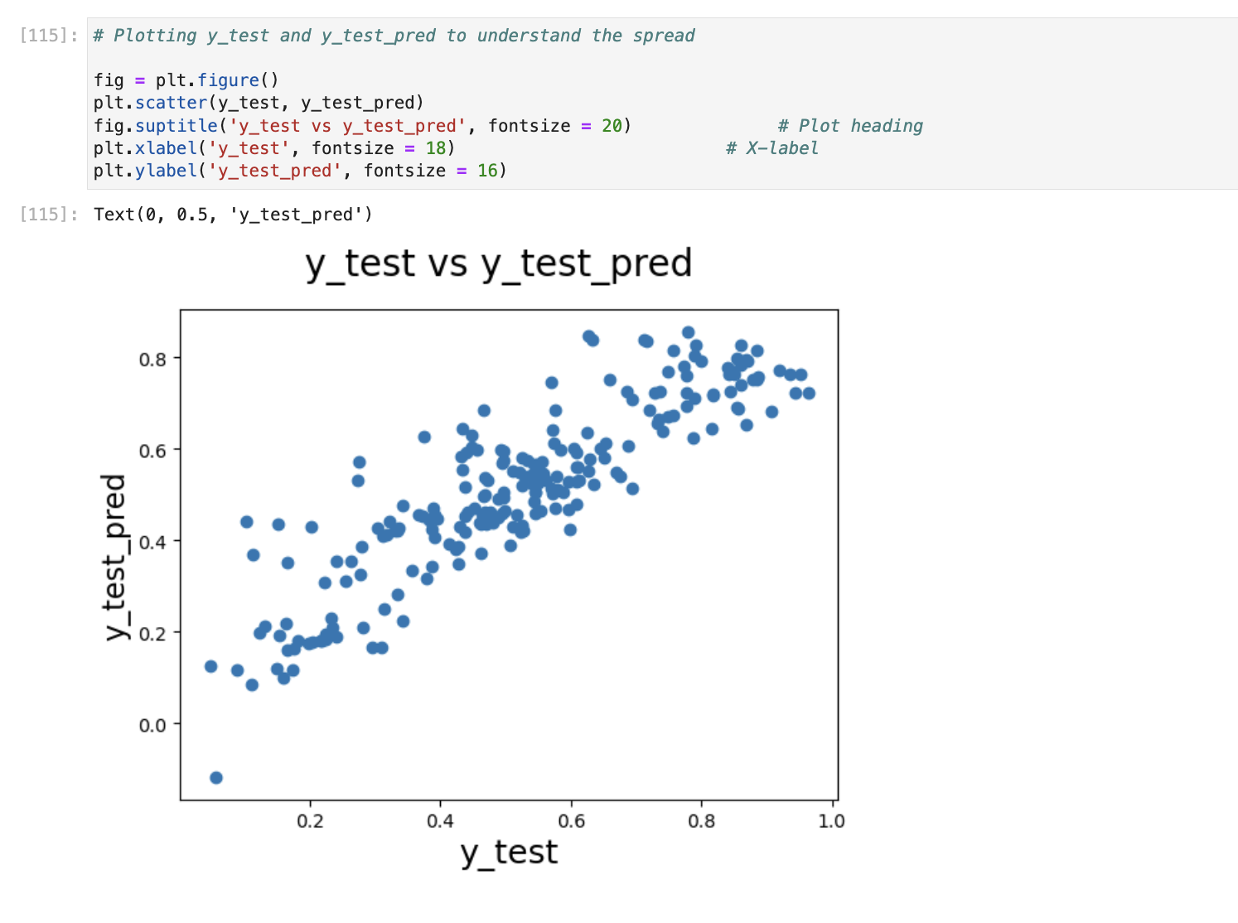

Slide 8
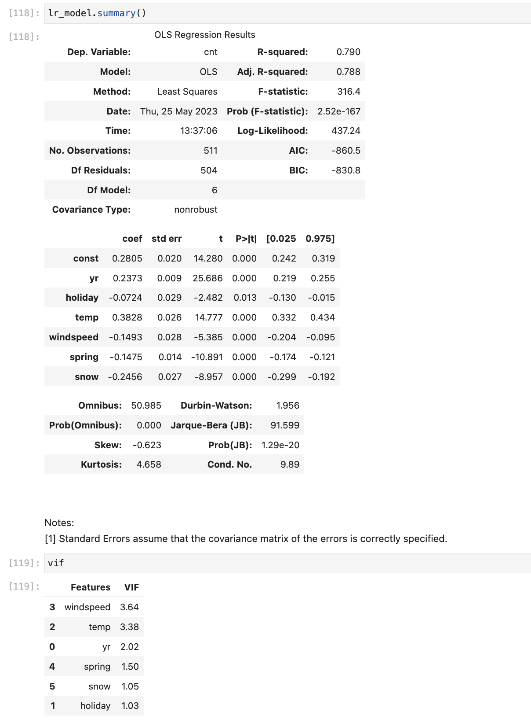
5. Based on the final model, which are the top 3 features contributing significantly towards explaining the demand of the shared bikes? (2 marks)
y = 0.2805 + 0.2373 * yr - 0.0724 * holiday + 0.3828 * temp - 0.1493 - 0.1475 * spring - 0.2456 * Snow
temp => 0.3828 - Positive Corelation
Snow => -0.2456 - Negative corelation
yr => 0.2805 - Positive Corelation

Slide 9
General Subjective Questions

Slide 10
1. Explain the linear regression algorithm in detail. (4 marks)
Linear regression assumes there is linear relation ship b/w the dependent variable and independent variable. We want to draw a best line passing through this point. For this we use, we want to minimize the Residual Sum Square.
We also want to make sure our model is overfitted and affected by multicollinearity. For that, we have VIF and p-value analysis.

Slide 11
2. Explain the Anscombe’s quartet in detail. (3 marks)
Anscombe's Quartet can be defined as a group of four data sets which are nearly identical in simple descriptive statistics, but there are some peculiarities in the dataset that fools the regression model if built. They have very different distributions and appear differently when plotted on scatter plots.

Slide 12
3. What is Pearson’s R? (3 marks)
In Statistics, the Pearson's Correlation Coefficient is also referred to as Pearson's r, the Pearson product-moment correlation coefficient (PPMCC), or bivariate correlation. It is a statistic that measures the linear correlation between two variables. Like all correlations, it also has a numerical value that lies between -1.0 and +1.0.

Slide 13
4. What is scaling? Why is scaling performed? What is the difference between normalized scaling and standardized scaling?
Standardization is a preprocessing method used to transform continuous data to make it look normally distributed. In scikit-learn this is often a necessary step because many models assume that the data you are training on is normally distributed, and if it isn’t, your risk biasing your model.
Scaling is a method of standardization.
Scaling transforms the features in your dataset so they have a mean of zero and a variance of one This will make it easier to linearly compare features. Also, this a requirement for many models in scikit-learn.

Slide 14
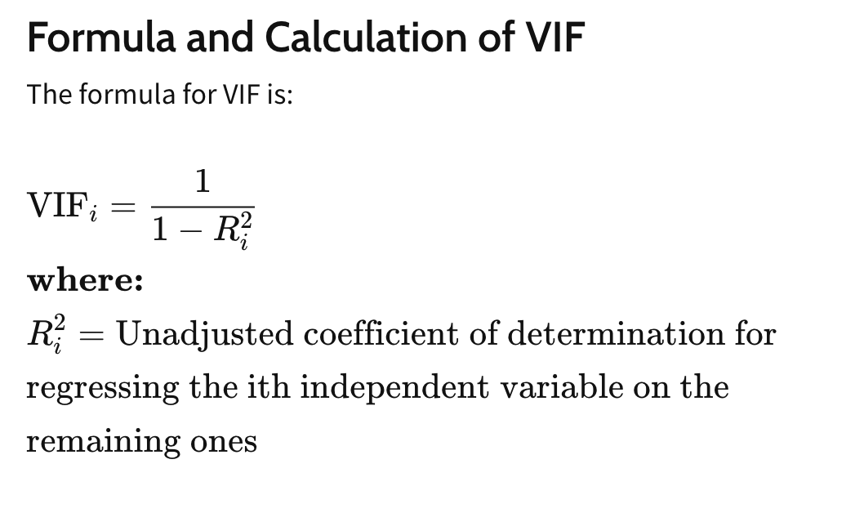
5. You might have observed that sometimes the value of VIF is infinite. Why does this happen? (3 marks)
The VIF of one feature will be infinity
When R^2 is 1
The R^2 is 1 When that feature is perfectly defined by all other feature.
So when one feature is perfectly defined by all other feature with R^2 value 1. In that case, the VIF of that feature will be infinity.
In practice, we don’t consider the feature have VIF greater than 5

Slide 15
6. What is a Q-Q plot? Explain the use and importance of a Q-Q plot in linear regression. (3 marks)
The (Q-Q plot) quantile-quantile plot is a graphical method for determining whether two samples of data came from the same population or not.
A q-q plot is a plot of the quantiles of the first data set against the quantiles of the second data set. By a quantile, we mean the
Usage:
Determine whether two samples are from the same population.
Whether two samples have the same tail
Whether two samples have the same distribution shape.
Whether two samples have common location behavior. fraction (or percent) of points below the given value.

Slide 16
THANK YOU

