Slide 1

Digital Portfolio
STUDENT NAME : VENKATRAJ .G
REGISTER NO & NMID : 24131190500122044
&
8D07F1DBA88B4FBA9D334ED5AAD6B4C8
Department : BCA
College Code : ANU119
College Name : Government Arts and Science College Tittagudi – 606106
University Name : Annamalai University

Slide 2
PROJECT TITLE
Digital Portfolio

Slide 3


AGENDA
Problem Statement
Project Overview
End Users
Tools and Technologies
Portfolio design and Layout
Features and Functionality
Results and Screenshots
Conclusion
Github Link
3/21/2024 Annual Review

Slide 4

PROBLEM STATEMENT
Definition:
A digital portfolio is an online collection of work that showcases your skills, experiences, and accomplishments. It can include various media types such as text, images, videos, and links.

Slide 5

PROJECT OVERVIEW
1.Project Title
2.Project Description
3.Your Role
4.Objectives and Goals
5.Tools and Technologies Used
6.Challenges Faced
7.Solutions Implemented
8.Results and Outcomes

Slide 6

WHO ARE THE END USERS?
1. Potential Employers
2. Clients
3. Collaborators
4. Industry Peers
5. Educational Institutions
6. General Public
7. Investors or Stakeholders
8. Recruitment Platforms

Slide 7

TOOLS AND TECHNIQUES
1.HTML5
2.CSS3
3.RESPONSIVE WEB DESIGN
4.NAVIGATION BAR
5.PrOFILE PICTRURE INTEGRATION
4.SEMANTIC HTML
7.CONTENT MANAGEMENT SYSTEM

Slide 8
POTFOLIO DESIGN AND LAYOUT
1. Choose a Clean and Professional Design
2. Typography
3. Layout Structure
4. Navigation
5. Project Presentation
6. Visual Elements
7. Responsive Design
8. Call to Action (CTA)
9. Testimonials and Endorsements
10. Regular Updates
8

Slide 9
FEATURES AND FUNCTIONALITY
1.Responsive Design
2.User -Friendly Navigation
3.Project Showcase
4.Search Functionality
5.Contact Form
6.Social Media Integration
7.Downloadable Resume
8.Testimonials and Endorsements

Slide 10
POTFOLIO DESIGN AND LAYOUT
1. Choose a Clean and Professional Design
2. Typography
3. Layout Structure
4. Navigation
5. Project Presentation
6. Visual Elements
7. Responsive Design
8. Call to Action (CTA)
9. Testimonials and Endorsements
10. Regular Updates
10

Slide 11
FEATURES AND FUNCTIONALITY
1.Responsive Design
2.User -Friendly Navigation
3.Project Showcase
4.Search Functionality
5.Contact Form
6.Social Media Integration
7.Downloadable Resume
8.Testimonials and Endorsements

Slide 12
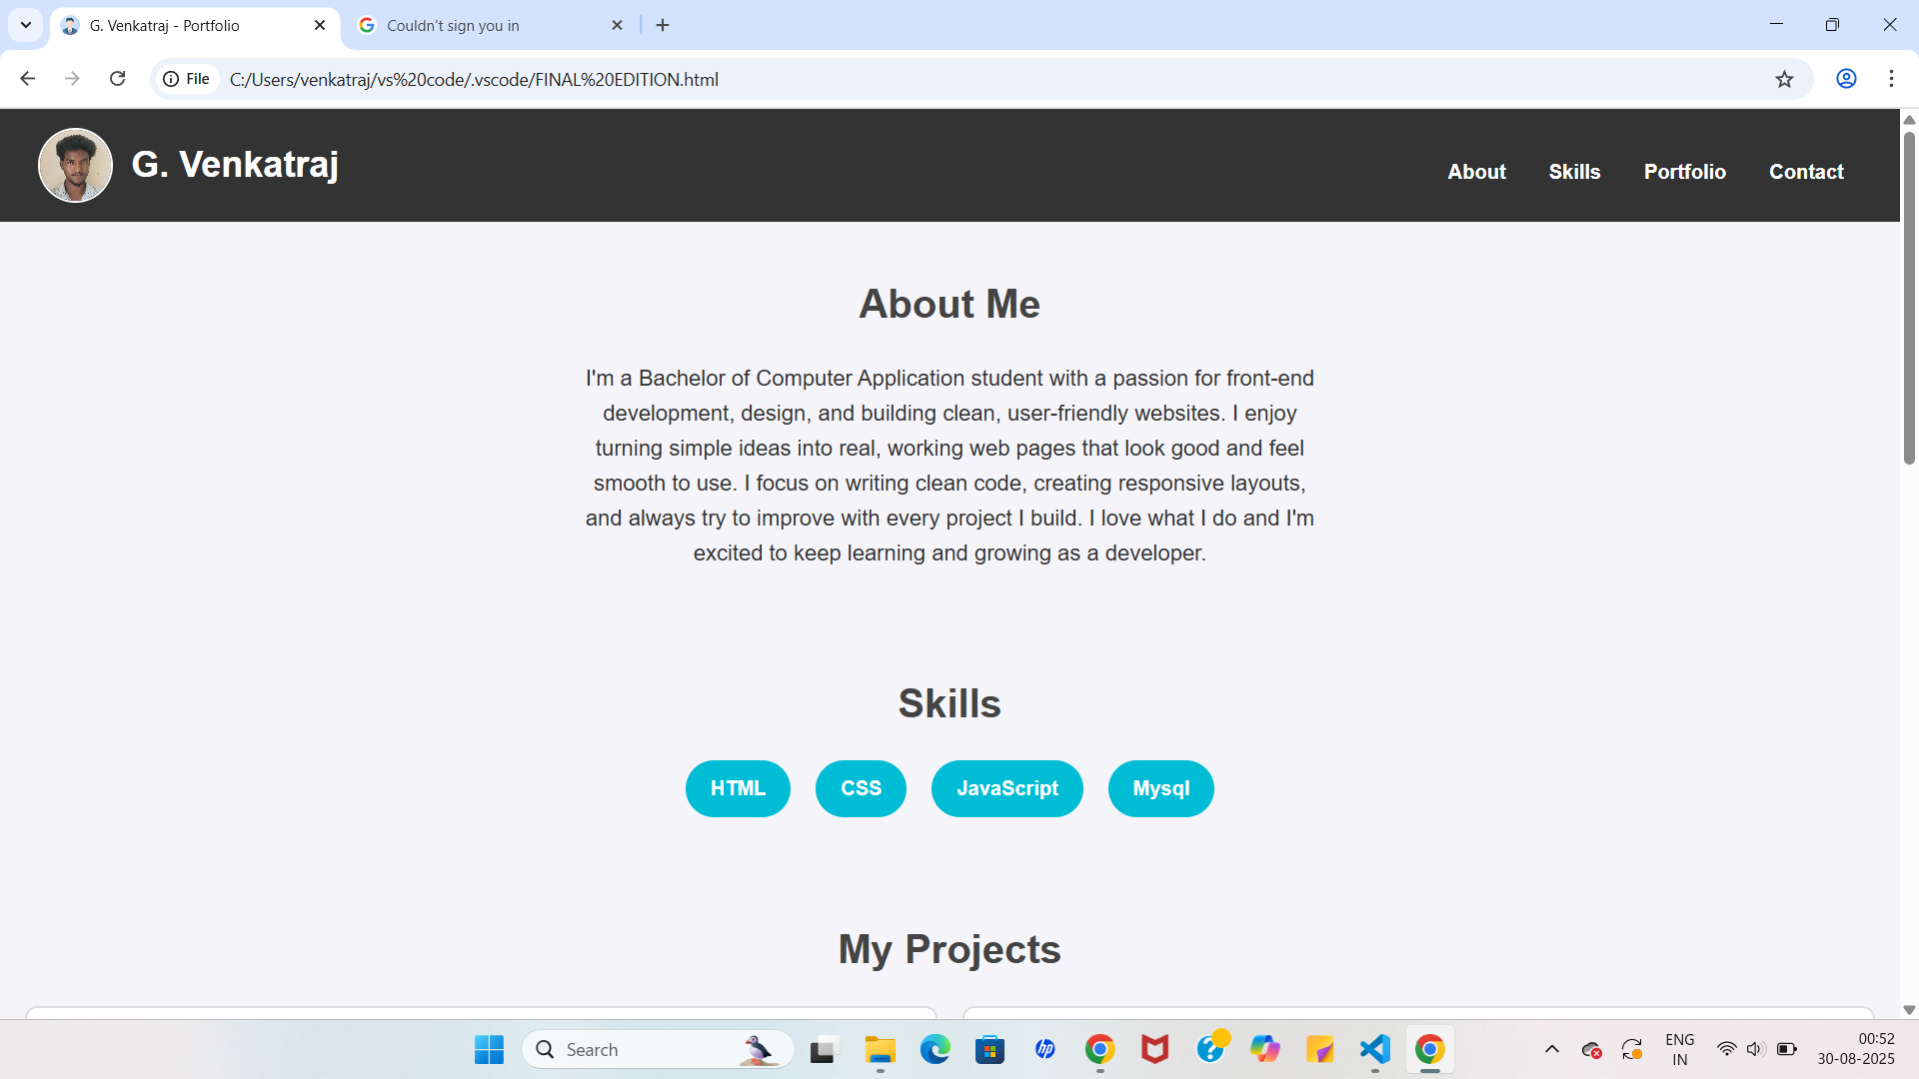

RESULTS AND SCREENSHOTS
3/21/2024 Annual Review
12

Slide 13
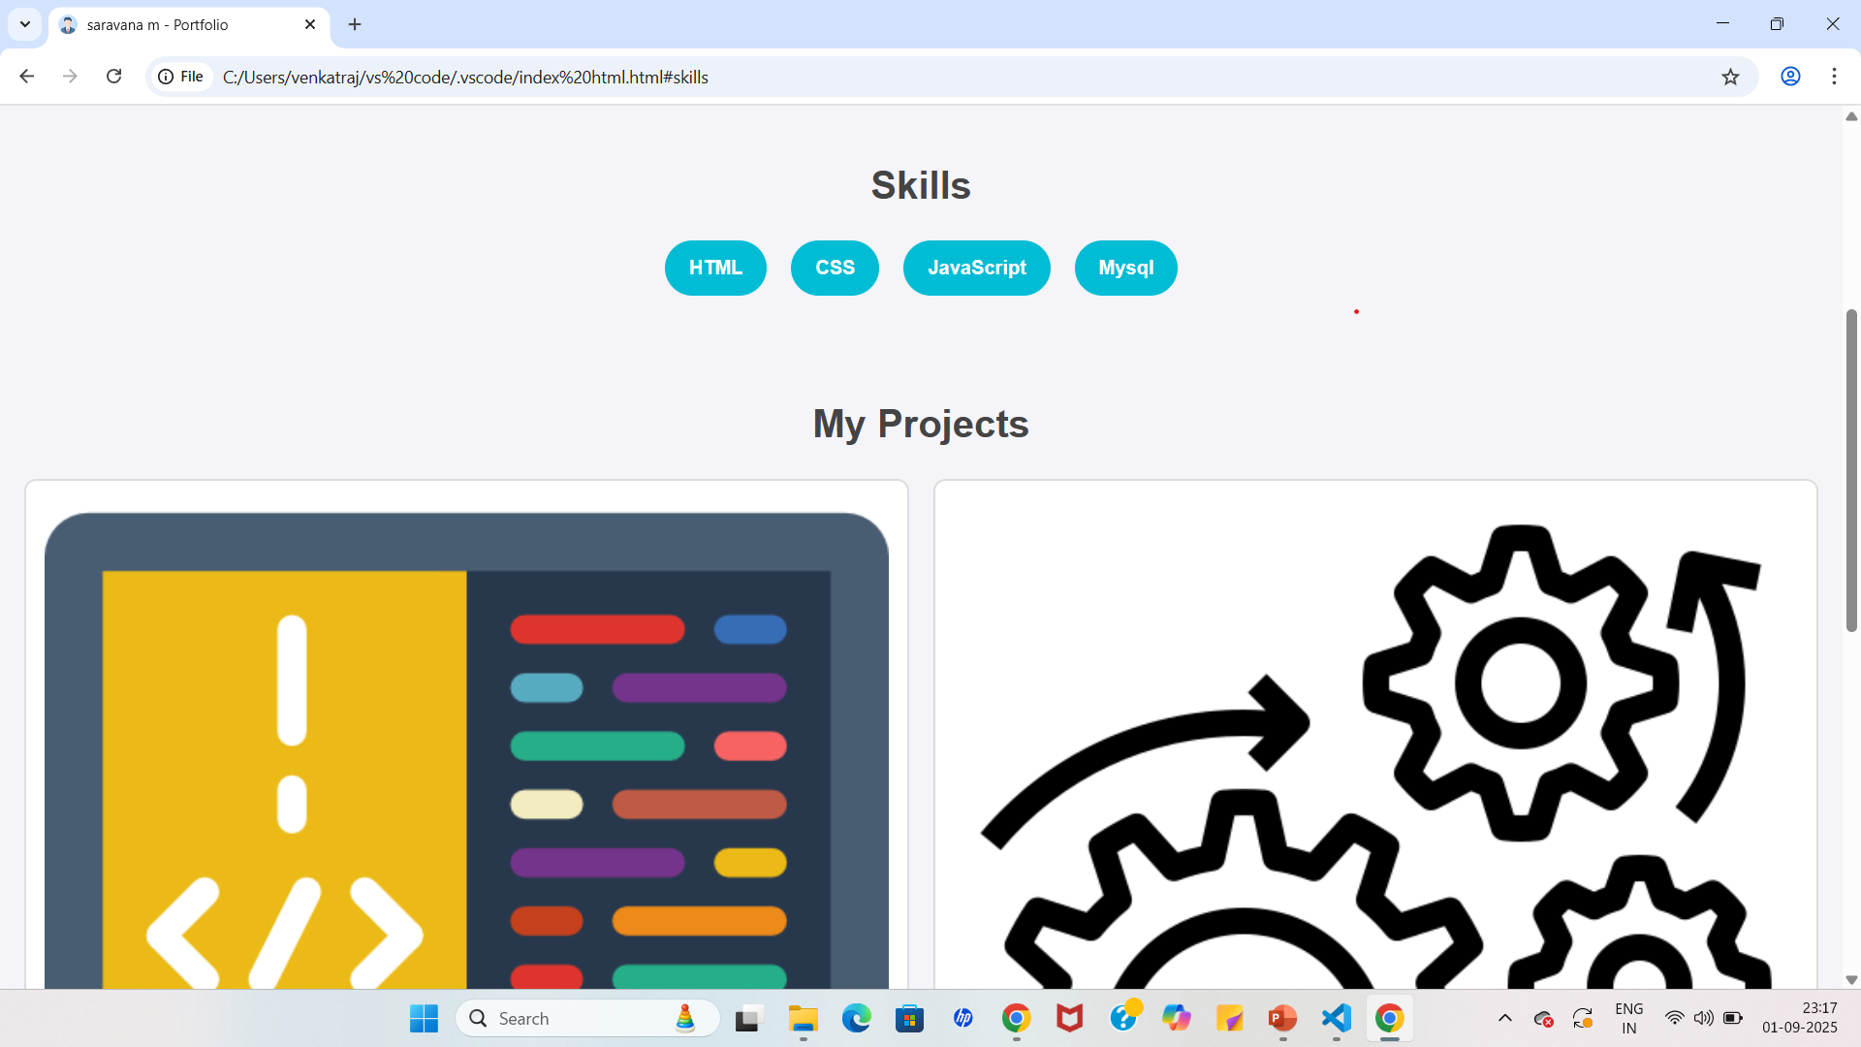
RESULTS AND SCREENSHOTS
3/21/2024 Annual Review
13

Slide 14
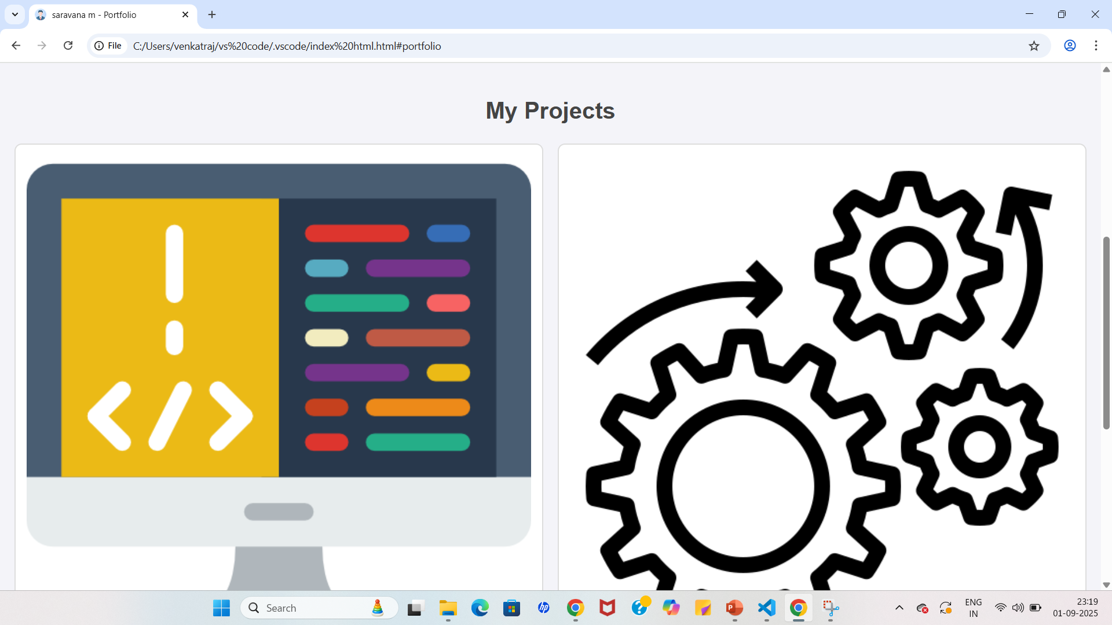
RESULTS AND SCREENSHOTS
3/21/2024 Annual Review
14

Slide 15
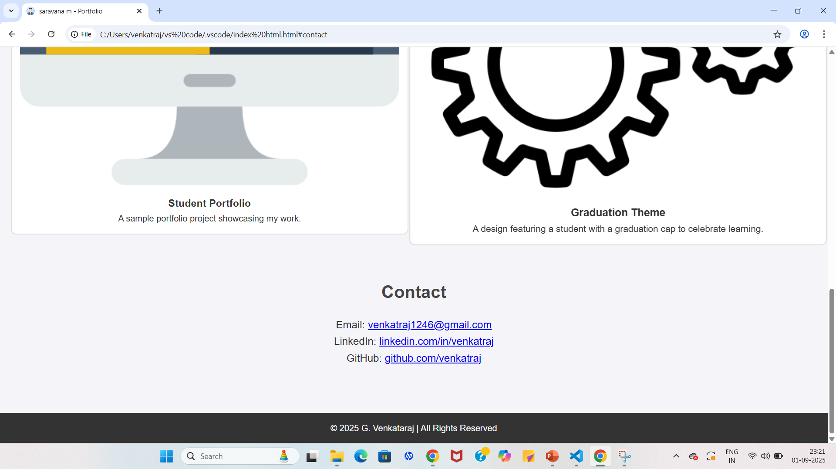
RESULTS AND SCREENSHOTS
3/21/2024 Annual Review
15

Slide 16
CONCLUSION
This portfolio is a static website developed using HTML and CSS, designed to showcase personal details, skills, and projects in a simple and responsive layout. It is lightweight, fast, and easy to maintain, though updates require manual code changes as it does not use a content management system (CMS).
16

Slide 17
GITHUB LINK
https://github.com/venkatraj1246-cloud/venkatraj-TNSDC-FWD-DP.git
17

