Slide 1
CREATE A POWERPOINT PRESENTATION FOR PHARMACOTHERAPEUTICS-1 ON THYROID DISEASES. INCLUDE THE FOLLOWING TOPICS: 1. INTRODUCTION TO THYROID GLAND 2. HYPOTHYROIDISM - DEFINITION - CAUSES (ETIOLOGY) - PATHOPHYSIOLOGY - SIGNS AND SYMPTOMS - DIAGNOSIS 3. HYPERTHYROIDISM - DEFINITION - CAUSES (ETIOLOGY) - PATHOPHYSIOLOGY - SIGNS AND SYMPTOMS - DIAGNOSIS 4. MANAGEMENT OF THYROID DISORDERS (AS PER STANDARD GUIDELINES) - PHARMACOLOGICAL TREATMENT - NON-PHARMACOLOGICAL MANAGEMENT - DRUG EXAMPLES AND MECHANISMS 5. CONCLUSION 6. REFERENCES MAKE THE SLIDES CLEAR, CONCISE, AND SUITABLE FOR ACADEMIC PRESENTATION. INCLUDE BULLET POINTS AND SIMPLE EXPLANATIONS.
Introduction to Thyroid Gland
Thyroid Gland Anatomy
Hypothyroidism Definition
Hypothyroidism Causes
05/05/2026
DEPARTMENT OF PHARMACY PRACTICE
1

Slide 2
Introduction to Thyroid Gland
The thyroid gland is a vital endocrine organ that produces hormones regulating metabolism, growth, and development. Located in the neck, it plays a crucial role in maintaining overall health. The thyroid gland produces two main hormones: triiodothyronine (T3) and thyroxine (T4).
▶ Regulates metabolism and energy production
▶ Influences growth and development
▶ Produces triiodothyronine (T3) and thyroxine (T4) hormones
05/05/2026
DEPARTMENT OF PHARMACY PRACTICE
2

Slide 3
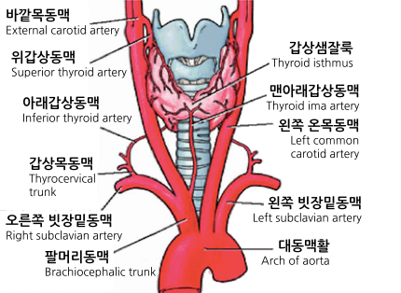
Thyroid Gland Anatomy
The thyroid gland is located in the neck, below the larynx. It consists of two lobes connected by an isthmus. The gland is surrounded by a fibrous capsule and contains follicles that produce and store thyroid hormones.
▶ Located in the neck, below the larynx
▶ Consists of two lobes connected by an isthmus
▶ Surrounded by a fibrous capsule
05/05/2026
DEPARTMENT OF PHARMACY PRACTICE
3

Slide 4
Hypothyroidism Definition
Hypothyroidism is a condition characterized by an underactive thyroid gland, resulting in insufficient production of thyroid hormones. This can lead to a range of symptoms, including fatigue, weight gain, and cold intolerance.
▶ Underactive thyroid gland
▶ Insufficient production of thyroid hormones
▶ Can cause fatigue, weight gain, and cold intolerance
05/05/2026
DEPARTMENT OF PHARMACY PRACTICE
4

Slide 5
Hypothyroidism Causes
Hypothyroidism can be caused by various factors, including autoimmune disorders, thyroid surgery, and radiation therapy. Other causes include certain medications, pituitary gland problems, and iodine deficiency.
▶ Autoimmune disorders (e.g., Hashimoto's thyroiditis)
▶ Thyroid surgery or radiation therapy
▶ Certain medications (e.g., lithium, amiodarone)
05/05/2026
DEPARTMENT OF PHARMACY PRACTICE
5

Slide 6
Hypothyroidism Pathophysiology
In hypothyroidism, the thyroid gland fails to produce sufficient thyroid hormones, leading to a decrease in metabolic rate. This can cause a range of symptoms, including fatigue, weight gain, and dry skin.
▶ Decreased production of thyroid hormones
▶ Decreased metabolic rate
▶ Can cause fatigue, weight gain, and dry skin
05/05/2026
DEPARTMENT OF PHARMACY PRACTICE
6

Slide 7
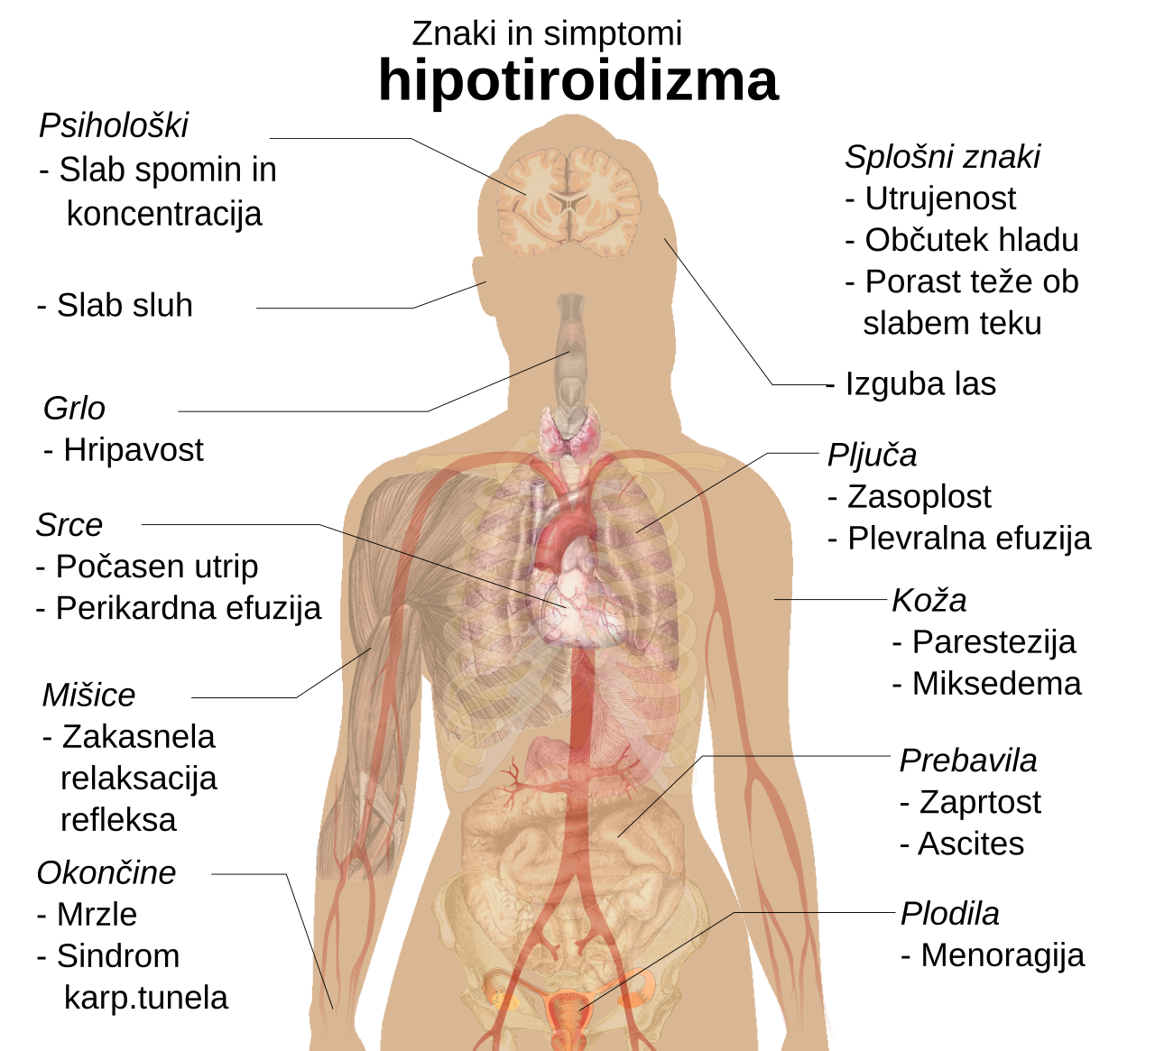
Hypothyroidism Signs and Symptoms
Hypothyroidism can cause a range of signs and symptoms, including fatigue, weight gain, and cold intolerance. Other symptoms include dry skin, hair loss, and depression.
▶ Fatigue and weakness
▶ Weight gain and cold intolerance
▶ Dry skin and hair loss
05/05/2026
DEPARTMENT OF PHARMACY PRACTICE
7

Slide 8
Hypothyroidism Diagnosis
Hypothyroidism is typically diagnosed using blood tests to measure thyroid hormone levels. Other diagnostic tests include thyroid-stimulating hormone (TSH) tests and free thyroxine (FT4) tests.
▶ Blood tests to measure thyroid hormone levels
▶ Thyroid-stimulating hormone (TSH) tests
▶ Free thyroxine (FT4) tests
05/05/2026
DEPARTMENT OF PHARMACY PRACTICE
8

Slide 9
Hyperthyroidism Definition
Hyperthyroidism is a condition characterized by an overactive thyroid gland, resulting in excessive production of thyroid hormones. This can lead to a range of symptoms, including weight loss, palpitations, and anxiety.
▶ Overactive thyroid gland
▶ Excessive production of thyroid hormones
▶ Can cause weight loss, palpitations, and anxiety
05/05/2026
DEPARTMENT OF PHARMACY PRACTICE
9

Slide 10
Hyperthyroidism Causes
Hyperthyroidism can be caused by various factors, including autoimmune disorders, thyroid nodules, and excessive iodine intake. Other causes include certain medications and pituitary gland problems.
▶ Autoimmune disorders (e.g., Graves' disease)
▶ Thyroid nodules or tumors
▶ Excessive iodine intake
05/05/2026
DEPARTMENT OF PHARMACY PRACTICE
10

Slide 11
Hyperthyroidism Pathophysiology
In hyperthyroidism, the thyroid gland produces excessive thyroid hormones, leading to an increase in metabolic rate. This can cause a range of symptoms, including weight loss, palpitations, and anxiety.
▶ Excessive production of thyroid hormones
▶ Increased metabolic rate
▶ Can cause weight loss, palpitations, and anxiety
05/05/2026
DEPARTMENT OF PHARMACY PRACTICE
11

Slide 12
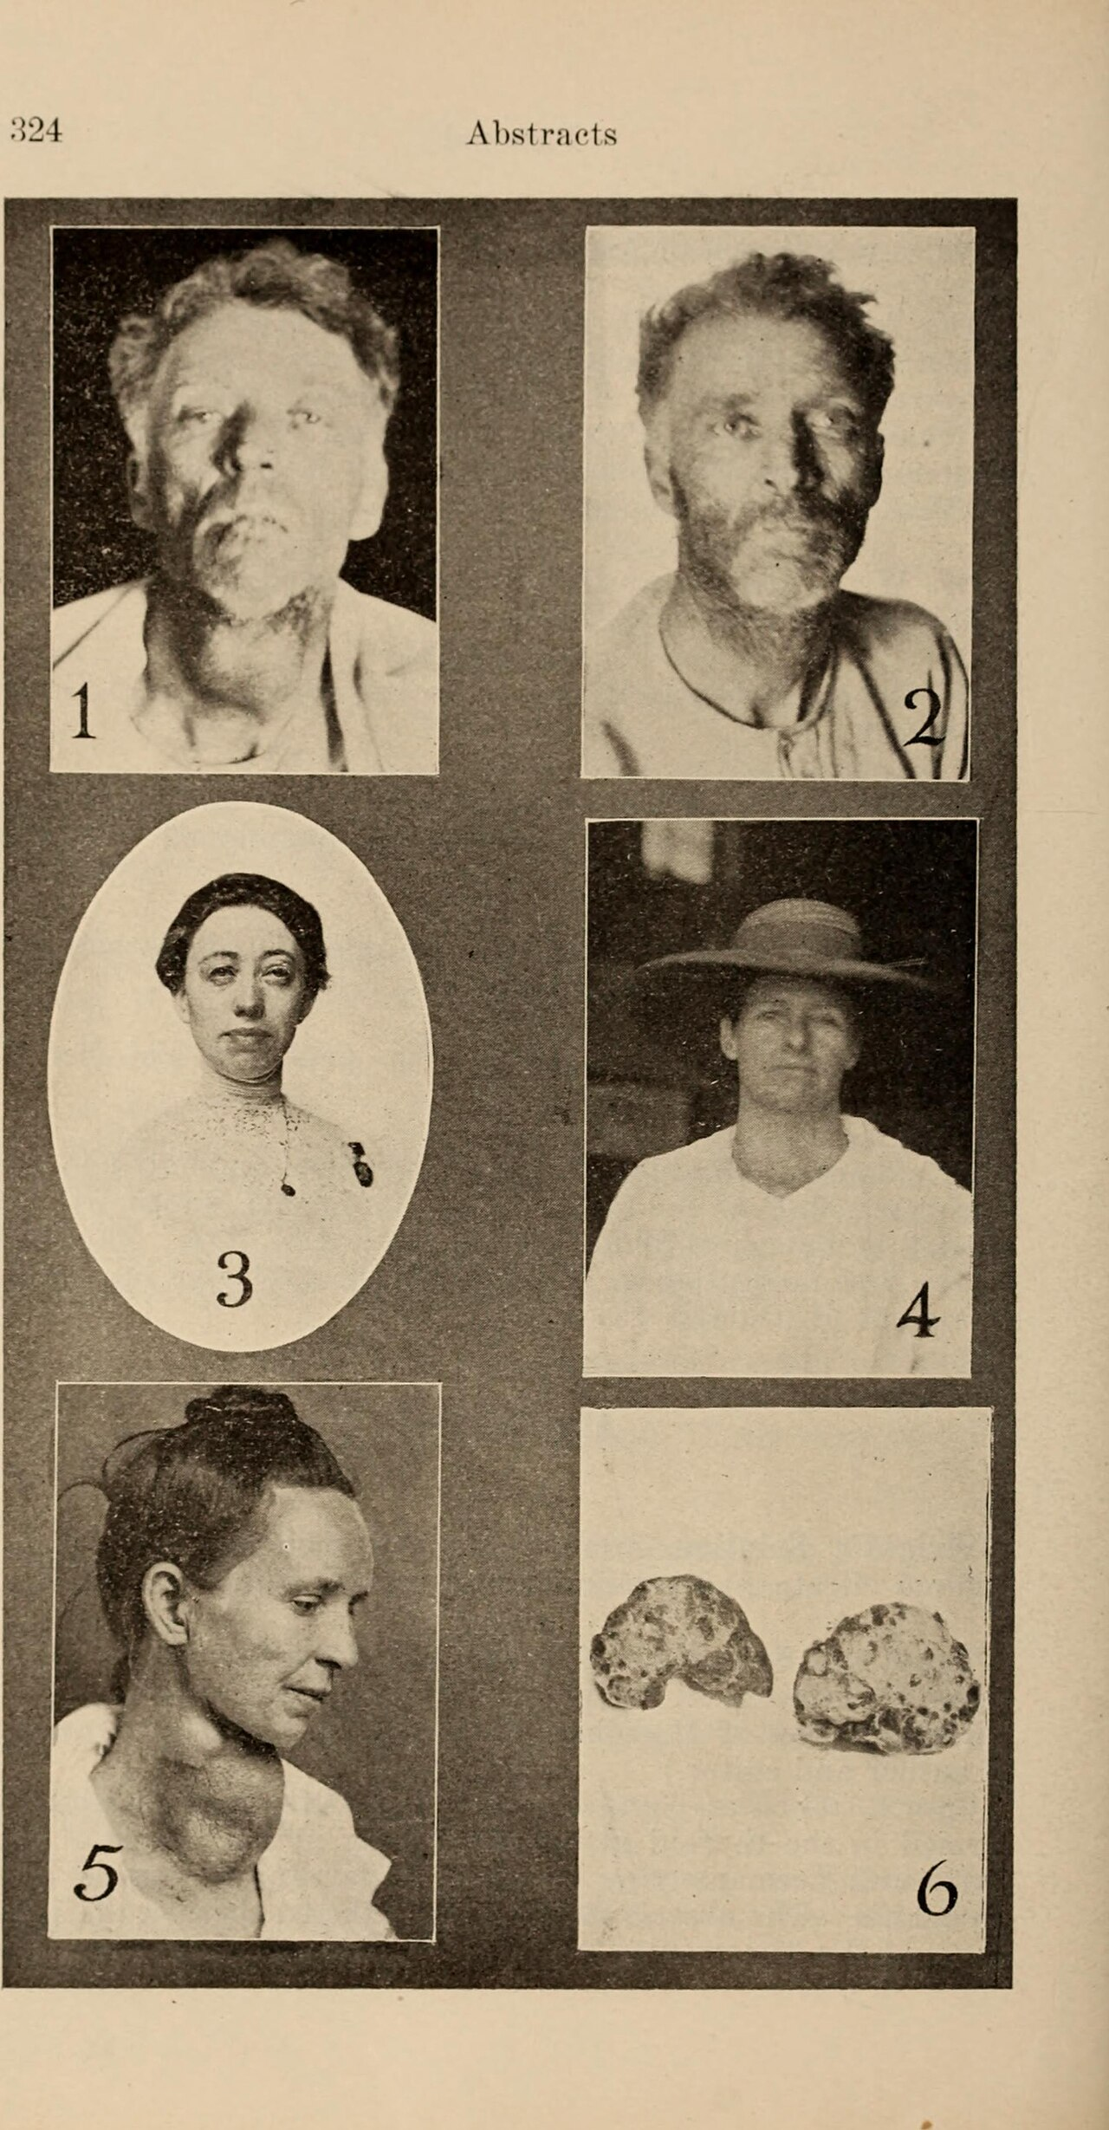
Hyperthyroidism Signs and Symptoms
Hyperthyroidism can cause a range of signs and symptoms, including weight loss, palpitations, and anxiety. Other symptoms include heat intolerance, tremors, and exophthalmos.
▶ Weight loss and palpitations
▶ Anxiety and heat intolerance
▶ Tremors and exophthalmos
05/05/2026
DEPARTMENT OF PHARMACY PRACTICE
12

Slide 13
Hyperthyroidism Diagnosis
Hyperthyroidism is typically diagnosed using blood tests to measure thyroid hormone levels. Other diagnostic tests include thyroid-stimulating hormone (TSH) tests and free thyroxine (FT4) tests.
▶ Blood tests to measure thyroid hormone levels
▶ Thyroid-stimulating hormone (TSH) tests
▶ Free thyroxine (FT4) tests
05/05/2026
DEPARTMENT OF PHARMACY PRACTICE
13

Slide 14
Management of Thyroid Disorders
The management of thyroid disorders typically involves a combination of pharmacological and non-pharmacological treatments. The goal of treatment is to restore normal thyroid hormone levels and alleviate symptoms.
▶ Pharmacological treatments (e.g., levothyroxine, methimazole)
▶ Non-pharmacological treatments (e.g., lifestyle modifications, surgery)
▶ Goal of treatment is to restore normal thyroid hormone levels
05/05/2026
DEPARTMENT OF PHARMACY PRACTICE
14

Slide 15
Pharmacological Treatment
Pharmacological treatment for thyroid disorders typically involves the use of thyroid hormone replacement therapy or anti-thyroid medications. The choice of medication depends on the specific condition and severity of symptoms.
▶ Thyroid hormone replacement therapy (e.g., levothyroxine)
▶ Anti-thyroid medications (e.g., methimazole, propylthiouracil)
▶ Choice of medication depends on condition and severity of symptoms
05/05/2026
DEPARTMENT OF PHARMACY PRACTICE
15

Slide 16
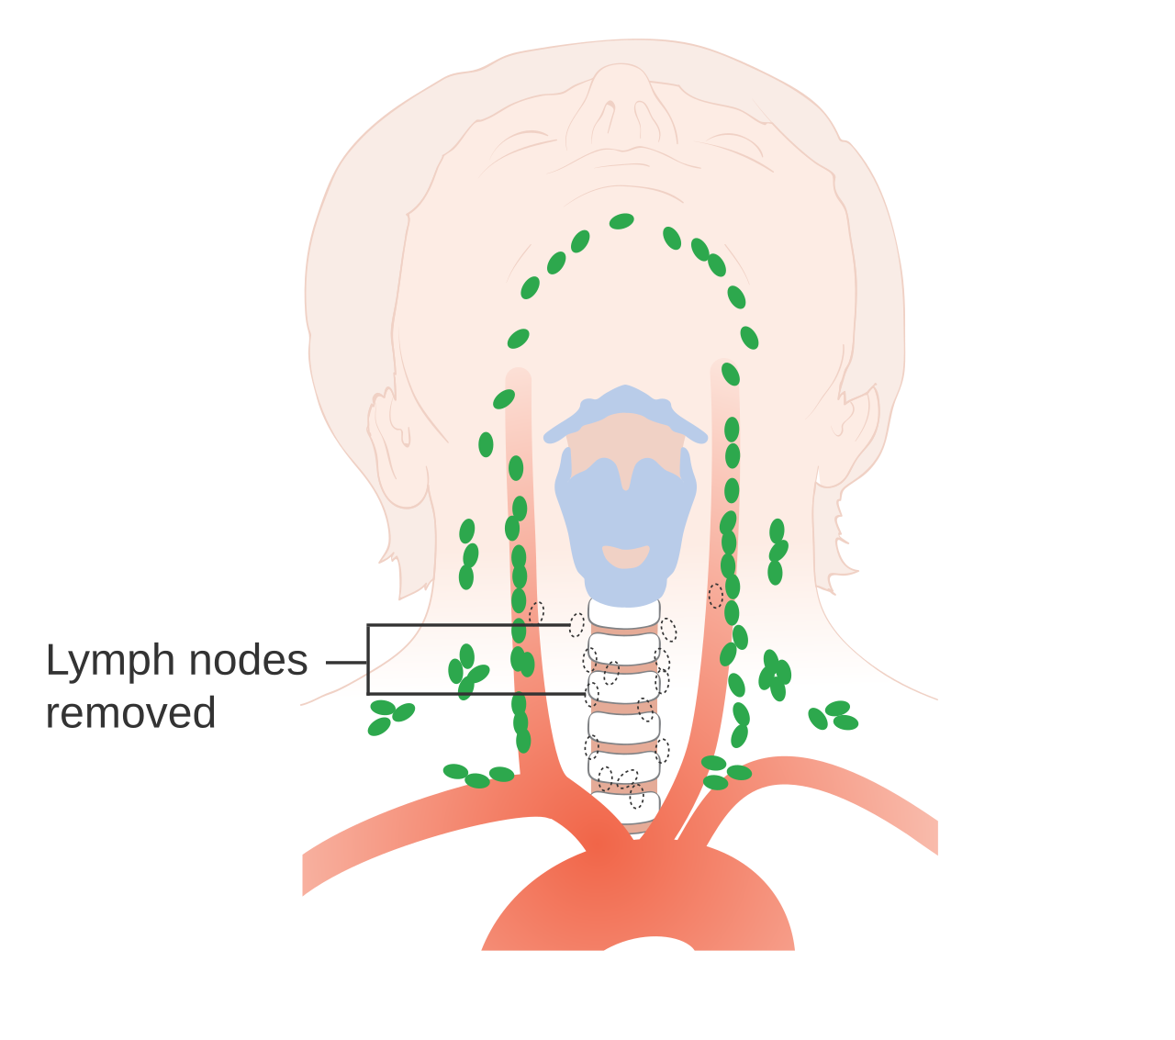
Non-Pharmacological Management
Non-pharmacological management of thyroid disorders typically involves lifestyle modifications, such as dietary changes and stress reduction. Surgery may also be necessary in some cases.
▶ Lifestyle modifications (e.g., dietary changes, stress reduction)
▶ Surgery (e.g., thyroidectomy, radioiodine ablation)
▶ Goal of non-pharmacological management is to alleviate symptoms
05/05/2026
DEPARTMENT OF PHARMACY PRACTICE
16

Slide 17
Drug Examples and Mechanisms
Examples of medications used to treat thyroid disorders include levothyroxine, methimazole, and propylthiouracil. These medications work by replacing or inhibiting thyroid hormones, respectively.
▶ Levothyroxine (thyroid hormone replacement therapy)
▶ Methimazole and propylthiouracil (anti-thyroid medications)
▶ Mechanisms of action involve replacement or inhibition of thyroid hormones
05/05/2026
DEPARTMENT OF PHARMACY PRACTICE
17

Slide 18
Treatment Algorithm
The treatment algorithm for thyroid disorders typically involves a step-wise approach, starting with lifestyle modifications and progressing to pharmacological treatment if necessary.
1
2
3
Lifestyle modifications
Pharmacological treatment
Surgery or other interventions
→
→
05/05/2026
DEPARTMENT OF PHARMACY PRACTICE
18

Slide 19
Conclusion
In conclusion, thyroid disorders are common endocrine conditions that require prompt diagnosis and treatment. A combination of pharmacological and non-pharmacological treatments can help restore normal thyroid hormone levels and alleviate symptoms.
▶ Thyroid disorders are common endocrine conditions
▶ Prompt diagnosis and treatment are essential
▶ Combination of treatments can help restore normal thyroid hormone levels
05/05/2026
DEPARTMENT OF PHARMACY PRACTICE
19

Slide 20
References
References for this presentation include various medical textbooks, journal articles, and online resources. A list of references is provided below.
▶ Medical textbooks (e.g., Harrison's Principles of Internal Medicine)
▶ Journal articles (e.g., New England Journal of Medicine, Journal of Clinical Endocrinology and Metabolism)
▶ Online resources (e.g., Mayo Clinic, National Institutes of Health)
05/05/2026
DEPARTMENT OF PHARMACY PRACTICE
20

Slide 21
THANK YOU
Create a PowerPoint presentation for Pharmacotherapeutics-1 on Thyroid Diseases. Include the following topics: 1. Introduction to Thyroid Gland 2. Hypothyroidism - Definition - Causes (Etiology) - Pathophysiology - Signs and Symptoms - Diagnosis 3. Hyperthyroidism - Definition - Causes (Etiology) - Pathophysiology - Signs and Symptoms - Diagnosis 4. Management of Thyroid Disorders (as per standard guidelines) - Pharmacological treatment - Non-pharmacological management - Drug examples and mechanisms 5. Conclusion 6. References Make the slides clear, concise, and suitable for academic presentation. Include bullet points and simple explanations.
05/05/2026
DEPARTMENT OF PHARMACY PRACTICE
21

