Slide 1
THYROID DISEASES - PHARMACOTHERAPEUTICS-1
Introduction to Thyroid Diseases
Hypothyroidism Overview
Hyperthyroidism Overview
Thyroid Hormone Replacement Therapy
05/05/2026
DEPARTMENT OF PHARMACY PRACTICE
1

Slide 2
Introduction to Thyroid Diseases
Thyroid diseases affect the thyroid gland, which plays a crucial role in regulating metabolism. The most common thyroid diseases include hypothyroidism and hyperthyroidism. Understanding these conditions is essential for effective management.
▶ Hypothyroidism: underproduction of thyroid hormones
▶ Hyperthyroidism: overproduction of thyroid hormones
▶ Thyroiditis: inflammation of the thyroid gland
▶ Thyroid cancer: abnormal cell growth in the thyroid gland
05/05/2026
DEPARTMENT OF PHARMACY PRACTICE
2

Slide 3
Hypothyroidism Overview
Hypothyroidism occurs when the thyroid gland does not produce enough thyroid hormones, leading to a decrease in metabolic rate. This condition can be caused by autoimmune diseases, radiation therapy, or surgical removal of the thyroid gland.
▶ Fatigue and weakness
▶ Weight gain and dry skin
▶ Cold intolerance and hair loss
▶ Depression and memory problems
05/05/2026
DEPARTMENT OF PHARMACY PRACTICE
3

Slide 4
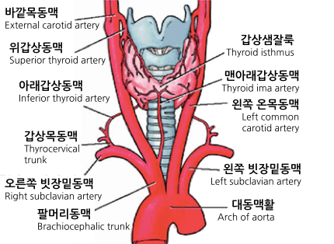
Hyperthyroidism Overview
Hyperthyroidism is characterized by an overproduction of thyroid hormones, leading to an increase in metabolic rate. This condition can be caused by Graves' disease, thyroid nodules, or excessive intake of thyroid hormones.
▶ Weight loss and increased appetite
▶ Rapid heartbeat and tremors
▶ Nervousness and anxiety
▶ Heat intolerance and sweating
05/05/2026
DEPARTMENT OF PHARMACY PRACTICE
4

Slide 5
Thyroid Hormone Replacement Therapy
Thyroid hormone replacement therapy is used to treat hypothyroidism. This therapy involves taking synthetic thyroid hormones to replace the missing hormones and restore normal metabolic function.
▶ Levothyroxine (T4) and liothyronine (T3) are commonly used synthetic hormones
▶ Dosage is individualized based on patient needs and response
▶ Regular monitoring of thyroid function is necessary to adjust dosage
05/05/2026
DEPARTMENT OF PHARMACY PRACTICE
5

Slide 6
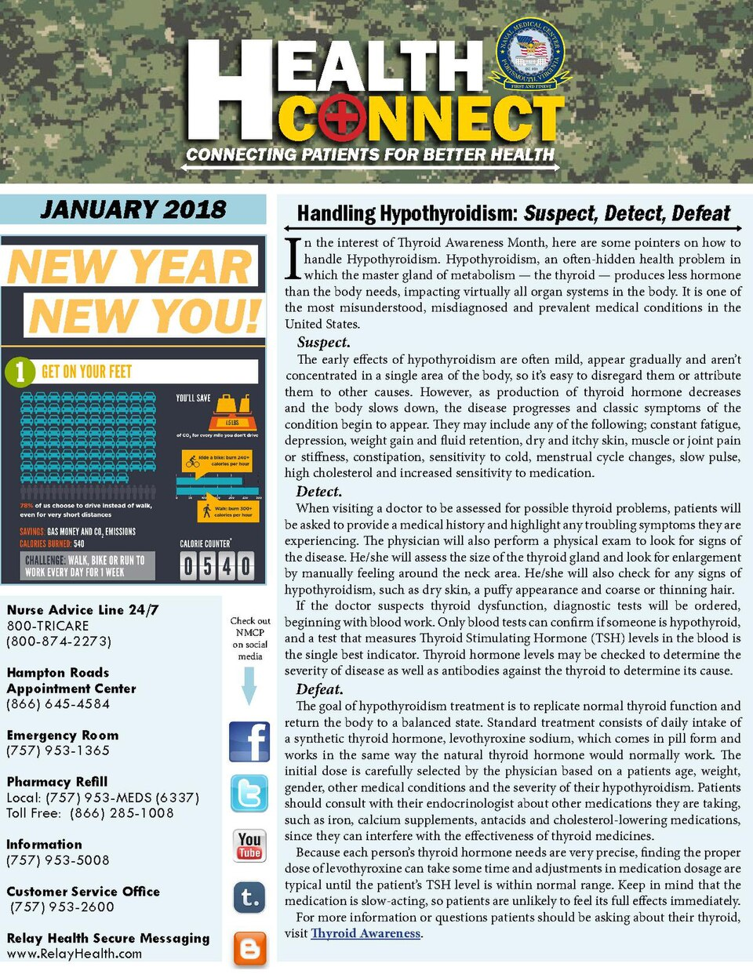
Antithyroid Medications
Antithyroid medications are used to treat hyperthyroidism. These medications work by reducing the production of thyroid hormones or blocking their effects on the body.
▶ Methimazole and propylthiouracil are commonly used antithyroid medications
▶ These medications can cause side effects such as rash, itching, and liver damage
▶ Regular monitoring of thyroid function and liver function is necessary
05/05/2026
DEPARTMENT OF PHARMACY PRACTICE
6

Slide 7
Radioactive Iodine Therapy
Radioactive iodine therapy is used to treat hyperthyroidism and certain types of thyroid cancer. This therapy involves taking a radioactive form of iodine, which destroys part or all of the thyroid gland.
▶ This therapy is usually used for patients who cannot tolerate antithyroid medications
▶ It can cause side effects such as nausea, vomiting, and neck pain
▶ Regular monitoring of thyroid function is necessary after therapy
05/05/2026
DEPARTMENT OF PHARMACY PRACTICE
7

Slide 8
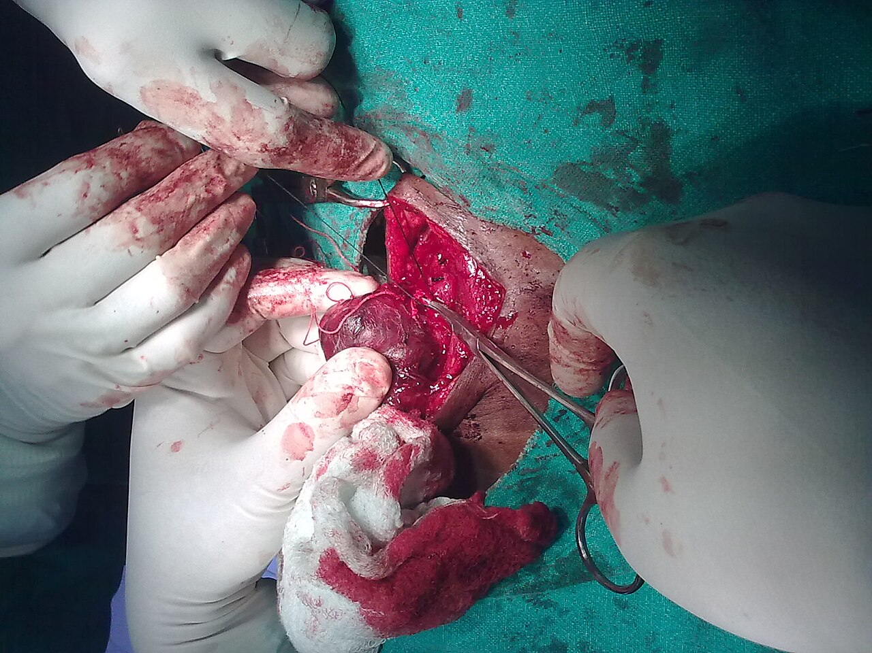
Surgical Treatment of Thyroid Diseases
Surgical treatment is used to remove part or all of the thyroid gland in cases of thyroid cancer, large goiters, or hyperthyroidism that does not respond to other treatments.
▶ Thyroidectomy is the surgical removal of the thyroid gland
▶ This surgery can cause side effects such as hoarseness, neck pain, and hypocalcemia
▶ Regular monitoring of thyroid function and calcium levels is necessary after surgery
05/05/2026
DEPARTMENT OF PHARMACY PRACTICE
8

Slide 9
Treatment Algorithm for Thyroid Diseases
The treatment algorithm for thyroid diseases involves a step-by-step approach to diagnose and manage the condition.
1
2
3
4
Diagnose thyroid disease
Determine the underlying cause
Choose the appropriate treatment option
Monitor thyroid function and adjust treatment as needed
→
→
→
05/05/2026
DEPARTMENT OF PHARMACY PRACTICE
9

Slide 10
Thyroid Disease Management
Thyroid disease management involves a comprehensive approach to diagnose, treat, and monitor the condition. This includes lifestyle modifications, medication adherence, and regular follow-up appointments.
▶ Maintain a healthy diet and exercise regularly
▶ Take medications as directed and attend follow-up appointments
▶ Monitor thyroid function and adjust treatment as needed
05/05/2026
DEPARTMENT OF PHARMACY PRACTICE
10

Slide 11

Conclusion and Future Directions
In conclusion, thyroid diseases are complex conditions that require a comprehensive approach to diagnosis, treatment, and management. Future research should focus on developing new treatments and improving patient outcomes.
▶ New treatments such as gene therapy and stem cell therapy are being explored
▶ Improving patient education and awareness is essential for effective management
▶ Continued research is necessary to improve our understanding of thyroid diseases
05/05/2026
DEPARTMENT OF PHARMACY PRACTICE
11

Slide 12
THANK YOU
Thyroid Diseases - Pharmacotherapeutics-1
05/05/2026
DEPARTMENT OF PHARMACY PRACTICE
12

