Slide 1
Robotic Operating System & Robot Simulation
21AIE213
Autonomous Mobile Robot Navigation in Complex Environments Integrated with Object Tracking
Ramisetty Lakshmi Venkat - CB.EN.U4AIE21152
Ashwin Devan - CB.EN.U4AIE21104
M Srinivasa Sai Kumar Reddy - CB.EN.U4AIE21128
M Sai Rahul - CB.EN.U4AIE21130
Here is where your presentation begins
Batch B - Group 11

Slide 2
Robot Architecture:
Architecture Components:
Components | Workflow
Chassis | Chassis act as a structural framework for our mobile robot
4-Wheel Mobile robot | Next we built the 4-wheel mobile robot on the chassis and serves as the base platform
3R robot | Later a 3R robot, consisting of three revolute joints, is mounted on the mobile robot's chassis.
Camera | The camera is attached to the end effector of the 3R robot.
LiDAR sensors | The LiDAR sensors are typically mounted on the chassis of the mobile robot.
Modules:
SLAM
Nav2 (Navigation 2.0)

Slide 3
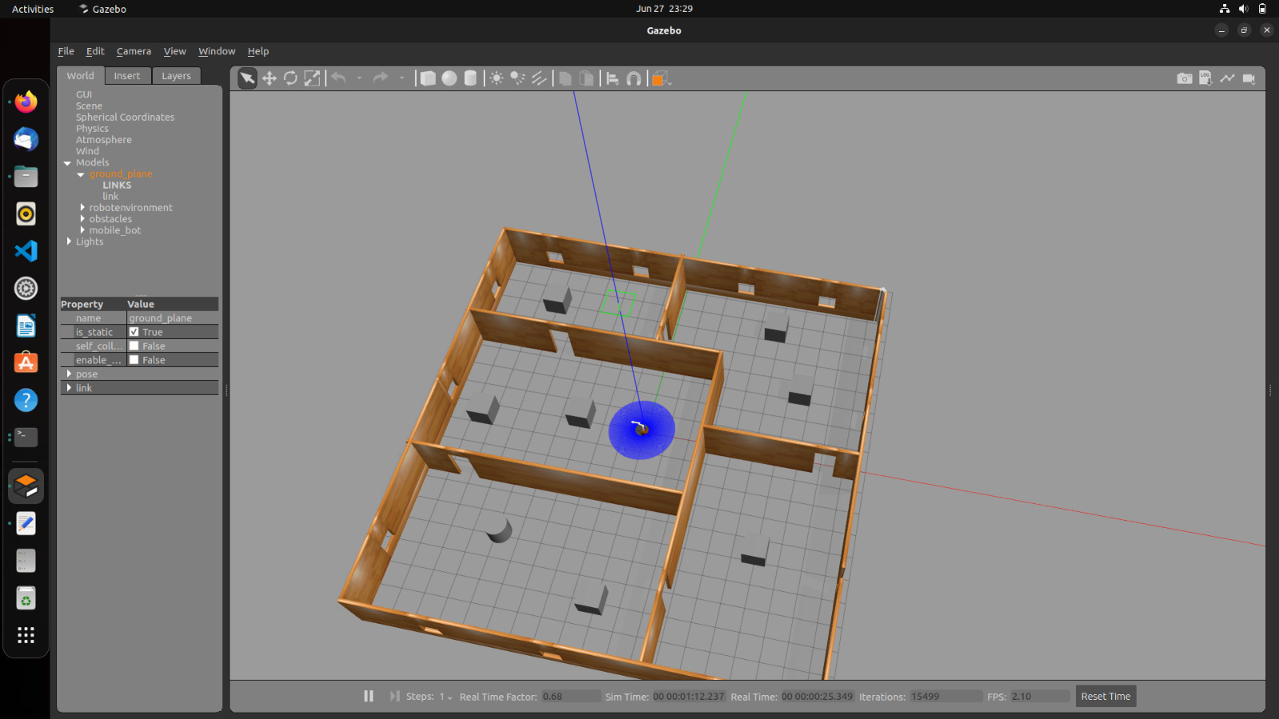
Environment for Gazebo

Slide 4
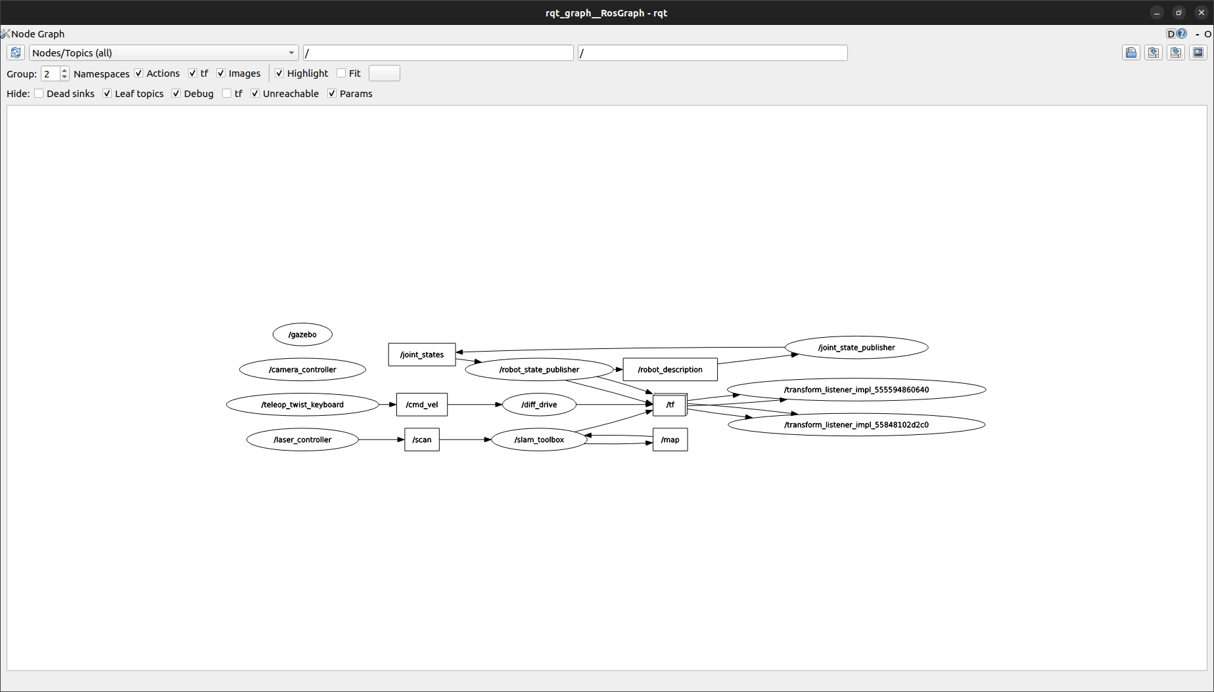
RQT Graph:

Slide 5
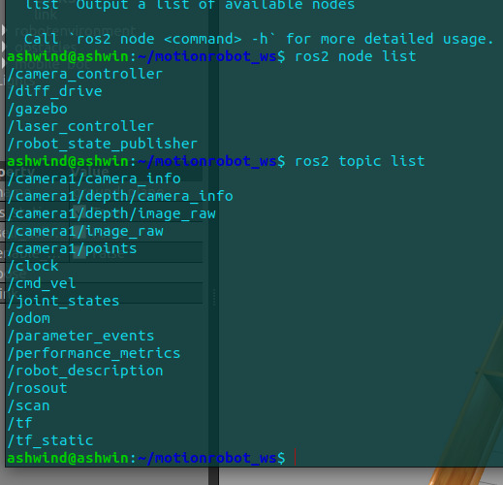
Perception:
In this autonomous mobile robot navigation integrated with object tracking.
A camera mounted on a 3R robot captures images of the environment. There are object detection algorithms identify objects of interest, while object tracking algorithms monitor their movement.
Obstacle detection techniques are used to identify potential obstacles.
By fusing data from the camera with other sensors, the system builds a comprehensive understanding of the environment, enabling safe and efficient navigation.

Slide 6
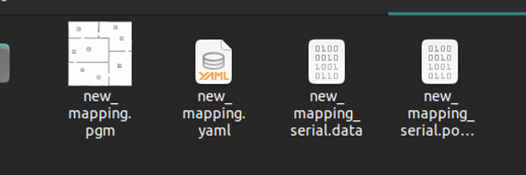
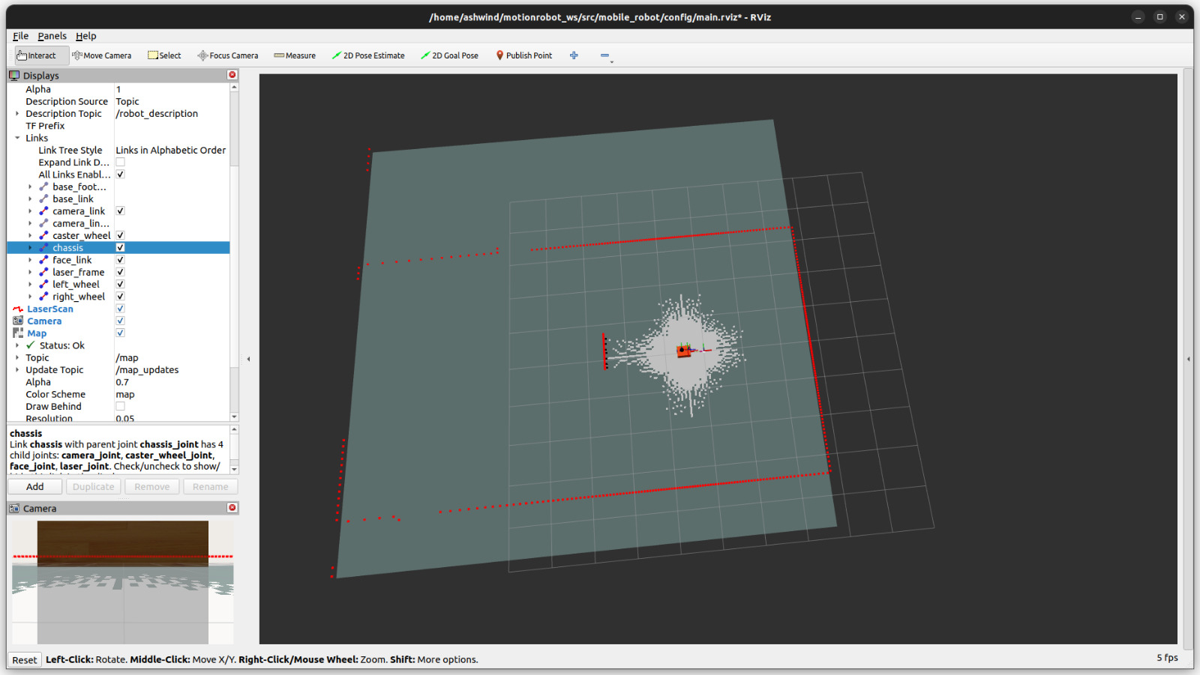
Navigation:
The navigation component in this project enables the autonomous mobile robot to autonomously navigate through complex environments while avoiding obstacles.
SLAM-This navigation system employs algorithms to generate optimal paths from the robot's current position to its destination. It considers the environmental map, obtained through SLAM.
Obstacle Avoidance Using the perception system's data, the navigation system dynamically adjusts the robot's trajectory to avoid collisions with obstacles.
Localization The navigation system continuously estimates the robot's pose within the environment. It uses sensor data, such as odometry or visual odometry, along with map information to accurately localize the robot during navigation.

Slide 7
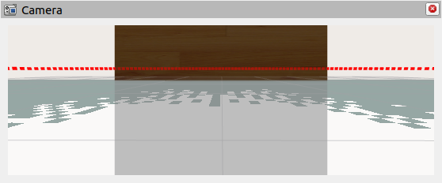
Object Tracking
3R robot integrated with a camera for object tracking.
Object tracking enables detection and following of specific objects.
Perception system processes camera images for object detection.
We used some algorithms for object detection and continuous tracking.
Navigation system adjusts path based on tracked object's location.
Improved obstacle avoidance and adaptive path planning.

Slide 8
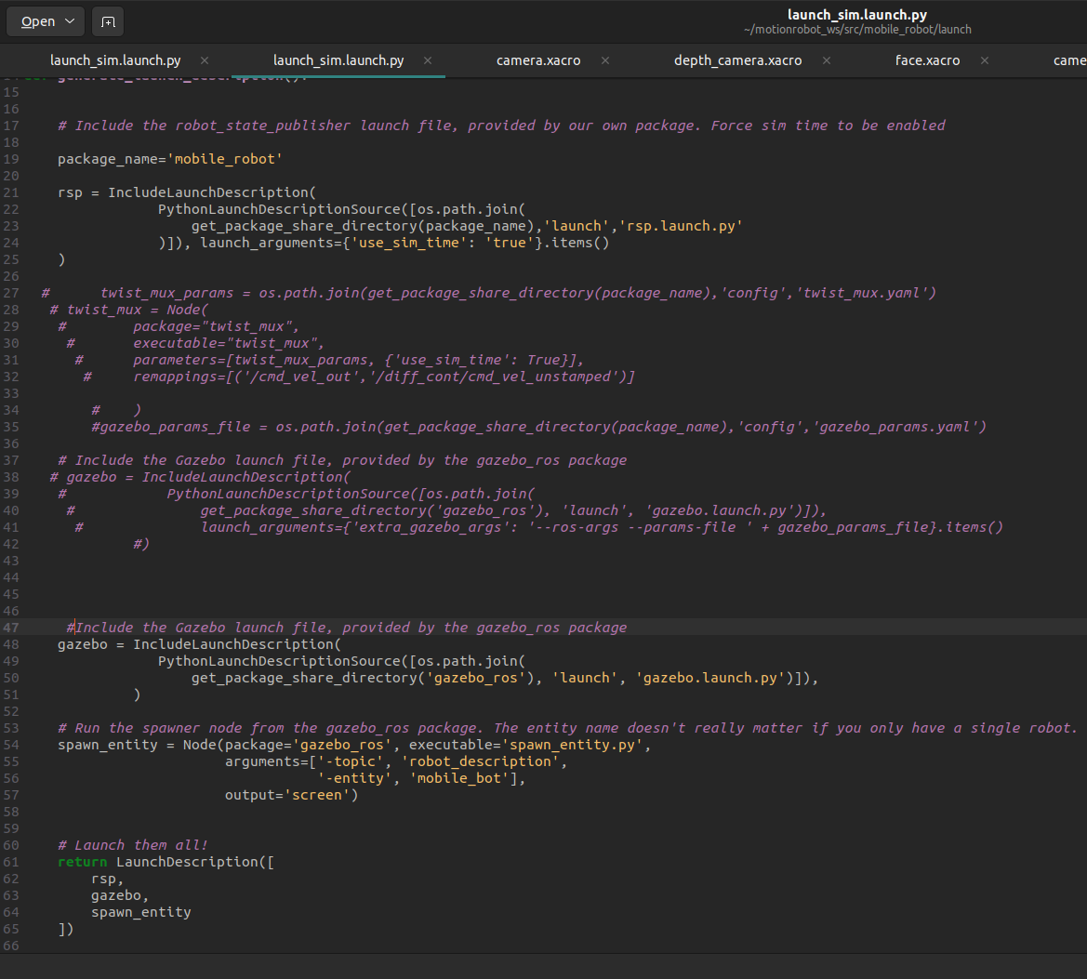
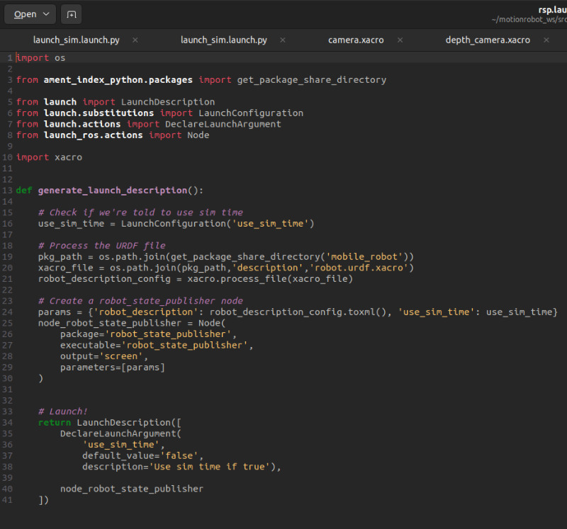
Launch File:

