Slide 1
Bigdata Analytics
21AIE214
END SEM PROJECT
Batch B – Group 11

Slide 2
TEAM MEMBERS
Ramisetty Lakshmi Venkat-CB.EN.U4AIE21152
Ashwin Devan-CB.EN.U4AIE21104
M Srinivasa Sai Kumar Reddy-CB.EN.U4AIE21128
M Sai Rahul-CB.EN.U4AIE21130

Slide 3
Data Analysis using RDD in Spark
RDDs are used for data analysis in Spark because they enable distributed computing, handle failures.
Allow in-memory processing, offer data transformations, and support multiple programming languages.
They make data analysis faster, more efficient, and scalable.
Data Transformation and Actions: RDD provides a rich set of transformations and actions that allow for flexible data manipulation and analysis. Transformations like map, filter, join, and aggregate can be applied to RDDs to transform and reshape the data.
Actions like count, collect, and reduce can be used to retrieve results or trigger computations.

Slide 4
Movies.dat
Format: MovieID::Title::Genres
Titles are identical to titles provided by the IMDB (including year of release)
Genres are pipe-separated and are selected from the following genres:
* Action
* Adventure
* Animation
* Children’s
* Comedy
* Crime
* Documentary
* Drama
* Fantasy
* Film-Noir
* Horror
* Musical
* Mystery
* Romance
* Sci-Fi
* Thriller
* War
* Western

Slide 5
About The Datasets
Ratings.dat
Format: UserID::MovieID::Rating::Timestamp
UserIDs range between 1 and 6040
MovieIDs range between 1 and 3952
Ratings are made on a 5-star scale (whole-star ratings only)
Timestamp is represented in seconds since the epoch as returned by time(2)
Each user has at least 20 ratings

Slide 6
Users.dat
Format: UserID::Gender::Age::Occupation::Zip
Gender is denoted by a "M" for male and "F" for female.
Age is chosen from the following ranges:
1: "Under 18"
18: "18-24"
25: "25-34"
35: "35-44"
45: "45-49"
50: "50-55“
56: "56+“

Slide 7
Occupation is chosen from the following choices:
* 0: "other" or not specified
* 1: "academic/educator"
* 2: "artist“
* 3: "clerical/admin"
* 4: "college/grad student"
* 5: "customer service"
* 6: "doctor/health care"
* 7: "executive/managerial"
* 8: "farmer“
* 9: "homemaker"
* 10: "K-12 student"
* 11: "lawyer“
* 12: "programmer"
* 13: "retired“
* 14: "sales/marketing"
* 15: "scientist"
* 16: "self-employed"
* 17: "technician/engineer"
* 18: "tradesman/craftsman“
* 19: "unemployed"
* 20: "writer"

Slide 8
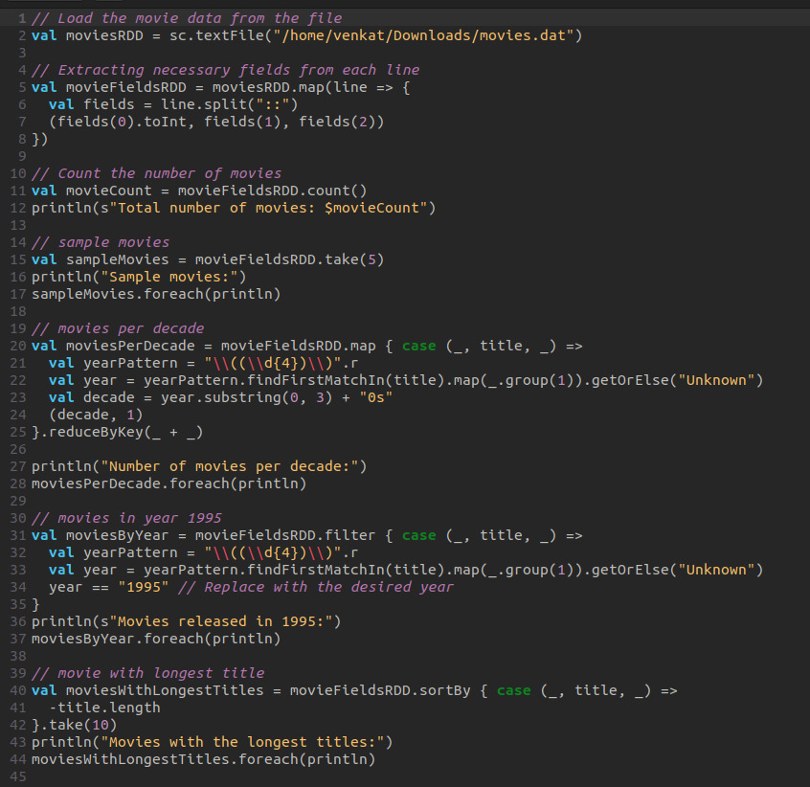
CODE:

Slide 9
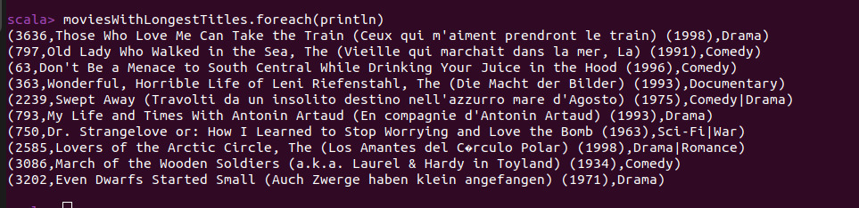
OUTPUT

Slide 10
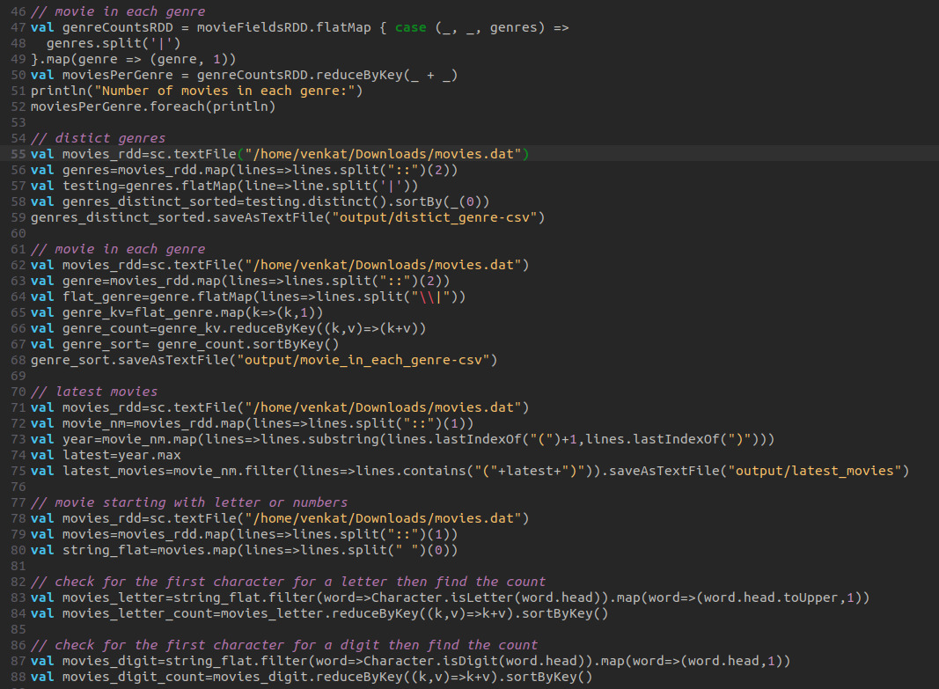
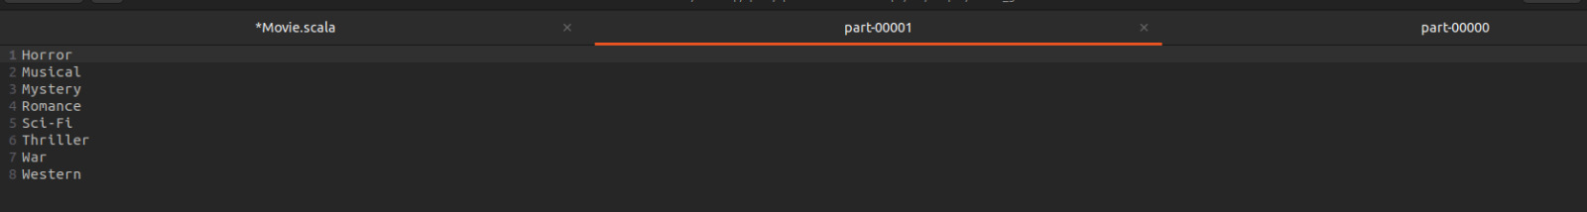
OUTPUT

Slide 11
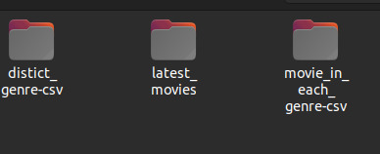
OUTPUT

Slide 12
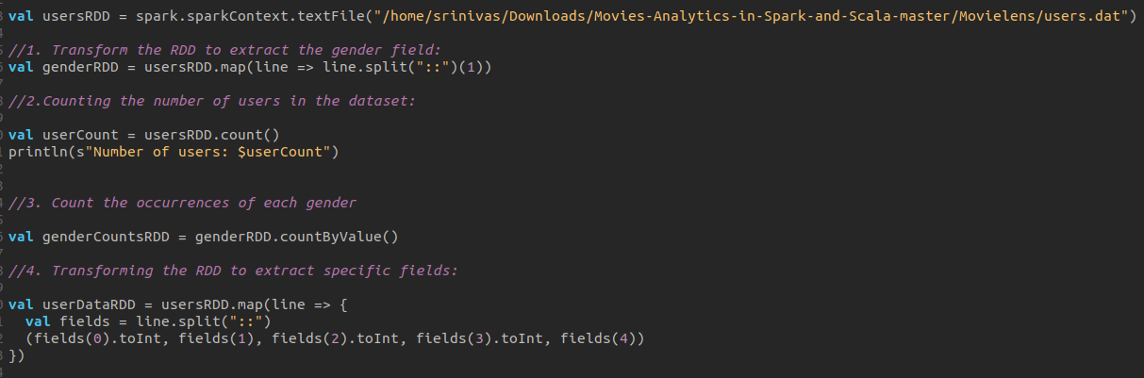
Users.dat Code

Slide 13
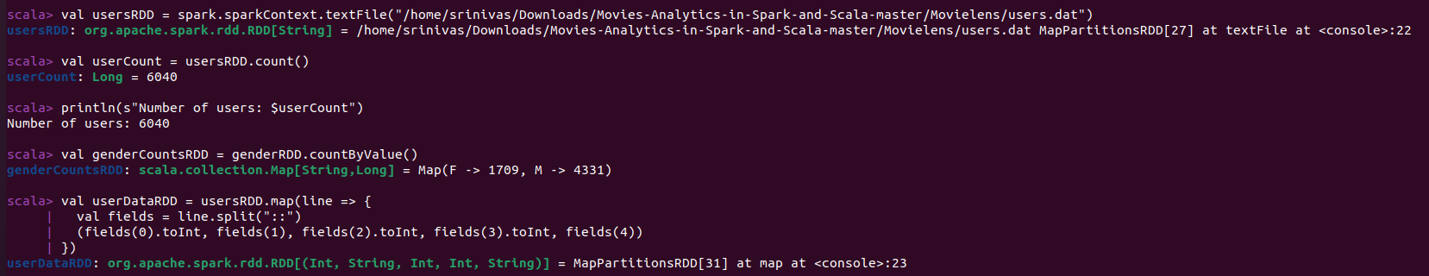
OUTPUT

Slide 14
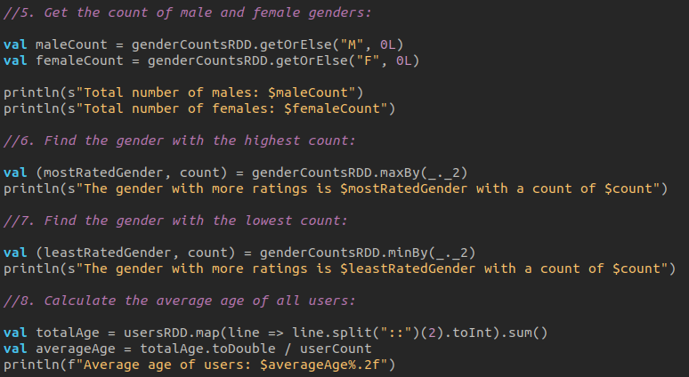

Slide 15
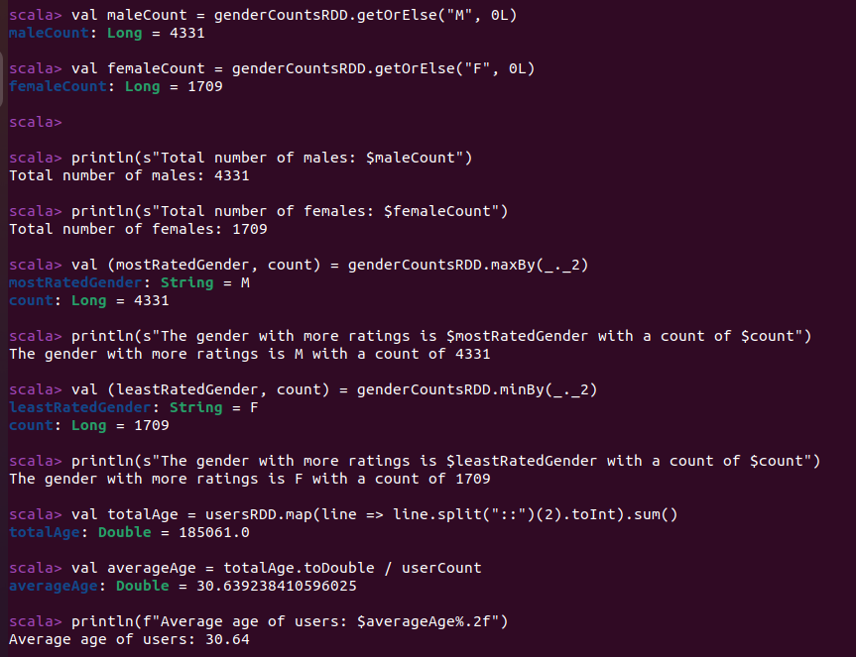
OUTPUT

Slide 16
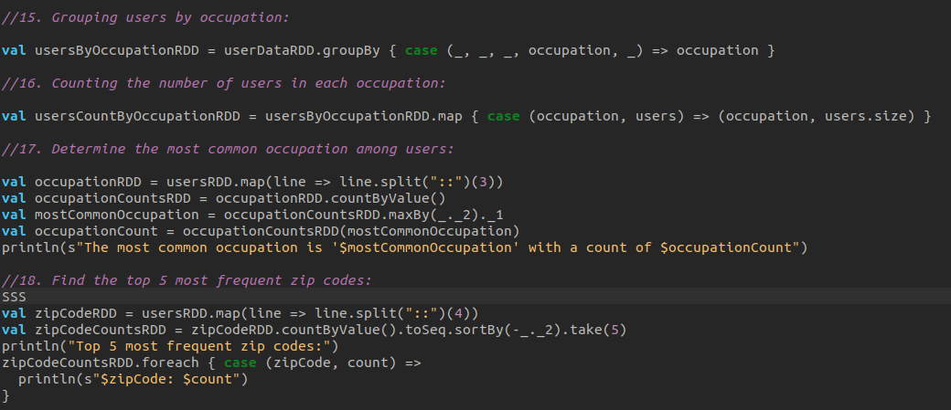

Slide 17
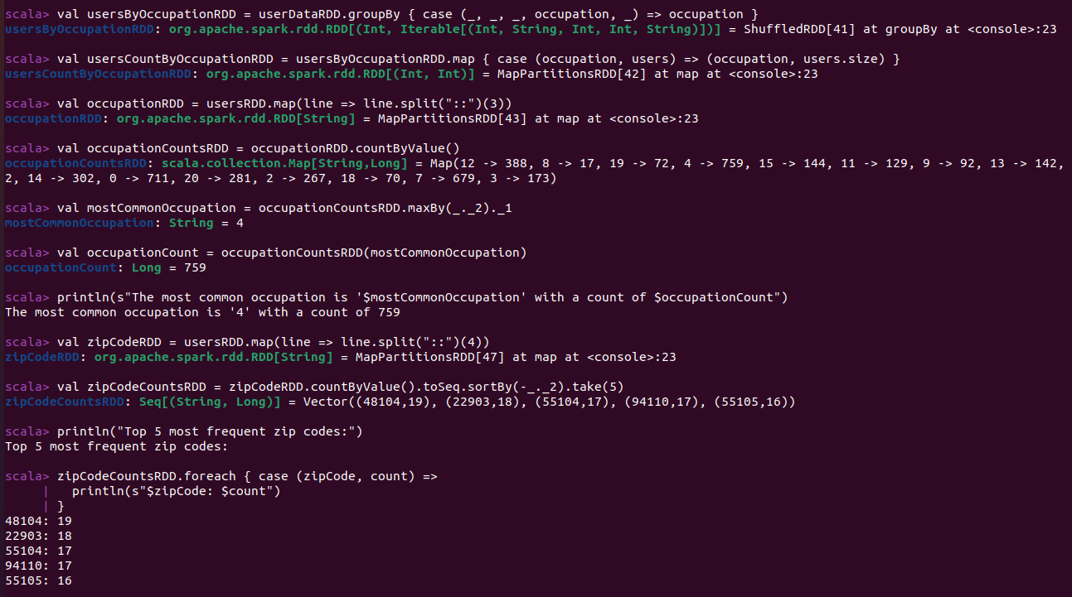
OUTPUT

Slide 18
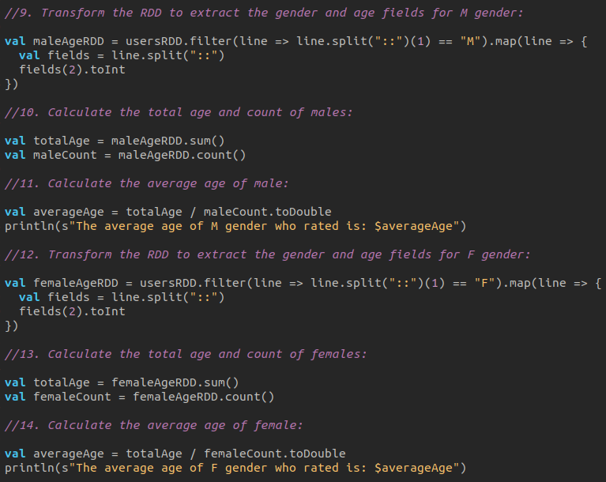

Slide 19
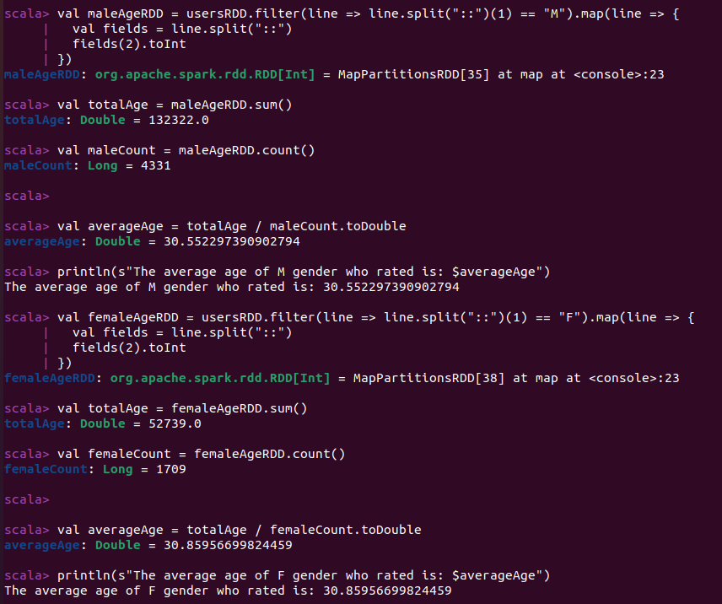
OUTPUT

Slide 20
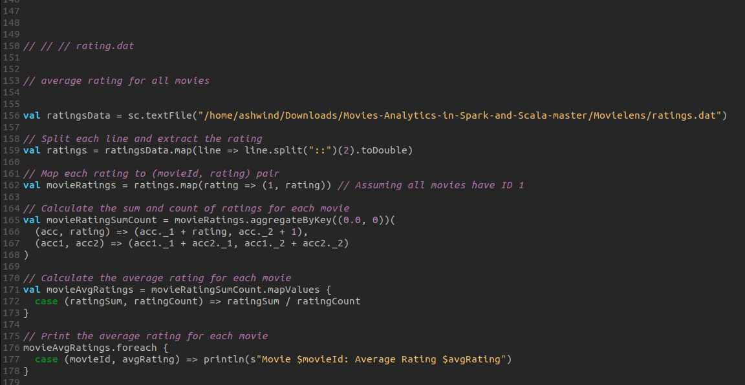
Ratings.dat Code

Slide 21
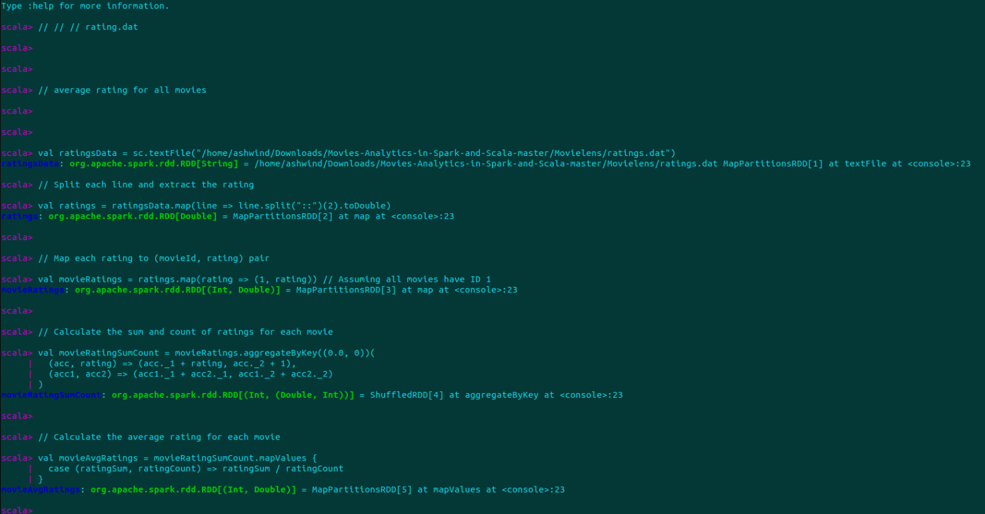
OUTPUT

Slide 22
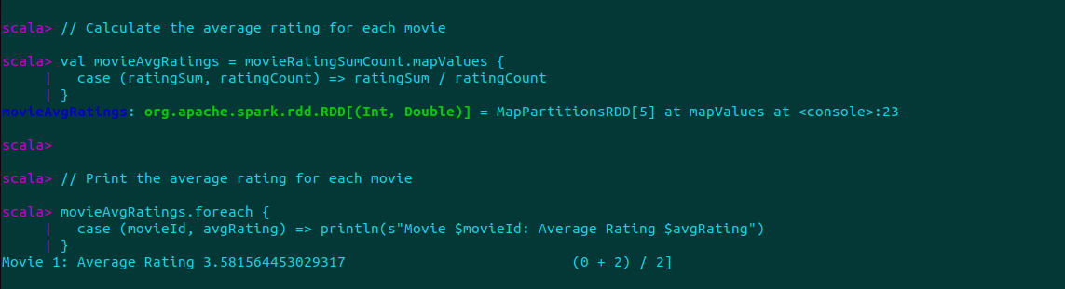

Slide 23
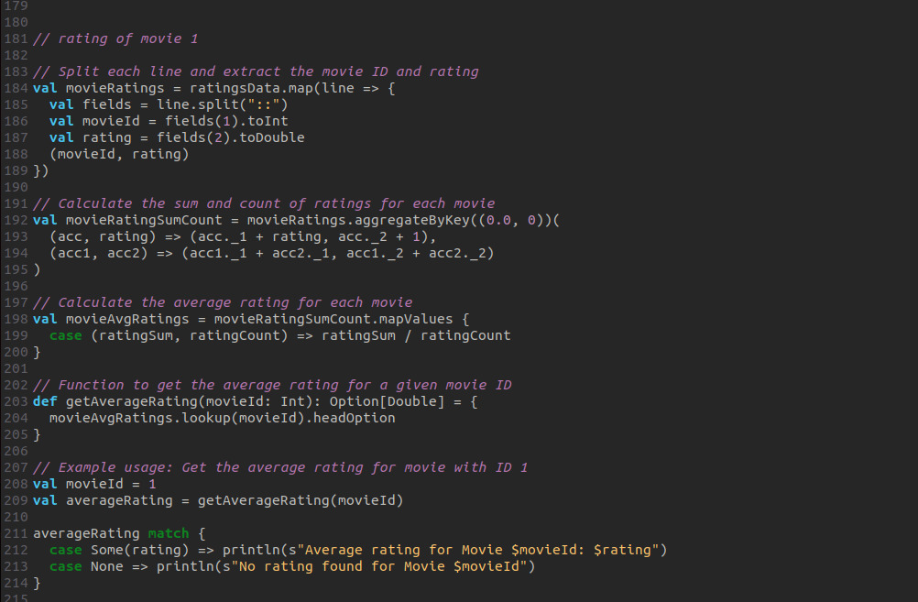

Slide 24
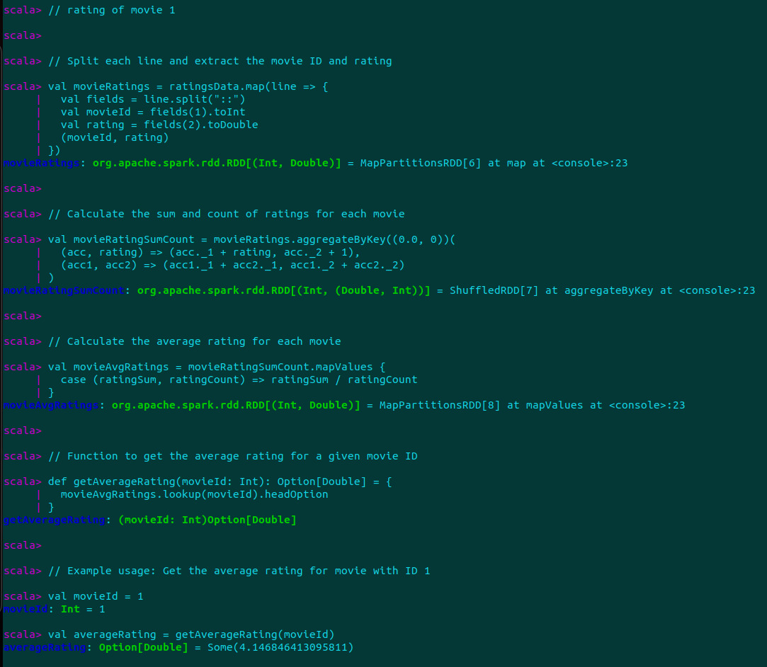
OUTPUT

Slide 25
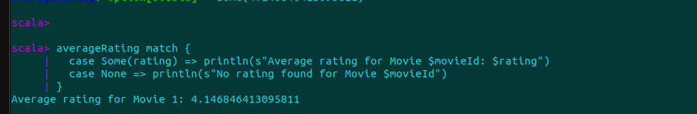

Slide 26

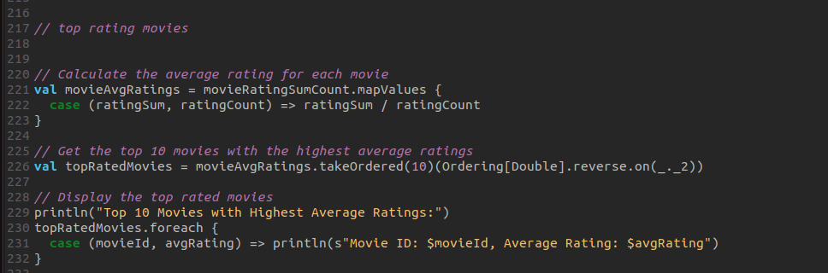

Slide 27
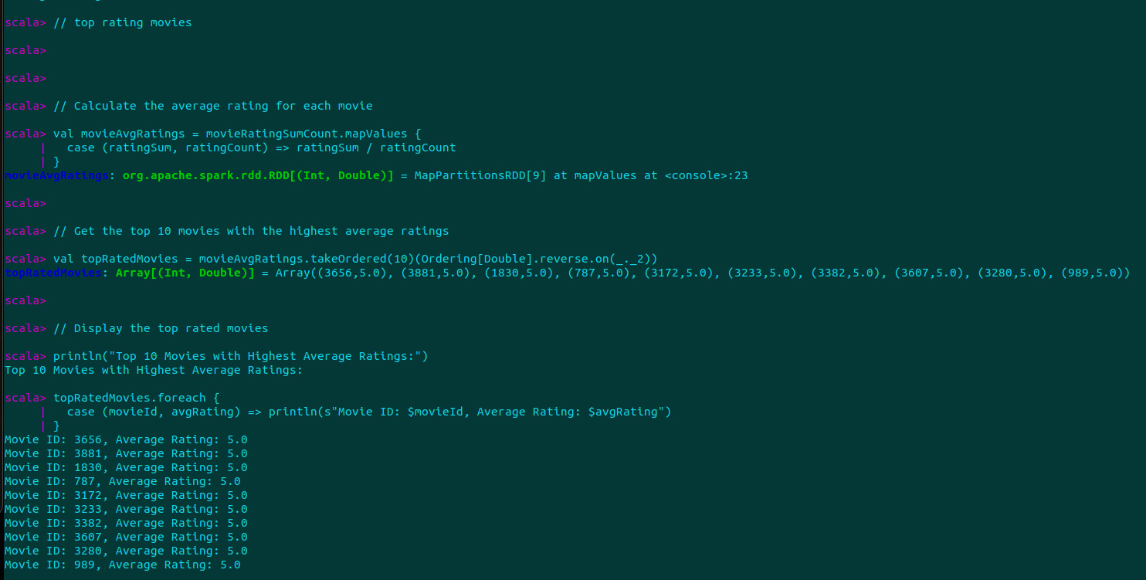

Slide 28
Thank You

