Slide 1
PRODUCT SEGMENTATION FOR RETAIL STORES
Supply Chain Analytics
MGT3015

Slide 2
Team Members
(Group -3)
19MIA1081 – Abhishek Kasam
19MIA1057 – M. Sree Reddy
19MIA1089 – A. Arvind Reddy
19MIA1104 – T. Venkat Reddy

Slide 3
INTRODUCTION
Product segmentation refers to the activity of grouping products that have similar characteristics and serve a similar market. It is usually related to marketing (Sales Categories) or manufacturing (Production Processes).
As a Logistic manager the attention is mainly focused on the sales volumes distribution demand variability and delivery lead time.
Logistic manager will mainly focus on managing products that have:
The highest contribution to your total turnover.
The most unstable demand.

Slide 4
PROBLEM STATEMENT
1
The Operational Director of a local Distribution Center (DC) delivers 10 Hypermarkets.
In our scope Operational director is responsible of
Preparation and delivery of replenishment orders from stores.
Demand Planning and Inventory Management.

Slide 5
SCOPE ANALYSIS
2
This analysis will be based on the M5 Forecasting
dataset of Walmart stores sales records taken from
Kaggle.
We will take only the first-year data (d_1 to d_365):
10 stores in 3 states (USA)
1,878 unique SKU
3 categories and 7 departments (sub-category)

Slide 6

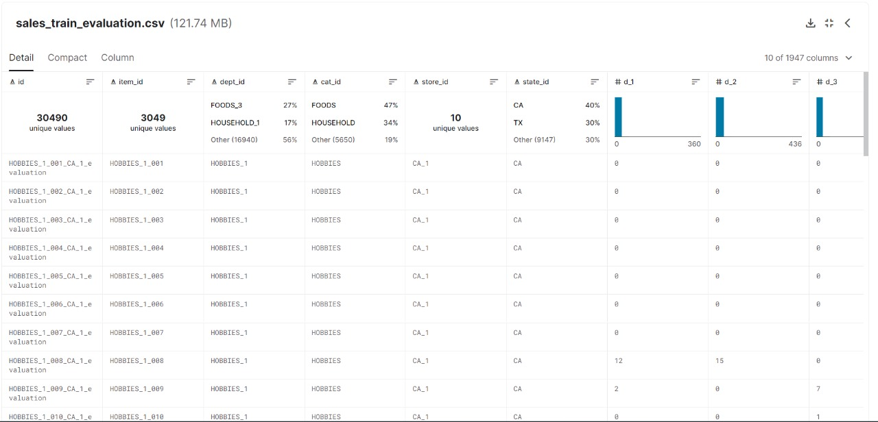

Slide 7
OBJECTIVE
3
What does impact the logistic performance?
Products Rotation
What are the references that are driving most of the
sales?
Very Fast Movers: top 5% (Class A)
The following 15% of fast movers (Class B)
The remaining 80% of very slow movers (Class C)
Checking the condition of pareto principle is satisfied or not.
This classification will also impact Demand Variability.

Slide 8
STANDARD DEVIATION
TAKING WALMART DATASET FROM KAGGLE
STATISTICAL ANALYSIS
std/mean
CO-EFFICIENT OF VARIATION
MEAN
TURNOVER
SEGMENTATION
ABC ANALYSIS
DEMAND VARIABILITY

Slide 9
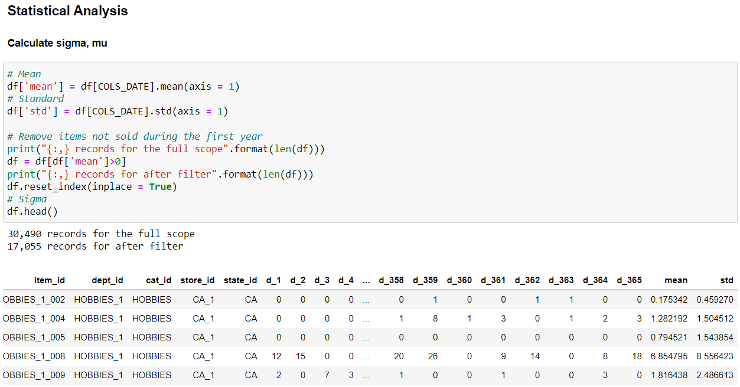

Slide 10
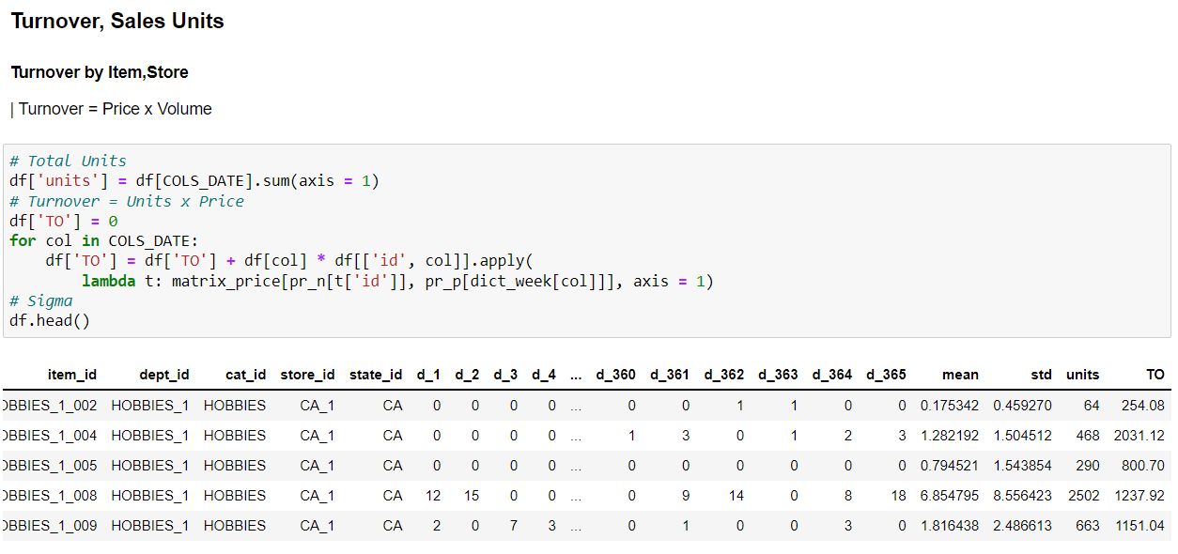

Slide 11
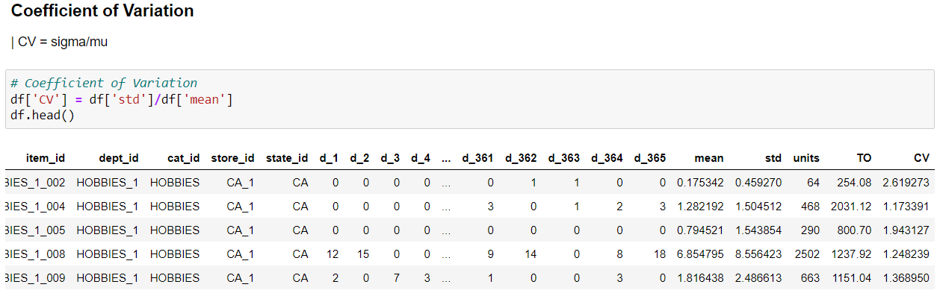

Slide 12
SEGMENTATION
4

Slide 13
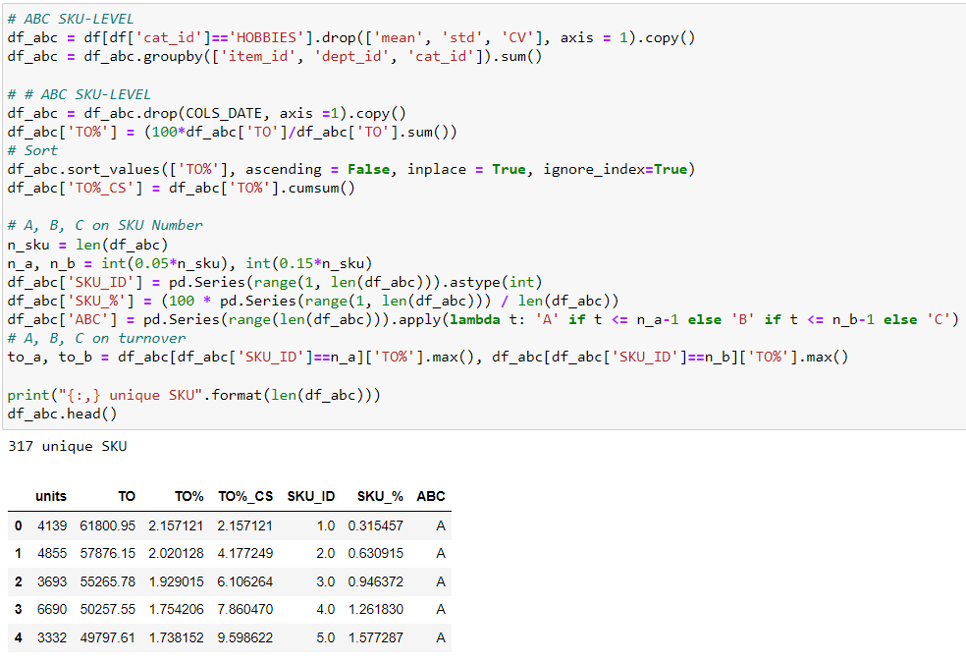
1.ABC ANALYSIS

Slide 14
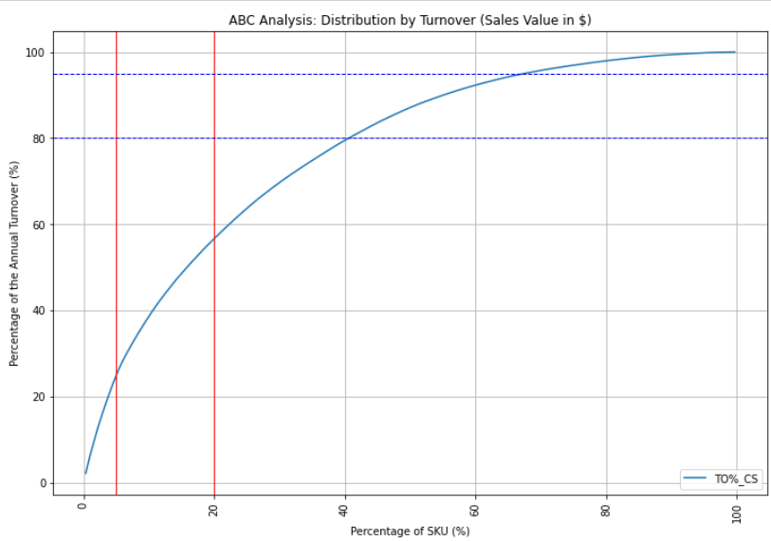

Slide 15
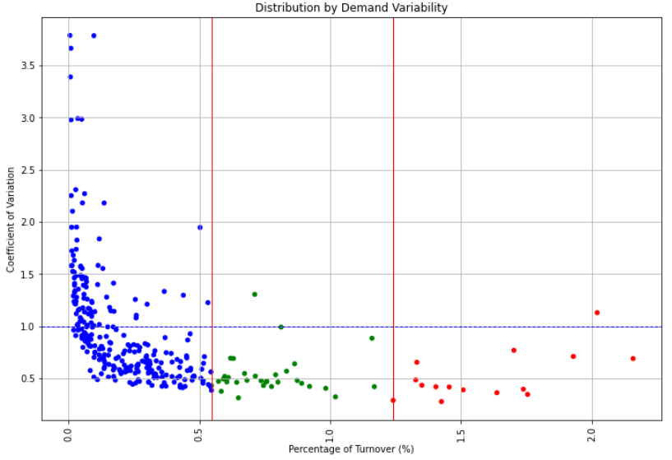
2.DEMAND VARIABILITY

Slide 16
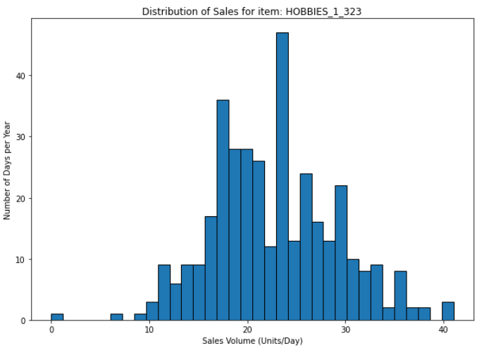
Class A(with low CV)
Fortunately, most of the A SKUs have a quite stable demand;
We won't be challenged by the most important SKUs.

Slide 17
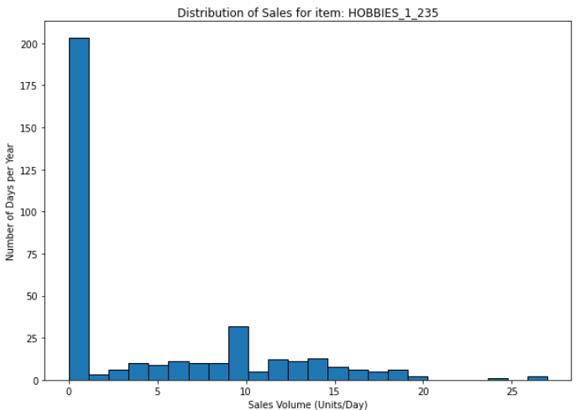
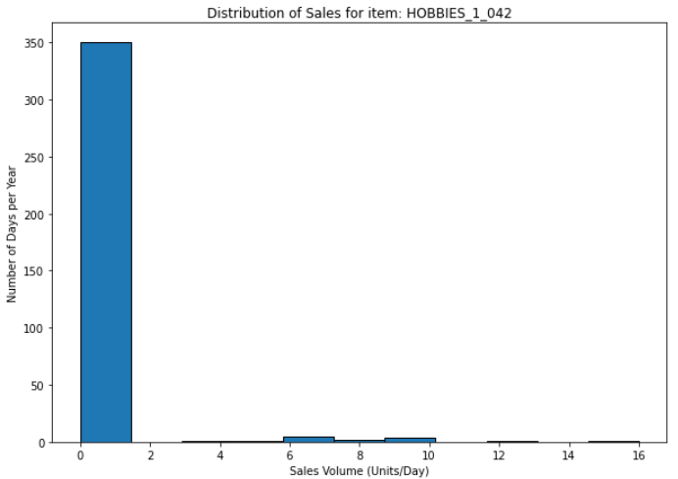
Class B (with high CV)
The majority of SKUs are in the stable area;
However, we still spend effort on ensuring optimal planning for the few references that have a high CV.
Class C (with very high CV)
Most of the SKUs have a high value of CV;
For this kind of reference, a cause analysis would provide better results than a statistical approach for forecasting.

Slide 18
Conclusion
This operationally driven segmentation gives us a few insights into the challenges your operations will face for planning and managing the goods flows to meet your store's demand.
5

Slide 19
THANK YOU!

